Slide 1
Terraform: infrastructure as code
Terraform is an open-source infrastructure as code tool that enables you to safely and predictably provision and manage infrastructure in any cloud.

Slide 2
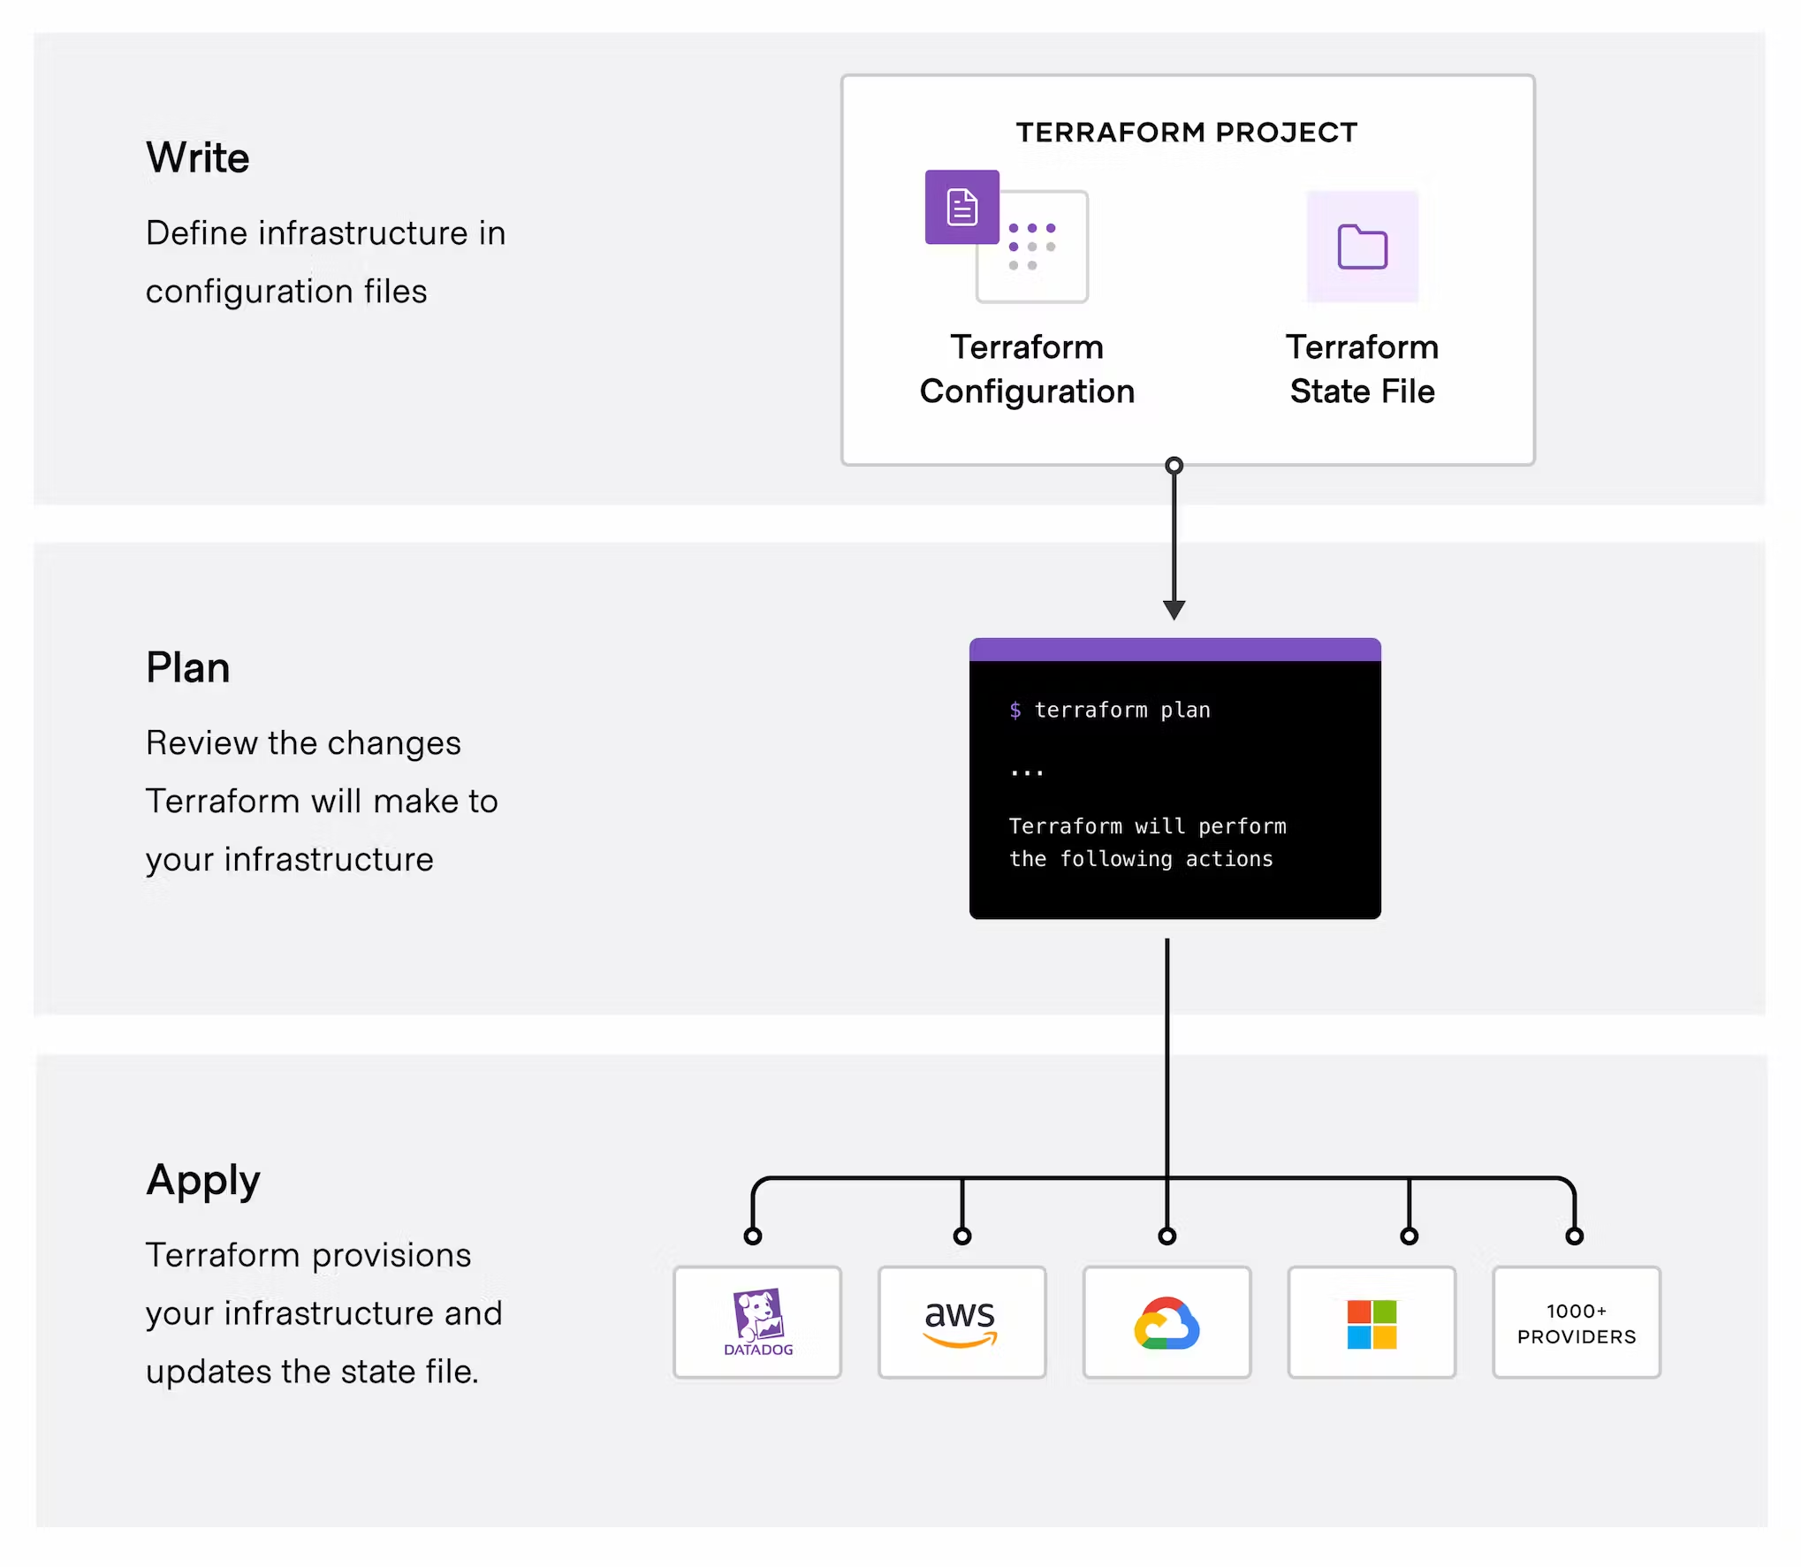

Slide 3
Structure
├── README.md
├── main.tf
├── variables.tf
├── outputs.tf
├── ...
├── modules/
│ ├── nestedA/
│ │ ├── README.md
│ │ ├── variables.tf
│ │ ├── main.tf
│ │ ├── outputs.tf
│ ├── nestedB/
│ ├── .../
├── examples/

Slide 4
Components
Providers: Defines the cloud provider or on-premise environment that Terraform will interact with to create and manage resources.
Variables: Defines the input variables used in the Terraform configuration file.
Outputs: Defines the output values produced by the Terraform configuration file.

Slide 5
Components
Resources: Defines the infrastructure resources that Terraform will create and manage.
Modules: Defines a collection of resources that can be reused across multiple Terraform configurations.
Backend: Defines the configuration for storing the Terraform state file remotely, allowing for better collaboration and state management.

Slide 6
Thanks

