Slide 1
LearnMate – Agentic Ai for Personalized Course Pathways
IBM AICTE PROJECT
Presented By :
Student name : Alzaim Ahmed Ansari
College Name & Department : Noida Institute of Engineering & Technology, Computer Science & Engineering(3rd Year)

Slide 2
OUTLINE
Problem Statement
Technology used
IBM Cloud services used
Wow factor
End users
Result
Conclusion
GitHub Link
Future scope
IBM Certifications

Slide 3
Problem Statement
Students and early-career professionals often struggle to identify the right learning path that aligns with their interests and long-term goals due to the overwhelming number of online courses and a lack of personalized guidance. With an overwhelming number of online courses and limited personalized guidance, learners struggle to make informed decisions about skill development and career direction.
Proposed Solution: LearnMate is an AI-powered academic advisor that leverages Natural Language Processing (NLP) and Large Language Models (LLMs) on IBM watsonx to guide users in building personalized course pathways. The agent interacts with students, understands their interests and current skill levels, and dynamically generates a tailored learning roadmap. It evolves based on user progress and preferences — offering a consistent, adaptive, and career-focused learning experience.

Slide 4
Technology used
IBM cloud lite services: Provides the platform to host and run AI services with zero cost, ideal for lightweight academic projects.
Natural Language Processing (NLP): Enables the agent to understand user input, extract intent, and interact in natural language.
Large Language Models(LLM): Powers the agent's ability to generate personalized learning plans and meaningful academic guidance.
IBM Granite model: A state-of-the-art multilingual LLM hosted on IBM watsonx.ai, used for generating structured, adaptive course roadmaps tailored to the learner’s goals and skill level.

Slide 5
IBM cloud services used
IBM Cloud Watsonx AI Studio: Provides an intuitive environment to build, test, and manage AI workflows — used for prompt creation and evaluation.
IBM Cloud Watsonx AI runtime: Executes and deploys prompts in real-time using the configured model parameters, ensuring consistent agent performance.
IBM Cloud Agent Lab: Enables the creation of agentic workflows where the AI acts autonomously to handle multi-step tasks like course planning and student assessment.
IBM Granite foundation model: A powerful Large Language Model (LLM) used to understand student input, assess learning needs, and generate personalized course roadmaps using natural language.

Slide 6
Wow factors
LearnMate helps students quickly identify the right courses aligned with their interests and career goals. It reduces the time spent on manual research and delivers adaptive learning paths that evolve with the learner's progress, ensuring focused and goal-driven education.
Unique features:
Personalized Course Roadmaps based on user interest and goals.
Skill-level Detection through natural conversation.
Dynamic Path Adjustment as the learner processes.
Smart Course & Certificate Suggestion.
Career Oriented Path Mapping

Slide 7
End users
Students and Early-Career Learners: seeking personalized guidance in choosing and following the right learning path
Academic Advisors and Educators: to support curriculum planning and individualized student mentoring
Universities and Training Institutes: aiming to offer AI-driven academic assistance to enhance learner engagement
EdTech Platforms: integrating personalized AI agents to scale guidance for a large user base

Slide 8
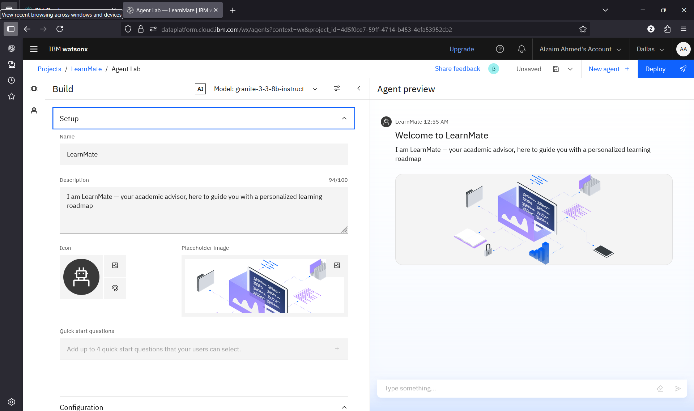
Results

Slide 9
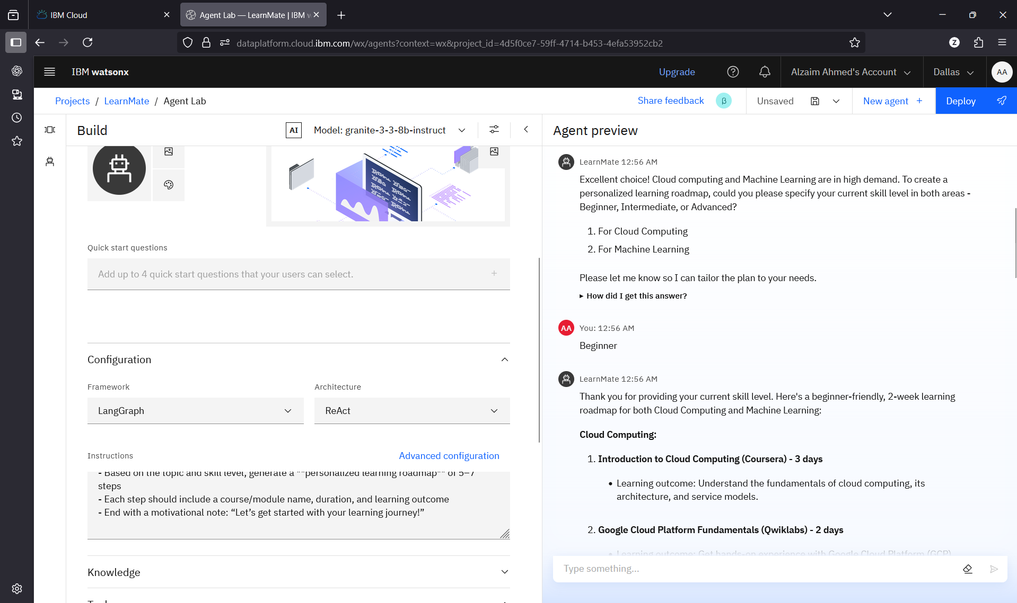
Results

Slide 10
Results

Slide 11
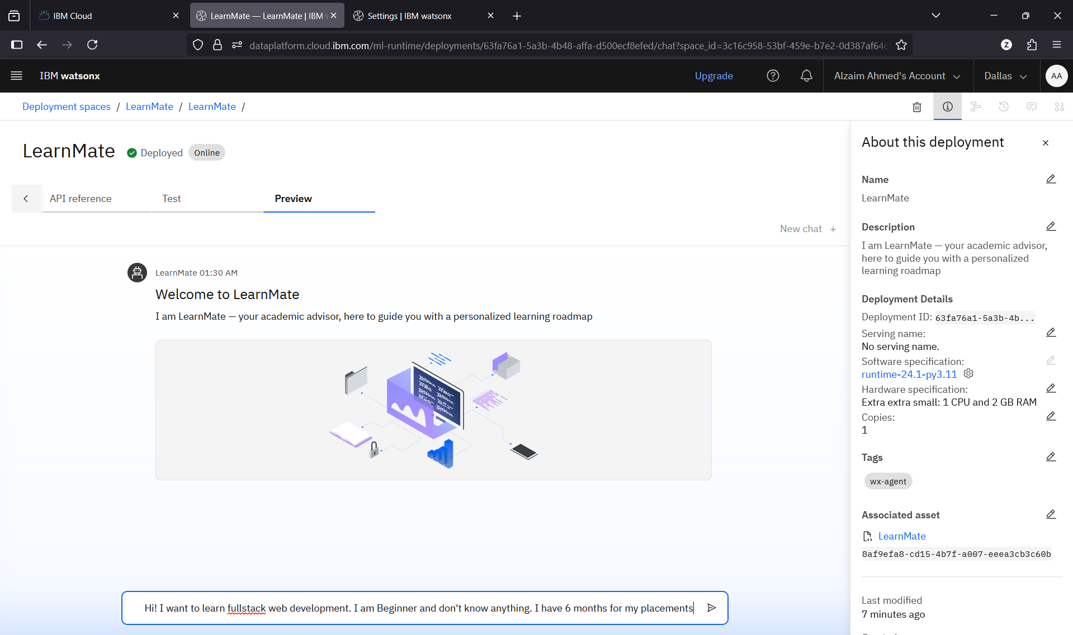
Results
Deployed AI Agent

Slide 12
Conclusion
LearnMate generates structured learning reports and personalized study plans for each user.
It suggests relevant learning goals based on the learner’s interests and current skill level.
It continuously updates the learning roadmap as the user progresses, ensuring adaptability.
LearnMate enhances learning efficiency, accuracy, and engagement through intelligent AI-driven support.
It serves both individual learners and educational institutions by providing personalized and scalable academic guidance.

Slide 13
GitHub Link
https://github.com/zaeim007/LearnMate

Slide 14
Future scope
LearnMate can be expanded to support multiple languages for global accessibility.
Integration with learning platforms (e.g., Coursera, edX, IBM SkillsBuild) can offer real-time course enrollment and tracking.
AI-driven mentorship matching could connect students with relevant mentors or industry experts.
The agent can be enhanced to recommend career paths and job opportunities based on learning history.
Offline functionality can be developed to make LearnMate accessible in low-connectivity environments
Support for group learning and peer collaboration can be introduced for a more social learning experience.

Slide 15
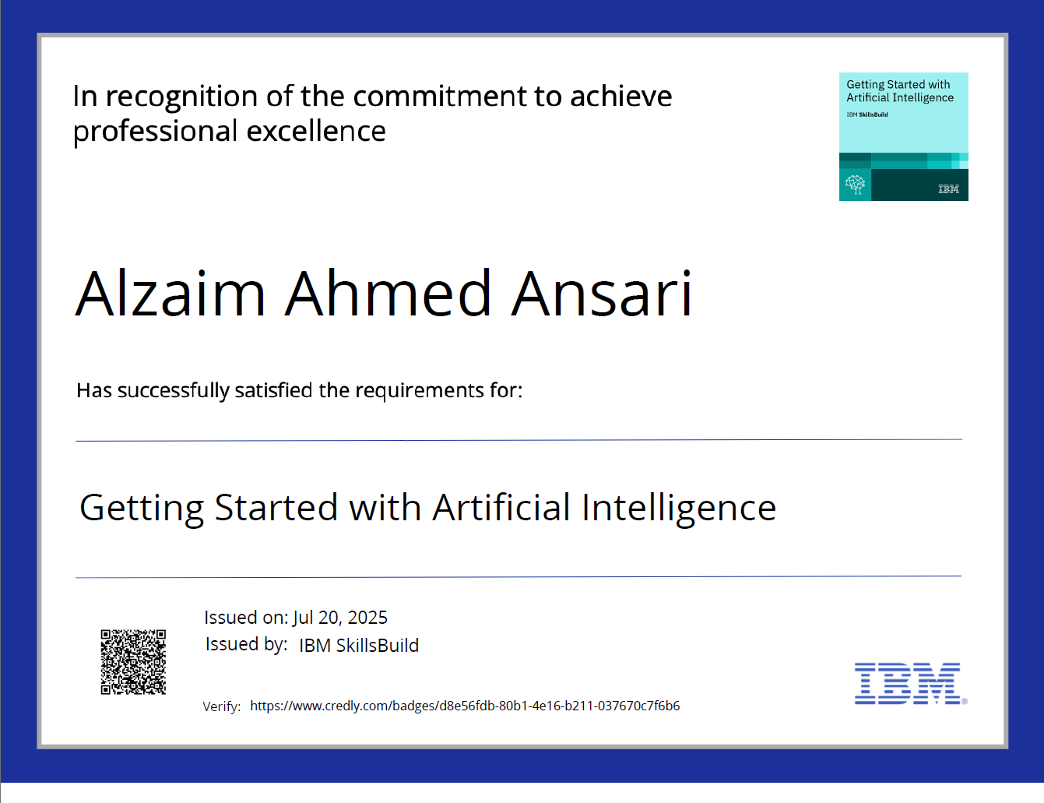
IBM Certifications
Getting Started with Artificial Intelligence

Slide 16
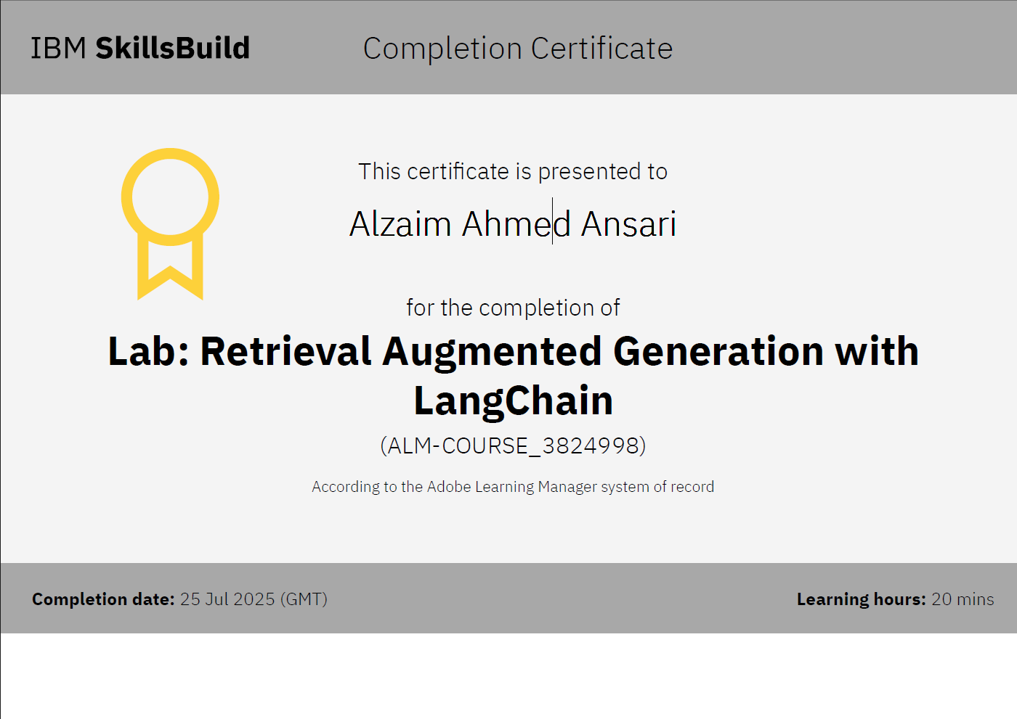
Lab: Retrieval Augmented Generation with LangChain

Slide 17
THANK YOU

