Slide 1
Case Study 4
INN Hotels
Nafis Zafar
8/23/2024

Slide 2
Contents / Agenda
Executive Summary
Business Problem Overview and Solution Approach
EDA Results
Data Preprocessing
Model Performance Summary
Appendix

Slide 3
Executive Summary
Check Hotels busiest weekdays
Check hotels busiest weekends
Check reservations by market segment
Check reservation by family size
Check cancellations
Build a statistical regression model with statsmodel and identify major keys predictors to make better decisions, predict cancellations and factors behind it
Create decision tree model and identify key factors that can help predict using pre-pruning and post-prunning

Slide 4
Business Problem Overview and Solution Approach
INN Hotels Group is facing crisis with high number of hotel cancellations. Due to change of plans and scheduling conflicts the hotel is seeing more cancellations each day. This is causing significant revenue loss for the hotel group. This is causing increased marketing cost, additional cost on resources to manage last minute bookings and additional cost of distribution channel cost.
INN Group has reached out for help in a data driven solution to help predict cancellations. This way they can accommodate additional bookings to measure for cancellations and stop the loss of revenue. As a data scientist we will load the bookings data from hotel group, do some EDA (Exploratory Data Analysis), find out key metrics, create a regression model for recommendations and a decision tree model and use pre-pruning and post-pruning techniques to help make better recommendations.

Slide 5
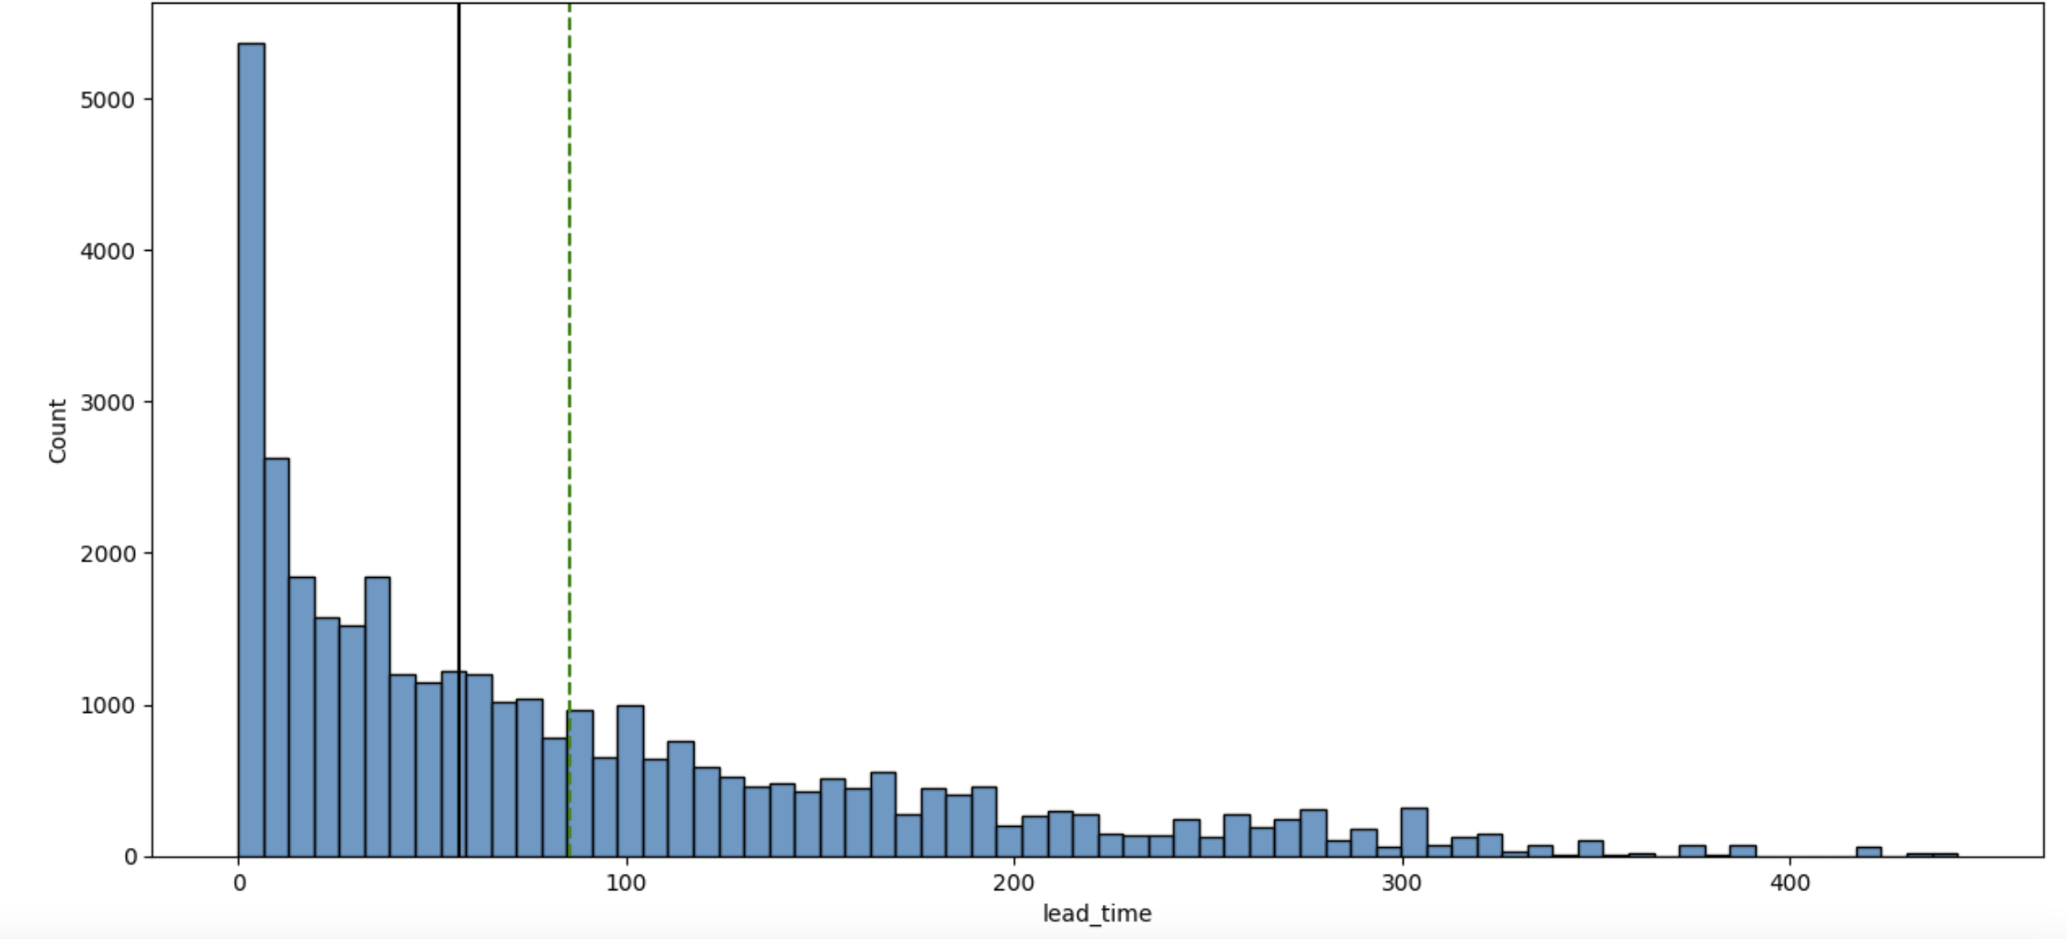
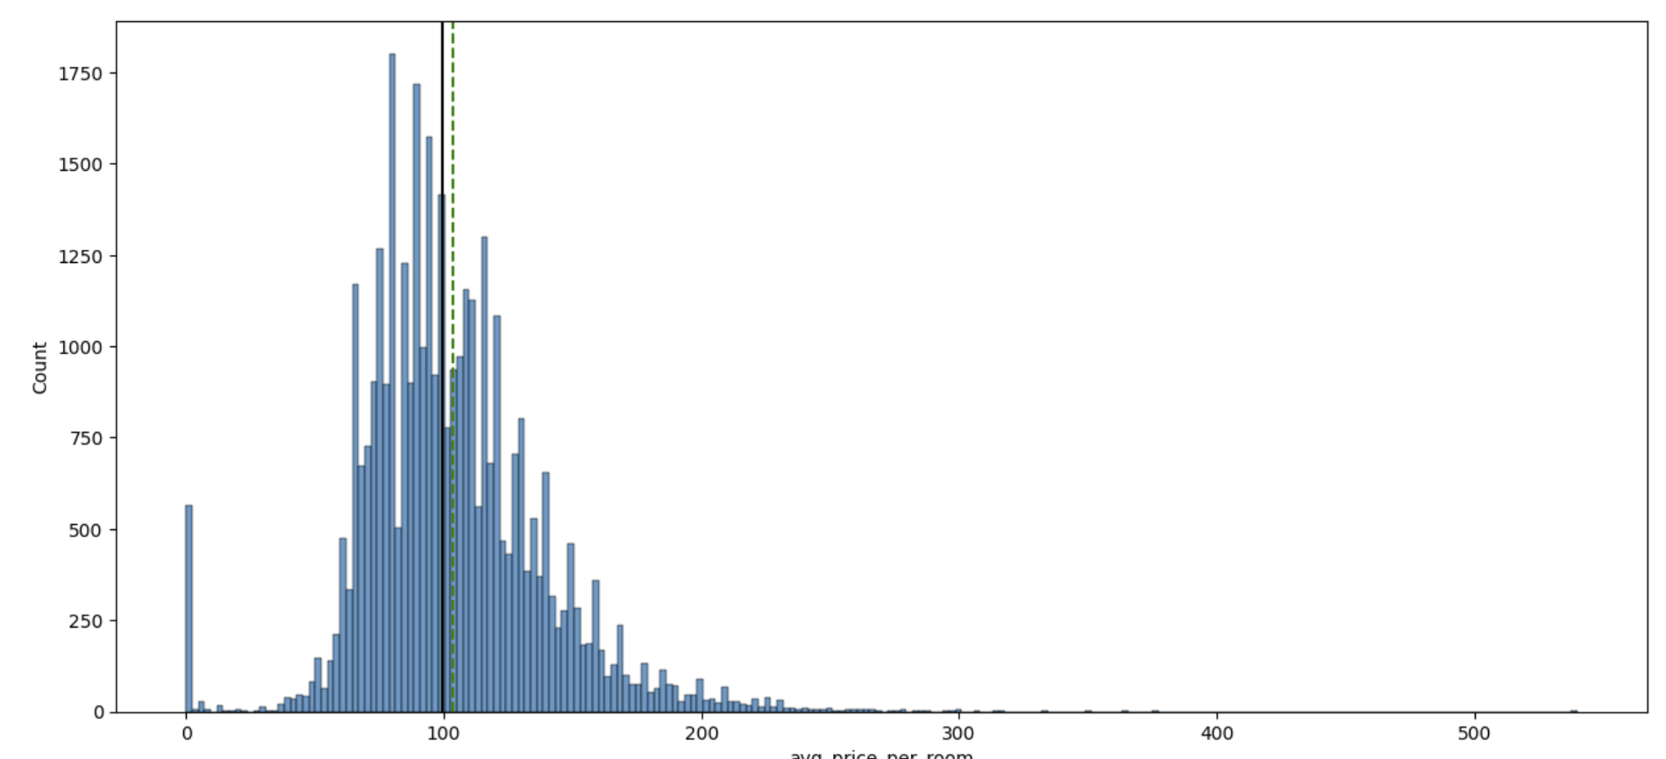
EDA Results - Univariate
The average lead time is approximately 85 days. The distribution is positively skewed, as the median 57 days.
The avg. price of room is $103

Slide 6
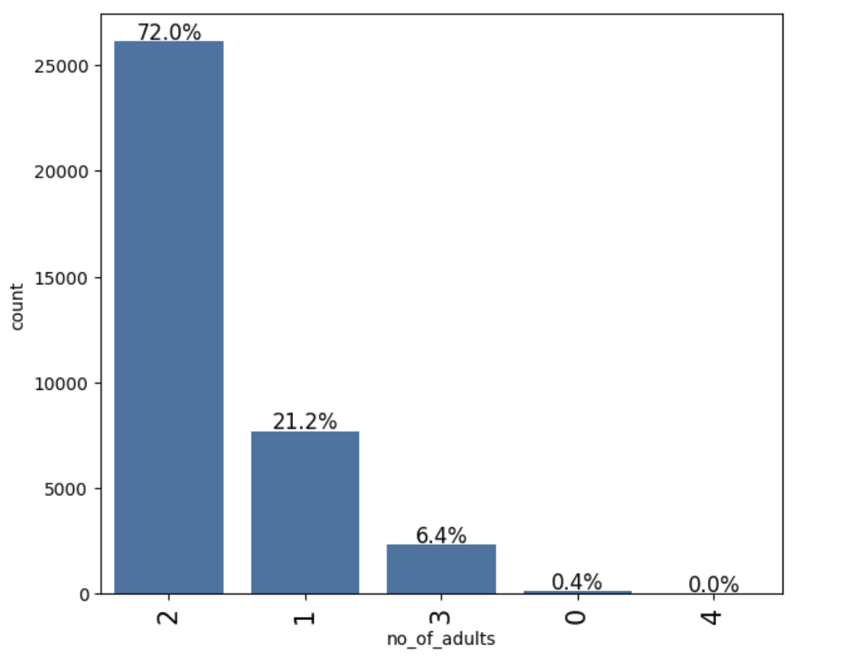
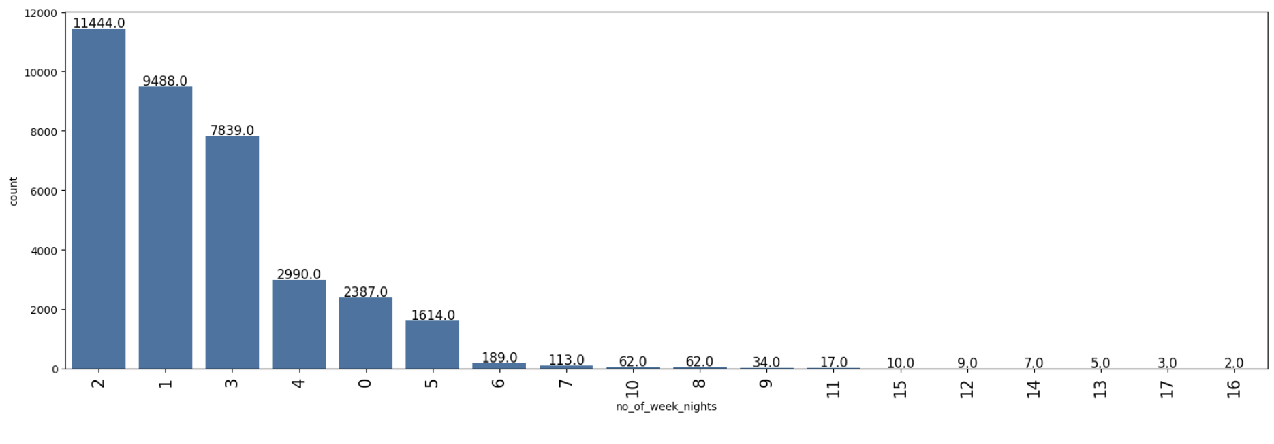
EDA Results - Univariate
Majority of the bookings have 2 adults
Most of the bookings were for 2, 1 or 3 weeknights

Slide 7
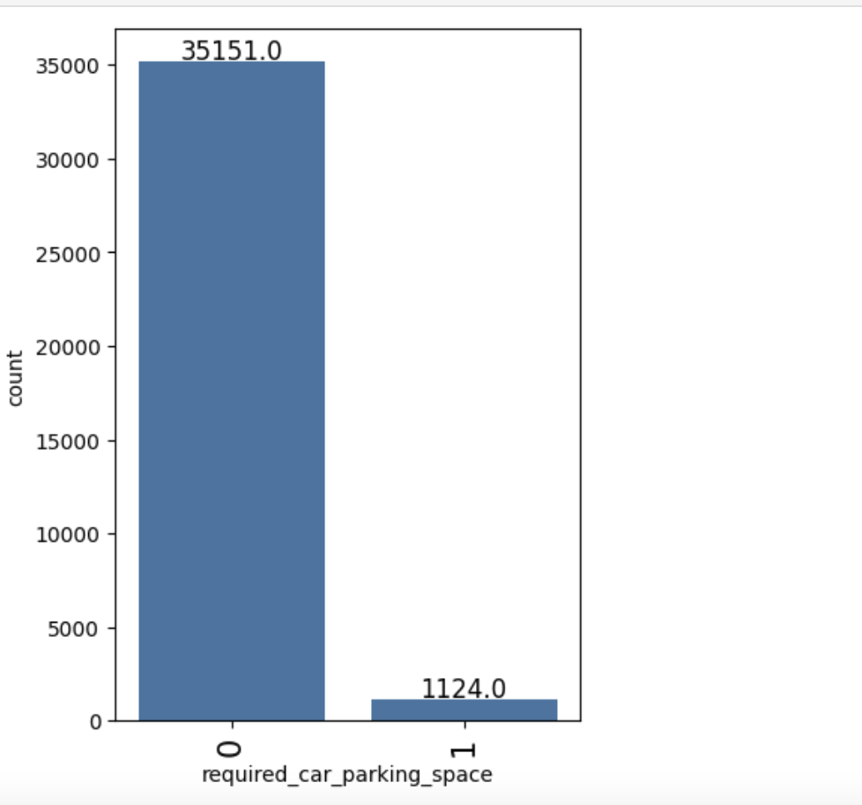
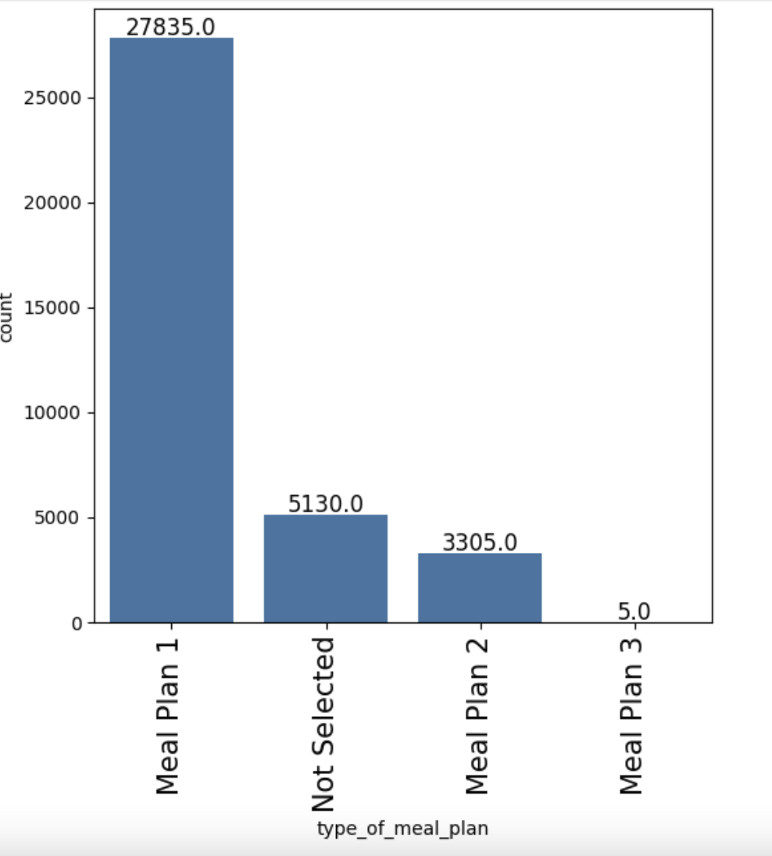
EDA Results - Univariate
Majority of the bookings (35k compared to 11k) needed car parking
Majority of the bookings selected the meal plan 1

Slide 8
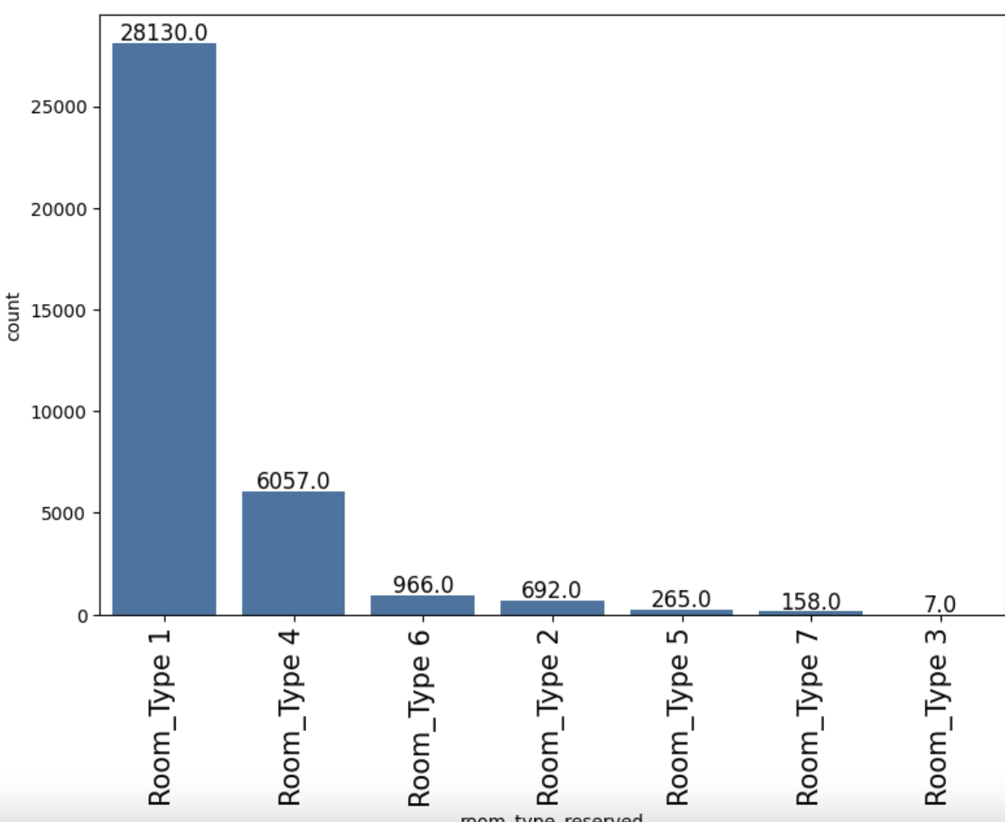
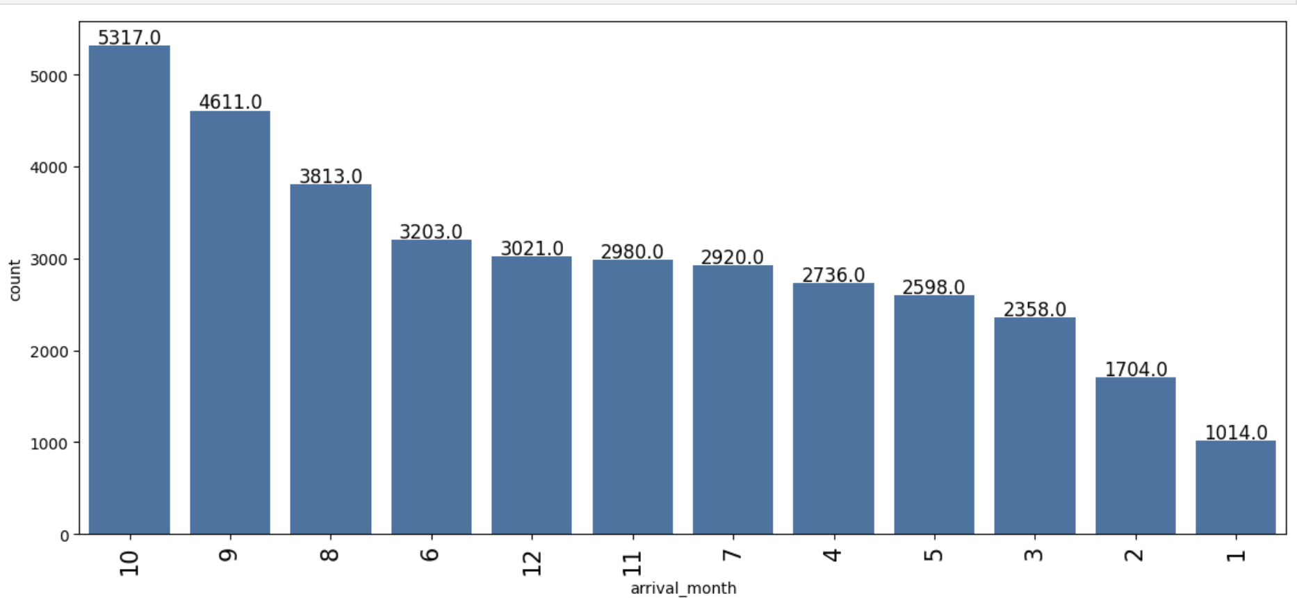
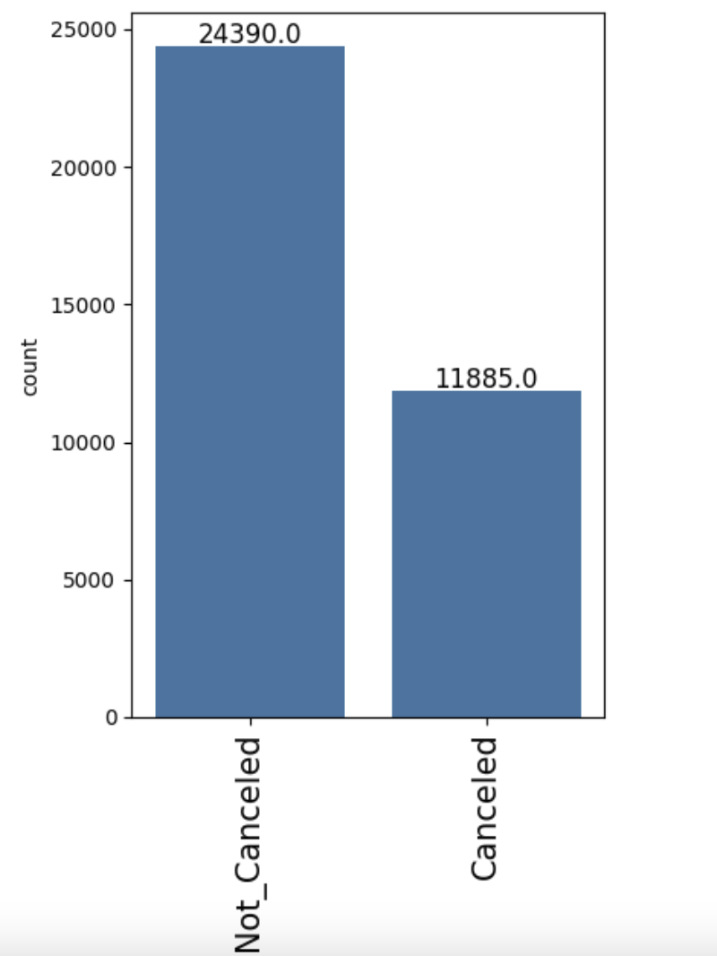
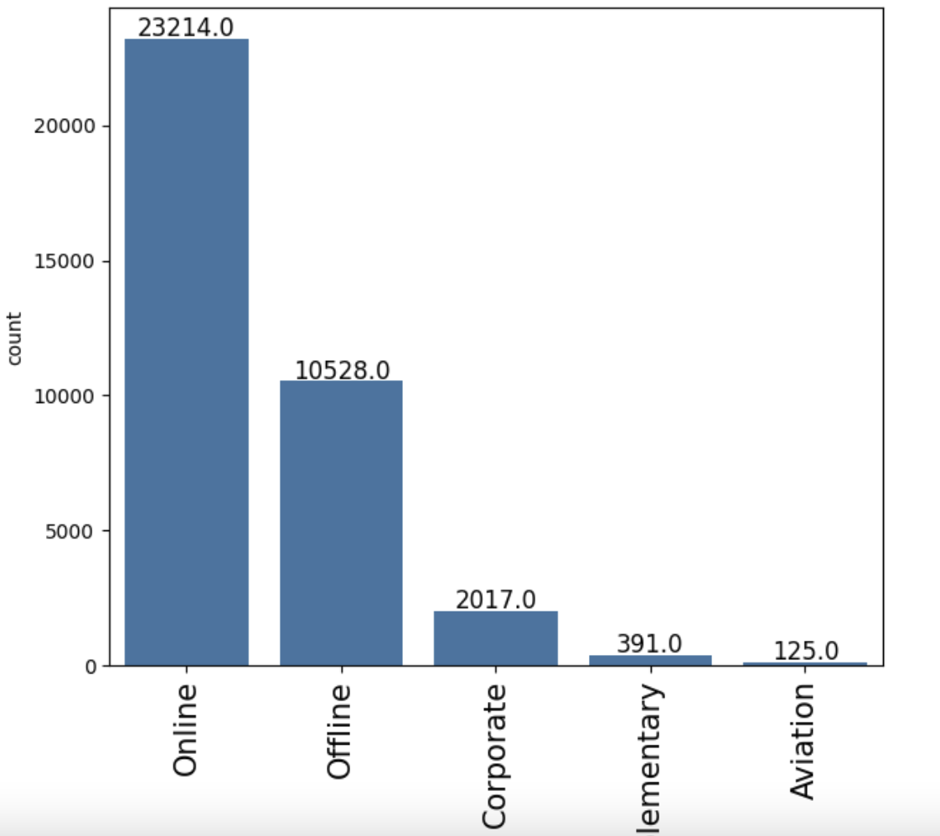
EDA Results - Univariate
Majority of bookings selected room type 1
September and October are the busiest months
Majority of booking were done online
32.8% of the bookings canceled and 67.2% of the bookings were
not canceled.

Slide 9
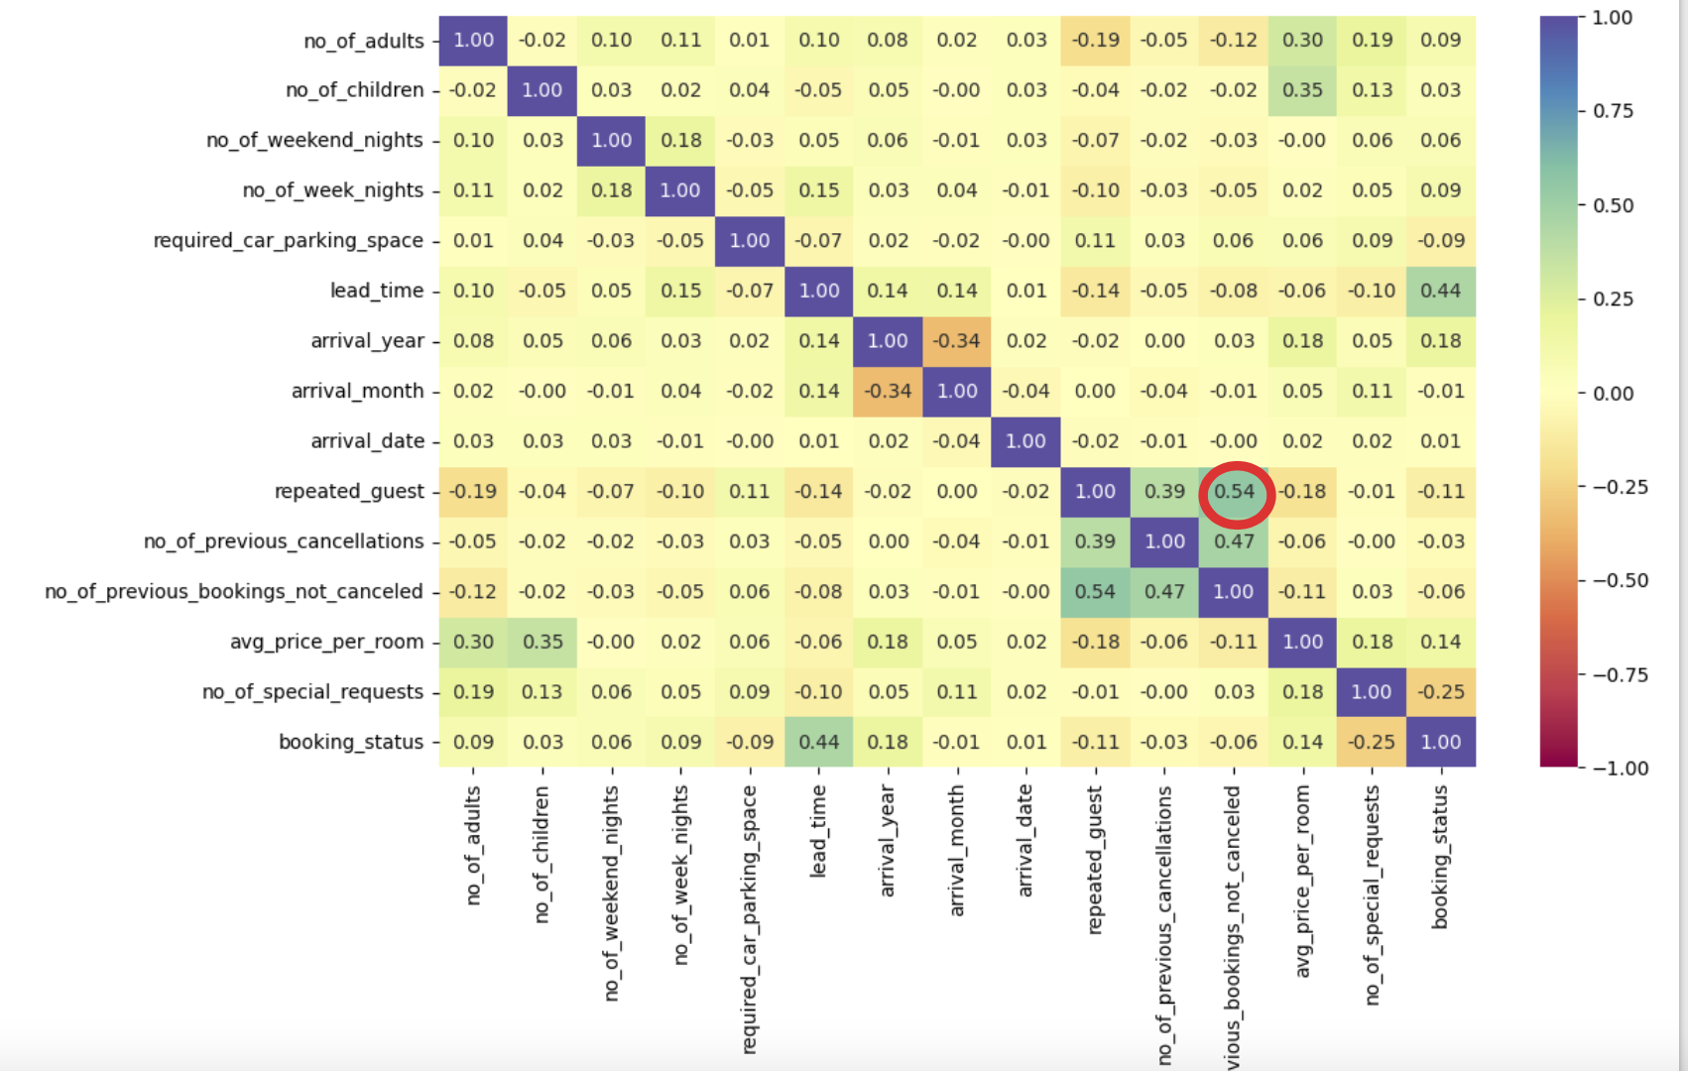
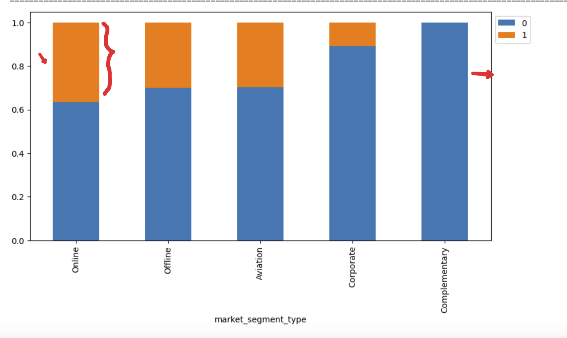
EDA Results - Bivariate
Repeated guests and non cancellations are highly correlated. So, repeat customers tend to cancel less
Corporate and complimentary bookings tend to cancel less, while online have most cancellations

Slide 10
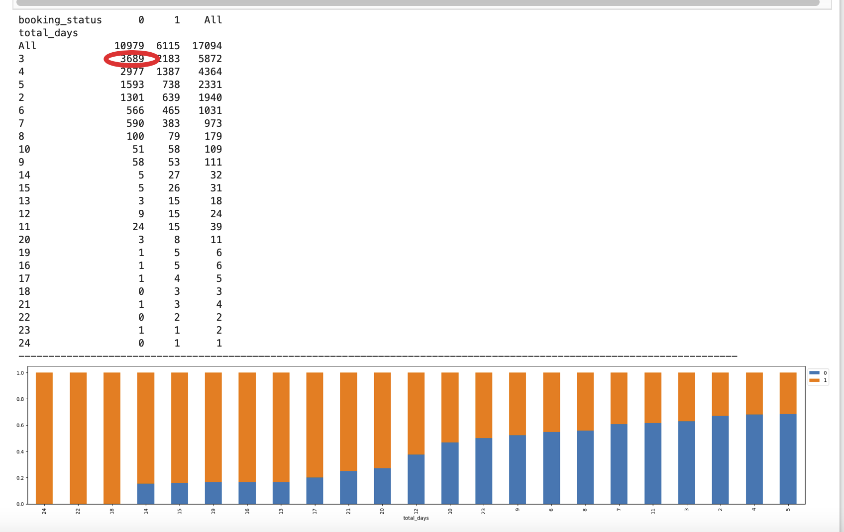
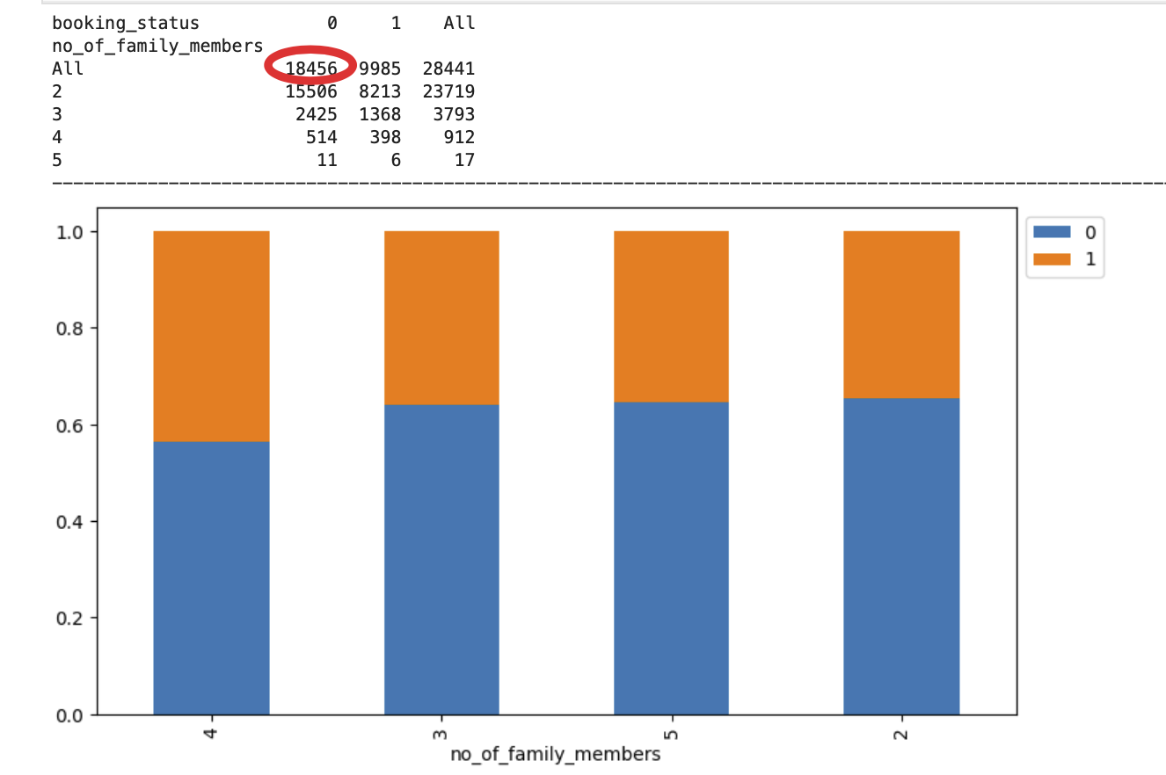
EDA Results - Bivariate
Family booking: Of all family bookings 18456 bookings were not cancelled and 9985 bookings were cancelled
Majority bookings were 3 days bookings followed by 2 day bookings

Slide 11
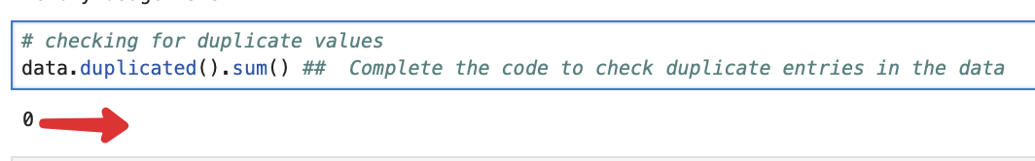
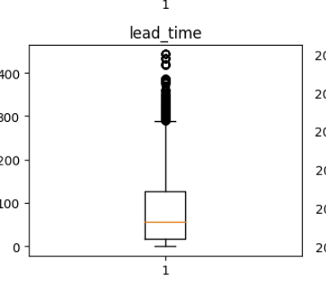
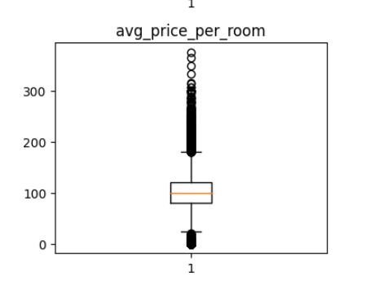
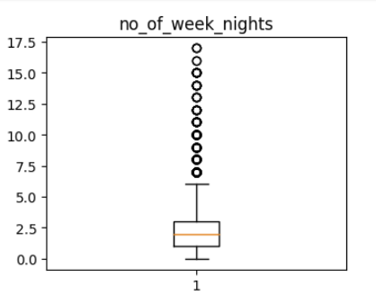
Data Preprocessing
No duplicate values found in dataframe
No missing value found in dataset
Lead time, avg price per room has high number of variables

Slide 12
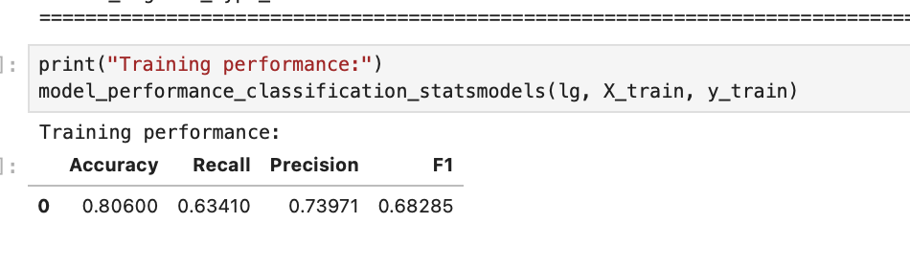
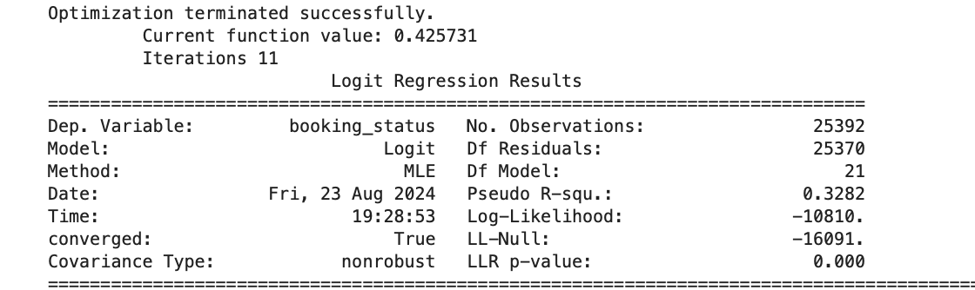
Model Performance Summary
F1 score of the train data set is .68. We need to remove multicollinearity from the data to get reliable coefficients and p-values
We will check the p-values of the variables, and drop the column with the highest p-value.

Slide 13
Data Background and Contents
We need to reduce both False Negatives and False Positives which are basically incorrect prediction of bookings’ cancellations prediction (and in fact they don’t cancel) and prediction of non-cancellation (and in fact if they cancel).
For that we need to improve F1 score.

Slide 14
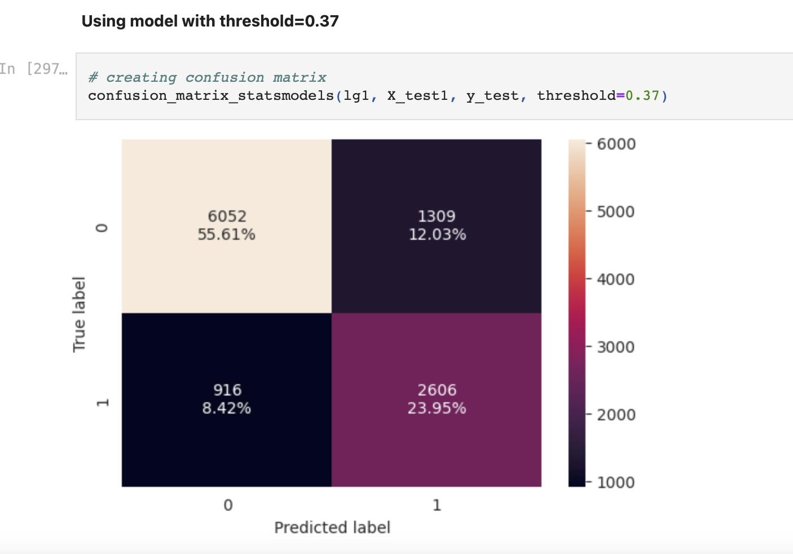
Model Building - Logistic Regression
Create confusion metrix
Check ROC-AUC Curve
Create multiple test train data combination using various threshold
see Precision-Recall curve and see if we can find a better threshold

Slide 15
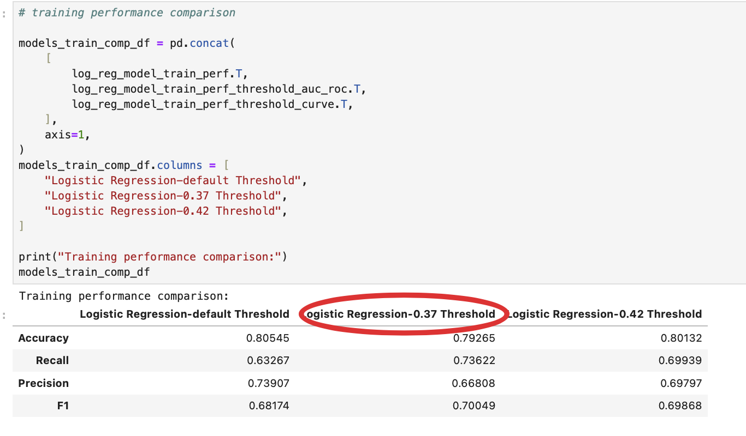
Model Performance Evaluation and Improvement - Logistic Regression
We can conclude that the logistic regression model with a threshold of 0.37 has the best performance across various metrics, including accuracy, recall, precision, and F1 score. Therefore, it is recommended as the optimal model for predicting booking cancellations in this scenario.
Note: You can use more than one slide if needed

Slide 16
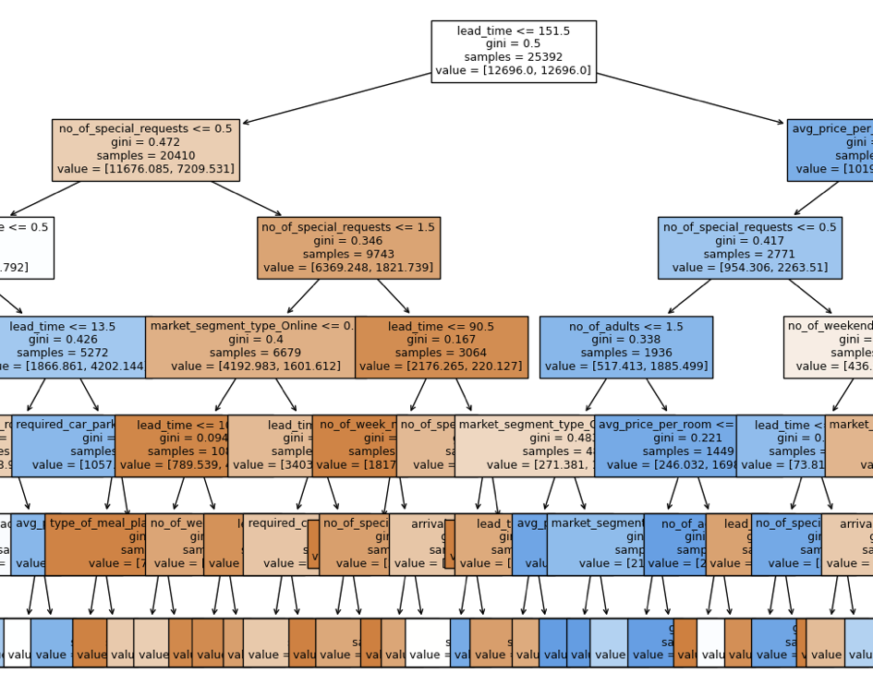
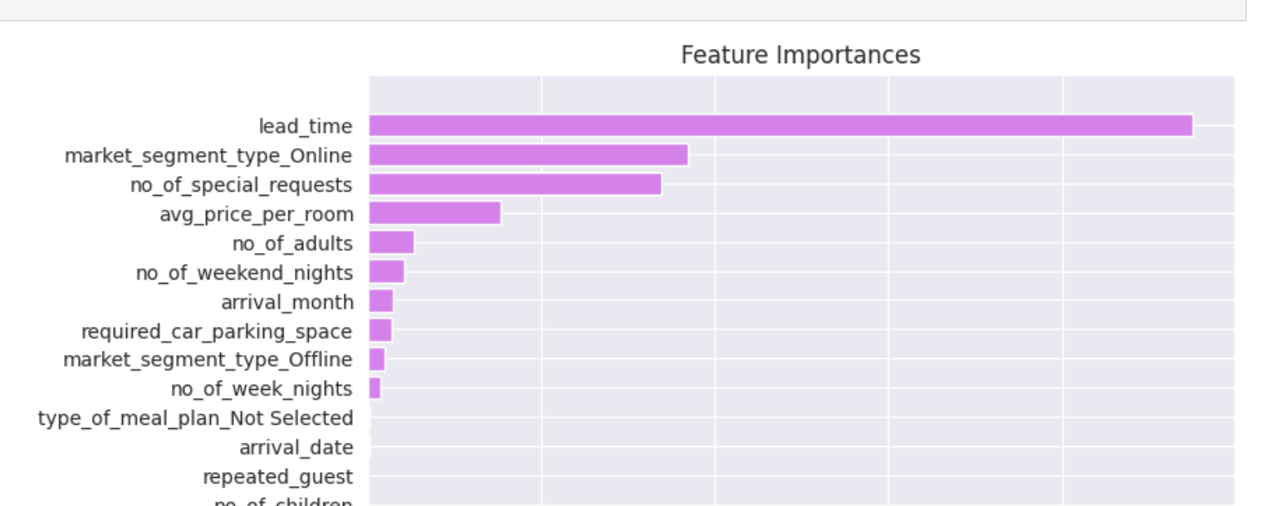
Model Building - Decision Tree
Visualize the tree (SC attached)
The tree starts by evaluating the lead time feature
The feauture importances the top 3 has changed for estimator:
  lead_time
  market_segment_type_online
  no_of_special_requests

Slide 17
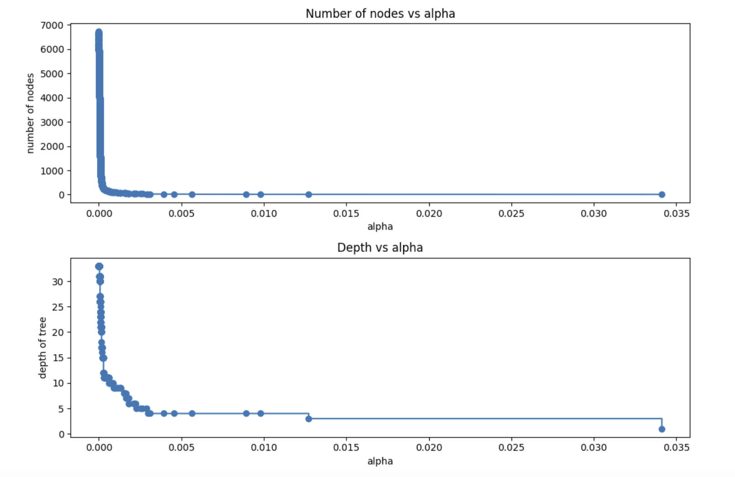
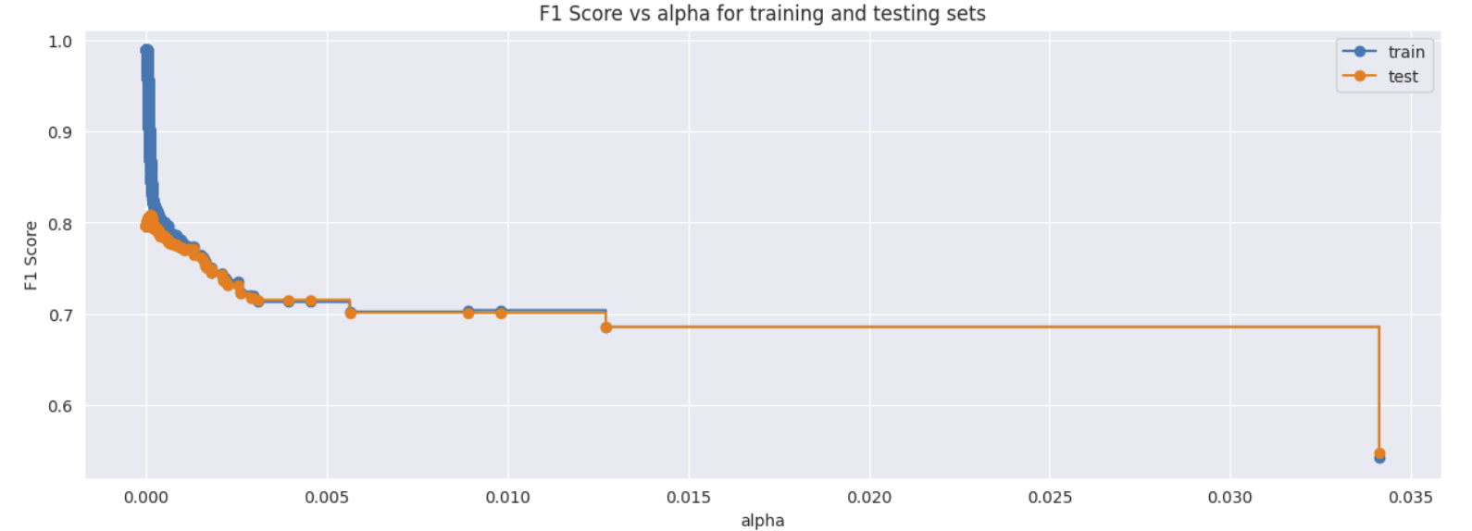
Model Performance Evaluation and Improvement - Decision Tree
Cost complexity pruning: Number of nodes in the last tree is: 1 with ccp_alpha: 0.081
F1 score vs Alpha in Trains vs Test data

Slide 18
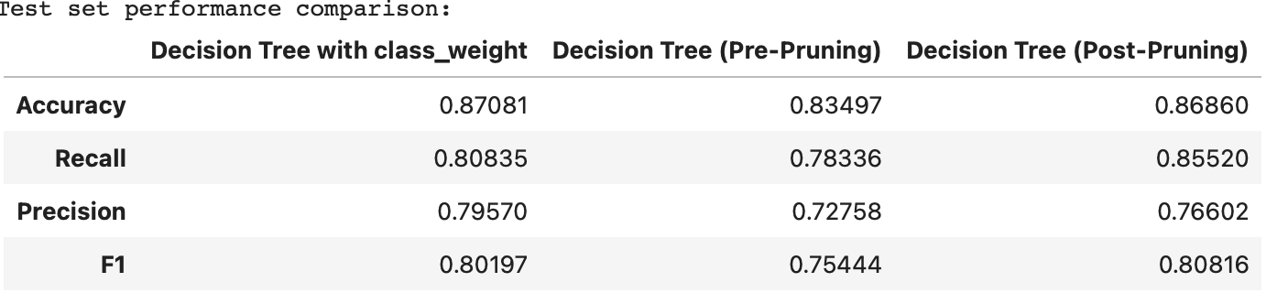
Slide Header
post-pruning is giving the highest recall on the test set
Booking with high Leadtime and avg booking price is likely to be cancelled
Recommendation for Hotel should be: paying special attention to Lead time, reduce average price per room, allow incentive for corporate bookings, increase price in peak season of October and reduce for other months.

