Slide 1
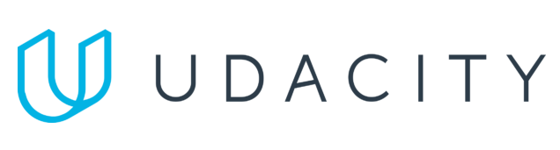
Data Lake Value Proposition
Medical Data Processing Company
Sohaib Zafar
Udacity IPS Version 1.0
Notes:
Hello everyone,
Welcome to the presentation about Data Lake Value Proposition

Slide 2
Agenda
What is a Data Lake
Components of a Data Lake
Data Lake vs Data Warehouse
Business Value of Data Lake Solution
Proposed Data Lake Architecture for Medical Data Processing system
Udacity IPS Ver. 1 2/2020
Notes:
Lets go through with the agenda of this presentation
In this presentation we will talk about
what is data lake
its components
difference between data lake and data warehouse
Business value that we can derive from the data lake
and eventually discussing the proposed data lake architecture

Slide 3
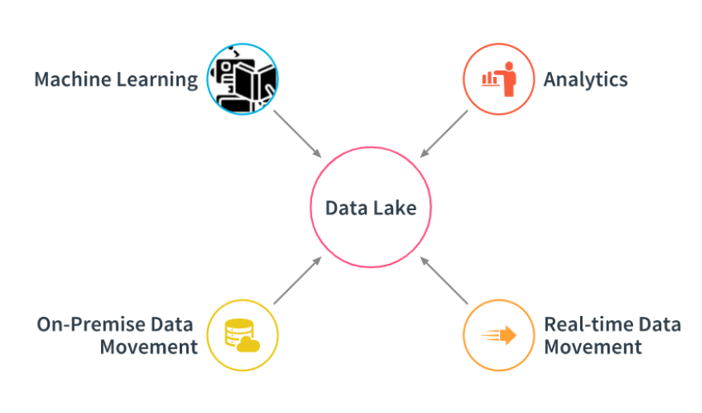
What is a Data Lake
Notes:
As u can see on the slide, data lake is the centralized place where u can do machine learning, and analytics use cases,
by ingesting real-time data or on prem data to data lake.

Slide 4
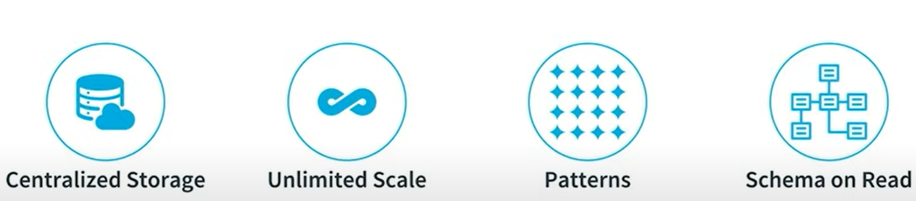
What is a Data Lake
Notes:
Lets dive a bit deeper to know what this really means, a data lake is a centralized storage repository that allows u to store all ur structured,
unstructured and semi structured data at scale. A data lake allows u to run different analytics use cases from dashboard to data visualization
from data processing to real time analytics. Alongwith that Data Lake provides native integration with machine learning to derive better decisions.
Data Lake allows businesses the ability to scale in both quantity of data and types of data. You can store ur data as is, without having to first structure the data.
Data lake democrizes the data within an organization and it is a cost effective way to store and process all of enterprise data.
With the help of data lake the analytist within the company can find meanigful patterns, because of easy access to the required data.
Data Lake uses Schema on read, meaning that u keep writing the data into data lake into its original raw format. Once data is written u enforce the schema when u need to read the data back
Which is different from data ware house and relational databases where schema needs to be defined first.
Data lake also breaks data silos

Slide 5
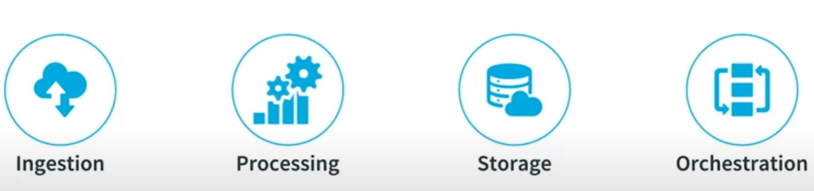
Components of Data Lake
Notes:
Data Lake consists of various ingestion tools. Data ingestion allows connectors to get data from different data sources and load data into the data lake.
For example, tools like kafka, nifi, flume, pulsar
it supports all sort of structured, semi- structued and unstructured data.
Processing - tools to process the data in Data Lake. For example, Apache Spark, Pig, Hive
Storage - Store the data at scale in a data lake. Mostly leveraging Object Storage solutions, for example HDFS
Orchestrations - Design and automate ETL workflows, for example Apache Airflow

Slide 6
Data Warehouse
Data Lake
Refined/structured/relational data
Schema designed at the start “schema-on-write”
Used by mainly business analysts
Used for historical analytics, visualizations, BI
Collects similar data from multiple resources
Unstructured, unrefined, not relational data
Schema designed at the end “schema-on-read”
Use by data scientists and data developers, business analysts
Used for predictive analytics, machine learning
Connecting various types of data from a wide variety of sources
Udacity IPS Ver. 1 2/2020

Slide 7
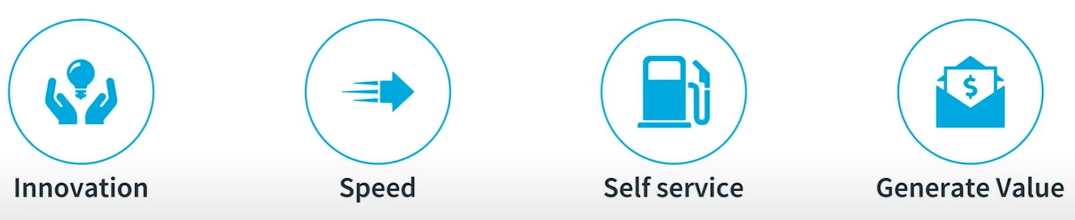
Business Value of Data Lake
Notes:
Innovation is enabled
Real-time, integrated-data Analytics is possible
Data silos are broken, which allows new collaboration and interactions
Companies can be ready for the unknown use case
Data, even new data, can be dynamic, easy to incorporate, and quick to access
Self-service access instead of weeks months of work to get what they need
Companies can readily identify new revenue streams, recognize patterns, provide new types of previously unknown(or unattainable) information to make strategic decisions

Slide 8
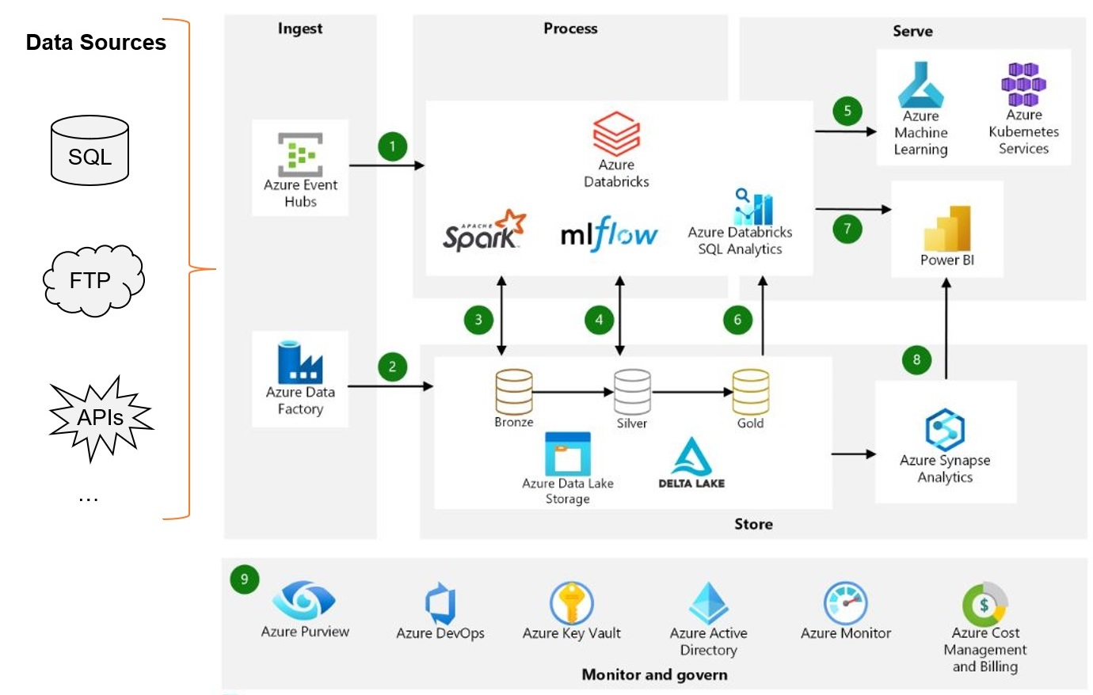
Data Lake Architecture
Notes:
Azure Databricks ingests raw streaming data from Azure Event Hubs.
Data Factory batch loads raw data into Data Lake Storage.
For data storage:
Data Lake Storage houses data of all types, such as structured, unstructured and semi-structured. It also stores batch and streaming data.
Delta Lake forms the curated layer of the Data Lake. It stores the refined data in an open-source format.
Azure Databricks works well with a medallion architecture that organizes data into layers:
Bronze: Contains raw data.
Silver: Contains cleaned, filtered data.
Gold: Stores aggregated data useful for business analysis.
The analytical platform collects the data from the various batch and streaming sources. Data analysts use different tools for these tasks.
data preparation
data exploration
model preparation
model training
MLflow manages parameter, metric, and model tracking in data science code runs. The coding options are flexible:
Code can be in SQL, Python, R and Scala.
The code can use popular open-source libraries and frameworks like Koalas, Pandas, and scikit-learn, which are pre-installed and optimized.
Practitioners can optimize performance and cost with single-node and multi-node compute options.
Machine learning models are available in different formats:
Azure Databricks stores information about models in the MLflow model registry . The registry exposes models via batch, streaming, and REST APIs.
The solution can also deploy models to Azure Machine Learning Web Services or Azure Kubernetes Service (AKS).
Services that work with the data connect to a single underlying data source to ensure consistency. For example, Azure Databricks SQL Analytics allows users to run SQL queries on the data lake. This service:
Provides a query editor and gallery, query history, basic dashboarding, and alerts.
Uses built-in security that includes row and column level permissions.
Uses a Photon-powered Delta engine to speed up performance .
Power BI generates analytical and historical reports and dashboards from the unified data platform. When working with Azure Databricks, this service uses the following features:
A built-in Azure Databricks connector to visualize the underlying data.
Optimized Java Database Connectivity (JDBC) drivers and ODBC (Open Database Connectivity) drivers.
Users can export gold datasets from the data lake to Azure Synapse using the streamlined Synapse connector. SQL pools in Azure Synapse provide a data warehousing and compute environment.
The solution uses Azure services for collaboration, performance, reliability, governance and security:
Microsoft Purview provides data discovery services, confidential data classification, and governance insights across the data estate.
Azure DevOps offers continuous integration and continuous deployment (CI/CD) and other built-in version control features.
Azure Key Vault securely manages secrets, keys, and certificates.
Azure Active Directory (Azure AD) provides single sign-on (SSO) for Azure Databricks users. Azure Databricks supports automated user provisioning with Azure AD for these tasks:
Creating new users.
Assign an access level for each user.
Remove users and deny access.
Azure Monitor collects and analyzes Azure resource telemetry. By proactively identifying problems, this service maximizes performance and reliability.
Azure Cost Management and Billing provides financial governance services for Azure workloads.

Slide 9
THANK YOU
Udacity IPS Version 1.0

