Slide 1
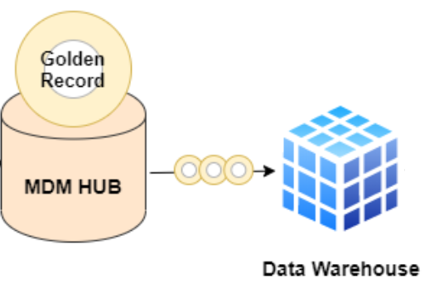
MDM Architecture
Customers
Inventory
Listings
Data Warehouse
Orders

