Slide 1


Data Governance @ SneakerPark
Prepared by:
Submitted on:

Slide 2
Background
SneakerPark is an online shoe reseller that allows people to buy and sell used and new shoes. Buyers can bid for shoes or buy them outright, and sellers can set a price or sell to the highest bidder.
Each buyer and seller must have an active account in order to sell, bid, or purchase sneakers using SneakerPark’s website.
SneakerPark authenticates the shoes before shipping them to the buyer, so before listing an item, the seller must ship it to SneakerPark’s warehouse. Upon receipt, SneakerPark assigns an item number to each pair of sneakers and notifies the seller that they are now free to list their item. If the item is not listed within 45 days, SneakerPark returns it to the seller and sends an invoice to the seller for the shipping cost.
If the item is found to be inauthentic or in an unacceptable condition, it is also returned back to the seller in a similar fashion.
When the item sells, the buyer’s account is credited with the purchase price minus the SneakerPark service fee and shipping fees to deliver the item to the buyer.
Currently, SneakerPark only supports sales within the United States.

Slide 3
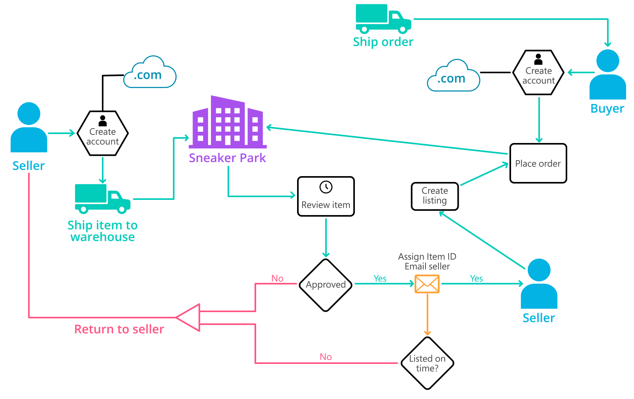
Background (cont’d)
Below you can see a diagram that will hopefully help you visualize some of SneakerPark's business processes. Keep in mind that it does not capture ALL processes and every nuance, but simply serves as another artifact to use in your project.

Slide 4
Step 1
Enterprise Data Catalog Part 1: Enterprise Data Model

Slide 5
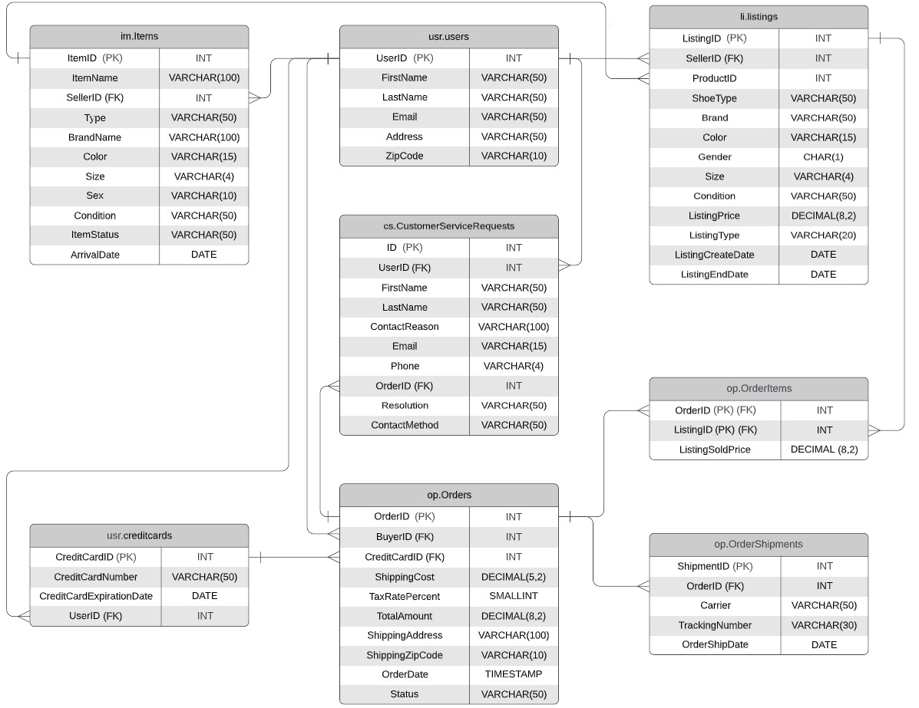
This Enterprise data model that will provide SneakerPark with a holistic view of its data systems and help you grasp the organization's important entities and relationships

Slide 6
Step 2
Enterprise Data Catalog Part 2: Metadata

Slide 7
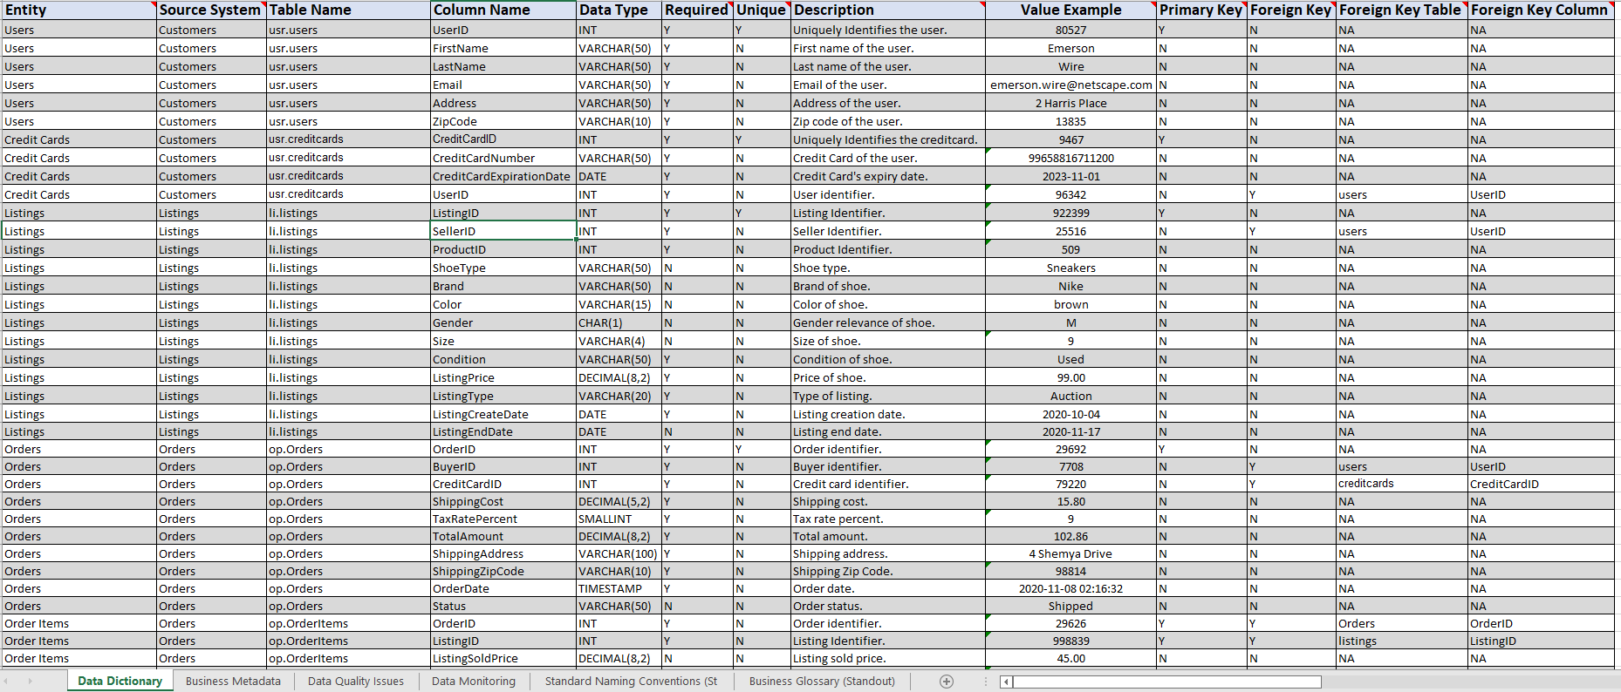
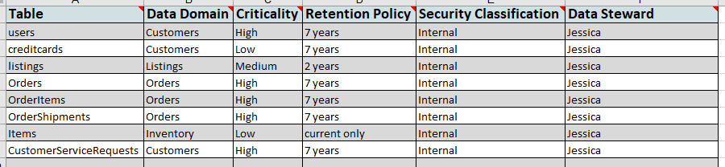
Here you can find the screen shot of the submitted excel sheets “SneakerPark_enterprise_data_catalog.xlsx“. .
Data Dictionary:
Business Metadata:

Slide 8
Step 3
Data Quality
Part 1: Profiling and Cleansing

Slide 9
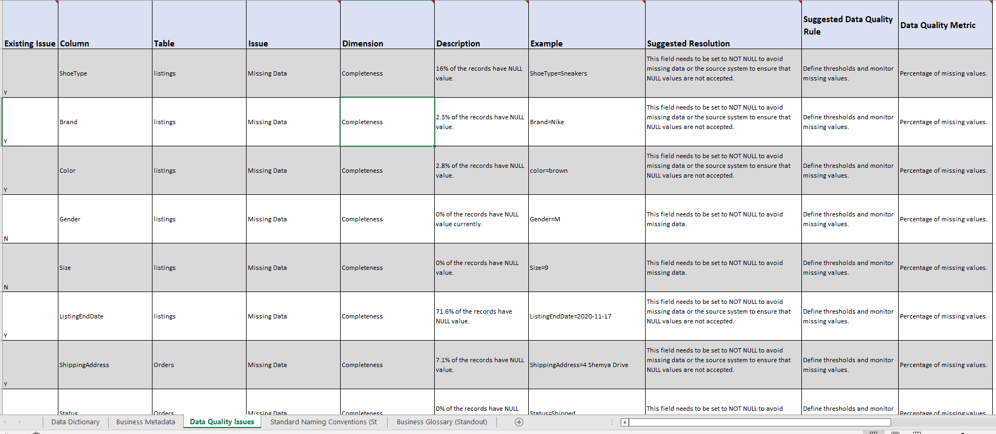
The data quality issues are mentioned in the submitted excel sheet “SneakerPark_enterprise_data_catalog.xlsx“. Here is the screenshot:

Slide 10
Step 4
Data Quality
Part 2: Monitoring

Slide 11
Here is a mock-up of a data quality monitoring dashboard that will be used to monitor the data to ensure compliance with your data quality rules.

Slide 13
Step 5
Master Data Management
Part 1: MDM Architecture

Slide 14
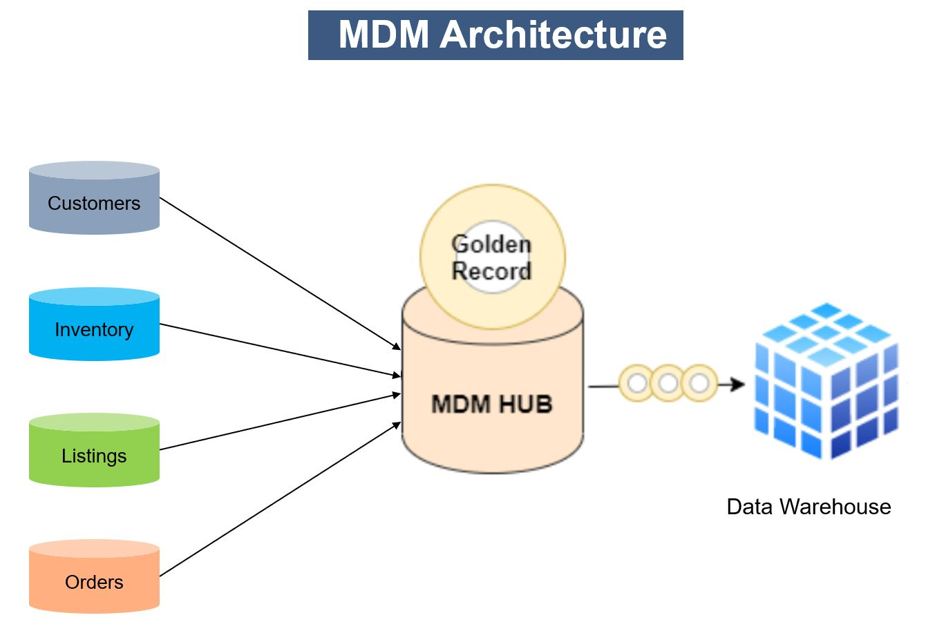
I've decided to use the Consolidated architectural style. Since there are so many various systems on SneakePark, it is challenging to track the same item and seller across them all. I assume there are analytical demands because the scenario description mentions that the organization intends to develop an Enterprise Data Warehouse solution to replace the current legacy data warehouse, MS Access databases, and excel reports. Because of this, I think the best course of action is to combine the data from all of these systems into a single MDM Hub, which can then send unified, cleansed, and validated golden records to data warehouses and reports. This architecture is also less intrusive and causes little system disruption.

Slide 15
Step 6
Master Data Management
Part 2: Master Record

Slide 16
Here, I define a set of matching rules that will be used by the SneakerPark's MDM Hub to match item and customer entities between the company's different systems.
Match item entities on:
ItemID from Inventory Management System.
ProductID from Listing Service.
Match customer entities on:
UserID from User Service and Customer Service Application.
BuyerID from Order Processing Service.
SellerID from Inventory Management System.

Slide 17
Step 7
Data Governance:
Roles and Responsibilities

Slide 18
1. Data governance lead – EXECUTIVE LEVEL
The data governance lead is responsible for all aspects of defining and operating the data governance policies and supporting the multiple data domains.
They are ultimately responsible for implementing the data governance program vision, promoting the role of governance and enforcing policy, while following data governance best practices.
The main responsibility is to provide leadership, support, sponsorship, and understanding of data governance to other departments.

Slide 19
2. . Data governance council – STRATEGIC LEVEL
This is the sole role on this list that doesn't belong to an individual. It belongs to a group of individual.
It is a governing body which is responsible for the strategic guidance of the data governance program, prioritization for the data governance projects and initiatives, approval of organization-wide data policies and standards, as well as enabling ongoing support, understanding and awareness of the data governance program.
This body sets the strategic direction for WHAT the data governance program needs to accomplish and WHEN it needs to accomplish it. In contrast, the data governance leads decides HOW these items should be accomplished.

Slide 20
3. Data owner(s) – TACTICAL LEVEL
A data owner is a person within your organization that has the authority to make decisions about business term definitions, data quality, accessibility and retention requirements as they tie to the business needs.
Data owner will also need to know, or at least be aware of, the regulations, policies, laws governing data privacy and understand the business needs and business rules, procedures, constraints, as these tie to their own area of data ownership.
It is likely to have several data owners within your data governance program, with each responsible for the data within their own area of the business.
Data owners are usually senior managers from different business functional areas. In turn, these business areas are the main stakeholders of specific data domains.
Focusing on the quality of data in a domain (subject area in most cases) for the “enterprise.”

Slide 21
4. Data Steward(s) – OPERATIONAL LEVEL
A data steward sits under a data owner and is generally appointed by the data owner to work with them or act as their representative in data stewardship domain group meetings. In the data governance hierarchy, they are part of at least one data stewardship domain group.
The data owner remains accountable, but they will delegate the day-to-day responsibility to a data steward. Data stewards often tend to be the subject matter experts but are still reasonably senior because they must be trusted by their data owner.
If you took, for example, a finance department, it is likely that the finance director or his deputy would be the data owner for all the finance data, then the head of each sub team within finance would be appointed as a data steward.
Data stewards maintain data quality using user feedback and concerns, define data quality metrics, evaluate and identifying problems, coordinate and implement remedies.

Slide 22
5. Data Custodian(s) – SUPPORT LEVEL
Data custodians are typically part of IT departments. This makes it fundamentally different from other roles - like data owners and data stewards - since those are all about the business.
Data custodians are usually divided further in their areas of expertise, such as: data modelling, data architecture, data engineering and database administration.
Maintaining, archiving, recovering, backing up data, preventing data loss/corruption etc.
Maintaining data and systems, moving data between systems, aggregating, and transforming data in accordance with the business requirements.
Ensuring that metadata critical to data governance is included in the metadata resource and is accessible.
Processes exist for data quality issue resolution in partnership with data stewards.
Data added to data sets are consistent with the data model.
Versions of master data are maintained along with the history of changes.

Slide 23
Jake has the skills required to fulfill the responsibilities of the data custodian. And Jessica has the experience to become the data steward. The company will need to hire new employees for the additional roles apart from these two.

