Slide 1
E-Waste Management System
Problem Statement
Electronic waste (E-Waste) is becoming a growing concern as the world becomes increasingly reliant on electronic devices. The increasing rate of technology obsolescence and the high rate of device replacement are leading to a rapid growth in the amount of E-Waste being generated. This presents a major challenge for waste management and recycling systems, as E-Waste often contains hazardous materials that can harm human health and the environment. In addition, E-Waste is often shipped to developing countries, where it is often managed in an unsafe and environmentally damaging manner. As a result, there is a pressing need for effective E-Waste management solutions that can reduce the environmental impact of E-Waste and promote sustainable practices.
Track : Planet
Team Leader: Mohammed Mubeen Uddin
Country: INDIA

Slide 2

Idea Description
The E-Waste management system is a comprehensive solution that aims to tackle the growing issue of electronic waste. The application is designed to manage the entire E-Waste lifecycle, from collection to disposal, while reducing the amount of E-Waste that ends up in landfills. The system operates through a network of E-Waste collection points and government facilities, and provides users with a convenient and secure way to dispose of their unwanted electronics.
The E-Waste management system provides several key features, including data destruction services and safe disposal methods, as well as tracking the flow of E-Waste from collection to recycling. The system also offers educational resources to help raise awareness about the environmental impact of E-Waste and encourage responsible disposal practices.
The application uses advanced analytics to gather data on E-Waste trends, disposal methods, and environmental impact, providing valuable insights into the E-Waste landscape. The goal of the E-Waste management system is to promote sustainable practices and reduce the environmental impact of electronic waste, while providing a convenient and effective solution for users.
Technology Stack:
Java to create App
Python – Analysis
Python Libraries : NumPy , Pandas, Scikit-learn, Geopy
Geographic Information Systems
Database-MySQL
2

Slide 3
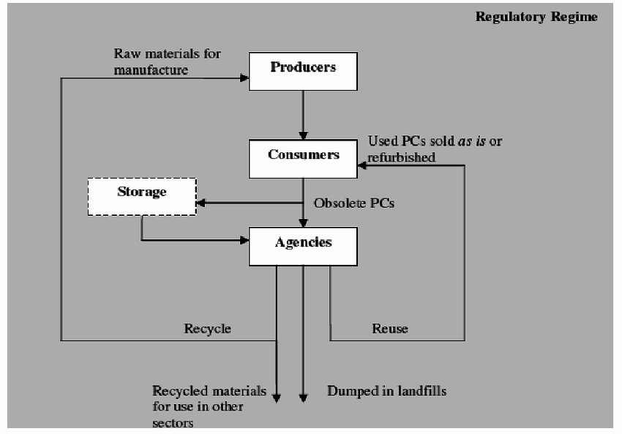
Use Cases
Collection and Recycling: E-Waste management systems can be used to track and manage the collection of E-Waste from individuals and businesses, and ensure that it is properly recycled.
Data Destruction: E-Waste management systems can be used to securely erase sensitive data from discarded electronic devices to protect privacy and data security.
Compliance: E-Waste management systems can be used to ensure that E-Waste management processes are compliant with relevant regulations and standards.
Reporting: E-Waste management systems can be used to generate reports on E-Waste generation and disposal, to track progress and monitor the effectiveness of E-Waste management programs.
Geolocation Tracking: E-Waste management systems can use geolocation tracking to track the movement of E-Waste from collection to recycling, and ensure that waste is managed and disposed of properly.
Process Automation: E-Waste management systems can automate E-Waste management processes, from collection to recycling, to streamline operations and improve efficiency.

Slide 4
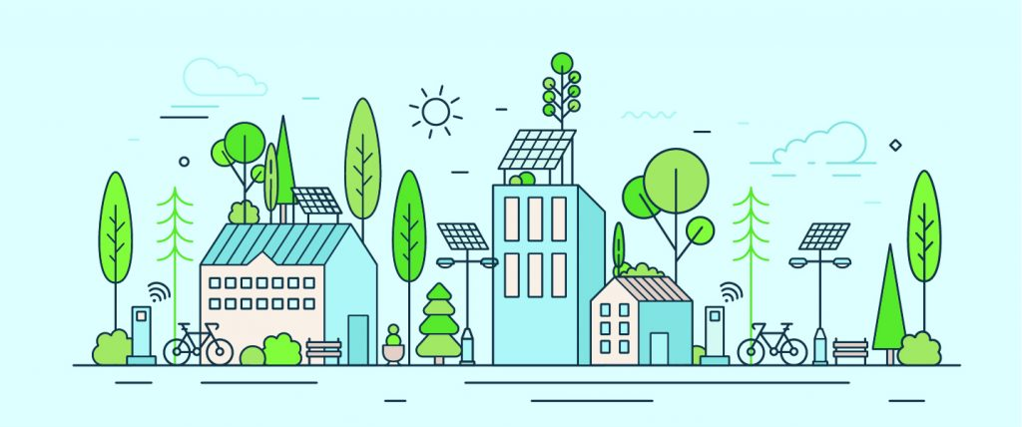
UNIQUE FEATURES
Life cycle of Electronics can be tracked .
Promote repair and repurposing of electronics.
Awareness about Environmental Impact.
E-Waste Data Analysis providing Market Intelligence.
The application allows to generate separate Login ID only for Collectors for security purposes.
Auto tracking and recording the flow of E-Waste from collection to Recycling.
Allow Government Facilities
The application model will be trained with Multiple data to gain higher accuracy.

