Slide 1
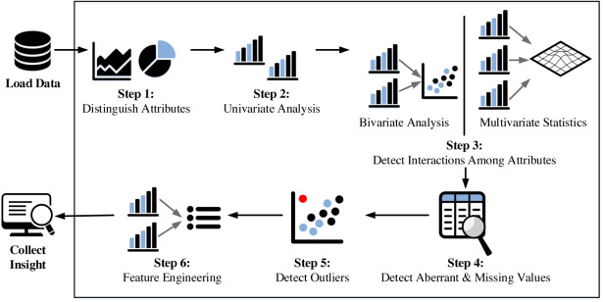
Exploratory Data Analysis

Slide 2

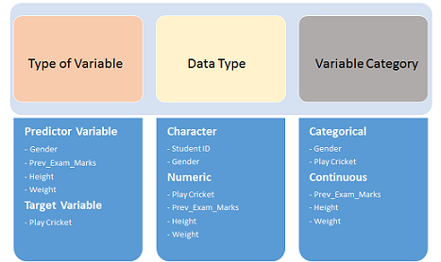
Variable Identification
Univariate Analysis
Bi-variate Analysis
Missing values treatment
Outlier treatment
Variable transformation
Variable creation

Slide 3


Slide 4
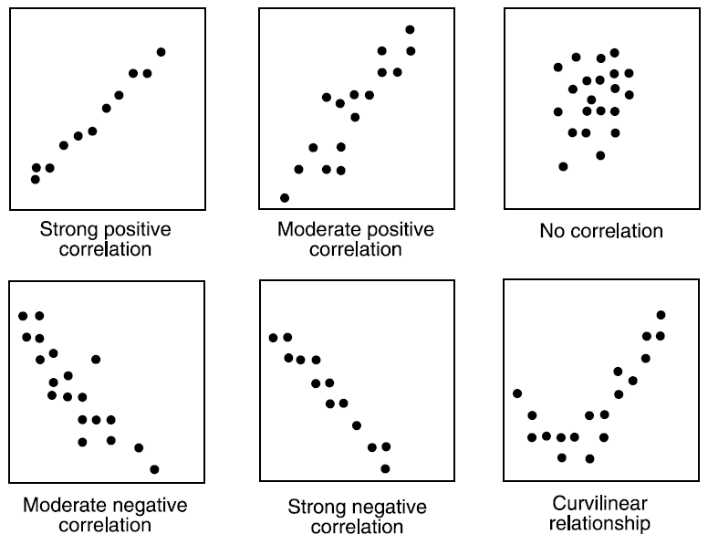


Slide 5


Slide 6
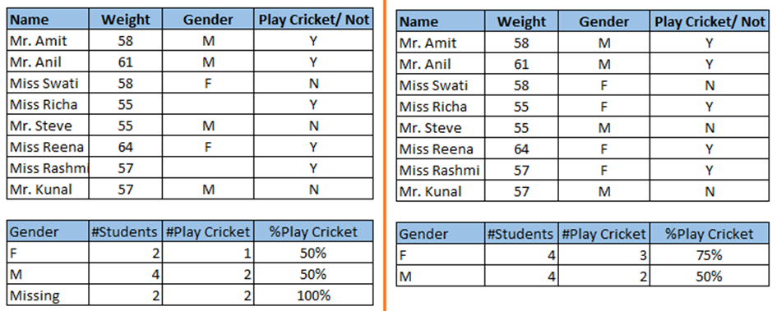
Missing Value

Slide 7
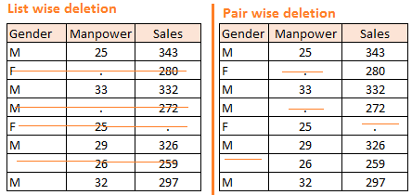

Slide 8
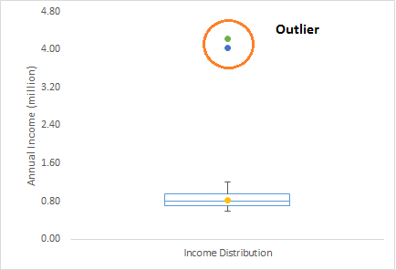


Slide 9
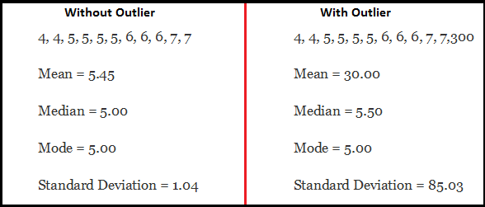


Slide 10


Slide 11
