Slide 1
CSE-246
Advanced Algorithm

Slide 2

Algorithm

Slide 3


Algorithm
A procedure for solving a problem in terms of
  the actions to be executed, and
  the order in which these actions are to be executed
is called an algorithm.
Correctly specifying the order in which the actions are to be executed is important.

Slide 4

Algorithm
A junior executive for getting out of bed and going to work
Consider the “rise-and-shine algorithm”
  (1) Get out of bed,
  (2) take off pajamas,
  (3) take a shower,
  (4) get dressed,
  (5) eat breakfast,
  (6) carpool to work.
This routine gets the executive to work well prepared to make critical decisions.

Slide 5

Algorithm
Suppose that the same steps are performed in a slightly different order:
  (1) Get out of bed,
  (2) take off pajamas,
  (3) get dressed,
  (4) take a shower,
  (5) eat breakfast,
  (6) carpool to work.
In this case, our junior executive shows up for work soaking wet.

Slide 6
General Concepts
Algorithm strategy
  Approach to solving a problem
  May combine several approaches
Algorithm structure
  Iterative ⇒ execute action in loop
  Recursive ⇒ reapply action to subproblem(s)
Problem type
  Satisfying ⇒ find any satisfactory solution
  Optimization ⇒ find best solutions

Slide 7
Some Algorithm Strategies
Divide and conquer algorithms
Dynamic programming algorithms
Greedy algorithms
Backtracking algorithms
Branch and bound algorithms
Heuristic algorithms

Slide 8

Divide and Conquer
Based on dividing problem into subproblems
Approach
  Divide problem into smaller subproblems
    Subproblems must be of same type
    Subproblems do not need to overlap
  Solve each subproblem recursively
  Combine solutions to solve original problem
Usually contains two or more recursive calls
Notes:
2

Slide 9
Divide and Conquer – Examples
Binary Search
Quicksort
  Partition array into two parts around pivot
  Recursively quicksort each part of array
  Concatenate solutions
Mergesort
  Partition array into two parts
  Recursively mergesort each half
  Merge two sorted arrays into single sorted array
Notes:
3

Slide 10
Mergesort
Array A = 5, 2, 4, 7, 1, 3, 2, 6.
5 | 2 | 4 | 1 | 7 | 3 | 2 | 6
5 | 2 | 4 | 1
7 | 3 | 2 | 6
5 | 2
4 | 1
7 | 3
2 | 6
5
2
4
1
7
3
2
6
2 | 5
1 | 4
3 | 7
2 | 6
1 | 2 | 4 | 5
2 | 3 | 6 | 7
1 | 2 | 2 | 3 | 4 | 5 | 6 | 7

Slide 11
Dynamic Programming Algorithm
Based on remembering past results
Approach
  Divide problem into smaller subproblems
    Subproblems must be of same type
    Subproblems must overlap
  Solve each subproblem recursively
    May simply look up solution
  Combine solutions into to solve original problem
  Store solution to problem
Generally applied to optimization problems

Slide 12
Fibonacci Algorithm
Fibonacci numbers
  fibonacci(0) = 1
  fibonacci(1) = 1
  fibonacci(n) = fibonacci(n-1) + fibonacci(n-2)
Recursive algorithm to calculate fibonacci(n)
  If n is 0 or 1, return 1
  Else compute fibonacci(n-1) and fibonacci(n-2)
  Return their sum

Slide 13

Dynamic Programming – Example
Dynamic programming version of fibonacci(n)
  If n is 0 or 1, return 1
  Else solve fibonacci(n-1) and fibonacci(n-2)
    Look up value if previously computed
    Else recursively compute
  Find their sum and store
  Return result

Slide 14
Dynamic Programming
Dynamic Programming is a general algorithm design technique
for solving problems defined by or formulated as recurrences with overlapping subinstances
Invented by American mathematician Richard Bellman in the 1950s to solve optimization problems and later assimilated by CS
“Programming” here means “planning”

Slide 15
Dynamic Programming
Main idea:
  set up a recurrence relating a solution to a larger instance to solutions of some smaller instances
  - solve smaller instances once
  record solutions in a table
extract solution to the initial instance from that table

Slide 16
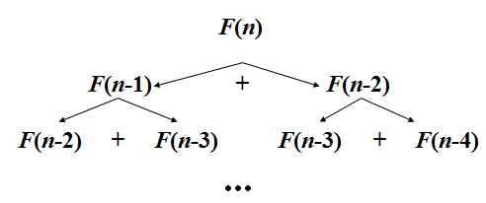
Example: Fibonacci numbers
Recall definition of Fibonacci numbers:
  F(n) = F(n-1) + F(n-2)
  F(0) = 0
  F(1) = 1
Computing the nth Fibonacci number recursively (top-down):

Slide 17

Example: Fibonacci numbers
Recall definition of Fibonacci numbers:
  F(n) = F(n-1) + F(n-2)
  F(0) = 0
  F(1) = 1

Slide 18
Dynamic Programming - Example
0-1 Knapsack
Longest Common Subsequence
Longest Increasing Sequence
Sum of Subset
Warshall’s All pairs shortest path
Bellman Ford’s Single Source Shortest Path
Matrix Chain Multiplication

Slide 19
Greedy Algorithm
Based on trying best current (local) choice
Approach
  At each step of algorithm choose best local solution
Hope local optimum lead to global optimum
Notes:
2

Slide 20
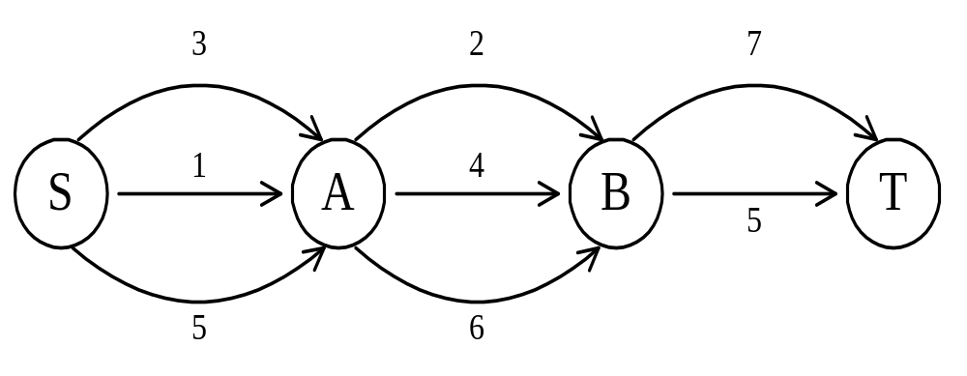
The shortest path
To find a shortest path in a multi-stage graph
Apply the greedy method : the shortest path from S to T :
1 + 2 + 5 = 8

Slide 21
Greedy Algorithm – Example
Kruskal’s Minimal Spanning Tree Algorithm
sort edges by weight (from least to most)
tree = ∅
for each edge (X,Y) in order
if it does not create a cycle
add (X,Y) to tree
stop when tree has N–1 edges
Picks best local solution at each step

Slide 22
Greedy Algorithm - Example
Dijkstra’s Single Source Shortest Path
Minimum Spanning Tree – Prim & Kruskal
Fractional Knapsack Problem
Huffman Coding

Slide 23
The shortest path
To find a shortest path in a multi-stage graph
Apply the greedy method :
the shortest path from S to T :
1 + 2 + 5 = 8

Slide 24
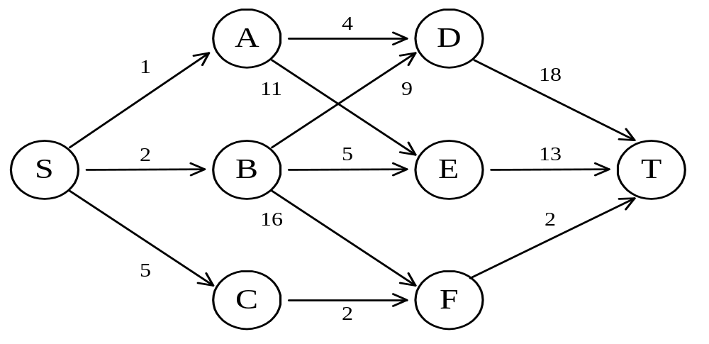
The shortest path in multistage graphs
e.g.
The greedy method can not be applied to this case: (S, A, D, T) 1+4+18 = 23.
The real shortest path is:
(S, C, F, T) 5+2+2 = 9.

Slide 25
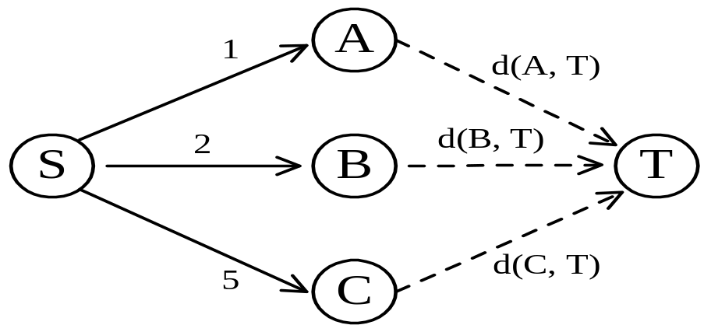
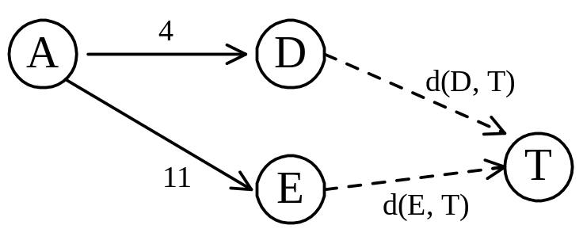
Dynamic programming
Dynamic programming approach (forward approach):
d(S, T) = min{1+d(A, T), 2+d(B, T), 5+d(C, T)}
d(A,T) = min{4+d(D,T), 11+d(E,T)}
= min{4+18, 11+13} = 22.

Slide 26
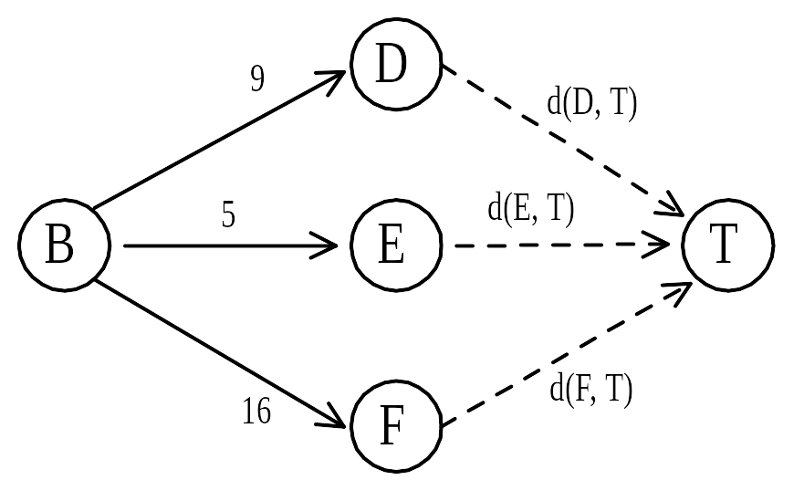
d(B, T) = min{9+d(D, T), 5+d(E, T), 16+d(F, T)}
= min{9+18, 5+13, 16+2} = 18.
d(C, T) = min{ 2+d(F, T) } = 2+2 = 4
d(S, T) = min{1+d(A, T), 2+d(B, T), 5+d(C, T)}
= min{1+22, 2+18, 5+4} = 9.
The above way of reasoning is called
backward reasoning.

Slide 27
Any Question???

