Slide 1
SESSION-01: UI/UX PRESENTATION • 5-MINUTE PITCH
Nuzzle: The AI-Powered Pet Social Network
Built for Bangladesh • MVP Development & Dhaka Launch
"An AI-powered, pet-first mobile social ecosystem uniting Dhaka's pet parents through dedicated pet profiles, 24/7 AI health triage, visual lost-pet matching, and emergency street-rescue dispatch."
👥 Project Team: Abu Zafor • Nadim Rahman • Rizvi Sarker | 📍 Focus: Dhaka Launch (July 2026)

Slide 2
🐾 Nuzzle
Slide 2 / 10 • UI/UX Pitch
CORE CONCEPT • THE STRATEGIC INSIGHT
What is Nuzzle & What Are We Solving?
🐾 What is Nuzzle?
⚡ What Problem Are We Solving?
The structural decision that defines the product: The pet holds the account, not the owner. An animal has its own profile with photo history, milestones, health logs, and personality-driven bio.
On top of this social foundation sit 3 AI systems:
• Visual Lost-Pet Matching (embedding similarity)
• 24/7 Health Urgency Triage (Bangla/English)
• Adoption Compatibility Matching & Street Rescue Alerts.
Bangladesh pet ownership surged +170% in 3 years (Tk 500 Cr cat food market), yet all interactions happen in unorganized Facebook groups:
1. Lost pets go unrecovered due to massive post volume.
2. First-time owners panic over basic symptoms.
3. Injured street animals have zero dispatch route.
4. Pet businesses have no targeted storefronts.
Daily Social Layer ⇄ Episodic AI Utility
Social retention generates the local density & training data that makes AI matching work in crises.
Technopreneurship 2026 • Abu Zafor, Nadim Rahman, Rizvi Sarker

Slide 3
🐾 Nuzzle
Slide 3 / 10 • UI/UX Pitch
SECTION 2 • UI/UX PRINCIPLES & INSIGHTS
Key Learnings from the UI/UX Session
🐾
💜
⚡
✨
Pet-As-Entity Architecture
Calm Lavender Ergonomics
Zero-Barrier Emergency UX
Tactile Pet Micro-Reactions
The pet holds the account, milestones, and medical record—providing structured canonical data for downstream AI matching.
During lost-pet panic or symptoms, loud feeds heighten anxiety. Our soothing lavender palette fosters trust & de-escalation.
Reporting an injured animal takes <30s with zero mandatory login—eliminating friction at life-or-death moments.
Facebook-style pet reaction dock: Paw Five 🐾, Nuzzle 💜, Treat 🦴, Fetch 🎾, and Purr 😻 for joyful community bond.
Core IA Strategy
Emotional UX
Frictionless Action
Micro-Interactions
Technopreneurship 2026 • Abu Zafor, Nadim Rahman, Rizvi Sarker

Slide 4
🐾 Nuzzle
Slide 4 / 10 • UI/UX Pitch
SECTION 3 • MARKET REALITY & PERSONAS
Problem Statement & Target Users in Bangladesh
+170% Pet Ownership Surge (3 Years)
3 Core Customer Segments (Dhaka Focus):
~90% cats • Tk 500 Cr (US$43M) cat-food market • 4,000+ shops • 225+ clinics
Segment A (B2C): Pet Parents & Adopters
Dhaka pet owners (Dhanmondi, Gulshan, Uttara) needing daily social community, digital passports, and 24/7 AI health support.
Core Pain Points in Bangladesh:
• Pets have zero persistent online identity on Facebook.
• Lost-pet posts get buried rapidly without visual matching.
• Symptom panic vs dangerous care delay for first-time owners.
• Injured street strays have no geo-targeted route to rescue.
Segment B (B2B): Pet Shops, Groomers & Clinics
4,225+ shops nationwide with zero pet-tailored digital discovery. Monetized via Tk 500/month verified subscriptions.
Segment C (Welfare): Rescue Volunteers & Shelters
Active Dhaka street-animal rescue network utilizing geo-fenced claim-and-lock dispatch free of charge.
Technopreneurship 2026 • Abu Zafor, Nadim Rahman, Rizvi Sarker

Slide 5
🐾 Nuzzle
Slide 5 / 10 • UI/UX Pitch
SECTION 4 • USER FLOWS & SYSTEM DESIGN
Design Process & Architectural Decisions
📍
🩺
🚨
1. Locality-First Feed
2. 3-Tier Health Triage
3. Claim-and-Lock Rescue
Ranked strictly by recency and neighborhood proximity rather than dopamine engagement algorithms. Builds local density so lost pets are recognized immediately by neighbors.
Symptoms described in Bangla or English. Classifies into: (1) Monitor at home, (2) See vet in 24-48h, or (3) Emergency Care Now. Escalation-biased for veterinary safety.
Geo-fenced alert broadcast to nearest registered NGO volunteers. First responder claims and locks report, preventing wasted trips and showing live arrival status.
PostGIS Geo-Radius Queries
Licensed Vet-Signed Taxonomy
Progressive Radius Dispatch
Technopreneurship 2026 • Abu Zafor, Nadim Rahman, Rizvi Sarker

Slide 6
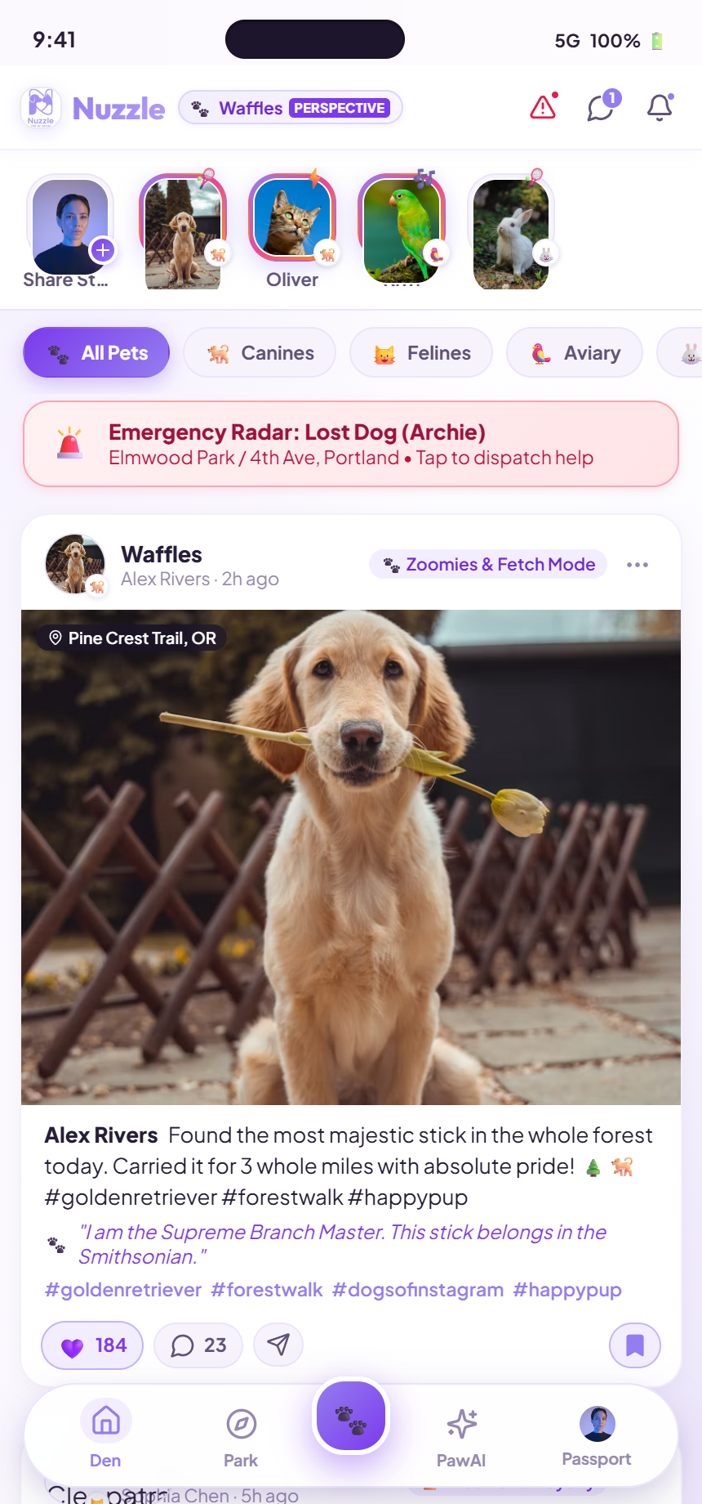
🐾 Nuzzle
Slide 6 / 10 • UI/UX Pitch
UI DEEP DIVE • FEED & MICRO-INTERACTIONS
Den Feed & Facebook-Style Pet Reaction Dock
✨ Key UI Components & Interactions:
1. Facebook-Style Pet Reaction Dock
Hover/click opens floating frosted dock with 1.4x zoom: 🐾 Paw Five, 💜 Nuzzle, 🦴 Treat, 🎾 Fetch, 😻 Purr.
2. Pet Mood & Soundbite Bar
Pills displaying active pet moods (🐾 Zoomies) and audio waveform barks (🎵 Excited Panting & Tail Wag).
3. Pet Thought Dialogue Bubbles
First-person pet monologues: 💭 "I am the Supreme Branch Master. This stick belongs in the Smithsonian."
4. Organic Media Container
22px asymmetric squircle corners with floating location capsules and double-tap celebration bursts.
Technopreneurship 2026 • Abu Zafor, Nadim Rahman, Rizvi Sarker

Slide 7



🐾 Nuzzle
Slide 7 / 10 • UI/UX Pitch
UI DEEP DIVE • AI VISION & TRIAGE SUITE
PawAI Intelligence Suite & 24/7 Triage
📸 PetScan AI Vision
🩺 24/7 Symptom Triage
🎙️ Audio Voice Translator
Computer vision biometric scanning for breed purity (98.4%), body condition score, coat sheen, and facial emotion.
Bangla & English natural language health triage classifying into Low, Moderate, or Critical urgency with emergency vet routing.
Captures bark and meow audio waveforms to translate pet vocalizations into humorous first-person thoughts.
Technopreneurship 2026 • Abu Zafor, Nadim Rahman, Rizvi Sarker

Slide 8



🐾 Nuzzle
Slide 8 / 10 • UI/UX Pitch
UI DEEP DIVE • SAFETY, STORIES & PASSPORT
Safety Radar, Snuggle Circles & Pet Passport
🚨 5-Mile Emergency Radar
✨ Snuggle Circles Stories
🐾 Pet Passport & Switching
Visual embedding photo comparison and <30-second zero-barrier injured animal report dispatch with claim-and-lock.
Squircle daily story carousel with live pet activity tags (☁️ Zoomies, 🎶 Singing) and glowing lavender borders.
Floating Island Navigation capsule bar, on-the-fly pet perspective switcher, and complete digital health passports.
Technopreneurship 2026 • Abu Zafor, Nadim Rahman, Rizvi Sarker

Slide 9

🐾 Nuzzle
Slide 9 / 10 • UI/UX Pitch
DESIGN SYSTEM • TOKENS & AESTHETICS
Lavender & White Textured Design Tokens
🎨 Curated Design Tokens:
• Primary Lavender (#947DEE): Evokes care, calm, and clinical trust.
• Deep Violet (#7C3AED): High-contrast accent for interactive states.
• Pearl White (#FCFAFF): Textured background reducing glare.
• Deep Plum Ink (#261E38): WCAG AAA compliant text contrast.
• Frosted Glassmorphism: backdrop-filter: blur(24px) with multi-layer shadows.
• Typography: Plus Jakarta Sans (body) & Outfit (display branding).
🌙 Dual Light & Dark Theme Accessibility
Seamless toggle preserving high-contrast legibility across bright daylight and night.
Technopreneurship 2026 • Abu Zafor, Nadim Rahman, Rizvi Sarker

Slide 10
🐾 Nuzzle
Slide 10 / 10 • UI/UX Pitch
SECTION 6 • LEARNINGS, ROADMAP & CONCLUSION
Conclusion & Six-Month Dhaka Launch Roadmap
🚀 6-Month Roadmap & Gate Criteria (Dhaka):
💡 Key Prototype Learnings:
• Months 1–2 (Foundation): Pet profiles, follow graph, locality feed, UX complete.
• Month 3 (Lost-Pet AI): Precision@5 ≥ 60% with visual embedding similarity.
• Month 4 (Triage & Rescue): Vet sign-off, <5% under-triage rate, 20+ responders.
• Month 5 (Adoption AI): Compatibility scoring, 50 verified shops, 10 shelters.
• Month 6 (Public Launch): 10,000 users, 12,000 pet profiles in Dhaka.
The social layer earns daily attention and generates continuous multi-photo training data; the AI features provide indispensable crisis support.
Neither half functions without the other, and building them together creates a compounding network moat.
🐾 CLOSING REMARK
"Pets are family. Nuzzle gives them the dedicated, intelligent, and compassionate platform they deserve."
Technopreneurship 2026 • Abu Zafor, Nadim Rahman, Rizvi Sarker

