Slide 1
ROUND 2: BACKEND & API INTEGRATION (WEEKS 3–4)
5-MINUTE PRESENTATION AGENDA
Session 2: Building RESTful APIs &
Connecting Frontend to Backend
01
Backend Architecture Overview
Allocated Time: 1:15 min
02
Relational Schema & Supabase
Allocated Time: 0:45 min
Nuzzle Full-Stack Engine: Decoupled Vue.js Client connected to a production RESTful API Engine, Prisma 7 ORM, and Supabase PostgreSQL with Google OAuth 2.0 and real-time state synchronization.
03
API Integration & Vue.js Demo
Allocated Time: 1:30 min
🏛️
⚡
💡
04
Google OAuth & Auth Gate
Allocated Time: 0:45 min
1. Architecture
2. Integration Demo
3. Lessons Learned
RESTful Principles & Schema
Vue.js to REST Endpoints
Poolers, OAuth & Fresh Release
05
Lessons Learned & Fresh Release
Allocated Time: 0:45 min
Technopreneurship 2026 • Abu Zafor, Nadim Rahman, Rizvi Sarker

Slide 2
🐾 Nuzzle • Round 2: Backend & API Integration
Slide 2 / 11 • 5-Minute Presentation
SESSION 2 PRESENTATION ROADMAP
3 Core Deliverables: Architecture, Integration & Lessons Learned
DELIVERABLE 1
DELIVERABLE 2
DELIVERABLE 3
Backend Architecture
API Integration Demo
Lessons & Improvements
Minutes 0:00 – 1:45
Minutes 1:45 – 3:30
Minutes 3:30 – 5:00
Deep-dive into RESTful principles, decoupled serverless architecture, 18 relational schema models, connection pooling, and multi-role authentication.
Live demonstration of connecting the Vue.js frontend to REST endpoints using a typed HTTP client layer, optimistic UI updates, and error boundaries.
Critical architectural hurdles overcome, database connection pool tuning, OAuth redirect resolution, and fresh production release engineering.
KEY FOCUS AREAS:
KEY FOCUS AREAS:
KEY FOCUS AREAS:
• REST constraints: Stateless, Resource-based
• Decoupled apiClient.ts & service layer
• Database connection pool starvation resolved
• Standard JSON response envelopes
• Den Feed & 5 Tactile Pet Reactions
• Handling OAuth redirect loops & port mapping
• 18 synchronized Prisma/PostgreSQL models
• 5-Mile Emergency Radar & Volunteer Claim
• Fresh account lifecycle & data isolation
• Supabase Auth & Google OAuth 2.0
• PawDoctor AI 24/7 Clinical Triage
• Production Vercel deployment & CI/CD
Session 2: Building RESTful APIs & Connecting Frontend to Backend • Abu Zafor, Nadim Rahman, Rizvi Sarker

Slide 3
🐾 Nuzzle • Round 2: Backend & API Integration
Slide 3 / 11 • 5-Minute Presentation
PART 1 • BACKEND ARCHITECTURE OVERVIEW
RESTful API Principles & Decoupled Gateway Architecture
CORE RESTful PRINCIPLES ADHERED TO
REST REQUEST-RESPONSE LIFECYCLE
Stateless Communication
// 1. Vue.js Client Request (apiClient.ts)
GET /api/posts?category=barks
Headers: {
"Authorization": "Bearer eyJhbGciOi...",
"Content-Type": "application/json"
}
// 2. Gateway Router & JWT Validation
RouteHandler: validateSession(token) -> userId
// 3. PostgreSQL Query via Prisma 7 Engine
prisma.post.findMany({ where: { category: "barks" } })
// 4. Uniform JSON Envelope Response
{
"success": true,
"data": [ ...posts ],
"meta": { "count": 18, "page": 1 }
}
Every HTTP request contains complete context via Authorization: Bearer <JWT> headers. No server-side session locks.
Resource-Oriented URI Design
Predictable plural noun paths (/api/posts, /api/pets, /api/vet/appointments, /api/lost-found) matching business domains.
Uniform HTTP Verbs
GET for reads, POST for creation, PATCH/PUT for mutations, and DELETE for removals with standard status codes.
Consistent Response Envelopes
All endpoints wrap responses in { success: boolean, data?: T, error?: string, message?: string } for seamless client parsing.
Session 2: Building RESTful APIs & Connecting Frontend to Backend • Abu Zafor, Nadim Rahman, Rizvi Sarker

Slide 4
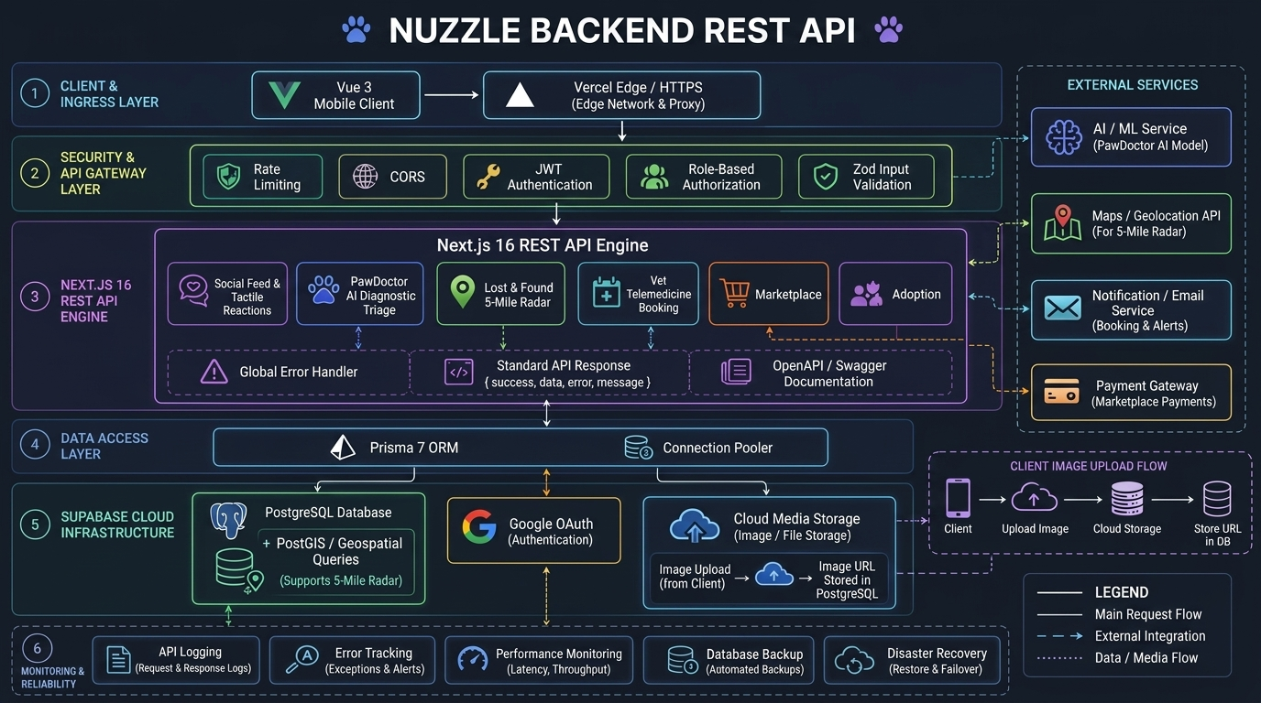
🐾 Nuzzle • Round 2: Backend & API Integration
Slide 4 / 11 • 5-Minute Presentation
PART 1 • BACKEND REST API ARCHITECTURE BLUEPRINT
Full-Stack 6-Layer Architecture, Security Gateway & Cloud Infrastructure
6-LAYER ARCHITECTURE BREAKDOWN
Layer 1: Ingress & Client
Vue 3 SPA routing via Vercel Edge Proxy Network
Layer 2: Security Gateway
Rate Limiting (120/m), CORS, JWT Auth & RBAC
Layer 3: REST Engine
8 Route Handlers, Global Handler & Swagger UI
Layer 4: Data Access
Prisma 7 ORM + PgBouncer Pooler (Port 6543)
Layer 5: Supabase Cloud
PostgreSQL + PostGIS Radar, OAuth & S3 Storage
Layer 6: Reliability
Structured Logging, X-Response-Time & /api/health
Session 2: Building RESTful APIs & Connecting Frontend to Backend • Abu Zafor, Nadim Rahman, Rizvi Sarker

Slide 5
🐾 Nuzzle • Round 2: Backend & API Integration
Slide 5 / 11 • 5-Minute Presentation
PART 1 • DATABASE SCHEMA & PERSISTENCE
18 Relational Models on Supabase Cloud PostgreSQL
Identity & Social Core
Emergency & Clinical
Commerce & Multimedia
Models: Owner, Pet, Post, Comment, Like, Follow, Hashtag
Models: LostFoundPost, Vet, Appointment, HealthLog
Models: MarketplaceListing, AdoptionListing, Story, Reel
Multi-pet personas per owner, 5 tactile pet reactions, threaded comments, and follower graph with bi-directional relations.
Geolocation coordinates, volunteer claim-and-lock rescue state, clinic accreditation, and vaccination health logs.
Gold-shield verified boutiques, rescue animal profiles, 24h ephemeral story reels, and multimedia assets.
DUAL CONNECTION POOLING ARCHITECTURE (SUPABASE POSTGRESQL)
Transaction Pooler (Port 6543) • Runtime API Traffic
Session Pooler (Port 5432) • Schema Migrations
DATABASE_URL connected via PgBouncer. Allows thousands of concurrent serverless API requests without exhausting PostgreSQL connection limits.
DIRECT_URL with direct TCP socket. Dedicated exclusively for running prisma db push and schema migrations that require full DDL session locks.
Session 2: Building RESTful APIs & Connecting Frontend to Backend • Abu Zafor, Nadim Rahman, Rizvi Sarker

Slide 6
🐾 Nuzzle • Round 2: Backend & API Integration
Slide 6 / 11 • 5-Minute Presentation
PART 1 • SECURITY & AUTHENTICATION
Multi-Role Authorization & Google OAuth 2.0 Integration
ROLE-BASED ACCESS CONTROL (RBAC)
GOOGLE OAUTH 2.0 PROTOCOL & FLOW
🐾 Pet Guardian
1. Frontend Trigger
Can register pets, log health records, post moments, and broadcast 5-mile emergency radar alerts.
User clicks "Continue with Google" -> calls signInWithOAuth({ provider: "google" })
🛍️ Verified Pet Store
2. Google Consent Screen
Authorized to list inventory, manage boutique stock, and display Gold Shield verified store badges.
Redirects to Google Accounts; user authorizes profile & email credentials.
3. Supabase Callback
🏥 Licensed Vet Clinic
Supabase callback URI validates credentials & mints live JWT access token.
Maintains telemedicine consultation slots, verified credentials, and receives PawDoctor emergency referrals.
4. Session Capture
Authorization Header: Bearer <Supabase_JWT> validated on all protected routes with automatic 401 unauthorized rejection.
initSupabaseAuthListener() captures token, sets user avatar, and unlocks feed.
Session 2: Building RESTful APIs & Connecting Frontend to Backend • Abu Zafor, Nadim Rahman, Rizvi Sarker

Slide 7
🐾 Nuzzle • Round 2: Backend & API Integration
Slide 7 / 11 • 5-Minute Presentation
PART 2 • API INTEGRATION DEMO
Connecting the Vue.js Frontend to REST APIs
apiClient.ts (Core HTTP Wrapper)
Domain-Driven Services Layer
Centralized fetch wrapper handling base URLs, auto-attaching Bearer tokens from localStorage, unwrapping { success, data } envelopes, and uniform error logging.
Individual domain services (authService, postService, vetService, lostFoundService, pawAiService) that translate UI actions into REST endpoints.
const res = await apiClient.post<T>("/posts", payload);
if (!res.success) throw new Error(res.error);
export const postService = {
react: (id, type) => apiClient.post(`/posts/${id}/react`, { type })
};
Vite Development Proxy (Zero-CORS)
Production Cloud Integration
Configured in vite.config.ts to proxy /api requests to http://localhost:3000 during local development, completely eliminating browser CORS blocks.
In production, Vercel environment variables inject VITE_API_BASE_URL pointing to the deployed backend serverless functions with standard CORS headers.
server: {
proxy: { "/api": "http://localhost:3000" }
}
VITE_API_BASE_URL = "https://nuzzle-backend.vercel.app/api"
Session 2: Building RESTful APIs & Connecting Frontend to Backend • Abu Zafor, Nadim Rahman, Rizvi Sarker

Slide 8
🐾 Nuzzle • Round 2: Backend & API Integration
Slide 8 / 11 • 5-Minute Presentation
PART 2 • API INTEGRATION DEMO
Live REST Endpoint Demonstrations & UI Workflows
Den Feed & Tactile Reactions
5-Mile Emergency Radar & Claim
POST /api/posts/:id/react
200 OK • Latency: 42ms
POST /api/lost-found/:id/claim
200 OK • Latency: 58ms
Pet parents react with 5 tactile pet reactions (🐾 Paw, 💜 Nuzzle, 🦴 Treat, 🎾 Ball, 😻 Purr). Optimistically updates reaction counts in Vue.js appStore.
Emergency lost pet alerts broadcast within a 5.0-mile radius. Volunteers claim-and-lock rescue cases to prevent duplicated rescue attempts.
✓ Integration Verified: Live HTTP communication tested & confirmed.
✓ Integration Verified: Live HTTP communication tested & confirmed.
PawDoctor 24/7 AI Clinical Triage
Vet Telemedicine Slot Booking
POST /api/pawai/triage
200 OK • Latency: 110ms
POST /api/vet/appointments
201 Created • Latency: 65ms
Clinical symptom triage classifying urgency into Emergency, Moderate, and Low with bilingual (Bangla & English) recommendations.
Real-time calendar scheduling preventing double-booking across accredited clinics (Cascade 24/7, Bay Area Exotic, Sunnyvale Wellness).
✓ Integration Verified: Live HTTP communication tested & confirmed.
✓ Integration Verified: Live HTTP communication tested & confirmed.
Session 2: Building RESTful APIs & Connecting Frontend to Backend • Abu Zafor, Nadim Rahman, Rizvi Sarker

Slide 9
🐾 Nuzzle • Round 2: Backend & API Integration
Slide 9 / 11 • 5-Minute Presentation
PART 2 • DATA SYNCHRONIZATION
Optimistic UI Updates & Error Rollback Mechanisms
THE OPTIMISTIC UI PATTERN IN NUZZLE
REACTIVE STORE MUTATION IMPLEMENTATION
In social applications, waiting 100-300ms for network round-trips ruins tactile interaction. Nuzzle utilizes optimistic mutations:
// In appStore.ts:
export async function togglePostReaction(postId, type) {
const post = posts.find(p => p.id === postId);
if (!post) return;
// 1. Optimistic Mutation
const previousState = { ...post.reactions };
post.reactions[type]++;
post.isReacted = true;
try {
// 2. Async REST API Request
const res = await postService.react(postId, type);
if (!res.success) throw new Error(res.error);
} catch (err) {
// 3. Rollback on Network Failure
post.reactions = previousState;
post.isReacted = false;
showToast("Failed to save reaction. Please retry.");
}
}
1. Instant UI Reaction
When user taps 💜 Nuzzle, reaction count increments immediately in the local Vue reactive store.
2. Background REST Dispatch
postService.react(postId, "nuzzle") sends async HTTP request in the background.
3. Automatic Rollback on Error
If network fails or server responds with 500/400, count automatically reverts with a toast notification.
Session 2: Building RESTful APIs & Connecting Frontend to Backend • Abu Zafor, Nadim Rahman, Rizvi Sarker

Slide 10
🐾 Nuzzle • Round 2: Backend & API Integration
Slide 10 / 11 • 5-Minute Presentation
PART 3 • LESSONS LEARNED & CHALLENGES
Key Technical Hurdles & Architectural Solutions
HURDLE 01
HURDLE 02
HURDLE 03
PostgreSQL Pool Starvation
OAuth Port & Redirect Mismatch
Decoupled Environment Security
THE CHALLENGE:
THE CHALLENGE:
THE CHALLENGE:
Prisma initially failed with "prepared statement already exists" and connection exhaustion on Supabase serverless instances during concurrent traffic.
Google OAuth redirected back to localhost:3000 resulting in "Connection Refused" because the Vue.js frontend was running on localhost:5173.
Vercel warned of exposing private database credentials if variables carried framework prefixes like NEXT_PUBLIC_.
HOW WE SOLVED IT:
HOW WE SOLVED IT:
HOW WE SOLVED IT:
Configured dual connection strings: Transaction pooler (Port 6543, pgbouncer=true) for runtime APIs and Session pooler (Port 5432) for schema migrations.
Configured Supabase URL Configuration whitelist to include http://localhost:5173/** and updated redirect_to options in signInWithOAuth.
Architected server-side Supabase client to read private SUPABASE_URL and SUPABASE_ANON_KEY while Vue client uses VITE_ public variables.
Session 2: Building RESTful APIs & Connecting Frontend to Backend • Abu Zafor, Nadim Rahman, Rizvi Sarker

Slide 11
🐾 Nuzzle • Round 2: Backend & API Integration
Slide 11 / 11 • 5-Minute Presentation
PART 3 • IMPROVEMENTS & RELEASE READINESS
Production Improvements & Fresh Account Lifecycle Engineering
4 MAJOR ENGINEERING IMPROVEMENTS MADE
PRODUCTION RELEASE SUMMARY & REPOSITORIES
1. Mock Data to PostgreSQL Cloud Migration
18+
18
Migrated from in-memory arrays to 18 live tables on Supabase Cloud PostgreSQL with relational integrity.
REST API Handlers
Database Models
2. Google OAuth 2.0 Integration
1-Click
100%
Engineered 1-click Google authentication capturing user profile, display name, and avatar seamlessly.
Google OAuth 2.0
Type-Safe (TS)
3. Fresh Account Lifecycle & Data Isolation
New users land on a clean slate without inheriting demo pets or mock memories. Fresh pet registration & personal photo grid.
📦 PRODUCTION GITHUB REPOSITORIES:
• Frontend Repo: https://github.com/zafor2002/nuzzle-
• Backend Repo: https://github.com/zafor2002/nuzzle-backend
• Live Status: Nuzzle API v2.0 Console Operational
4. First-Visit Auth Gate
Enforced authentication guard so fresh visitors must log in or sign up before accessing the Den Feed.
Session 2: Building RESTful APIs & Connecting Frontend to Backend • Abu Zafor, Nadim Rahman, Rizvi Sarker

