Slide 1
Welcome to Core Spring
A 4-day bootcamp that trains you how to use the Spring Framework to create well-designed, testable, business, applications

Slide 2

Logistics
Student introductions
Self introduction
Course registration (if needed)
Courseware
Internet access
Phones on silent
Working hours
Lunch and breaks
Toilets/Restrooms
Fire alarms
Emergency exits
Any other questions?

Slide 3

How You will Benefit
Learn to use Spring for web and other applications
Gain hands-on experience
  Generous mixture of presentation and labs
Access to experienced, certified instructors

Slide 4
Covered in this section
Agenda
Spring and Pivotal
Notes:
Don't get too hung up the actual days, different groups will go at their own pace.

Slide 5

Course Agenda: Day 1
Introduction to Spring
Using Spring to configure an application
Java-based dependency injection
Annotation-based dependency injection
Spring FactoryBeans

Slide 6

Course Agenda: Day 2
Inside the Spring Container
  Bean Lifecycle and related Post Processors
Testing a Spring-based application using multiple profiles
Adding behavior to an application using aspects
Introducing data access with Spring
Simplifying JDBC-based data access

Slide 7

Course Agenda: Day 3
Driving database transactions in a Spring environment
Introducing object-to-relational mapping with JPA
Working with JPA in a Spring environment
Rapidly start new projects with Spring Boot
Using Spring Data Repositories
Getting started with Spring MVC
Notes:
Note that Spring Boot is now introduced just after JPA. Here's why ...
Once they have seen how much configuration JPA needs, students can appreciate what Boot is doing for them.
It also means the Spring MVC section now assumes Spring Boot simplifying the lab ans making it more reliable (no separate Tomcat server needed).

Slide 8

Course Agenda: Day 4
Advanced Spring Boot
Securing web applications with Spring Security
Implementing REST with Spring MVC
Optional topics
  Microservices and Cloud Native Applications using Spring Cloud
  Reactive Programming with Spring
Notes:
A lot of this day is optional, so slower groups can catch up.
Although the Advanced Boot section is optional, it is recommended as it goes into how Boot actually works. This is why students still need to appreciate how Spring Configuration works – Boot is built on it. However nothing in this deck is in the Certification exam, hence it is marked optional.
Similarly the Microservices & Reactive sections are optional (not in the exam) but one or other topic should be of interest to most groups.

Slide 9
Covered in this section
Agenda
Spring and Pivotal
Notes:
This section smacks of marketing – don't over do it! We want to raise the profile of Pivotal, but not annoy paying students.
On the other hand, Spring is free because Pivotal funds it. It is not unreasonable for Pivotal to blow its own trumpet ... a bit.

Slide 10
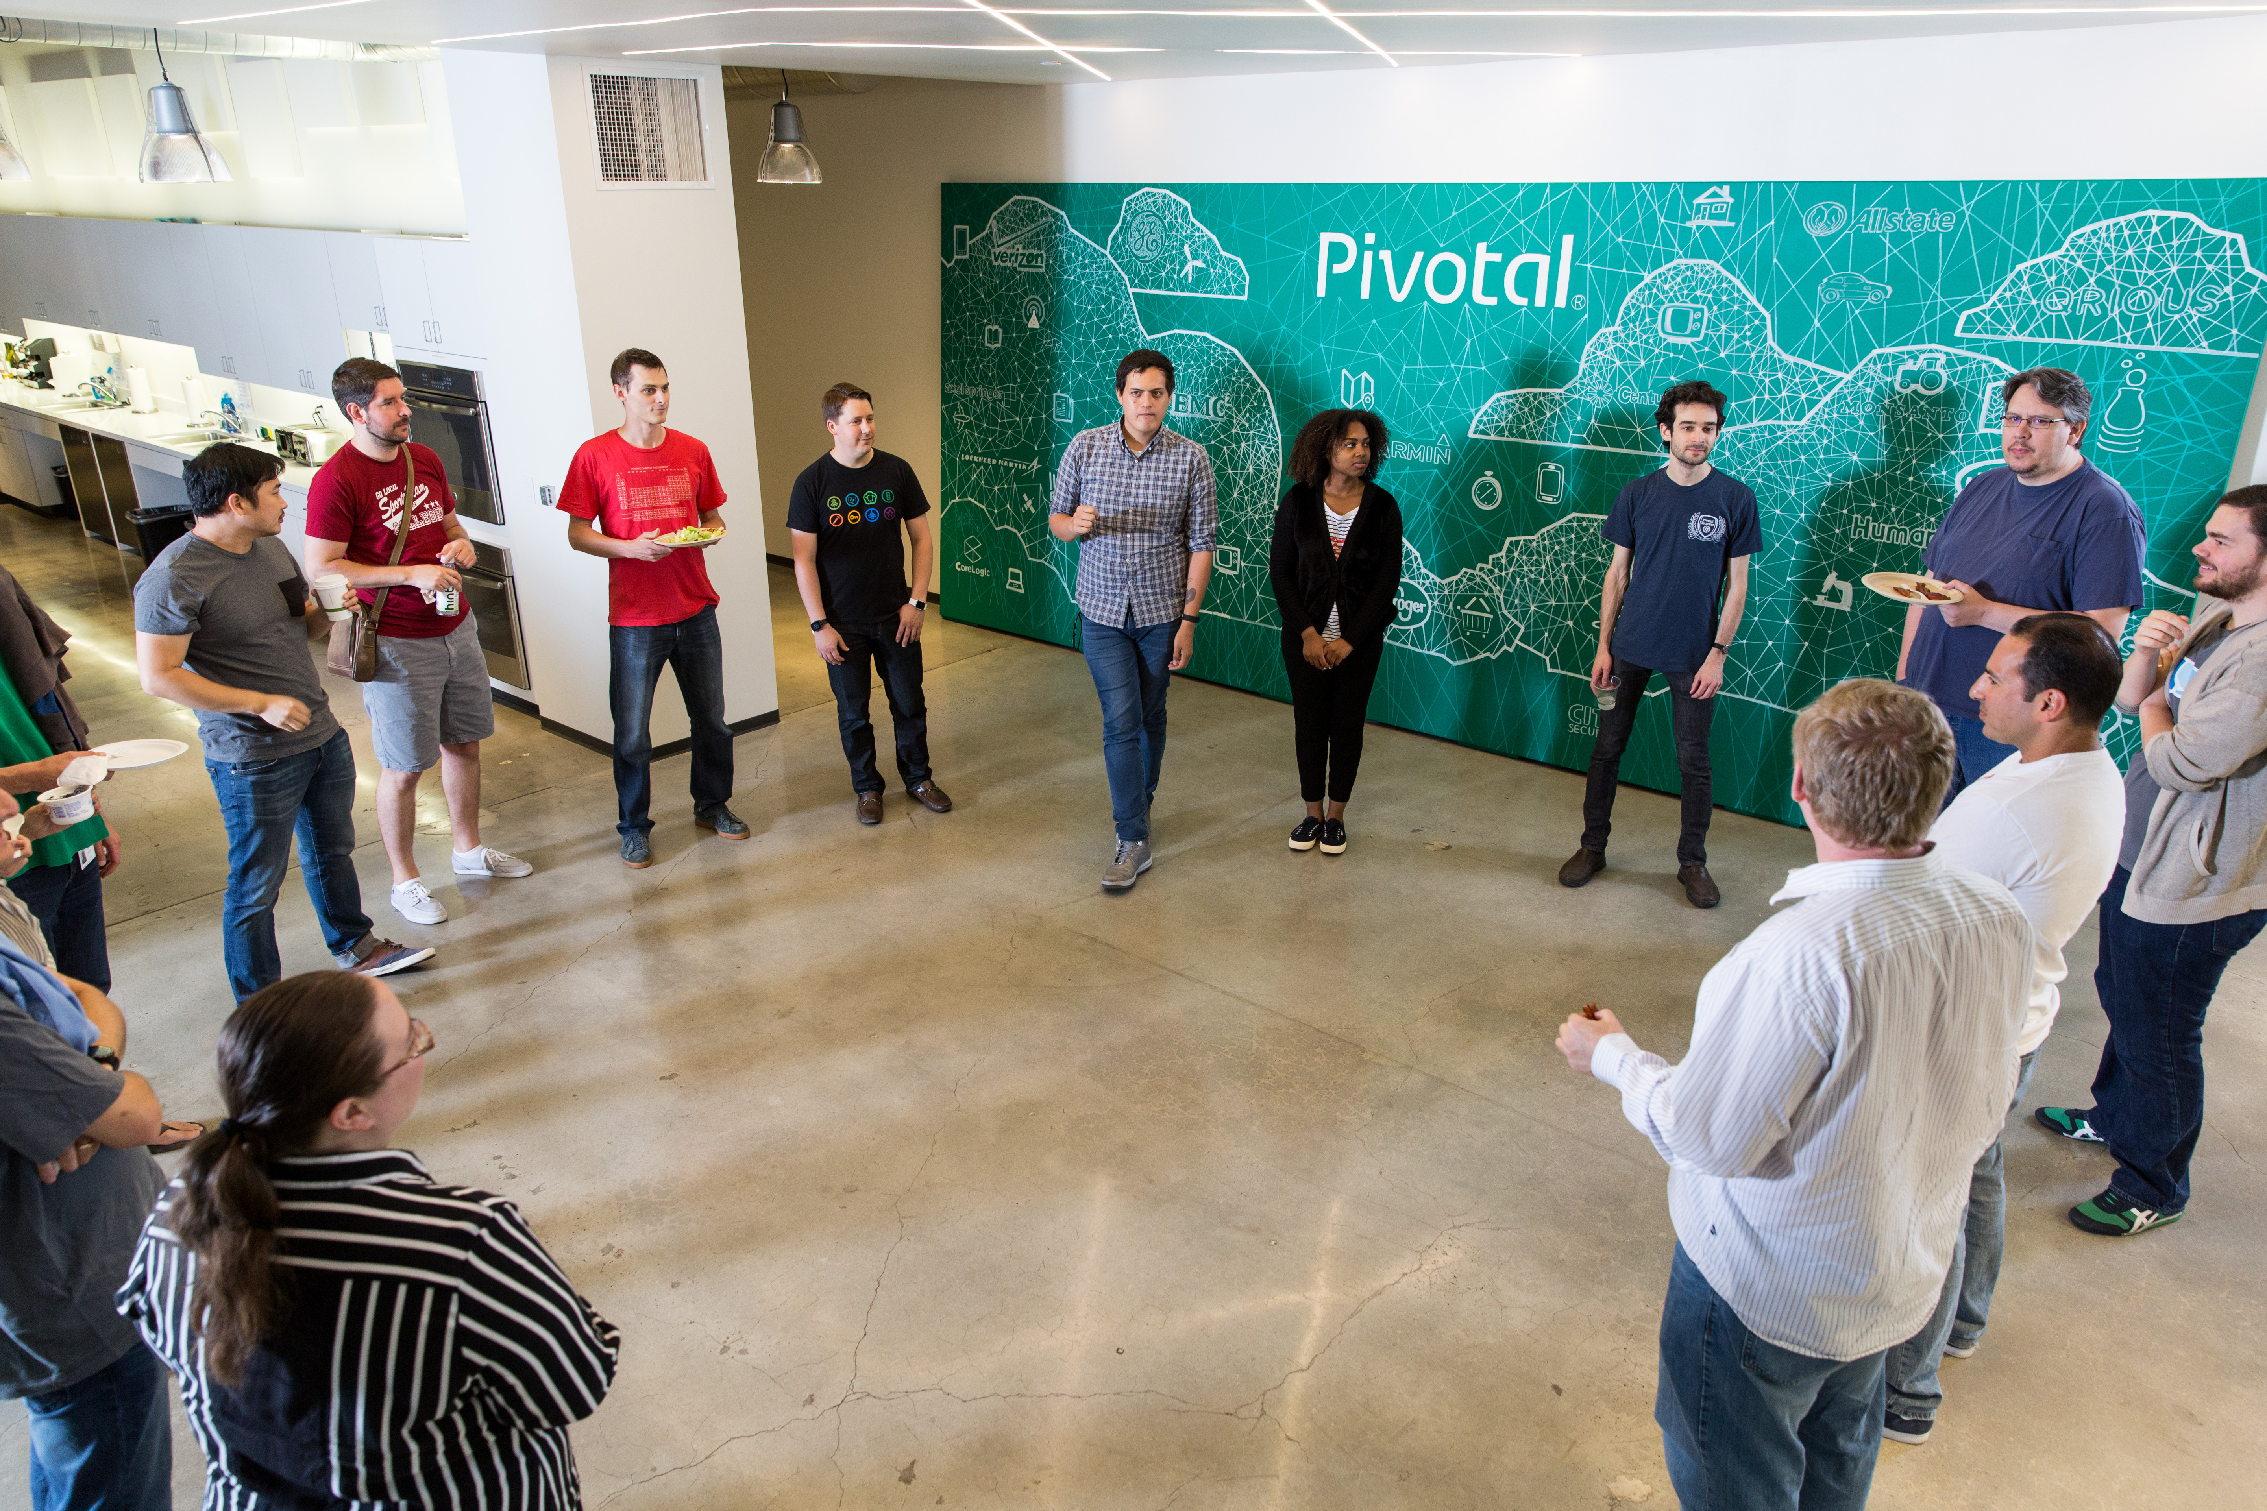
We believe transforming how the world builds software will shape
the future of our world
Notes:
Ambitious? Absolutely!
Pivotal provides a suite of tools, technologies, and processes that will help customers make/complete that transformation. Spring is a key part of that vision.
Remember: The Cloud is not where you run your applications – but how (next slide).
The cynics amongst you may not wish to promote Pivotal's marketing here, but the reality is that how we build, test and deploy software is changing – a trend that did not start with The Cloud but has been accelerated by it. Automated testing, container-based deployments, microservices and distributed applications are enabling small companies to take on much bigger competitors, heavily enabled by their IT.
Pivotal funds Spring because it is part of the company's mission to be an enabler in this space. Pivotal deserves credit for funding and expanding the Spring projects. Spring is a lot more than an JEE replacement.

Slide 11



Spring @Pivotal
SpringSource, the company behind Spring
  acquired by VMware in 2009
  transferred to Pivotal joint venture 2013
Spring projects key to Pivotal's big-data and cloud strategies
  Cloud Foundry PaaS
    Deploy to private, public, hybrid clouds
    Microservices, Spring Cloud
  Real-time analytics, IoT
    Spot trends as they happen
    Spring Data, Spring Hadoop, Spring Cloud Data Flow
Notes:
Background: Why Virtualize, Why big data, Why Spring?
Virtualizing Java applications saves money – moving to Tomcat saves even more money because the licensing is cheaper (compared to Websphere/Weblogic) and requires less resources. Most users typically do not use most of the JEE stack – but pay for it anyway.
CLOUD: Moving to a Cloud environment you gain several advantages,
1. The Cloud is not where you run your applications – but how: inherently distributed, virtual environments. Also more complicated to deploy and manage (hence need for a PaaS). Advantages are scalable, resilient, agile systems (microservices) that are easier to enhance and maintain.
2. Charge users (internal departments) for compute resources they use – chargeback. Managing IT as a Service (ITSM) means IT department can commit to guaranteed service levels and, in return, different departments in the company pay for what they actually use. So marketing and sales pay more for email because they use and rely on it more. Especially true for Intranet services.
3. At peak periods, cloud based system can overflow onto public clouds to handle the extra load. Or IT can provision extra resources temporarily. Application owners pay extra during the peak, but not the rest of the time. Once peak is over, resources reclaimed and given to a different application. IT can handle peaks and troughs and charge for usage. If marketing run a special offer, they pay for the extra traffic it generates.
Net Result: IT as an Enabler not an Overhead.
DATA: Tracking users online, on the phone (however they interact with IT systems), telemetry from the Internet of Things (IoT) = petabytes of data to be mined to spot trends, what customers like/hate, do/buy/like if offered. Spot trends in (near) real-time – see trouble coming, rectify it before it fails (out-of-stock/runs on certain products, dropped calls on a network, too many users giving up when shopping online, scamming, fraud-detection, online bullying and abuse …) The Hadoop platform is a popular way to store such huge amounts of data, but it is complex to install, configure and maintain. Raw Map/Reduce code is frustratingly low-level – the EJB or our decade! Pivotal and Spring to the rescue! See also other Pivotal products: HDB (HAWQ), Greenplum, Gemfire.

Slide 12
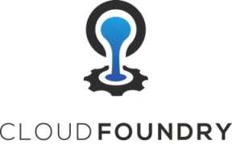









Pivotal Platform
Cloud Foundry
Cloud Independence
Microservices
Continuous Delivery
Dev Ops
Development
Frameworks
Services
Analytics
Big Data Suite
High Capacity
Real-time Ingest
SQL Query
Scale-out Storage
Working with clients to build better apps more quickly
Notes:
Quick overview of Pivotal.
Essentially three divisions:
1. Our Open PaaS: Cloud Foundry – an ideal place to run Spring (and other) applications. Provides HA, failover, automatic scalability, resilience and automated recovery. Supports many languages, not just Java.
2. Our Data Suite – featuring both Big Data (HDB (formerlyHAWQ) and Greenplum) and Fast (real-time) Data (Gemfire)
3. Application Development – open-source products like Spring and Rabbit/MQ and our project tracking tool Pivotal Tracker.
All the products shown here (except Pivotal Tracker) have a free, open-source option.
Pivotal Labs intersects all three providing mentoring in agile application development including fast-data analytics. Very specific business model – you come to us so we can work in an environment of our choosing. Avoids a lot of the on-site issues (security passes, network/machine access, company restrictions and distractions) that otherwise arise.

Slide 13


















Spring
Projects
Project
Reactor
Spring
Security
Spring
Integration
Spring
Data
Spring
Batch
Spring (SOAP)
Web Services
Spring
Social
Spring
AMQP
Spring
Cloud
Spring Framework
Spring
Session
Spring
Hateoas
http://spring.io
Spring
Android
Spring
Kafka
Spring Cloud
Data Flow
Spring
Mobile
Spring
Boot
Spring Web Flow
Notes:
Project Reactor: Reactor is a foundational library for building non-blocking applications on the JVM based on the Reactive Streams Specification. At least three implementations are available: the Flow classes in JDK 9, RxJava or Pivotal's Reactor project. RxJava and Reactor enable reactive support if you are still using JDK 8.
Spring 5 has a lot of support for Reactive development but does not implement that specification.
Reactor is not of itself a Spring Project (although it is also sponsored by Pivotal - see also Github project).
Most of the others are self explanatory If not sure, go to http://spring.io/projects.

Slide 14


Covered in this section
Agenda
Spring and Pivotal
Let's get on with the course..!
Notes:
Enough marketing .. let's get going ..

