Slide 1
Spring Boot - Basics
Getting started with Spring Boot
Starter POMs, Auto-Configuration

Slide 2

Objectives
After completing this lesson, you should be able to:
  Explain what Spring Boot is and why it is Opinionated
  Describe how Spring Boot is driven by dependencies, properties and auto-configuration
Notes:
Set the scene. Why does Spring Boot exist? What problems are we trying to solve?

Slide 3

What is Spring Boot?
Spring Applications typically require a lot of setup
  Consider working with JPA. We needed:
    DataSource, TransactionManager, EntityManagerFactory ...
  Soon we will look at using Spring MVC
    Needs significant configuration
  An MVC app using JPA would need all of this
BUT: Much of this is predictable
  Spring Boot can do most of this setup for you

Slide 4

What is Spring Boot?
An opinionated runtime for Spring Projects
Supports different project types, like Web and Batch
Handles most low-level, predictable setup for you
It is not:
  A code generator
  An IDE plugin
See: Spring Boot Reference
http://docs.spring.io/spring-boot/docs/current/reference/htmlsingle

Slide 5
Topics in this Session
What is Spring Boot?
  Definition and Hello World example
Spring Boot Explained

Slide 6
Opinionated Runtime?
Spring Boot uses sensible defaults, “opinions”, mostly based on the classpath contents.
For example
  Sets up a JPA Entity Manager Factory
    If a JPA implementation is on the classpath.
  Creates a JdbcTemplate
    If spring-jdbc.jar is on the classpath
Everything can be overridden easily
  But most of the time that is not necessary

Slide 7
Hello World example
Just three files to get a running Spring application
pom.xml
Setup Spring Boot (and any other) dependencies
application.properties
Database setup
Application class
Application launcher
Maven is just one option. You can also use Gradle or Ant/Ivy.
Our slides will use Maven.
Notes:
For a non-web application no Controller is required, so you could write a simple application using only three files (POM, properties, Java class).
By combining the Controller and Application class (which works but is not how a real application would be written) even this Web application could be reduced to 4 files.
But it's not a competition! This is simply an example to prove the point. A real application would, of course, require more files than this.

Slide 8
Hello World (1a) – Maven descriptor
Parent POM
<parent>
<groupId>org.springframework.boot</groupId>
<artifactId>spring-boot-starter-parent</artifactId>
<version>2.0.0</version>
</parent>
<dependencies>
<dependency>
<groupId>org.springframework.boot</groupId>
<artifactId>spring-boot-starter-jdbc</artifactId>
</dependency>
<dependency>
<groupId>org.hsqldb</groupId>
<artifactId>hsqldb</artifactId>
</dependency>
</dependencies>
Defines dependencies for:
Spring JDBC, JDBC Connection Pool, Spring Boot itself
Embedded SQL Database
pom.xml
Notes:
Please note that the labs use Spring Boot 2.0.M5 because that was current at the time Core Spring 5.0.a was released. Moreover Spring Boot releases typically breaks compatibility as they upgrade (unlike the Spring Framework) so we have kept the older version to avoid changing and/or retesting all the labs.
JSP is not assumed by Spring Boot – in fact the Spring Boot guys don't especially like JSP. So you must include its dependencies explicitly.
Jasper is the JSP compiler and JSTL (Java Standard Template Library) defines the tags like <c:foreach>, <c:if> and so on.
Of course you are free to use whichever view technology you prefer, client or server side as you wish. For consistency with the previous (Spring MVC) section we will stick with JSP.
This POM continues on the next page ...

Slide 9
Hello World (1b) – Maven descriptor
Will also use the Spring Boot plugin
pom.xml (continued)
<!-- Continued from previous slide -->
<build>
<plugins>
<plugin>
<groupId>org.springframework.boot</groupId>
<artifactId>spring-boot-maven-plugin</artifactId>
</plugin>
</plugins>
</build>
Makes “fat” executable jars
Notes:
Sadly the POM doesn't fit on one slide, so this continues the previous slide.
You can skim the maven plugin for now – its use is covered shortly.
A similar plugin exists for Gradle.
There is an Antlib for Ant users:
http://docs.spring.io/spring-boot/docs/current/reference/html/build-tool-plugins-antlib.html

Slide 10
Hello World (2) – Database Properties
Spring Boot has many, many configuration properties
  We will see more throughout the course
  For now … configure the database
application.properties
spring.datasource.schema=/testdb/schema.sql
spring.datasource.data=/testdb/data.sql
Automatically configures HSQLDB as an embedded in-memory database – and populates by running specified scripts
Notes:
Spring Boot automatically looks for application.properties and uses it properties. Spring Boot has many, many predefined properties that allow for customization.

Slide 11
Hello World (3) – Application Class
This annotation turns on Spring Boot
@SpringBootApplication
public class Application {
public static final String QUERY = "SELECT count(*) FROM T_ACCOUNT";
public static void main(String[] args) {
ApplicationContext ctx = SpringApplication.run(Application.class, args);
JdbcTemplate jdbcTemplate = ctx.getBean(JdbcTemplate.class);
System.out.println("Hello, there are "
+ jdbcTemplate.queryForObject(QUERY, Long.class)
+ " accounts");
}
}
Automatically created by Boot
Application.java
Main method will be used to run the packaged application from the
command line – old style!
Notes:
This is the same SpringApplication.run() we have been using all along. But the annotation switches it to Spring Boot mode. All Spring Boot's defaults come into play.
The annotation also causes Spring Boot to look for application.properties and load it via as a property-source..

Slide 12
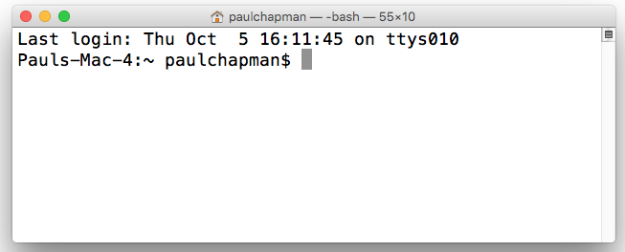
Putting it all together
mvn package
Maven command to generate an archive file
helloApp-0.0.1-SNAPSHOT.jar
Generates “fat” executable jar
generated file
App started from command line
java -jar helloApp-0.0.1-SNAPSHOT.jar
$> java -jar helloApp-0.0.1-SNAPSHOT.jar
...
Hello, there are 24 accounts
...
$>
App runs and generates output
Notes:
The application runs as an executable jar – just like you wrote when you first learnt Java, before moving on to use JEE containers.

Slide 13
Topics in this Session
What is Spring Boot?
Spring Boot Explained
  Dependency Management
  Auto Configuration
  Packaging
  Testing

Slide 14




Spring Boot Needs Dependencies
Spring Boot relies on analyzing the classpath
  If you forget a dependency, Spring Boot can't configure it
  A dependency management tool is recommended
  Spring Boot parent and starters make it much easier
Spring Boot works with Maven, Gradle, Ant/Ivy
  Our content here will show Maven
Notes:
We will see soon that Spring Boot auto-configuration works (in part) by looking to see what is on the classpath.
You don't have to use a dependency management tool and you don't have to use Spring Boot's parent or starter POMs but it is much, much easier if you do. Especially when first starting a new application.
You can always revisit your dependencies nearer to deployment and either exclude the dependencies you aren't using or get rid of the starters and define the dependencies explicitly for yourself.
Spring Boot V1.0 did not have starter POMs. You had to get the dependencies right yourself, otherwise Spring Boot wouldn't find and configure them. It was far too easy to get it wrong, so starter POMs were added.

Slide 15
Spring Boot Parent POM
Parent POM
  Defines key versions of dependencies and Maven plugins
    Uses a dependencyManagement section internally
<parent>
<groupId>org.springframework.boot</groupId>
<artifactId>spring-boot-starter-parent</artifactId>
<version>2.0.0.RELEASE</version>
</parent>
Defines properties for dependencies, for example:
${spring.version} = 5.0.0.RELEASE

Slide 16
Spring Boot “Starter” Dependencies
Easy way to bring in multiple coordinated dependencies
  Including “Transitive” Dependencies
<dependencies>
<dependency>
<groupId>org.springframework.boot</groupId>
<artifactId>spring-boot-starter</artifactId>
</dependency>
</dependencies>
Resolves ~ 16 JARs!
spring-boot-*.jar spring-core-*.jar
spring-context-*.jar spring-aop-*.jar
spring-beans-*.jar aopalliance-*.jar
...
Version not needed!
Defined by parent.

Slide 17
Test “Starter” Dependencies
Common test libraries
<dependencies>
<dependency>
<groupId>org.springframework.boot</groupId>
<artifactId>spring-boot-starter-test</artifactId>
</dependency>
</dependencies>
Resolves
spring-test-*.jar
junit-*.jar
mockito-*.jar
…

Slide 18
Available Starter POMs
Not essential but strongly recommended
Coordinated dependencies for common Java enterprise frameworks
  Pick the starters you need in your project
To name a few:
  spring-boot-starter-jdbc
  spring-boot-starter-data-jpa
  spring-boot-starter-web
  spring-boot-starter-batch
See: Spring Boot Reference, Starter POMs
https://docs.spring.io/spring-boot/docs/current/reference/htmlsingle/#using-boot-starter
Notes:
You don't have to use the starters but it is much harder to have to manage dependencies in your POM yourself. And if you miss a dependency, Spring Boot won't be able to configure it for you.
This was why starters were invented – Spring Boot is heavily dependent on you getting your classpath correct.

Slide 19
Creating a New Spring
Boot Project
SPRING INITIALIZR
Use Spring Initializr at https://start.spring.io
  Online Form: specify project meta-data, packaging, maven/gradle and your starters (dependencies)
  Create and download project zip
  Unzip and import into your IDE
STS: New Spring Starter Project Wizard
  Creates new project directly into STS
    Uses Spring Initializr to do so
No need to do this for the lab, but you will find it useful when starting your own applications. See appendix in lab-instructions.
Notes:
Getting the dependencies (classpath) right is important – Spring Boot won't configure what it doesn't see.
Fortunately there is an easy way to create a project. A quick demo of using the Spring Initializr would go well here: https://start.spring.io. They do not need to use Initializr to do the lab.

Slide 20
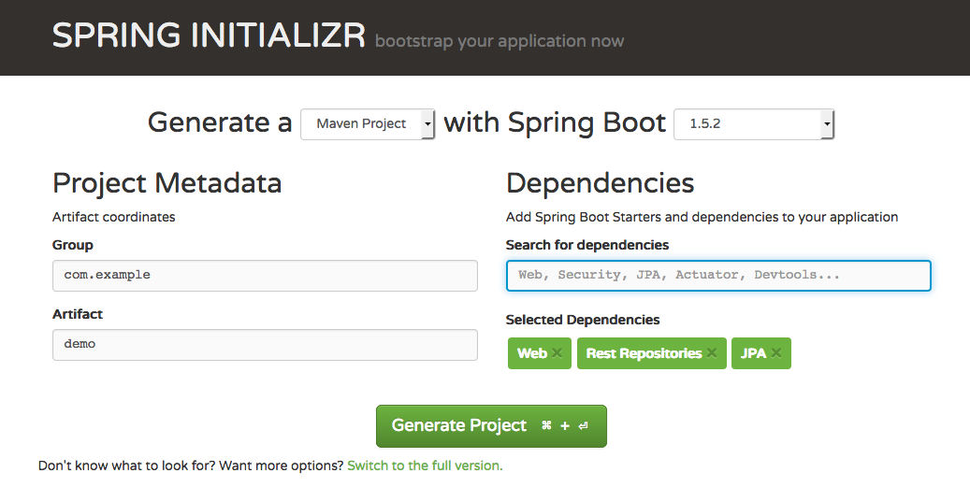
Spring Initializr Web Page
SPRING INITIALIZR
Specify dependencies
Switch to full version: more options, explicit check-list of dependencies
Notes:
An example of the current (Q4 2017) home-page. It gets redesigned periodically.

Slide 21
Topics in this Session
What is Spring Boot?
Spring Boot Explained
  Dependency Management
  Auto Configuration
  Packaging
  Testing

Slide 22
Spring Boot @EnableAutoConfiguration
@EnableAutoConfiguration annotation on a Spring Java configuration class
  Spring Boot will automatically create the beans it thinks you need
  Usually based on classpath contents, can easily override
@Configuration
@ComponentScan
@EnableAutoConfiguration
public class Application {
public static void main(String[] args) {
SpringApplication.run(Application.class, args);
}
}
No packages specified = scan current package and all sub-packages
SpringApplication is actually a Spring Boot class
Notes:
We have been using SpringApplication.run() throughout this course.
It is really a Spring Boot class, but unless you specify @EnableAutoConfiguration Spring Boot is not invoked.
As soon as you add the @EnableAutoConfiguration annotation, Spring Boot “springs” into action!
Auto-configuration relies on the classpath contents – this was why dependency management was so important earlier on.

Slide 23
Shortcut: @SpringBootApplication
Very common to use @EnableAutoConfiguration, @Configuration, and @ComponentScan together
@SpringBootConfiguration
@ComponentScan
@EnableAutoConfiguration
public class Application {
...
}
@SpringBootApplication
public class Application {
...
}
@SpringBootConfiguration simply extends @Configuration – see @SpringBootTest for why.
Notes:
@SpringBootApplication is another composed annotation – a shorthand for three annotations commonly used together.
@SpringBootConfiguration was introduced by Spring Boot 1.5 and is simply an extension of @Configuration:
@Target(ElementType.TYPE)
@Retention(RetentionPolicy.RUNTIME)
@Documented
@Configuration
public @interface SpringBootConfiguration {
}
There can only be one per application and is used as a marker by Spring Boot to find the application class when testing – discussed in later slides in this deck.

Slide 24
Auto-configuration: Examples
At Runtime, Spring
Boot checks if
What Spring
Boot does
What you include
Embedded DB dependency
HSQLDB
(or H2 or Derby)
on classpath
Embedded DataSource registered
Starter JDBC
If DataSource registered
JdbcTemplate registered
If DataSource
not registered
Runtime Error: JDBC found with no datasource
Notes:
In general Spring Boot configuration is the result of three steps:
1. You include a dependency
2. Spring Boot runs a pre-defined configuration that looks for that dependency.
3. The dependency is detected so some aspect of Spring is configured.
These are just typical examples:
1. You define starter web, a Spring Boot configuration recognizes this and sets up Spring MVC, including registering a DispatcherServlet (and a lot more besides).
2. You include a database dependency (here HSQLDB) and the Spring Boot database configuration creates a DataSource because it finds HSQLDB on the classpath.
3. Building on example (2), if you add the JDBC starter, Spring Boot recognises this and sets up a JdbcTemplate for you – using the DataSource defined by example (2). Example (3) will fail unless a database has also been detected (as in example 2).
If you are pushed on step 2 – Spring Boot is simply a large number of @Configuration files that we have pre-written. Each one only performs configuration conditionally (in the same way that @Profile allows Spring Beans to be created some times and not others. How this works is covered in the next slideset. The conditional configuration in Spring Boot involves looking for certain classes on the classpath, which in turn is governed by the dependencies you use.

Slide 25
Configuration Properties
Using application.properties
Developers commonly externalize properties to files
  Easily consumable via Spring Property-Source
  But developers name / locate their files different ways
Spring Boot looks for application.properties
  Many properties exist to control auto-configuration
  Can put any properties you need in here
    Boot will automatically find and load them
  Available to Environment and @Value in usual way
See Appendix A of Spring Boot documentation:
http://docs.spring.io/spring-boot/docs/current/reference/html/common-application-properties.html
Notes:
Spring Boot is most easily configured by setting some of its many, many configuration properties. By convention these are put in application.properties although you can put any property in application.properties .
The Spring Boot advanced slide deck has more on properties and also discusses using YML instead.
In the advanced section we note that the possible locations for application.properties are:
In current working directory
In config sub-directory of current working directory
In root of classpath
In config package on classpath
Appendix A of the online Spring Boot documentation list (most of) these properties.

Slide 26
Example: External Database
Configuring an external database
  Such as MySQL
  Make sure project defines JDBC driver dependency
spring.datasource.url=jdbc:mysql://localhost/test
spring.datasource.username=dbuser
spring.datasource.password=dbpass
spring.datasource.driver-class-name=com.mysql.jdbc.Driver
spring.datasource.schema=/testdb/schema.sql
spring.datasource.data=/testdb/data.sql
Notes:
The embedded databases can be set up using default user name and password as long s the dependency (including the JDBC Driver) is on the classpath.
For an external database Spring Boot needs more help. Just declaring the dependency is not enough. Your need to set these properties too.

Slide 27
Example: Controlling Logging Level
Boot can control the logging level
  Just set it in application.properties
Works with most logging frameworks
  Java Util Logging, Logback, Log4J, Log4J2
logging.level.org.springframework=DEBUG
logging.level.com.acme.your.code=INFO
application.properties
Try to stick to SLF4J in the application.
The advanced section covers how to change the logging framework
Notes:
We saw the database setup properties already. Here is another example: logging.
Avoiding the whole nightmare of incompatible logging libraries make Spring Boot worth using for this one reason alone!
“Try to stick to SLF4J in the application”:
This is the default in Spring Boot, don't have to exclude/include dependencies
SLF4J is a mature implementation, written by the creator of LOG4J (more or less as a version 2)
LOG4J 2 has some momentum, but we'll wait for a few years to see if it's massively adopted.

Slide 28
Topics in this Session
What is Spring Boot?
Spring Boot Explained
  Dependency Management
  Auto Configuration
  Packaging
  Testing

Slide 29

Packaging
Spring Boot creates your archive
  JAR (or WAR)
Gradle and Maven plugins available
  Generates an executable JAR
  java -jar yourapp.jar

Slide 30
Maven Packaging
Recall: Spring Boot Maven plugin in pom.xml
<build>
<plugins>
<plugin>
<groupId>org.springframework.boot</groupId>
<artifactId>spring-boot-maven-plugin</artifactId>
</plugin>
</plugins>
</build>

Slide 31
Packaging Result
“mvn package” execution produces (in target)
  .jar.original contains only your code (a traditional JAR file)
  .jar contains your code and all libs – executable
    Notice that it is much bigger
22M yourapp-0.0.1-SNAPSHOT.jar
5K yourapp-0.0.1-SNAPSHOT.jar.original

Slide 32
Topics in this Session
What is Spring Boot?
Spring Boot Explained
  Dependency Management
  Auto Configuration
  Packaging
  Testing

Slide 33
Testing: @SpringBootTest
Loads the specified configuration applying same Spring Boot defaults
@ExtendWith(SpringExtension.class)
@SpringBootTest(classes=Application.class)
public class TransferServiceTests {
@Autowired
private TransferService transferService;
@Test
public void successfulTransfer() {
TransferConfirmation conf = transferService. transfer(...);
...
}
}
@Configuration
@EnableAutoConfiguration
@ComponentScan(“transfers”)
public class Application {
// Bean methods
}
Notes:
Causes a test to be run using the Spring Boot's setup of the specified class – in this case the configuration of Application.
If Application defines a Spring Boot application, with a public static main() method invoking SpringApplication.run(application.class, args), then essentially this means the test will use the same Spring Boot setup the Application uses when it is run as an application.
For example, if Application uses JPA and JPA is on the classpath, then Spring Boot will setup a TransactionManager, EntityManagerFactoryBean and, given the right properties or dependencies, a DataSource.
By specifying Application.class to @SpringBootTest, if the classpath is the same, the test will get the same JPA setup configured for it by Spring Boot.
NOTE: If you don't specify @SpringBootTest, the configuration classes listed will not be checked for @EnableAutoConfiguration, so Spring Boot is not used.
This is what students will need for the lab – since they are only running tests and have no application (yet).

Slide 34
Testing: @SpringBootConfiguration
Spring Boot can find configuration class for itself
  Provided it is in a package above the test
  Only one @SpringBootConfiguration allowed in a hierarchy
@ExtendWith(SpringExtension.class)
@SpringBootTest // classes not needed
public class TransferServiceTests {
// Same tests as previous slide
}
@SpringBootConfiguration
@EnableAutoConfiguration
@ComponentScan("transfers")
public class Application {
// Bean methods
}
≡ @SpringBootApplication(scanBasePackages="transfers")
Notes:
This is where @SpringBootConfiguration is actually used. Spring Boot looks for the class annotated with @SpringBootConfiguration (or @SpringBootApplication) and uses its annotations to configure the test. Only once such class is allowed in the hierarchy.
As with all conventions, this is fine as long as everyone understand how it works. The previous slide showed the explicit use of @SpringBootTest(classes=...) to specify the @Configuration class(es) needed for the test.
This won't work in the lab as RewardsConfig is not in the rewards package hierarchy.

Slide 35
Summary
Spring Boot significantly simplifies Spring setup
  Will setup much of your application for you
  Uses in-built defaults (opinions) to do the obvious setup
  Many properties available to customize what it does
  Use @SpringBootTest to enable Spring Boot in tests
See optional Advanced Spring Boot section in Student Handout PDF for more on Spring Boot configuration and usage.
Notes:
This section has no lab.
In the next section, we apply Spring Boot to our JPA application and use Spring Data Repositories as well.

