Slide 1
Microservices with Spring
Optional Section
Building Cloud Native Applications
Introduction to Spring Cloud

Slide 2
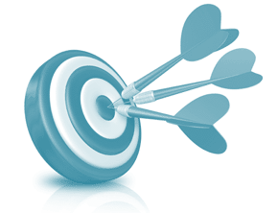
Objectives
After completing this lesson, you should be able to:
  Describe a Microservices Architecture and explain the Pros and Cons
  Explain the Challenges of Managing Microservices
  Describe Spring's Support for Microservice Applications
  Build a Simple Microservice System
Notes:
Optional section on Microservices with Spring.
Just a taste of what's involved. The Spring Cloud Services course goes into a lot more detail.
This section is no longer required for Certification. You may cover this section and/or the Reactive section depending on available time and group interest.

Slide 3


Roadmap
What is Microservices Architecture?
Pros and Cons of Microservices
Managing Microservices
Tooling: Spring, Spring Cloud, Netflix
Building a Simple Microservice System

Slide 4

Introduction
“Microservices” is not a new concept
  Term coined in 2005 by Dr Peter Rodgers
    Then called “micro web services” and based on SOAP
  Term started becoming popular since 2010
    Proposed by a group of architects in Venice during 2011
    Used in 2012 in a presentation from James Lewis
See also: http://martinfowler.com/articles/microservices.html
Notes:
When Peter Rodgers first proposed this he used SOAP – no-one was doing REST at that time.
As is often the case, it was an idea waiting for technology to catch up with it.

Slide 5
Without Microservices
Using a “monolith” architecture
  All-in-One application
Client
Web
Mobile
Server
Shopping Application
Store, Config, Cart...
DB
Notes:
Can scale up by running multiple instances assuming we wrote the application to support that – typically not the case with older JEE applications for example.
However this is bunt – scales every part of the application, even though only some of it functionality is under load.
Only very disciplined teams can roll-out more than a couple of upgrades a year.

Slide 6


With Microservices
Main application divided into a set of sub-applications
  Called microservices
Client
Web
Mobile
Server
API Gateway
API Gateway
Shopping
Micro-
services
Store
Catalog
Cart
StoreDB
ProductsDB
CartDB
Notes:
Can now scale each microservice independently (among other advantages – see later slide). If the Cart Service is the busiest we can have more instances of that service compared to, say, the mostly read-only Catalog Service.
Can develop each independently – easier to achieve shorter rollout periods.
Each microservice could be written in a different language and/or use a different database. The use of MySql and Redis here are just examples, not recommendations.

Slide 7
What are Microservices?
Adrian Cockcroft (Netflix) describes this approach
  Fine grained, loosely coupled Service Oriented Architecture (SOA) with Bounded Contexts
  SOA as originally intended
    Interactive, collaborating applications
    Not an overpriced Enterprise Service Bus!
  Bounded contexts from Domain Driven Design
    Each microservices maintains its view of the data
    Only what it needs to do its job
Adrian Cockroft was Technical lead at Netflix and pioneered a microservices approach
Notes:
The use of the term SOA by Adrian here is brave!
He is not referring to an overpriced Enterprise Service Bus requiring hours of consultants to integrate. SOA has a deservedly bad reputation because of this. Moreover SOA attempted to integrate applications never intended to be integrated.
Adrian is instead referring to the original concept behind SOA – integrating applications as providing services to each other. This is easier with REST than SOAP, especially when the applications are expressly designed for this purpose.
Bounded contexts are a concept from Domain Driven Design. The model only has to support what each microservices needs. Take for example a Media Streaming service.
The Product Catalog microservice for a would view a Movie as content. It would be concerned with the type of movie, who was in it, who directed it.
The Ordering microservice would see a Movie as a chargeable item. The content would be irrelevant here. Instead the type of media (DVD, online streaming), cost, availability become important.
In a monolithic application we have to encompass with both these things in the Movie object. This makes it more complicated and more likely for small changes to affect multiple parts of the system.

Slide 8
Roadmap
What is Microservices Architecture?
Pros and Cons of Microservices
Managing Microservices
Tooling: Spring, Spring Cloud, Netflix
Building a Simple Microservice System

Slide 9

Core Spring Concepts
Applied to Application Architecture
Spring enables separation-of-concerns
  Loose Coupling: Effect of change is isolated
  Tight Cohesion: Code performs a single well-defined task
Microservices exhibit the same strengths
  Loose Coupling
    Applications are built from collaborating services (processes)
    Can change independently if protocols and data-exchange formats are unchanged
  Tight Cohesion
    An application (service) that deals with a single view of data
    Also known as “Bounded Contexts” (Domain-Driven Design)
Notes:
Microservices embody similar principles to Spring itself. Conceptually they are not such a big step.
Spring has aways emphasized well-structured applications using highly independent components (Spring Beans) that enable separation-of concerns. This in turn provides:
Loose Coupling: changes to the component do not knock through the system requiring many other components to change. Spring encourages the use of interfaces for this reason.
Tight Cohesion: a component has a well-defined purpose with no extraneous functionality. Spring AOP is in response to this. Such classes are easier to test and maintain as they have fewer side-effects.
Like Spring Integration, with microservices we are moving to a message-driven architecture typically using HTTP RET or messaging (AMQP, JMS).
A separate process with a well-defined interface (fixed protocol and data-exchange formats) is the ultimate in a loosely coupled system. The notion of Bounded Contexts is an echo of tight-cohesion.
Microservices have no necessary connection with Spring (they need not be written in Java or use Spring at all) but they embody the core concepts we have been seeing all the way through this course.
If you are happy with what Spring does for you application (or you wouldn't be taking this course) you should be open to how Microservices apply the same principles to your entire system.

Slide 10

Microservice Benefits
Smaller code base is easy to maintain
Easy to scale
  Scale individual component
Technology diversity
  Mix libraries, frameworks, data storage, languages
Better support for smaller, parallel teams
Independent development/deployment of individual microservices
  A critical change in one service can be deployed separately from a slower, on-going development effort in another service.
Notes:
Microservice advantages
More targeted to its purpose, smaller and easier to maintain, easier for new developers to learn
Can be written in any programming language that suits the problem, can use any suitable framework or backend storage (Polyglot Persistence). Can try out different implementations without having to rewrite entire system, just one process.
No longer limited to a common single framework
Can be enhanced independently of the others, each having a separate release cycle, provided its interface is unchanged – no longer tied to a grand release cycle
Interface can be HTTP REST, a message queue …
Ideally you can lose one microservice but the rest of the application can keep running. This is both a challenge, to setup, and a benefit once in place.
Smaller teams and independent deployment only work if the organization is setup to support it – this is a challenge listed on the next page.

Slide 11

Microservice Challenges
Difficult to synchronize data across services
  ACID transactions do not span multiple processes
  Eventual consistency, Compensating transactions
Distributed system
  Harder to debug/trace
  Greater need for end-to-end testing
  Expect, test for and handle the failure of any process
  More components to maintain: redundancy, HA
Typically requires “cultural” change (Dev Ops)
  How applications are developed and deployed
  Dev and Ops working together, even on same team!
Notes:
Microservices are not without their challenges
A single monolithic application is replaced by 10-20 collaborating processes (we will see that additional infrastructure processes are also required). End-to-end testing needed to ensure they work together correctly.
A lot more moving parts – typically each microservice is replicated for redundancy and for resilience. Expect failure, handle it and test for it.
Harder to monitor and debug so many processes. Much more complicated system to test.
This is where a Platform (PaaS) like Cloud Foundry, AWS or Heroku comes in – makes it easier to deploy and keep running so many processes
Transactions – the “elephant in the room” no-one wants to talk about because it is hard!
Distributed 2-phase commit global transactions should be the solution of last resort as they are more complicated and add extra overhead. Need to be creative and consider other alternatives
Eventual consistency: Data is eventually the same in all processes but not immediately (similar to master-slave replication),
Compensating transactions: Use a second transaction to undo the effect of the first, a form of manual rollback that is OK if modified data is not acted on immediately. Example: create new order then realize you shouldn't and cancel it. If order service has a small built-in delay before orders are processed this works OK.
Ideally supported by an agile Dev Ops culture – no good if the microservice can be updated and enhanced rapidly but go-to-production processes end up preventing rapid deployment
Ultimately a cultural change may be required – for many companies this is extremely hard (typically it would be easier to declare World Peace!)

Slide 12
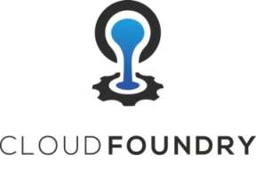
Use a Platform to Support This
Platforms* like Pivotal Cloud Foundry aid deployment
  Easily run, scale, monitor and recover multiple processes
  Run up a complete dev system for end-to-end testing
Support for
  Continuous Deployment
  Rolling upgrades of new versions of code
    Also termed: Blue/Green or Canary rollout
    Quick rollback in case of defects
  Running multiple versions of same service at same time
    Makes migration easier for downstream projects
*Platform as a Service (PaaS)
Notes:
We are now much more dependent on a deployment environment that supports what you are doing – this is where a good PaaS comes into play. Regardless of whether you choose Pivotal's Cloud Foundry, your Platform should allow you to easily run multiple instances of the same application, scale it up and down under load and recover a failed process quickly.
Many organizations find it hard to replicate their production environment for realistic testing. PCF for example provides isolated spaces to run applications in – one for dev, one for test, one for QA and eventually one for production. Can be setup identically.
No longer calling local methods but making remote calls (like RPC/RMI). Compiler will reject bad method calls, but it won't help us with a bad RPC request. So, end-to-end testing is required – need to test all components working together. This brings us onto Continuous Deployment: when any component is changed it is tested on its own and then redeployed (into test not production) for testing with the other microservices. You need somewhere to deploy to → your platform of choice.
If you want to get into it:
Canary or Blue-Green deployment is a phased roll-out. One microservice instance is taken down (other instances of same service take up the load) and an upgraded version is deployed. If all is well, do the same with another instance and another until all instances have been upgraded with no downtime. If any upgraded instance fail reverse the process to redeploy the previous version.
Note: Not so simple, but still possible: if a database upgrade is also required. Typically it requires multiple rollouts to achieve.

Slide 13
Roadmap
What is Microservices Architecture?
Pros and Cons of Microservices
Developing Microservices
Tooling: Spring, Spring Cloud, Netflix
Building a Simple Microservice System

Slide 14
Microservice Infrastructure
We only cover
these today
Multiple processes working together
Issues that now arise:
  How do they find each other?
  How do we decide which instance to use?
  What happens if a microservice is not responding?
  How to we secure access?
  How do they communicate?
  To just name a few!
Service Discovery
Client-side
Load Balancing
Fault
Tolerance
OAuth, ...
Messaging
REST
Notes:
Unfortunately the Platform can't do everything for us. Our microservices system is going to need some extra functionality to make it work.
Note that deciding which instance to use involves two actions:
Find what instances of a service are available and how to access them for example via RESTful URL)
Secondly, we use client-side load-balancing to spread multiple calls from one service to another ()remember the all our services will be multi-threaded) across all available instances.
This introduction can't go into all of these, so we shall just show that:
Spring Cloud provides an easy way to use many of these
Service Registration and Client-side Load-Balancing using OSS components from Netflix
Another advantage of Pivotal Cloud Foundry is that it provides several of the Spring Cloud services for you – including the Eureka Discovery service we will be using in a moment.

Slide 15
Roadmap
What is Microservices Architecture?
Pros and Cons of Microservices
Managing Microservices
Tooling: Spring, Spring Cloud, Netflix
Building a Simple Microservice System

Slide 16

Microservices with Spring
Setup a new service using Spring Boot
Expose resources via a RestController
Consume remote microservices using RestTemplate
Leverage capabilities from Spring Cloud Project
Notes:
Again this is not the only way to write a microservice in Java, but Spring has everything you need.

Slide 17




What is Spring Cloud?
Building blocks for Cloud and Microservice applications
  Microservices Infrastructure
    Provides useful services such as Service Discovery, Configuration Server and Monitoring
    Several based on other Open Source projects
      Netflix OSS, HashiCorp's Consul, Apache Zookeeper ...
  Platform Support
    Access platform-specific information and services
      Available for Cloud Foundry, AWS and Heroku
  Uses Spring Boot style starters
    Requires Spring Boot to work
http://projects.spring.io/spring-cloud
Notes:
We are concerned here with the services (processes) that Spring Cloud provides to support a Microservices architecture such as service discovery and registration and inter-client load-balancing. Other services (out of scope today) are
Shared configuration using Spring Cloud Config Server
Using Netflix Hystrix to enable fault-tolerance
Security using OAuth2 and Netflix Zuul
Cluster management using Spring Cloud Cluster (which provides leadership election in failover scenarios and supports Zookeeper, Redis, Hazelcast or Consul)
And more – see project (clickable URL at bottom of slide)
Consul comes from Hashicorp (more well-known perhaps for their Vagrant tool) and is an alternative to both Eureka and Spring Cloud Config Server.
Support for Cloud Platforms is another group of Spring Cloud projects that make it easier to interact with the underlying Platform whether you have deployed to Cloud Foundry, Heroku or AWS. See Spring Cloud Connectors and Spring Cloud AWS.
Most of the Spring Cloud facilities build on Spring Boot and have similar starter POMs.

Slide 18
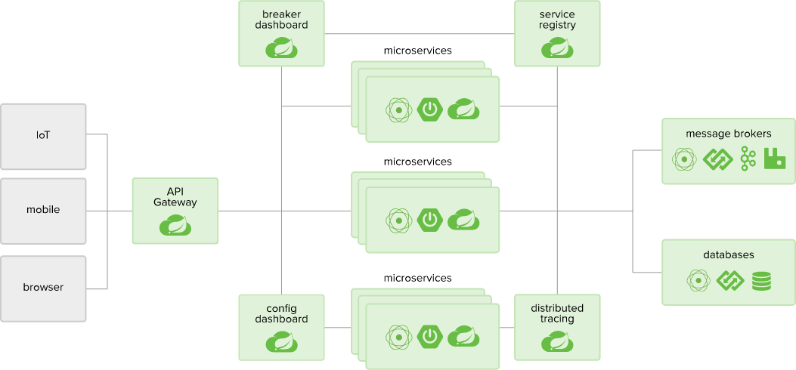

Spring Cloud Ecosystem
* Today we only have time
to look at Eureka & Ribbon
Breaker
Dashboard
Discovery
Service
* Eureka
microservices
Ribbon
*
IoT
microservices
API
Gateways
mobile
*
browser
microservices
Config
Server
Distributed
Tracing
*
Spring Cloud is at http://projects.spring.io/spring-cloud/
Notes:
Diagram shows
Requests enter the system via a Gateway. Typically different gateways handle different types of client.
Common configuration supplied by Spring's Config server
Integration with Netflix Hystrix helps handle when a microservice stops responding – so the whole system doesn't back up. Breaker Dashboard shows system status.
Spring supports Netfix's Zipkin product for distributed tracing – trace a request through multiple microservices
We will cover Service Discovery and Ribbon (client-side load balancing) only.
Spring Cloud also includes:
Spring Cloud Connectors & Spring Cloud AWS – APIs for easy integration of Cloud Native applications with Salesforce, Heroku, Pivotal Cloud Foundry and Amazon Web Services
Spring Cloud Security – Support for OAuth2 security for REST clients and Netflix Zuul proxy
Spring Cloud Cluster – Leadership election and common stateful patterns with an abstraction and implementation for Zookeeper, Redis, Hazelcast, Consul.
Spring Cloud Stream – A lightweight event-driven microservices framework to quickly build applications that can connect to external systems. Simple declarative model to send and receive messages using Apache Kafka or RabbitMQ between Spring Boot apps. Part of the underpinning for Spring Cloud Data Flow.

Slide 19
Why We Need Service Discovery – 1
Communication via REST
  But how do the two services find each other?
  What happens if we run multiple instances?
Multiple instances
for throughput
and resilience
Product
Catalog
Service
Cart
Service
Checkout
Service
REST request
Cart
Service
Cart
Service
JSON
Need
Service
Discovery
Order
DB
Cart
DB
Which
Instance?
Notes:
There is no reason why two microservices should communicate via REST, but it is very common. So Service Discovery is needed – don't want to hard-code URLs in each application – too brittle. Moreover, if there are multiple instances that come and go over time (due to scaling up/scaling down/failure and recovery/phased “canary” roll-out) we can't know all the URLs ahead of time or which ones are currently valid.
Note that any point-to-point protocol would need service-discovery.
However, if messaging is used, all you need to know is the name of the queue for each service. No service discovery or load-balancing is needed – your messaging system handles it all.
The choice is between synchronous or asynchronous microservice communication.
Synchronous communication using REST is easier given that the originating requests are synchronous HTTP requests from browsers or mobile applications. Hence REST is very popular in this space.
Asynchronous communication is much harder to manage. We (Pivotal Training) are aware of microservice projects that have moved from messaging to REST to avoid the complexity associated with asynchronous messaging.

Slide 20
Why We Need Service Discovery – 2
Discovery
Server(s)
2. Register
Cart
Service
1. Register
Checkout
Service
Discovery
Server(s)
register
register
3. Find Cart
Service
Cart
URL(s)
consult
Product
Catalog
Service
Cart
Service
Checkout
Service
REST request
Cart
Service
Cart
Service
JSON
Products
DB
4. Make a
request
Cart
DB
Notes:
The previous slide showing Service Discovery happening.
Typically run more than one Discovery Server to protect against process failure.

Slide 21
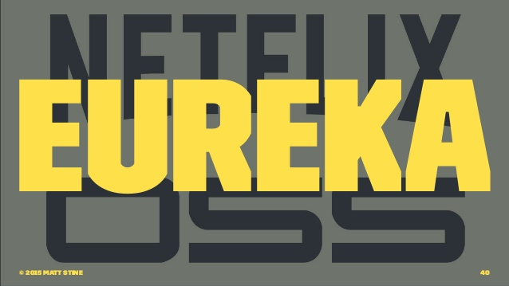
Implementing Service Discovery
Spring Cloud supports several
  Netflix Eureka (and Ribbon)
  HashiCorp Consul
  Apache Zookeeper
Spring Cloud makes it easy
  To utilize either of those servers
  Hiding their internal complexity
Our choice today
See also: http://spring.io/blog/2015/07/14/microservices-with-spring
Notes:
What are we trying to do:
1. Register with the system so other microservices can find us
2. Use the same registry to find other microservices
We need an extra process – the Service Registry (which we will refer to using the SpringCloud terminology: Discovery Service).
We have a choice of Service Registries – we will be using Netflix OSS (Open Source Software) components today, so that means Eureka.
However Consul and Apache Zookeeper are also a popular choices and Spring Cloud supports both. Background: HashiCorp is better know for its Vagrant product and Zookeeper is used inside Hadoop. The man with the shovel is the Zookeeper product logo.
We will be using Ribbon too later – another project from Netflix OSS. Eureka tells clients all the available instances of the service they have looked up – so we need Ribbon to load-balance between them.

Slide 22

Implementing Client-Side Load Balancing
Discovery server may return the location of multiple instances
  Recall: multiple instances for resilience and load-sharing
  Client needs to pick one
We will use Netflix Ribbon
  Provides several algorithms for client-side load-balancing
Spring provides a “smart” RestTemplate
  Enhanced with Ribbon “built-in”
    Performs Service-discovery and load-balancing
  @LoadBalanced
Notes:
One nice feature of deploying multiple instances of each microservice is that they are active, all processing requests concurrently to provide loa-sharing and increased capacity. However all of them are standbys for each other. If one fails, the others simply pick-up its load.
But, when one microservice is making requests of another we don't want all the requests to go to the same instance (assuming we have multiple instances as described).
The client microservice should spread its requests across all instances of the microservice it is calling.
We will use Ribbon from Netflix to do this but hide it inside a specially enhanced RestTemplate – there is a slide on this later. Ribbon fetches the available instances from Eureka periodically and picks the best instance to use each time.
Eureka “forgets” a service instance if it stops responding. The next time Ribbon fetches the list of instances for a given service, any failed service will be missing and any new ones added to the list. For efficiency, Ribbon doesn't fetch the list of available instances on every request, but does so regularly enough to keep up to date.
Ribbon is smart enough to track how well different instances respond to requests. Instances that respond most quickly are prioritized to get more requests in future.

Slide 23
Roadmap
What is Microservices Architecture?
Pros and Cons of Microservices
Managing Microservices
Tooling: Spring, Spring Cloud, Netflix
Building a Simple Microservice System

Slide 24
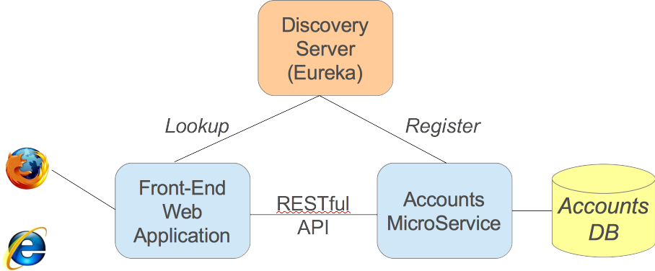
Our Simple Microservice System
A
C
B
Consumer
Producer
requests
data from
Notes:
There s a lot more to building a system than we have time to cover here. So we will build the simplest possible microservice system involving two microservices and a discovery server. A diagram on the whiteboard is useful here. Similar to the Cart and Checkout example we saw before, but this matches the lab they will do.
The terms server and client get very confusing since both our microservices (blue-green boxes) are clients of the Discovery Server, but the Front-End Web Application is a client of the Accounts Microservice (which is acting as a server for account information).
Instead we will use the messaging terms Producer and Consumer. These may not be familiar to students so make a point of explaining them to students.
In the next few slides:
Server – only refers to the Discovery Server (in our case Eureka).
Producer – refers to the Accounts microservice
Consumer – refers to the Front End web-application.

Slide 25
Building our Simple Microservice System
A) Run a Discovery Service
  We will see how to create a Eureka Discovery Service
B) Run a Microservice (the Producer)
  Ensure it registers itself with the Discovery Service
  Registers its logical service name with A
C) How do Microservice Consumers find service B?
  Discovery client using a “smart” RestTemplate
    Spring performs service lookup for you
    Uses logical service names in URLs
Notes:
Three processes to implement.
A
B
C

Slide 26
Maven Dependencies
<parent>
<groupId>org.springframework.cloud</groupId>
<artifactId>spring-cloud-starter-parent</artifactId>
<version>Dalston.SR4</version>
</parent>
<dependencies>
<dependency>
<groupId>org.springframework.boot</groupId>
<artifactId>spring-boot-starter-web</artifactId>
</dependency>
<dependency>
<groupId>org.springframework.cloud</groupId>
<artifactId>spring-cloud-starter</artifactId>
</dependency>
<dependency>
<groupId>org.springframework.cloud</groupId>
<artifactId>spring-cloud-starter-netflix-eureka-client</artifactId>
</dependency>
</dependencies>
Parent
“Release train” = a consolidated
set of releases
Spring Cloud
Access Eureka
registry server
pom.xml
Dependencies for A, B & C. Spring Cloud is based on Spring Boot
Notes:
Spring Cloud does a lot of magic and it sits on Spring Boot to do so. Most of Spring Cloud cannot be used without Spring Boot.
These dependencies apply to all three services that we are going to build. The spring-cloud-starter-netflix-eureka-client makes the application a Eureka client that can register itself and/or look up microservices by name.
This means even the Discovery Server is also a Discovery Client which seems a bit odd. It allows a server to find any other Discovery Servers when we are using moe than one for resiliency. Hence the configuration on the next slide to tell the Eureka service not to register with itself (since we are only running one instance).
Note that this dependency has changed its name from spring-cloud-starter-eureka. An optional slide after the Labs slide covers this change.

Slide 27
(A) Eureka Server using Spring Cloud
server:
port: 8761
eureka:
instance:
hostname: localhost
client: # Not a client
registerWithEureka: false
fetchRegistry: false
application.yml
All you need to implement
your own registry service!
@SpringBootApplication
@EnableEurekaServer
public class EurekaApplication {
public static void main(String[] args) {
SpringApplication.run(EurekaApplication.class, args);
}
}
main.java
<dependency>
<groupId>org.springframework.cloud</groupId>
<artifactId>spring-cloud-starter-netflix-eureka-server</artifactId>
</dependency>
pom.xml
Notes:
We can take a minimal Spring Boot application and make it a Discovery Server just by using @EnableEurekaServer. This in turn does an @Import of the configuration necessary to setup the Eureka Service Registry. The key dependency, the Eureka Server, is shown in the gray box. Note that this dependency has also changed its name, from spring-cloud-starter-eureka-server.
By default the Server also tries to register (in this case with itself) so we use properties to turn that off. We also need to define what port the server listens on (localhost:8761 is actually the default). We use 1111 in the lab.
For resilience you would run at least two instances and in this case you do want them to register – with each other. They keep each other up-to-date and in sync as other processes register with them. So if one dies the other can take over.
So now we have our Discovery Service based on Eureka.
Trivia: Eureka means ”I found it” in Ancient Greek. Allegedly this is what Archimedes exclaimed when he noticed that the water in his bath washed over the slides when he go into it. From this he was able to prove that a crown, recently made for the king, was fake. He measured the volume that a lump of pure gold of same weight would displace, then the volume displaced by the crown (which was more because the crooked goldsmith has substituted lighter silver for gold, making crown larger for same weight).
https://en.wikipedia.org/wiki/Eureka_(word)
More relevant to today, Eureka is the only Netflix project name that actually makes sense in context. What does Hystrix actually mean? (Wikipedia says its a skin disorder, a plant or a porcupine – take your pick!) Why is a Ribbon a load-balancer?!

Slide 28
(B) Accounts Producer Microservice
Performs Service Registration
Microservice declares itself as an available service
  Using @EnableDiscoveryClient
  Registers using its application name
@SpringBootApplication
@EnableDiscoveryClient
public class AccountsApplication {
public static void main(String[] args) {
SpringApplication.run(Application.class, args);
}
}
spring:
application:
name: accounts-microservice
eureka:
client:
serviceUrl:
defaultZone: http://localhost:8761/eureka/
Service name
Eureka Server URL
Notes:
Everything else in the system makes itself a Discovery Client – both producers and consumers.
This annotation causes the process to register with the Discovery Service. Notice the annotation is generic – this client could register with a Eureka or a Consul Discovery Service. If your microservice is only ever a consumer you can disable registration if you really want to.
So now our Accounts producer service is available to service incoming requests.
The properties file defines:
The URL of the Discovery Service
The name of the application – this is the name it will be registered under and the name other services should use to find it.
Warning - The terminology here is very confusing. The Spring "application name" will be used as the "service name" by the service discovery solution. Eureka refers to this as "service ID". Ribbon calls it a "named client".
If multiple instances of this process are run, they will all register.
If there are multiple discovery servers the defaultZone property can specify a list. Client will automatically try all of them until it gets a response. We do not want the Discovery Server to be a single-point f failure.

Slide 29
(C) Consumer Service – Step 1
Enable our consumer to find the producer
Same annotation also allows service lookup
Same annotation as (B) – allows us to query Discovery Server to find microservices
@SpringBootApplication
@EnableDiscoveryClient
public class FrontEndApplication {
public static void main(String[] args) {
SpringApplication.run(Application.class, args);
}
// Will use this template to access the microservice
// Spring will enhance this to do service discovery
@Bean @LoadBalanced
public RestTemplate restTemplate() {
return new RestTemplate();
}
}
Notes:
Our consumer (Account service client) has to do two things:
1. Find the microservice
2. Use it
This slide shows that the main class is also a DiscoveryClient. So it will automatically connect to the Discovery Service and register itself (even though no-one ever looks for it).
However it can also look for other services, which is what we want.
This double function is a bit confusing. Make sure students realize that in most cases microservices talk to each other – so they are at the same time both producers of information (servers) and consumers (clients).
The RestTemplate we are creating will be augmented with extra smarts to both do the service-discovery and to perform load-balancing if the Discovery Server responds with multiple instances – more on next few slides. Don't try to explain it yet.

Slide 30
(C) Consumer Service – Step 2
Let our consumer use the producer
@Service
public class RemoteAccountManager implements AccountService {
// Spring injects the “smart” service-aware template
// defined on previous slide
// It performs a load-balanced lookup (see next slide)
@Autowired
@LoadBalanced
RestTemplate restTemplate;
public Account findAccount(String id) {
// Fetch data
return restTemplate.getForObject
("http://accounts-microservice/accounts/{id}",
Account.class, id);
}
}
Service name
Notes:
We have created a Remote version of an AccountService which will access the microservice using the “smart” RestTemplate (fully explained in next few slides).
How does this work? The RestTemplate has been enhanced by Spring to use the Netflix Ribbon load-balancer to work with Eureka.
So it takes the logical service-name (as registered with the discovery-server in Step 2) and uses it to request the actual URL of the chosen microservice from the Discovery Service. Eureka returns URLs for all available instances, so Ribbon then picks one using a load-balancing algorithm (which you can configure if you wish).
It is possible that you might have more than one RestTemplate declared so the @LoadBalanced annotation acts a @Qualifier to pick the right one. If you look at the definition of @LoadBalanced you will see that it is annotated with @Qualifier.

Slide 31
Load Balanced RestTemplate
Create using @LoadBalanced – an @Qualifier
  Spring Cloud enhances it for service lookup & load-balancing
Inject using same qualifier
  If there are multiple RestTemplates you get the right one
  Can be used to access multiple microservices
@Bean @LoadBalanced
public RestTemplate restTemplate() {
return new RestTemplate();
}
@Autowired
@LoadBalanced
RestTemplate restTemplate;
Notes:
How does this work?
1. By annotating the @Bean method with @LoadBalanced Spring uses AOP to enhance the RestTemplate with additional capability that integrates Service Discovery and Netflix Ribbon.
2. When the template is used, it takes the logical service name in the rwquest URL (on previous slide we passed http://accounts-microservice/accounts/{id}). It looks up the logical service name “accounts-microservice” (we can do this because this application is a discovery service client). If multiple URLs are returned by the Discovery Server (Eureka) it passes them to Ribbon which uses a load-balancing algorithm to pick one. RestTemplate then uses the URL from Ribbon to build the actual URL and invokes it in the usual way.
If you look in the RibbonClientHttpRequestFactory you will see this code:
String serviceId = originalUri.getHost(); // accounts-microservice
ServiceInstance instance =
loadBalancer.choose(serviceId); // loadBalancer uses Ribbon
... if instance non-null ... // If service exists
URI uri = loadBalancer.reconstructURI(instance, originalUri);

Slide 32
Load Balancing with Ribbon
Our “smart” RestTemplate effectively integrates two Netflix utilities
  “Ribbon” client-side load-balancer
    Which in turn works with Eureka (in this case)
End result
  Eureka returns the URL of all available instances
  Ribbon determines the best available service to use
Just inject the load-balanced RestTemplate
  Automatic lookup by logical service-name
Notes:
This is a summary if what we have just covered. The RestTemplate conveniently abstracts away everything to do with generating a request, but that just means it is hard to understand what is actually happening.
Typically each microservice runs multiple instances for resilience. So, which instance should an application talk to? Client-side load-balancing ensures that when the service lookup occurs, the best available instance is picked automatically.
A simple microservice application thus involves running multiple processes:
Each component process requires at least a second instance for fail-over
All register with the registration service
Load-balancing is required across instances (as described above)
Instances need to share the same data-store in a consistent way
If an instance fails it must be restarted ASAP
One way to overcome these logistical challenges is by running microservices in the cloud and/or on a Platform (PaaS).
Note that this is not the same load-balancing that students may be familiar with in front of a cluster of web-application servers (where they might use F5 for example). That is server-side load-balancing. Here we are using client-side load-balancing.

Slide 33
Spring Cloud Resources
We have only covered a few Spring Cloud features
  Project Home page
    http://projects.spring.io/spring-cloud
  Matt Stine's free book on Cloud Native Architectures
    https://pivotal.io/platform/migrating-to-cloud-native-application-architectures-ebook
  Spring Blog article
    https://spring.io/blog/2015/07/14/microservices-with-spring
Consider taking our Spring Cloud Services course
See: http://pivotal.io/academy
Notes:
The Spring Cloud Services course covers many more Spring Cloud components that we don't have time to cover now, such as the Config Server, Service Bus, Netflix Hystrix ...
Course information at https://pivotal.io/academy/course/spring-cloud-services

Slide 34
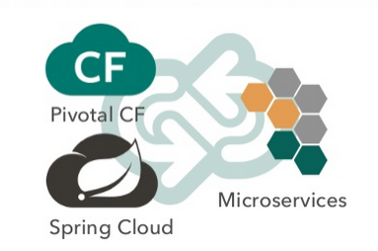
Summary
After completing this lesson, you should have learned:
  What is a Microservice Architecture?
  Advantages and Challenges of Microservices
  A little bit about Spring Cloud projects

Slide 35
Lab
Building a simple Microservices system
Coming Up: Legacy dependency names

Slide 36
Note: Dependencies have Changed
Older applications (before Finchley build-train)
  Warning: many online examples use old names
<!-- Client Dependency -->
<dependency>
<groupId>org.springframework.cloud</groupId>
<artifactId>spring-cloud-starter-eureka</artifactId>
</dependency>
<!-- Server Dependency -->
<dependency>
<groupId>org.springframework.cloud</groupId>
<artifactId>spring-cloud-starter-eureka-server</artifactId>
</dependency>
Notes:
The dependencies have been renamed to incorporate netflix in the name and to explicitly spcify client or server.
Students with existing Spring Cloud applications or using online examples will se different dependencies.

