Slide 1
Reactive Spring Applications
Optional Section
Introducing Reactive Programming
Spring's reactive support

Slide 2

Objectives
After completing this lesson, you should be able to:
Describe the basic concepts of Reactive Programming
Write a “reactive” Spring application
Notes:
Description of theory presented in this Section
Just enough about Reactive Programming concepts to understand WebFlux. We discuss Futures, CompletableFutures and stream processing, but do not discuss the publishers and subscribers that are required to generate/consume the data.
Then we cover WebFlux and how a Controller can become reactive by returning data as a Mono or Flux.
Recommended presentation time:
30 minutes
What will students have learnt after this module?
A general idea of what Reactive Programming is about
An appreciation of Spring 5's upcoming Reactive Web support
What are prerequisites?
A reasonably good grasp of Java, Enterprise app development and Spring MVC.
Suggested discussions, required reading, et cetera:
See references slide at end of presentation.

Slide 3
Roadmap
What is Reactive Programming?
Reactive Features
Reactive Stream Implementations
Reactive Spring Features

Slide 4
What is Reactive Programming?
* André Staltz – see references at end
Programming with asynchronous data streams*
  Everything (almost) can be seen as a stream
    Messages, variables, user input, data structures, ...
  Stream: Ongoing events ordered in time
    Series of user clicks through our web app
    Calls to a web server over time
    Separate values returned from a function
    Rows returned from a DB query
  Event: (almost) anything
    User clicks, calls to a web server, function returning a result, row returned from a DB query

Slide 5
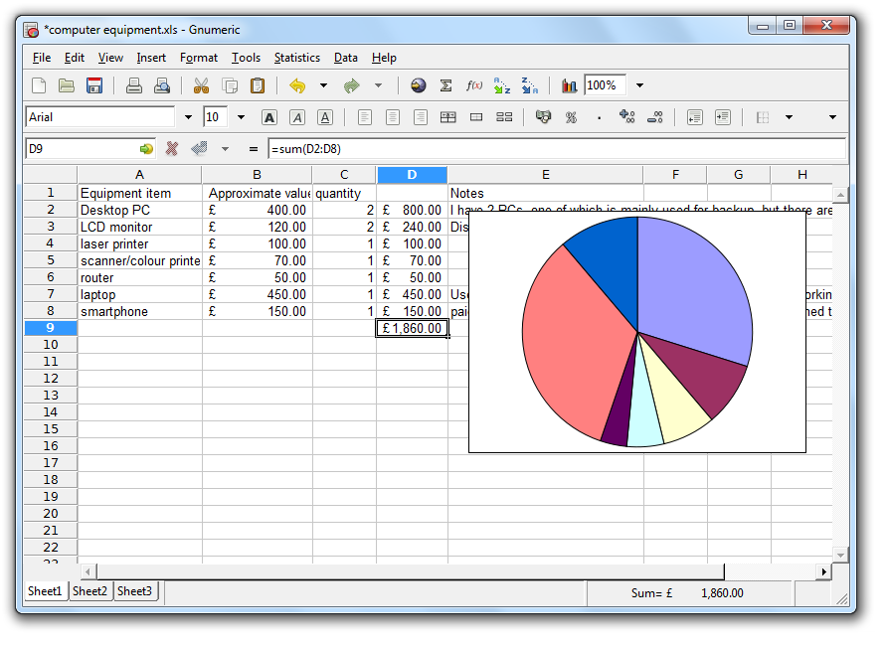
Familiar Example 1: Spreadsheets
Spreadsheets
  Formula cells in a spreadsheet automatically “react” to changes in the cells used by the formula
  Spreadsheet recalculates whenever such cells are modified
Notes:
We have been using a reactive tool for decades – it's called a spreadsheet!
Cells that contain formulas automatically recalculate when any cell in the formula changes its value – the formula cell “reacts” to changes in the cells it depends on.
Formulas may depend on other formulas, so now we have a chain of events (cell recalculations) that have to happen.

Slide 6
Familiar Example 2: User Interfaces
Implementing a GUI
  Must respond to mouse/keyboard events
  Setup Listeners
  Respond to events by running handlers asynchronously
JavaScript (AJAX, SPA) web-pages
  Make a REST request to back-end server
  Define a call-back for when data is returned
  Call-back invoked asynchronously

Slide 7


Why Reactive?
New applications and environments
  Distributed multi-process applications
    Cloud, PaaS, Microservices
Challenges
  Latency inevitable
  Redundancy and recovery
  Scale out, not up
Imperative (traditional) logic
becomes very complicated
  Too many nested call-backs
projectreactor.io
Notes:
One driver for reactive is the shift to “cloud computing” and “distributed applications” such as microservice architectures.
To misquote Paul Maritz: The cloud is about how computing is done not where.
Distributed environments (such as, but not limited, to “the Cloud”) offer new challenges.
Concurrent, multi-threaded, asynchronous applications have always been very hard to design and implement well and procedural languages like Java haven't offered much support. That is changing with new features since Java 7 (util.concurrency classes, streaming APIs and the upcoming Reactive Streams support in Java 9). We see some of these soon.
This section does not mention Functional Programming (introducing FP as well was too much detail). However, a lot of these features are borrowed from FP, adapted to run in Java.

Slide 8

Reactive Programming Examples
Reactive is good for
  Time series processing without storing state
  Non-blocking processing - threads do not need to wait for calls to complete
  Speed / Throughput - Far more efficient use of threads and memory
  Building complex event-driven systems without “callback-hell”
It is not appropriate or necessary for all applications
  Considerable learning-curve
Notes:
Here are some example scenarios
As with anything, you need to decide if it is the right tool for the task at hand.
There is a definite learning curve so if you don't need it, don't use it,

Slide 9
Roadmap
What is Reactive Programming?
Reactive Features
Reactive Stream Implementations
Reactive Spring Features

Slide 10
Reactive Programming
Non-blocking applications
  Asynchronous, event-driven
  Scale using a minimal number of threads
  Flow control (backpressure)
  Stream processing
Implications
  Major shift from imperative style logic to a declarative pipeline of asynchronous logic
  Intelligent routing and consumption of events
  Comparable to CompletableFuture in Java 8 and composing follow-up actions via lambda expressions
Notes:
Andre Stalz 's definition sums it up well – his excellent article is referenced at the end of these slides.
Key concepts:
Everything is defined to be asynchronous (even if it ends up being synchronous when run).
The number of threads required is a lot less than in the past because they are kept as busy as possible. Tasks are queued up and run as soon as the thread is ready to take them. The trick is to keep all the threads busy – see also two slides on.
However to stop too many events overlaoding the system there is the concept of backpressure – an event receiver (Subscriber) can “push back” against the event generator (Publisher).
Everything becomes declarative – we define what we want to happen (like tasks) and then let the system schedule and run them when it has capacity and when all the prerequisites (such as response from an external system) are in place. Hence asynchronous. The flow of control is no longer so obvious.

Slide 11
Asynchronous Components
Similar to messaging systems
  Independent components (tasks)
    Respond to incoming events
    Pass on results by generating events
  But components do not get their own thread
    Thread selects and runs components that are ready
    Then switches to next ready-to-run component
    Switching components much cheaper than thread-switching
Analogous concepts
  Actors, Coroutines, C.S.P.
CSP = Communicating Sequential Processes
Notes:
One of the goals of Reactive Programming is to provide a similar kind of abstraction over communicating, parallel-processing agents that messaging does. It bears similarities to other concepts.
Actor Model: Similar to OO Programming (actors go back to the 1970s) provide an abstraction over computation (as opposed to data and behavior) that allows for concurrency as a natural consequence, so in practical terms they can form the basis of a concurrent system. Actors send each other messages, so there is a lot of overlap between systems that style themselves as Actors or Reactive. Implementation varies, Actors in Akka can be distributed across processes. Objects responding to messages was the model used by Smalltalk.
Coroutines: A generalization of a "subroutine" — it has an entry point, and exit point(s) like a subroutine, but when it exits it passes control to another coroutine (not necessarily to its caller), and whatever state it accumulated is kept and remembered for the next time it is called. Can be used as a building block for higher level features like Actors and Streams. Fibres in Ruby, Generators in Scala and Python.
CSP: Communicating Sequential Processes (proposed in 1977 by Tony Hoare, Oxford University) is a a formal language for describing patterns of interaction in concurrent systems. Sending and receiving events is a built-in primitive of the language.
Java does not have these concepts built-in, but various libraries and frameworks enable Reactive Systems to be built.

Slide 12
Back-Pressure
Controls data flow though the reactive pipeline
  Ensures producers don’t overwhelm subscribers (consumers)
  Options: Ignore excess events or block until ready
Example
  Pipeline of reactive components from the HTTP socket to database
    Too many HTTP requests, data repository slows down or stops until capacity
    frees up
Producer
Subscriber
Back Pressure
Notes:
Imagine reactive web-request processing. Each incoming request becomes a task to be processed. Most of these in turn will spawn a data-access task. Since this involves a request across the network to a database server, this is an ideal opportunity to go asynchronous. Data-access tasks wait until their data arrives and then queue up to generate the data to be returned to the client, ending request-processing.
If the database is too busy, data-access task creation can be throttled back, in turn slowing down the initial request processing tasks and ultimately forcing a limit on the number of incoming requests the system can handle. After that Server Busy can be returned, rather than the whole system blowing up.

Slide 13
Roadmap
What is Reactive Programming?
Reactive Features
Reactive Stream Implementations
Reactive Spring Features

Slide 14

Handle Stream of Events Asynchronously
Reactive Streams
  Specification of Interfaces
  Needs an implementation
onError
onComplete
onNext onNext onNext
Notes:
The underlying concept is Reactive Streams – an interface with several implementations – and part of Java since JDK 9 (via the Flow interface).
This diagram shows the possible events on a stream
onNext – invoked for each valid event in the stream
onError – invoked when a stream generates an error
onComplete – invoked when the stream ends
This diagram style is copied from Pivotal Reactor.

Slide 15
Reactive Streams
Require a publisher and a subscriber
  Like messaging
Publisher provides data & specifies how to process it
  Produces a “stream” of 0, 1 or more data items
Subscriber actually processes the events in the stream
  Nothing happens without a subscriber
Subscriber
Publisher
subscribe()
onNext()
onError()
onComplete()
Data Sink
Data Source
Notes:
Streams is a push model – so the publisher invokes the callbacks once the subscriber has made itself known by subscribing.
Compare to Java 8 streams – this is a pull model – the stream pulls (fetches) data from the source.

Slide 16

Reactive Stream Implementations
Flow classes
  Part of Java 9 JDK
Project Reactor from Pivotal
  Supported by Spring 5
    http://projectreactor.io
RxJava
  Rx has several implementations
Spring supports Reactor and RxJava
  Don't require Java 9
PROJECT REACTOR
Notes:
Java 9 was delayed several times and was released about the same time as Spring Framework 5.
For that reason we don't discuss the Java 9 Flow classes in this section. Full JDK 9 support is expected in Spring 5.1. This course will be updated in due course.
Students may be familiar with the JavaScript implementation of Rx. RxJava is just on such!

Slide 17
Stream Types
A sequence of zero or more events
  Reactor calls this a Flux
  RxJava calls this Observable
Common special case
  Stream of 0 or 1 events
    Called a Mono or Single
All are publishers of events
Notes:
Two fundamental data-types:
Reactor: Mono and Flux
RxJava: Single and Observable. (Strictly speaking a Single is a Mono[1]).

Slide 18
Basic Types: Sequence of [0 .. N]
Flux, Observable are Publishers
Return continuous stream of events with failure handling
  Flux (Reactor) or Observable (RxJava)
  Can apply operation(s) to all items in stream
Stream
Completed
Stream
Completed
1
2
3
4
5
6
Operator
a
b
c
X
New stream may complete, or (as here) fail.
Notes:
Events pass their value, one at a time, to the Operator as they become ready, queuing up if need be. This is the Flux or Observable (a stream of events).
Again a new event may be generated for each data value processed by the Operator, or a value may fail.
A data-item, that needs to go through a number of processing steps, is passed from one Operator to the next until its processing has completed. At each step the output of an operator is itself a new stream. So the items in the new stream may be queued for processing later.
Essentially if each event generates a single event, the effect is that the original event may have to queue up multiple times, once for each operator. And the system will be processing many such data-items at once.

Slide 19
Basic Types: Sequence of [0 .. 1]
Mono and Single are Publishers
Used to return a single result (or fail doing so)
  Mono (Reactor) or Single (RxJava)
Completed
Mono eventually generates an item
Mono
timeline
1
Item is processed by one (or more) operations
Operator
Operation produces a new Mono (a) or Fails (X)
new Mono
timeline
a
X
Time ...
Notes:
A Mono is a special case of a stream of 0 or 1 events (a Single is a stream of just 1 event). Strictly speaking a Single is a Mono[1].
The original Mono waits until its internal value is ready and passes it to the Operator step. This Mono is now complete.
The Operator is some functionality that has to happen (essentially a transformation of the incoming value to some outgoing value).
The operator processes the data and either a new Mono is created (lower timeline) or it fails (the red X) .

Slide 20
Subscribing to a Stream
Reactor Syntax
Two options
  Implement a Subscriber<T>
    onSubscribe, onNext, onError, onComplete
  Provide a Consumer
    Has a single accept(T) – equivalent to onNext
      Can pass a lambda
Flux.just( "red", "green", "blue" ) // The producer
.log() // Stream operator: log item
.map(String::toUpperCase()) // Stream operator: convert to upper case
.subscribe(System::println); // Subscribe, Consumer prints each item
Notes:
In this example, subscribe passes in a Consumer whose accept method is invoked for each event received (like onNext) and can be implemented by a lambda – in this case System::println.

Slide 21

Java Streams are not Reactive
pushmi-pullyu
Java Streams
  Subscriber actively pulls in data, blocks if not available
Reactive Streams
  Data is sent (pushed) to subscriber via callbacks
  By “pushing-back” we get back-pressure
List<Shop> shops = customer.getVendors();
List<BigDecimal> discountedPrices =
shops.stream() // Fetches data from list
.map(Shop::getPrice)
.map(Discount::applyDiscount)
.collect(Collectors.toList());
Notes:
Java Streams and Reactive streams are frequently confused. Although both involve streaming data, they are fundamentally different. Java Streams actively fetch or pull the data they need. If not available they block.
Trivia: The picture is of a two-headed llama, as shown in Disney's 1967 Dr Dolittle film, and is called a pushmi-pullyu = Push Me, Pull You. (In the original book it was a two-headed gazelle-unicorn cross.)

Slide 22
Roadmap
What is Reactive Programming?
Reactive Stream Implementations
Reactive Features
Reactive Spring Features

Slide 23
Reactive Features in Spring
Spring Data Reactive Repositories
  Returns query results as a Stream
Web Client
  Reactive alternative to RestTemplate
WebFlux
  Reactive @Controllers

Slide 24
Reactive Spring Data Repository
Return immediately, even if data not available, but will block if used.
Using
Reactor API
public interface CustomerRepository
extends ReactiveCrudRepository<Customer, Long> {
Mono<Customer> findBySocialSecurityNumber(String ssn);
Flux<Customer> findBySuburb(String suburb);
}
Reactor defines Mono and Flux
Using
RxJava API
public interface CustomerRepository
extends RxJavaCrudRepository<Customer, Long> {
Single<Customer> findBySocialSecurityNumber(String ssn);
Observable<Customer> findBySuburb(String suburb);
}
RxJava defines Single and Observable instead
Notes:
Starting at the Repository back-end, that can be reactive too.
Here is a Spring Data repository interface that returns single or multiple results as a Mono or Flux respectively.
The finder methods shown here can return immediately, but behind the scenes the Mono or Flux is waiting for their data to come in from the database.
The methods can return immediately – Mono, Flux, Single and Observables are promises – objects that may return data eventually. Only if the code attempts to extract the data they represent do they block.

Slide 25
WebClient – 1
The Mono is processed in the same thread
Asynchronous alternative to RestTemplate
  HTTP response automatically handled by different thread to HTTP request
WebClient client = WebClient.create(ACCOUNT_SERVER_URL);
Mono<Account> result = client.get()
.uri("/accounts/{id}", id)
.accept(MediaType.APPLICATION_JSON)
.retrieve() // Send request
.bodyToMono(Account.class);
Account account = result.block(); // Wait for account to be returned
HTTP GET for account {id}
Response (a Mono) so block until available

Slide 26
WebClient – 2
The Mono is processed in a different thread
Alternative ways of processing the Mono
  Note you must subscribe() to do anything
Pass lambda to subscribe()
// Option 1: Subscribe using lambda
result.subscribe(a -> logger.info("Account: " + a.getName());
// Print the account name when its returned (onSuccess)
// Option 2: Define success/failure callbacks
result.doOnSuccess(a -> {
// For each item returned
a -> logger.info("Account: " + a.getName();
}).doOnError(e -> {
System.out.println(e.getMessage());
}).subscribe();
These are just callbacks
Must subscribe()

Slide 27
Spring WebFlux
Consider incoming HTTP Requests as a stream
  Process in usual way
  Controllers return Reactive Streams
A Reactive Web Pipeline
HTTP
Server
Web
Framework
Controller
Repository
End-to-end back-pressure
Notes:
Reactive programming applied to web-applications.
Here is the overall processing pipeline. Each step is an Operator and the request is passed from one step to the next.
Any component in this chain may exert back-pressure on the pipeline. The HTTP server will only tolerate a certain load from the web framework, which only tolerates certain load from controller, which only tolerates certain load from repo…
Also, each step is NOT an operator as previously defined - an operator is something that works on a stream, emitting a new stream. Each step here consumes the stream from the previous step (on the right).

Slide 28
Reactive Web Controller
Using Reactor API
@Controller
public class CustomerController {
private final CustomerRepository customerRepository; // Reactive repository
@Autowired
public CustomerController (CustomerRepository customerRepository) {
this.customerRepository = customerRepository;
}
@GetMapping("/customers/{id}")
public Mono<Customer> getCustomer(@PathVariable Long id) {
return customerRepository.findById(id); // Or return Single<Customer>
}
@GetMapping("/customers")
public Flux<Customer> getCustomers() { // Or return Observable<Customer>
return customerRepository.findAll();
}
Notes:
Mostly like any other Controller but the values returned are also Mono or Flux objects.
This is a good illustration of the previous slide - this controller is NOT operating on the stream at all, just returning it. Similarly calls to customer repository do NOT wait for the DB to return a customer; they only wait for the repository to define and return a stream.
Behind the scenes the system waits until the data represented by the Mono/Flux is ready and generates the HTTP response. Meanwhile the current thread can process the next incoming request. Overall far fewer threads are required because threads no longer block waiting on data or remote interfaces or whatever.

Slide 29
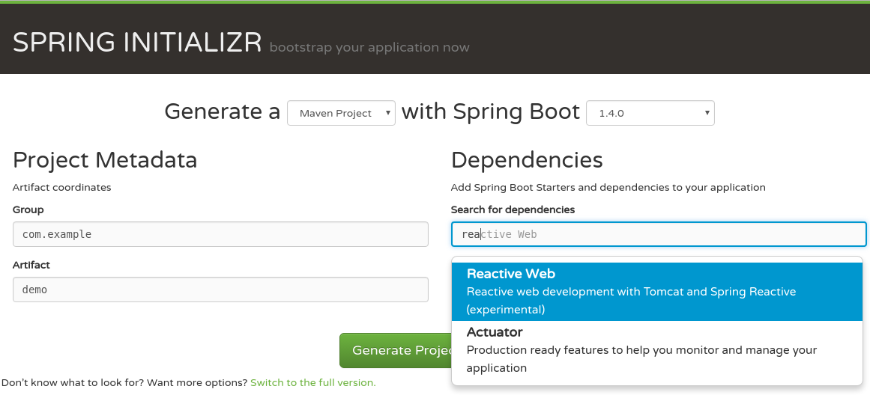
Getting Started
Support in Spring Boot 2.0 and Spring Initializr
2.0.0
Notes:
Spring Boot V2 has WebFlux support. You can easily setup a WebFlux application using Spring Initialzr . Try creating WebFlux aware projects and give it a go.

Slide 30

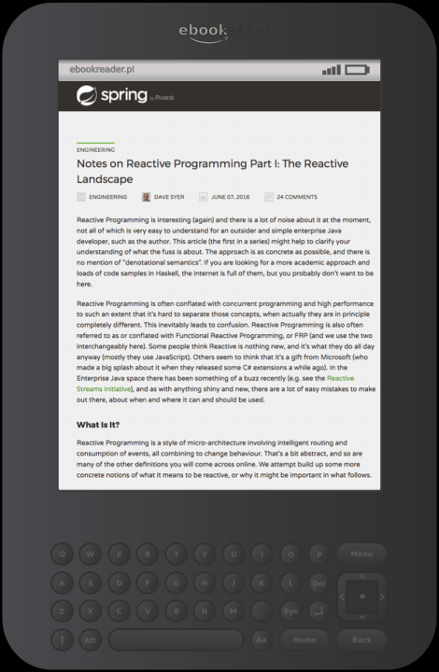
References
Reactive Programming
  Spring Blog article by Dave Syer
    Part 1, Part 2, Part 3
  An Introduction to Reactive by André Staltz
  Project Reactor documentation
WebFlux
  Article by Rossen Stoynchev (Spring MVC lead)
  WebFlux in Spring reference documentation
Notes:
Hope these help!

Slide 31
Summary
What is Reactive Programming?
  What are
    Mono, Flux, Single, Observable?
How does Spring incorporate Reactive Features?
  Reactive Repositories
  Web Client
  Web Flux
projectreactor.io

Slide 32
Lab
Building a simple Reactive Application

Slide 33

Spring 5 – Web Stack
@Controller @RequestMapping
Router
Functions
Spring Web MVC
Spring WebFlux
Servlet API
HTTP / Reactive Streams
Servlet Container
Tomcat, Jetty, Netty, Undertow
Notes:
Here is the overall stack (as at March 2017). This diagram is subject to change – when I first saw it (August 2016) there were no Router functions and Jetty wasn't supported.
Existing Servlet containers are supported via adapters and they are adding asynchronous support. Other containers, like Netty become possible, because we are no longer tied to the Servlet API.

