Slide 1
Performance and Operations
Optional Section
Management and Monitoring of Spring Java Applications
Exporting Spring Beans to JMX

Slide 2

Objectives
After completing this lesson, you should be able to:
  Explain Basic JMX Concepts and Architecture
  Automatically export Spring Beans as MBeans
  Setup and Use Spring Insight
Notes:
Set the scene. Why does Spring exist? What problems are we trying to solve?

Slide 3
Topics in this Session
J M X
Introduction
JMX
Introducing Spring JMX
Automatically exporting existing MBeans
Spring Insight

Slide 4
Overall Goals
Gather information about application during runtime
Dynamically reconfigure app to align to external occasions
Trigger operations inside the application
Even adapt to business changes in smaller scope

Slide 5
Topics in this Session
Introduction
JMX
Introducing Spring JMX
Automatically exporting existing MBeans
Spring Insight

Slide 6
What is JMX?
The Java Management Extensions specification aims to create a standard API for adding management and monitoring to Java applications
Management
  Changing configuration properties at runtime
Monitoring
  Reporting cache hit/miss ratios at runtime

Slide 7
How JMX Works
To add this management and monitoring capability, JMX instruments application components
JMX introduces the concept of the MBean
  An object with management metadata

Slide 8
JMX Architecture
JSR-160
Connector
JSR-160
Connector
MBeanServer
MBean
MBean
MBean

Slide 9
JMX Architecture
MBeanServer acts as broker for communication between
  Multiple local MBeans
  Remote clients and MBeans
MBeanServer maintains a keyed reference to all MBeans registered with it
  object name
Many generic clients available
  JDK: jconsole, jvisualvm
Notes:
It's probably worthwhile to show one of the generic clients here. Of course Hyperic would be the best in our case, but students might wanna see what they get with a plain JDK, too.

Slide 10
JMX Architecture
An MBean is an object with additional management metadata
  Attributes (→ properties)
  Operations (→ methods)
The management metadata can be defined statically with a Java interface or defined dynamically at runtime
  Simple MBean or Dynamic MBean respectively

Slide 11
Plain JMX – Example Bean
public interface JmxCounterMBean {
int getCount(); // becomes Attribute named 'Count'
void increment(); // becomes Operation named 'increment'
}
public class JmxCounter implements JmxCounterMBean {
...
public int getCount() {…}
public void increment() {…}
}
Notes:
- Export controlled purely by naming conventions
- Class has to implement an interface ${className}MBean

Slide 12
Plain JMX – Exposing an MBean
MBeanServer server = ManagementFactory.getPlatformMBeanServer();
JmxCounter bean = new JmxCounter(…);
try {
ObjectName name = new ObjectName("ourapp:name=counter");
server.registerMBean(bean, name);
} catch (Exception e) {
e.printStackTrace();
}
Notes:
- manual lookup of MBean server required
- technical code

Slide 13
Topics in this Session
Introduction
JMX
Introducing Spring JMX
Automatically exporting existing MBeans
Spring Insight

Slide 14
Goals of Spring JMX
Using the raw JMX API is difficult and complex
The goal of Spring's JMX support is to simplify the use of JMX while hiding the complexity of the API

Slide 15
Goals of Spring JMX
Configuring JMX infrastructure
  Declaratively using context namespace or FactoryBeans
Exposing Spring beans as MBeans
  Annotation based metadata
  Declaratively using Spring bean definitions
Consuming JMX managed beans
  Transparently using a proxy-based mechanism

Slide 16
Spring JMX Steps
Configuring MBean Server
Configure Exporter
Control Attribute / Operation Exposure.

Slide 17
Step 1: Creating an MBeanServer
Use context namespace to locate or create an MBeanServer
Or declare it explicitly
XML
<context:mbean-server />
or JavaConfig
@Bean
public MBeanServerFactoryBean mbeanServer () {
MBeanServerFactoryBean server = new MBeanServerFactoryBean();
server.setLocateExistingServerIfPossible( true );
...
return server;
}
Notes:
First step, create or locate a server...

Slide 18
Step 2: Exporting a Bean as an MBean
Start with one or more existing POJO bean(s)
Use the MBeanExporter to export it
  By default: all public properties exposed as attributes, all public methods exposed as operations.
<bean id="messageService" class="example.MessageService"/>
JavaConfig
@Bean
public MBeanExporter mbeanExporter () {
MBeanExporter exporter = new MBeanExporter();
exporter.setAutodetect ( true );
...
return exporter;
}
or XML
<context:mbean-export/>
Notes:
Second step, given you have one or more beans you want to expose over JMX, use the MBeanExporter and list the beans.
This works great except 1) you have to explicitly list all of the beans to expose and 2) all properties and methods exposed. If only there were a way to control this...

Slide 19
Step 1 & 2: JavaConfig Shortcut
One annotation defines server and exporter:
@Configuration
@EnableMBeanExport
public class MyConfig {
…
}
Specific server bean
configurable if desired
Notes:
In the upcoming lab, all the student needs to do is add this annotation to one of the configuration classes.

Slide 20
3. Control Attribute/Operation Exposure:
Combine Annotations with Exporter:
  Only annotated attributes/operations exposed.
@ManagedResource(objectName=“statistics:name=counter”,
description=“A simple JMX counter”)
public class JmxCounterImpl implements JmxCounter {
@ManagedAttribute(description=“The counter value”)
public int getCount() {…}
@ManagedOperation(description=“Increments the counter value”)
public void increment() {…}
}
Notes:
Using Annotations, place @ManagedResource on the bean you want to expose over JMX. Only beans with this annotation are exposed, only annotated attributes / operations are exposed.
For the curious, you can mix the approaches like this:
<bean class="org.springframework.jmx.export.MBeanExporter">
<property name="assembler">
<bean class="org.springframework.jmx.export.assembler.MetadataMBeanInfoAssembler">
<constructor-arg>
<bean class="org.sfwk.jmx.export.annotation.AnnotationJmxAttributeSource"/>
</constructor-arg>
</bean>
</property>
<property name="beans">
<map>
<entry key="statistics:name=monitorFactory" value-ref="monitorFactory"/>
</map>
</property>
</bean>

Slide 21
Spring in the JMX architecture
Client Process
Server Process
<<interface>>
JmxCounter
<<interface>>
JmxCounter
<<interface>>
JmxCounter
MBean
Server
Client
Spring
Proxy
MBean
JmxCounterImpl
Generated
at startup
Spring
MBeanExporter
Registration
at startup
Notes:
Client and Server process could be the same: if not, a JSR-160 connector needs to be registered
It's not explained in this presentation, but the proxy is generated by an MBeanProxyFactoryBean
The interface used to generate the proxy doesn't actually have to be implemented by the class of the exposed object, as long as the methods match. This means you can make up your own interfaces for exposed third party classes.

Slide 22
Topics in this session
Introduction
JMX
Introducing Spring JMX
Automatically exporting existing MBeans
Spring Insight

Slide 23
Automatically Exporting
Pre-existing MBeans
Some beans are MBeans themselves
  Example: Log4j's LoggerDynamicMBean
  Spring will auto-detect and export them for you
@EnableMBeanExport
@Configuration
class ContextConfiguration {
@Bean
public LoggerDynamicMBean loggerDynamicMBean() {
Logger logger = Logger.getLogger("org.springframework.jmx");
return new LoggerDynamicMBean(logger);
}
}

Slide 24
Automatically Exporting
Pre-existing Mbeans – XML
Same configuration using XML
<context:mbean-export/>
<bean class="org.apache.log4j.jmx.LoggerDynamicMBean">
<constructor-arg>
<bean class="org.apache.log4j.Logger"
factory-method="getLogger"/>
<constructor-arg value="org.springframework.jmx" />
</bean>
</constructor-arg>
</bean>

Slide 25
Topics in this session
Introduction
JMX
Introducing Spring JMX
Automatically exporting existing Mbeans
Spring Insight

Slide 26
Spring Insight Overview
Use with tc Server Developer Edition
  Comes with STS
  Monitors web applications deployed to tc Server
  http://localhost:8080/insight
Focuses on what's relevant
  esp. performance related parts of the application
Detects performance issues during development
  Commercial version for production: vFabric APM

Slide 27
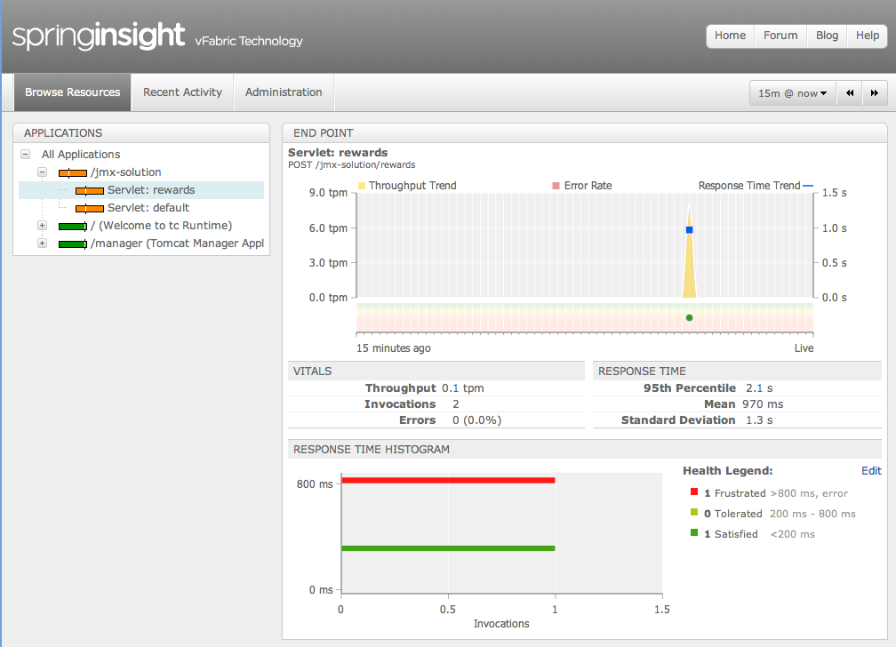
Spring Insight Overview
Timeline
Servlet Selector
Servlet Selector

Slide 28
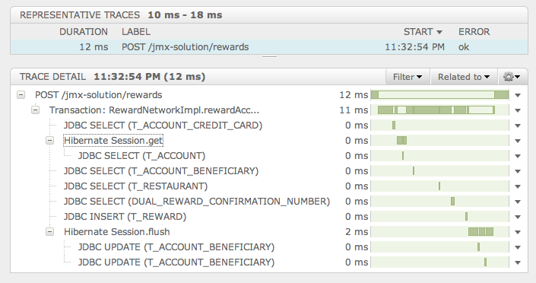
Spring Insight Overview
A request trace from HTTP POST to SQL

Slide 29
Setting up Spring Insight
tcServer comes with a number of preconfigured setups
  Spring Insight is no longer one of them since 3.2.x
Instead
  Download from our Template Repository
  Create the Insight template
  Create a new Server in STS
    Ask for Pivotal → tc Server
    Point it to the Insight instance when prompted
1
2
1
./tcruntime-admin.sh get-template spring-insight-developer
./tcruntime-instance.sh create Insight -t insight
2

Slide 30
Summary
J M X
Spring JMX
  Export Spring-managed beans to a JMX MBeanServer
  Simple value-add now that your beans are managed
Steps
  Create MBean server
  Automatically export annotated and pre-existing Mbeans
    Use @EnableMBeanExport or <context:mbean-server> and <context:mbean-export>
  Use Spring annotations to declare JMX metadata
Spring Insight (tc Server Developer Edition)
  Deep view into your web-application in STS

Slide 31
Optional Lab
Monitoring and Managing a Java Application

