Slide 1
Enterprise Spring

Slide 2
Spring Web Services
Chapter 4

Slide 3
Chapter Topics
Introduction To Web Services
Spring Web Services
Client Access
Review
Lab

Slide 4
So What's Wrong With Remoting?
Among the problems that have limited widespread use of remoting technologies like RMI have been
  System administrators have been reluctant to open new ports on the firewall to support remoting protocols for fear of exposing their systems to attack
    Indeed, one of the side benefits of using Spring's HttpInvoker is that it piggybacks on ports that are already likely to be open
  Remoting technologies have traditionally not been highly interoperable
    If I want to do business with your company, and your company exposes business services using a particular technology (e.g. RMI) then I must have an RMI developer on staff and support that technology, even if I have no need for it elsewhere in my organization

Slide 5
An Alternative Approach: Web Services
One approach that addresses problems posed by traditional remoting technologies is known as Web Services
  “A standards based suite of technologies designed to support interoperable application to application interactions over a network”
    Provost.uiowa.edu/maui/Glossary.html
What is the value proposition behind web services?
  Interoperability
  Loose coupling
  The ability to penetrate firewalls over existing ports

Slide 6
Web Service Styles: SOAP Vs REST
Web service technology has evolved in 2 distinct directions over the years
  SOAP based web services, which rely heavily on
    Standards
      XML
      SOAP
      WSDL
      UDDI
    Tools to automate a complex development process
RESTful web services, which rely heavily on
  Conventions
  Simple interfaces like those found in Http
In this chapter the focus is on SOAP based web services
Note that the term “SOAP” is both
  A generic name for a style of web service
  A specific standard for defining messages

Slide 7
The Origins Of SOAP
Developed by a consortium headed by Microsoft and IBM, as a platform for delivering standardized, loosely coupled, interoperable, automated services built on top of Http
In 2000, this consortium submitted a formal set of standards to W3C, SOAP, which focused on key aspects of an interoperable, distributed computing protocol, including mechanisms for
  Representing messages
    Headers, Body, Attachments
  Handling Errors
    Faults
  Providing extensibility
    Headers, attachments
  Representing Data in ways that are portable, extensible and universal
    XML
  Representing Services
    WSDL
  Supporting different types of services
    Service centric
    Document centric
  Locating web services over a network
    UDDI

Slide 8
XML – A Standard For Describing Data
One issue the consortium considered was how to represent end user data in ways that were interoperable and ubiquitous
  Here, the decision was made to support the one type of data recognized on every platform
    Text
  Of course, even today computers are not good at understanding plain (unstructured) text
    What was needed was a way to structure the text to make it easier to work with
      For this, the consortium chose XML
        Extensible Markup Language

Slide 9
SOAP – A Standard For Representing Messages
Another issue the consortium considered was how to represent messages exchanged between clients and service providers
  What was desired was a flexible, extensible mechanism capable of supporting the requirements of a variety of client/server interactions
The standard they proposed was named SOAP
  Simple Object Access Protocol
  SOAP defines a set of standards describing
    The contents of a message
      Headers, payload, attachments, faults
    The recipients of the message
    Whether or not handling of the message is optional
    Message serialization requiements

Slide 10
WSDL – A Standard For Describing Services
Another issue addressed by the consortium was how a service provider would describe the service details to a client, such as
  The name of the service
  The service URL
  Service parameter requirements
  The service return value
  Potential faults generated by the service
  The service interface
  all specified in ways that would decouple the client from the service
So they came up with another standard known as WSDL
  Web Service Description Language

Slide 11
UDDI – A Standard For Locating Web Services
So how does a client locate the web service, so it can acquire the WSDL, necessary to implement the client interface?
  Email the web service provider?
    The client might not know the provider or even that the service exists
      e.g. In a yellow pages scenario
  Download the WSDL from a web or ftp site?
    Same objection as above
    Besides, what if the web service moves?
  Google the WSDL?
To address this concern, the consortium came up with a standard known as UDDI
  Universal Discovery and Integration Interface
  A standard for a naming service for web services
    Capable of supporting named or categorical queries (e.g. White pages vs Yellow pages)
Not widely used today
  Some enterprises implement UDDI within the enterprise
  A few public UDDI naming services do exist

Slide 12
Early Versions Of SOAP Were Anything But Simple
Early generations of SOAP based web services were very hard to implement, because you had to do most of the work manually
  Create the messages
  Create a servlet to send / receive messages
  Extract the message from an HttpRequest
  Package the response in an HttpResponse
  Convert XML to Java
  Convert Java to XML
  Gain access to the model (in the business tier)
  Write the schemas
  Write the WSDLs
  Write the application artifacts derived from the schemas and WSDLs
  Create and maintain the registries
  Package the web service artifacts into a deployment unit

Slide 13
The Emergence Of Tools (1 Of 2)
But in time, SOAP based web services became easier to implement, as tools were introduced to:
  Automate the development process
  Abstract SOAP considerations from the source code
Among the tools widely used today are:
  Tools to build SOAP messages
  Tools to encrypt XML messages
  Tools to validate XML messages and WSDLs
  XML editors
  Tools to generate XML from source code
    WSDLs or Schema
  UDDI browsers
  Testing tools
  Generic SOAP client templates
  Integrated SOAP stacks
  Tools to convert binary data types to XML
    xjc
  Tools to generate WSDL / Schema from programming code
    schemagen

Slide 14
The Emergence Of Tools (2 Of 2)
Most of these tools generate web service artifacts (XML) from Java code
  Known as “Code First” because the XML artifacts (contracts) are generated from previously written code
  Advantages
    Popular among developers who would rather write code than XML
    Fits the development lifecycle, because in many cases the goal of a web service is to expose an existing business service to a new clientele
  Disadvantages
    Insufficient attention to design
    Interoperability problems
More recently, tools have been introduced that promote a “Contract First” based approach (widely considered a best practice,) in which code artifacts / templates are generated from XML

Slide 15
The Emergence Of SOAP Stacks
Over the years many SOAP frameworks have been developed by different vendors, each targeted at
  Standardizing the development of SOAP based web services
  In ways that shield developers from many of the low level implementation details of SOAP based web services
JEE (Java Enterprise Edition) defines a “portable” standard for implementing SOAP based web services in the Java world, implemented by many ApplicationServers
  Originally JAXRPC
  Now JAXWS, and JAXB
Spring Web Services offer an alternative style for developing SOAP based web services, independent of the JEE standards

Slide 16
Spring Recommendations For Implementing Web Services (1 Of 5)
SOAP != Web Services
  SOAP is merely one way to implement a web service, but not the only way (e.g. REST)
  Indeed, the consensus opinion in recent years has been that its not even the best way to implement a web service
SOAP != RPC
  SOAP is merely one way to implement a remote procedure call, but not the only way (e.g. Remoting with RMI or an HttpInvoker)

Slide 17
Spring Recommendations For Implementing Web Services (2 Of 5)
Design the contract first, independently of the service interface (code)
  Designing the service interface first (Code First) tends to result in:
    Tight coupling to platform specific data types
    Interoperability problems
    Fragility as the business requirements evolve

Slide 18
Spring Recommendations For Implementing Web Services (3 Of 5)
Refrain from using stubs / skeletons (e.g. HttpInvoker) which tend result in tight coupling
  Consider using XPath parsers instead
    XPath, the XML Path Language, is a query language for selecting nodes from an XML document
    XPath parsers overcome differences in messages (ordering, nesting, …) by searching the DOM tree
    Contrast a human processing a paper order form vs a machine processing an automated order form
      If the client makes mistakes in the form, the human can often figure out the right thing to do
        Providing data in the wrong order
      In contrast, stubs / skeletons have strict expectations about incoming data, which if not followed result in exceptions

Slide 19
Spring Recommendations For Implementing Web Services (4 Of 5)
Refrain from using stubs / skeletons (e.g. HttpInvoker) which tend result in tight coupling
  Use XPath parsers instead
    XPath, the XML Path Language, is a query language for selecting nodes from an XML document
    XPath parsers overcome differences in messages (ordering, nesting, …) by searching for values in the DOM tree
    Analogy
      Contrast a human processing a paper order form vs a machine processing an automated order form
        If the client makes mistakes in the form, the human can often figure out the right thing to do
          e.g. Providing data in the wrong order
        In contrast, stubs / skeletons have strict expectations about incoming data, which if not followed result in exceptions
    XPath also provides increased flexibility for clients who could provide additional properties in the request which could be safely ignored by the web service, but passed on to subsequent handlers in the processing chain
    Of course, there is a performance penalty to pay for such parsing

Slide 20
Spring Recommendations For Implementing Web Services (5 Of 5)
Be conservative in what you do, be liberal in what you accept from others
  Postel's Law
When appropriate, don’t validate incoming requests
  Some web service providers perform XML schema validation on all incoming requests
    If a request does not conform to the schema requirements, it is rejected without further processing, even if the data itself is correct
    But this degrades performance and results in tight coupling
  Schema validation is also prone to “versioning” issues
  XPath can again be helpful here
  But note the phrase “when appropriate”
    Some use cases may be required to provide validation due to legal / regulatory constraints

Slide 21
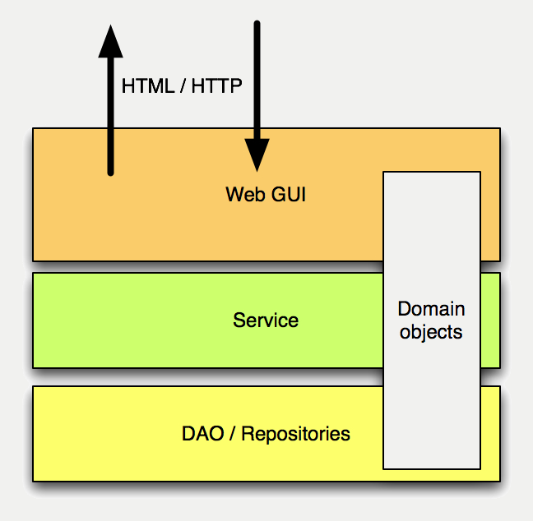
A Web GUI Is An Adapter
A Web GUI provides compatibility between the HTML-based world of the user (the browser) and the object oriented world of your service

Slide 22
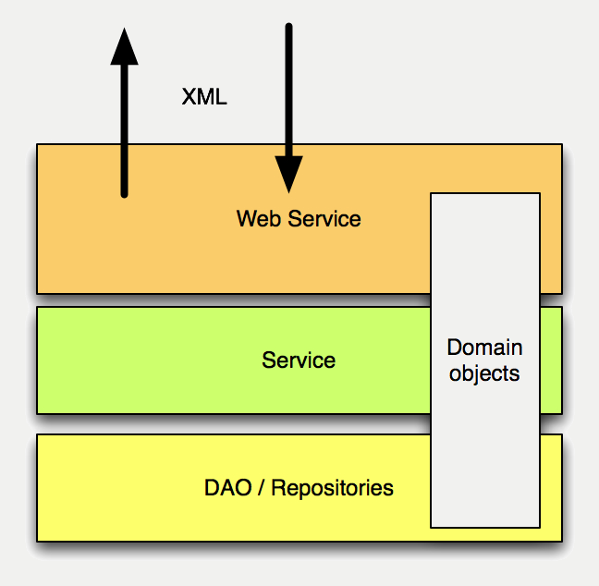
A Web Service Is Also An Adapter
A Web Service provides compatibility between the XML-based world of the user (a client application) and the object oriented world of your service
  So as in a web application, there will be some work adapting the incoming request to the needs of the application
  Its not quite as easy as Remoting

Slide 23
Chapter Topics
Introduction To Web Services
Spring Web Services
Client Access
Review
Lab

Slide 24
Why Spring Web Services? (1 Of 2)
Encourages best practices
  Reliance on the WS-I basic profile
  Contract-First development
    Providing loose coupling between contract and implementation
Powerful routing capabilities
  You can distribute an incoming XML request to any object, based on the type Message payload,the value in a SOAP Action header or an XPath expression
XML API support
  Incoming XML messages can be handled using standard JAXP APIs such as DOM, SAX, and StAX, but also JDOM, dom4j, XOM or even marshaling technologies
Flexible XML Marshaling
  Supports JAXB 1 and 2, Castor, XMLBeans, JiBX, and Xstream
  Because it is a separate module, you can reuse Spring's OXM mapping module in non-Web service code as well

Slide 25
Why Spring Web Services? (2 Of 2)
Leverages your Spring expertise
  Spring-WS uses Spring application contexts for all configuration
  The architecture of Spring-WS resembles that of Spring-MVC
Supports WS-Security
  Allowing you to sign SOAP messages, encrypt and decrypt them, or authenticate against them
Integrates with Spring Security
  Reuse your existing security configuration for your SOAP service as well

Slide 26
Contract First
Spring-WS encourages contract first development
  Start with an XML message (rather than the XSD or WSDL itself)
  Use the XML message to generate code templates
    Rather than using code to generate XML templates
Why Contract First?
  It avoids OXM (Object to XML Mapping) problems common to Code First implementations, such as
    Java does not handle many XSD Extensions well
    Many data types lack standard representations in XML, so are not guaranteed to be portable
    Cyclic object graphs
  Code first is very fragile
    Changes to the interface cascade through the implementation
  Loss of control under Code First
    Under Code First implementations you are at the mercy of your mapping tool
  It's not as hard as you may have been led to believe

Slide 27
Contract First In 3 Steps
Create 1+ sample messages
  e.g. Request message, Response message
Infer contracts from those messages
  Manually
  Using a tool
    Trang (Java based)
    Microsoft XML to Schema
    XML Spy
Tweak the resulting contracts manually

Slide 28
Create 1+ Sample Messages
<transferRequest
xmlns="http://mybank.com/schemas/tr"
amount="1205.15">
<credit>S123</credit>
<debit>C456</debit>
</transferRequest>

Slide 29
Define A Schema For Each Message
<transferRequest
xmlns="http://mybank.com/schemas/tr"
amount="1205.15">
<credit>S123</credit>
<debit>C456</debit>
</transferRequest>
Again, you can generate this schema manually or with a tool
<xs:schema
xmlns:xs="http://www.w3.org/2001/XMLSchema"
xmlns:tr="http://mybank.com/schemas/tr"
elementFormDefault="qualified"
targetNamespace="http://mybank.com/schemas/tr">
<xs:element name="transferRequest">
<xs:complexType>
<xs:sequence>
<xs:element name="credit" type="xs:string"/>
<xs:element name="debit" type="xs:string"/>
</xs:sequence>
<xs:attribute name="amount" type="xs:decimal"/>
</xs:complexType>
</xs:element>
</xs:schema>

Slide 30
Tweak The Resulting Contract Manually To Provide Sufficient Detail
<xs:schema
xmlns:xs="http://www.w3.org/2001/XMLSchema"
xmlns:tr="http://mybank.com/schemas/tr"
elementFormDefault="qualified"
targetNamespace="http://mybank.com/schemas/tr">
<xs:element name="transferRequest">
<xs:complexType>
<xs:sequence>
<xs:element name="credit" type="xs:string">
<xs:simpleType>
<xs:restriction base="xs:string">
<xs:pattern value="/w/d{3}"/>
</xs:restriction>
</xs:simpleType>
</xs:element>
<xs:element name="debit" type="xs:string"/>
</xs:sequence>
<xs:attribute name="amount" type="xs:decimal"/>
</xs:complexType>
</xs:element>
</xs:schema>
Be as precise as possible (within the constraints of Postel's Law)

Slide 31
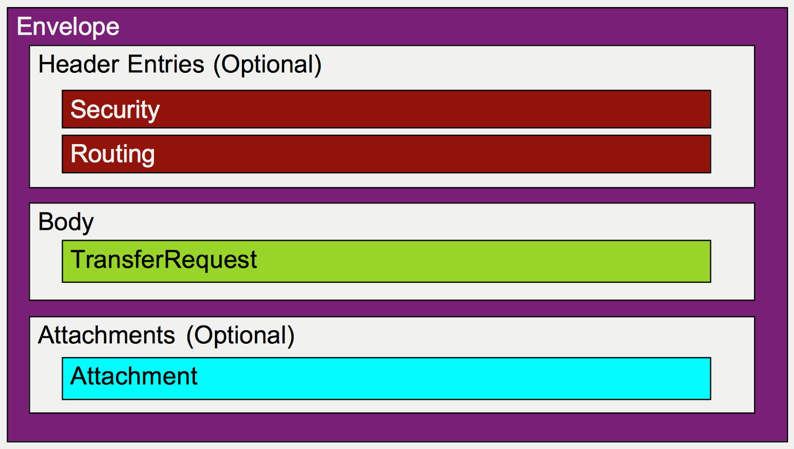
The Structure Of A SOAP Message

Slide 32
Simple SOAP 1.1 Message (Without Headers / Attachments)
<SOAP-ENV:Envelope
xmlns:SOAP-ENV="http://schemas.xmlsoap.org/soap/envelope/">
<SOAP-ENV:Body>
<tr:transferRequest
xmlns:tr="http://mybank.com/schemas/tr"
amount="1205.15">
<tr:credit>S123</tr:credit>
<tr:debit>C456</tr:debit>
</tr:transferRequest>
</SOAP-ENV:Body>
</SOAP-ENV:Envelope>

Slide 33
A Simple SOAP Message In An Http Request
POST /StockQuote HTTP/1.1
Host: www.bankserver.com
Content-Type: text/xml; charset="utf-8"
Content-Length: 360
SOAPAction: "Some-URI"
<SOAP-ENV:Envelope
xmlns:SOAP-ENV="http://schemas.xmlsoap.org/soap/envelope/">
<SOAP-ENV:Body>
<tr:transferRequest
xmlns:tr="http://mybank.com/schemas/tr"
amount="1205.15">
<tr:credit>S123</tr:credit>
<tr:debit>C456</tr:debit>
</tr:transferRequest>
</SOAP-ENV:Body>
</SOAP-ENV:Envelope>

Slide 34
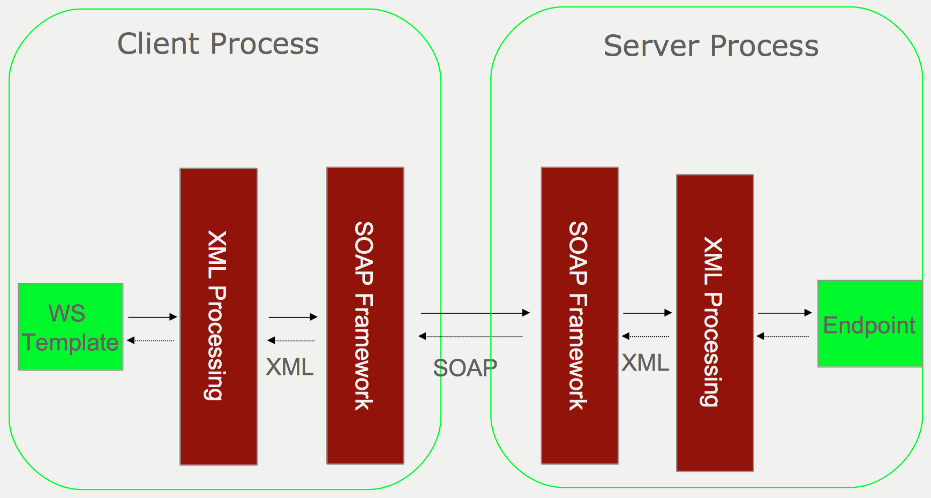
Spring Web Services

Slide 35
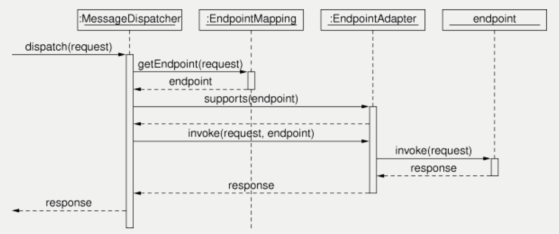
Spring Web Services WorkFlow

Slide 36
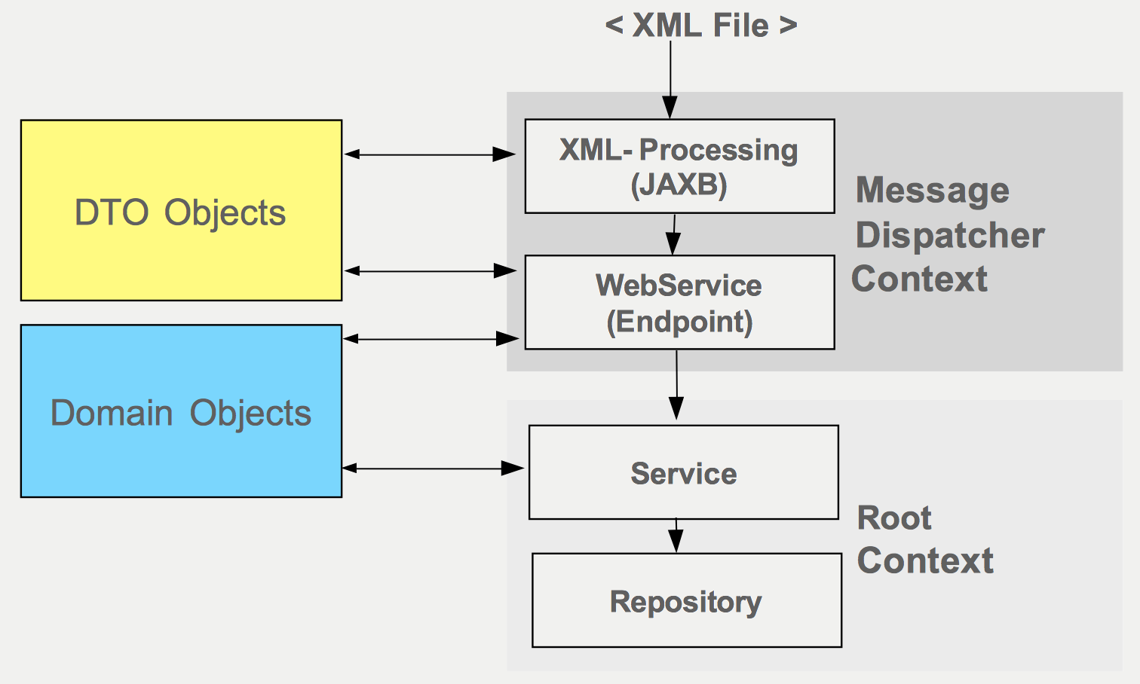
Spring Web Services Configuration

Slide 37
Bootstrap The Application Tier
web.xml
By default, Spring looks for the Root (Business) Context in a file named applicationContext.xml in the WEB-INF directory
  This is the same Context you would use for your business services in a web application
  The <context-param> element is only required if you name the file differently, place it in another location or have additional configuration files
<context-param>
<param-name>contextConfigLocation</param-name>
<param-value>
/WEB-INF/applicationContext.xml
</param-value>
</context-param>
<listener>
<listener-class>
org.springframework.web.context.ContextLoaderListener
</listener-class>
</listener>

Slide 38
Wire Up The Front Controller (MessageDispatcher)
web.xml
By default, Spring looks for the Child (Web infrastructure) Context in a file whose name is derived from the servlet-name element, also in the WEB-INF directory
  This is the conceptually equivalent to the Context you would use for your web infrastructure in a web application
    It has access to the beans in the Root context, but beans in the Root Context have no access to it
  The <init-param> element is only required if you name the file differently, place it in another location or have additional configuration files to wire up
<servlet>
<servlet-name>transfer-ws</servlet-name>
<servlet-class>
org.springframework.ws.transport.http.MessageDispatcherServlet
</servlet-class>
<init-param>
<param-name>contextConfigLocation</param-name>
<param-value>/WEB-INF/transfer-ws-cfg-servlet.xml</param-value>
</init-param>
<load-on-startup>1</load-on-startup>
</servlet>

Slide 39
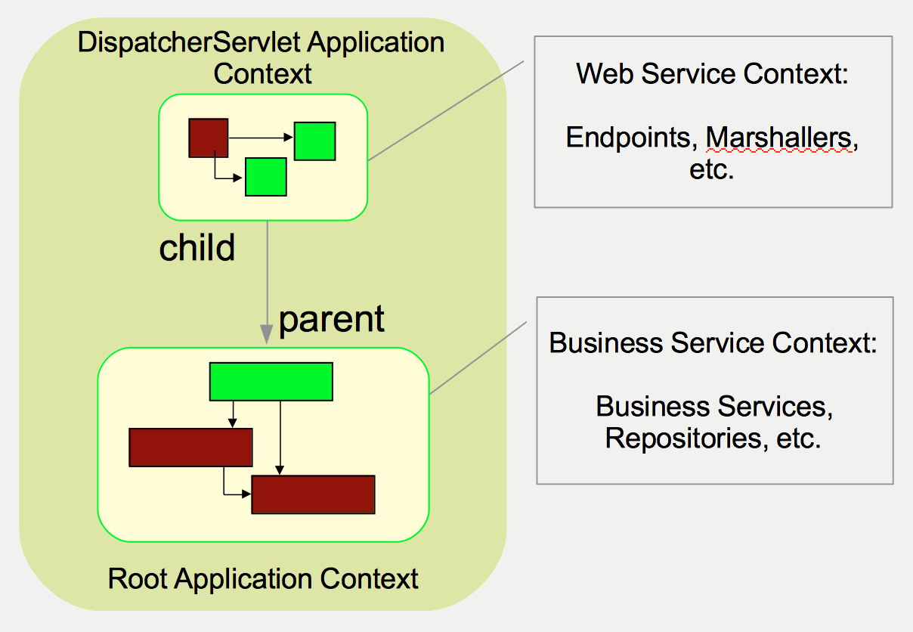
The Servlet Container After Bootstrapping

Slide 40
Endpoints
Endpoints handle incoming SOAP message (payload)
  Spring-WS strips off the surrounding metadata so you don't have to
Spring-WS Endpoints are similar to Spring MVC Controllers
  Handling (adapted) input messages
  Invoking methods on business services
  Creating a response message
  Component Scanned
With Spring-WS you focus on the Message Payload, rather than the message structure or representation
  Making it easier to switch from SOAP to POX without code change

Slide 41
XML Handling Options
Spring supports many techniques for handling XML, among them
  Marshalling / Unmarshalling
    Low level techniques
      DOM (JDOM, dom4j, XOM)
        Manipulates XML documents as trees
      SAX
        Event based (push) standard for parsing XML
      StAX
      Request based (pull) standard for parsing XML
    High level techniques
      JAXB (1 and 2)
        Generates Java classes and interfaces corresponding to the top-level elements of an XML message
      Castor
        An alternative to JAXB for XML to Java binding
      XMLBeans
        Another alternative to JAXB and Castor for XML to Java Binding
      JiBX
      XStream
  Querying XML
    XPath argument binding
      Uses XSLT to address parts of an XML document
Indeed, the OXM (Object to XML Mapping) portion of the Spring core was actually spawned from the Spring Web Services project

Slide 42
JAXB 2 (1 Of 2)
Java API for XML Binding
Part of Java EE 5 and JDK 6
Uses annotations for mapping metadata
Capable of generating classes from a schema or schema from classes
  schemagen
  xjc
Also supported as part of Spring's OXM namespace
http://docs.spring.io/spring/docs/3.2.x/spring-framework-reference/html/oxm.html
<bean id="marshaller" class="org.springframework.oxm.jaxb.Jaxb2Marshaller">
<property name="contextPath" value="transfer.ws.types"/>
</bean>
<bean class="org.springframework.ws.server.endpoint.adapter.GenericMarshallingMethodEndpointAdapter">
<constructor-arg ref="marshaller" />
</bean>
<oxm:jaxb2-marshaller id="marshaller" contextPath="rewards.ws.types"/>

Slide 43
JAXB 2 (2 Of 2)
Or, if you are using Spring-WS 2.0 endpoints, and Spring's ws namespace, no explicit marshaller bean definitions are required (for JAXB 2 marshallers)
  Just enable default marshallers by declaring your application to be "annotation-driven"
  Automatically scans the classpath for standard OXM marshallers defined in the OXM namespace
<!-- The following Spring-WS 2.0 tag registers all infrastructure beans needed for
annotation-based endpoints, including JAXB 2 marshalling / unmarshalling beans. -->
<ws:annotation-driven/>

Slide 44
Implement The Endpoint
@Endpoint
public class TransferServiceEndpoint {
private TransferService transferService;
@Autowired
public TransferServiceEndpoint(TransferService transferService) {
this.transferService = transferService;
}
@PayloadRoot(localPart="transferRequest",
Namespace="http://mybank.com/schemas/tr")
public @ResponsePayload TransferResponse newTransfer
(@RequestPayload TransferRequest request) {
// extract necessary info from request and invoke service
}
}
http://docs.spring.io/spring/docs/3.2.x/spring-framework-reference/html/oxm.html
Spring WS Endpoint
Identifies this method as
the request handler
Identifies the message
and its defining schema
Indicates the type of the
unmarshalled response
payload
Indicates the type of the
unmarshalled request
payload

Slide 45
Configuring Spring-WS And Endpoint Beans
Classes annotated with @Endpoint are component-scanned when component-scanning has been enabled
  Eliminates having to write lots of trivial XML bean definitions
  Business components are easily Autowired into the Endpoints
<!-- Enable component scanning -->
<context:component-scan base-package="transfers.ws"/>
<!--
Register all infrastructure beans needed for
annotation-based endpoints, including JAXB 2
marshalling / unmarshalling beans
-->
<ws:annotation-driven/>

Slide 46
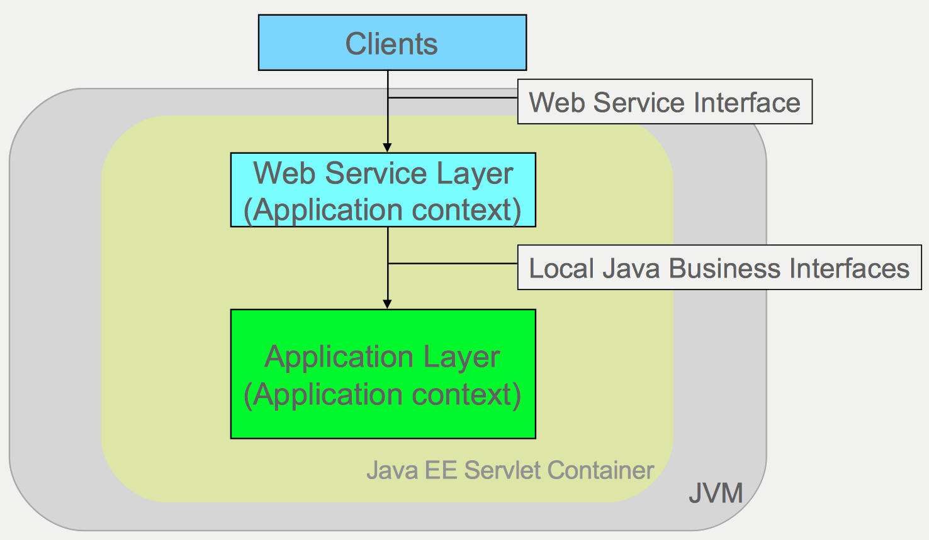
Application Architecture For The Aforementioned Web Service

Slide 47
Alternative Mapping Techniques
@PayloadRoot is not the only way to map Spring-WS Endpoints to a particular method of an Endpoint
You can also map Endpoint methods in XML using standards like:
  Message Payloads
    From the message body itself
  SOAPAction HttpRequest Header
  WS-Addressing
    A transport-neutral mechanism, to address Web services and messages
  XPath expressions
  http://docs.spring.io/spring-ws/site/reference/html/server.html#server-endpoint-mapping

Slide 48
Publishing The WSDL
Spring-WS can dynamically generate WSDLs based on the given XSD
  The WSDL id automatically becomes part of WSDL URL
    LocationURI + bean name + .wsdl
Most useful during development
  Static WSDLs are preferable in production
    Just switch from <ws:dynamic-wsdl> to <ws:static-wsdl> when shifting to production deployment
<ws:dynamic-wsdl
id="transferDefinition"
portTypeName="Transfers"
locationUri="http://somehost:8080/transferService/">
<ws:xsd location="/WEB-INF/transfer.xsd"/>
</ws:dynamic-wsdl>
<oxm:jaxb2-marshaller id="marshaller" contextPath="rewards.ws.types"/>

Slide 49
Chapter Topics
Introduction To Web Services
Spring Web Services
Client Access
Review
Lab

Slide 50
Spring Web Services On The Client
As in other parts of the Spring architecture, Spring provides a Template class for generating web service requests from the client, the WebServiceTemplate
  Simplifies web service access
    Handles infrastructure
    Eliminates the need for boilerplate code
  Works directly with the XML payload
    Extracts the body of a SOAP message
    Also works with POX (Plain Old XML)
  Can use marshallers / unmarshallers
  Provides convenience methods for sending and receiving web service messages
  Provides callbacks for more sophisticated requirements

Slide 51
Marhsalling/Unmarshalling With The WebServiceTemplate
<bean id="webServiceTemplate"
class="org.springframework.ws.client.core.WebServiceTemplate">
<property name="defaultUri" value="http://mybank.com/transfer"/>
<property name="marshaller" ref="marshaller"/>
<property name="unmarshaller" ref="marshaller"/>
</bean>
<!-- Not using the oxm namespace. Castor must be in the classpath. -->
<bean id="marshaller"
class="org.springframework.oxm.castor.CastorMarshaller">
<!--
Unlike JAXB, Castor is not configurable using annotations,
so designate mapping information in an xml file.
-->
<property
name="mappingLocation" value="classpath:castor-mapping.xml"/>
</bean>
WebServiceTemplate ws = context.getBean(WebServiceTemplate.class);
TransferRequest request = new TransferRequest("S123", "C456", "85.00");
TransferResponse response =
(TransferResponse) ws.marshalSendAndReceive(request);

Slide 52
Chapter Topics
Introduction To Web Services
Spring Web Services
Client Access
Review
Lab

Slide 53
Chapter Topics
Introduction To Web Services
Spring Web Services
Client Access
Review
Lab

