Slide 1
Enterprise Spring

Slide 2
Global Transactions Using XA, JTA And Spring
Chapter 10

Slide 3
Chapter Topics
Introduction
Two Phase Commit And XA
JTA And Spring
Spring Transaction Demarcation
Spring Declarative Transaction Propagation
Spring Declarative Rollback Rules
Review

Slide 4
Local Transactions
Manage transactions on a single resource
  JDBC Connection
  JMS Session
  Also known as “Native Transactions”
Local transactions are the best solution when a transaction is limited to a single resource
  Universally supported
  Very fast

Slide 5
Limits Of Local Transactions
Unfortunately, enterprise applications often need to coordinate the activities of multiple resources in a single unit of work as we have seen it previous chapters
  Updating multiple databases as part of a transaction
  Updating a database, then sending a message as part of a transaction
ACID properties can no longer be guaranteed when you manage the transaction at the resource level, because one resource manager cannot control the activities of another
  What you need is a higher level abstraction, capable of managing the activities of multiple resource managers as a single unit of work

Slide 6
Global / Distributed Transactions
To address this problem, the X/Open Group devised a standard for managing transactions spanning multiple independent resource managers known as XA
The XA standard introduces the concept of a external transaction manager
  A separate resource manager capable of coordinating the activities of multiple independent resource managers in ways that provide ACID guarantees
    Using a technique known as a Two-Phase Commit
  JEE's Java Transaction API (JTA) is one widely adopted implementation of this standard
Global transactions are the best solution when a unit of work spans multiple resource managers, and the requirement for ACID guarantees distribution of resources outweigh the increased latency of the operation

Slide 7
What Makes Global Transactions Slower Than Local Transactions?
Distribution
With multiple resources, transactions cannot be committed in a single step
  One resource manager might fail after another resource manager has already committed successfully
  Consequently the process involves multiple steps
    Hence, the name Two-Phase Commit
Add to this the inherent latency involved in managing resources distributed over a wide geographic area and it becomes apparent why global transactions don't perform as well as their local counterparts

Slide 8
Chapter Topics
Introduction
Two Phase Commit And XA
JTA And Spring
Spring Transaction Demarcation
Spring Declarative Transaction Propagation
Spring Declarative Rollback Rules
Review

Slide 9
Two Phase Commit
Global transactions follow something called a Two Phase Commit protocol
  Driven by an XA compliant transaction manager
Phase 1:
  The transaction manager checks with all of the participating resource manager to see if they are ready to commit
    If so, the transaction manager proceeds to step 2, otherwise the transaction is rolled back
Phase 2:
  The transaction is committed
https://en.wikipedia.org/wiki/Two-phase_commit_protocol

Slide 10
Two Phase Commit Basic Algorithm: Phase 1
Commit Request Phase
  The coordinator sends a query to commit message to all participants and waits until it has received a reply from each
  Each participant executes the transaction up to the point where it will be asked to commit
    As part of this process, each writes an entry to its undo log and another entry to its redo log, so that it is prepared to respond to different types of failure
  Each participant replies with an agreement message (Yes to commit), if its preparation succeeded, or an abort message (No, not to commit), if the participant experiences a failure that will make it impossible to commit

Slide 11
Two Phase Commit Basic Algorithm: Phase 2
Commit Phase
  Phase 1 Success: All participants agree to commit
    The coordinator sends a commit message to all the participants
    Each participant completes the operation, releasing all locks and resources acquired during the transaction
    Each participant sends an acknowledgment to the coordinator
    The coordinator completes the transaction once all acknowledgments have been received
  Phase 1 Failure: 1+ participants do not agree to commit (or a timer expires)
    The coordinator sends a rollback message to all participants
    Each participant undoes the transaction using the undo log, releasing all locks and resources acquired during the transaction
    Each participant sends an acknowledgement to the coordinator
    The coordinator undoes the transaction once all acknowledgements have been received

Slide 12
Transaction Manager Responsibilities
An XA compliant transaction manager performs the following operations on participating resources
  start(Xid)
    Tells the resource manager where its participation in the unit of work begins
  end(Xid)
    Tells the resource manager where its participation in the unit of work ends
  prepare(Xid)
    Triggers the Prepare to Commit Phase
  commit(Xid)
    Triggers the Commit Phase
  Where Xid is the transaction identifier for a resource consisting of
    Global transaction identifier, identical for all resources participating in the transaction
    A branch qualifier, indicating which part of the larger transaction each resource manager is responsible for

Slide 13
XA Aware Resources
To implement a global transaction under the XA standard, you need 2 components
  An XA aware transaction manager
    JTA provides this
  XA aware resource managers
    The resource vendor provides this

Slide 14
Two Phase Commit Failures
Two Phase Commit can handle many challenging problems
  A resource becomes available after having responded Yes to being ready to commit
  The transaction manager fails during execution
Ultimately, it is the transaction manager's responsibility to ensure that ACID guarantees are enforced
  Typically with the assistance of log files that, in the event of failure, can be used to synchronize state across resources

Slide 15
Is A Two Phase Commit Foolproof?
In the previous chapter we talked a lot about ACID guarantees
  It turns out, that the word “guarantee” is a slight exaggeration
    If the coordinator fails permanently, some participants will never resolve their transactions, because under a Two Phase Commit they block until they receive an acknowledgement
    Undo or redo logs can be lost or become corrupted
  Two Phase Commit will handle many difficult use cases, but there may be some circumstances in which it requires human intervention
http://courses.cs.washington.edu/courses/csep545/01wi/lectures/class7.pdf

Slide 16
Chapter Topics
Introduction
Two Phase Commit And XA
JTA And Spring
Spring Transaction Demarcation
Spring Declarative Transaction Propagation
Spring Declarative Rollback Rules
Review

Slide 17
What Is Java Transaction API (JTA)
A JEE standard for global transactions
  JTA can be used with XA to manage global transactions
  JTA can be used without XA to mange local transactions
  However, XA (in the Java world), requires JTA
    Though not necessarily a JEE application server
JTA support is built into all JEE compliant application servers
  Standalone implementations of JTA also exist
    Atomikos
    JOTM
    Arjuna (now Jboss Transactions)
JTA can be used
  Programmatically
  Declaratively

Slide 18
Using JTA
JTA is required when Enterprise JavaBeans (EJB) participate in a transaction
  Even local transactions
  Which means you incur the overhead of a Two Phase Commit, whether you really need it or not
JTA is optional when Spring Beans participate in a transaction
  Use it for global transactions, but not local transactions
  Switching from global to local transactions in Spring is easy

Slide 19
Using JTA With Spring
A JtaTransactionManager is part of Spring's transaction management support
This transaction manager integrates with external JTA transaction managers from different vendors (as well as many implementations of local transaction managers) from different vendors
  Raw JTA functionality is provided by the vendor
  Spring provides thin wrappers for transaction managers from different vendors to
    Enhance its behavior (AOP)
    Integrate with the rest of the Spring framework
Most of the time, integration with these transaction managers requires little configuration, and no changes to the code

Slide 20
Configuring JTA With Spring (1 Of 2)
Within a JEE application server
  Ask Spring to look up the JTA transaction manager
    Creates a bean named “transactionManager”
    Uses a vendor specific subclass to implement the transaction
      Could support features beyond those declared in the JTA spec
  Ask Spring to look up related resources, perhaps using JNDI
<tx:jta-transaction-manager/>
<jee:jndi-lookup id="dataSource"
jndi-name="java:comp/env/jdbc/myDataSource"/>
<jee:jndi-lookup id="connectionFactory"
jndi-name="java:comp/env/jms/myConnectionFactory"/>

Slide 21
Configuring JTA With Spring (2 Of 2)
Without a JEE application server (standalone)
  Declare and configure a bean for the transaction manager
    It is considered a best practice in Spring to name your transaction manager “transactionManager”
    If you follow this convention, many other Spring components can find your transaction manager without explicit wiring instructions
    Convention over configuration
<bean id="transactionManager"
class="org.springframework.tx.jta.JtaTransactionManager">
<property name="transactionManager" ref="jtaTxMgr"/>
<property name="userTransaction" ref="userTx"/>
</bean>

Slide 22
Configuring Transactional Resources
For JDBC or JMS, using XA aware resources is normally enough
  No need to configure them in your application, as they are already configured in the application server
However, other components may still require configuration in order to locate transaction manager
  This will be true whether or not you are using Spring
<bean id="sessionFactory"
class="org.springframework.orm.hibernate3.LocalSessionFactoryBean">
<property name="hibernateProperties">
<value>
hibernate.transaction.factory_class = \
org.hibernate.transaction.JTATransactionFactory
hibernate.transaction.manager_lookup_class = \
org.hibernate.transaction.WeblogicTransactionManagerLookup
hibernate.current_session_context_class = jta
</value>
...
</property>
...
</bean>

Slide 23
Chapter Topics
Introduction
Two Phase Commit And XA
JTA And Spring
Spring Transaction Demarcation
Spring Declarative Transaction Propagation
Spring Declarative Rollback Rules
Review

Slide 24
What Is Transaction Demarcation?
The process by which you indicate the boundaries of a transaction
  Where it begins
  Where it ends
In Spring, transaction demarcation can be implemented
  Programmatically
    Just write code indicate where a transaction begins, commits or rollsback using any of numerous APIs Spring supports
      PlatformTransactionManager
      TransactionTemplate
      Connection
  Declaratively
    Just declare the transactional requirements of your business services using either
      XML
      Annotations
    Spring applies those properties using AOP Around Advice
    This is the preferred style of transaction demarcation in Spring
What's more, the process is uniform across both local and global transactions
  No code modification is required to switch from one mode to the other
Demos: Spring-Transactions

Slide 25
Transaction Demarcation In Spring For JTA (1 Of 2)
For databases or synchronous JMS
  Declare the transactional requirements of your business methods
    Annotations
    XML
public class RewardNetworkImpl implements RewardNetwork {
@Transactional
public RewardConfirmation rewardAccountFor(Dining d) { ... }
}
<tx:annotation-driven/>
<aop:config>
<aop:pointcut id="rewardNetworkMethods"
expression="execution(* rewards.RewardNetwork.*(..))"/>
<aop:advisor pointcut-ref="rewardNetworkMethods" advice-ref="txAdvice"/>
</aop:config>
<tx:advice id="txAdvice">
<tx:attributes>
<tx:method name="get*" read-only="true" timeout="10"/>
<tx:method name="find*" read-only="true" timeout="10"/>
<tx:method name="*" timeout="30"/>
</tx:attributes>
</tx:advice>

Slide 26
Transaction Demarcation In Spring For JTA (2 Of 2)
For asynchronous JMS global transactions
  Declare your JTA transaction manager as an attribute of your JMS listener container
For asynchronous JMS local (non-JTA) transactions
  Declare the acknowledge attribute of your JMS listener container to be “transacted”
<jms:listener-container transaction-manager="transactionManager">
<jms:listener ref="jmsListener" destination="queue.name"/>
</jms:listener-container>
<jms:listener-container acknowledge="transacted">
<jms:listener ref="jmsListener" destination="queue.name"/>
</jms:listener-container>

Slide 27
Chapter Topics
Introduction
Two Phase Commit And XA
JTA And Spring
Spring Transaction Demarcation
Spring Declarative Transaction Propagation
Spring Declarative Rollback Rules
Review

Slide 28
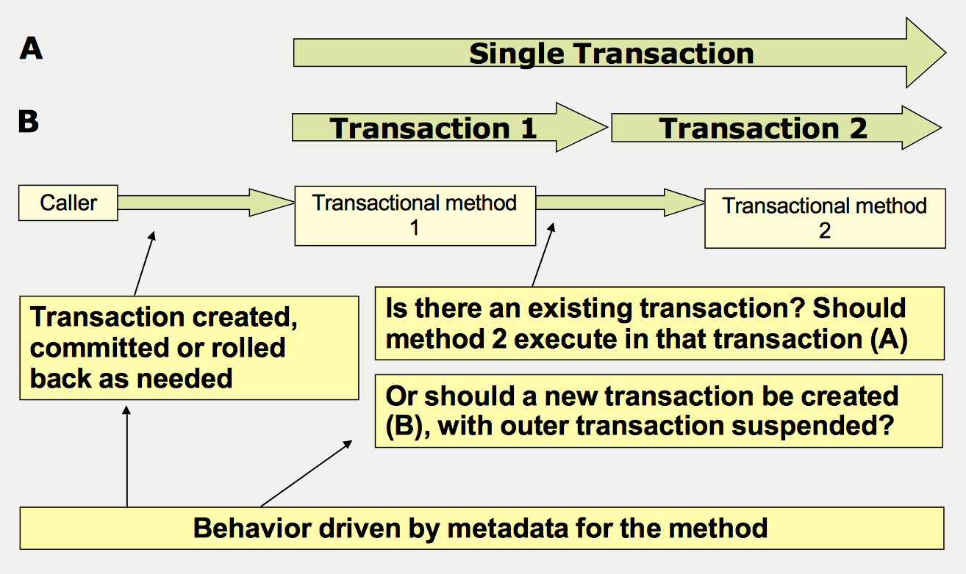
Declarative Transaction Propagation

Slide 29
Declarative Transaction Propagation Levels
7 Levels of Propagation
  REQUIRED
    Default
  REQUIRES_NEW
  SUPPORTS
  NOT_SUPPORTED
  MANDATORY
  NEVER
  NESTED
Propagation rules when a method of one bean invokes a method of another bean
  Is the calling method participating in a transaction?
    Yes or No
  What are the requirements for the method being invoked?
    7 levels
These propagation rules are recursive

Slide 30
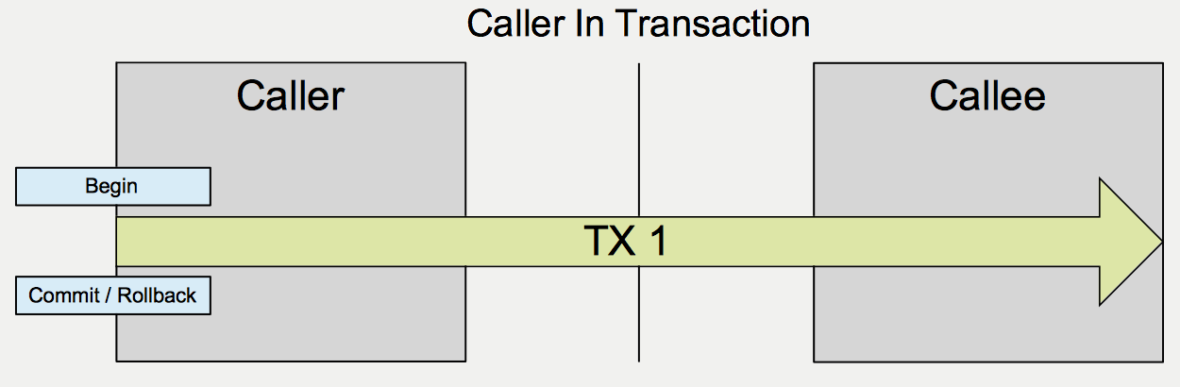
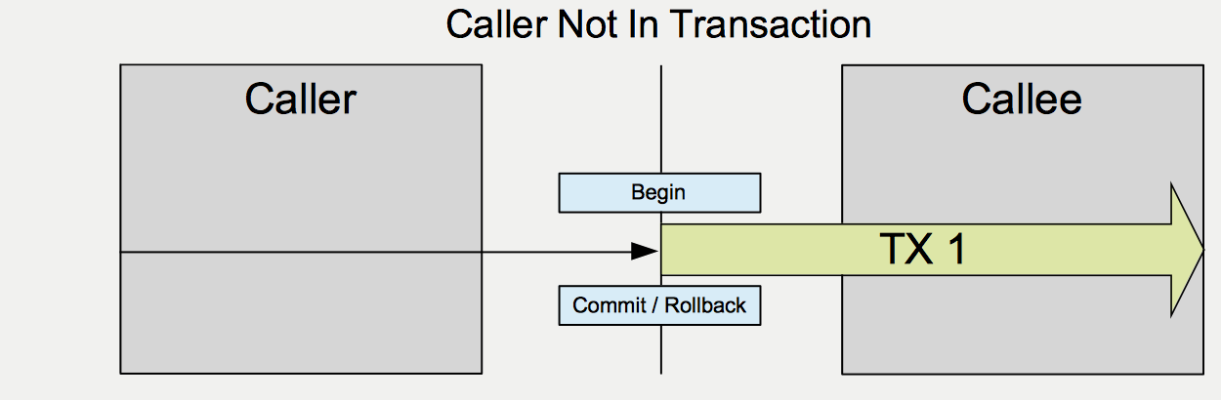
REQUIRED
The callee always runs in a transaction
  Default setting
    No explicit declaration required
If the caller is in a transaction when the method is invoked on the callee
  The callee joins the caller's transaction
  Both caller and callee are committed / rolled back as a unit
If the caller is not in a transaction when the method is invoked on the callee
  The callee starts its own transaction, committed / rolled back upon completion of the callee's method
@Transactional(propagation=Propagation.REQUIRED)

Slide 31
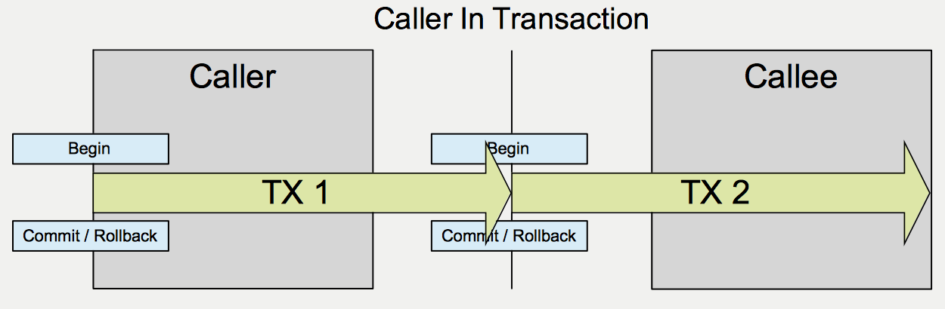
REQUIRES_NEW
The callee always runs in a new transaction
If the caller is in a transaction when the method is invoked on the callee
  The caller's transaction is suspended
  The callee starts its own transaction, committed or rolled back upon completion of the callee's method
  The caller's transaction wakes up
  The caller and callee transactions are committed / rolled back independently of one another
If the caller is not in a transaction when the method is invoked on the callee
  The callee starts its own transaction, committed / rolled back upon completion of the callee's method
@Transactional(propagation=Propagation.REQUIRES_NEW)

Slide 32
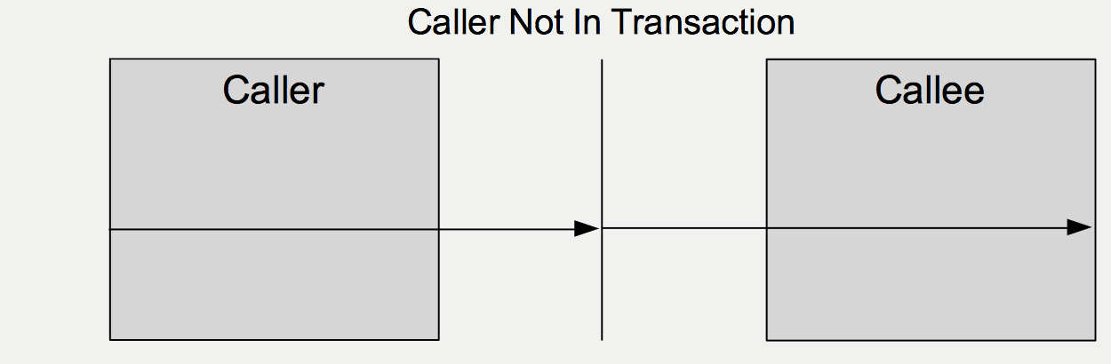
SUPPORTS
The callee mimics the caller
If the caller is in a transaction when the method is invoked on the callee
  The callee joins the caller's transaction
  Both caller and callee are committed / rolled back as a unit
If the caller is not in a transaction when the method is invoked on the callee
  The callee does not run in a transaction
@Transactional(propagation=Propagation.SUPPORTS)

Slide 33
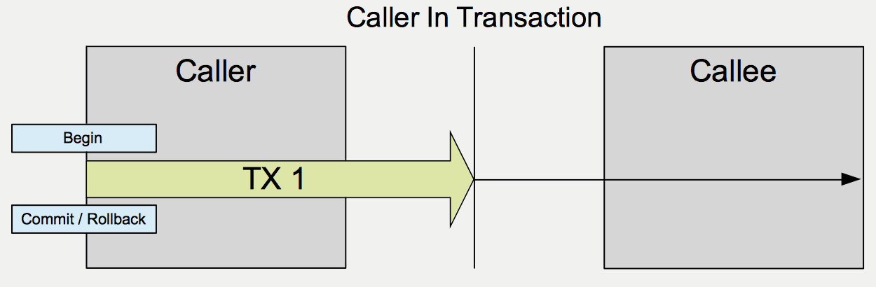
NOT_SUPPORTED
The callee does not run in or propagate a transaction
If the caller is in a transaction when the method is invoked on the callee
  The caller's transaction is suspended
  The callee's method executes outside of the boundaries of the caller's transaction
  Upon completion of the callee's method, the caller's transaction wakes up
  The work of the callee is not committed with the work of the caller
If the caller is not in a transaction when the method is invoked on the callee
  The callee does not run in a transaction
@Transactional(propagation=Propagation.NOT_SUPPORTED)

Slide 34
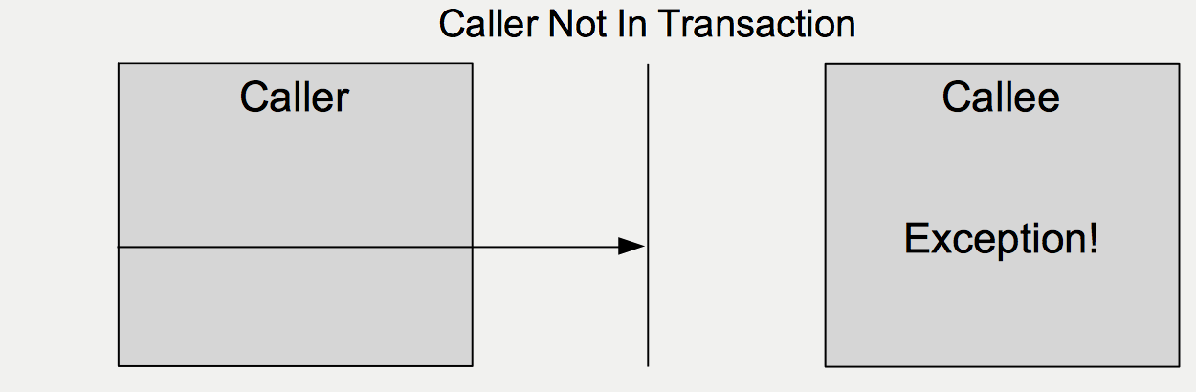
MANDATORY
The callee requires a transaction or fails
If the caller is in a transaction when the method is invoked on the callee
  The callee joins the caller's transaction
  Both caller and callee are committed / rolled back as a unit
If the caller is not in a transaction when the method is invoked on the callee
  The callee throws an Exception
@Transactional(propagation=Propagation.MANDATORY)

Slide 35
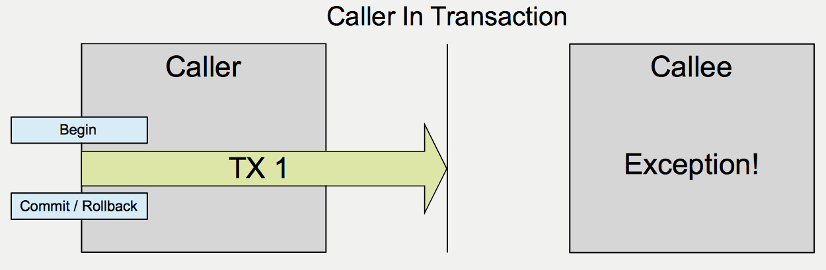
NEVER
The callee requires the absence of a transaction or fails
If the caller is in a transaction when the method is invoked on the callee
  The callee throws an Exception
If the caller is not in a transaction when the method is invoked on the callee
  The callee does not run in a transaction
@Transactional(propagation=Propagation.NEVER)

Slide 36
NESTED
Special Case
  Supports temporary inner transactions
    Start the outer transaction
      REQUIRES_NEW
    Start the nested transaction
      NESTED
      The outer transaction is suspended
    Rollback the nested transaction, but not the outer transaction
    Redo the nested transaction
    Commit the nested transaction
      The outer transaction wakes up
    Commit or rollback both transactions as a unit
  The outer transaction must commit in order for the inner transaction to commit

Slide 37
Chapter Topics
Introduction
Two Phase Commit And XA
JTA And Spring
Spring Transaction Demarcation
Spring Declarative Transaction Propagation
Spring Declarative Rollback Rules
Review

Slide 38
Declarative Rollback Rules
By default, a declarative transaction is rolled back in response to a RuntimeException
By default, a declarative transaction is not rolled back in response to a checked Exception
public class RewardNetworkImpl implements RewardNetwork {
@Transactional
public RewardConfirmation rewardAccountFor(Dining d) {
if ( somethingWrong ) // This triggers
throw new RuntimeException(); // a rollback
}
}
public class RewardNetworkImpl implements RewardNetwork {
@Transactional
public RewardConfirmation rewardAccountFor(Dining d) {
if ( somethingWrong ) // This does not
throw new IOException(); // trigger a
} // rollback
}

Slide 39
Overriding Declarative Rollback Rules
These default behaviors are easily overridden
  Use the rollbackFor attribute to declare checked Exceptions intended to cause a rollback
  Use the noRollbackFor attribute to declare RuntimeExceptions intended not to cause a rollback
public class RewardNetworkImpl implements RewardNetwork {
@Transactional
(rollbackFor={RemoteException.class,MyOwnException.class})
public RewardConfirmation rewardAccountFor(Dining d)
throws SQLException, RemoteException, MyOwnException {
// ...
}
@Transactional(noRollbackFor=RuntimeException.class)
public RewardConfirmation rewardAccountFor(Dining d) {
// ...
}
}

Slide 40
Chapter Topics
Introduction
Two Phase Commit And XA
JTA And Spring
Spring Transaction Demarcation
Spring Declarative Transaction Propagation
Spring Declarative Rollback Rules
Review

