Slide 1
Performance and Operations with Spring
Management and Monitoring of Java Applications
Notes:
Read notes on slide 10 about connecting to TomCat to give people a feel for the process.

Slide 2
Topics in this Session
Introduction
JMX
Introducing Spring JMX
Explicitly Exporting Beans with Spring
Automatically Exporting Existing MBeans
Spring Insight

Slide 3
The Problem
Often, developers needs to:
  Gather information about the state of an application at runtime
    Memory usage
    Thread count
  Reconfigure the application in response to changes in its environment
    Increase the size of a connection pool
    Reconfigure a resource without restarting the application
  Trigger operations inside of the application
    Refresh a cache experiencing a poor hit/miss hit ratio

Slide 4
Topics in this Session
Introduction
JMX
Introducing Spring JMX
Explicitly Exporting Beans with Spring
Automatically Exporting Existing MBeans
Spring Insight

Slide 5
What is JMX?
JMX (Java Management Extensions) is a specification for building tools that allow you to manage and monitor Java applications at runtime
Management
  Changing configuration properties at runtime
Monitoring
  Auditing features of the runtime environment
Standard products that use JMX include:
  Application servers
  Database frameworks (Hibernate)
  Web containers
  3rd Party utilities (e.g. Logging)

Slide 6
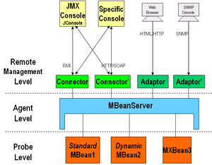
JMX Architecture

Slide 7
The JMX Architecture Consists of: (1 of 2)
MBeans
  Objects that include management metadata
    Like JavaBeans, MBean contain getters and setters that allow an application at runtime to:
      Read metadata from managed resource
      Write metadata to managed resources
      Invoke methods on managed resources
      Instantiate managed resources
      Broadcast notifications in response to events on managed resources
MBeanServer
  Holds a collection of MBeans
    MBeans register with the server during startup
    Each MBean is identified by a unique key
  Acts as a broker for communication between clients and registered MBeans

Slide 8
The JMX Architecture Consists of: (2 of 2)
MBean Client
  Monitors / managed MBean instances
  Many generic MBean clients are available
    Jconsole
    Jvisualvm
    Hyperic
MBean Connector
  Manages communication between clients and the MBeanServer

Slide 9
JMX Mbean Example
public interface JmxCounterMBean {
int getCount(); // becomes Attribute named 'Count'
void increment(); // becomes Operation named 'increment'
}
public class JmxCounter implements JmxCounterMBean {
public int getCount() {…}
public void increment() {…}
}

Slide 10
JMX Client Example
MBeanServer server = ManagementFactory.getPlatformMBeanServer();
JmxCounter bean = new JmxCounter(…);
try {
ObjectName name = new ObjectName("ourapp:name=counter");
server.registerMBean(bean, name);
} catch (Exception e) {
e.printStackTrace();
}
Demonstration: JMX Without Spring

Slide 11
Topics in this Session
Introduction
JMX
Introducing Spring JMX
Explicitly Exporting Beans with Spring
Automatically Exporting Existing MBeans
Spring Insight

Slide 12
What's Wrong with JMX?
Among the critiques of the JMX API are:
  It is too complex
  Much of the code appearing in a JMX client is boilerplate code
Spring JMX strives to simplify the use of JMX
public class Main {
public static void main(String[] args) throws Exception {
MBeanServer server = ManagementFactory.getPlatformMBeanServer();
JmxCounter bean = new JmxCounter();
try {
ObjectName name = new ObjectName("ourapp:name=counter");
mbs.registerMBean(bean, name);
} ncatch(Exception e) {
e.printStackTrace();
}
System.out.println("Waiting ...");
Thread.sleep(Long.MAX_VALUE);
}
}

Slide 13
How does Spring Simplify JMX?
Exposing existing Spring beans as MBeans
  Transparently without changing any Java code
  Declaratively using Spring bean definitions
Configuring JMX infrastructure
  Declaratively using FactoryBeans
Consuming JMX managed beans
  Transparently using a proxy-based mechanism
public class Main {
public static void main(String[] args) throws Exception {
ApplicationContext applicationContext =
new ClassPathXmlApplicationContext("applicationContext.xml");
System.out.println("Waiting ...");
Thread.sleep(Long.MAX_VALUE);
}
}

Slide 14
Configuring Spring JMX
Create an MBeanServer
Create the MBean
Export the MBean

Slide 15
Creating an MBeanServer
To locate or create an MBeanServer declaratively
  Use the context namespace
  Or declare it explicitly
<context:mbean-server />
<bean id="mbeanServer”
class="org.springframework.jmx.support.MBeanServerFactoryBean">
<property name="locateExistingServerIfPossible" value="true"/>
</bean>

Slide 16
Topics in this Session
Introduction
JMX
Introducing Spring JMX
Explicitly Exporting Beans with Spring
Automatically Exporting Existing MBeans
Spring Insight

Slide 17
You can Export a Bean as a JMX MBean using Annotations
Annotate your class and methods to be exposed
Activate the MBean exporter
By default, the ObjectName is derived from the Mbean's fully qualified class name
  Or, optionally, passed as an attribute of the @ManagedResource annotation
@ManagedResource(description=“A simple JMX counter”)
public class JmxCounterImpl implements JmxCounter {
@ManagedAttribute(description=“The counter value”)
public int getCount() {…}
@ManagedOperation(description=“Increments the counter value”)
public void increment() {…}
}
<context:mbean-export/>

Slide 18
What is Spring's MbeanExporter?
Transparently exposes an existing POJO bean to the MBeanServer
  Avoids the need to write the registration code yourself
  Avoids the need to create an explicit management interface or create an ObjectName instance
    Uses reflection to manage all properties and methods
    Uses a map key as the ObjectName

Slide 19
You can also Export a Bean as a JMX MBean using XML
Start with an existing POJO bean
Use an MBeanExporter to export it
<bean id="messageService" class="MessageService"/>
<bean class="org.springframework.jmx.export.MBeanExporter">
<property name="beans">
<util:map>
<entry key="service:name=messageService"
value-ref="messageService"/>
</util:map>
</property>
</bean>
Notes:
DEMO: a demo for this can be found in the cookbook section of the jmx-1 module

Slide 20
Controlling MBean Details
In many cases the default strategies for creating the management interface and setting the ObjectName are not sufficient
  Custom naming strategies
  Restrict access to attributes / properties of an Mbean
The MBeanExporter allows alternative strategies to be injected
  ObjectNamingStrategy
  MBeanInfoAssembler

Slide 21
Spring in the JMX Architecture
Client Process
Server Process
<<interface>>
JmxCounter
<<interface>>
JmxCounter
<<interface>>
JmxCounter
MBean
Server
Client
Spring
Proxy
MBean
JmxCounterImpl
Generated
at startup
Spring
MBeanExporter
Registration
at startup

Slide 22
Topics in this Session
Introduction
JMX
Introducing Spring JMX
Explicitly Exporting Beans with Spring
Automatically Exporting Existing MBeans
Spring Insight

Slide 23
Automatically Exporting
Pre-Existing Mbeans (1 of 2)
Some beans are themselves Mbeans (designed to be configured/monitored by their developers)
  Hibernate StatisticsService
Spring can easily autodetect these and export them for you
<context:mbean-export/>
<bean id="statisticsService"
class="org.hibernate.jmx.StatisticsService">
<property name="sessionFactory" ref="sessionFactory"/>
</bean>

Slide 24
Automatically Exporting
Pre-Existing Mbeans (2 of 2)
Log4j - LoggerDynamicMBean
<context:mbean-export/>
<bean class="org.apache.log4j.jmx.LoggerDynamicMBean">
<constructor-arg>
<bean class="org.apache.log4j.Logger"
factory-method="getLogger"/>
<constructor-arg value="org.springframework.jmx" />
</bean>
</constructor-arg>
</bean>

Slide 25
Summary
Spring JMX allows you to easily export
Spring-managed beans to a JMX MBeanServer
  Simple value-add now that your beans are managed
Use <context:mbean-server> to create MBean server
Use Spring annotations to declare JMX metadata
Use <context:mbean-export> to automatically export pre-existing MBeans

Slide 26
Topics in this Session
Introduction
JMX
Introducing Spring JMX
Explicitly Exporting Beans with Spring
Automatically Exporting Existing MBeans
Spring Insight

Slide 27
What is Spring Insight?
Part of the Spring's tc Server Developer Edition
Monitors web applications deployed into the
tc Server
Focuses on what's relevant
  Especially performance related parts of the application
Detects performance issues during development

Slide 28
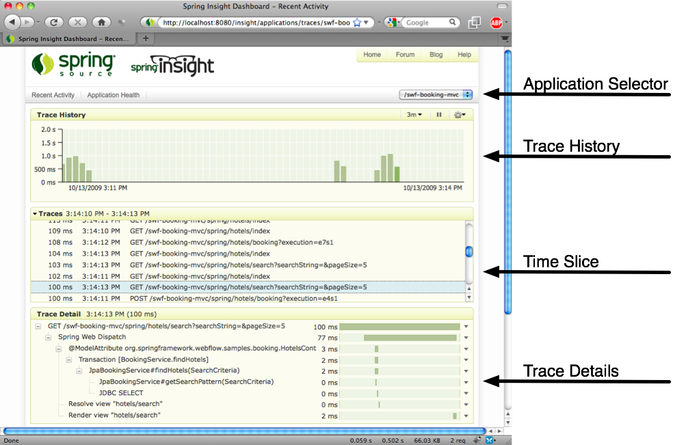
Spring Insight Overview

Slide 29
LAB
Adding Management and Monitoring
with Spring JMX

