Slide 1
Spring Web Services
Implementing Loosely Coupled Communication with Spring Web Services

Slide 2
Topics In This Session
Introduction to Web Services
  Why use or build a web service?
  Best practices for implementing a web service
Spring Web Services
Client Access
Notes:
The first part of this session can be done very quickly (if you don’t have the time to elaborate a lot) or very extensively. This all depends on your own knowledge of the subject and/or the audience (does the audience know about web services already). Spring Web Services generally goes down quite well, once the audience understands the purpose of it; and sometimes this is quite a challenge to get across! The first couple of slides introduce the audience to the world of web services and how to create robust, maintainable web services that stand the test of time.

Slide 3
So What's Wrong With Remoting?
Perhaps the biggest problem limiting widespread adoption of remoting technologies like CORBA has been with protocols / firewalls
  System administrators have been reluctant to open additional ports on the firewall to support remoting protocols for fear of exposing their systems to attack
  This concern has driven major industry players to look for standard ways to piggyback remoting technology on top of trusted protocols like http, which has led to a different approach toward interoperability known as a web service

Slide 4
An Alternate Approach: Web Services
What are Web Services?
  “A standards based suite of technologies designed to support interoperable application to application interactions over a network”
    provost.uiowa.edu/maui/Glossary.html
What is the primary goal of Web Service technology?
  Loose coupling between applications
    Loose coupling increases tolerance
    Changes to an application should not break other applications that depend on it

Slide 5
SOAP vs REST
Web service technology has evolved in 2 distinct directions
  SOAP based web services
  RESTful web services
Of the two approaches, SOAP based web services are the more “challenging”
  The problem is that SOAP based web services involve many standards
    In order to communicate both client and server must agree on:
      The standards they will use
      Which versions of those standards they will use
      Which features of those standards they will use
    The good news is that over the years, metadata tools have been developed that generate many of the SOAP artifacts for you
  REST, in contrast, rather than inventing new standards, relies on standards already built into the HTTP protocol, making RESTful development less complex
    The bad news is that lacking the metadata standards that SOAP provides, RESTful web services do not lend themselves as readily to standardization and automation via tools as do SOAP based web services

Slide 6
The Origins Of SOAP
Developed by a consortium headed by Microsoft and IBM, which focused on 4 aspects of client / server communication:
  A standard for describing data
    XML
  A standard for representing messages
    SOAP
  A standard for describing services
    WSDL
  A standard for locating services
    UDDI

Slide 7
XML – A Standard For Describing Data
One issue the consortium considered was how end user data would be represented
  Here, the decision was made to support the one type of data recognized on every platform
    Text
  Of course, even today computers are not good at understanding plain (unstructured) text
    What was needed, it was felt, was a way to structure the text to make it easier to work with
      For this, the consortium chose XML
        Extensible Markup Language

Slide 8
SOAP – A Standard For Representing Messages
RPC messages contain more than just end user data
  They can designate services
  They can have parameters and return values
  They can have metadata
  They can have properties
  They follow rules for marshalling / unmarshalling parameters and return values
  The can come in different types
    Request
    Response
    Error
So a standard was developed for representing web service messages
  That standard was named SOAP
    Simple Object Access Protocol

Slide 9
WSDL – A Standard For Describing Services
Another question addressed by the group was “How would a service provider describe service details to potential clients?”
  The name of the service
  The network protocol
  The service URL
  The service port
  Service parameter requirements
  The service return value
  Potential exceptions generated by the service
  Service interfaces
So yet another standard was developed for describing service details to potential clients
  That standard is known as WSDL
    Web Service Description Language

Slide 10
UDDI – A Standard For Locating Services
So how does a client developer obtain a WSDL to guide development of the client application?
  Email the web service provider?
  Download the WSDL from a Web or FTP site?
  Google the WSDL?
The group decided to take an approach like that used to publish distributed component services in technologies like RMI and CORBA; a naming service
  UDDI
    Universal Discovery and Description And Integration
      White pages
      Yellow pages
    This feature is not widely used
      Web service search engines have filled this void somewhat

Slide 11
SOAP Was Hard
Early generations of SOAP were very hard to use
  You had to do most of the work yourself
    Create the messages
    Create a servlet to send / receive messages
    Extract the message from an HttpRequest
    Package the response in an HttpResponse
    Convert XML to Java
    Convert Java to XML
    Gain access to the model (in the business tier)
    Write the schemas
    Write the WSDLs
    Write the application artifacts derived from the schemas and WSDLs
    Create and maintain the registries
    Package the web service artifacts into a deployment unit

Slide 12
The Role Of Tools (1 of 2)
That changed as tools were introduced to:
  Automate the development process
  Abstract SOAP considerations from the source code
Among the tools widely used today are:
  Tools to build SOAP messages
  Tools to encrypt XML messages
  Tools to validate XML messages and WSDLs
  XML editors
  Tools to generate XML from source code
    WSDLs or Schema
  UDDI browsers
  Testing tools
  Generic SOAP client templates
  Integrated SOAP stacks
  Tools to convert binary data types to XML
    xjc
  Tools to generate WSDL / Schema from programming code
    Schemagen

Slide 13
The Role Of Tools (2 of 2)
Most of these tools generate web service artifacts (XML) from Java code
  Because developers would rather write code than XML
  Known as “Code First” because the XML artifacts (contracts) are generated from the code
  More recently, tools have been introduced that promote a “Contract First” based approach, in which code artifacts / templates are generated from XML
Unfortunately, historically, this code first approach has lead to difficulties
  Inadequate attention to design
  Interoperability problems

Slide 14
Spring's Best Practices For Implementing Web Services (1 of 2)
Web Services != SOAP
  SOAP is a popular way to implement a web service, but not the only way (e.g. REST, Remoting)
Design the contract independently of the service interface
  Designing the service interface first (Code First) tends to result in:
    Tight coupling to platform specific data types
    Interoperability problems
Refrain from using stubs and skeletons, which limit flexibility
  Contrast a human processing a paper order form vs a machine processing an automated order form
    If the client makes mistakes in the form, the human can often figure out the right thing to do
      Providing data in the wrong order
    In contrast, stubs / skeletons have strict expectations about incoming data, which if not followed result in exceptions
Notes:
This slide again, can be somewhat meaty if you want to spend a lot of time on it. It contains a lot in one slide. Refrain from elaborating if you’re not comfortable presenting it in detail. Some explanations:
Web Services != SOAP. A web service is generally implemented using XML, but REST is just as much based on XML as SOAP. Web Services does not generally mean SOAP. Some people are actually ironically saying: the worst possible choice you can make to implement a web service is to use SOAP. Of course you should take this with a grain of salt, but one should certainly not immediately choose SOAP to implement a web service
Designing your contract independently from your service interface ensures you have the possibility to design a contract that is entirely focus on a clean and simple message exchange instead of an easy mapping to your service interface. This also ensures you will much more likely be able to change your service interface (or your contract for that matter) without you requiring to change your contract a lot.
Refrain from using stubs and skeletons. These are usually generated using a build process and sometimes by hand. Stubs and skeletons are usually directly coded against, without providing for a compatibility layer. Here as well, stubs and skeletons tightly couple the two systems instead of loosely coupling them, which is bad

Slide 15
Spring's Best Practices For Implementing Web Services (2 of 2)
Use Xpath parsers instead of stubs / skeletons
  Xpath parsers are like a SQL queries for XML
  XPath parsers overcome differences in messages (ordering, nesting, …) by searching the DOM tree
Don’t validate incoming requests
  Some web service providers perform XML schema validation on all incoming requests
    If a request does not conform to the schema requirements, it is rejected without further processing
  Schema validation is prone to “versioning” issues
  This principle is not universally accepted
    Some prefer strict adherence to Schema requirements
    Particularly where legal / financial risk applies
Postel’s law:
“Be conservative in what you do; be liberal in what you accept from others.”
Notes:
Don’t use validation: there’s this law (Postel’s Law) that says: be liberal in what you accept, be conservative in what you send. Validating the incoming message would immediately mean you don’t adhere to this law anymore--you’re strictly validating incoming messages, which directly means only one format is accepted (think about this: does it really matter if a <user-id> tag is inside a compound <person> tag or not)
Use XPath. Using XPath you can overcome differences in messages (ordering, nesting, et cetera). XPath does not care, whereas parsers based on StAX, SAX or even certain Object-XML mappers are not really flexible about this. Again, does it matter is a first-name tag appears before or after the last-name tag.

Slide 16
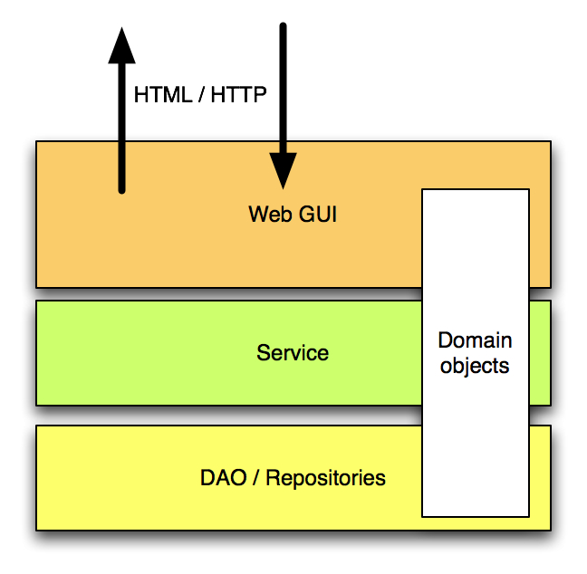
A Web GUI Is An Adapter
A Web GUI provides compatibility between the HTML-based world of the user (the browser) and the object oriented world of your service

Slide 17
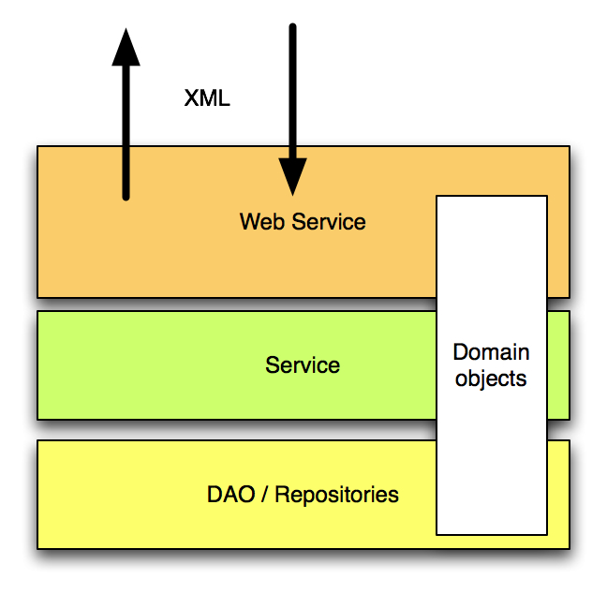
A Web Service Is Also An Adapter
A Web Service provides compatibility between the XML-based world of the user (a client application) and the object oriented world of your service
Switching from one to the other does not require any change to the existing business infrastructure
Notes:
Just mention that we’re going to use the same approach we’ve used for the Web GUI for the web services layer. In the end this will lead to the necessary conclusion that web services are not *just* another remoting protocol and that it’ll require more time to implement a web services than ‘just putting an extra line of XML in service-config.wsdd as with Axis1’.
You can mention here that the web service layer takes care of all compatibility issues such as versioning, incomplete messages, et cetera.

Slide 18
Topics In This Session
Introduction to Web Services
  Why use or build a web service?
  Best practices for implementing a web service
Spring Web Services
Client Access

Slide 19
Contract-First
Spring-WS encourages Contract-First development
  Start with a Schema
  Use the Schema to generate a WSDL
    Don't generate the WSDL from Java code
Why Contract First?
  There are problems converting Java objects to XML (similar to problems faced in O/R mapping)
    XSD Extensions
    Unportable data types
    Cyclic graphs
  Fragility of Contract-Last
    Changes to the interface may break the contract (since the contract is generated from the interface)
  Performance
    Loss of control when the framework generates the XML/Contract
Contract-First is widely considered a best practice
  Solves many interoperability issues

Slide 20
Contract-First In 3 Simple Steps
Create 1+ sample messages
Infer a contract from those messages
  Manually
  Using a tool
    Trang (Java based)
    Microsoft XML to Schema
    XML Spy
Tweak the resulting contract manually

Slide 21
Create 1+ Sample Messages
<transferRequest
xmlns=”http://mybank.com/schemas/tr”
amount=”1205.15”>
<credit>S123</credit>
<debit>C456</debit>
</transferRequest>

Slide 22
Infer A Contract From Those Messages
<xs:schema
xmlns:xs="http://www.w3.org/2001/XMLSchema"
xmlns:tr="http://mybank.com/schemas/tr"
elementFormDefault="qualified"
targetNamespace="http://mybank.com/schemas/tr">
<xs:element name="transferRequest">
<xs:complexType>
<xs:sequence>
<xs:element name="credit" type="xs:string"/>
<xs:element name="debit" type="xs:string"/>
</xs:sequence>
<xs:attribute name="amount" type="xs:decimal"/>
</xs:complexType>
</xs:element>
</xs:schema>
Notes:
Refer back to the best practices slides, as this is the first thing that you might want to do when looking at a web service for the transfer service.

Slide 23
Tweak The Resulting Contract Manually
<xs:element name="credit" >
<xs:simpleType>
<xs:restriction base="xs:string">
<xs:pattern value="\w\d{3}"/>
</xs:restriction>
</xs:simpleType>
</xs:element>
1 Character + 3 Digits

Slide 24
JAXB Tool Support
schemagen
Java Class
XML Schema
Compile Time
Tools
xjc
Validate/Marshall
Java Object
XML Document
Run Time
API
Unmarshall
Runtime API supports Marshalling & Validation
  The validator can inspect a Java object on the client to see if it can be marshalled before marshalling and sending it

Slide 25
SOAP Message Architecture (Sans HTTP)
Envelope
Header (Optional)
Security
Routing
Body
TransferRequest
Attachments (Optional)
Attachment

Slide 26
SOAP 1.1 Message Example (No Headers / Attachments)
<SOAP-ENV:Envelope xmlns:SOAP-ENV="http://schemas.xmlsoap.org/soap/envelope/">
<SOAP-ENV:Body>
<tr:transferRequest xmlns:tr="http://mybank.com/schemas/tr"
amount=”1205.15”>
<tr:credit>S123</tr:credit>
<tr:debit>C456</tr:debit>
</tr:transferRequest>
</SOAP-ENV:Body>
</SOAP-ENV:Envelope>

Slide 27
Spring Web Service Architecture
Client Process
Server Process
SOAP Framework
XML Processing
WS
Template
XML Processing
SOAP Framework
Endpoint
XML
SOAP
XML

Slide 28
Spring Request Processing
Message Dispatcher
Endpoint
Mapping
Endpoint
Adapter
Endpoint
getEndpoint(MessageContext)
invoke(MessageContext, selectedEndpoint)
invoke(MessageContext)

Slide 29
Load The ApplicationContext For Your Business Services
Inside <webapp/> within web.xml
By default, Spring looks for the web application's ApplicationContext in a file named applicationContext.xml residing in the WEB-INF directory
  The <context-param> element is only required if you name the file differently, place it in another location or have additional configuration files
<context-param>
<param-name>contextConfigLocation</param-name>
<param-value>
/WEB-INF/transfer-app-cfg.xml
</param-value>
</context-param>
<listener>
<listener-class> org.springframework.web.context.ContextLoaderListener
</listener-class>
</listener>
The business ApplicationContext configuration file(s)
Loads the ApplicationContext into the ServletContext
before any Servlets are initialized
Notes:
Mention that this might (or actually *will*) be the same context as the one used by the web app.

Slide 30
Load The ApplicationContext For Your Web Infrastructure
Define inside <webapp> within web.xml
By default, Spring looks for the DispatcherServlet's configuration in a file whose name is derived from the servlet's name, residing in the WEB-INF directory
  Servlet-name : rewardsadmin
  Configuration File : rewardsadmin-servlet.xml
  The <init-param> element is only required if you name the file differently, place it in another location or have additional configuration files
<servlet>
<servlet-name>transfer-ws</servlet-name>
<servlet-class>...MessageDispatcherServlet</servlet-class>
<init-param>
<param-name>contextConfigLocation</param-name>
<param-value>/WEB-INF/transfer-ws-cfg.xml</param-value>
</init-param>
<load-on-startup>1</load-on-startup>
</servlet>
The application context’s configuration file(s)
containing the web service infrastructure beans

Slide 31
Map The MessageDispatcher Servlet To Its URLs
Inside <webapp/> within web.xml
<servlet-mapping>
<servlet-name>transfer-ws</servlet-name>
<url-pattern>/services/*</url-pattern>
</servlet-mapping>

Slide 32
Servlet Container After Starting Up
DispatcherServlet Application Context
Web Layer Context:
Controllers, Views, Resolvers, etc.
child
parent
Application Layer Context:
Business Services, Repositories, etc.
Root Application Context

Slide 33
Spring Based SOAP Endpoints
Endpoints handle incoming SOAP message (payloads)
Spring-WS Endpoints are similar to Spring MVC Controllers
  Handling input messages
  Invoking methods on business services
  Creating a response message
With Spring-WS you can focus on the Message Payload, rather than the message structure or representation
  Making it easier to switch from SOAP to POX without code change

Slide 34
XML Handling Techniques
Low-level techniques
  DOM (JDOM, dom4j, XOM)
    Manipulates XML documents as trees
  SAX
    Event based (push) standard for parsing XML
  StAX
    Request based (pull) standard for parsing XML
Marshalling
  JAXB (1 and 2)
    Generates Java classes and interfaces corresponding to the top-level elements of an XML message
  Castor
    An alternative to JAXB for XML to Java binding
  XMLBeans
    Another alternative to JAXB and Castor for XML to Java Binding
XPath argument binding
  Uses XSLT to address parts of an XML document

Slide 35
JAXB 2 (1 of 2)
Java API for XML Binding
Part of Java EE 5 and JDK 6
Uses annotations for mapping metadata
Capable of generating classes from a schema or vice-versa
  schemagen
  xjc
Also supported as part of Spring-OXM namespace
  Spring Object / XML Mapping
<bean id="marshaller" class=...Jaxb2Marshaller">
<property name="contextPath" value="transfer.ws.types"/>
</bean>
<bean class="...GenericMarshallingMethodEndpointAdapter">
<constructor-arg ref="marshaller" />
</bean>
<oxm:jaxb2-marshaller id="marshaller" contextPath="rewards.ws.types"/>

Slide 36
JAXB 2 (2 of 2)
Or, if you are using Spring-WS 2.0 endpoints, no explicit marshaller bean definitions are required (for JAXB-2 marshallers)
  Further simplifies configuration
  Automatically scans the classpath for standard OXM marshallers defined in the OXM namespace
<!-- The following Spring-WS 2.0 tag registers all infrastructure
beans needed for annotation-based endpoints, including JAXB 2
marshalling / unmarshalling beans. -->
<ws:annotation-driven/>

Slide 37
Implementing The Endpoint
@Endpoint
public class TransferServiceEndpoint {
private TransferService transferService;
@Autowired
public TransferServiceEndpoint(TransferService transferService) {
this.transferService = transferService;
}
@PayloadRoot(localPart="transferRequest",
namespace="http://mybank.com/schemas/tr")
public @ResponsePayload TransferResponse newTransfer
(@RequestPayload TransferRequest request) {
// extract necessary info from request and invoke service
}
}
Spring WS Endpoint
Identifies this method as
the request handler
Map incoming metadata
to be converted using
JAXB 2. See slides 28,
24-25. Analogous to
@RequestMapping
Created with xjc
Java return type
Java request type

Slide 38
Configuring Spring-WS And The Endpoint Beans
@Endpoint annotated classes are component-scanned
  Eliminates having to write lots of trivial XML bean definitions
  Business components are easily Autowired into Endponts
<!-- Instead of defining explicit endpoints beans
we rely on component scanning -->
<context:component-scan
base-package="transfers.ws"/>
<!-- Registers all infrastructure beans needed for
annotation-based endpoints, including JAXB 2
marshalling / unmarshalling beans -->
<ws:annotation-driven/>

Slide 39
Application Architecture
Clients
Web Service Interface
JVM
Java EE Servlet Container
Web Service Layer (application context)
Local Java Business Interfaces
Application Layer
(application context)

Slide 40
Additional XML Mapping Techniques
@PayloadRoot is not the only way to map Spring-WS Endpoints
You can also map your Endpoints in XML using standards like:
  Message Payloads
    This is what we have been doing until now
  SOAP Action Headers
  WS-Addressing
  Xpath
These give you the option of controlling what parts of the payload you want to work with
  See Spring-Ws reference manual for details

Slide 41
Publishing The WSDL
Spring-WS can dynamically generate WSDLs based on a given XSD
  The WSDL id automatically becomes part of WSDL URL
Most useful during development
Prefer static WSDLs in production
  The contract shouldn't change unless YOU change it
<ws:dynamic-wsdl id="transferDefinition"
portTypeName="Transfers"
locationUri="http://somehost:8080/transferService/">
<ws:xsd location="/WEB-INF/transfer.xsd"/>
</ws:dynamic-wsdl>
http://somehost:8080/transferService/transferDefinition.wsdl
Notes:
The bean id determines the URL where the WSDL can be retrieved.
LocationURI + bean name + .wsdl

Slide 42
Topics In This Session
Introduction to Web Services
  Why use or build a web service?
  Best practices for implementing a web service
Spring Web Services
Client Access

Slide 43
Spring Web Services On The Client
WebServiceTemplate
  Simplifies web service access
    Handles infrastructure
    Eliminates the need for boilerplate code
  Works directly with the XML payload
    Extracts the body of a SOAP message
    Also works with POX (Plain Old XML)
  Can use marshallers / unmarshallers
  Provides convenience methods for sending and receiving web service messages
  Provides callbacks for more sophisticated requirements

Slide 44
Marshalling On The Client With A WebServiceTemplate
<bean id=“webServiceTemplate”
class=“org.springframework.ws.client.core.WebServiceTemplate”>
<property name=“defaultUri” value=“http://mybank.com/transfer”/>
<property name=“marshaller” ref=“marshaller”/>
<property name=“unmarshaller” ref=“marshaller”/>
</bean>
<!-- Castor must be in the classpath. -->
<bean id=“marshaller” class=“org.springframework.oxm.castor.CastorMarshaller”>
<!-- Unlike JAX-B, Castor is not configurable using annotations, so designate mapping information in an xml file. -->
<property name=“mappingLocation” value=“classpath:castor-mapping.xml”/>
</bean>
WebServiceTemplate ws = context.getBean(WebServiceTemplate.class);
TransferRequest request = new TransferRequest(“S123”, “C456”, “85.00”);
Receipt receipt = (Receipt) ws.marshalSendAndReceive(request);

Slide 45
LAB
Exposing SOAP Endpoints Using
Spring Web Services

