Slide 1
Predictive Analytics for premium users' acquisition: Insights, modelling and measurable Impact
Made by Group 8:
Dharmpal Jhala, Hsu Ya Chin, Raman Choudhary, Zafrin Ahmed

Slide 2






Current Setup
Initial State
Desired State
Website XYZ, a music-listening social networking platform, operates on a freemium model, offering basic services for free and premium features through a monthly subscription. They aim to predict the likely adopters and convert more free users to premium subscribers.
The Marketing Team is responsible for attracting new premium subscribers through promotional campaigns. Free-tier users enjoy basic services but have not yet converted to premium subscription. The Data Analytics Team is working to improve conversion rate
Our project aims to build a predictive model using past campaign data to help the Marketing Team identify and prioritize users with high conversion potential enabling the team to focus their outreach on individuals who are most likely to respond positively to promotions.
Ultimately, this will lead to an increase in conversion rates and provide a higher return on investment for future marketing initiatives
Problem/Gap
Despite efforts from the Marketing Team, past campaigns have had low conversion rates, with limited ability to identify which users are most likely to upgrade to premium.

Slide 3
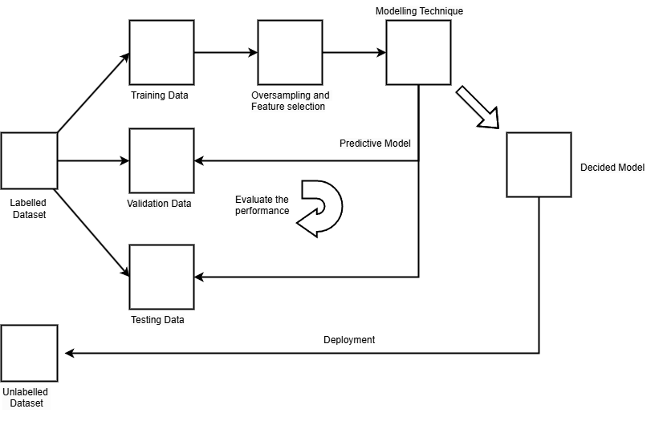








Modelling Pipeline
Conversion rate
From 3.7 to 5.4% is the expected conversion rate after deploying our best predictive model, Logistic Regression, which was developed by analyzing and building upon data from the previous promotional campaign.

Slide 4


Evaluation Metrics: Recall and F1 score
Recall (0.632) - The model successfully predicts 63.2% recall. A high recall rate means the model does a good job of finding users who are likely to switch to paid subscriptions, reducing missed chances to convert them.
F1 score (0.83) - The F1 score of represents the balance between capturing as many potential subscribers as possible (recall) and accurately identifying those truly likely to subscribe (precision), helping optimize both reach and targeting efficiency.
Confusion Matrix | Actual adopters (1) | Actual non-adopters (0)
Predicted adopters (1) | 146 | 1770
Predicted non-adopters (0) | 85 | 4230

Slide 5
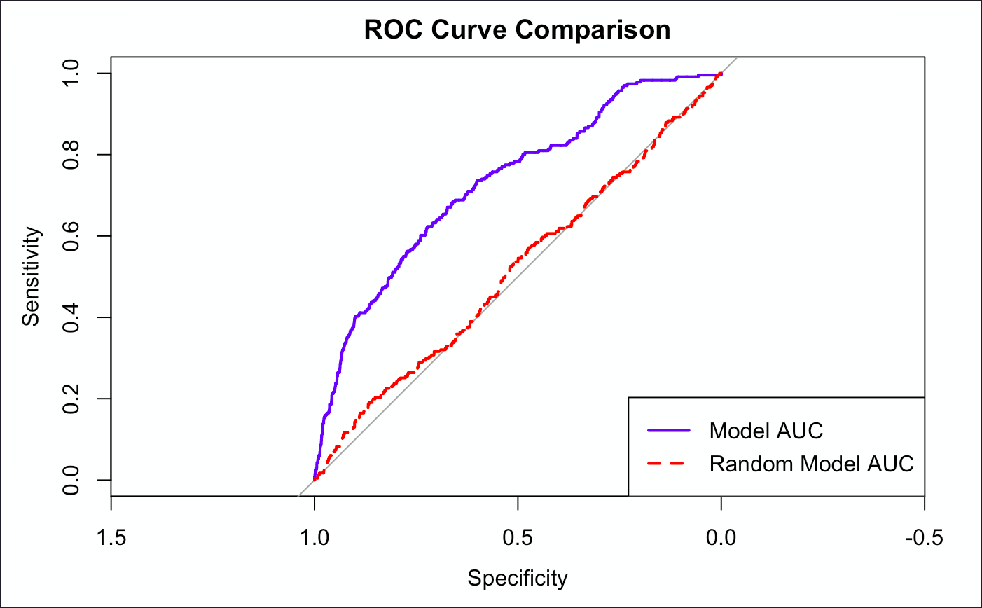
Evaluation Metric: ROC Curve and AUC
ROC Curve indicates how effectively the model can distinguish between adopters and non-adopters, without too many false alarms.
A more effective model is represented by an ROC curve that approaches the top-left corner, indicating higher accuracy in distinguishing between outcomes compared to the benchmark model.
The Area Under the Curve (AUC) quantifies the performance of a classifier by measuring the area under the ROC curve, with a maximum value of 1 indicating a perfect classifier. Our model achieved an AUC of 0.728, means that there is a 72.8% probability that the model ranks an adopter higher than a non-adopter.
Consequently, the efficiency of your marketing campaigns has improved with a 44% increase in conversion rates achieved through our model.

Slide 6



Enhanced Impact and Value Created
Precision-Driven
Decision Making
The marketing team can make data-driven decisions to target high-potential customers, optimizing resource allocation, ultimately reducing campaign and maximizing ROI
Scalable Model for Ongoing Campaign Success
The predictive model can be continuously updated with new data, making it scalable for future campaigns and adaptable to changing user behavior, ensuring sustained marketing effectiveness and adaptability over time
Customer-Centric Approach
By understanding customer behavior and preferences, we can deliver personalized experiences that drive customer satisfaction and loyalty, ultimately leading to long-term business growth. Eg Premium trial offers, exclusive content, personalized playlists to the top priority customers

Slide 7
Thank You!

