Slide 1

Welcome To Our Presentation
Page-01

Slide 2
Presentation on 5G Networks Adviser: Nazrul Islam Assistant Professor, Dept. of ICT,MBSTU. Presented By: # Zafrul Hasan Khan (ID : IT-18003) # Hasibul Islam Imon (ID : IT- 18047)
Page-02

Slide 3
Outline
Introduction
Desideratum of 5G Networks
Reqirement and advantages of 5G Networks
Challenges in the Development of 5G Networks
Implementation Issues in 5G Networks
Developers of 5G Networks.
Applications of 5G networks
Page-03

Slide 4
Introduction
What will be done by 5G and how?
The increase of 3D (‘D’evice, ‘D’ata, and ‘D’ata transfer rate)
Features
Ubiquitous connectivity
Zero latency
High-speed Gigabit connection
Page-04

Slide 5
Why not 4G is enough?
No support for bursty data traffic
Inefficient utilization of processing capabilities of a base-station
Co-channel interference
No support for heterogeneous wireless networks
No separation of indoor and outdoor users
Page-05

Slide 6
Desideratum of 5G Networks
Dramatic upsurge in device scalability
Massive data streaming and high data rate
Spectrum utilization
Ubiquitous connectivity
Zero latency
Page-06

Slide 7
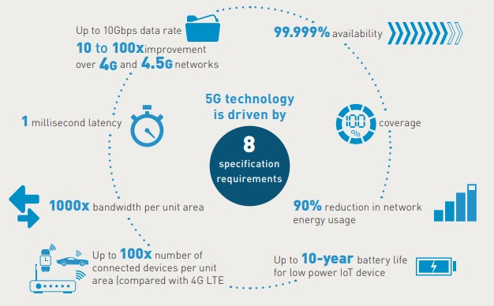
Requirements of 5g
Page-07

Slide 8
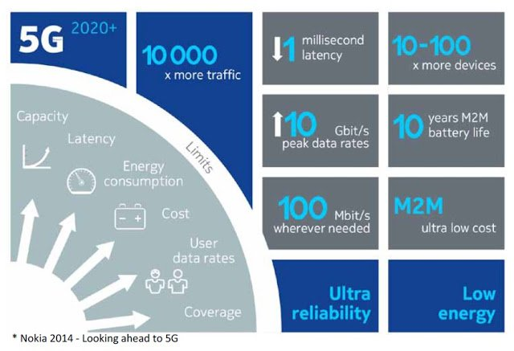
Advantages of 5G
Page-08

Slide 9
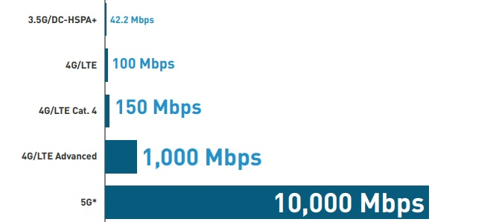
How fast is 5G?
5G is 10 to x100 faster than what you can get with 4G.
Page-09

Slide 10
Challenges in the Development of 5G Networks
Data rate and network capacity expansion with energy optimization
Scalability and flexibility
Single channel for both UL and DL
Handling interference
Environmentally friendly
Low latency and high reliability
Network performance optimization
Economical impacts
High mobility and handoff
Self-healing infrastructures
QoS
Security and privacy of the network and UEs
Page-10

Slide 11
Implementation Issues in 5G Networks
However, the implementation of 5G networks is challenged by the following issues:
Interference
Handoff
QoS
Load balancing
Channel Access Control Management
Security and Privacy
Page-11

Slide 12
What are the real 5G use cases?
Fixed wireless access (from 2018-2019 onwards)
Enhanced mobile broadband with 4G fall-back (from 2019-2020-2021)
Massive M2M / IoT (from 2021-2022)
Ultra low-latency IoT critical communications (from 2024-2025)
Page-12

Slide 13

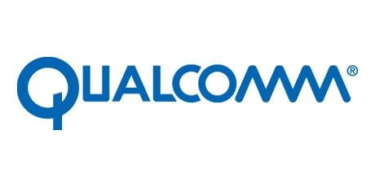


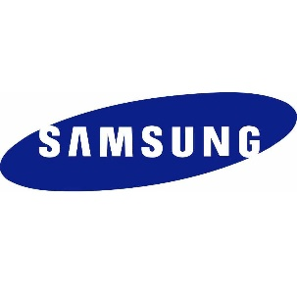





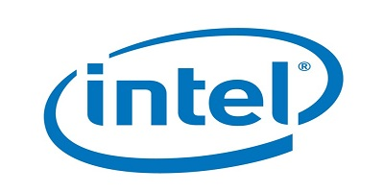



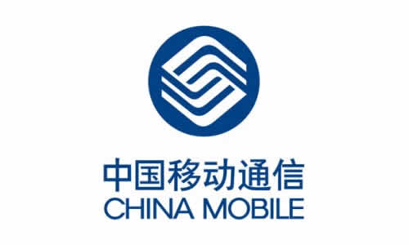







Who are developing 5G?
Page-13

Slide 14
What are the differences between the previous generations of mobile networks and 5G?
The previous generations of mobile networks are 1G, 2G, 3G, and 4G.
First generation - 1G 1980s: 1G delivered analog voice.
Second generation - 2G Early 1990s: 2G introduced digital voice (e.g. CDMA- Code Division Multiple Access).
Third generation - 3G Early 2000s: 3G brought mobile data (e.g. CDMA2000).
Fourth generation - 4G LTE 2010s: 4G LTE ushered in the era of mobile broadband.
5G is a unified, more capable air interface.
Page-14

Slide 15
How will 5G affect the global economy
5G is driving global growth.
• $13.2 Trillion dollars of global economic output • 22.3 Million new jobs created • $2.1 Trillion dollars in GDP growth
Page-15

Slide 16
Is 5G available now?
Yes, 5G is already here today, and global operators started launching new 5G networks in early 2019. In 2020, many countries expect nationwide 5G mobile networks. Also, all major Android phone manufacturers are commercializing 5G phones. And soon, even more people may be able to access 5G.
Page-16

Slide 17
Application of 5G Networks
Personal usages
Virtualized homes
Smart societies
Smart grids
The tactile Internet
Automation
Healthcare systems
Logistics and tracking
Industrial usages
Page-17

Slide 18
Any Questions??? Thank you
Page-18

