Slide 1
Ulaanbaatar Street
Network Data
KNOWLEDGE GRAPH ENGINEERING (ICSI500)
20B1NUM1111, T. Enkhjin
20B1NUM1201, G. Zandan-Ochir

Slide 2
Purpose Formalization

Slide 3
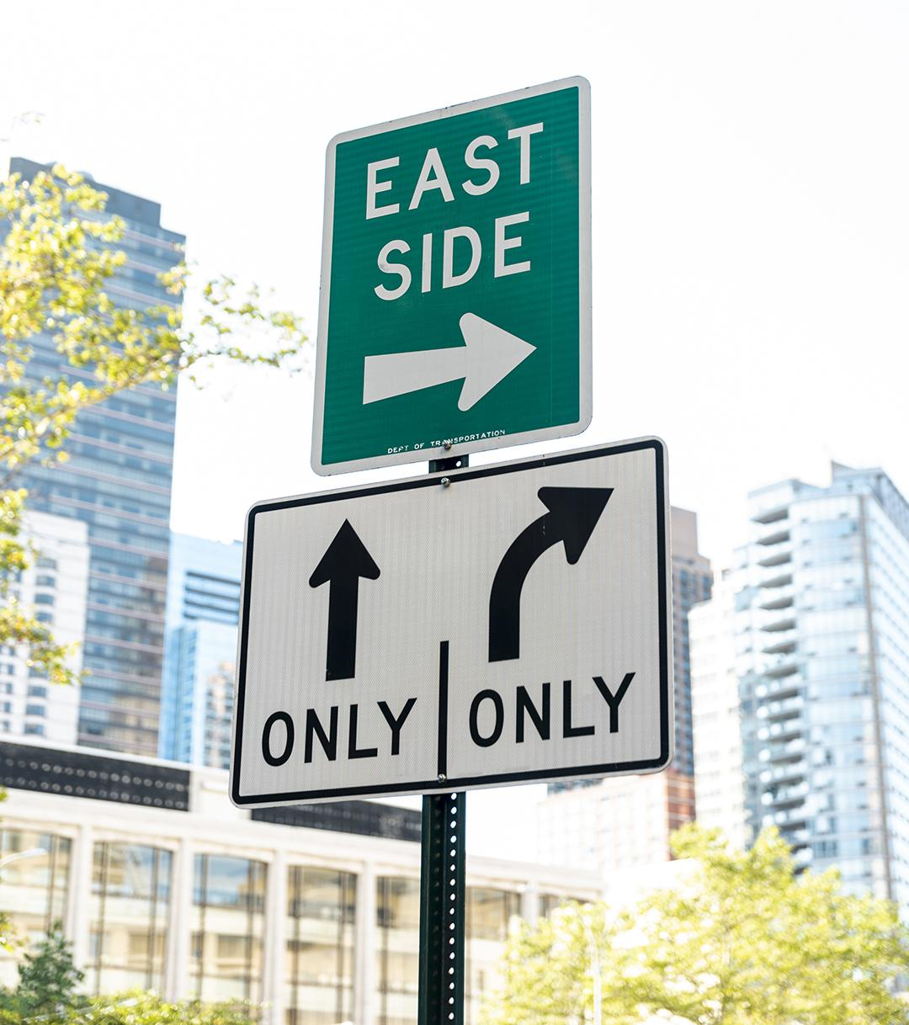
Project objective
Our project objective is to merge Ulaanbaatar’s street network data into a cohesive knowledge graph. This graph will enable users to easily navigate from one location to another within Ulaanbaatar, offering clear and dependable routes.

Slide 4
Scenarios definition
Scenario 1: UB has a dense architectural layout, thus it’s walk-able to most places like schools, and hospitals.
Scenario 2: Residents of Ulaanbaatar enjoy escaping the city’s air pollution by hiking to various nearby trails and scenic spots.
Scenario 3: Because of the country’s prime location bridging Central and East Asia, Ulaanbaatar hosts a variety of Asian restaurants and pubs like Korean, Japanese, Uzbek and so on

Slide 5
Personas
Persona 1
Persona 2
Persona 3
Freshman Bataa is going to the National University of Mongolia for the first time from his home located in Sansar and he quite doesn’t know the path to get there.
Dondog, a 40-year-old hiker, enjoys discovering various hiking spots in the vicinity of Ulaanbaatar.
Bocca, visiting professor residing near the city center, is passionate about culinary exploration.

Slide 6
Competency Questions (CQs):
1. Recommend Bataa possible paths to National University of Mongolia from his home in Sansar.
2. Give Dondog route information from his current location to nearby hiking spots.
3. Recommend Bocca, restaurants and pubs near his home.

Slide 7
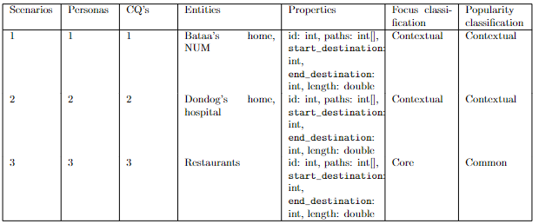
Concepts identification:

Slide 8
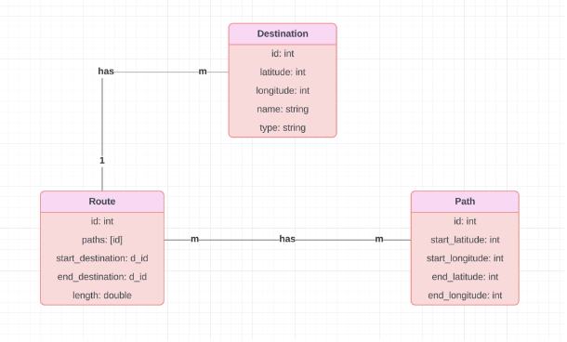
ER MODEL:

Slide 9
Information Gathering

Slide 10
Data and Knowledge Source
This section details the comprehensive data collection and processing steps undertaken to gather footway-specific information for Ulaanbaatar’s streets. Utilizing Humanitarian OpenStreetMap Team (HOT) as a primary source, we aimed to assemble a dataset that allows for the detailed representation of pedestrian pathways within the urban fabric of the city

Slide 11
Data and Knowledge Source
Footways Dataset
Buildings Dataset
This dataset includes geospatial coordinates for footpaths and pedestrian areas. Attributes such as path width, surface type, and the presence of amenities like lighting and signage were collected.
As a complement to the footway information, we collected data on building outlines and types to provide context to the street network.

Slide 12
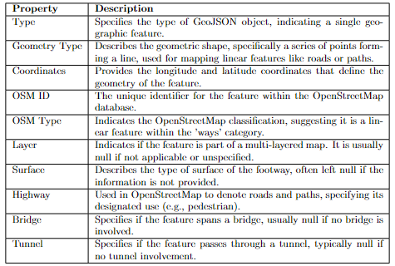
Resource Collection, Processing, and Scraping
HOT Footways Data
The ‘kgefootways.geojson‘ file, containing details of footpaths and pedestrian zones in Ulaanbaatar, was retrieved using HOT’s Export Tool. Subsequent processing ensured that the data conformed to our ER model, ready for integration into our street network knowledge grap

Slide 13
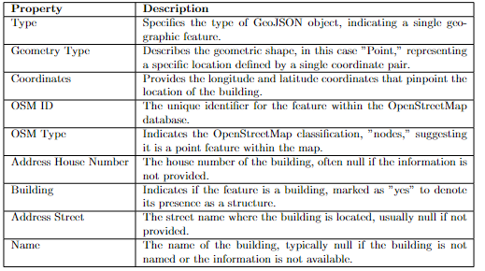
Resource Collection, Processing, and Scraping
HOT Buildings Data
Alongside footway data, we extracted building data from the ‘KGE- buildings.geojson‘ file. This provided us with comprehensive outlines and classifications of buildings, which were crucial for augmenting our street network with contextually relevant information

Slide 14
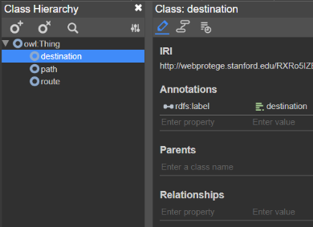
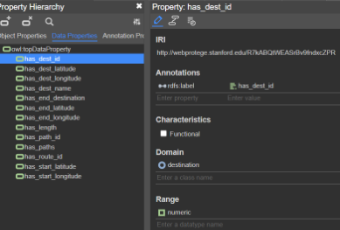
Formal Resource Collection and Scraping from Consumer
Each file in the data abstracted from HOT represents an etype. To systematically organize these
etypes, we derived from the HOT data, as depicted in Figure 3. This ontology, designed using the
Protege tool, includes modifications tailored to our specific research needs.

Slide 15
Language Definition

Slide 16
Language Definition
In this section, we extracted entity types (etypes), data properties, and object properties from OSM data source. We then formalized the language of these concepts for each source by mapping them to the Global Identifiers (GIDs) in the Universal Knowledge Core (UKC). In the UKC, each GID corresponds to a unique definition of a concept. If the UKC returns the GID of a concept, we link the concept with the GID, e.g., bar_GID-14950; otherwise, we assign a new GID to the concept, ranging from NUM24-0 to NUM24-999. The producer aims to work with the concepts from the three resources that we have already identified in the above section. Meanwhile, the consumer aims to identify new concepts that will be used to integrate these resources.

Slide 17
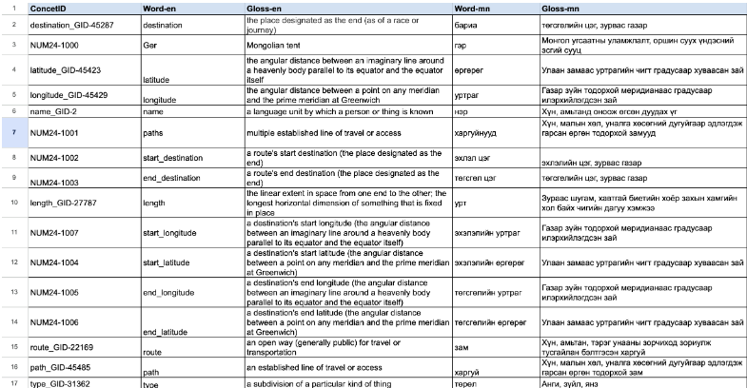
Formalize Concepts

Slide 18
Knowledge Definition

Slide 19
Knowledge Definition
The Knowledge Definition phase for the Ulaanbaatar street network data involves structuring and formalizing the knowledge required to effectively utilize and analyze the street network for various purposes, such as urban planning, traffic management, and infrastructure development. Below is a detailed description of the sub-activities performed by the team members and the expected outcomes.

Slide 20
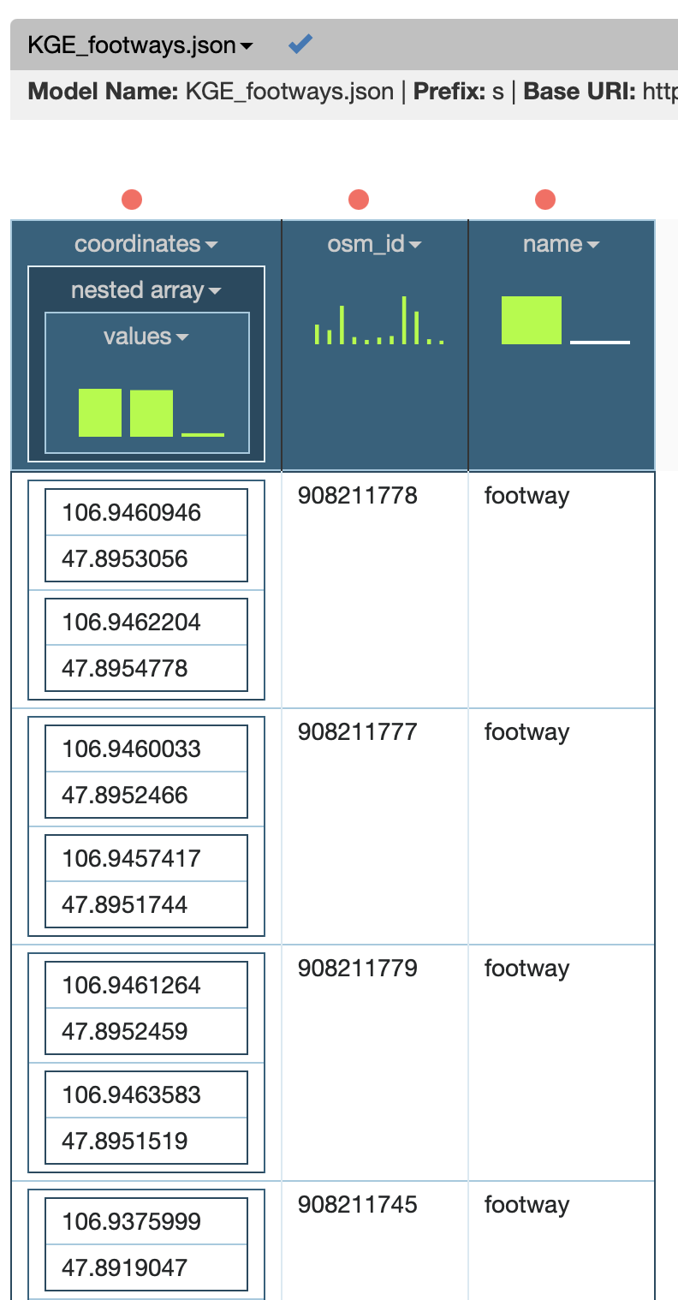
Knowledge Definition

