Slide 1
AutoEncoders for Anomaly Detection
Represented by:
Athbah Alshuaibi
Fajer Alhumidhan
Zahra Alsaad

Slide 2
Review
Definition of anomaly detection
Applications of anomaly detection
Methods for anomaly detection
The process of finding patterns in data that do not conform to a model of normal behavior.
Anomaly detection can be applied to a wide range of domains.
Statistical approaches
Clustering algorithms
Deep learning models
Autoencoders
Notes:
Defention of Anomaly detection:
The process of finding patterns in data that do not conform to a model of normal behavior. These unexpected patterns are referred to as anomalies or outliers. Anomalies may indicate errors or fraud in the data, or they may represent unusual or interesting phenomena that warrant further investigation.
Applications of Anomaly Detection:
Anomaly detection can be applied to a wide range of domains, including finance, cybersecurity, medical diagnosis, and predictive maintenance.
methods for detecting anomalies
There are many different methods for detecting anomalies, such as
statistical approaches,
clustering algorithms, and
deep learning models One popular method of Deep Learning for anomaly detection is using Autoencoders which is our focus in this project.

Slide 3
Deep learning models: AutoEncoders
Definition of AutoEncoder
Autoencoders are a type of neural network architecture.
The goal of an autoencoder is to learn a compressed representation of the input data by encoding the input into a lower-dimensional representation, and then decoding the representation back into the original input.
Uses of AutoEncoder
Components of Autoencoders
Unsupervised Learning
Dimensionality Reduction
Anomaly Detection
Encoder
Hidden Layer (Code)
Decoder
Notes:
Defention on AutoEncoder
Autoencoders are a type of neural network architecture.
The goal of an autoencoder is to learn a compressed representation of the input data by encoding the input into a lower-dimensional representation, and then decoding the representation back into the original input.
Uses of AutoEncoders
Why to Use Autoencoders?
Unsupervised Learning: They don’t need labeled data. They learn patterns directly from the data.
Dimensionality Reduction: They reduce the number of features while keeping important information.
Anomaly Detection: Autoencoders can recognize patterns in normal data. If they encounter data that doesn’t fit the pattern, they struggle to reconstruct it, meaning that there’s an anomaly.
Components of Autoencoders
1. Encoder: it takes the input data and compress it into a smaller representation.
- It applies several transformations (usually matrix operations and activation functions) to extract meaningful patterns from the data.
2. Hidden Layer (Code): This is the heart of the autoencoder because it makes it useful for tasks like dimensionality reduction, anomaly detection, and data compression. It holds the compressed, lower-dimensional version of the input data.
- This layer also called the (bottleneck layer) because it forces the network to focus on the most important features of the data.
3. Decoder: The decoder takes the compressed representation (the Code) and reconstructs it back into the original format or close as possible to it.

Slide 4
AutoEncoders for Anomaly Detection
The goal of the autoencoder is to recreate the input data as accurately as possible, but with a smaller, more compact representation, minimizing the difference between the input and the reconstructed output.
This difference, known as reconstruction error, is a key factor in anomaly detection. During training, the autoencoder learns patterns from "normal" data.
- When tested on new data, the autoencoder performs well on data similar to the training set, producing low reconstruction errors.
- For anomalous data the autoencoder struggles to reconstruct them accurately, resulting in a higher reconstruction error.
By setting a threshold for reconstruction error based on the normal data, we can detect anomalies: if the error exceeds the threshold, the input is flagged as an anomaly.

Slide 5
Used dataset: MNIST Dataset
Content: a collection of 70,000 images of handwritten digits (0-9), with each image being 28x28 pixels.
The dataset is divided into two main subsets:
Training Set
Test Set
Consists of 60,000 images along with their labels, commonly used for training machine learning models.
Contains 10,000 images with their corresponding labels, used for evaluating the performance of trained models.

Slide 6
Why AutoEncoders for MNSIT?
Handling High-Dimensional Data: The MNIST dataset contains images (28x28 pixels), which are high-dimensional compared to simple tabular data.
Simplicity and the ease of Implementation
Computational Efficiency: Autoencoders typically use simple feedforward networks with a clear encoder-decoder structure, making them computationally lightweight compared to more complex models like GANs or RNNs.
Since MNIST consists of static, non-sequential grayscale images, Autoencoders are perfectly suited for this data type without the need for the sequential processing capabilities of RNNs or the adversarial complexity of GANs.
Notes:
Computational Efficiency:
- GANs require training both a generator and a discriminator, which involves more computational resources and time.
- RNNs are computationally intensive when applied to large datasets like MNIST due to their recurrent connections.
3. Comparison with RNNs:
RNNs are designed for processing sequential or time-series data, where the order of data points is important (e.g., speech, text, or stock prices). Since MNIST images lack temporal structure, the sequential processing capabilities of RNNs are unnecessary and would add computational overhead without any advantage.
4. Comparison with GANs:
GANs are powerful for generating new data samples, often with a focus on realism and diversity. However, GANs involve a more complex training process, requiring the coordination of a generator and a discriminator in an adversarial framework. For tasks like dimensionality reduction or anomaly detection (common uses for Autoencoders on MNIST), the complexity of GANs is not needed.

Slide 7
Implementation goal
The goal behind this implementation is to show that the Autoencoder (AE) can be used for anomaly detection based on reconstruction error.
Input
Output
Images from the MNIST dataset
The reconstruction loss for both
Anomalous image
Normal images
Process
The Autoencoder is trained to reconstruct the MNIST images, and we introduce an anomalous image to evaluate the model's performance.

Slide 8
Activation Function
An activation function is a mathematical function applied to the output of a neuron. The activation function decides whether a neuron should be activated by calculating the weighted sum of inputs and adding a bias term. This helps the model make complex decisions and predictions by introducing non-linearities to the output of each neuron [1].
[1] GeeksforGeeks. (2024b, November 19). Activation functions in Neural Networks. GeeksforGeeks. https://www.geeksforgeeks.org/activation-functions-neural-networks/

Slide 9
Types of Activation Functions in Deep Learning
Sigmoid (sigmd):
The sigmoid function maps any real-valued number to a value between 0 and 1. This makes it useful for binary classification problems, as it can represent probabilities.
ReLU (Rectified Linear Unit):
ReLU outputs the input directly if it is positive; otherwise, it outputs zero.
Tanh (Hyperbolic Tangent):
The tanh function is similar to the sigmoid but outputs values between -1 and 1. This centering around zero can make optimization easier and faster.
Softmax
Softmax is typically used in the output layer of multi-class classification problems. It converts raw scores from the model into probabilities for each class.

Slide 10
Why we use sigmoid
The sigmoid activation function is used in the output layer of the autoencoder because it outputs values between 0 and 1, which matches the normalized pixel values of the MNIST images. This helps the model accurately rebuild the original images. Since the loss function used is mean squared error (MSE), which measures how close the predictions are to the actual values, having the output in the same range makes it easier for the model to learn and improve its performance in image reconstruction.

Slide 11
The final results
Now let’s look at the output of our code where the training progress shows that the model is effectively learning, as both training and validation loss values are steadily decreasing. The first image shows the training loss consistently decreasing from around 0.825 to approximately 0.812, suggesting that the model is successfully improving its performance on the training data. This trend, along with the good performance in distinguishing normal from anomalous data highlighted by the average reconstruction loss metrics, points to a positive outcome.

Slide 12
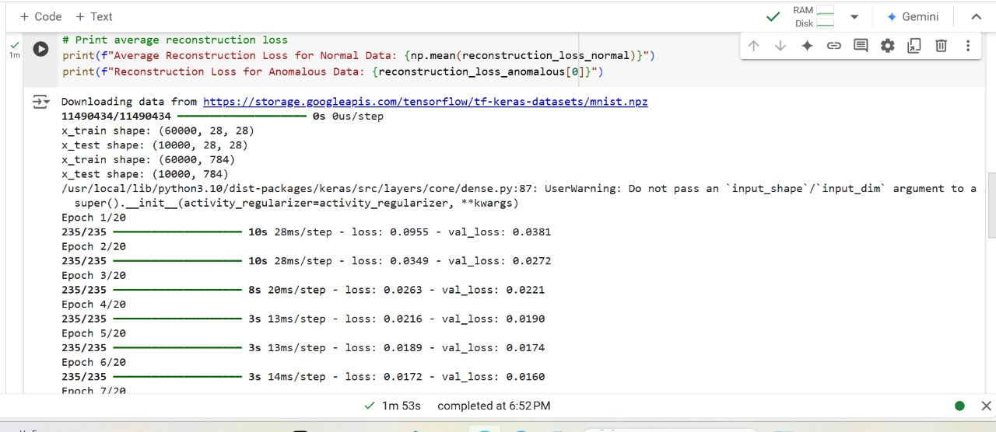
The final results

Slide 13
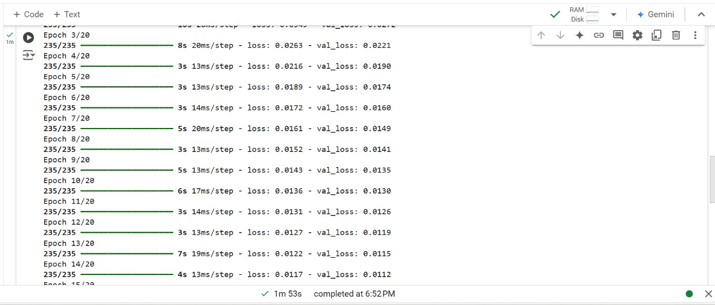
The final results

Slide 14
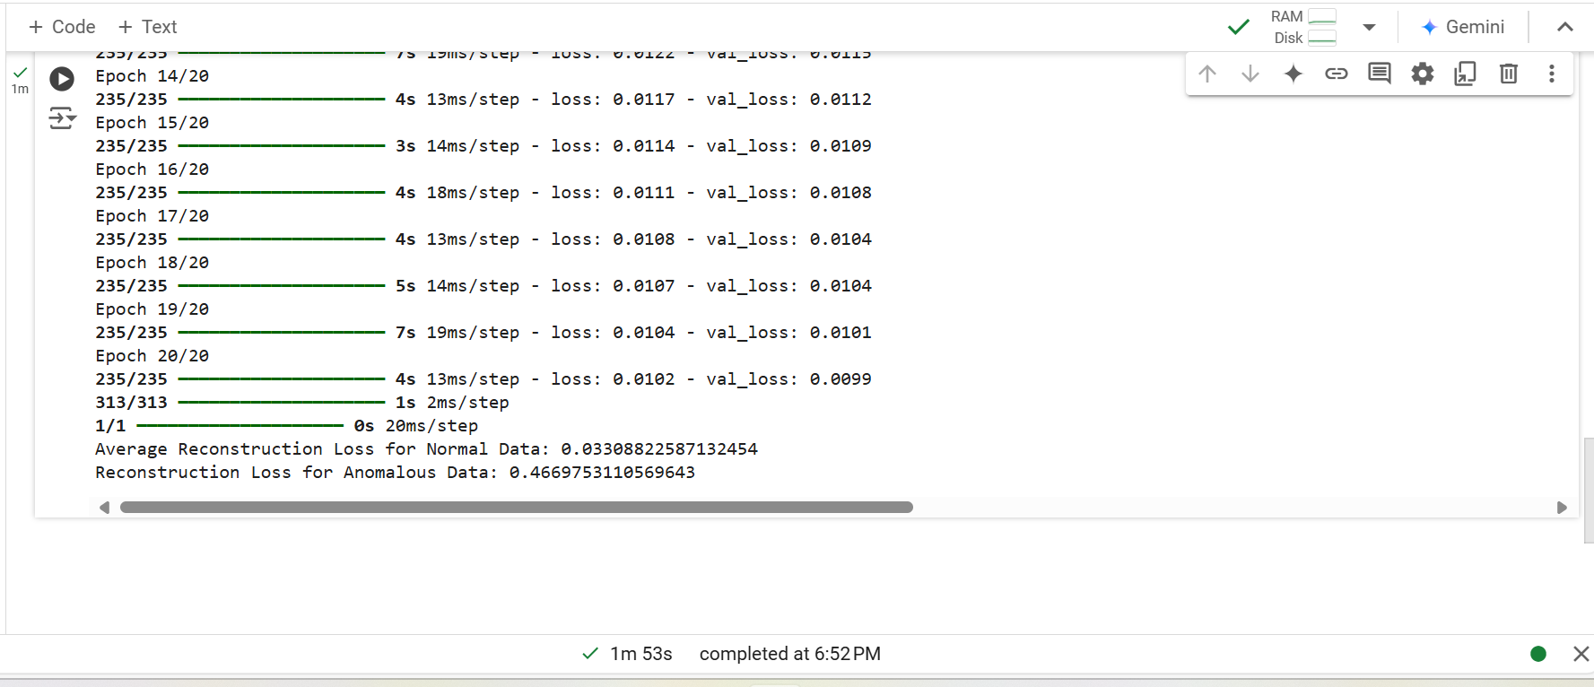
The final results
Here we can see the average of reconstruction of loss data , where we can decide if it normal data or not

Slide 15
Thanks
For
Listening!
Feel free to ask any question!

