Slide 1
Machine learning:
prediction,
classification and
clustering
UBB Faculty of Sociology

Slide 2
Course Agenda
#1 Intro, Simple Linear Regression
#2 Python recap, Git, Handling data, EDA
#3 Regression, Decision Trees
#4 Bias, Variance, Overfitting, Classification, Metrics
#5 Random Forest Classifier, Clustering
#6 Neural Newtorks
#7 Help Final Project
#8 Help Final Project

Slide 3
3. Linear Regression, Decision Trees
#3.1 Catch up
#3.2 Linear Regression recap
#3.3 Decision Trees Regression
#3.4 Regression implementation
#3.5 Final Project Task 2 - Census Data EDA
#3.6 Questions & Further reading

Slide 4

3.1 Catch up
Share one thing that stood out to you:
one thing you found surprising / interesting / useful etc.

Slide 5
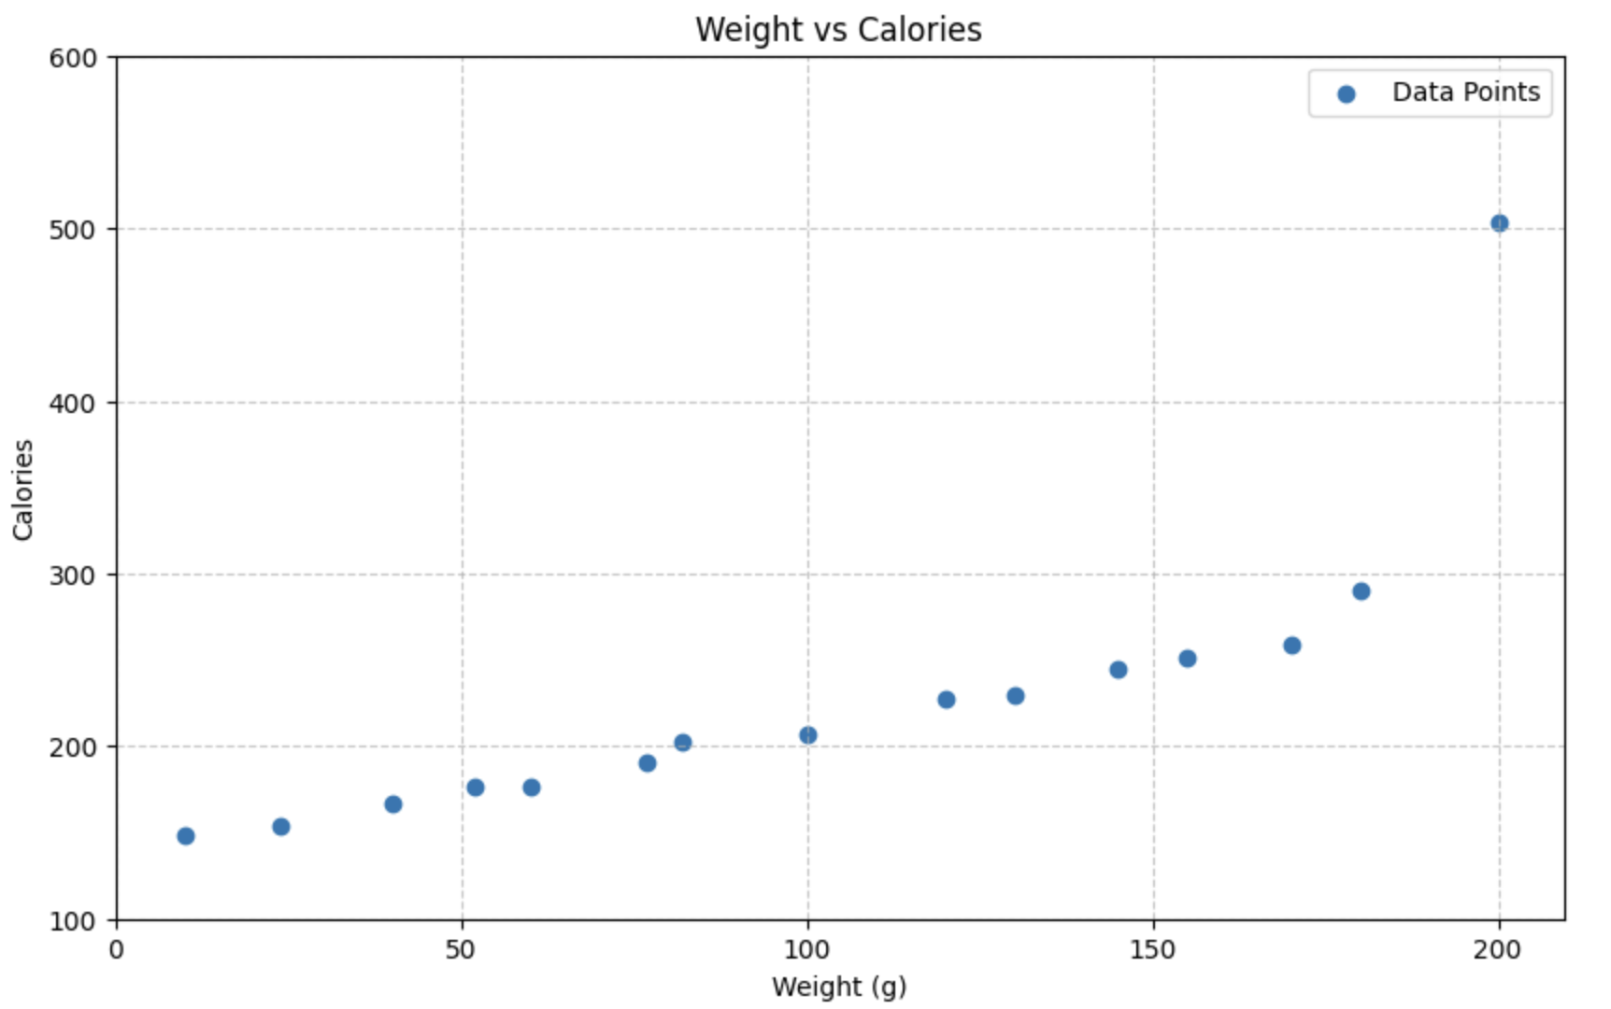
Predict calories
3.2 Linear Regression recap
Eq of the line:
y = ax + b
Where:
a: slope
b: intercept
x: data
How lines work:
Calories =
Slope * Weight + Intercept

Slide 6
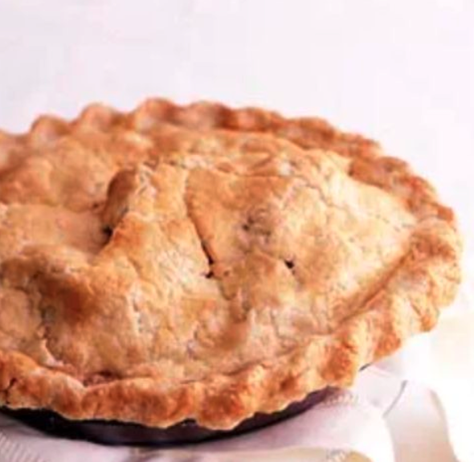
Predict the calories
Calories for 15 apple pie slices:
148, 154, 167, 176, 176,
191, 203, 207, 227, 230,
245, 251, 259, 290, 503
Mean: 228,47
Median: 207

Slide 7
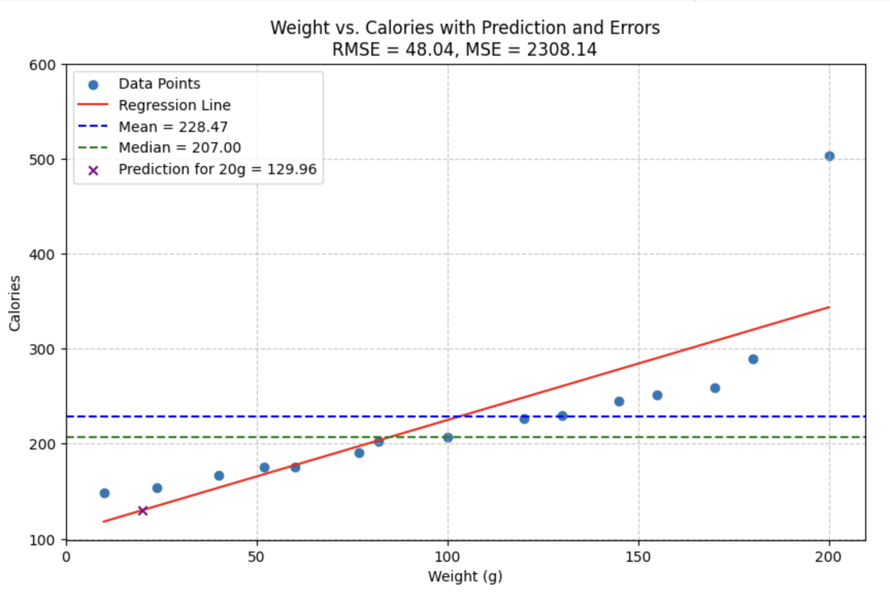
Predict calories
Eq of the line:
y = ax + b
Where:
a: slope
b: intercept
x: data
How lines work:
Calories =
1.19*20 + 106.2=131
Code on Colab

Slide 8
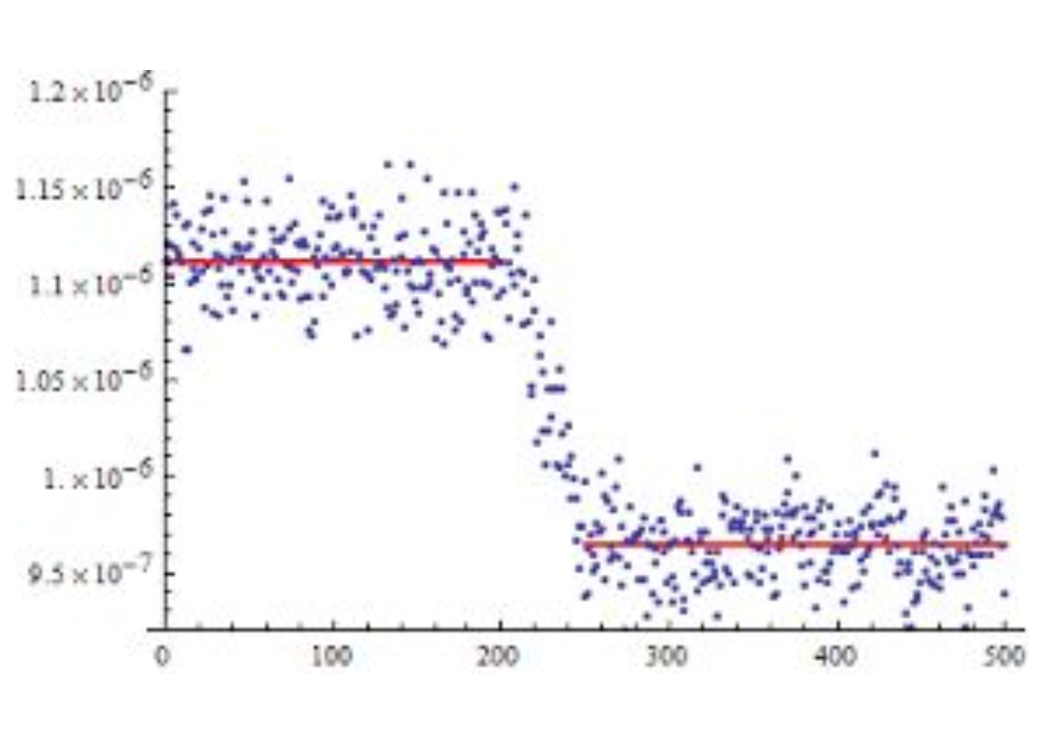
Data is not always linear
No problem!
There are non-linear regression models:
● Decision Tree Regression
● SVM with non-linear kernels
● Neural networks
● KNN
● Ensemble methods

Slide 9
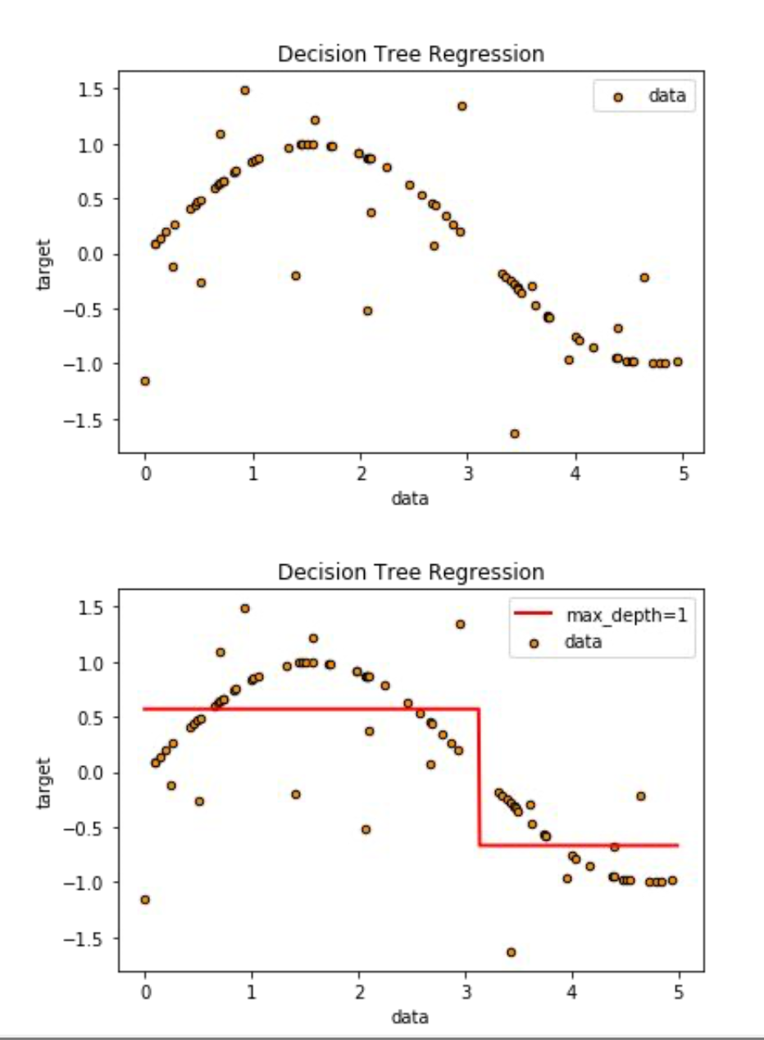
3.3 Decision Trees Regression
Decision Tree Regression
Decision Trees Regression is a very fast algorithm How it works: A two step repeating process
Take some random samples in the subtree split the dataset in two
Save the random split which separates the data by value the best
Then, repeat for the newly created subtrees

Slide 10
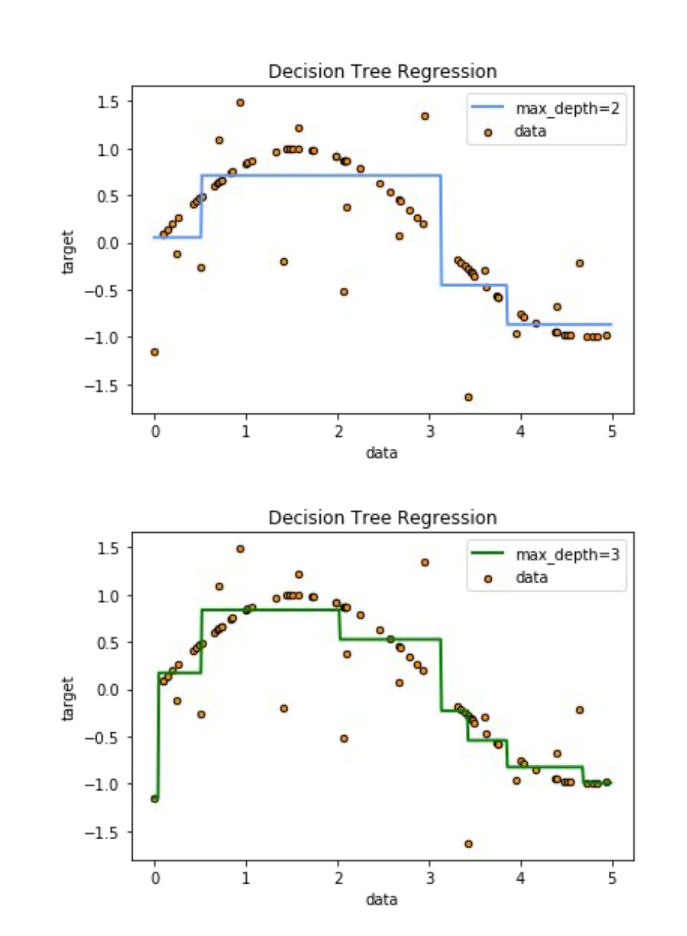
Decision Tree Regression
Decision Trees Regression is a very fast algorithm How it works: A two step repeating process
Step 1
  Take some random samples in the subtree split the dataset in two
  Save the random split which separates the data by value the best
Step 2
  Take some random samples in the subtree split the dataset in two
  Save the random split which separates the data by value the best

Slide 11
Decision Tree Regression
Decision Trees Regression is a very fast algorithm How it works: A two step repeating process
Step 3
  Take some random samples in the subtree split the dataset in two
  Save the random split which separates the data by value the best
……..
n. Step n
n.1 Take some random samples in the subtree split the dataset in two
n.2 Save the random split which separates the data by value the best

Slide 12
Decision Tree Regression
Stop Criteria:
Maximum Depth: Stops growing the tree when the maximum depth is reached.
Minimum Samples per Leaf: Requires a minimum number of samples in each leaf node.
Minimum Samples per Split: Requires a minimum number of samples to attempt a split.
Maximum Number of Nodes: Limits the total number of nodes in the tree.
No Further Split Improves Performance: Stops when no split improves the target metric.
Early Stopping with Cross-Validation: Stops if validation performance does not improve.
Insufficient Data: Stops if a node has too few samples for further splitting.

Slide 13
Decision Tree Regression
Advantages:
We get a nice, explainable model, easy to understand by humans
Very fast prediction for new samples

Slide 14
Decision Tree Regression
Disadvantages:
Leaves grow exponentially by depth
Very prone to overfitting

Slide 15
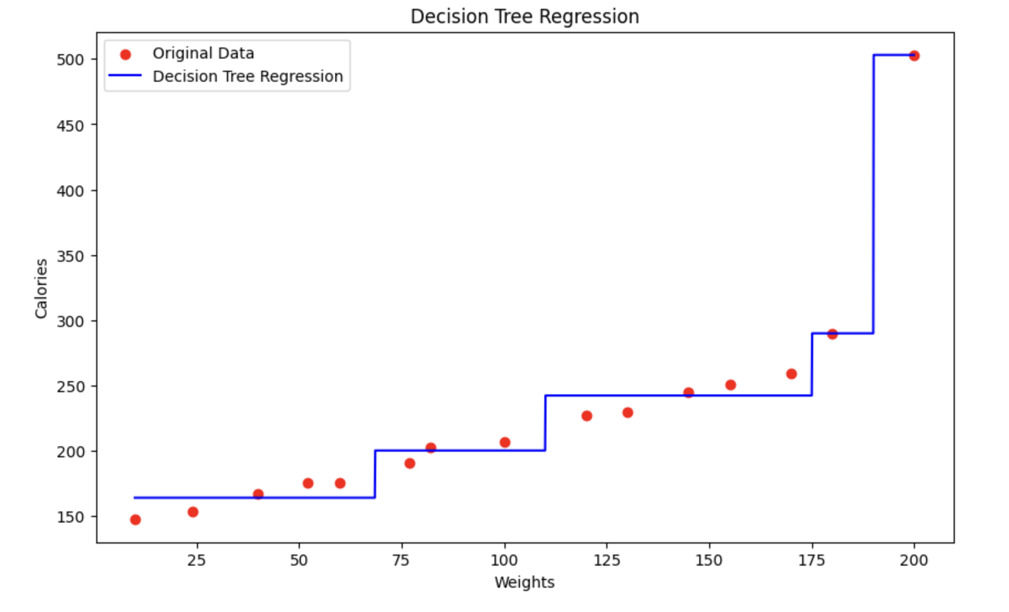
Decision Tree Regression Calories
Code on Colab

Slide 16
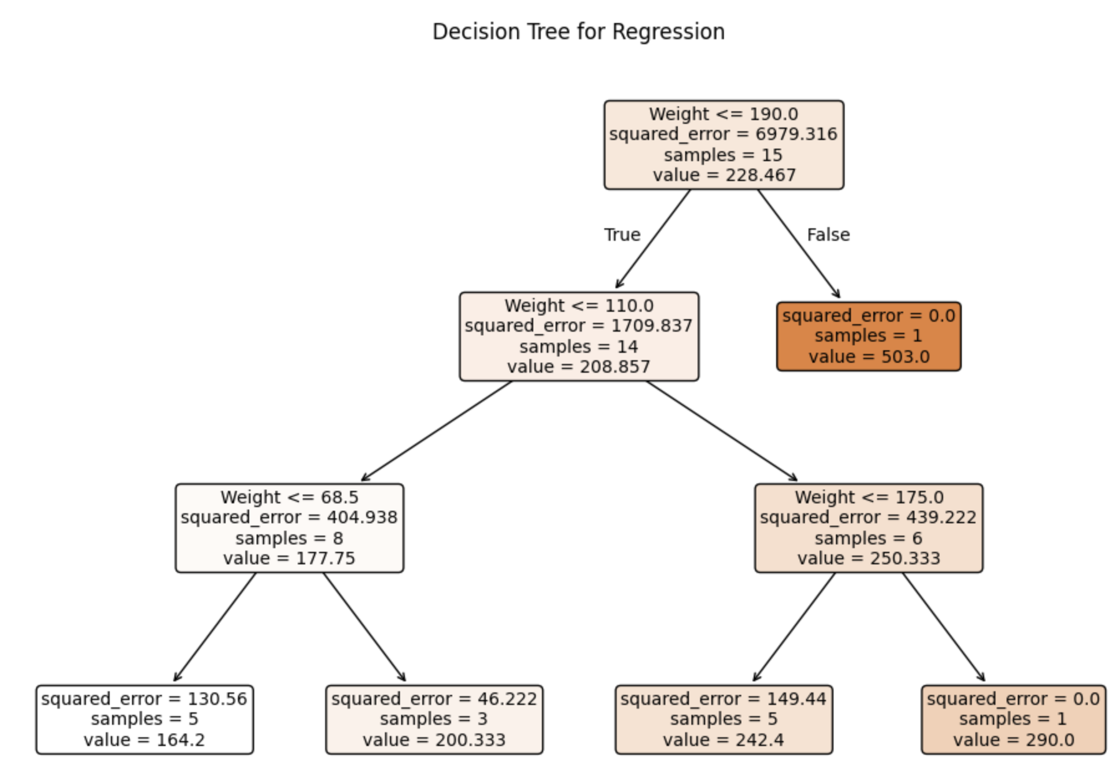
Decision Tree Regression Calories
Code on Colab

Slide 17
3.4 Regression implementation
Penguins size
California Housing

Slide 18
3.5 Final Project Task 2 - Census Data EDA
https://github.com/zahariesergiu/ubb-sociology-ml/blob/main/final_project/Final_Project_Task_2_Census_EDA.ipynb

Slide 19
3.6 Further Reading & Questions
#1 Regression Trees explained: https://www.youtube.com/watch?v=g9c66TUylZ4
#2 Decision Trees Split Criteria: https://scientistcafe.com/ids/splitting-criteria
#3 Self-supervised learning: https://ai.meta.com/blog/self-supervised-learning-the-dark-matter-of-intelligence/
#4 Feature scaling @ Kaggle: https://www.kaggle.com/code/mysarahmadbhat/all-about-feature-scaling/notebook
#5 Nature article: statistics and machine learning: https://www.nature.com/articles/nmeth.4642?source=post_page-----64b49f07ea3--------------------------------
#6 If correlation doesn’t imply causation, then what does?: https://michaelnielsen.org/ddi/if-correlation-doesnt-imply-causation-then-what-does/
#7 Requirements for talking about cause and effect: https://towardsdatascience.com/are-you-guilty-of-using-the-word-experiment-incorrectly-9068baeab7a4

Slide 20
Thank you !!
Machine Learning Engineer / Data Scientist
zahariesergiu@gmail.com
https://www.linkedin.com/in/zahariesergiu/
https://github.com/zahariesergiu/ubb-sociology-ml

