Slide 1
Machine learning:
prediction,
classification and
clustering
UBB Faculty of Sociology

Slide 2
Course Agenda
#1 Intro, Simple Linear Regression
#2 Python recap, Git, Handling data, EDA
#3 Regression, Decision Trees
#4 Bias, Variance, Overfitting, Classification, Metrics
#5 Random Forest Classifier, Clustering
#6 Neural Newtorks
#7 Help Final Project
#8 Help Final Project

Slide 3
4 Bias, Variance, Overfitting, Classification
#4.1 Catch up
#4.2 Bias, variance tradeoff
#4.3 Overfitting
#4.4 Classification
#4.5 Classification Metrics
#4.6 Final Project Task 3 - Census Data Regression
#4.7 Questions & Further reading

Slide 4

4.1 Catch up
Share one thing that stood out to you:
one thing you found surprising / interesting / useful etc.

Slide 5
4.2 Bias, variance tradeoff
2 types of errors
Machine Learning Errors
Reducible Error
Irreducible Error
Bias
Variance

Slide 6
Bias refers to the error introduced by approximating a real-world problem with a simplified model, leading to underfitting.
Variance refers to the model's sensitivity to small changes in the training data, often resulting in overfitting.

Slide 7
Bias and Variance
Bias can be also inherent to our model: a classifier can be biased to a particular kind of solution (e.g. linear classifier).
HIGH bias and LOW variance ---> underfitting
the model is unable to capture the underlying pattern of the data
train error > test error
is not robust enough to produce accurate predictions
use more complex model
Boosting
LOW bias and HIGH variance ---> overfitting
train error << test error
add more data, reduce model complexity
Bagging

Slide 8
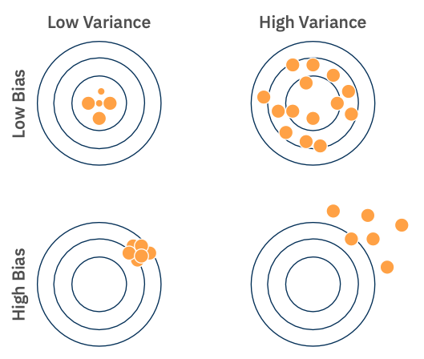
Bias, variance tradeoff
LOW bias and LOW variance will give us a balanced mode

Slide 9
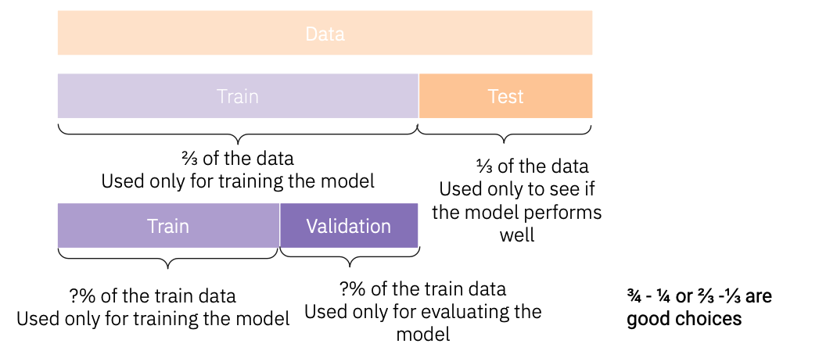
4.3 Overfitting
Validation set

Slide 10
Train Set: Used to train the model by adjusting its parameters to minimize error.
Validation Set: Used to tune hyperparameters and evaluate the model's performance during training to avoid overfitting.
Test Set: Used for the final evaluation of the model's performance on unseen data.

Slide 11
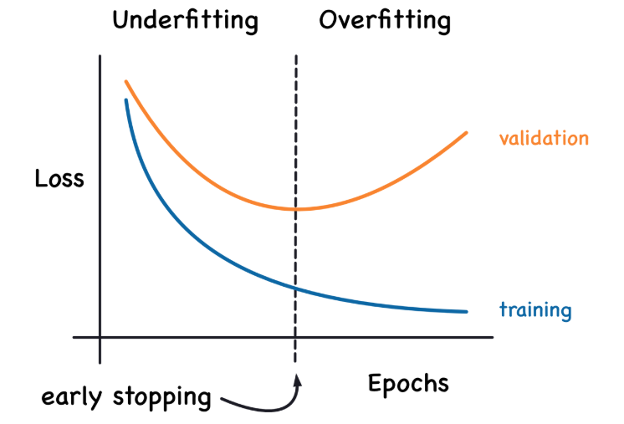

Slide 12
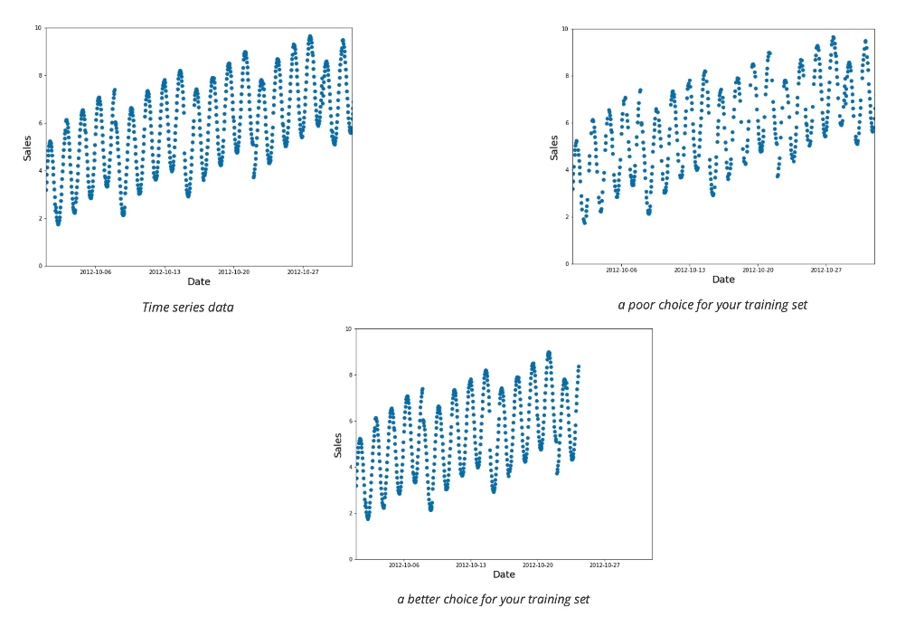
Time series data

Slide 13
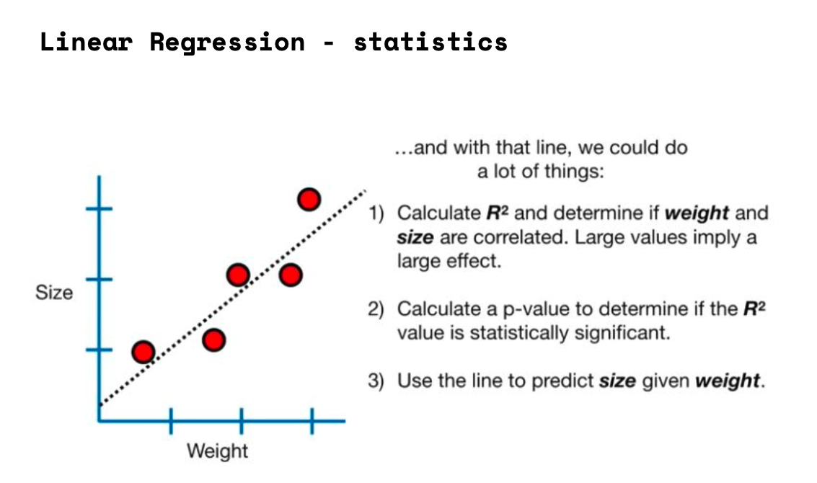
4.4 Classification

Slide 14
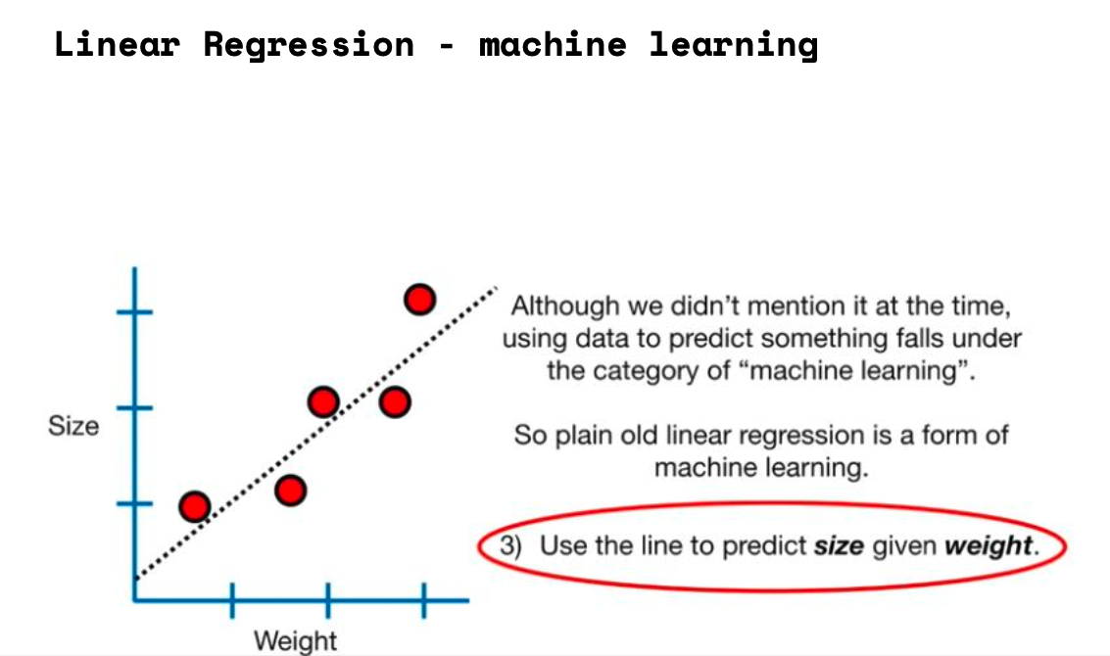

Slide 15
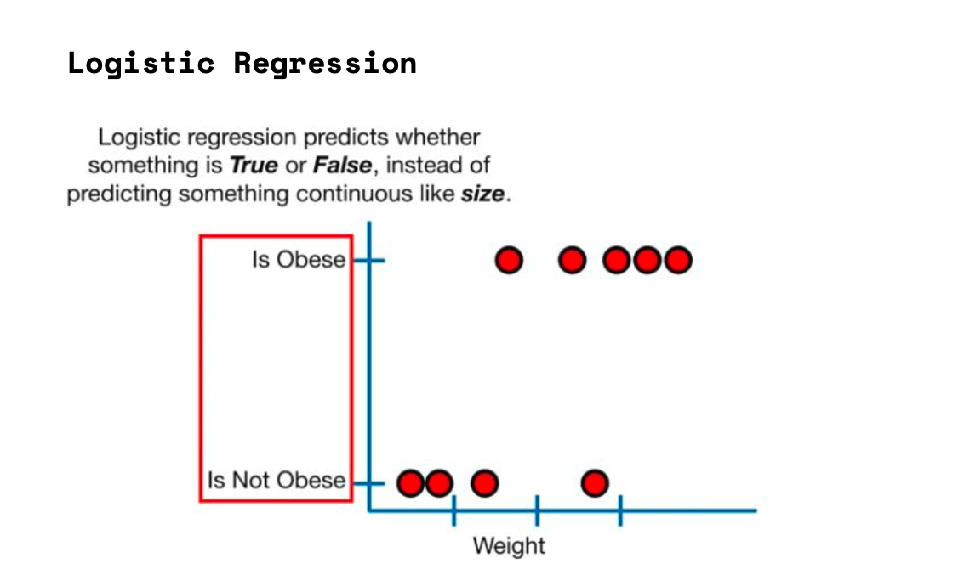

Slide 16
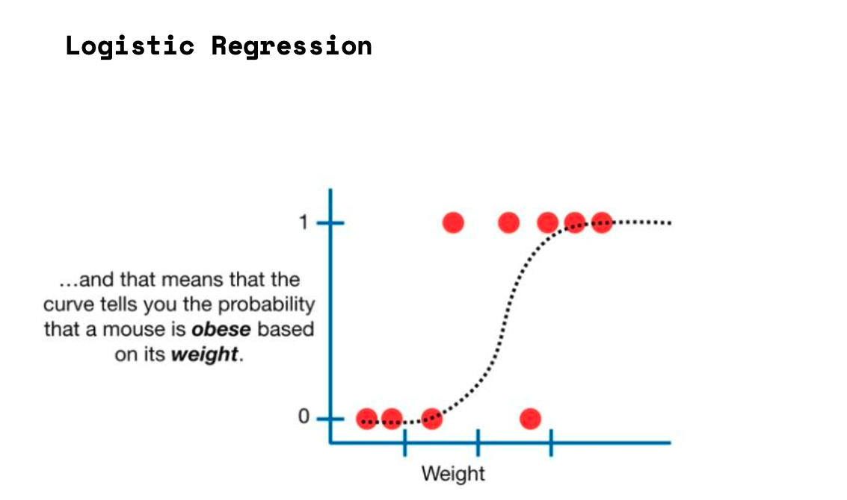

Slide 17
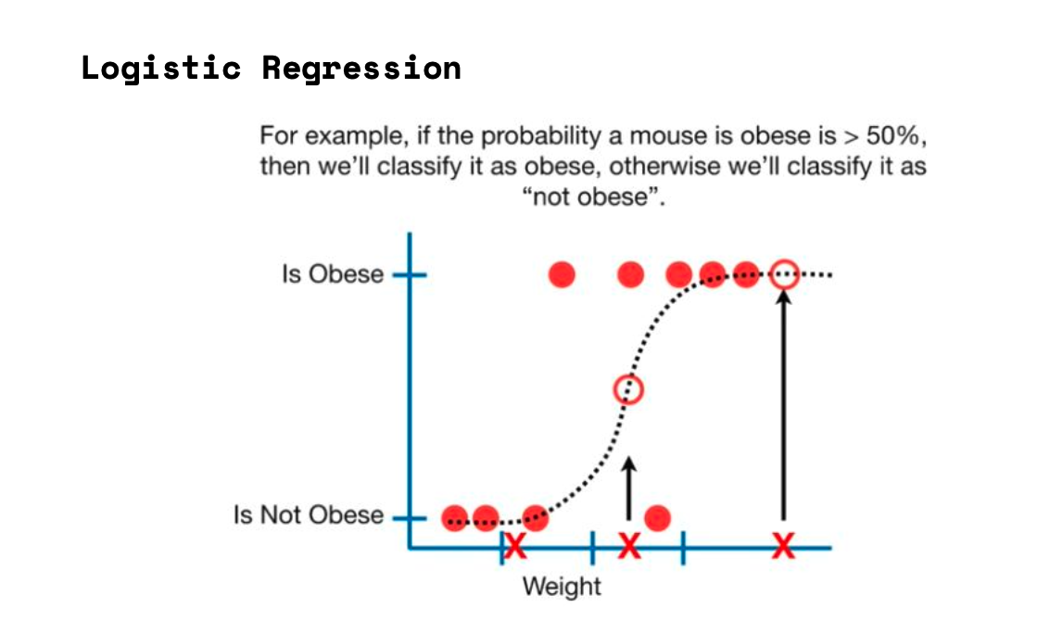

Slide 18
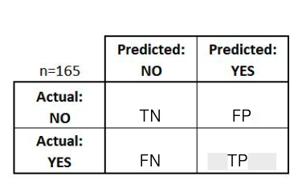
4.5 Classification Metrics
Misclassification
Confusion Matrix
Perfect classification is very rare.
We use the Confusion Matrix to evaluate our classification results.
In general there are 4 values in the 2 class case:
true positive (TP) = Predicted True & Actual True
true negative (TN) = Predicted False & Actual False
false positive (FP)= Predicted True & Actual False
false negative (FN)= Predicted False & Actual True
However, there are other important statistics.

Slide 19
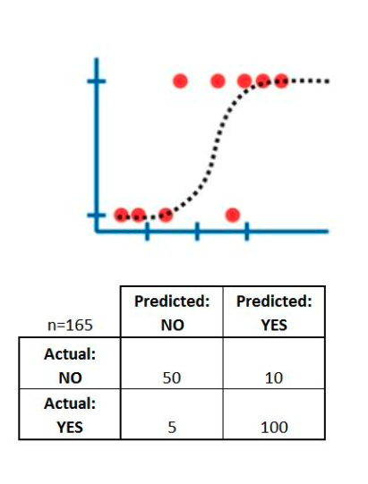
Important statistics
Accuracy: Overall, how often is the classifier correct?
(TP+TN) / total = (100+50)/165 = 0.91
Precision: When it predicts yes, how often is it correct?
TP / (TP+FP) = 100/(100+10) = 0.91
Recall/Sensitivity/TPR: How good is it at positive?
TP / (TP+FN) = 100/(100+5) = 0.95
Specificity: How good is it at negative?
TN / (TN+FP) = 50/(50+10) = 0.83
False Positive Rate
FPR = FP / (TN + FP) = 10/(50+10) = 0.6

Slide 20
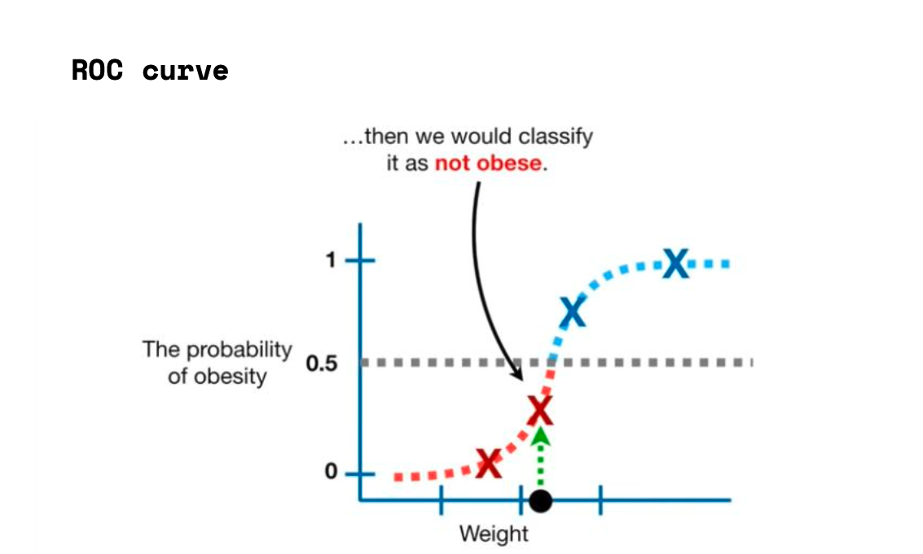

Slide 21
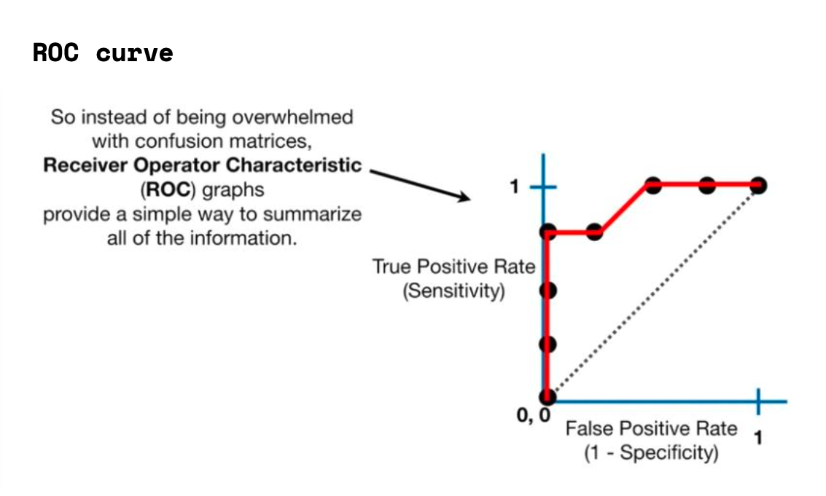

Slide 22
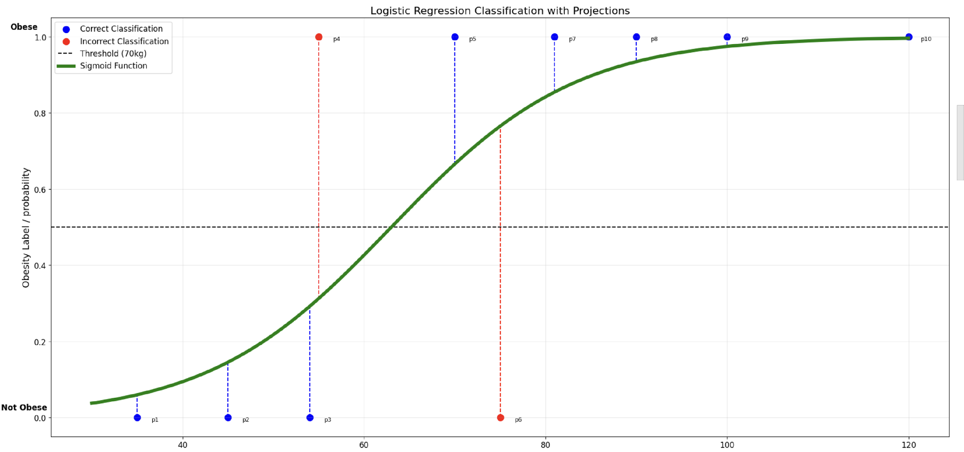
Code on colab

Slide 23
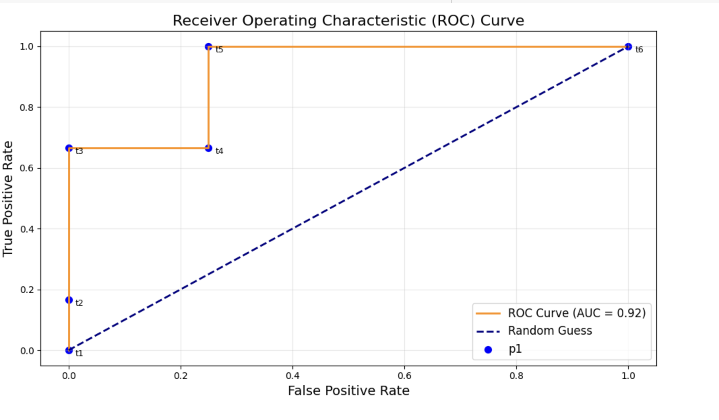
Code on colab

Slide 24
4.6 Final Project Task 3 - Census Data Regression
https://github.com/zahariesergiu/ubb-sociology-ml/blob/main/final_project/Final_Project_Task_3_Census_Modeling_Regression.ipynb

Slide 25
4.7 Further Reading & Questions
#1 Bias versus variance: https://inria.github.io/scikit-learn-mooc/overfit/bias_vs_variance_slides.html
#2 Bias variance decomposition: https://www.youtube.com/watch?v=zUJbRO0Wavo
#3 How (and why) to create a good validation set: https://www.fast.ai/posts/2017-11-13-validation-sets.html
#4 Problems with metrics: https://www.fast.ai/posts/2019-09-24-metrics.html
#5 Evaluating models: https://alan-turing-institute.github.io/rds-course/modules/m4/4.4-ModelEvaluation.html
#6 Sensitivity and Specificity for more than two classes: https://www.youtube.com/watch?v=vP06aMoz4v
#7 Should Computers Run the World? - with Hannah Fry: https://www.youtube.com/watch?v=Rzhpf1Ai7Z
#8 Build a classification tree using Gini impurity: https://www.youtube.com/watch?v=_L39rN6gz7Y&t=196s
#9 Adaptive Boosting (AdaBoost) on Penguin data: https://github.com/INRIA/scikit-learn-mooc/blob/main/notebooks/ensemble_adaboost.ipynb
#10 ROC and AUC: https://developers.google.com/machine-learning/crash-course/classification/roc-and-auc#:~:text=The%20points%20on%20a%20ROC,to%20the%20specific%20use%20case.
#11 What is the Classification Threshold in Machine Learning?: https://www.iguazio.com/glossary/classification-threshold/

Slide 26
Thank you !!
Machine Learning Engineer / Data Scientist
zahariesergiu@gmail.com
https://www.linkedin.com/in/zahariesergiu/
https://github.com/zahariesergiu/ubb-sociology-ml

