Slide 1
Data visualization
Happy Planet Index

Slide 2
About Happy Planet Index
The Happy Planet Index provides a compass to guide nations, and shows that it is possible to live good lives without costing the Earth
The Happy Planet Index measures what matters: sustainable wellbeing for all
It tells us how well nations are doing at achieving long, happy, sustainable lives

Slide 3
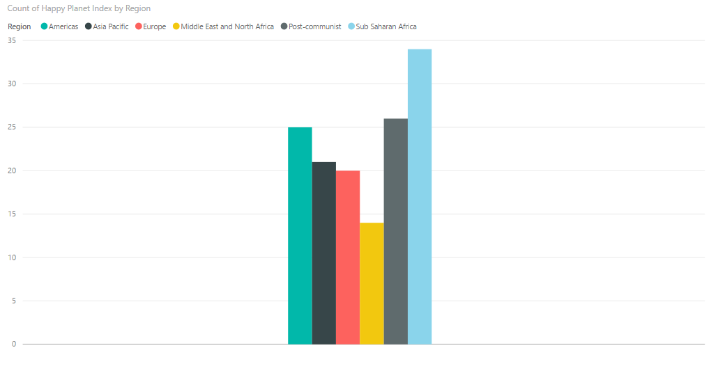
Bar graph (PowerBI)

Slide 4
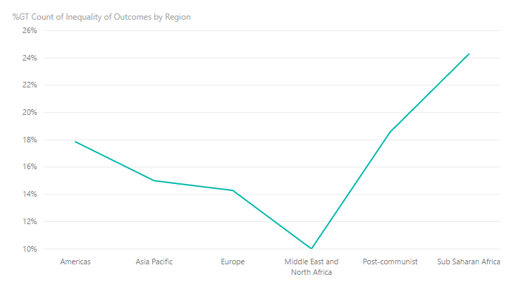
Line Graph (PowerBI)

Slide 5
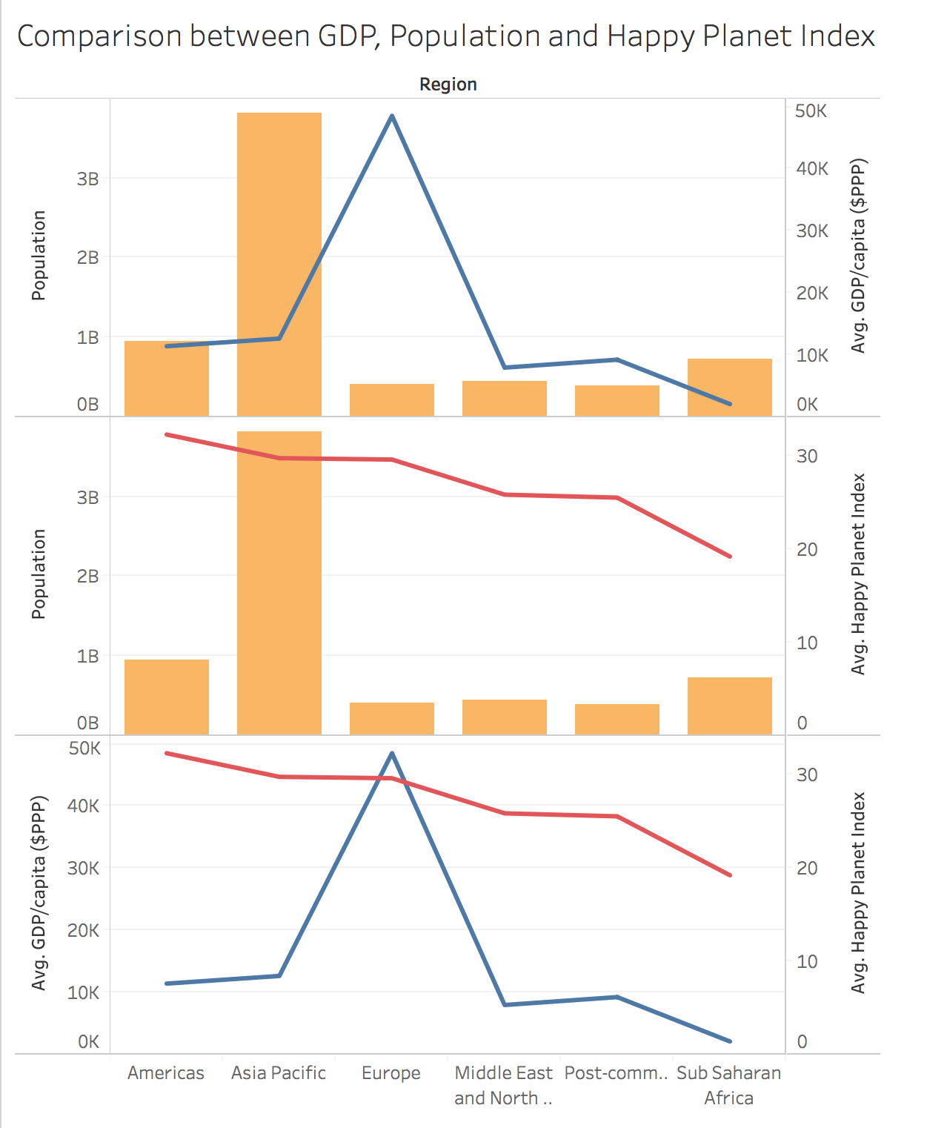
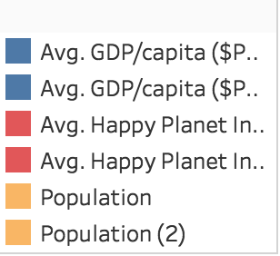
Comparison between GDP, Population and Happy Planet Index

Slide 6
