Slide 1


Kaarkun: AI-Powered Multiplatform Service Marketplace
An AI-Powered multi-platform marketplace connecting customers with service providers. Final Year Project demonstrating end-to-end engineering across cloud-hosted backend, admin panel, web app, and native mobile application.

Slide 2



Team Members
Zaheer Abbas
Muhammad Dawood
Ismail Khan
Full Stack Developer
Frontend Developer
DevOps Engineer

Slide 3

Project Overview & Architecture
How Kaarkun is structured from cloud infrastructure to multi-platform clients.

Slide 4
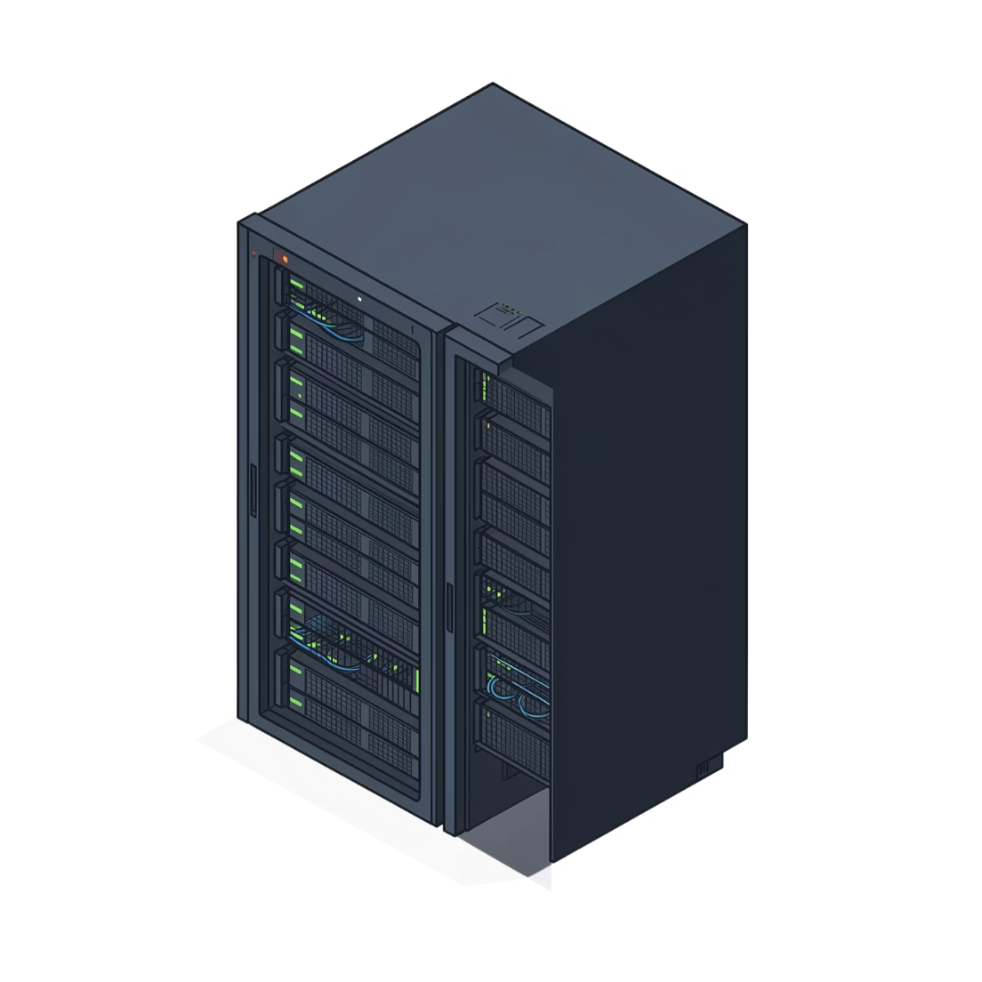


System Architecture
Cloud Infrastructure
Three Frontend Clients
AWS: ECS Fargate, RDS MySQL, S3, ALB, Secrets Manager
Flutter mobile (Android), Next.js web app, Next.js admin panel
Unified Backend
Load Balancing
Node.js + Express REST API + Socket.IO real-time server
ALB routes traffic by path: /api, /socket.io, /admin

Slide 5
Technology Stack Overview
Backend
Frontend Web
Node.js & Express
MySQL + Socket.IO
JWT, bcryptjs, Multer, Nodemailer
Next.js 15 + React
TypeScript + TailwindCSS
Axios
Mobile
Infrastructure
Flutter / Dart
Provider + GoRouter
Dio + socket_io_client
Terraform IaC
GitHub Actions CI/CD
Docker containerization

Slide 6
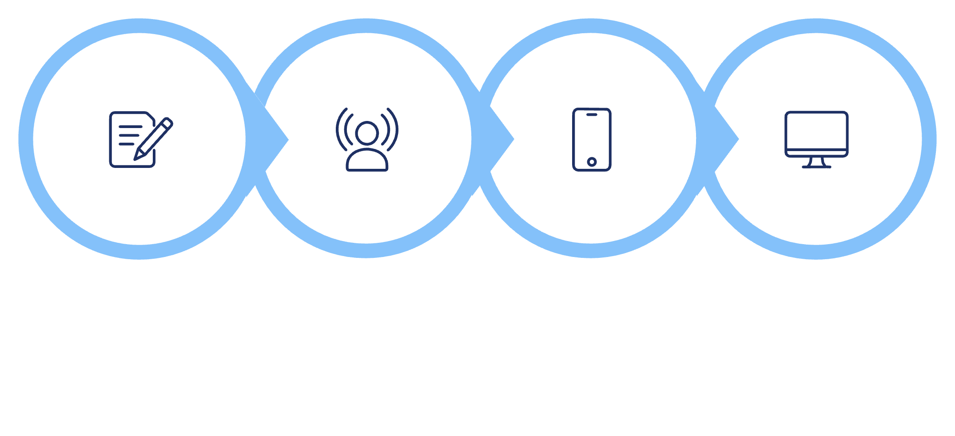
Multi-Platform Synchronization
One Action, Every Platform
All three clients : mobile, web, and admin connect to the same REST API and Socket.IO server, ensuring seamless, instant synchronization.
Job posted on mobile appears instantly on web app and admin dashboard
Admin actions (suspend, verify) take effect across all platforms in real-time
Unified notification system via Socket.IO ensures no user misses critical updates
Customer Posts
Socket.IO Broadcasts
Clients Receive
Admin Dashboard

Slide 7
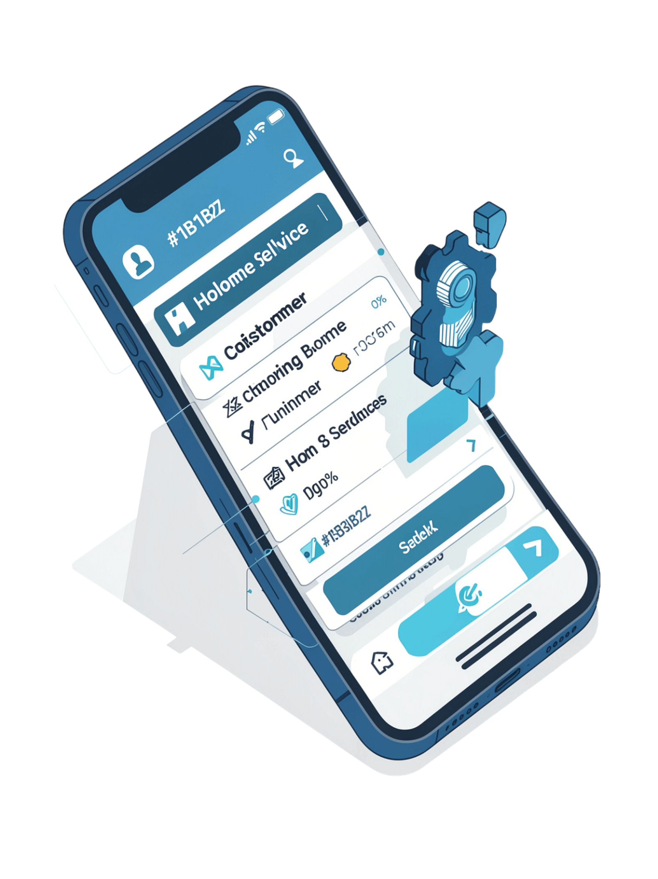
Core Features & User Experience
The end-to-end journey from posting a job to leaving a review across every Kaarkun platform.

Slide 8
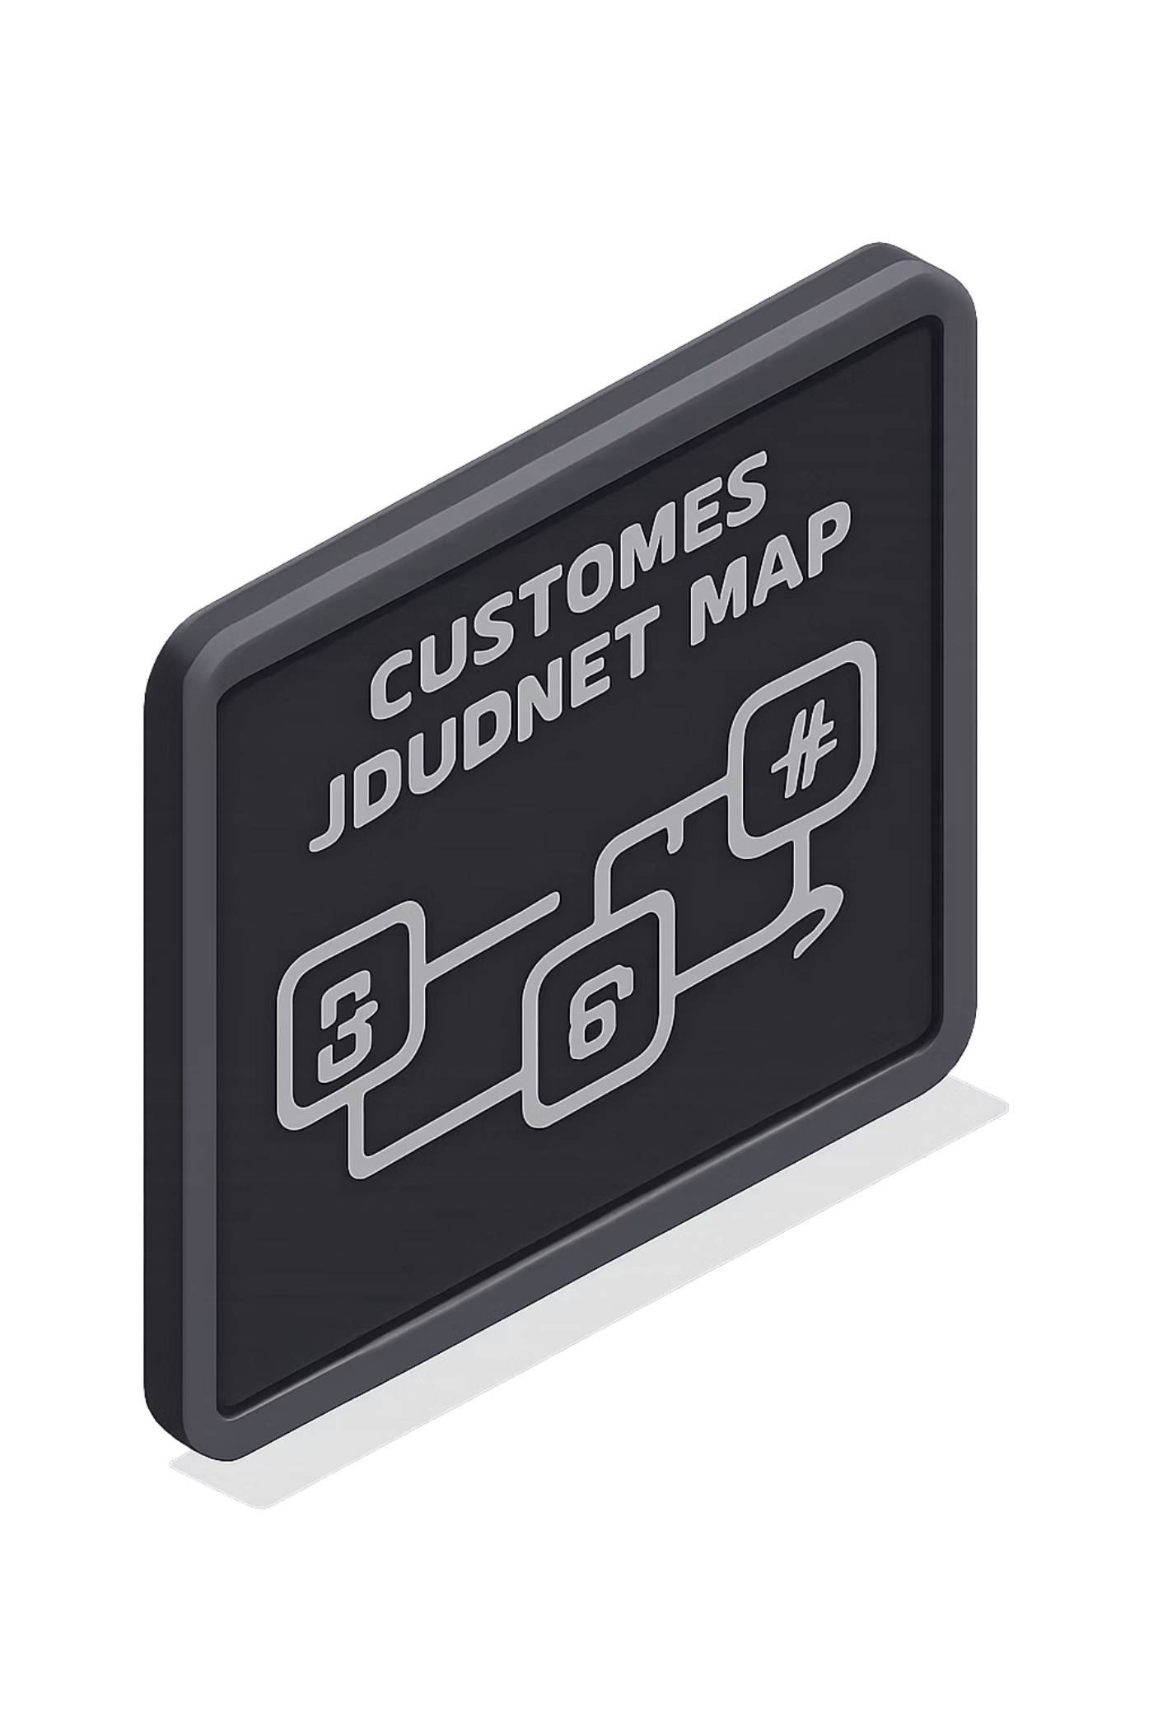
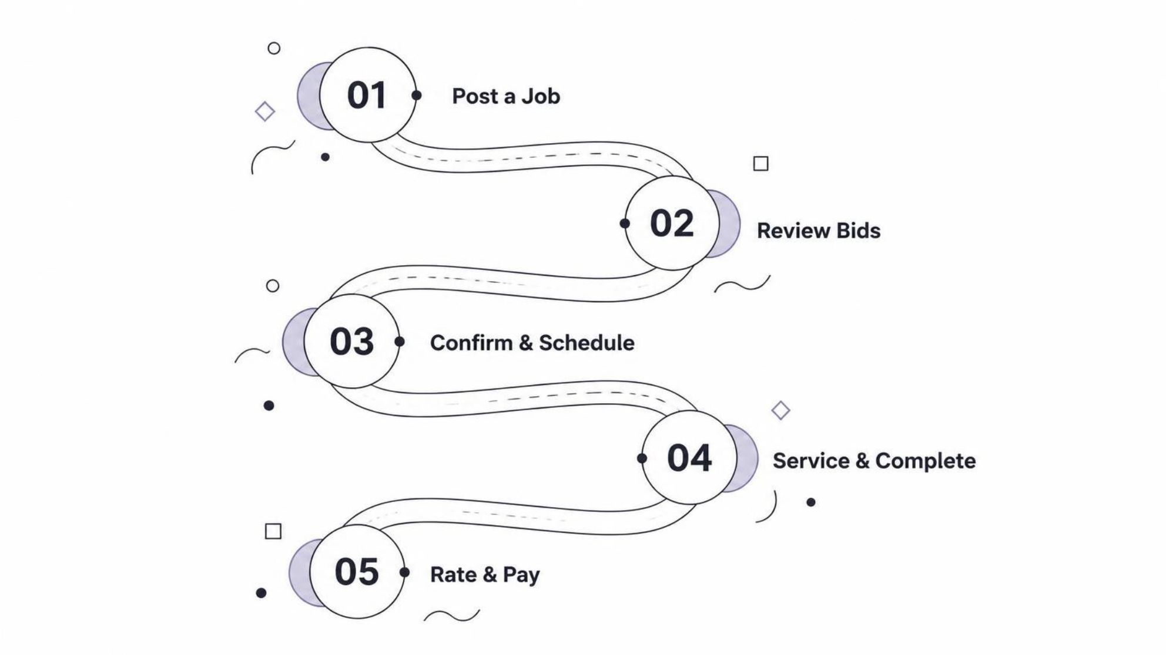
The Customer Workflow
From initial need to satisfied completion, Kaarkun streamlines the home service experience across five intuitive steps for both customers and providers.

Slide 9




The Provider Workflow
Providers experience a streamlined process, from discovering new opportunities to confirming job completion, all within the Kaarkun platform.
Browse & Discover
Bid & Compete
View available service requests filtered by skill, location, and budget.
Submit competitive offers with estimated time and custom cover letters.
Emergency Response
Secure Handshake
Quickly accept urgent jobs for immediate dispatch, bypassing the bidding process.
Verify arrival with customers using QR code scan or PIN entry for secure job initiation.

Slide 10



Admin Dashboard & User Management
Kaarkun's comprehensive admin panel empowers operators with powerful tools to oversee and manage the entire platform efficiently.
Real-time KPIs
Monitor platform performance, job statuses, and user activity with key metrics updated instantly.
User Management
Efficiently suspend, delete, or modify user accounts, ensuring compliance and platform integrity.
Provider Verification
AI-assisted KYC (Know Your Customer) streamlines background checks and ensures trusted service providers.
Account State Management
Control user and provider account states, including activation, deactivation, and privilege adjustments.

Slide 11
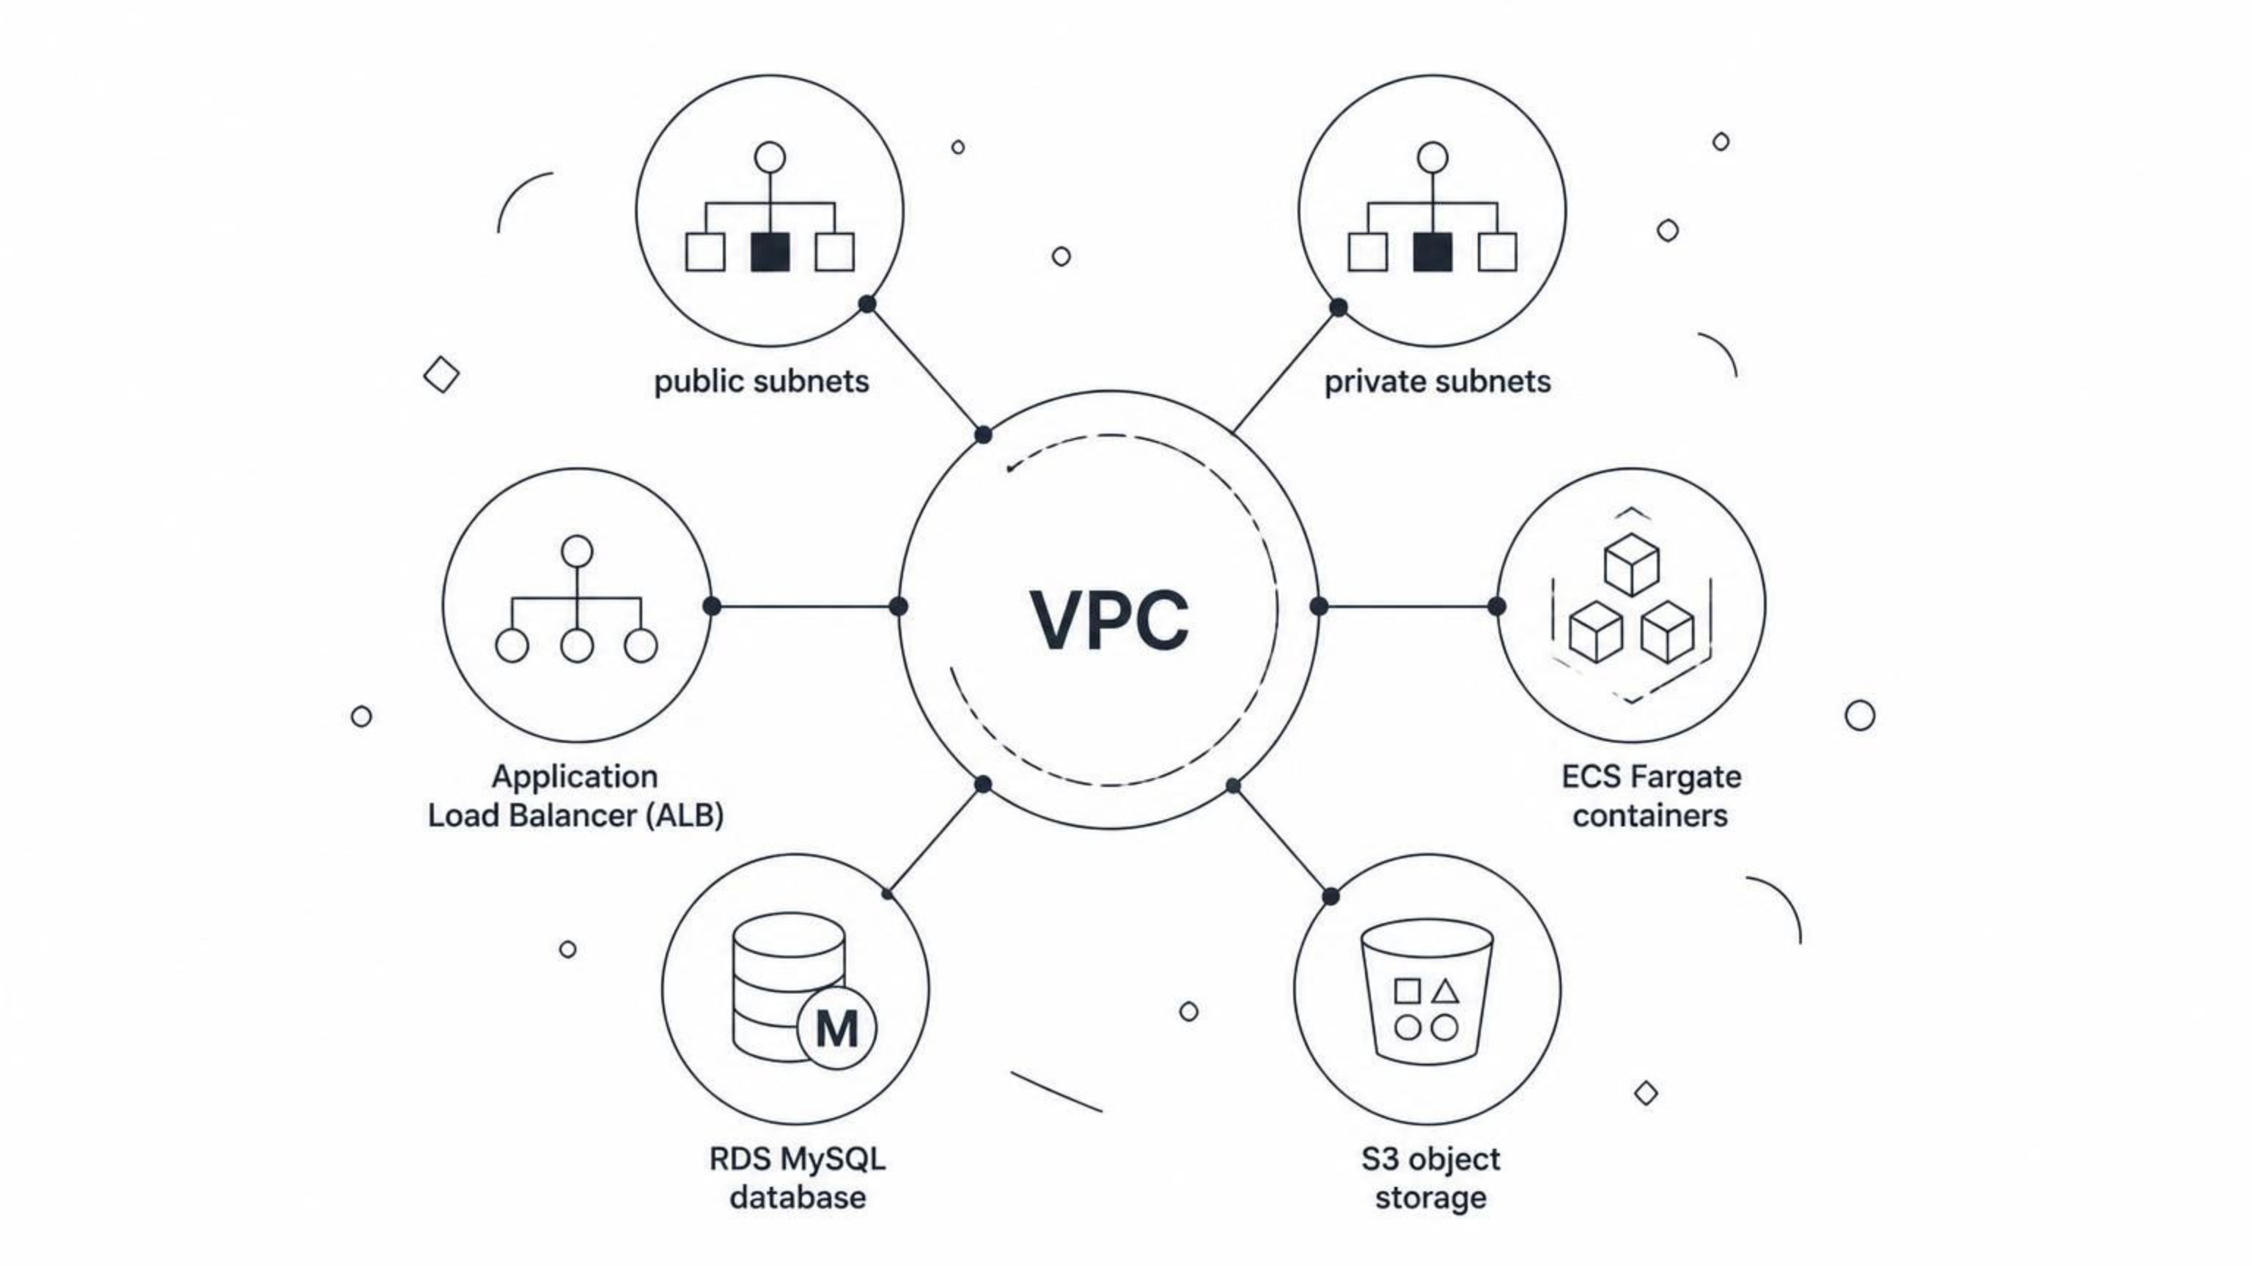
AWS Architecture Overview
A closer look at Kaarkun's cloud infrastructure deployed within the AWS ap-south-1 region, designed for scalability, security, and high availability.
The Virtual Private Cloud (VPC) provides a dedicated and isolated network environment. Within this VPC, resources are organized into public and private subnets to control access. The Application Load Balancer (ALB) efficiently distributes incoming application traffic to the stateless microservices running on ECS Fargate. Data persistence is handled by RDS MySQL for structured data and S3 for media and static assets.

Slide 12




CI/CD Pipeline with GitHub Actions
Kaarkun's deployment process ensures rapid, reliable, and continuous delivery of updates to all environments.
Master Branch Trigger
Docker Build & Push
Pushes to the master branch initiate the workflow.
GitHub Actions builds new Docker images and pushes them to AWS ECR.
ECS Task Updates
Zero-Downtime Deploy
Terraform applies changes to update ECS task definitions with the latest image.
ECS performs a rolling update, ensuring continuous service availability.

Slide 13





Authentication & Authorization
Robust security measures to protect user data and control access.
Secure Password Hashing
Role base Authentication
Account Status Blocking
Utilizes bcryptjs to hash all user passwords before storage, preventing plaintext exposure.
Implements JSON Web Tokens (JWT) for secure session management and role-based access control across all API endpoints.
System-wide blocking based on account status (e.g., suspended, unverified) to restrict access to platform features.
Rate Limiting
Protects against brute-force attacks and abuse by limiting attempts for login and OTP verification.

Slide 14




Real-Time Communication
Socket.IO powers instant, bidirectional communication across Kaarkun, enabling dynamic user experiences and immediate data synchronization for all platforms.
Live Chat & Messaging
Dynamic Notifications
Instant, job-specific discussions between customers and providers, facilitating quick coordination and query resolution.
Real-time alerts for new job postings, bid updates, booking confirmations, and critical status changes directly in-app.
GPS Tracking Updates
Secure Handshake
Live location tracking for active jobs, allowing customers to monitor provider progress and estimated arrival times.
Initial secure WebSocket connection established via JWT for robust session validation and user authentication.

Slide 15







Seven AI-Powered Features
Smart Job Matching
Bid Price Suggestion
Job Description Autocomplete
AI recommends the most suitable service providers for each customer's job, ensuring optimal pairings based on skills, location, and availability.
Providers receive data-driven suggestions for competitive and profitable bid prices, improving their chances of winning jobs.
Customers benefit from AI-powered suggestions and autocomplete functionality when drafting job descriptions, making posting quick and clear.
Support Chatbot
Review Fraud Detection
Dispute Summarization
An intelligent chatbot provides instant answers to common customer and provider queries, offering 24/7 support and reducing agent workload.
AI algorithms analyze review patterns to detect and flag suspicious or fraudulent reviews, maintaining the integrity of provider ratings.
Complex dispute details are automatically summarized by AI, enabling faster understanding and resolution for admin staff.
KYC Verification
Automated Know Your Customer (KYC) processes verify provider identities and documents swiftly and securely, enhancing platform trust.

Slide 16
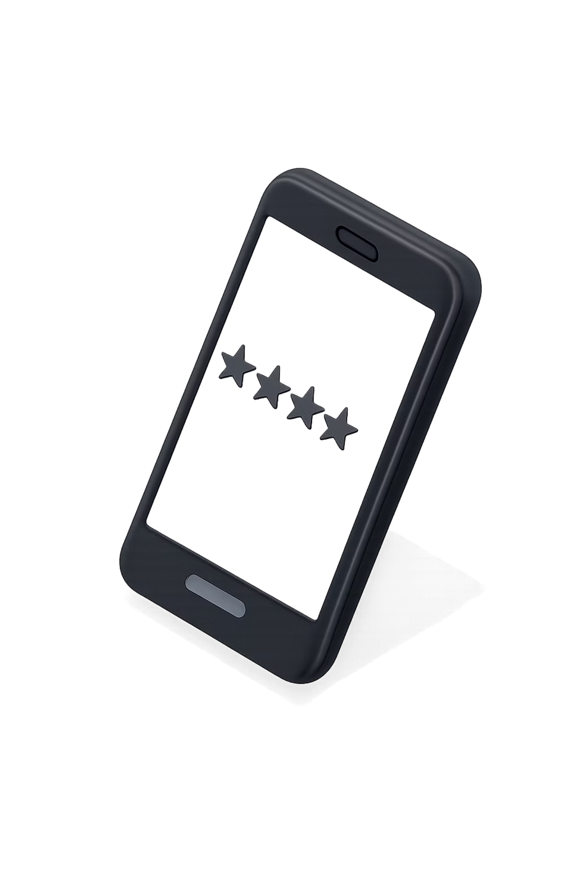
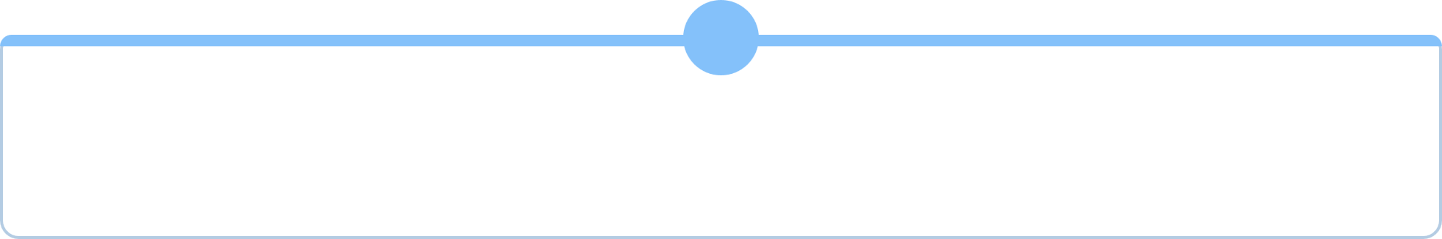




Building Trust: Reviews & Verifications
Ensuring quality, safety, and accountability for every transaction with robust systems for feedback, performance tracking, and dispute resolution.
Post-job Ratings
Customers provide 1-5 star ratings and comments after service completion, ensuring continuous quality feedback for providers and future customers.
Provider Metrics
Aggregated data on job completion rates, average ratings, response times, and cancellation rates visible to customers for informed choices.
AI Fraud Detection
Machine learning models identify suspicious activity, fake reviews, or unusual booking patterns to maintain platform integrity and fairness.
Admin Dispute Tools
Comprehensive admin panel features allow efficient summarization and resolution of disputes, with communication logs and evidence management.

Slide 17

Thank You for Your Time
We deeply appreciate your interest in the Kaarkun project and the opportunity to share our vision.
For any questions, further details, or potential collaborations, please feel free to reach out to us.
Contact Information:
Email: zabbasdev@gmail.com
Website: http://academy-dev-alb-1183018762.ap-south-1.elb.amazonaws.com/
Project Team: Zaheer Abbas, Muhammad Dawood, Ismail Khan

