Slide 1
FinGenie Digital Banking & Wealth Management System
• Digital Banking Solution
• Developed Using ReactJS & Spring Boot
•Presented By: Zaheer Hussain

Slide 2
Problem Statement
• Manual banking processes are slow
• Limited accessibility
• Need secure online banking
• Reduce paperwork and branch dependency
• Improve customer experience

Slide 3
Objectives
• Secure authentication
• Online transactions
• Loan management
• Investment tracking
• Admin monitoring
• Scalable architecture

Slide 4
Technology Stack
• ReactJS Frontend
• Spring Boot Backend
• MySQL Database
• JWT Security
• Swagger Documentation
• Lombok & Validation

Slide 5
System Architecture
• Customer Interface
• React Frontend
• REST APIs
• Spring Boot Services
• Repository Layer
• MySQL Database

Slide 6
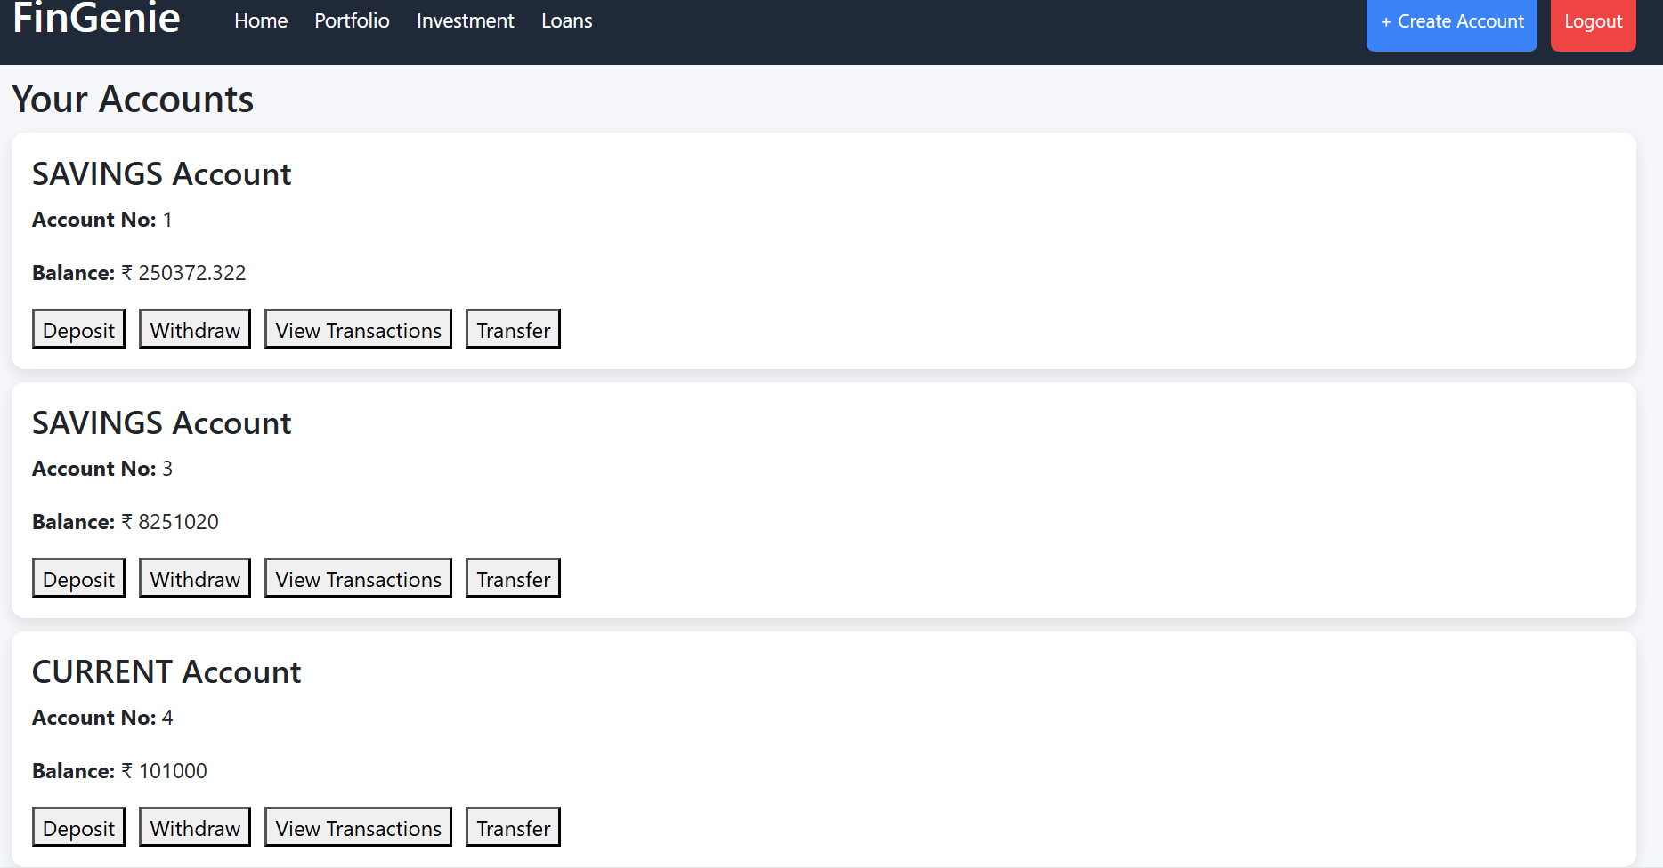
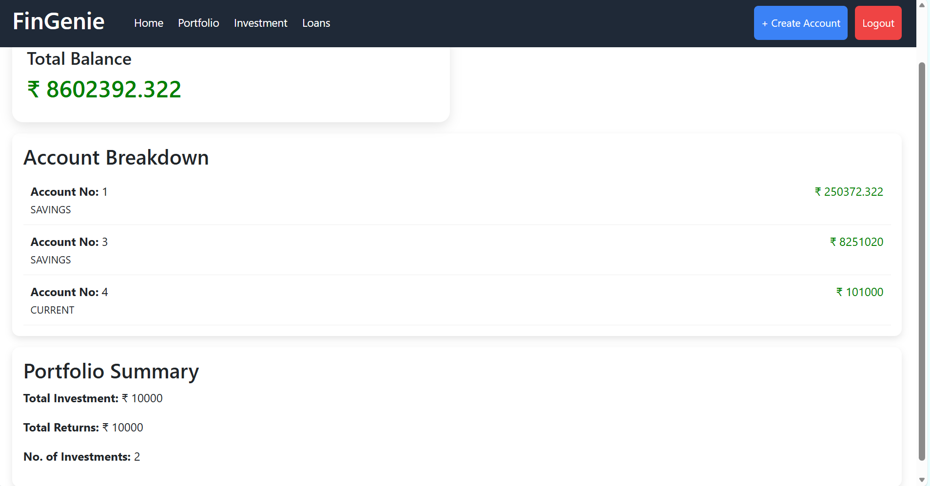

Slide 7
Database Design
• Users Management
• Account Information
• Transaction Records
• Loan Details
• Investment Data
• Role-based Access Tables

Slide 8
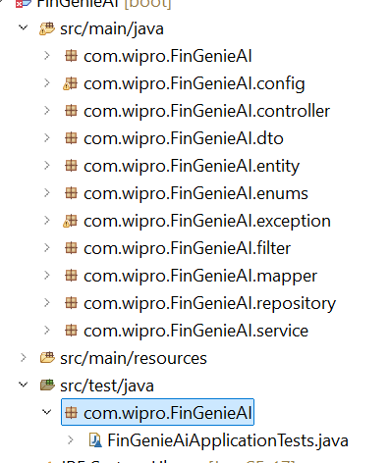
Backend Architecture
• Controller Layer
• Service Layer
• Repository Layer
• Entity Layer
• DTO Layer
• Global Exception Handling
• Logging Support

Slide 9
Frontend Architecture
• Reusable Components
• React Router Navigation
• Axios Integration
• Responsive Dashboard
• Form Validation
• State Management

Slide 10
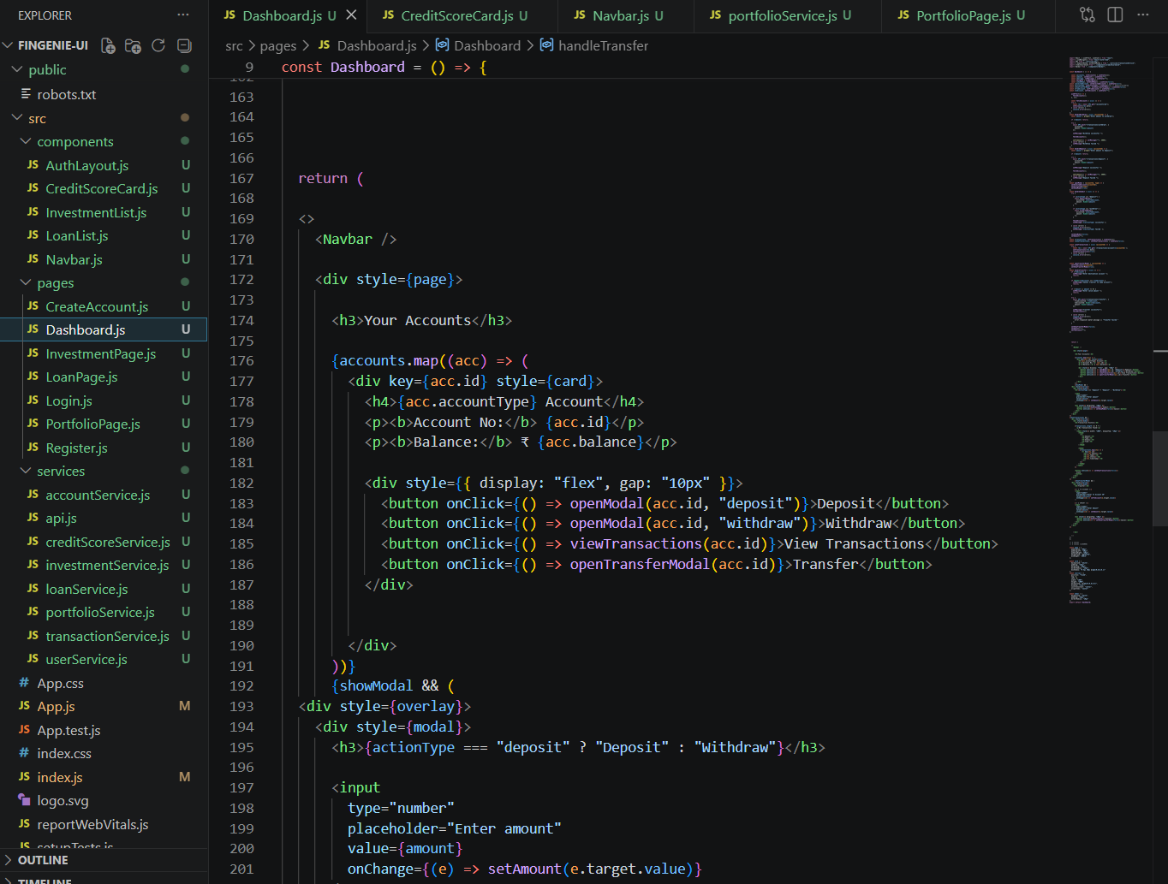

Slide 11
Authentication & Security
• JWT Authentication
• Role-Based Access Control
• BCrypt Password Encryption
• Input Validation
• Protected APIs
• Secure Session Handling

Slide 12
Achievements
• Secure Banking Platform
• Scalable Architecture
• Modern UI/UX
• REST API Development
• Industry Best Practices
• Clean Layered Design

Slide 13
THANK YOU

