Slide 1

Project DRC Presentation on
PREVENTING DoS ATTACKS IN SERVER
BY
SAYED GOUSE JAHEER
Reg. No : 21131F0041
IV semester M.C.A
Under the guidance of
Mr. P .V .V. R Chandra Sekhar
Assistant professor
DEPARTMENT OF COMPUTER APPLICATIONS
GAYATRI VIDYA PARISHAD COLLEGE OF
ENGINEERING (AUTONOMOUS)
VISAKHAPATNAM – 530048
2021-23

Slide 2
ABSTRACT
The rise of the internet has brought about significant advancements in communication. However, it has also led to a major problem in the form of cybercrime or e-crimes. It is evident that there is a common issue to combat it effectively. One possible solution is to install a network packet monitor on the server, which can examine all incoming requests. If the request file size is within the server's processing limit and no virus packets in the file, it will be forwarded to the server. Otherwise, the monitor will discard the request to prevent the server from crashing or being subjected to a DoS attack.

Slide 3
PROBLEM STATEMENT
In this system, it cover various attacks such as Denial of Service (DoS), Middleman attacks, Malware and describing technique to avoid such attacks by installing network monitor and antivirus to check packets in file and to control the attacks.

Slide 4
INTRODUCTION
Denial of Service (DoS) attacks are a major threat to the availability and stability of servers. A DoS attack occurs when an attacker overwhelms a server with a flood of traffic, causing it to crash or become unresponsive.
To prevent DoS attacks, it is essential to implement effective measures that can detect and mitigate these attacks in real-time. In this system, it provide an overview of some of the most effective techniques for preventing DoS attacks in servers, including network monitor, middleman attacks and detecting virus packets in files. By implementing these measures, server administrators can better protect their systems and ensure the continued availability of their services.

Slide 5
PROPOSED SYSTEM
In this system, to prevent DoS attacks where attacker will send huge amount of request to server and server will get busy in processing such huge request data and get crashed and services to normal users will be denied. To overcome from such issue, this system attach with a network packet monitor and big - data Hadoop Map Reduce programming model to evaluate all packets request and then inform to server whether request is normal packet size or attack. Network monitor which will inspect all incoming request and if upload file size is in server processing limit then it will forward request to server otherwise monitor will discard request to save server from getting crash and from DOS attack.
ADVANTAGES
To reduce the overhead of the cyber threats.
Monitoring through Hadoop Map Reduce programming.

Slide 6
SYSTEM REQUIREMENTS
MINIMUM HARDWARE REQUIREMENTS:
PROCESSOR : I3 or above
RAM : 4 GB or above
HARD DISK : 150 GB or above
MINIMUM SOFTWARE REQUIREMENTS
Operating system : Windows 10/11.
Coding Language : JAVA

Slide 7
FUNCTIONAL REQUIREMENTS
Traffic Filtering : The system must be able to filter and block any traffic that is suspected to be par of a DoS attack.
Resource Management : The system should be able to monitor its resource usage and take action when it reaches a certain threshold.
Rate Limiting : The system should be able to limit the rate of incoming traffic from a single IP address or subnet to prevent one client from consuming too many resources.
Logging and Auditing : The system should be able to log and audit all traffic, including rejected traffic, to help identify and mitigate potential DoS attacks.

Slide 8
NON-FUNCTIONAL REQUIREMENTS
SCALABILITY : The system should be able to handle a large number of requests and traffic without being overwhelmed or crashing.
RELIABILITY : The system should be available and responsive even during a DoS attack.
PERFORMANCE : The system should be able to maintain its performance levels even when under attack.
AVAILABILITY : The system should remain available to legitimate users even during a DoS attack.
MONITORING : The system should have monitoring tools in place to detect and migitate DoS attacks in real-time.

Slide 9
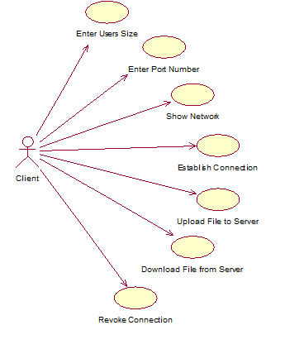
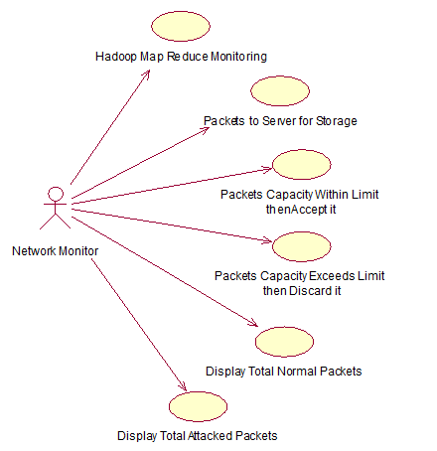
USE CASE DIAGRAM

Slide 10
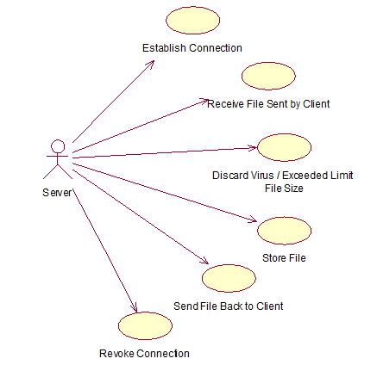
USE CASE DIAGRAM

Slide 11
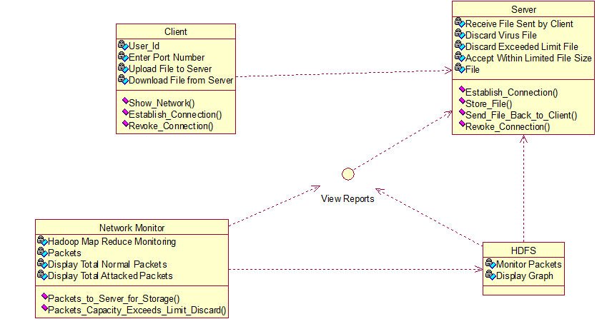
CLASS DIAGRAM

Slide 12
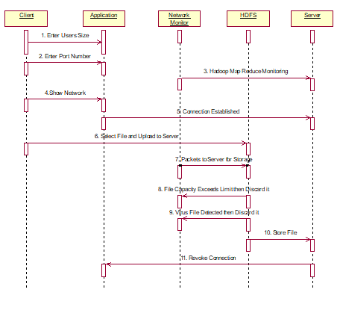
SEQUENCE DIAGRAM

Slide 13
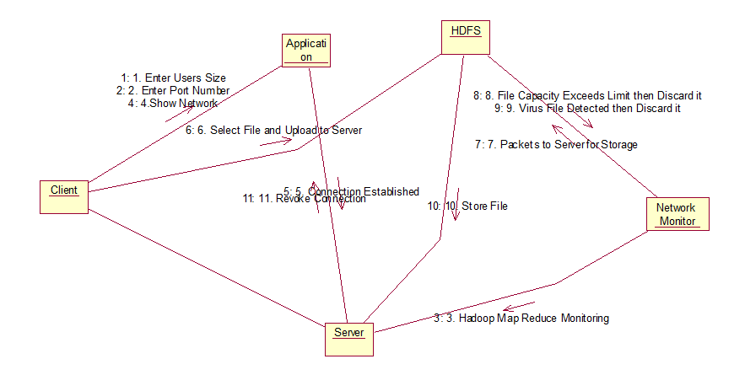
COLLABORATION DIAGRAM

Slide 14
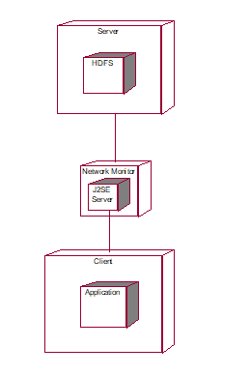
DEPLOYMENT DIAGRAM

Slide 15
THANK YOU!!!

