Slide 1
British Airways
Customer ratings analysis and insights
2022-11-09

Slide 2
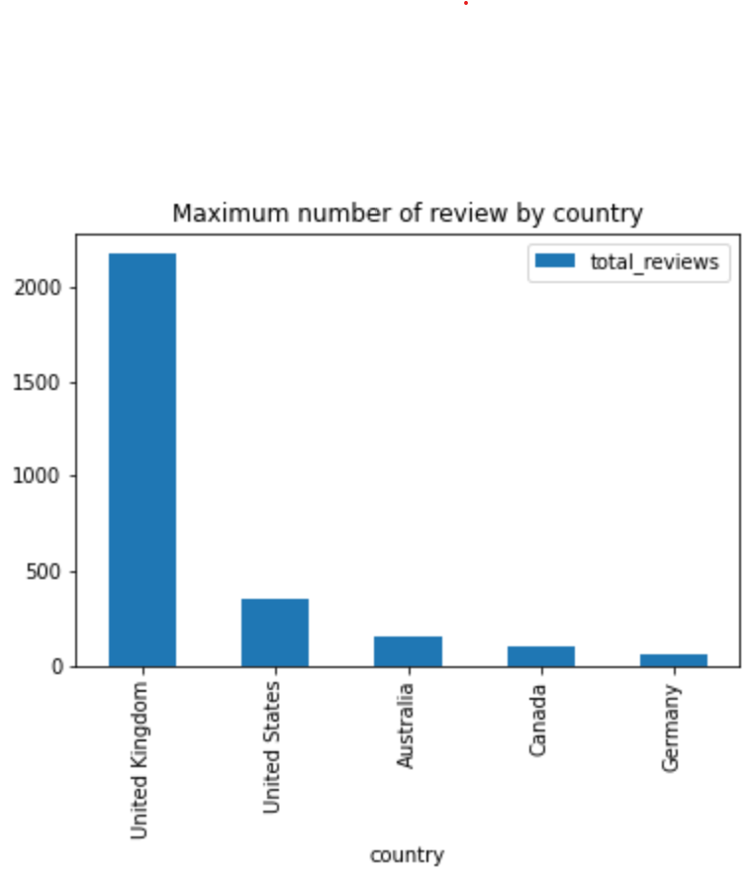
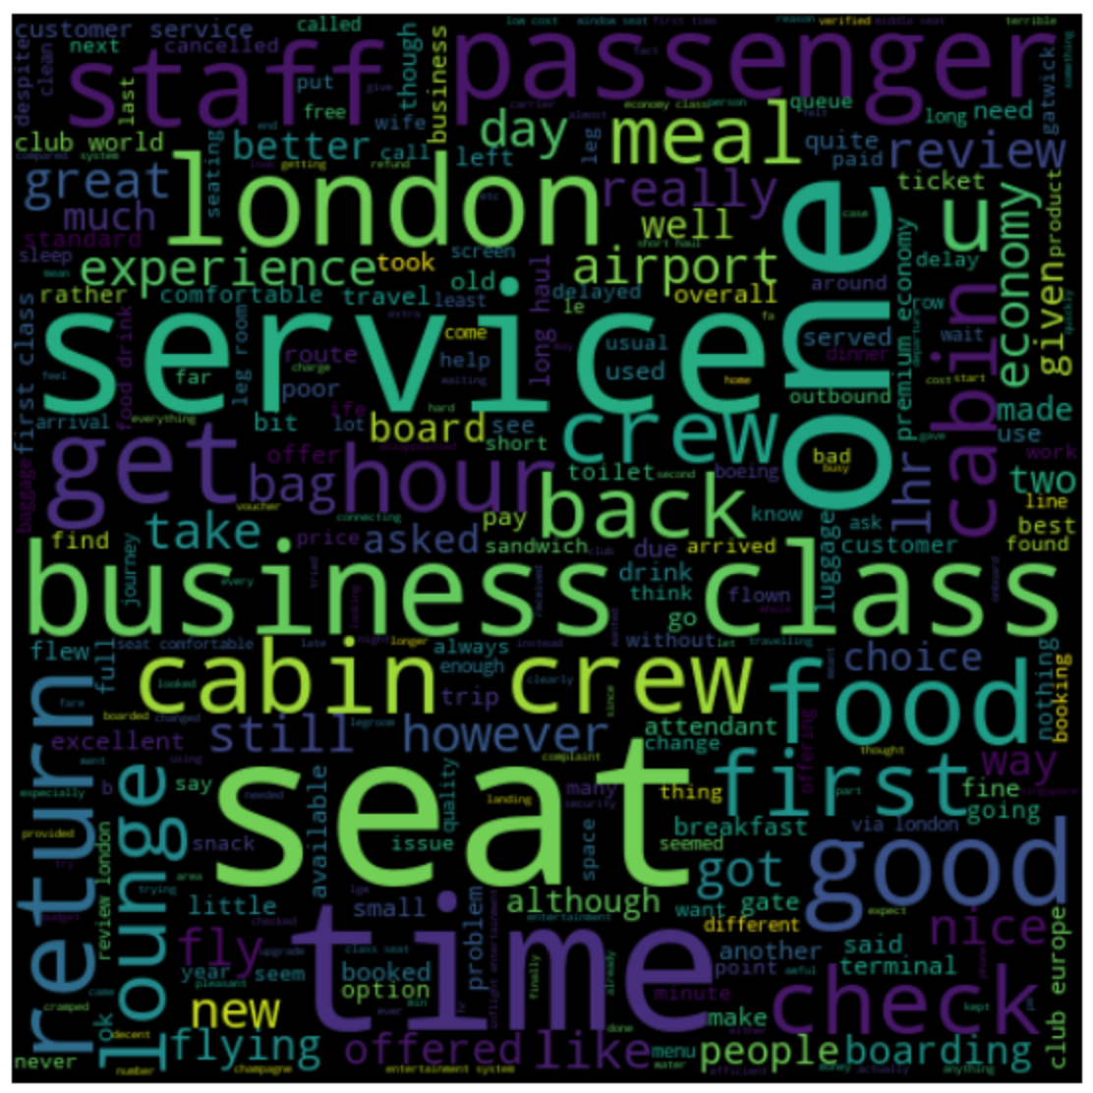
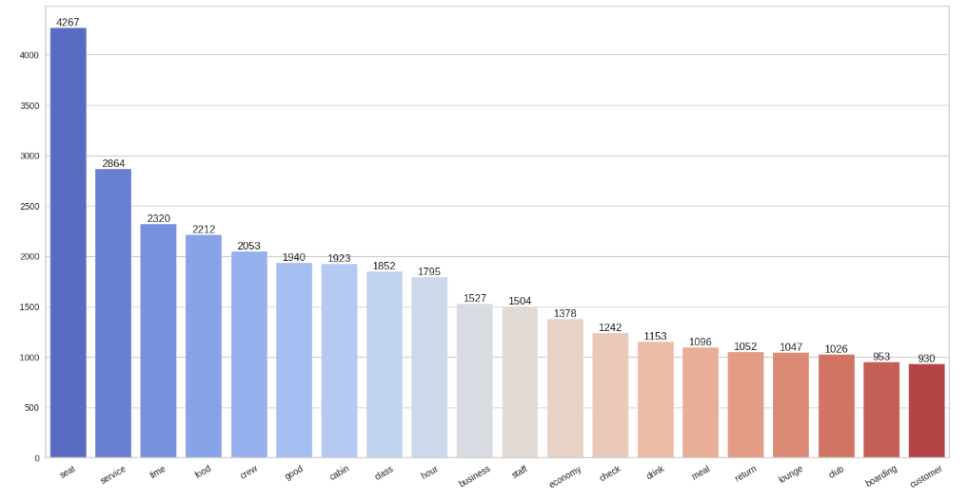
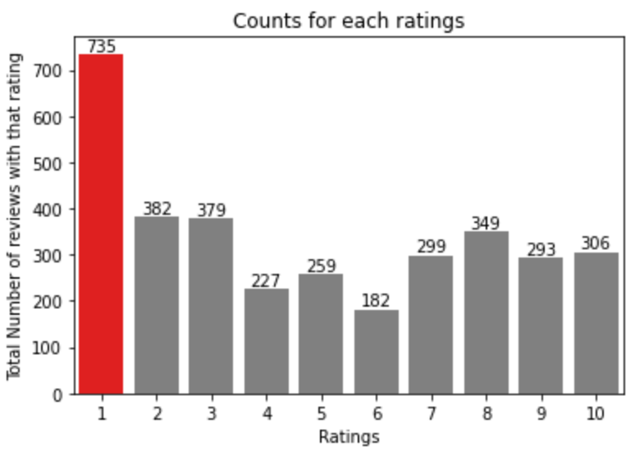
Key metrics
Average Overall Rating
4.84 /10
Reviews from 69 Countries
3411 Total reviews
collected
What customers are happy and unsatisfied about for different ratings class:
High ratings (7 – 10) praised comfortable seats, good inflight entertainment, and descent food quality.
Moderate ratings (4 – 6) cited problems with small screens, long passport check queues, and poor business class experiences.
Low ratings (1 – 3) expressed dissatisfaction with congested middle seats and small screens, despite liking the seats and food.
All Customers liked Cabin crew service and staff, general economy seats. Many travelled in Business class.
Focus on – Economy class service, seats, enhance inflight entertainment experience and importantly Delays. Enhance the experience of business class, it seems customers want value for money. Improve Customer service on refund requests and process.

