Slide 1
Washington Highway CMF Analysis
Benchmark vs Best Model MetaCount Research Group

Slide 2
Objective
Show one thing clearly: does the new hierarchical model beat the benchmark model on out-of-sample performance, and what do the coefficient differences imply for safety interpretation.

Slide 3
Dataset Snapshot
Metric | Value
Segments | 275
Response | FREQ (crash count)
Main exposure | AADT
Offset | log(Length)
Family used in selected model | NB2

Slide 4
Benchmark Model
Baseline characteristics | Value
AADT treatment | Fixed offset style
AADT-varying CMFs | No
Random heterogeneity | No
logμ=α+logAADT+logL+j​βjxj

Slide 5
Best Model Found
Best-model characteristics | Value
AADT treatment | Estimated elasticity
AADT-varying CMFs | Yes
Random heterogeneity support | Yes (when RP refit available)
logμ=α+βAADTlogA+j​βjxj+k​γkxklogA+logL

Slide 6
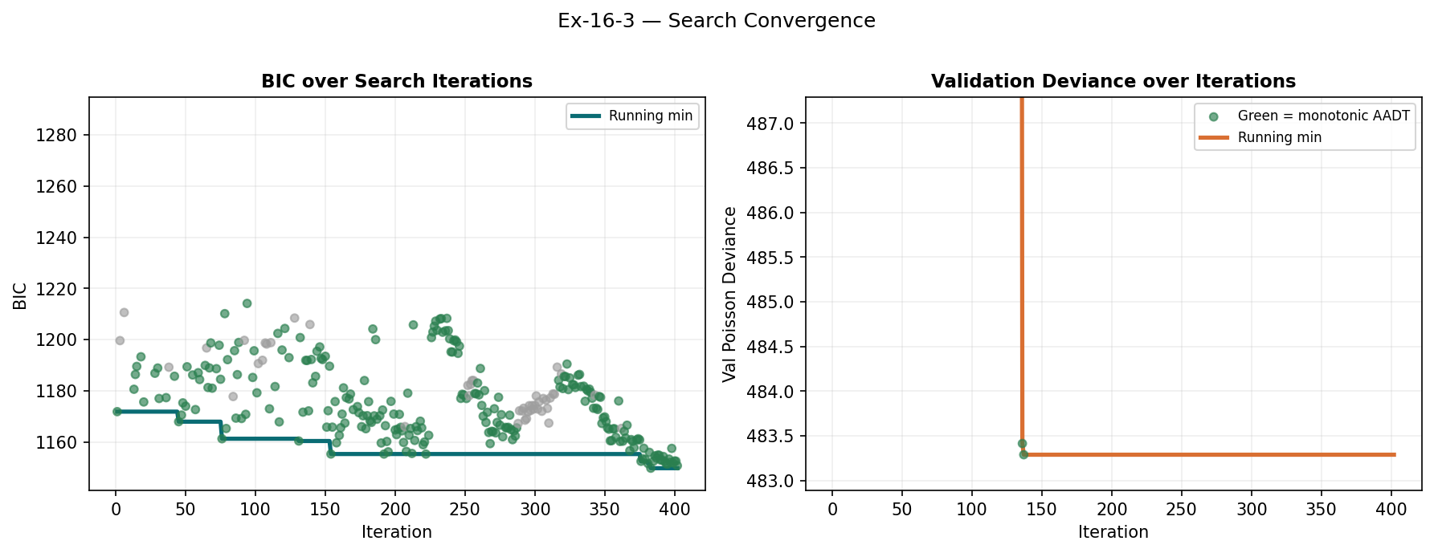
Search Outcome (Concise)
Search convergence (selection-stage metrics).

Slide 7
Search Phase | Candidates evaluated | Best BIC | Best Val RMSE | Median BIC | Median Val RMSE | First iter within 0.5% of best BIC
Simulated Annealing | 177.00 | 1,149.85 | 14.7784 | 1,174.27 | 17.2133 | 376.00
Harmony Search | 95.0000 | 1,155.37 | 13.7222 | 1,172.22 | 17.3585 | 131.00

Slide 8
Benchmark vs Best: Key Result
Model | BIC | AIC | Test RMSE | Test Poisson Dev | Test R2
Benchmark (Ex16-3 literature model) | 1607.72 | 1577.18 | 14.186 | 315.17 | 0.5432
Hierarchical CMF (selected) | 1593.77 | 1556.44 | 12.8741 | 308.15 | 0.6238

Slide 9
Lower BIC, lower Test RMSE, and higher Test R2 all point in the same direction: the best model outperforms the benchmark on held-out data.

Slide 10
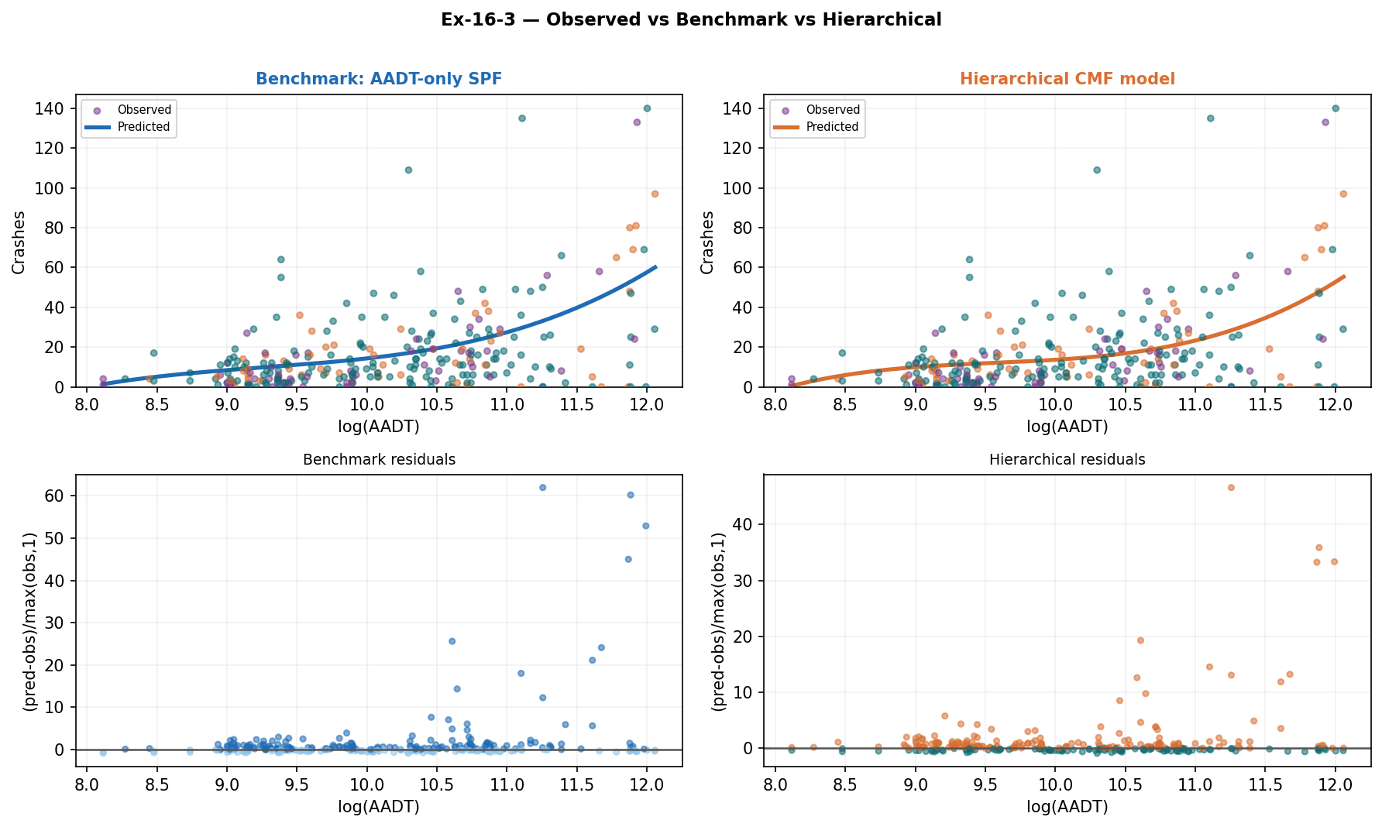
Observed vs Predicted Comparison
Observed and predicted crashes for benchmark vs best model.

Slide 11
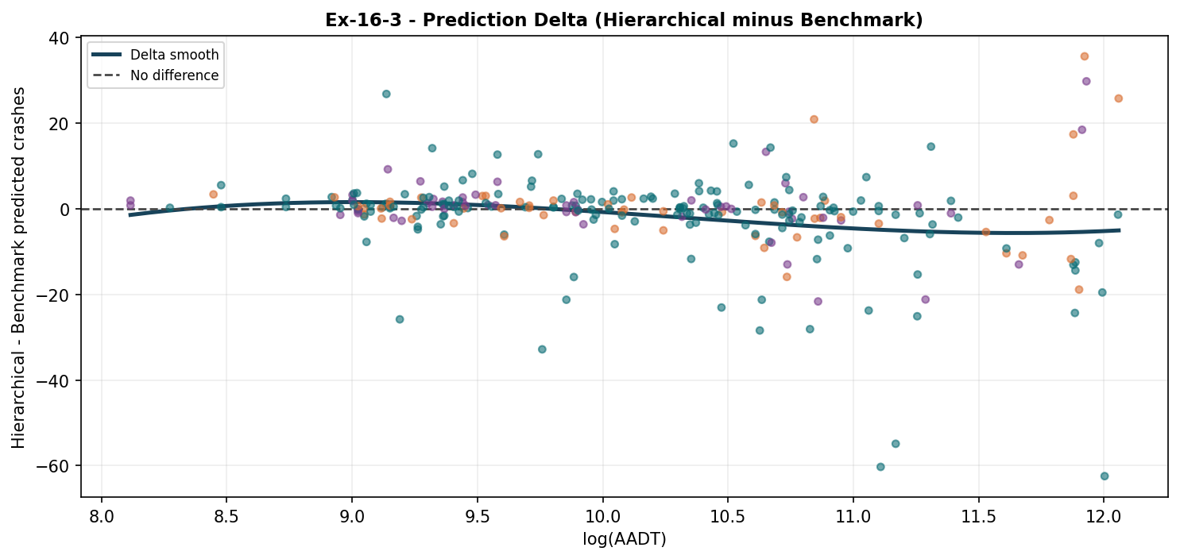
Difference Plot: Best Minus Benchmark
Positive values mean the best model predicts more crashes than benchmark at that traffic level; negative values mean fewer.
Prediction delta by traffic level: hierarchical minus benchmark.

Slide 12
What Coefficient Differences Suggest About Safety
Parameter | Benchmark coef | Proposed coef | Safety implication
Intercept | -8.2280 | -7.0970 | higher value linked with lower crashes; weaker than benchmark
Average Longitudinal Slope (%) |  | -1.4595 | higher value linked with lower crashes; new or benchmark-missing term
log(AADT) |  | 0.883433 | higher value linked with higher crashes; new or benchmark-missing term
Average Longitudinal Slope (%) x log(AADT) |  | 0.149102 | higher value linked with higher crashes; new or benchmark-missing term
Lane Width (ft) |  | -0.093587 | higher value linked with lower crashes; new or benchmark-missing term
Minimum Vertical Grade (%) |  | -0.060196 | higher value linked with lower crashes; new or benchmark-missing term
Number of Horizontal Curves (count) |  | -0.022981 | higher value linked with lower crashes; new or benchmark-missing term
Posted Speed Limit (mph) |  | -0.011960 | higher value linked with lower crashes; new or benchmark-missing term

Slide 13
Final Takeaway
Question | Answer
Did the best model beat benchmark on held-out data? | Yes
Is the improvement consistent across metrics? | Yes (BIC, RMSE, R2)
Does the model change safety interpretation? | Yes, via coefficient direction/magnitude differences and interaction effects

Slide 14
Next action: use the safety-implication terms to prioritize policy checks on road segments where benchmark and best-model predictions diverge most.

Slide 15
Appendix: Compact Coefficients
Parameter | Benchmark coef | Proposed fixed | Random mean | Random SD
Average Annual Precipitation (in/yr) x log(AADT) |  | 0.006028
Average Longitudinal Slope (%) |  | -1.4595
Average Longitudinal Slope (%) x log(AADT) |  | 0.149102
Exposure Index | -0.066386
Grade-Break Rate per Mile | 0.011867
High-Snow Days per Year (snowfall > 1 in/day) | 0.212231
Horizontal Curve Density (curves per mile) | 0.061300
Intercept | -8.2280 | -7.0970
Intersection Density (intersections per mile) | -0.027817
Lane Width (ft) |  | -0.093587
Lane Width (ft) x log(AADT) |  | 0.007206
Low-Precipitation Days per Year (precip < 1.5 in/month) | -0.124630
Minimum Vertical Grade (%) |  | -0.060196
Number of Horizontal Curves (count) |  | -0.022981
Pavement Friction, Skid Number (higher = more grip) | 0.015220
Posted Speed Limit (mph) |  | -0.011960
log(AADT) |  | 0.883433

