Slide 1
Washington Highway CMF Analysis
Hierarchical Crash Modification Factors MetaCount Research Group

Slide 2
Data Overview
Metric | Value
Road segments | 275
Variables | 39
Response | Crash count (FREQ)
Traffic | AADT
Exposure | Length (log offset)
Model family | NB2
Category | Key Variables
Traffic | AADT, PEAKHR, ADTLANE, EXPOSE
Geometry | INCLANES, DECLANES, WIDTH, MEDWIDTH
Alignment | CURVES, MINRAD, TANGENT, GRADEBR
Grade | MIGRADE, MXGRADE, MXGRDIFF, SLOPE
Roadside | MIMEDSH, MXMEDSH, ACCESS, FRICTION
Climate | AVEPRE, AVESNOW, HISNOW, LOWPRE
Road class | URB, FC, SINGLE, DOUBLE, TRAIN
Auxiliary | INTPM, CPM, INTECHAG

Slide 3
Baseline vs Best Model
logμi=α+βAADTlogAADTi⏟AADT elasticity+j​βjxij⏟Upper: direct+k​γkxiklogAADTi⏟Lower: modify elasticity+logLi

Slide 4
Benchmark model (baseline)
logμ=α+logAADT+logL+j​βjxj
Fixed AADT offset style
No AADT interaction terms
No random-parameter heterogeneity
Best hierarchical model (found by search)
logμi=α+βAADTlogAi+j​βjxij+k​γkxiklogAi+logLi
Estimates AADT elasticity from data
Adds traffic-interaction CMF terms
Supports random-parameter heterogeneity in refit

Slide 5
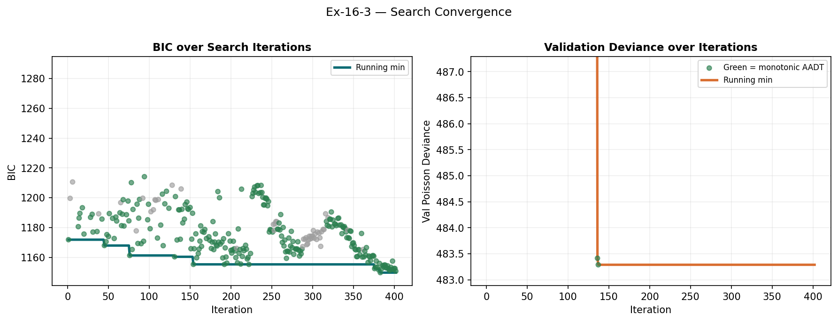
Search Outcome (Selection Stage)
Dotted line = all proposed models · Solid envelope = running best · Green = monotonic AADT · Grey = excluded · Star = global best
Metric scope note
Search-convergence plots report validation metrics during selection (train-fit evaluated on validation split).
Benchmark comparison slide reports held-out test metrics after final refit on train+validation.
These numbers are expected to differ because they are computed on different splits and at different fit stages.
Convergence: proposed-path trace (dotted) + running best solid envelope for BIC (left) and Validation RMSE (right). Green = monotonic AADT, grey = non-monotonic (excluded), star = global best.

Slide 6
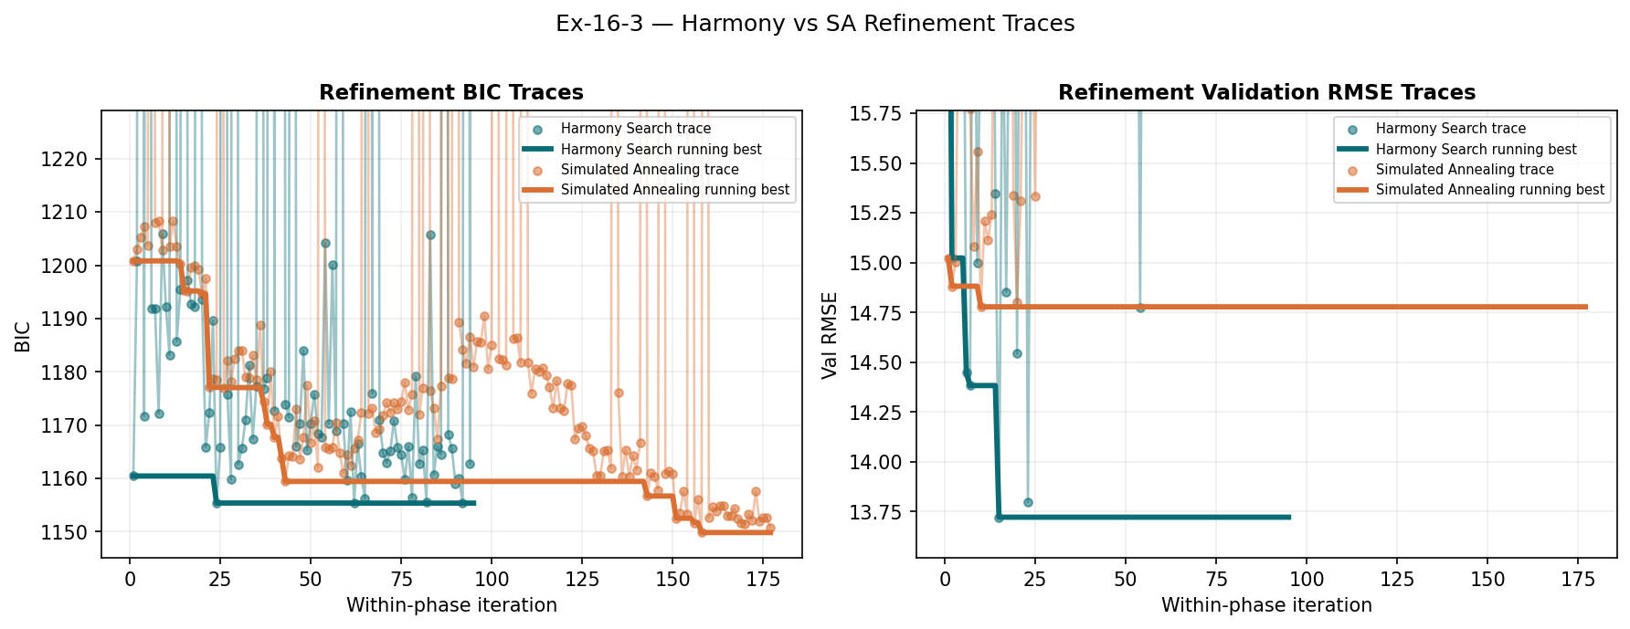
Best Model Found by Search
Bottom line: both refinement methods converged to the same winning specification.
Both refinement phases shown together: Harmony Search (left) and Simulated Annealing (right). BIC and Validation RMSE axes are windowed to show only competitive models. Running-best envelopes in bold; per-iteration proposals in lighter dots.

Slide 7
Phase | Best iteration | Best BIC | Best validation RMSE
Simulated Annealing | 2,203 | 1,147.82 | 16.2576
Harmony Search | 1,129 | 1,147.82 | 16.2576

Slide 8
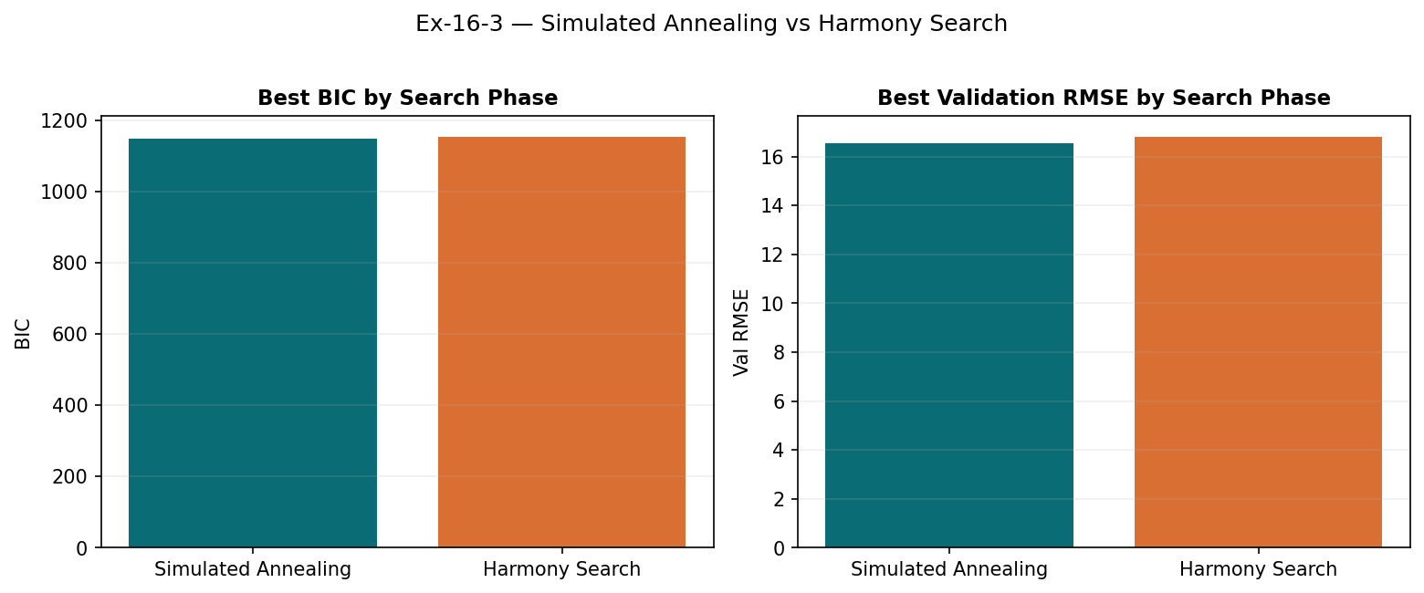
Simulated Annealing vs Harmony (Side-by-Side)
Best SA candidate vs best Harmony candidate by BIC and Validation RMSE.

Slide 9
SA vs Harmony - Distribution Differences
Search Phase | Candidates evaluated | Best BIC | Best Val RMSE | Median BIC | Median Val RMSE | First iter within 0.5% of best BIC
Simulated Annealing | 177.00 | 1,149.85 | 14.7784 | 1,174.27 | 17.2133 | 376.00
Harmony Search | 95.0000 | 1,155.37 | 13.7222 | 1,172.22 | 17.3585 | 131.00

Slide 10
Final Model — Random-Parameters NB2
Type | Meaning
Fixed effects | Same coefficient for every segment
Random means | Average effect across sites
Random SDs | How much the effect varies by site
Full coefficient table: fixed effects + random parameters (Mean ± SD across sites)
Random parameters capture site-level heterogeneity in the effect of each variable.
Random-parameters summary

Slide 11
Random-Parameters NB2 | unavailable
Compact random-parameter table unavailable in this run.

Slide 12
Fixed-Effects Decomposition
Variable | Full Name | Coefficient | CMF
Intercept | Intercept | -7.0970
log(AADT) | log(AADT) Elasticity | +0.8834
CURVES | Number of Horizontal Curves (count) | -0.0693 | 0.9773
MIGRADE | Minimum Vertical Grade (%) | -0.0648 | 0.9416
SLOPE | Average Longitudinal Slope (%) | -1.1840 | 0.2324
SPEED | Posted Speed Limit (mph) | -0.0669 | 0.9881
WIDTH | Lane Width (ft) | -1.5104 | 0.9107
Upper terms (AADT-independent CMFs) and lower terms (AADT-interaction effects)
Upper terms — direct CMF (same at any AADT level)
$\text{CMF}=e^{ β Δx}$

Slide 13
Variable | Full Name | Coefficient
AVEPRE | Average Annual Precipitation (in/yr) | +0.0141
SLOPE | Average Longitudinal Slope (%) | +0.1210
WIDTH | Lane Width (ft) | +0.1163
Lower terms — modify AADT elasticity
$\text{CMF}\left(\text{AADT}\right)={\text{AADT}}^{ γ Δx}$

Slide 14
Benchmark Comparison
Model | BIC | AIC | Test RMSE | Test Poisson Dev | Test R2
Benchmark (Ex16-3 literature model) | 1607.72 | 1577.18 | 14.186 | 315.17 | 0.5432
Hierarchical CMF (selected) | 1593.77 | 1556.44 | 12.8741 | 308.15 | 0.6238
Hierarchical CMF vs Benchmark — key metrics

Slide 15
What the numbers mean
Model difference
Metric | Better is… | Result
BIC | Lower | Hierarchical wins
Test RMSE | Lower | Hierarchical wins
Test R² | Higher | Hierarchical wins
Feature | Benchmark | Hierarchical
AADT coefficient | Fixed = 1.0 | Estimated elasticity
Variable CMFs | Fixed only | Fixed + AADT-varying
Site heterogeneity | None | Random parameters
AADT monotonicity | Not enforced | Enforced during search
Lower BIC = model improvement is genuine, not overfitting
Lower RMSE = better predictions on unseen segments
Higher R² = more crash variance explained

Slide 16
Parameter | Benchmark coef | Proposed coef | Safety implication
Intercept | -8.2280 | -7.0970 | higher value linked with lower crashes; weaker than benchmark
Average Longitudinal Slope (%) |  | -1.4595 | higher value linked with lower crashes; new or benchmark-missing term
log(AADT) |  | 0.883433 | higher value linked with higher crashes; new or benchmark-missing term
Average Longitudinal Slope (%) x log(AADT) |  | 0.149102 | higher value linked with higher crashes; new or benchmark-missing term
Lane Width (ft) |  | -0.093587 | higher value linked with lower crashes; new or benchmark-missing term
Minimum Vertical Grade (%) |  | -0.060196 | higher value linked with lower crashes; new or benchmark-missing term
Number of Horizontal Curves (count) |  | -0.022981 | higher value linked with lower crashes; new or benchmark-missing term
Posted Speed Limit (mph) |  | -0.011960 | higher value linked with lower crashes; new or benchmark-missing term
Metric scope note
Search-convergence plots report validation metrics during selection (train-fit evaluated on validation split).
Benchmark comparison slide reports held-out test metrics after final refit on train+validation.
These numbers are expected to differ because they are computed on different splits and at different fit stages.

Slide 17
Side-by-Side Model Forms
Form | Structure
Benchmark | log(mu_hat) = alpha + log(AADT) + log(L) + sum(beta_j * x_j)
Hierarchical | log(mu_hat) = alpha + beta_AADTlog(A) + sum(beta_jx_j) + sum(gamma_kx_klog(A)) + log(L)

Slide 18
Main difference | Benchmark | Hierarchical
AADT slope | Fixed at 1.0 | Estimated
CMFs | Fixed only | Fixed + traffic-varying
Heterogeneity | None | Random parameters

Slide 19
What Is Gained Beyond Benchmark CMFs
Capability | Benchmark SPF | Hierarchical CMF
Traffic-only CMF between two AADT levels | Yes: (A2/A1)^beta_AADT | Yes
Variable-specific CMF (lane width, shoulder, etc.) | No | Yes (upper terms)
AADT-varying CMF for a variable | No | Yes (lower terms)
Site heterogeneity in parameter effects | No | Yes (random parameters)
Monotonic AADT enforcement during selection | Not explicit | Explicit (elasticity constraint)
CMF capability: benchmark vs hierarchical approach

Slide 20
Practical meaning: the benchmark can only scale crashes with traffic volume globally. The hierarchical model can answer policy questions like “how does widening shoulder or changing curvature affect risk at low vs high AADT, and how variable is that effect across sites?”
Benchmark CMF form: (A2/A1)^beta_AADT
Hierarchical CMF forms: exp(betadelta_x) and AADT^(gammadelta_x)

Slide 21
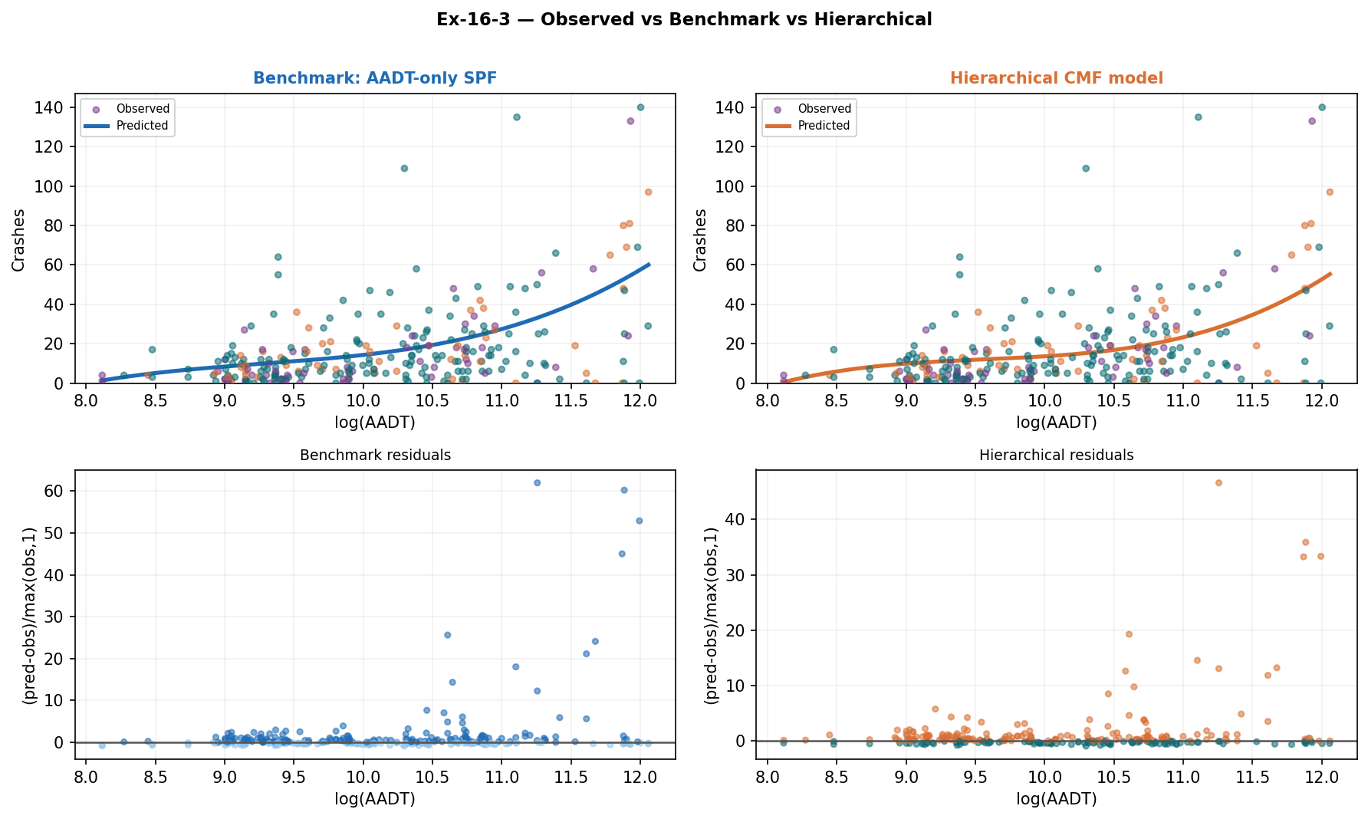
Model Comparison — Baseline vs Hierarchical
Observed crashes + both predicted curves on the same AADT axes
Observed crashes (dots by split) vs polynomial-smooth predictions from the AADT-only benchmark (blue dashed) and the hierarchical CMF model (orange solid). Bottom panel shows normalised residuals for each model vs AADT.

Slide 22
Model | BIC | AIC | Test RMSE | Test Poisson Dev | Test R2
Benchmark (Ex16-3 literature model) | 1607.72 | 1577.18 | 14.186 | 315.17 | 0.5432
Hierarchical CMF (selected) | 1593.77 | 1556.44 | 12.8741 | 308.15 | 0.6238

Slide 23
Why curves can look similar: both models track the same traffic-exposure trend. The improvement appears in residual structure and test metrics (RMSE and R2), not only visual separation of smoothed lines.

Slide 24
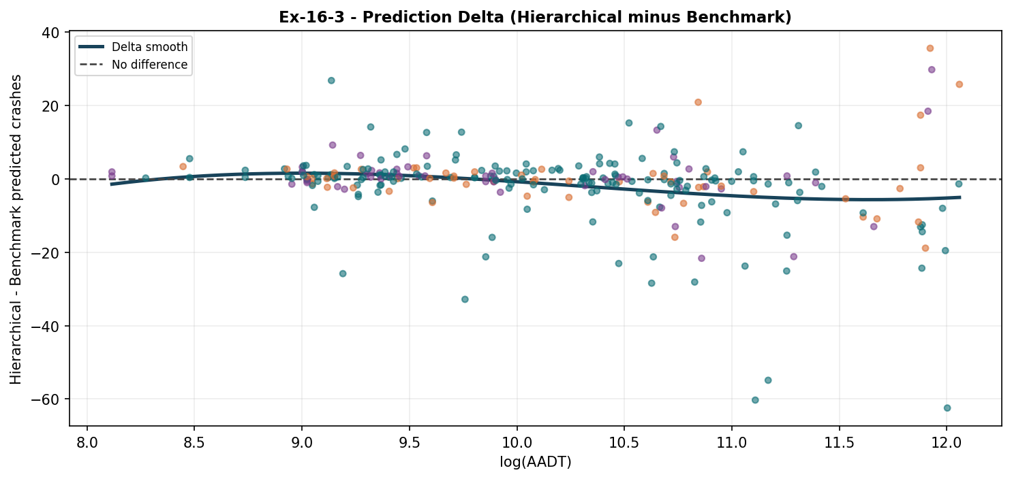
Prediction Delta vs AADT
Prediction difference by traffic level: hierarchical minus benchmark predicted crashes, plotted against log(AADT). Values above zero indicate the hierarchical model predicts more crashes; below zero indicates fewer than benchmark.

Slide 25
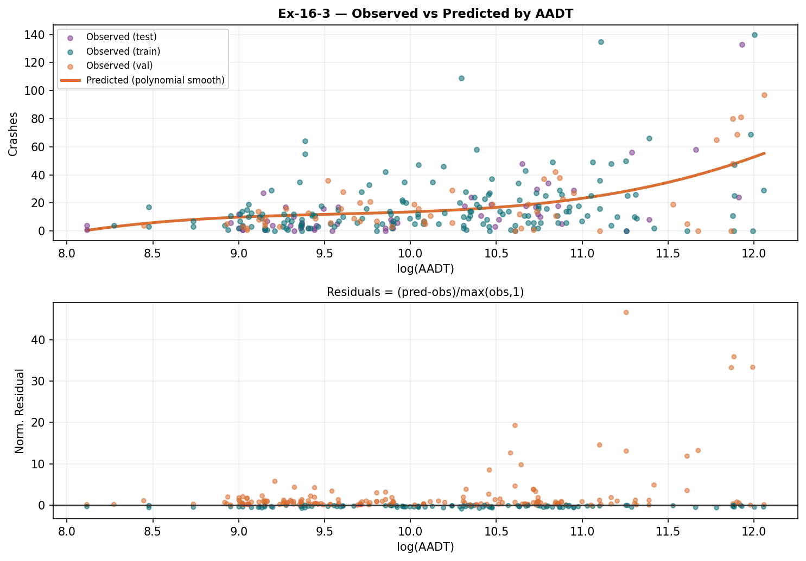
AADT Response — Hierarchical Model
Observed vs hierarchical predictions with normalised residuals
Observed crashes vs hierarchical model polynomial smooth. Bottom: normalised residuals — orange = over-predicted, teal = under-predicted.

Slide 26
The Fitted Model — Every Term Spelled Out
Variable | Full Name | Coefficient | CMF
Intercept | Intercept | -7.0970
log(AADT) | log(AADT) Elasticity | +0.8834
CURVES | Number of Horizontal Curves (count) | -0.0693 | 0.9773
MIGRADE | Minimum Vertical Grade (%) | -0.0648 | 0.9416
SLOPE | Average Longitudinal Slope (%) | -1.1840 | 0.2324
SPEED | Posted Speed Limit (mph) | -0.0669 | 0.9881
WIDTH | Lane Width (ft) | -1.5104 | 0.9107
Upper terms — direct CMF ($e^{ β Δx}$, same at any AADT)

Slide 27
Variable | Full Name | Coefficient
AVEPRE | Average Annual Precipitation (in/yr) | +0.0141
SLOPE | Average Longitudinal Slope (%) | +0.1210
WIDTH | Lane Width (ft) | +0.1163
Lower terms — modify AADT elasticity (${\text{AADT}}^{ γ Δx}$)

Slide 28
Full equation: logμi=α+βAADTlogAi+j​βjxij+k​γkxiklogAi+logLi

Slide 29
How to Read Each Coefficient as a CMF
logμ=α⏟intercept+βAADTlogA⏟base AADT+j​βjxj⏟upper+k​γkxklogA⏟lower+logL

Slide 30
Upper term — fixed CMF at any AADT
$${\text{CMF}}_{j}=e^{ β_{j} Δx_{j}} \text{(same for all traffic levels)}$$
A negative $β$ (e.g. shoulder width) means more of that variable = fewer crashes, at any AADT.
Lower term — CMF scales with traffic
$${\text{CMF}}_{k}\left(\text{AADT}\right)={\text{AADT}}^{ γ_{k} Δx_{k}}$$
A positive $γ$ means the variable amplifies crash sensitivity to traffic. Higher-AADT roads feel this effect more strongly.
Quick reference
Sign | Term type | Effect
beta > 0 | upper | more = higher crash rate
beta < 0 | upper | more = lower crash rate
gamma > 0 | lower | amplifies AADT sensitivity
gamma < 0 | lower | dampens AADT sensitivity
Offset — log(Length)
Always included at coefficient = 1. A 2-mile segment is expected to have exactly twice as many crashes as a 1-mile segment with identical characteristics.
See “The Fitted Model” slide for every coefficient with exact values.

Slide 31
Why More Trucks / Wider Median Can Mean More Crashes
Variable | Sign | Likely interpretation
Double-unit trucks | Positive | Older rural corridors with heavier freight use
Median width | Positive upper term | High-speed divided arterials with more severe crashes
Counter-intuitive results usually reflect correlated road types, not literal safety effects.

Slide 32
Key insight: a large random-parameter SD means the effect varies strongly by site.

Slide 33
Interactive CMF Dashboard
Feature | What it does
Variable dropdown | Select a model variable
Mode toggle | Switch between predicted crashes and CMF
AADT slider | Move between low and high traffic
Fan chart | Shows low / median / high response curves
Interactive CMF Dashboard — open results/ex16_3_cmf/hierarchical_cmf_dashboard.html in any browser.

Slide 34
Fan chart key: parallel lines = upper-level effect · diverging lines = traffic-interaction effect

Slide 35
Key Findings & Benefits
Benefit | Summary
Two-level structure | Separates baseline crash rate from traffic sensitivity
Random search | Optimises RMSE and Poisson deviance together
Monotonicity constraint | Keeps crashes increasing with traffic
Model result | Better BIC, lower RMSE, higher R² than the benchmark

Slide 36
Run: python build_washington_presentation.py to regenerate HTML and PPTX.

Slide 37
Appendix: Coefficients Side-by-Side
Parameter | Benchmark coef | Proposed fixed | Random mean | Random SD
Average Annual Precipitation (in/yr) x log(AADT) |  | 0.006028
Average Longitudinal Slope (%) |  | -1.4595
Average Longitudinal Slope (%) x log(AADT) |  | 0.149102
Exposure Index | -0.066386
Grade-Break Rate per Mile | 0.011867
High-Snow Days per Year (snowfall > 1 in/day) | 0.212231
Horizontal Curve Density (curves per mile) | 0.061300
Intercept | -8.2280 | -7.0970
Intersection Density (intersections per mile) | -0.027817
Lane Width (ft) |  | -0.093587
Lane Width (ft) x log(AADT) |  | 0.007206
Low-Precipitation Days per Year (precip < 1.5 in/month) | -0.124630
Minimum Vertical Grade (%) |  | -0.060196
Number of Horizontal Curves (count) |  | -0.022981
Pavement Friction, Skid Number (higher = more grip) | 0.015220
Posted Speed Limit (mph) |  | -0.011960
log(AADT) |  | 0.883433
Benchmark vs proposed — all parameters

