Slide 1
FUNCTIONAL ENGLISH
QUEST,NAWABSHAH
Hijab-e-zahra
TEACHING ASSISTANT (ENGLISH)
EMAIL:hijabezahra1515@gmail.com

Slide 2
OBJECTIVES
To teach students to read application or application requests carefully before responding.
To teach students the importance of creating application documents.
To teach students basic application formats and Application writing strategies.

Slide 3


Slide Title
Make Effective Presentations
Using Awesome Backgrounds
Engage your Audience
Capture Audience Attention

Slide 4
Introduction
An Application letter is written on any occasion when someone wants to politely ask for a favor or permission for a particular matter. It is an official document that shows the intention of requesting something like a permission or assistance.
A formal request to be considered for a position or to be allowed to do or have something, submitted to an authority, institution or organization.

Slide 5
Writing an Effective Application
Its Parts

Slide 6
-Inside the Address
Subject
Salutation
Body
Complimentary Close
Signature Line
Date Line
PARTS

Slide 7
INSIDE THE ADDRESS
Information about the addressee
To,position and address
Example:
To, The Principal, Head or Chairman Telecom Department, QUEST. Nawabshah,Pakistan

Slide 8
SUBJECT
One line below inside the address.
Your subject line is a way to describe your purpose of Application(Objective).
Example:
Subject: Application for Sick Leave, Application for Change of Subjects, Application for Return of Original Documents and Application for arranging a Trip.

Slide 9
SALUTATION
Two lines below the subject.
Write a Comma(,) after it.
Salutes the reader
Sir/Madam/Respected Sir/Madam.
My dear Sir,/My dear Madam- highly formal
Dear Sir,/Dear Madam,/ Dear Dr,- formal
Mr. Ahmed,/Ms.Qazi,/Dr.Arsalan- personal

Slide 10
Body
Longest part
Contains your message
To the point and focused
With no grammatical errors.

Slide 11
COMPLIMENTARY CLOSE
Consist of two or three words.
Example
Very respectfully yours,- most formal
Respectfully yours,/Very truly yours- more formal
Truly yours,/Sincerely yours,- formal
Friendly yours,/Always,/ Sincerely,/Lovingly yours,- informal

Slide 12

SIGNATURE LINE
One line after the Complimentary Close.
Name: Class: Roll number: Date:
Respectfully yours

Slide 13
Dateline
Dateof the day when the letter is written.
Example
July 07, 2014
Or
07 July 2014

Slide 14
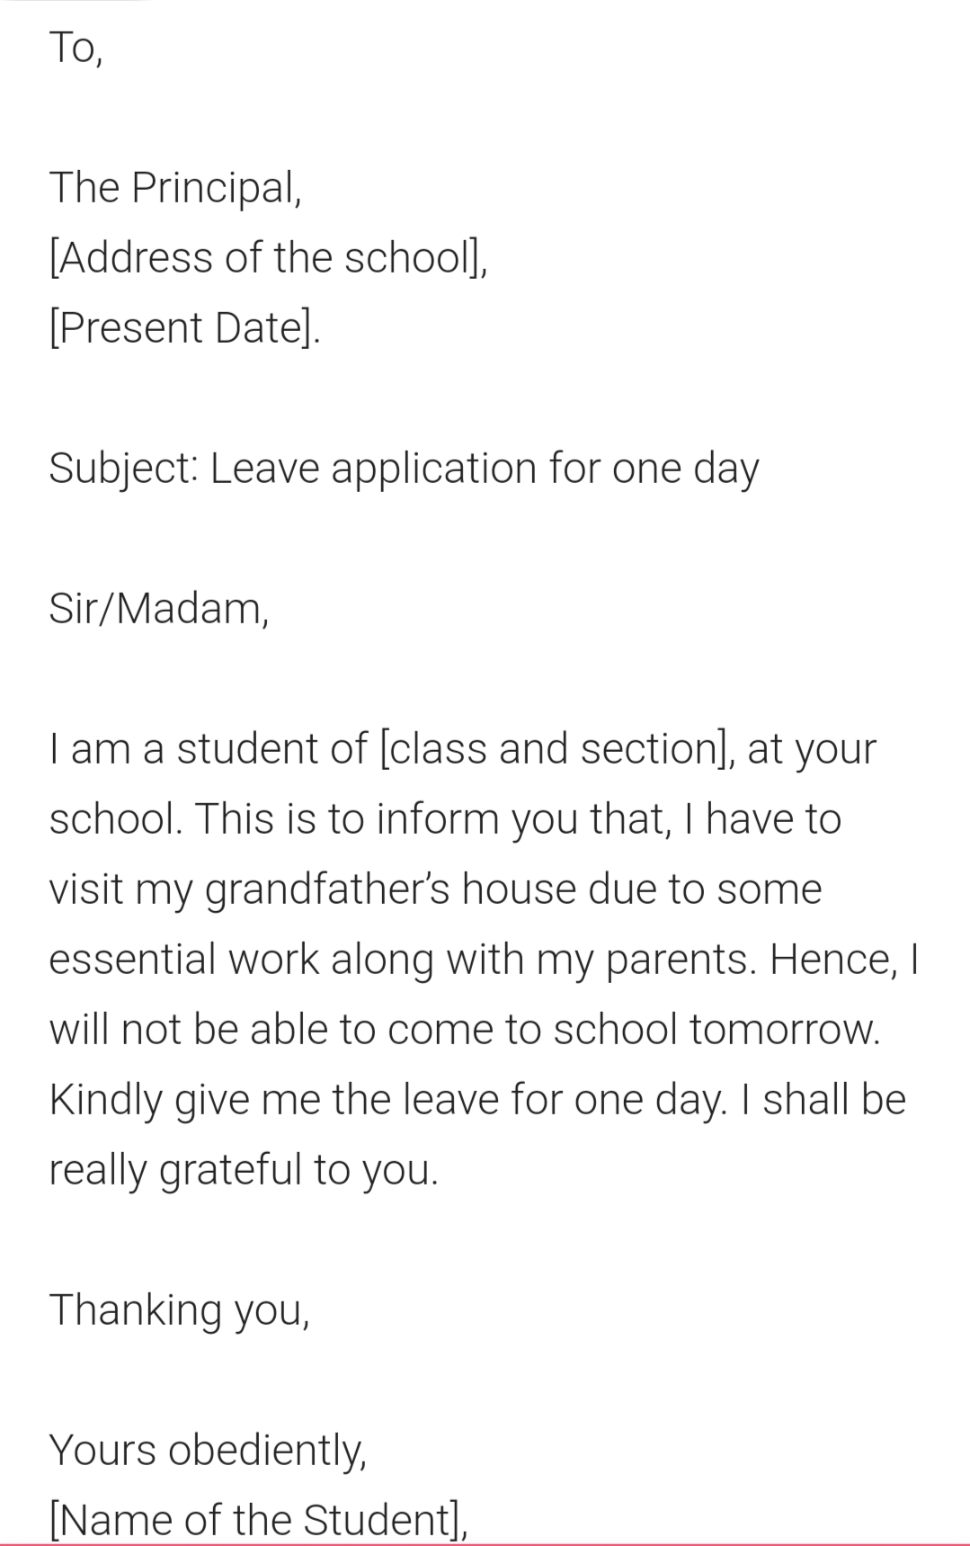

Slide 15
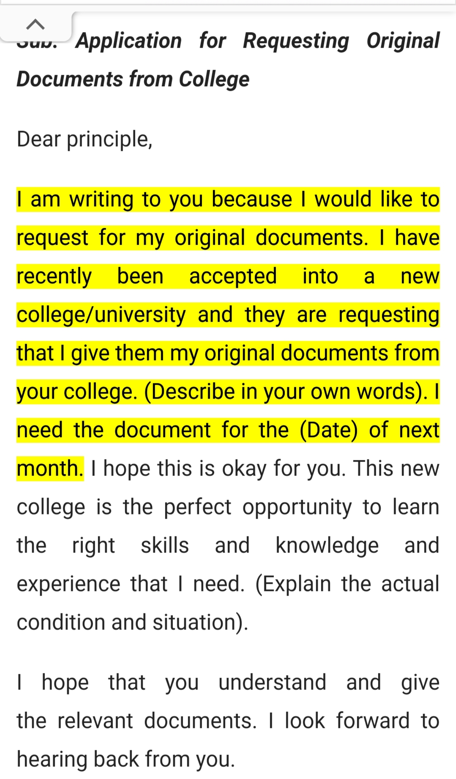

Slide 16
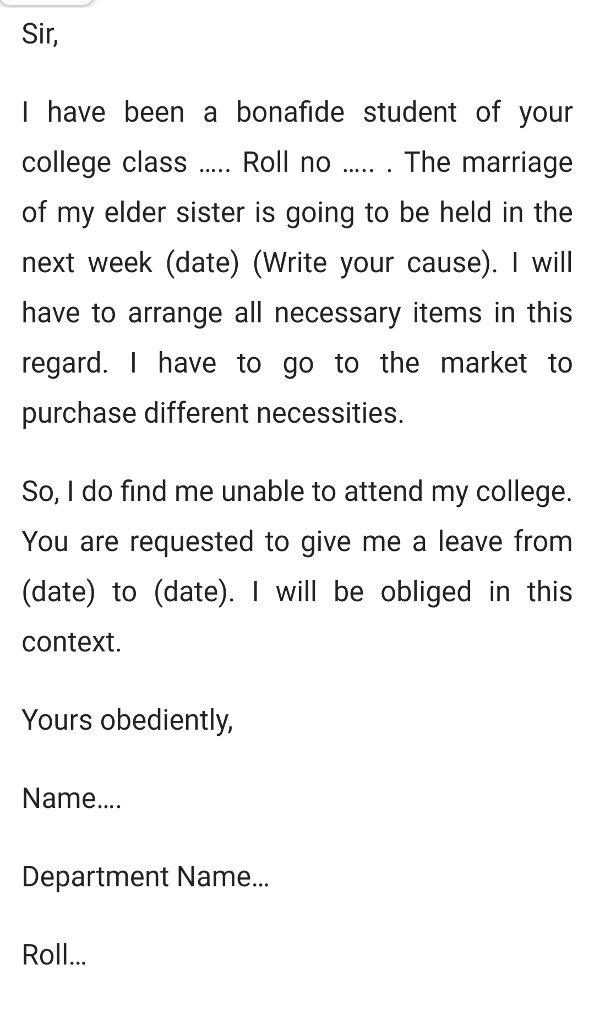

Slide 17
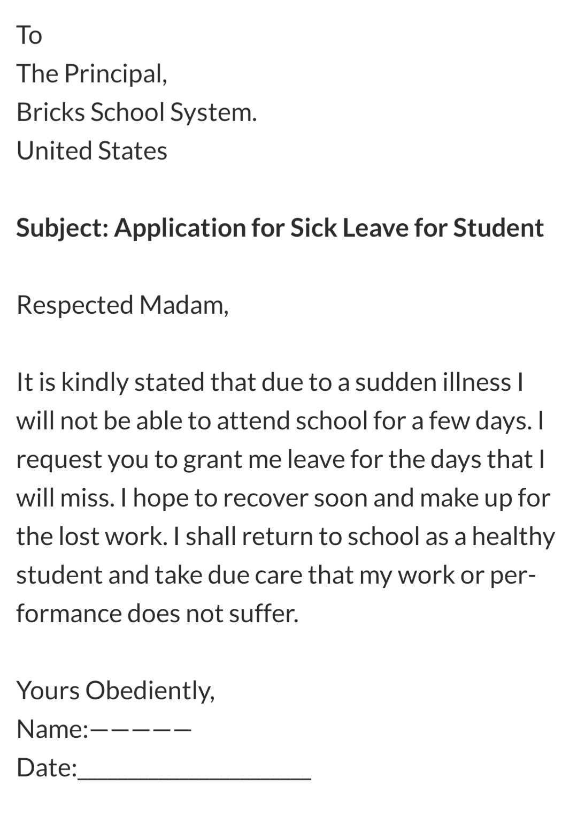

Slide 18


Slide 19
REFERENCES
https://www.thebalancecareers.com/email-subject-lines-for-job-applications-2061890#:~:text=Your%20subject%20line%20is%20your,position%20you%20are%20interested%20in.
https://www.assignmentpoint.com/other/sample-leave-application-format-for-traveling.html

