Slide 1


VASAVI COLLEGE OF ENGINEERING (AUTONOMOUS)
IBRAHIMBAGH, HYDERABAD – 500 031
ACCREDITED BY NAAC WITH 'A++' GRADE
Department of Information Technology
Team ID: TSH089

Slide 2
Basic Details of the Team and Problem Statement
Tech Savishkaar
Theme Name: Renewable Energy
Problem Statement Title: Sustainify: Sustainable Living Made Easy
Team Name: Triumph Card(IT089)
Team Leader Name: Asish Killamsetty
Institute Name: Vasavi College Of Engineering

Slide 3
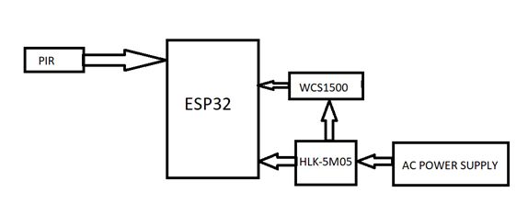
Idea/Approach Details
The idea is to develop a web application that tracks electricity usage using IoT devices.
Sensors like PIR, temperature, humidity, and proximity can help conserve energy in households.
The PIR sensor detects movement and automatically turns off lights and fans if left on.
It is connected to an Arduino, which links to a battery, buzzer, and LED.
The sensor turns off the LED and rings the buzzer if no motion is detected.
Movement turns on the LED, thus conserving energy using sensors.
The power consumption of each appliance can be displayed graphically
Technology stack :
Software:
Front end :HTML,CSS and JavaScript
Backend connections : SQL , React functions
Hardware:
Arduino , ESP32 , LED, 9v Battery
Sensors- PIR sensors – motion detection, WCS current sensor

Slide 4
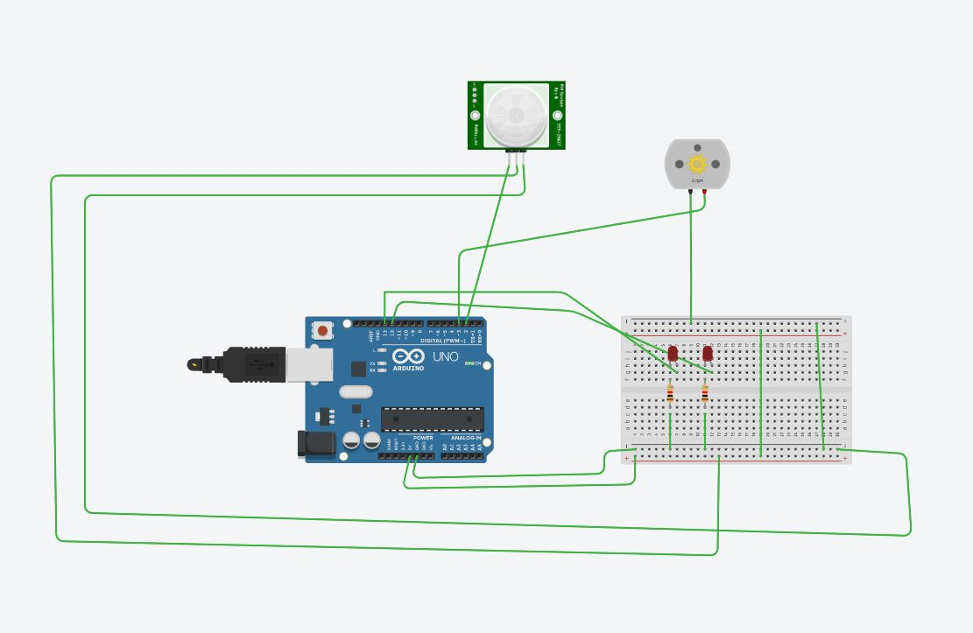
Idea/Approach Details
Simulation:
Use Cases:
Detection of energy consumed: Power automatically turned off in unoccupied rooms to save energy.
Data Update to cloud: Energy consumption data uploaded to cloud for storage and analysis.
Data visualization: Visual representation of appliance power and current usage over time.
Sending Email: Notification sent to user when appliance power usage exceeds limit.
Dependencies:
IoT devices : PIR sensor
Arduino Microcontroller Board
Wed Tools : HTML, CSS, JavaScript, node js, python
ThinkSpeak Cloud Platform
Network Infrastructure

Slide 5
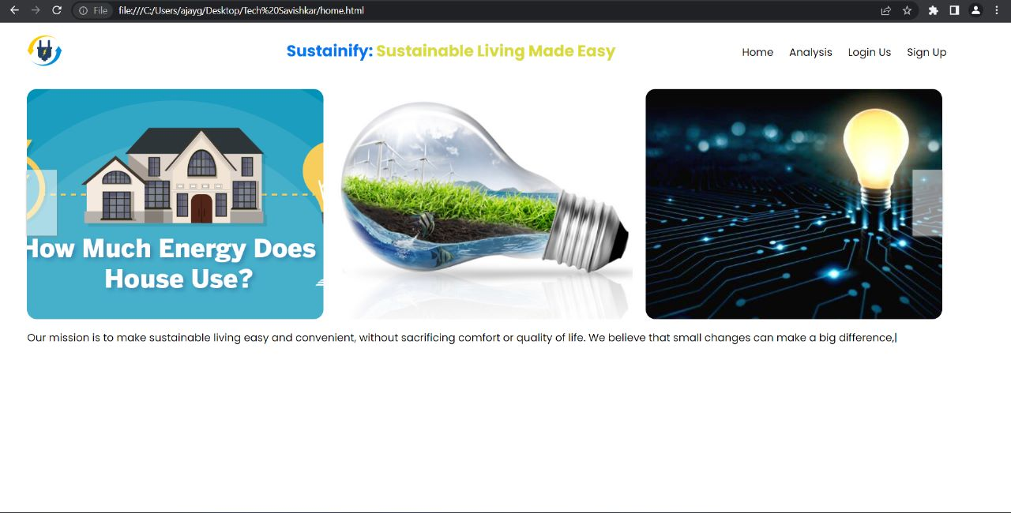
Outputs: Home Screen

Slide 6
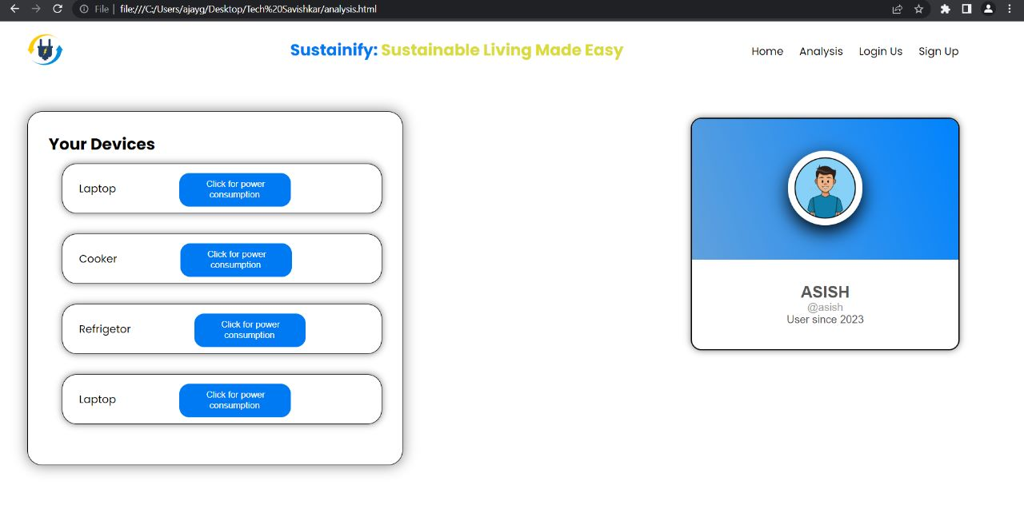
Outputs: Home Screen

Slide 7
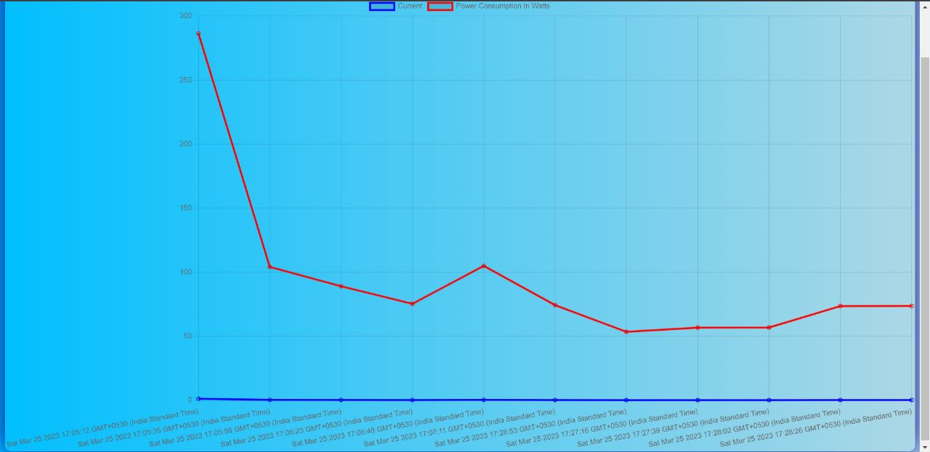
Outputs: Power Consumption By Laptop

Slide 8
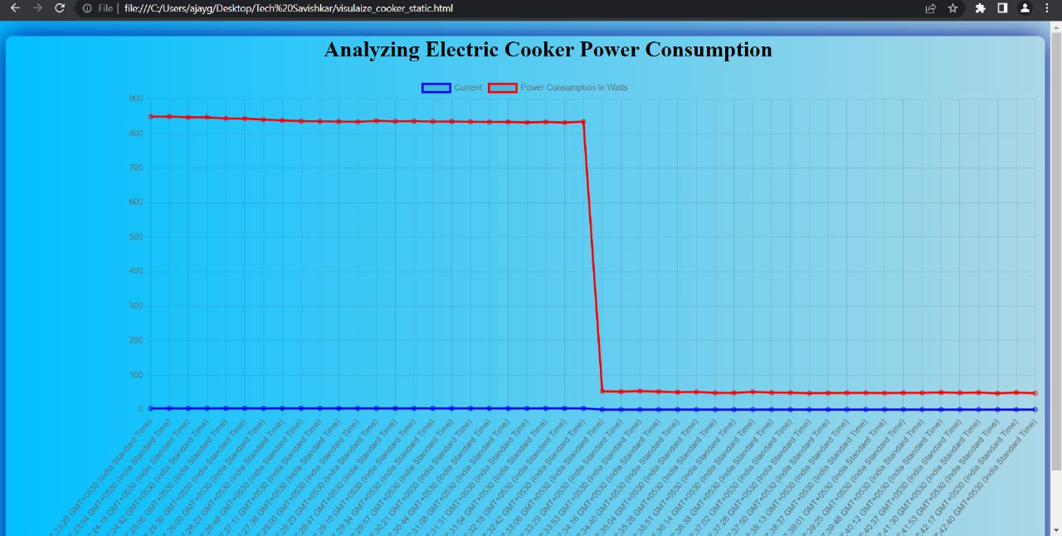
Output: Power Consumption By Electric Cooker

Slide 9
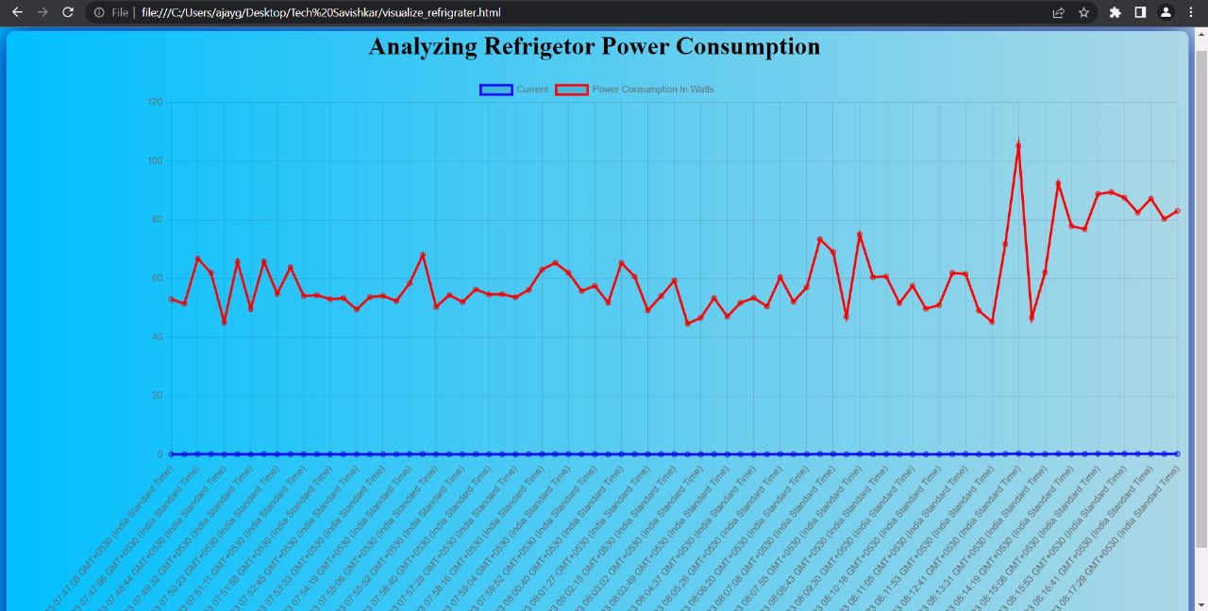
Output: Power Consumption By Refrigerator

Slide 10
Team Member Details
Team Leader: Asish Killamshetty
Branch: IT -B College: Vasavi College Of Engineering Year: 3rd year
Team Member 2: Khateeb Mohammed Zahid Parvez
Branch: IT-B College: Vasavi College Of Engineering Year:3rd year
Team Member 1: Bathini Ajay Goud
Branch: IT-B College: Vasavi College Of Engineering Year:3rd year
Team Member 3: V. Pavan Kumar
Branch: ECE-C College: Vasavi College Of Engineering Year:3rd year

