Slide 1

Wireless Sensor Network

Slide 2
Outline
Sensor, Sensor node, Sensor network
WSN Architecture
WSN Challenges
Communication Protocol Model
Applications of WSN
Different Topologies of WSNs
- Flat/Unstructured Topology
- Cluster-Based Topology
- Chain-Based Topology
- Tree-Based Topology
WSN Routing Protocols
Data Aggregation in WSNs

Slide 3
Introduction
sensor
A transducer
Converts physical phenomenon e.g. heat, light, motion, vibration, and sound into electrical signals
sensor node
Basic unit in sensor network
Contains on-board sensors, processor, memory, transceiver, and power supply
sensor network
Consists of a large number of sensor nodes
Nodes deployed either inside or very close to the sensed phenomenon
Notes:
Sensor Nodes---
10 kbytes of memory , 8bit processor
Battery driven - strict power consumption

Slide 4
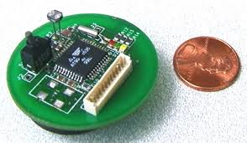
Wireless Sensor Network
A wireless sensor network is a group of specialized transducers with a communications infrastructure for monitoring and recording conditions at diverse locations.
Commonly monitored parameters are temperature, humidity, pressure, wind direction and speed, illumination intensity, vibration intensity, sound intensity, power-line voltage, chemical concentrations, pollutant levels and vital body functions.
WSN node
Notes:
a device that converts variations in a physical quantity, such as pressure or brightness, into an electrical signal, or vice versa.

Slide 5
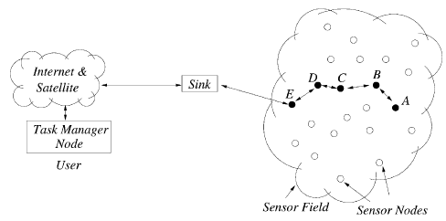
WSN Network

Slide 6
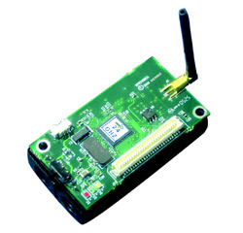
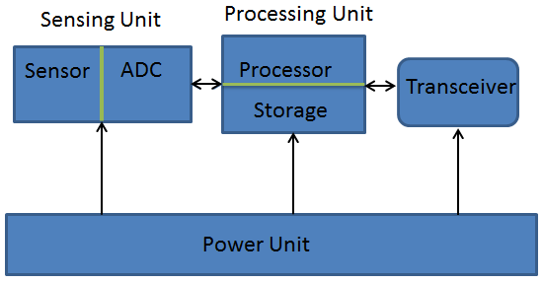
WSN Architecture
The structure of sensor node consists of
Sensing unit (sensor and analog to digital converter)
Processing unit (processor and storage),
Communication unit (transceiver) and
Power supply unit.

Slide 7
WSN Architecture contd…
The sensor node construction focuses to the following factors -
Reduce cost
Increase flexibility
Provide fault tolerance
Improve development process
Conserve energy

Slide 8
Characteristics of WSN
The large number of sensors nodes are deployed in a sensor network.
Sensor nodes are densely deployed (ad-hoc deployment)
The topology of a sensor network changes very frequently.
Sensor nodes mainly use broadcast communication paradigm.
Sensor nodes are limited in power, computational capacities, and memory.
Sensor nodes may not have global identiﬁcation (ID) because of the large amount of overhead and large number of sensors.

Slide 9
Challenges in WSN
Low Production Cost: In the WSN normally hundreds or thousands of sensor nodes are deployed to measure any physical environment , therefore it is necessary to minimize the overall network cost.
Energy Efficient: Energy in WSN is used for different purpose such as computation, communication and storage. Sensor node consumes more energy compare to any other for communication, so they often become invalid as we do not have any option to recharge. Therefore the protocols and algorithm development should consider the power consumption in the design phase.

Slide 10
Challenges in WSN
Computational Power: normally the node has limited computational capabilities as the cost and energy need to be considered.
Communication Capabilities: WSN typically communicate using radio waves over a wireless channel. In short range, with narrow and dynamic bandwidth. With the hostile operational environment it is difficult to run WSN smoothly. So, the hardware and software for communication must have to consider the robustness, and resiliency.

Slide 11
Challenges in WSN
Security and Privacy: Each sensor node should have sufficient security mechanisms in order to prevent unauthorized access , attacks and unintentional damage of the information inside of the sensor node.
Dynamic network topology: In general WSN are dynamic network. The sensor node can fail for battery exhaustion or other circumstances, communication channel can be disrupted. Thus, the WSN nodes have to be embedded with the function of reconfiguration, self-adjustment.

Slide 12
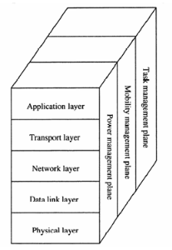
Communication Protocol Model of WSN

Slide 13
Communication Protocol Model of WSN
Physical layer: This layer is responsible for frequency selection, carrier frequency generation, signal detection, modulation, and data encryption.
Data Link Layer: The data link layer is concerned with the media access control (MAC) protocol. MAC protocol at the data link layer has to be power-aware and should have the capability of minimizing the collisions.
Network Layer: The network layer manages the routing the data supplied by the transport layer or between the nodes.

Slide 14
Communication Protocol Model of WSN
Transport Layer: The transport layer is able to maintain the data flow if the WSN application requires that. Various type of application can be implemented in the application depending the physical environmental sensing.
Application layer: Responsible for traffic management and provide software for different applications that translate the data in an understandable form or send queries to obtain certain information.

Slide 15
Communication Protocol Model of WSN
Orthogonal to the five layers there are three management plan.
Power management.
Mobility management
Task management
These management plans helps the sensor nodes to coordinate sensor tasks and minimize the overall power consumption.

Slide 16
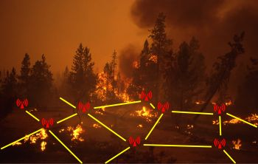
Applications of WSN
Military applications:
Monitoring friendly forces and equipment
Military-theater or battle ﬁeld surveillance
Targeting
Nuclear, biological, and chemical attack detection
Environmental applications:
Microclimates
Forest ﬁre detection
Flood detection
Precision agriculture

Slide 17
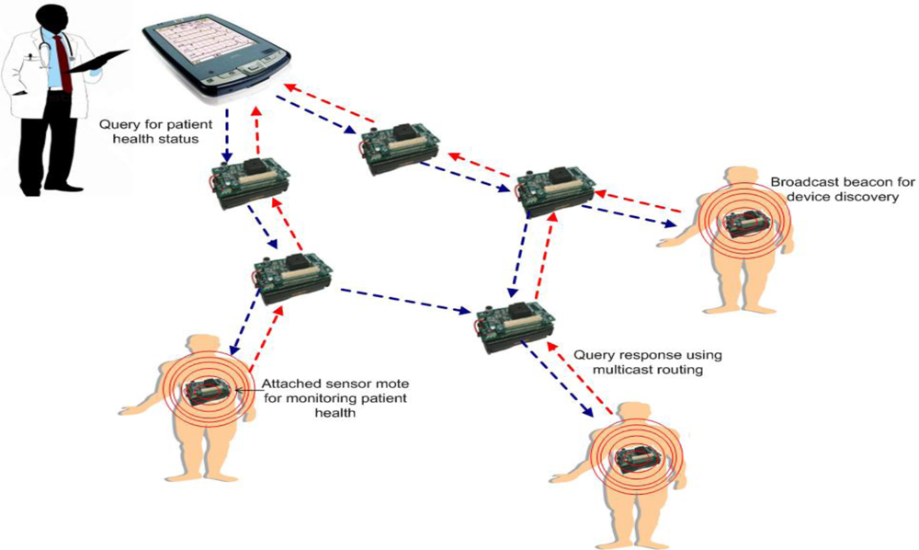
Applications of WSN contd…
Health applications :
Remote monitoring of physiological data
Tracking and monitoring doctors and patients inside a hospital
Drug administration
Elderly assistance
Home applications :
Home automation
Instrumented environment
Automated meter reading

Slide 18
Different Topologies of WSNs
Different Topologies of WSNs
Flat/Unstructured Topology
Cluster-Based Topology
Chain-Based Topology
Tree-Based Topology

Slide 19
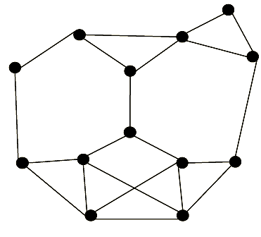
Flat/Unstructured Topology
In ﬂat topology, each sensor plays equal role in network formation. All the protocols, while using ﬂat topology, attempt to ﬁnd good-quality routes from source nodes to sink nodes by some form of ﬂooding.
Fig: Flat topology architecture.

Slide 20
Flat/Unstructured Topology
Advantages:
Good quality routes from source to sink.
No topology maintenance overhead.
Disadvantages:
The main way of communication is ﬂooding, which is an expensive operation.
High consumption of bandwidth
Non-uniform energy distribution occurs in ﬂat/unstructured topology

Slide 21
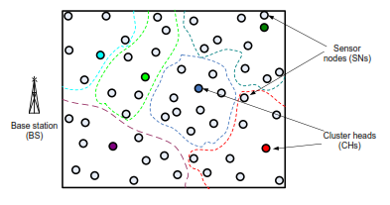
Cluster-Based Topology
Cluster-Based topologies have widely been used in WSNs for various types of protocols, to create a hierarchical structure and minimize the path cost when communicating with the base station.
Fig: Cluster-based topology architecture.

Slide 22
Cluster-Based Topology
Advantages:
Cluster-based routing protocols greatly increase the scalability of a sensor network
The overall energy consumption of the nodes compared with the ﬂat topology protocols is reduced
leading to prolonged network lifetime
Disadvantages:
Energy dissipation rate is highly different from one sensor to another sensor, even if they are in the same cluster.
Because of very long-way communications, some sensors consume energy rapidly and die. As a result, network lifetime decreases.

Slide 23
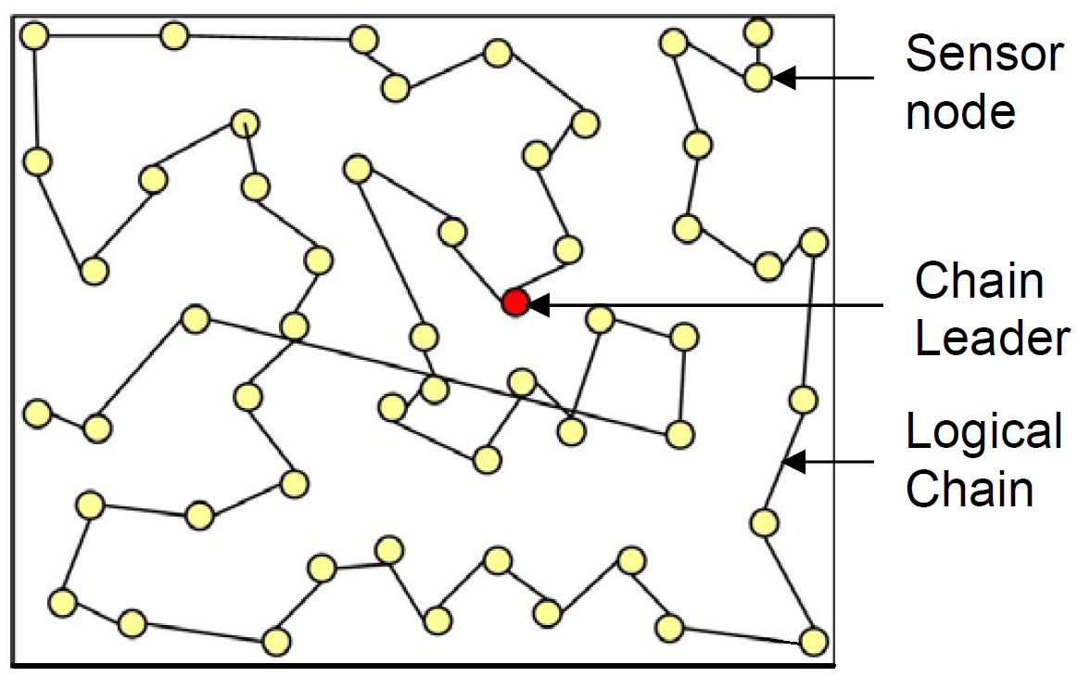
Chain-Based Topology
In this topology, the protocols construct transmission chain(s) connecting the deployed sensor nodes to save energy dissipation of data transmission. A leader is selected in a chain that acts as the sink. All sensor nodes communicate with each other along the chain.
Fig: Chain-oriented topology architecture

Slide 24
Chain-Based Topology
Advantages:
Chain-oriented topology saves more energy than cluster-based topologies do.
Energy distribution in a chain-oriented topology is even
longer lifetime
Disadvantages:
Too much delay for data collection.
Topology management overhead is high.

Slide 25
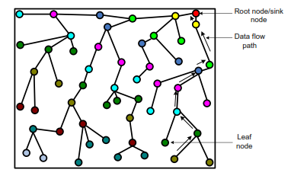
Tree-Based Topology
In this topology, all the deployed sensors construct a logical tree. Data are passed from a leaf node to its parent nodes. In turn, a receiver node receiving data from the child node sends data to receiver’s parent node after aggregating data with its own data.
Fig: Tree-Based topology architecture

Slide 26
Tree-Based Topology
Advantages:
It consumes less power than ﬂat topology, as ﬂooding is not necessary for data communication
it can save a bit more energy than some protocols based on cluster topology.
Disadvantages:
Formation of tree is time consuming and costly.
It is not resilient to node failures. If a parent node fails, then its entire sub-tree is cut off from the base station.
Tree maintenance overhead is high.

Slide 27
Classification of WSN Routing Protocols
Classification of WSN Routing Protocol
Path Establishment
Proactive
Reactive
Network Structure
Data-centric Protocol
Hybrid
Hierarchical Protocol
Location based Protocol

Slide 28
WSN Routing Protocols
Data Centric Protocol: In data-centric routing, the sink sends queries to certain regions and waits for data from the sensors located in the selected regions. Since data is being requested through queries. Here data is usually transmitted from every sensor node within the deployment region with significant redundancy. Example: SPIN, GBR,
Hierarchical Protocol: Hierarchical Protocol or cluster based methods are well known techniques with special advantage of scalability and efficient communication. Nodes play different roles in the network. Example: LEACH, APTEEN etc.

Slide 29
WSN Routing Protocols
Location based Protocol: In location aware routing, nodes know where they are in a geographical region. Location information is used to improve the performance of routing and to provide new types of services. Example: GEAR.

Slide 30
WSN Routing Protocols
Proactive Protocol: A proactive protocol sets up a routing paths and states before there is a demand for routing traffic. Paths are maintained even there is no traffic flow at that time. Example: SPIN, OSPF
Reactive Protocol: In reactive routing protocol, paths are set up on demand when queries are initiated. Example: AODV
Hybrid protocol: Hybrid protocol use combination of these two ideas.

Slide 31
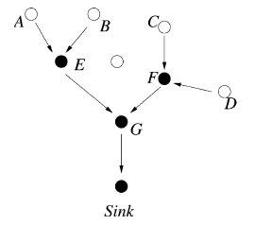
Data Aggregation in WSNs
Data coming from multiple sensor nodes are aggregated if they are about the same attribute of the phenomenon when they reach the same routing node on the way back to the sink
Solves implosion and overlap problem
Energy efficient

