Slide 1
Identification of Vehicle Plate Number Using Optical Character Recognition based on Augmented Reality
Name: Hossain, Md. Zahid
ID: 16-31628-1
Sec: A

Slide 2
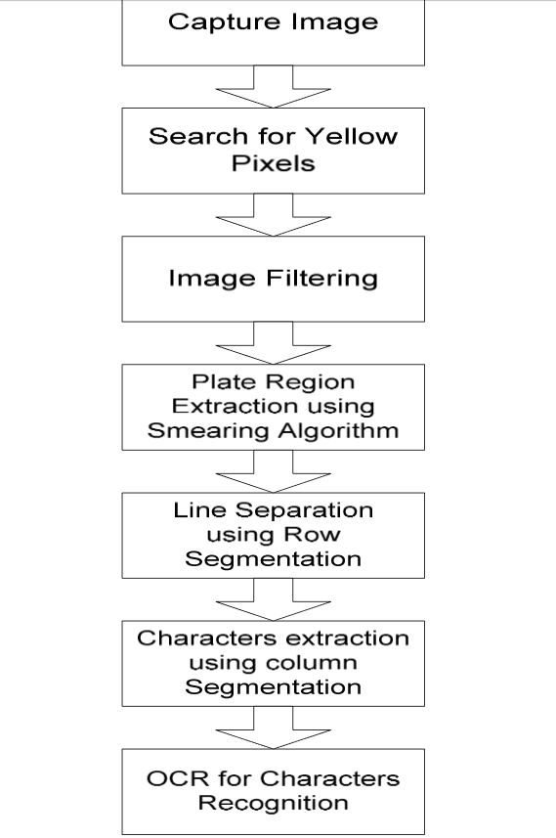
Framework

Slide 3
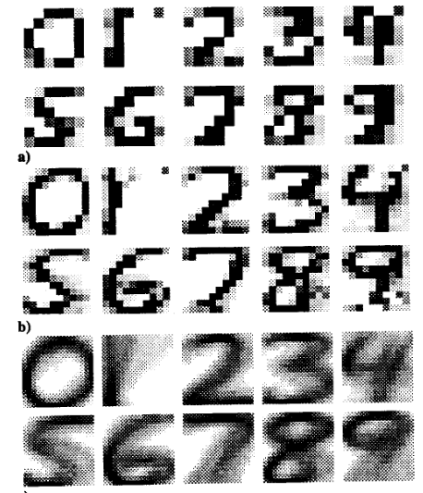
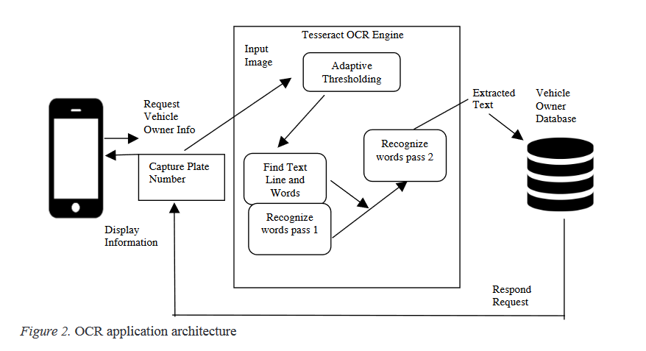
Outcome

Slide 4
Limitation of the project
Can’t detect plate number of high speed running vehicle
Range of the sensor position doesn’t work well in less than 20 degrees
Edge detection problem is still unsolved
High quality cameras are still quite expensive

Slide 5
Future work
Need improvement in short angle number plate recognition
Reducing cost of the total project

