Slide 1
Lecture-2 (Final) Processor Logic Design Contd…

Slide 2
Status Register
It is sometimes convenient to supplement the ALU with a status register where the status bit(overflow, zero indication, sign) conditions are stored for further analysis.
Status-bit conditions are sometimes called condition-code bits or flag bits.

Slide 3
Setting bits in a status register
8-bit ALU with a 4-bit status register
Fig. 9-14

Slide 4
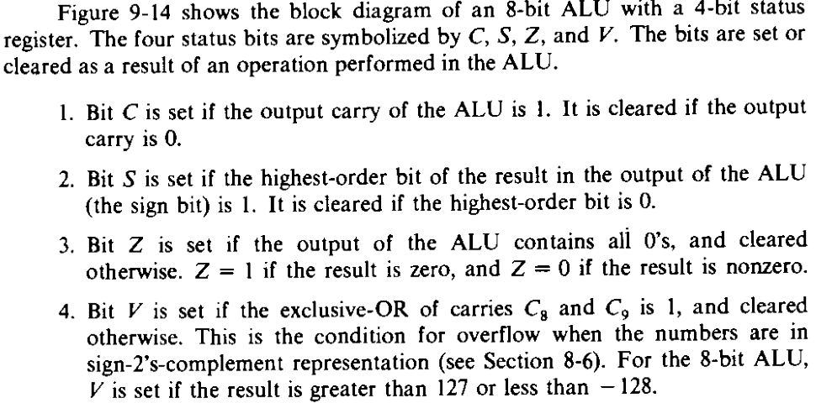

Slide 5
Status bits after the subtraction of unsigned Numbers(A-B)

Slide 6
Status bits after the subtraction (A-B) of two signed binary numbers when negative numbers are in 2’s complement form

Slide 7
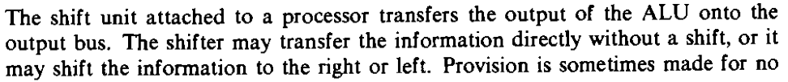
Design of Shifter

Slide 8
Design of Shifter

Slide 9
Function table for shifter
To add more operations in the shifter 8 X 1 MUX are needed with a third selection
variable H2. If CLC L or CLC R is used, IL and IR must be connected to Carry (C).
CLC R – Circulate Left with Carry
CRC R – Circulate Right with Carry

Slide 10
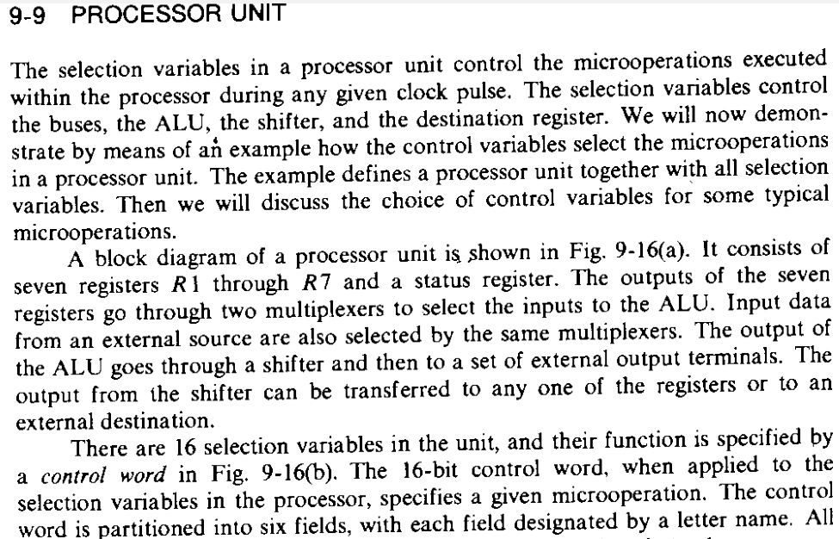

Slide 11
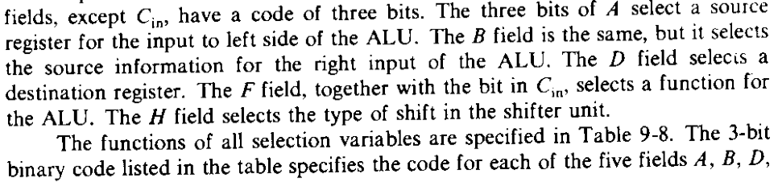
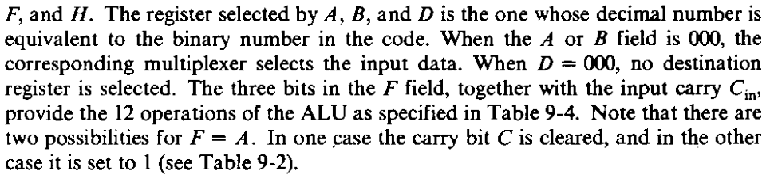

Slide 12
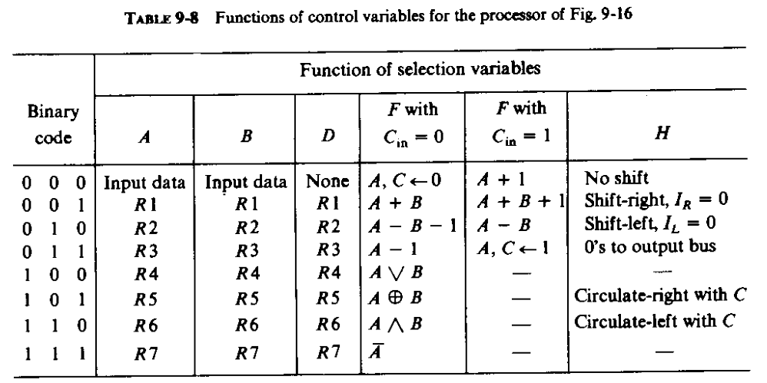

Slide 13
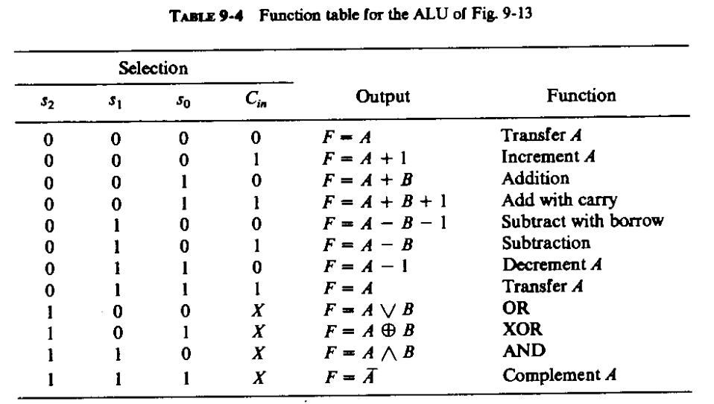

Slide 14
Processor Unit with Control Variable
Fig. 9-16(a)

Slide 15
Examples of Microoperations
If we want to place the contents of a register into the Shifter without changing the carry bit, we can use OR Logic operations with same register selected for bot ALU input A and B.

Slide 17
Next…
Flowchart, State Diagram and Microprogrammed Control Unit Design for addition/subtraction of signed numbers.

