Slide 1


Road Accident Intelligence Dashboard
Interactive Business Intelligence Dashboard using Power BI
Prepared by
Md Zahid
Ramtanay Chakraborty
Prince Kumar

Slide 2


Project Overview
Business Problem & Objectives
Dataset & Technologies
Road traffic collisions pose a significant socio-economic challenge. This initiative aims to thoroughly analyze historical collision data to identify high-risk zones, peak incident times, and underlying contributing factors.
Source: UK Road Safety Accident Dataset (Kaggle)
Tools Used:
▪
Microsoft Power BI
▪
Power Query (ETL)
▪
DAX (Data Analysis Expressions)
Expected Impact: The resulting intelligence empowers stakeholders to deploy targeted safety interventions, optimize traffic law enforcement, and ultimately reduce overall casualty rates.
▪
Dimensional Data Modeling

Slide 3




Data Preparation & Modeling
2. Data Cleansing
4. DAX & Visuals
Validating data types, checking for duplicates, handling missing values, and text standardization.
Authoring optimized DAX measures and deploying the interactive Power BI dashboard.
1. Power Query ETL
3. Star Schema
Extracting raw historical datasets and loading them into the transformation engine.
Creating a dedicated Date table and establishing robust 1-to-many relationship modeling.

Slide 4










Dashboard Architecture Workflow
Executive Dashboard
Detailed Analysis
Business Insights
Decision Making
High-level KPI Cards, severity distribution, and monthly trend tracking designed for strategic leadership.
Deep-dive into Time Intelligence, localized road conditions, and granular environmental factors.
Dynamic cross-filtering, map visuals, and drill-down capabilities to uncover hidden collision correlations.
Translating visual intelligence into data-driven recommendations for traffic enforcement optimization.

Slide 5
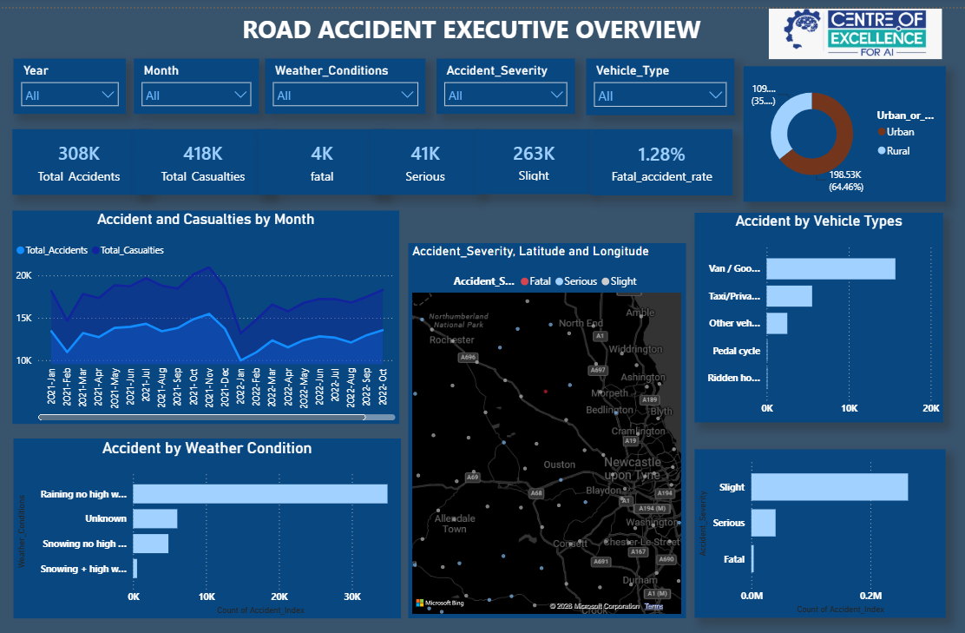
Executive Dashboard Overview
Core Visualizations
▪
Geographic Profiling: 64.46% (198.53K) located in Urban areas.
▪
Temporal Trends: Monthly casualty spikes and drops mapped.
▪
Interactive Elements: Dynamic slicers for Year, Month, Weather, and Severity.
Executive KPIs
▪
Total Incidents: 308K Accidents & 418K Casualties
▪
Severity Breakdown: 263K Slight, 41K Serious, 4K Fatal
▪
Fatal Accident Rate: 1.28%

Slide 6
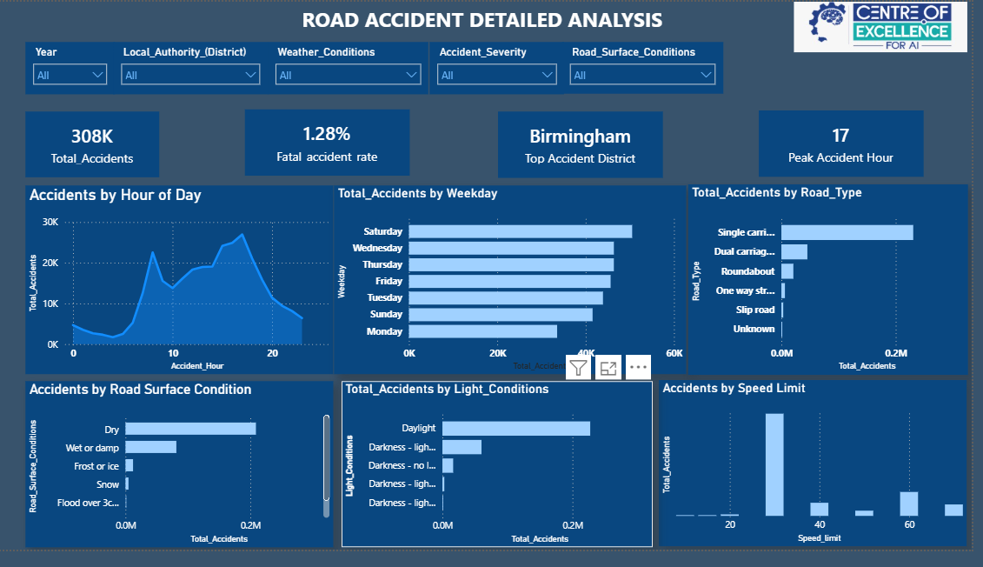
Detailed Analysis Dashboard
Key Risk Factors
▪
Peak Accident Hour: 17:00 (5 PM) afternoon rush.
▪
Top District: Birmingham recorded the highest volume.
▪
Speed Limit Impact: 30 mph zones show the most collisions.
Infrastructure & Environment
▪
Road Type: Single carriageways are the most accident-prone.
▪
Surface & Light: Peak volumes paradoxically occur during Daylight and on Dry surfaces.
▪
Day of Week: Saturdays show the highest total accidents overall.

Slide 7


DAX Measures & Analytics
Analytical Framework
Semantic Model Core Measures
Fatal Accident Rate = DIVIDE([fatal],[Total_Accidents],0)
The semantic model utilizes highly optimized DAX expressions to deliver rapid, dynamic insights across a large dataset:
Total_Accidents = CALCULATE(COUNT(‘Road Accident Data’ [Accident_Index]))
▪
Base Aggregations: Total Accidents, Total Casualties.
▪
Severity Filters: Explicit CALCULATE measures for Fatal, Serious, and Slight categorizations.
Total_Casualties = CALCULATE(SUM(‘Road Accident Data’ [Number_of_Casualties]))
▪
Ratio Engineering: Fatal Accident Rate (utilizing safe DIVIDE).
▪
Advanced Ranking: TOPN functions to isolate peak incident hours dynamically.

Slide 8
Key Business Insights
Infrastructure Risk: Most accidents (over 200K) occurred on single carriageway roads, indicating a critical need for safety interventions on these routes.
Urban Concentration: Urban environments experienced significantly more accidents (64.46%) due to higher baseline traffic density and complex junctions.
Temporal Peaks: 17:00 (5 PM) afternoon rush hour recorded the absolute highest accident frequency across the dataset.
Weekend Surges: Contrary to commuting assumptions, Saturdays recorded the highest overall daily accident volume.
Speed Zones: Roads with a 30 mph speed limit recorded the highest incident count, reflecting dense urban driving patterns.
Weather Paradox: Dry road conditions and daylight hours still held the highest accident numbers, driven purely by the sheer volume of active traffic.

Slide 9
Actionable Recommendations
Targeted Enforcement: Increase traffic police presence and speed monitoring heavily around the 17:00 peak hour.
Infrastructure Upgrades: Modernize junction layouts and intersection safety designs specifically on Single Carriageways.
Zone-Specific Awareness: Launch localized road safety awareness campaigns focused intensely on urban 30 mph zones.
District Focus: Prioritize Birmingham for initial pilot programs regarding new smart traffic monitoring systems.
Weekend Patrols: Adjust emergency resource allocation to account for the unexpected Saturday traffic incident surges.
Predictive Deployment: Improve accident prevention strategies by integrating these historical trends into predictive analytics.

Slide 10








Future Enhancements
Predictive Analytics
Real-Time Integration
Enterprise Deployment
Implement Machine Learning (ML) algorithms for accident prediction and AI-powered risk detection based on historical patterns.
Integrate live Traffic and Weather APIs to transition the platform into a real-time monitoring dashboard.
Deploy to Power BI Service utilizing Row-Level Security (RLS) and optimize layout for the Mobile Dashboard experience.

Slide 11
Thank You!
Questions & Discussion

