Slide 1
WELCOME TO OUR PRESENTATION

Slide 2
TEAM INFORMATION
Name | ID
Zahid Hasan | 201902060
Sadikur Rahman | 201902064
Department of Computer Science and Engineering

Slide 3
TITLE
Image Recognition System

Slide 4
AGENDA
Introduction
Objectives
Application
Tools & Libraries
Project Details
Lol!
Implementation
Limitation
Future work
Q&A Session
sokale nah utle akta guta dis amre

Slide 5
INTRODUCTION
The Image Recognition System project focuses on developing an advanced and accurate model for image recognition.
By utilizing a Kaggle dataset and TensorFlow from Keras, the project aims to train a model capable of effectively classifying objects in images.

Slide 6
Objectives
The objective is to provide a comprehensive analysis of the system’s design, implementation, and evaluation, offering insights for improving accuracy and efficiency.
The project contributes to the field of image recognition and provides practical recommendations for real-world applications.

Slide 7
APPLICATION
Security.
Robotics.
Healthcare
Retail.

Slide 8
TOOLS & LIBRARIES
For making this project we have used some tools and libraries those are given:
● Kaggle.
● TensorFlow with Keras.
● Python.
● NumPy.
● OpenCV.
●Matplotlib.
● Scikit-learn.

Slide 9
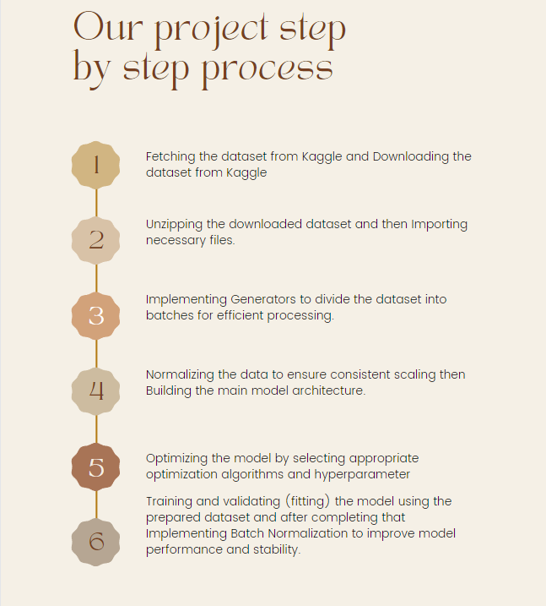
PROJECT DETAILS
Process

Slide 10


IMPLEMENTATION
Downloading data-set and Generating

Slide 11
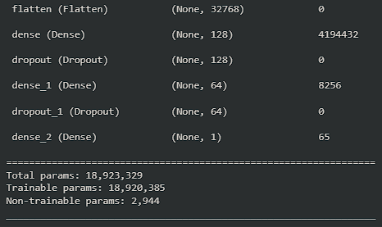
IMPLEMENTATION
Our Model Summary

Slide 12
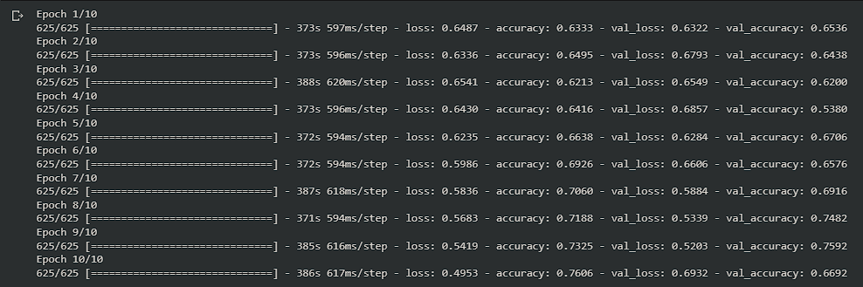
IMPLEMENTATION
Accuracy and validation

Slide 13
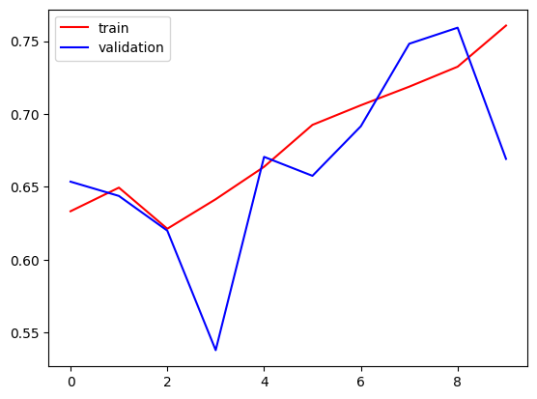
IMPLEMENTATION
After Batch Normalization and Dropout finding Learning Curve

Slide 14
Limitation
Quality and diversity of the data set.
Constraints in real-time image processing.
The system is not robust to noise and variations in lighting conditions.
The system is not able to recognize all objects as we only trained our model with cat vs dog data set.

Slide 15
Future work
Improve the accuracy of the system.
Make the system more robust to noise and variations in lighting conditions.
Make the system more efficient.
Extend the system to recognize more classes of objects.
Deploy the system in a real-world application.

Slide 16

Q&A Sessions

Slide 17

THANK YOU

