Slide 1

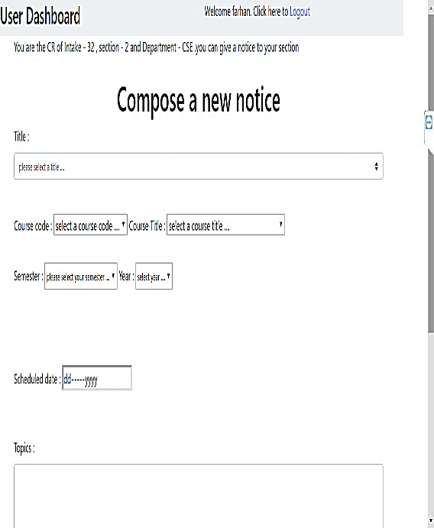
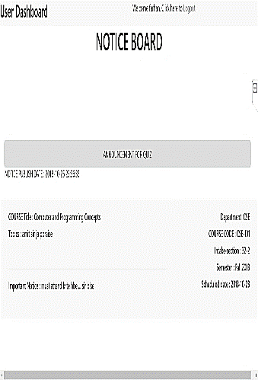


WELCOME
To our presentation
SECTION NOTICE BOARD

Slide 2
About Us
Taufique Ahmed:
Dept. of CSE,
Intake: 32, Sec: 02
ID: 15162103057.
Bangladesh University of Business & Technology (BUBT)
Zahid Ahmed:
Dept. of CSE,
Intake: 32, Sec: 02, ID: 15162103067.
Bangladesh University of Business & Technology (BUBT)
Farhan Fardid:
Dept. of CSE,
Intake: 32, Sec: 02, ID: 1516210362.
Bangladesh University of Business & Technology (BUBT)

Slide 3

Let,s Introduce with the project
Section Notice Board System is a web-based application for students and teachers who want to get and retrieve class, examination, assignments whole information instantly via internet sitting in their own home.
The major benefit of this web portal is to store the assignment, class-test and quiz-tests information at one place and it can be accessed via online interaction.
By developing this project, students can easily know about class and examinations information also can know the assignment submission date and its topic.

Slide 4



Why we makes the project ??
Course registration of students are much easier .
Students can get the notices very easily and also can get important notice
Students have no chance to miss the Class Test & Quiz Test Schedule.
Students can also submit the Assignment in time.

Slide 5
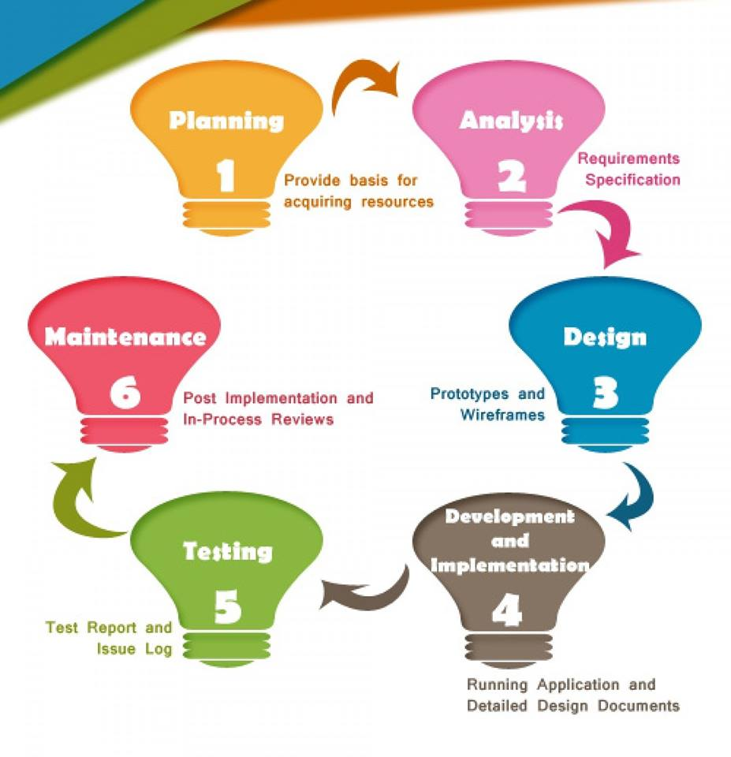
Approach that we have selected - SDLC

Slide 6
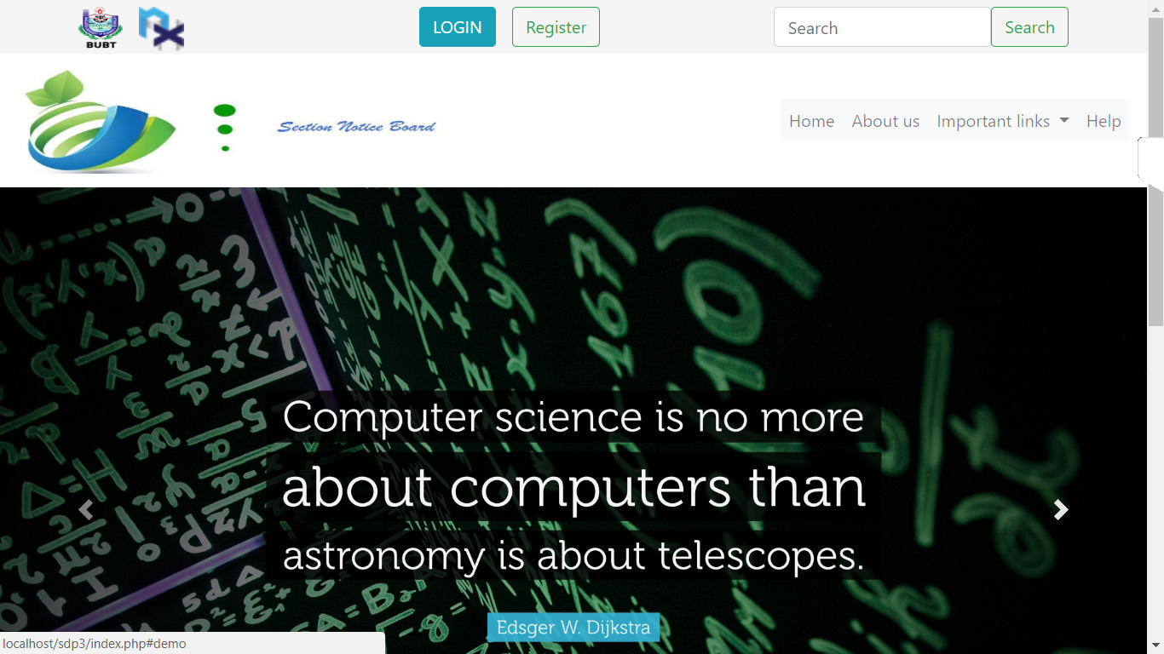
This is the home page of our website

Slide 7
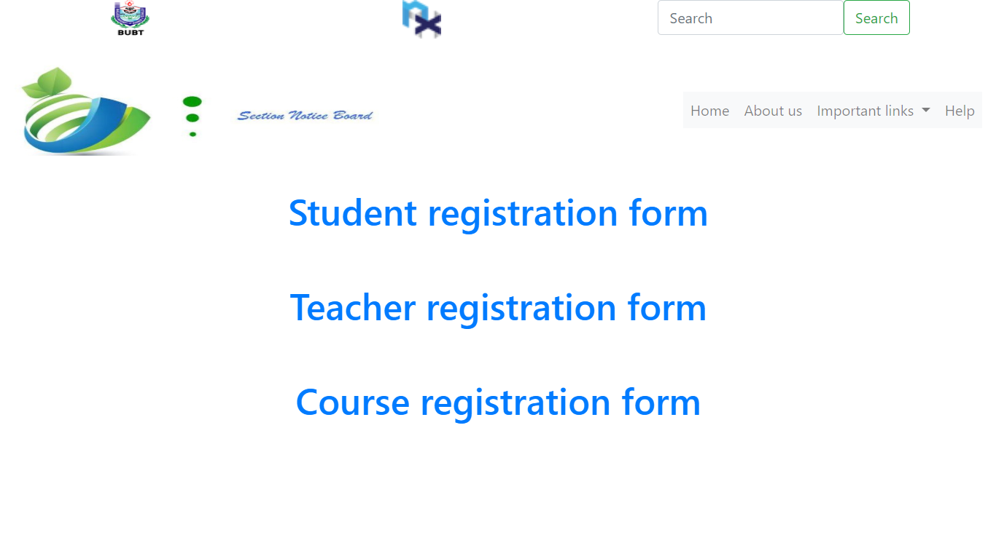
At first the Student have to enter in student registration form and Enter his details , and the teacher who will have the permission to registration of students shall enter in course registration form .

Slide 8
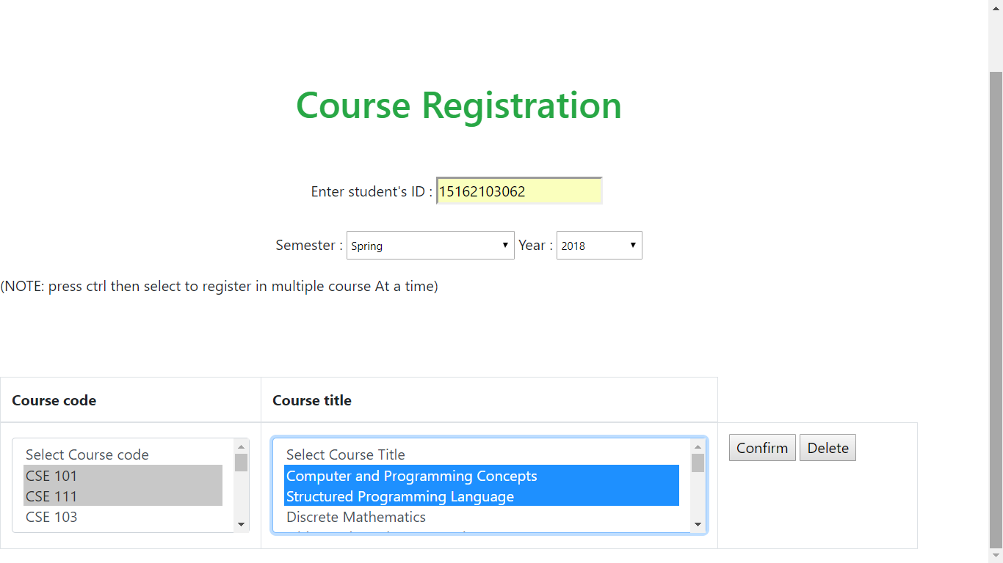
Then the teacher can do the registration process and click confirm

Slide 9
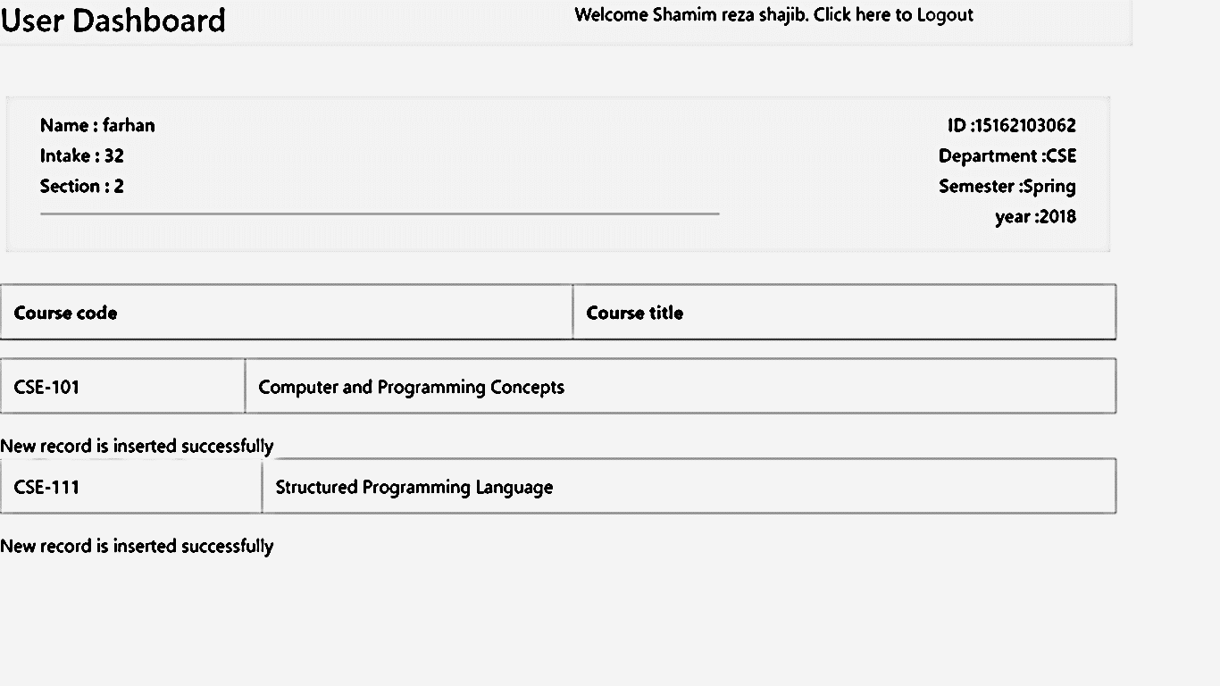
After that , the course will successfully registered to student who want to register.

Slide 10
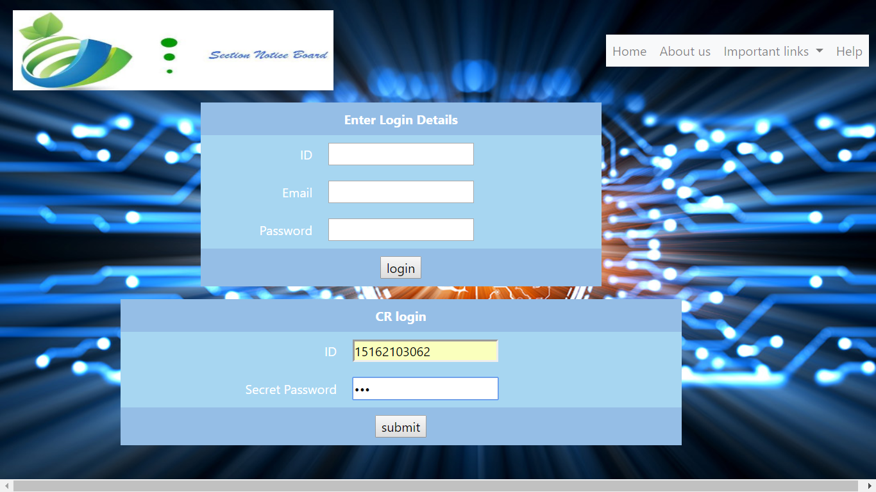
After that , Any CR who have the secret password can login and compose a new notice .

Slide 11
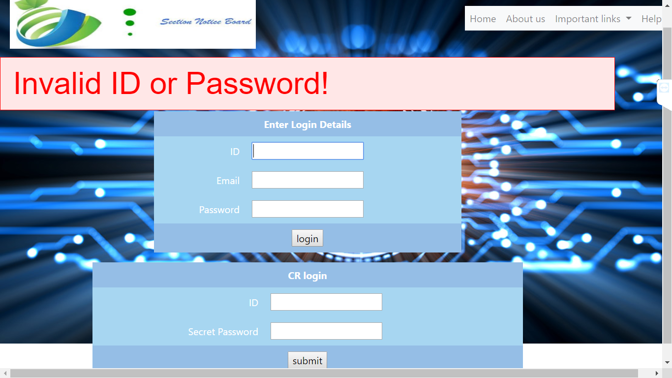
If anyone have no secret password then he could not be able to login to the website and unable to compose a new notice .

Slide 12
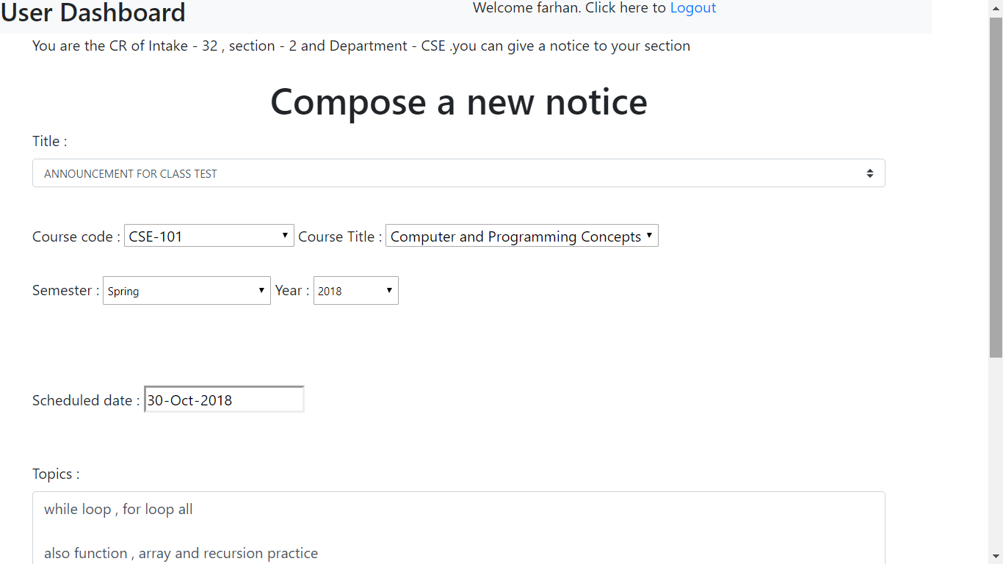
Here the CR can compose a new notice to his Intake and section .

Slide 13
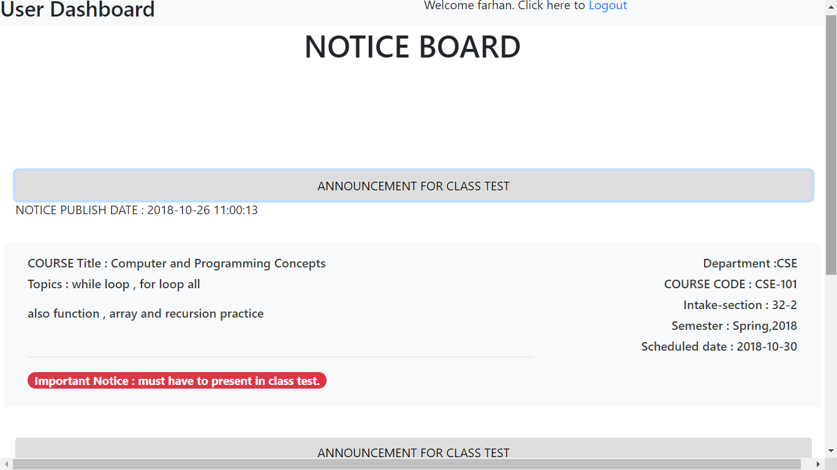
Any student can able to see the notice board in those subject which they have done in course registration .

Slide 14
THE END
Thanks For Watching Our presentation
May Allah gives you best reward
ASSALAMUALAIKUM WARAHMATULLAH

