Slide 1
COMPUTER VISION
Week 8
Lecture 11 & 12 (17/09/2026)
0714 02 CSE 4239

Slide 2
From Feature Detection to Description
Once features are detected (or extracted) in an image, we want to be able to match them with features in other images.
We need to extract from each feature some kind of signature that describes the local appearance around the location of the feature.
To find correspondences between images, we need to compare their feature descriptors.
The simplest feature descriptor directly represents the image patch corresponding to each detected feature using a vector of raw intensity values.

Slide 3
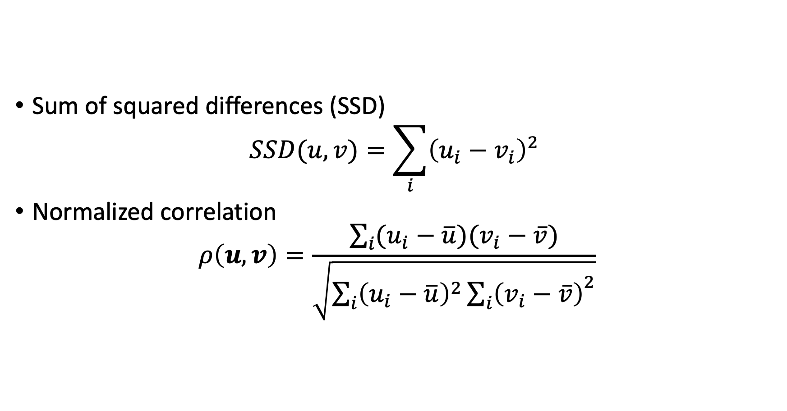
Patch Comparison Methods
Sum of squared differences (SSD)
$$SSD(u,v)=\sum_{i}{{\left(u_{i}−v_{i}\right)}^{2} }$$
Normalized correlation
$$ρ\left(u, v\right)=\frac{\sum_{i}{(u_{i}−\overline{u})(v_{i}−\overline{v})}}{\sqrt{\sum_{i}{{\left(u_{i}−\overline{u}\right)}^{2}{\sum_{i}{\left(v_{i}−\overline{v}\right)}}^{2}}}}$$

Slide 4
SIFT
Images can look very different depending on their size, angle, scale, or lighting, which makes it difficult for machines to identify them consistently.
SIFT solves this problem.
SIFT is designed to find and describe unique keypoints in an image, such as corners, edges, or patterns that remain recognizable even when the image is resized, rotated, or lit differently.

Slide 5
Scale Invariance
The image is blurred at different levels to create multiple versions.
SIFT then looks through these versions to find patterns and details that stay the same, regardless of how the image changes in size or sharpness.
Notes:
For instance, a road sign photographed from a few meters away will look much bigger than the same sign captured at a distance, but SIFT can still detect the same distinctive features. This makes it possible to match the two images correctly, even though the sign appears at very different scales.

Slide 6
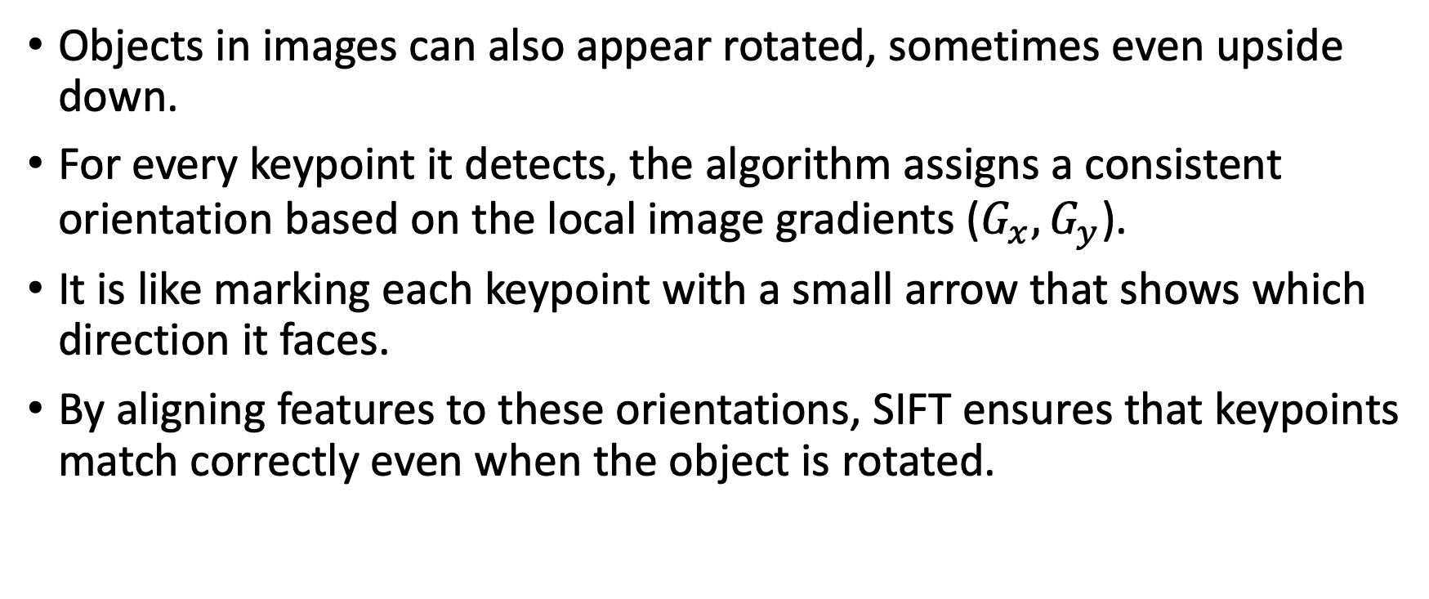
Rotation invariance
Objects in images can also appear rotated, sometimes even upside down.
For every keypoint it detects, the algorithm assigns a consistent orientation based on the local image gradients ($G_{x}, G_{y}$).
It is like marking each keypoint with a small arrow that shows which direction it faces.
By aligning features to these orientations, SIFT ensures that keypoints match correctly even when the object is rotated.
Notes:
For example, a landmark captured in a landscape photo can still be identified correctly even if another photo of it is taken with the camera tilted at an angle.

Slide 7
Other image variations
Images can also change in other ways,
  illumination changes.
  lighting on an object might go from bright to dim,
  camera angle might shift slightly, or
  image could be blurred or noisy.
SIFT is built to handle these kinds of variations. It does this by focusing on keypoints that are distinctive and high in contrast, since these features are less affected by changes in lighting or small shifts in viewpoint.

Slide 8
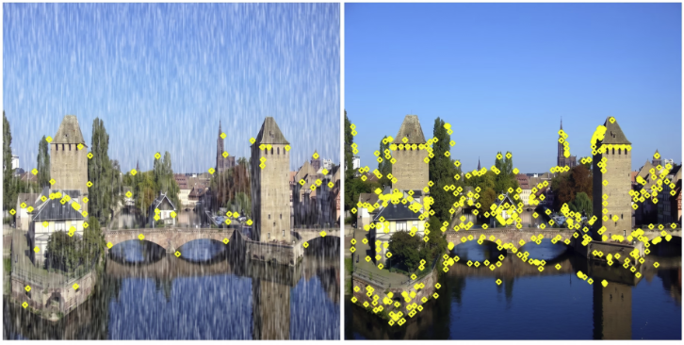

Slide 9
SIFT – Scale Invariant Feature Transform
Main steps:
  Scale-space peak selection: Potential location for finding features.
  Keypoint Localization: Accurately locating the feature keypoints.
  Orientation Assignment: Assigning orientation to keypoints.
  Keypoint descriptor: Describing the keypoints as a high dimensional vector.
  Keypoint Matching

Slide 10
Step 1: Scale-space extrema detection
Keypoints: distinctive spots in the image, such as corners or sharp changes in texture, that help track or recognize an object.
To achieve scale invariance
  SIFT builds a scale space. A collection of images created by gradually blurring the original image with a Gaussian filter and grouping the results into layers called octaves.
  Each octave contains the same image at increasing levels of blur, while the next octave is a smaller version of the image.
By subtracting one blurred image from another, SIFT calculates the Difference of Gaussians (DoG), which highlights areas where brightness changes sharply.
These areas are chosen as candidate keypoints because they remain consistent when the image is zoomed in or out.

Slide 11
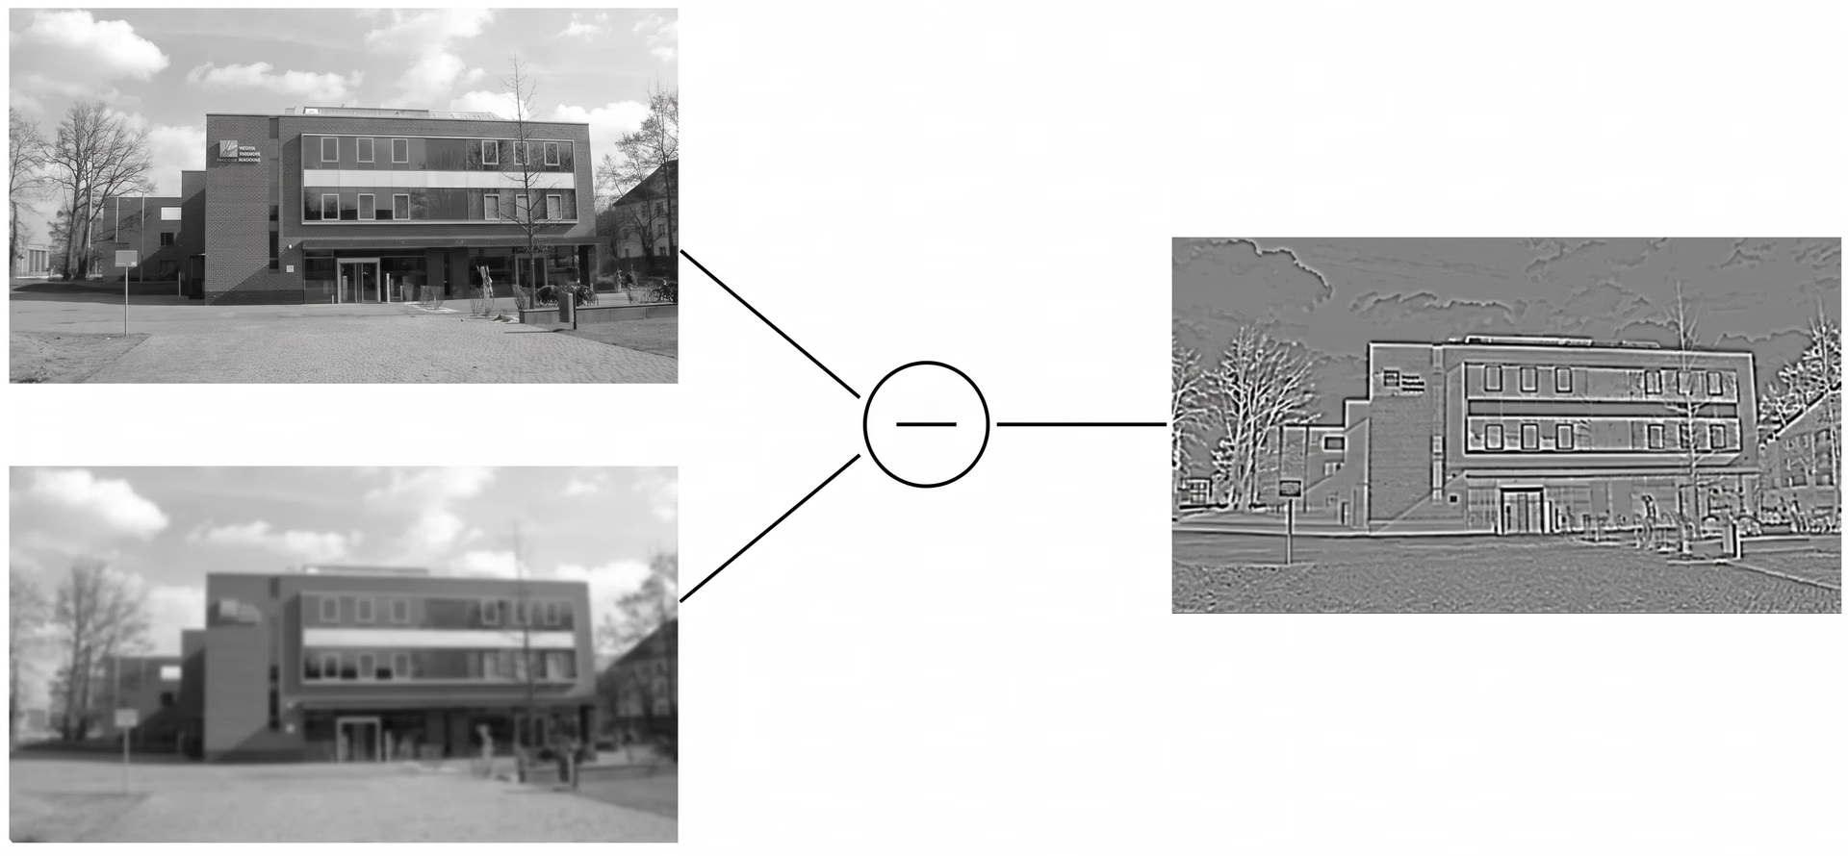
Difference of Gaussians (DoG)

Slide 12
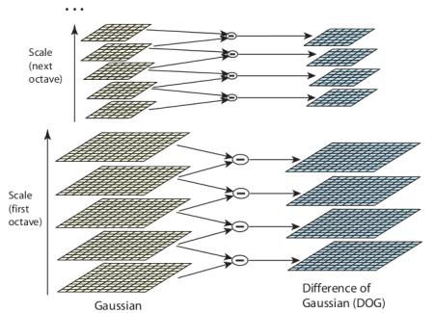
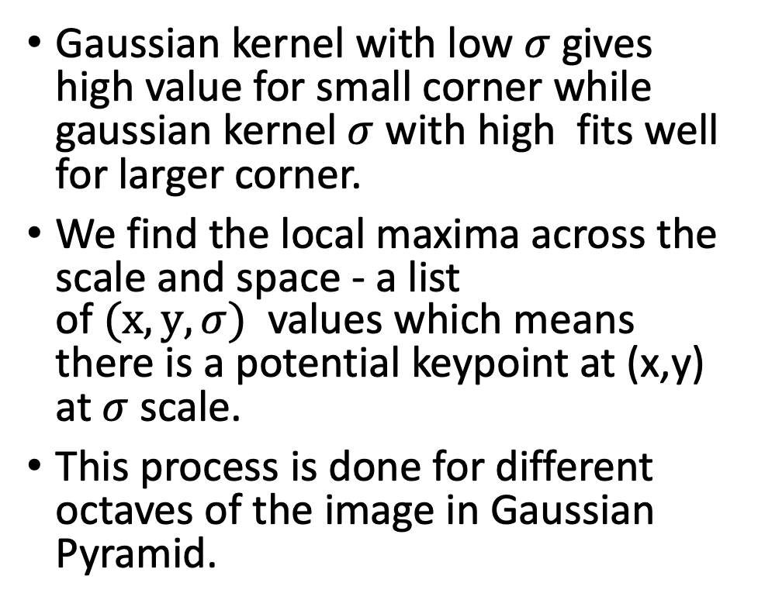
Scale-space Extrema Detection
Gaussian kernel with low $σ$ gives high value for small corner while gaussian kernel $σ$ with high fits well for larger corner.
We find the local maxima across the scale and space - a list of $(x,y,σ)$ values which means there is a potential keypoint at (x,y) at $σ$scale.
This process is done for different octaves of the image in Gaussian Pyramid.
an octave refers to a group or level in a pyramid of
images where the image resolution is constant,
but the amount of Gaussian blur applied to
it increases progressively
A SIFT octave represents a doubling of the scale (blur) and a halving of the image dimensions
(width and height divided by 2) relative to the previous octave.

Slide 13
Step 2: Keypoint localization
Not all candidate keypoints are useful because some may be weak or unstable.
SIFT uses Taylor Series Expansion to estimate the exact position of a keypoint. During this step, unreliable points are removed.
Keypoints with low contrast, which blend into their surroundings, are discarded, as well as those that lie directly on edges, since they can shift too easily.
This filtering step leaves behind only the most stable and distinctive keypoints.

Slide 14
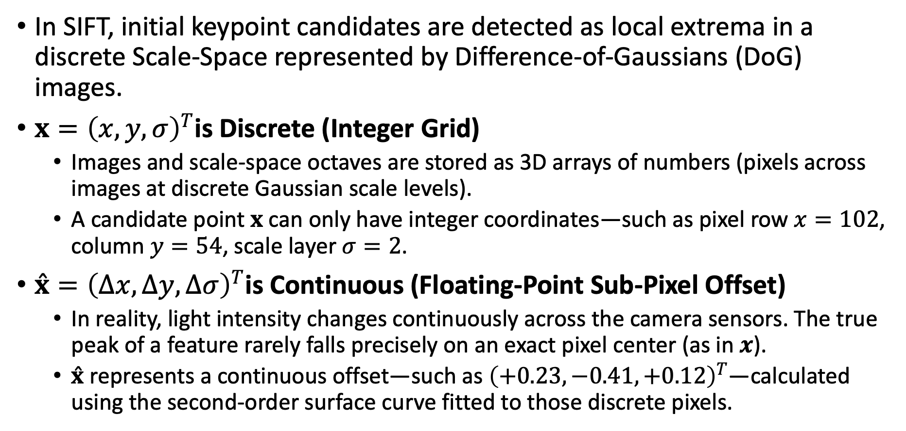
Low-Contrast Keypoint Rejection
In SIFT, initial keypoint candidates are detected as local extrema in a discrete Scale-Space represented by Difference-of-Gaussians (DoG) images.
$x={\left(x,y,σ\right)}^{T}$is Discrete (Integer Grid)
  Images and scale-space octaves are stored as 3D arrays of numbers (pixels across images at discrete Gaussian scale levels).
  A candidate point $x$can only have integer coordinates—such as pixel row $x=102$, column $y=54$, scale layer $σ=2$.
$\overset{ˆ}{x}={\left(Δx,Δy,Δσ\right)}^{T}$is Continuous (Floating-Point Sub-Pixel Offset)
  In reality, light intensity changes continuously across the camera sensors. The true peak of a feature rarely falls precisely on an exact pixel center (as in $x$).
  $\overset{ˆ}{x}$ represents a continuous offset—such as ${\left(+0.23,−0.41,+0.12\right)}^{T}$—calculated using the second-order surface curve fitted to those discrete pixels.

Slide 15
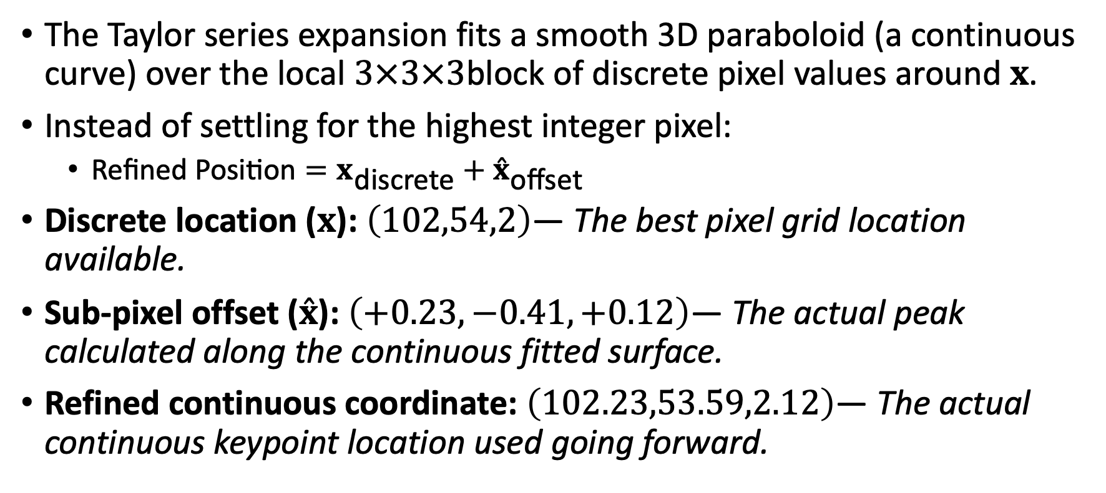
Refinement
The Taylor series expansion fits a smooth 3D paraboloid (a continuous curve) over the local $3×3×3$block of discrete pixel values around $x$.
Instead of settling for the highest integer pixel:
  $\text{Refined Position}=x_{\text{discrete}}+{\overset{ˆ}{x}}_{\text{offset}}$
Discrete location ($x$): $\left(102,54,2\right)$— The best pixel grid location available.
Sub-pixel offset ($\overset{ˆ}{x}$): $\left(+0.23,−0.41,+0.12\right)$— The actual peak calculated along the continuous fitted surface.
Refined continuous coordinate: $\left(102.23,53.59,2.12\right)$— The actual continuous keypoint location used going forward.
Notes:
Calling $\overset{ˆ}{x}$ a "continuous refinement" simply means moving from a coarse, grid-bound estimation ($x$) to a precise floating-point estimate ($\overset{ˆ}{x}$) by modeling the continuous surface between pixels.

Slide 16
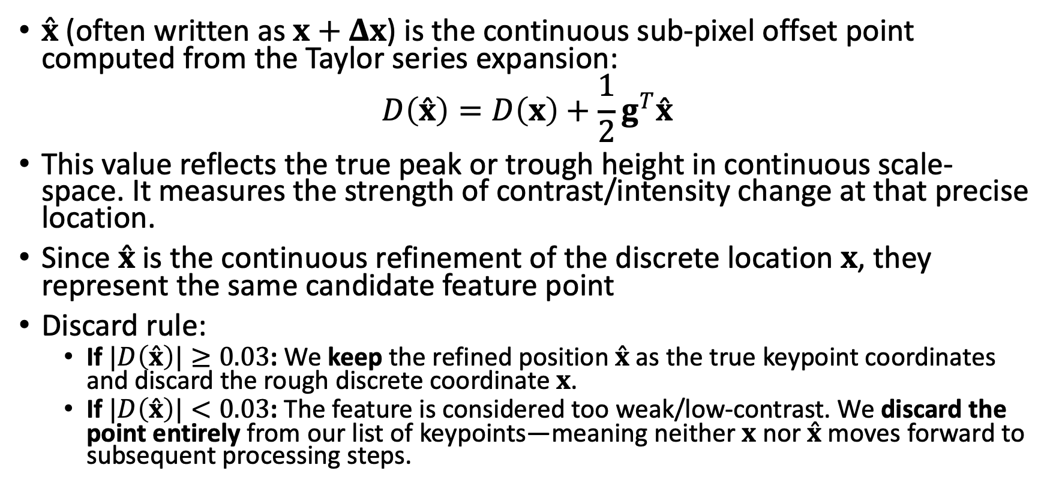
Refinement
$\overset{ˆ}{x}$ (often written as $x+Δx$) is the continuous sub-pixel offset point computed from the Taylor series expansion:
$$D\left(\overset{ˆ}{x}\right)=D\left(x\right)+\frac{1}{2}g^{T}\overset{ˆ}{x}$$
This value reflects the true peak or trough height in continuous scale-space. It measures the strength of contrast/intensity change at that precise location.
Since $\overset{ˆ}{x}$is the continuous refinement of the discrete location $x$, they represent the same candidate feature point
Discard rule:
  If $|D\left(\overset{ˆ}{x}\right)|≥0.03$: We keep the refined position $\overset{ˆ}{x}$ as the true keypoint coordinates and discard the rough discrete coordinate $x$.
  If $|D\left(\overset{ˆ}{x}\right)|<0.03$: The feature is considered too weak/low-contrast. We discard the point entirely from our list of keypoints—meaning neither $x$ nor $\overset{ˆ}{x}$ moves forward to subsequent processing steps.

Slide 17
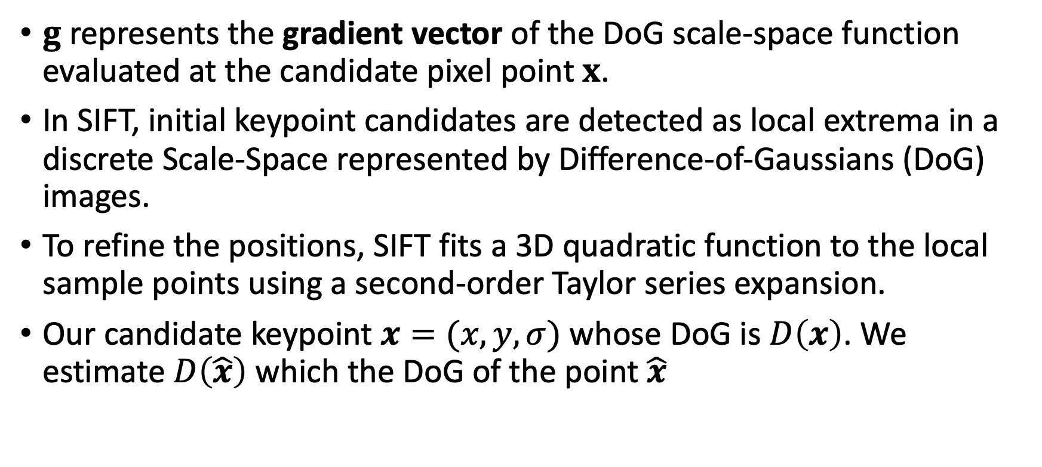
Gradient vector of the DoG
$g$ represents the gradient vector of the DoG scale-space function evaluated at the candidate pixel point $x$.
In SIFT, initial keypoint candidates are detected as local extrema in a discrete Scale-Space represented by Difference-of-Gaussians (DoG) images.
To refine the positions, SIFT fits a 3D quadratic function to the local sample points using a second-order Taylor series expansion.
Our candidate keypoint $x=(x,y, σ)$ whose DoG is $D\left(x\right)$. We estimate $D\left(\hat{x}\right)$ which the DoG of the point $\hat{x}$

Slide 18
Step 3: Orientation assignment
SIFT makes the stable keypoints rotation invariant, which means they can still be matched even if the image is turned sideways or upside down.
To do this, SIFT analyzes how brightness changes (i.e., gradient) around each keypoint.
For each keypoint, SIFT considers the gradients within a surrounding region and groups them into a histogram of orientations.
The tallest peak in this histogram indicates the dominant direction of intensity change, which is then assigned as the keypoint’s orientation.
If there are other peaks that are nearly as strong, SIFT assigns multiple orientations to the same keypoint. This prevents important features from being lost when objects appear at unusual angles.

Slide 19
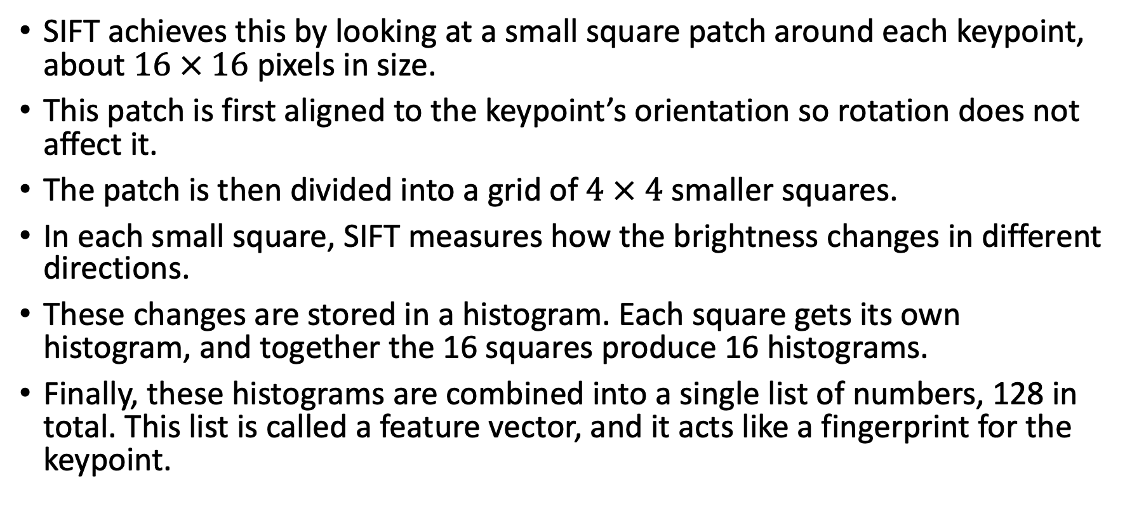
Step 4: Keypoint descriptor
SIFT achieves this by looking at a small square patch around each keypoint, about $16 × 16$ pixels in size.
This patch is first aligned to the keypoint’s orientation so rotation does not affect it.
The patch is then divided into a grid of $4 × 4$ smaller squares.
In each small square, SIFT measures how the brightness changes in different directions.
These changes are stored in a histogram. Each square gets its own histogram, and together the 16 squares produce 16 histograms.
Finally, these histograms are combined into a single list of numbers, 128 in total. This list is called a feature vector, and it acts like a fingerprint for the keypoint.

Slide 20
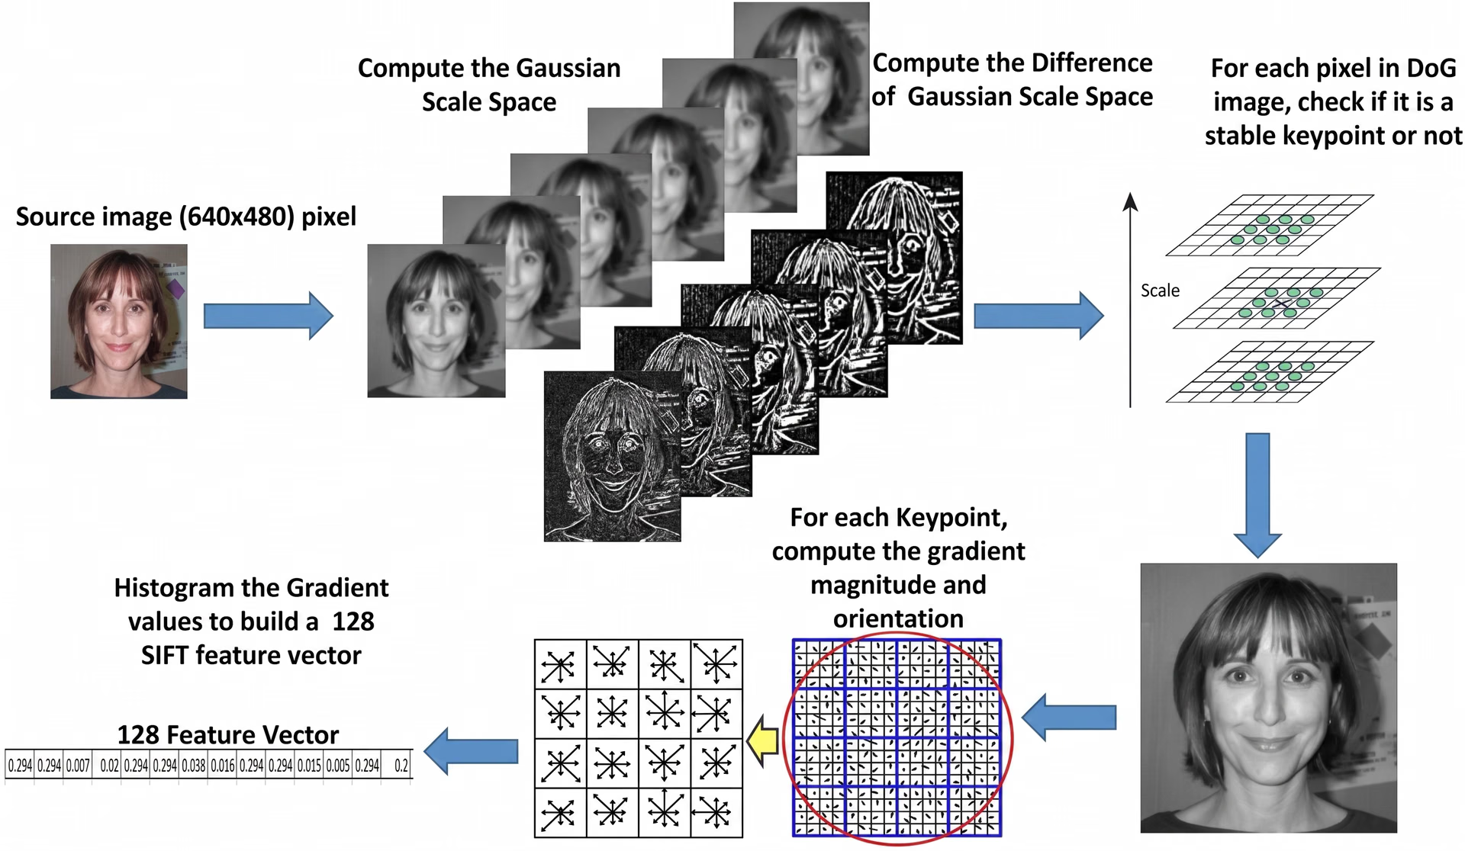

Slide 21
The Viola/Jones Face Detector
Sliding Window Face Detection
Training is slow, but detection is very fast
Key components
  Haar-like Features: Identifying key facial patterns.
  Integral Images: Speeding up calculations.
  AdaBoost Classifier: Selecting the most relevant features.
  Cascade Classifier: Making detection lightning-fast.

Slide 22
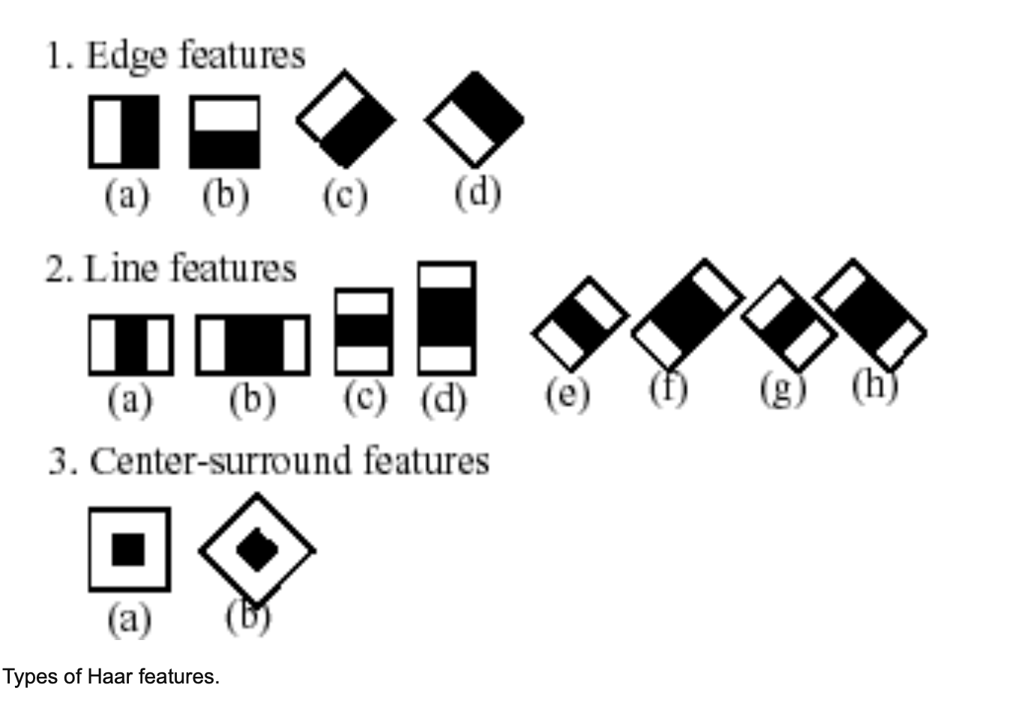
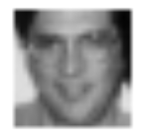
Haar-like Features: Identifying Facial Patterns
A human eye is generally darker than the surrounding skin.
The bridge of the nose is usually
brighter compared to the eye sockets.
These patterns can be represented as
Haar-like features, which resemble
black-and-white rectangles.
Value = ∑ (pixels in white) – ∑ (pixels in black)

Slide 23
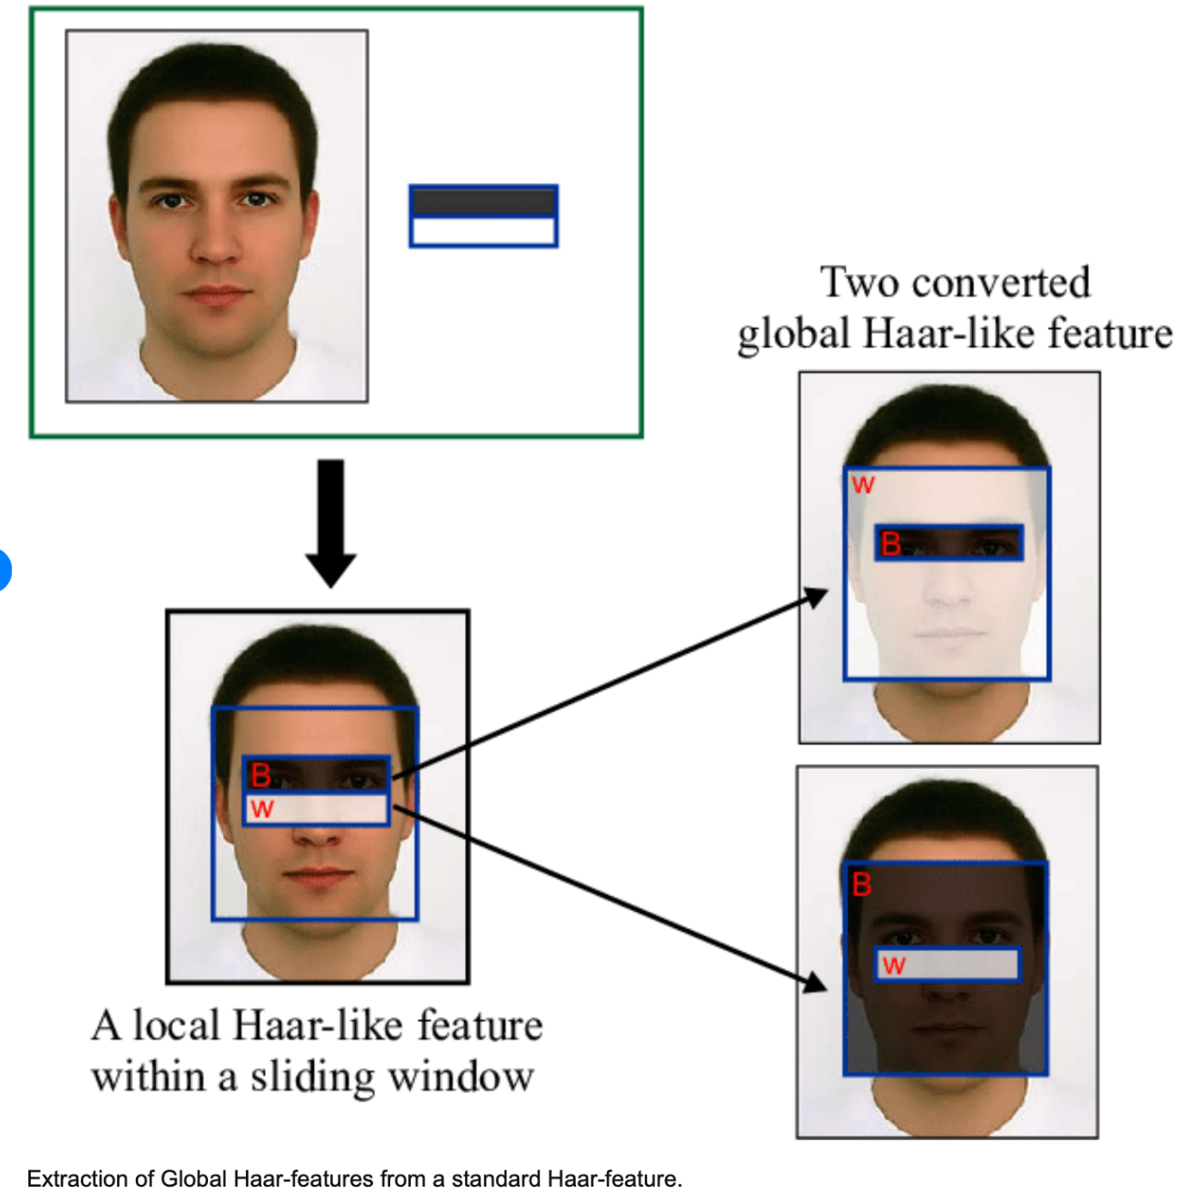
Consider a 24×24-pixel image.
There are about 160,000 Haar-like features in such an image.
Notes:
Clearly, we need a fast way to process them.

Slide 24
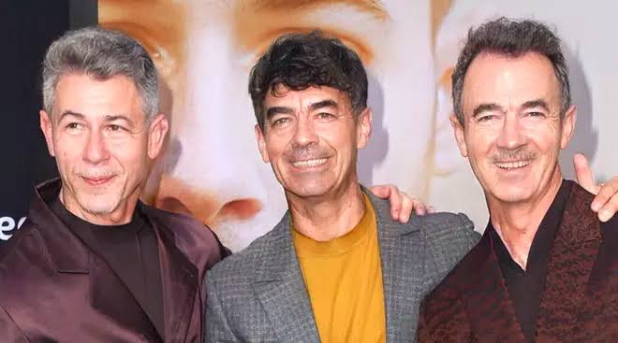
HAAR
At each position, the
algorithm asks:
- Does this window
contain a face?
- If yes, it records
a detection.
- If no, it rejects
the window.

Slide 25
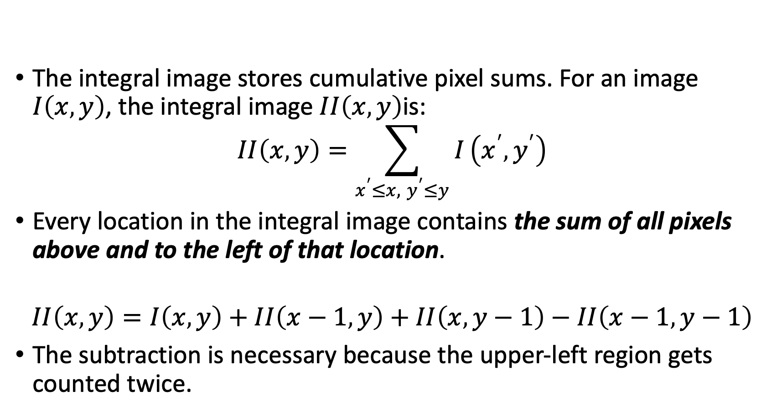
Integral Images: Speeding Up Computations
The integral image stores cumulative pixel sums. For an image $I\left(x , y\right)$, the integral image $II\left(x , y\right)$is:
$$II\left(x , y\right)=\sum_{x^{′}≤x, y^{′}≤y}{I}\left(x^{′} , y^{′}\right)$$
Every location in the integral image contains the sum of all pixels above and to the left of that location.
$$II\left(x , y\right)=I\left(x , y\right)+II\left(x−1 , y\right)+II\left(x , y−1\right)−II\left(x−1 , y−1\right)$$
The subtraction is necessary because the upper-left region gets counted twice.

Slide 26
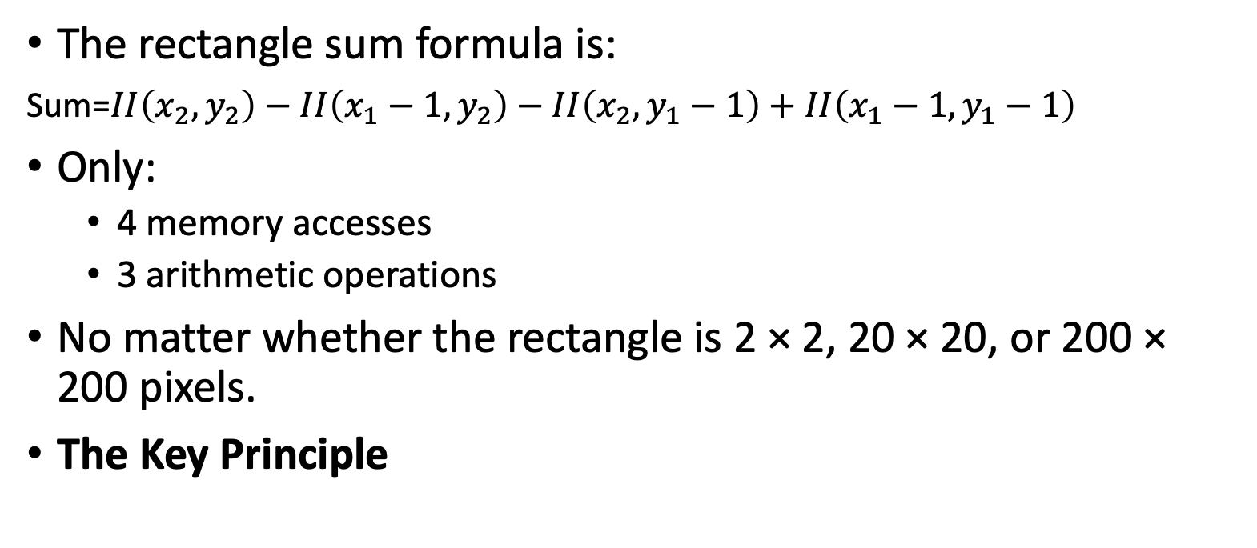
Calculating Rectangle Sums Quickly
Image coordinates:
(1,1) ----------- (2,1)
| |
| Rectangle |
| |
(1,2) ----------- (2,2)
The rectangle sum formula is:
Sum=$II\left(x_{2}​,y_{2}​\right)−II\left(x_{1}​−1,y_{2}​\right)−II\left(x_{2}​,y_{1}​−1\right)+II\left(x_{1}​−1,y_{1}​−1\right)$
Only:
  4 memory accesses
  3 arithmetic operations
No matter whether the rectangle is 2 × 2, 20 × 20, or 200 × 200 pixels.
The Key Principle

Slide 27
AdaBoost: Selecting the Best Features
Train weak classifiers: Each weak classifier looks at a single Haar-like feature.
Weight updates: Features that perform well are given higher weights.
Boosting: The best-performing features are combined into a single, strong classifier.

Slide 28
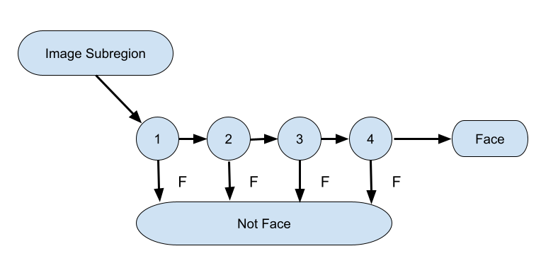
Cascade Classifier: The Secret to Speed
Strong features are formed into a binary classifier:
  Positive matches are sent along to the next feature.
  Negative matches are rejected and exit computation.
Reduces the amount of computation time spent on false windows.
Threshold values might be adjusted to tune accuracy. Lower threshold yield higher detection rated and more false positives.

Slide 29
ML and DL for CV

Slide 30
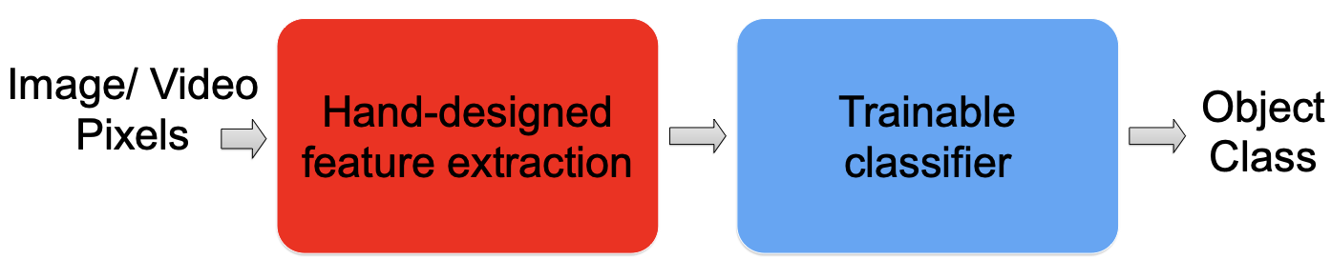
Traditional recognition approach

Slide 31
Image classification using HOG
https://www.kaggle.com/code/zahidbd/lecture11-classification-hog-nb1/

Slide 32
Face detection using SIFT
https://www.kaggle.com/code/zahidbd/lecture11-classification-sift-nb2/

Slide 33
Image classification using HAAR
https://www.kaggle.com/code/zahidbd/lecture11-classification-lj-nb3/

Slide 34
Readings
https://cvl-umass.github.io/intro-cv-spring-2025/assets/notes/localfeatures.pdf
  Section: 6
SIFT:
  https://www.ultralytics.com/blog/what-is-the-scale-invariant-feature-transform-sift#resilience-to-other-image-variations
  https://blog.roboflow.com/sift/
VJ Method:
  https://pub.towardsai.net/the-magic-behind-face-detection-a-deep-dive-into-the-viola-jones-algorithm-51f323f16cd2
  https://towardsdatascience.com/viola-jones-algorithm-and-haar-cascade-classifier-ee3bfb19f7d8/
Notebooks:
  https://www.kaggle.com/code/zahidbd/lecture11-classification-hog-nb1/
  https://www.kaggle.com/code/zahidbd/lecture11-classification-sift-nb2/
  https://www.kaggle.com/code/zahidbd/lecture11-classification-lj-nb3/

