Slide 1
COMPUTER VISION
Week 3
Lecture 3 (11/08/2026)
0714 02 CSE 4239

Slide 2
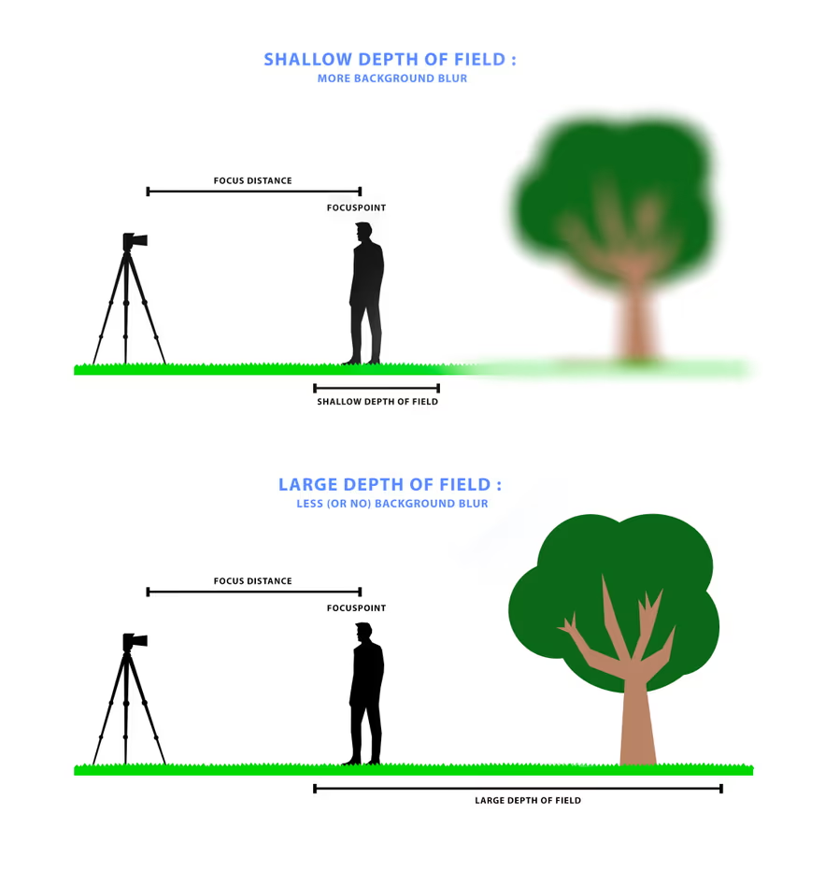
Lens Phenomenon: DoF
Depth of field refers to the range of depth values for which objects appear acceptably sharp in the image.
Pinhole camera: has an infinite depth of field.
Lens camera: a lens camera has a finite depth of field.
Notes:
- Depth of field is defined for a camera.
- Depth of field (DoF) is the area that appears sharp in your photo.
- Pinhole camera: has an infinite depth of field, meaning that objects at any depth appear perfectly sharp.

Slide 3
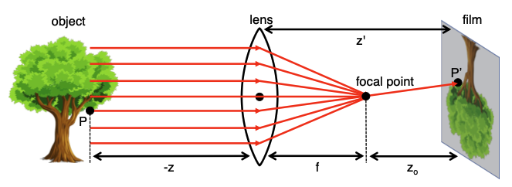
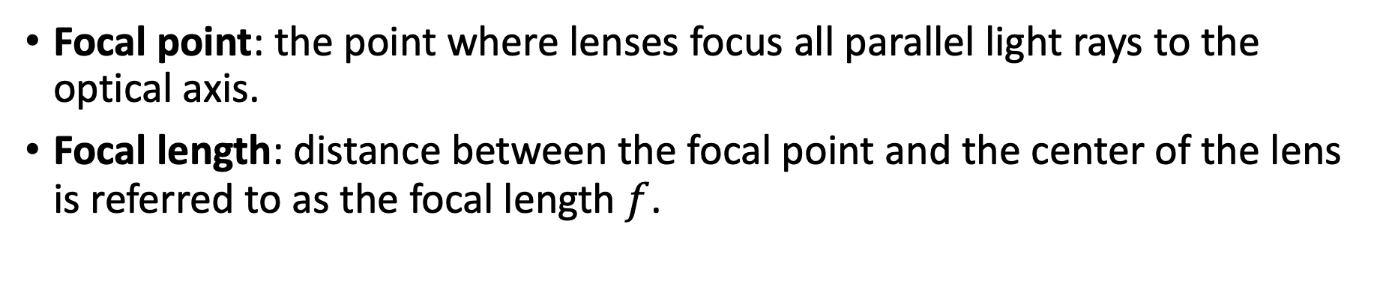
Lens Phenomenon
Focal point: the point where lenses focus all parallel light rays to the optical axis.
Focal length: distance between the focal point and the center of the lens is referred to as the focal length $f$.
The depth of field is inversely related to the focal length.
- Microscopes use high magnification and long effective focal lengths/close focus, which results in an extremely narrow (shallow) depth of field.
Notes:
— The depth of field is inversely related to the focal length. Cameras with a small focal length (e.g., microscopes) have a narrow depth of field, while those with a large focal length (e.g., telescopes) have a large depth of field.
- Focal length effect: A shorter focal length gives a deep depth of field. A longer focal length gives a shallow depth of field.
- Microscope reality: Microscopes use high magnification and long effective focal lengths/close focus, which results in an extremely narrow (shallow) depth of field.
- Telescope reality: Telescopes focus on distant objects and often have deep focus across celestial fields, but the traditional photographic rule states long lenses compress space and blur backgrounds.

Slide 4
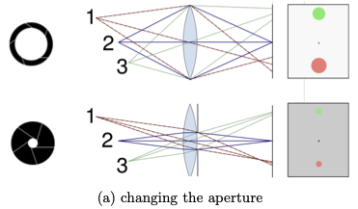
Depth of Field
Focal length: A wide lens (small mm) gives a large depth of field. A telephoto lens (large mm) gives a narrow depth of field.
We can control the depth of field by adjusting the aperture size.
- Reducing the aperture size increases the depth of field.
Notes:
- We can control the depth of field by adjusting the aperture size. Reducing the aperture size increases the depth of field.

Slide 5
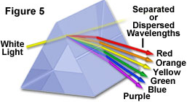
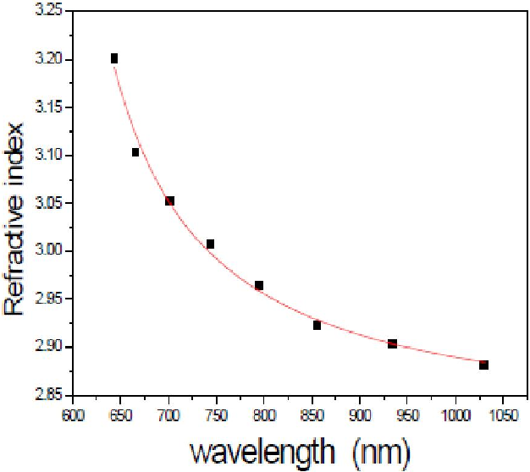



Lens Flaws
Wavelength of visible light: from 400 to 700 nanom,
  Blue light: 400
  Red light: 700
  Green light is at about 550 nanometers.
The property that models the bendingness of light rays in lens is called the refractive index.
Raw materials for lens e.g., glass or plastic has different refractive indices.
Refractive index is a function of the wavelength i.e., the focal length of a lens also depends on the wavelength.
$f$ depends on $RI$
$f$ depends on $WL$
$RI$ depends on WL

Slide 6
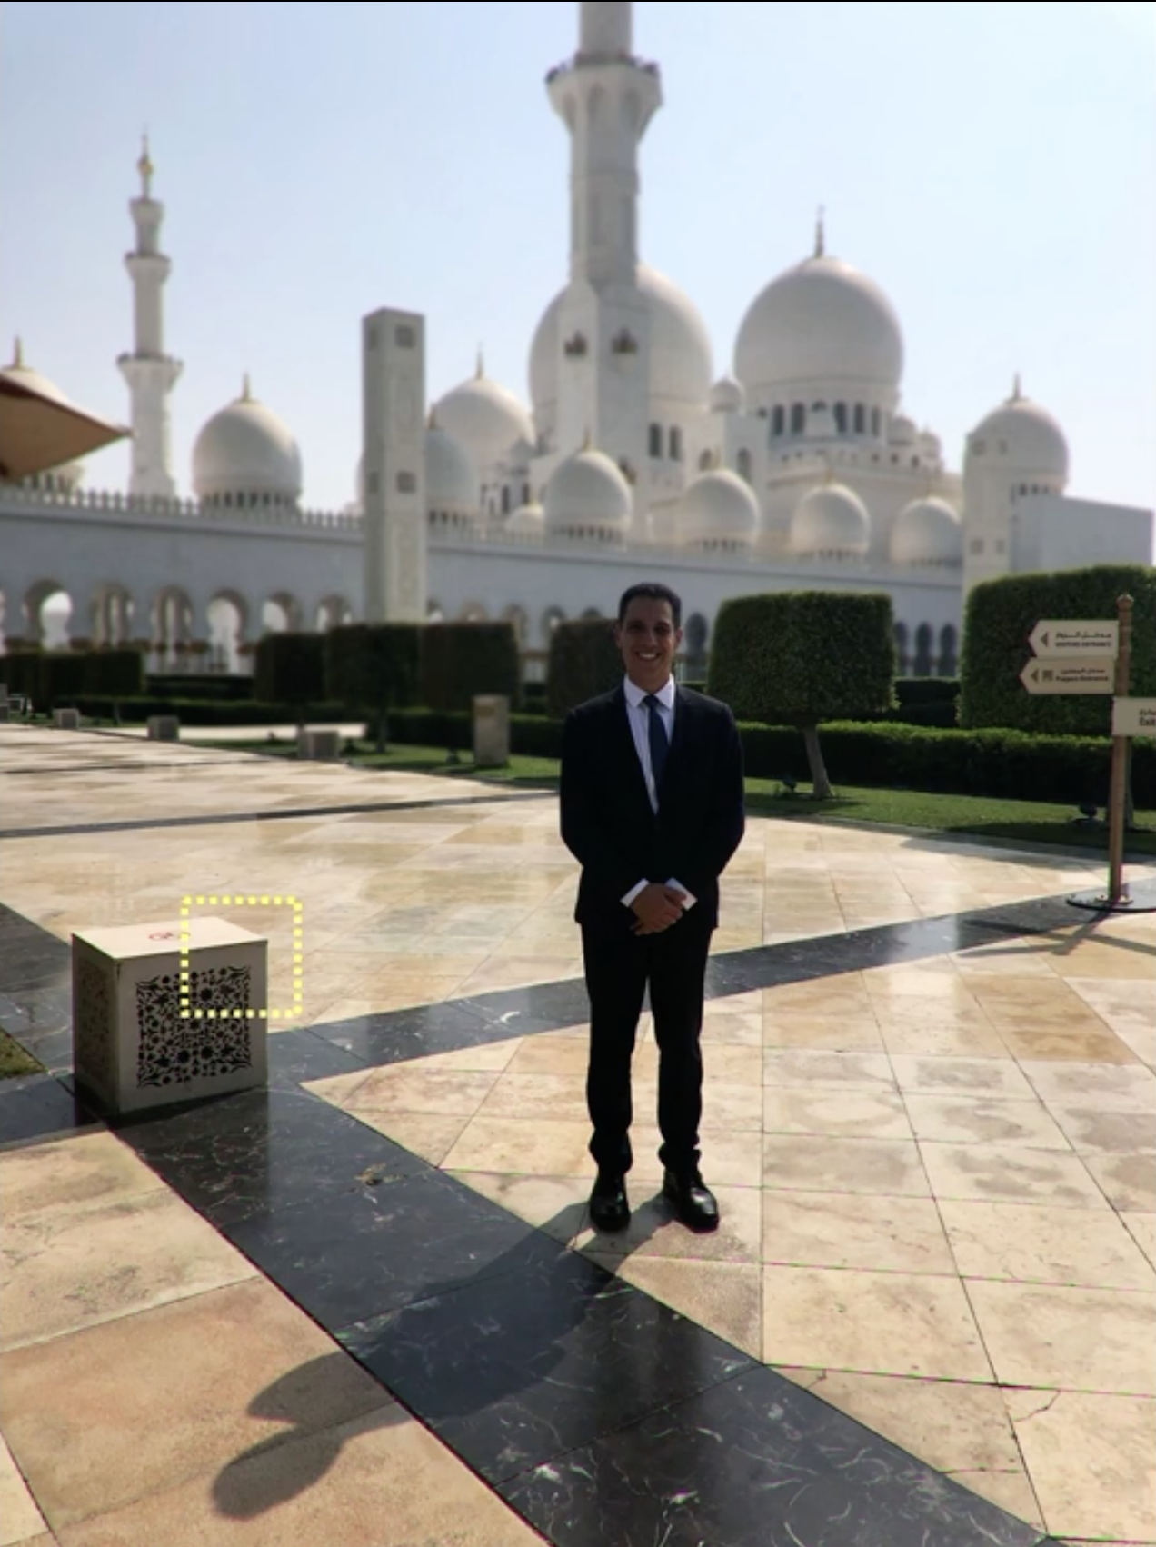
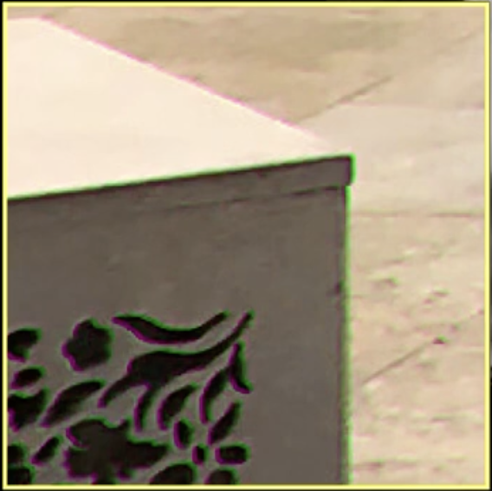
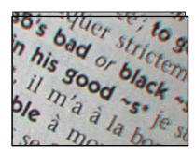

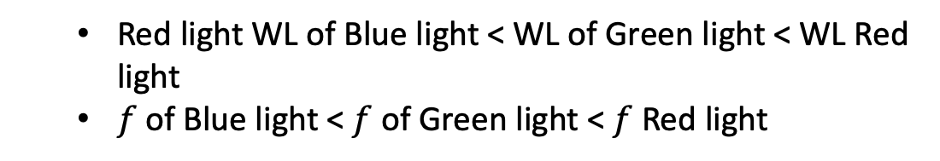





Lens Flaws
$$θ_{B}$$
$$θ_{R}$$
$$θ_{G}$$
  Red light WL of Blue light < WL of Green light < WL Red light
  $f$ of Blue light < $f$ of Green light < $f$ Red light
$$f_{B}$$
$f_{R}$
$$f_{G}$$
Notes:
This causes some shifts in color in the image. On the right is an image of a printed sheet of paper. Even though the sheet itself has no color (it has only shades of gray), its image has color effects around the edges of the printed letters. This is called chromatic aberration.'

Slide 7
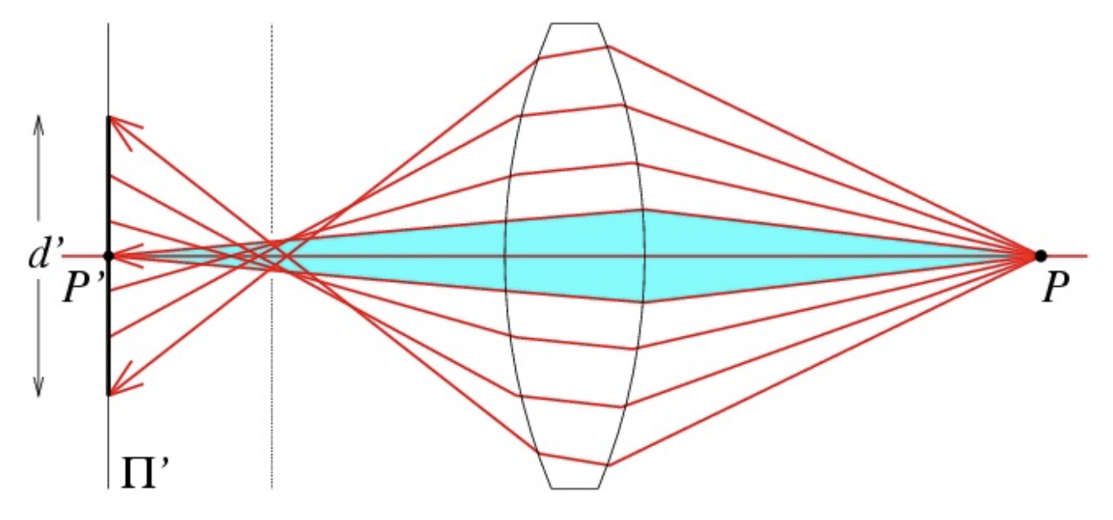
Lens flaws: Spherical (radial) aberration
Spherical lenses don’t focus light perfectly
Rays farther from the optical axis focus closer
Deviations are most noticeable for rays that pass through the edge of the lens
As we move away from the center of the image plane, points tend to get pushed
Geometric aberration
Two well-known geometric distortions are:
Spherical or radial or barrel distortion
Tangential distortion.
Notes:
Caused by imperfect lenses
Deviations are most noticeable near the edge of the lens

Slide 8
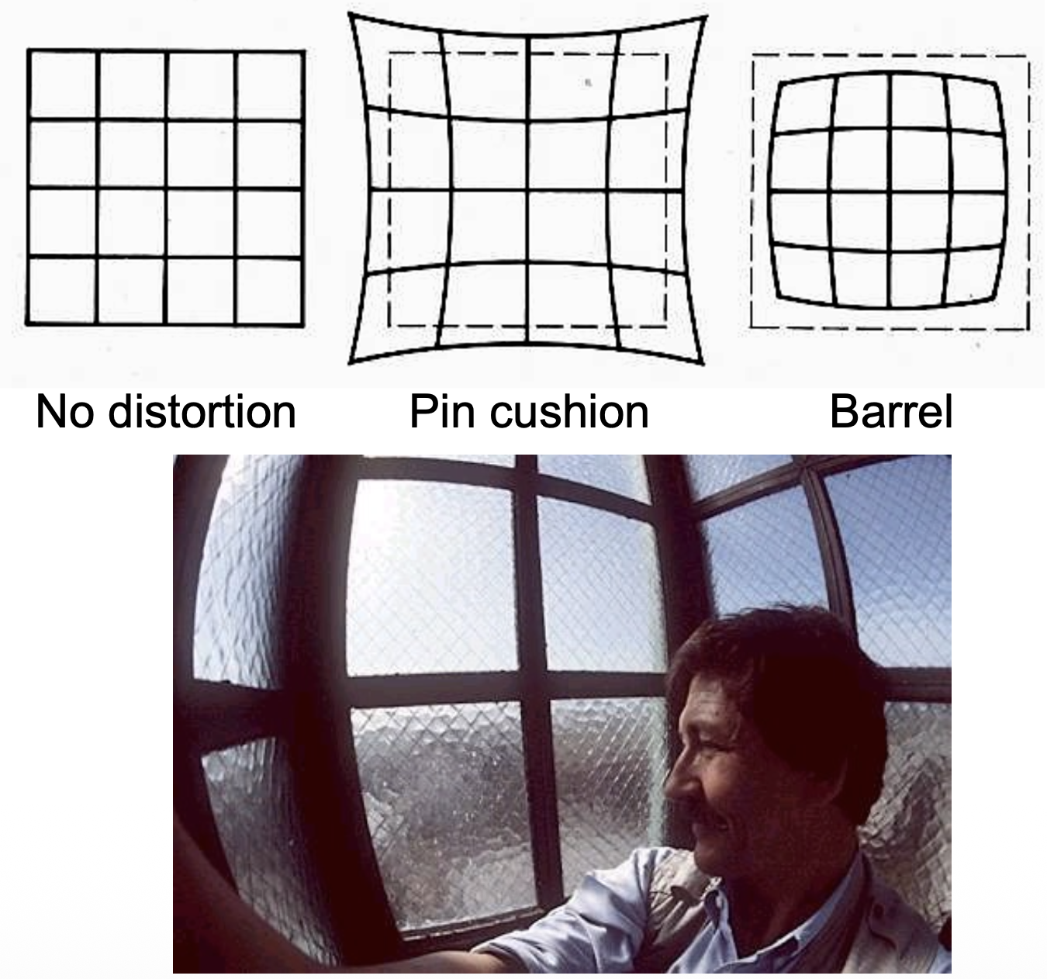
Radial Distortion

Slide 9
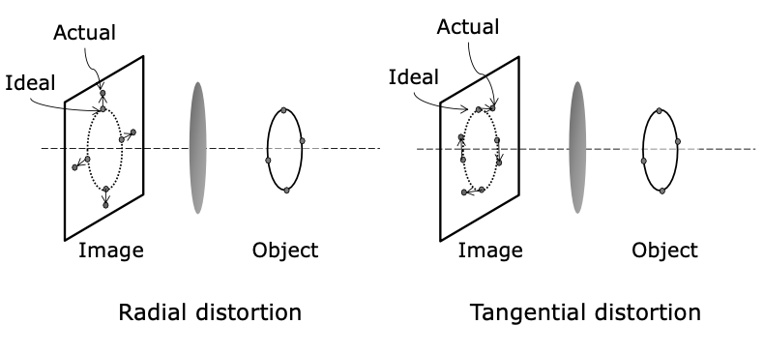
Issues with lenses: Radial Distortion
A high-quality lens tends to be made of several individual lenses whose shapes and materials are optimized to minimize all of the above effects.

Slide 10
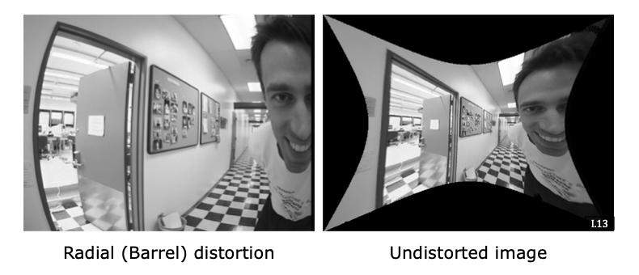
Geometric distortion correction
Barrel distortion is often found in images taken with wide-angle lenses.
The field of view of the corrected image is not rectangular because, due to barrel distortion,
the field of view of the original image itself was not rectangular even though the image
was formed on a rectangular sensor.
Notes:
Barrel distortion is often found in images taken with wide-angle lenses. On the left is an image taken with one such lens.
Note that straight lines in the scene no longer map to straight lines in the image.
If we know a priori what the barrel distortion is, we can take this captured image and apply a simple mapping software to obtain a pure perspective image, such as the one on the right.
In the right image, all straight lines in the scene do end up as straight lines in the image. An interesting thing to note here is that the field of view of the corrected image is not rectangular because, due to barrel distortion, the field of view of the original image itself was not rectangular even though the image was formed on a rectangular sensor.

Slide 11
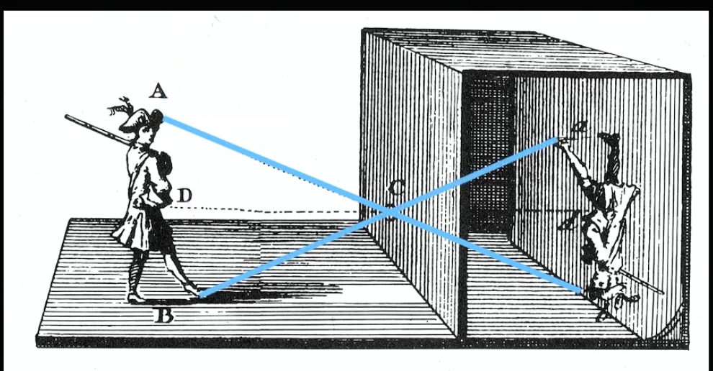
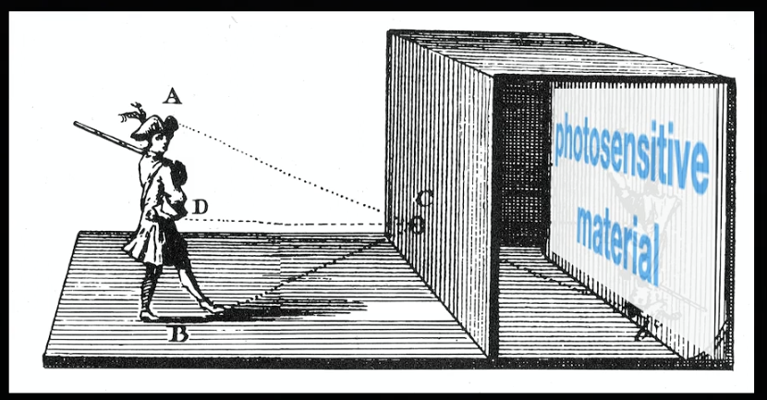
Image acquisition

Slide 12
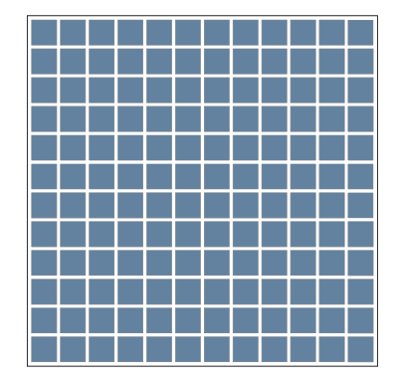
Sensor arrays
Revision form Gonzalez book

Slide 13
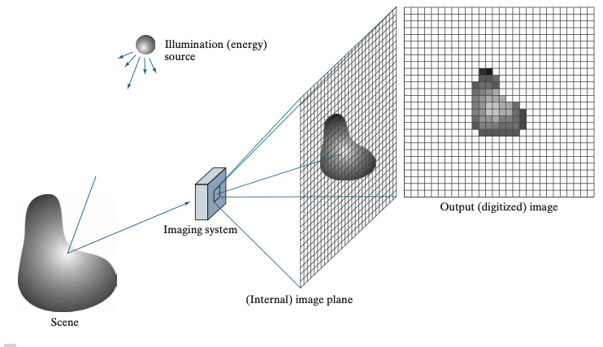
Image acquisition
Notes:
Figure shows the principal manner in which array sensors are used.
This figure shows the energy from an illumination source being reflected from a scene.
The first function performed by the imaging system is to collect the incoming energy and focus it onto an image plane.
The front end of the imaging system is an optical lens that projects the viewed scene onto the focal plane of the lens, as Fig. 2.15(d) shows.
The sensor array, which is coincident with the focal plane, produces outputs proportional to the integral of the light received at each sensor.
Digital and analog circuitry sweep these outputs and convert them to an analog signal, which is then digitized by another section of the imaging system.

Slide 14
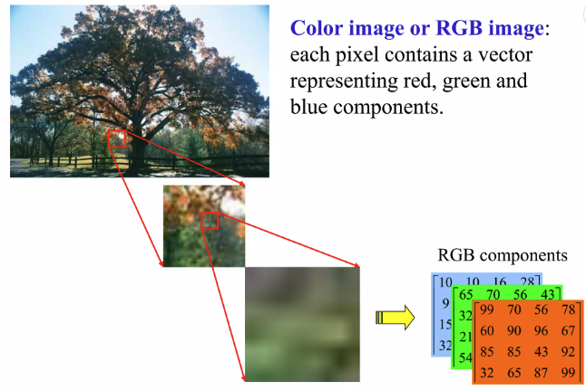
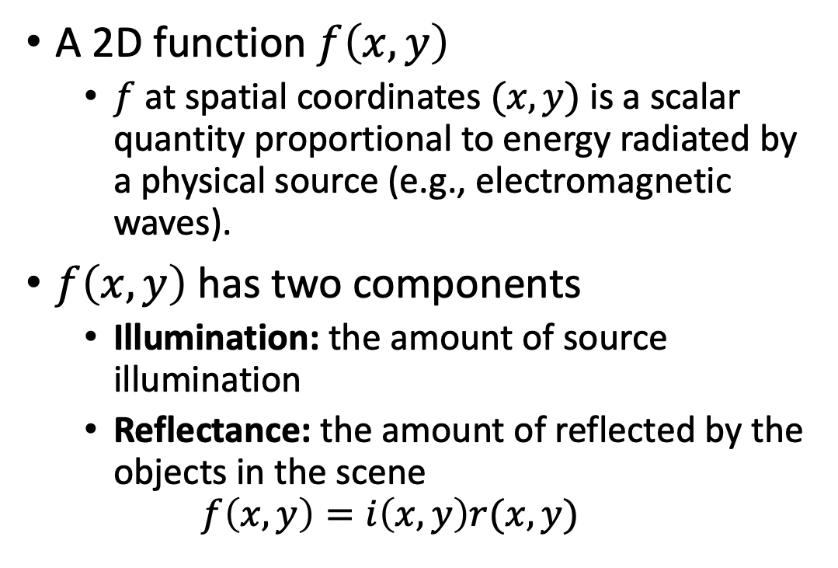



Image formation model
A 2D function $f\left(x,y\right)$
  $f$ at spatial coordinates $(x, y)$ is a scalar quantity proportional to energy radiated by a physical source (e.g., electromagnetic waves).
$f\left(x,y\right)$ has two components
  Illumination: the amount of source illumination
  Reflectance: the amount of reflected by the objects in the scene
  $$f\left(x,y\right)=i\left(x,y\right)r(x,y)$$
$$0≤f\left(x,y\right)<∞$$
$$0≤i\left(x,y\right)<∞$$
$$0≤r\left(x,y\right)<1$$
Notes:
Reflectance is bounded by 0 (total absorption) and 1 (total reflectance).
The nature of i (x, y) is determined by the illumination source, and r (x, y) is determined
by the characteristics of the imaged objects.

Slide 15
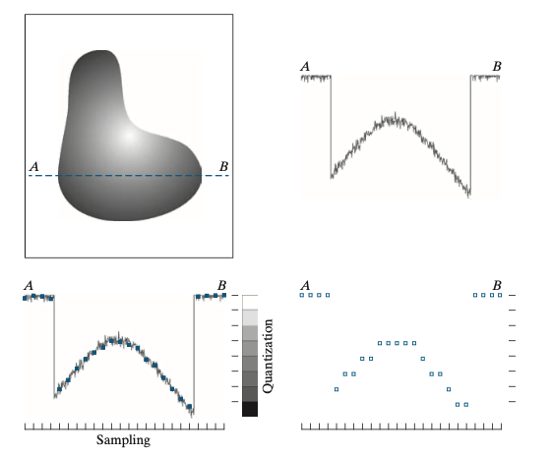
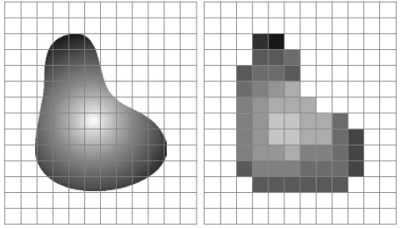
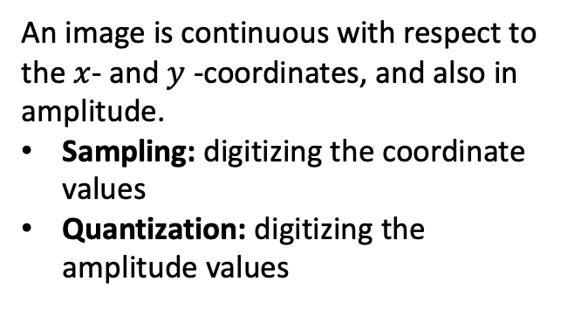
Sampling & Quantization
An image is continuous with respect to
the $x$- and $y$-coordinates, and also in amplitude.
Sampling: digitizing the coordinate values
Quantization: digitizing the amplitude values
Notes:
The random variations are due to image noise.
To sample this function, we take equally spaced samples along line AB, as shown in Fig. 2.16(c).
The discrete spatial locations of the samples are indicated by corresponding tick marks in the bottom of the figure.
The set of dark squares constitute the sampled function.
However, the values of the samples still span (vertically) a continuous range of intensity values.
In order to form a digital function, the intensity values also must be converted (quantized) into discrete quantities.
The vertical gray bar in Fig. 2.16(c) depicts the intensity scale divided into eight discrete intervals, ranging from black to white.
The vertical tick marks indicate the specific value assigned to each of the eight intensity intervals.

Slide 16
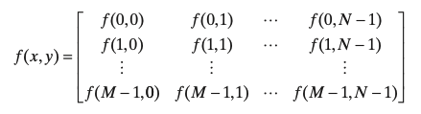
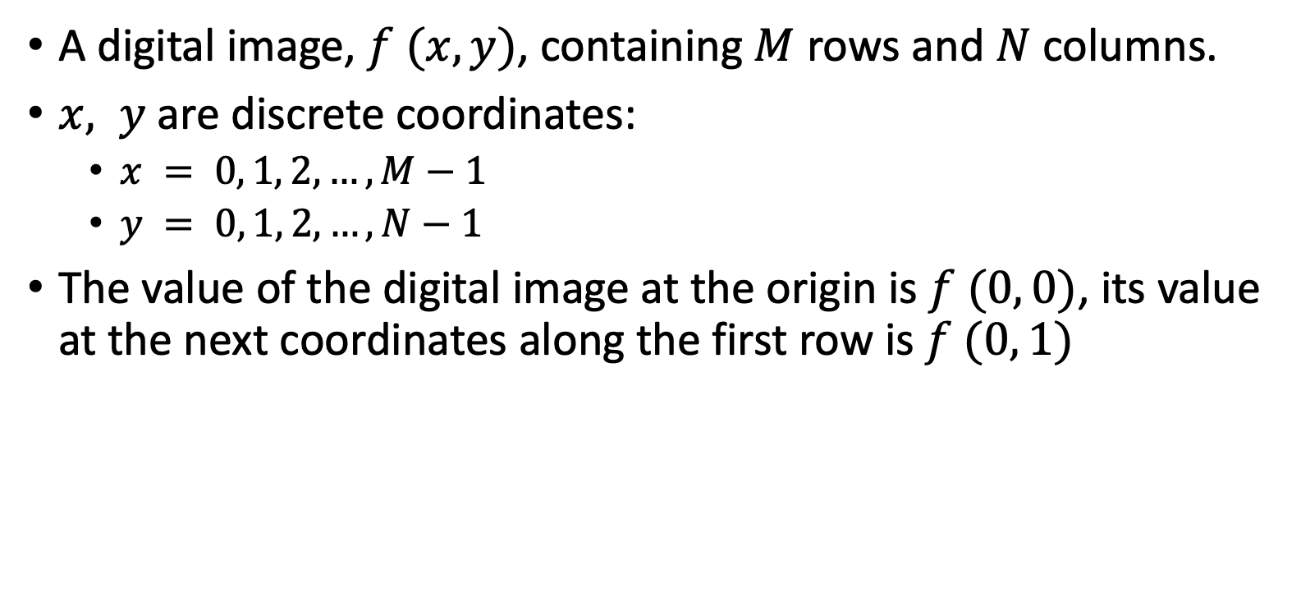
Digital image representation
A digital image, $f (x, y)$, containing $M$ rows and $N$ columns.
$x, y$ are discrete coordinates:
  $x = 0, 1, 2, …, M−1$
  $y = 0, 1, 2, …, N−1$
The value of the digital image at the origin is $f (0, 0)$, its value at the next coordinates along the first row is $f (0, 1)$
these are not the values of the physical coordinates.
Notes:
Here, the notation (0, 1) is used to denote the second sample along the first row. It does not mean that these are
the values of the physical coordinates when the image was sampled.

Slide 17
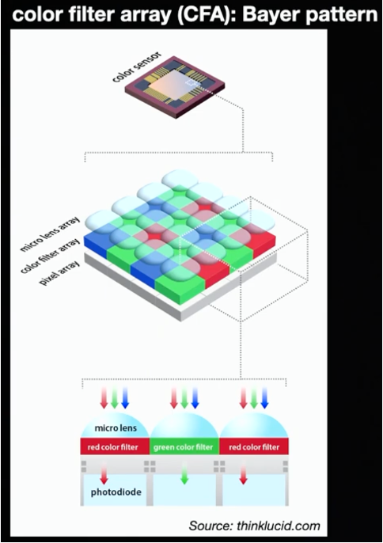
What a CMOS sensor does?
Sensors converts light into a different signal.
Digital cameras take photons and convert the photons into pixels.
Notes:
Sensors converts light into a different signal.
On top of each of these colors is a little tiny lens they focuses the lights onto the specific colour sensors.
Each pixel so each of those little cells that we are seeing is going to correspond to a single Pixel in the image.
In a 35 millimeter negative (sensor) it uses a photo process to convert light into something that can be recorded and exposed and made into an image.
Here we can divert it into a digital signal so it's a sort of an analog to digital converter.
In this perspective, digital cameras are some sort of analog to digital converter.
Digital cameras take photons and convert the photons into pixels.
We're going to read out the amount of light that strikes and

Slide 18
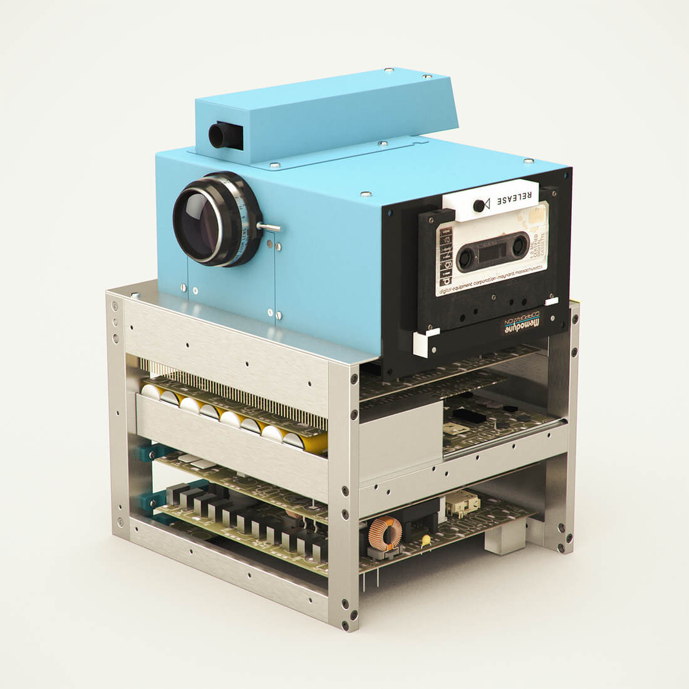
What is a color image?
A color image is a collection of pixels.
Every pixel has three colors associated with it – red, green and blue colors.
A camera records at every pixel -
  how much red light came in the part of the visible spectrum
  how much green light in the part of the visible spectrum
  how much blue light
Notes:
Back in the day the original digital cameras which were huge had three sensors and some beam splitting Optics that split the light into three sensors.
Consequences:
- reducing the light input by a factor of 3 i.e., you had a low light yield because you were spreading the light
- you had three sensors which was very expensive

Slide 19
Limitations of 3 sensor models
Consequences:
  Reducing the light input by a factor of 3
  A low light yield because of spreading the light
  Three sensors were very expensive

Slide 20
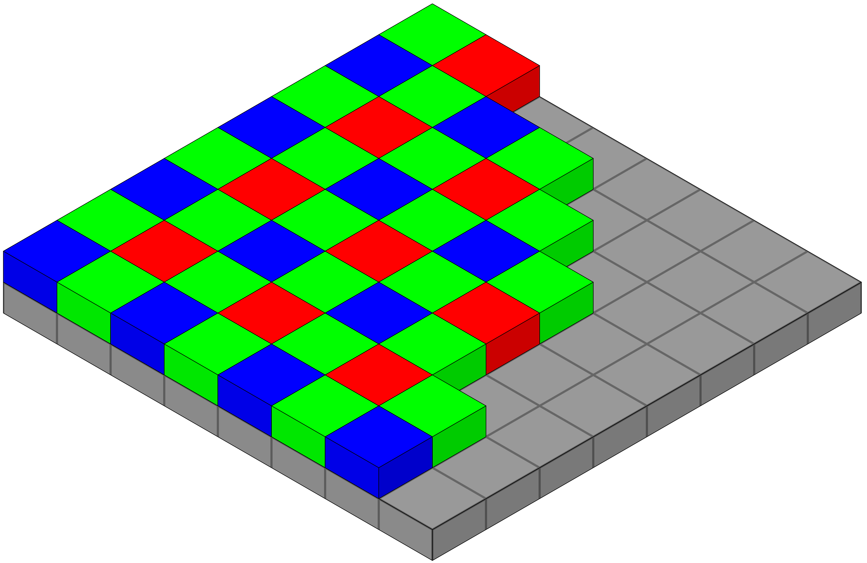
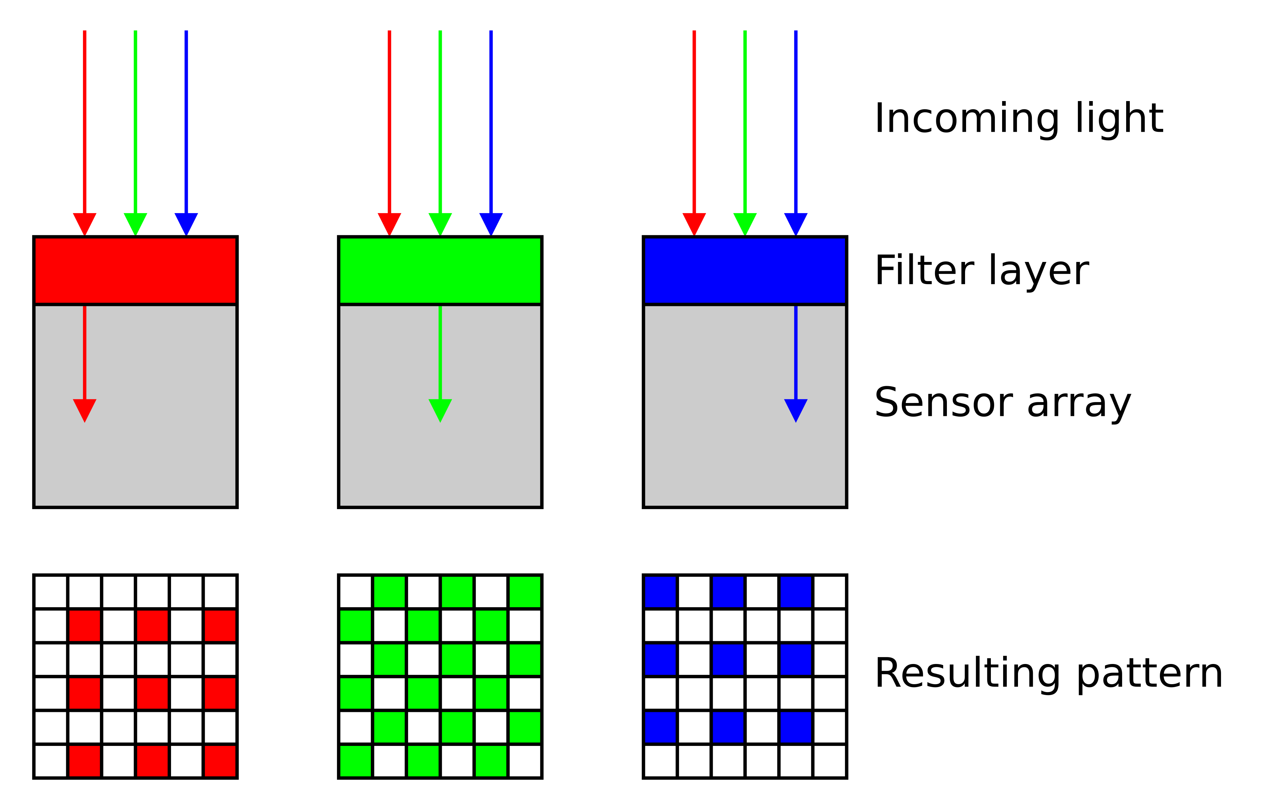
The Bayer pattern
Modern cameras use a color filter array in Bayer patterns.
Every sensor only records one of the values that we need for a RGB image.
Why is green over represented here?
  In the world there are more things in the green part of the visible spectrum than in red and blue
  Human visual system is more sensitive to the green part of the visible spectrum
  Our retina over samples the green part of the visible spectrum
Notes:
and you can see that this cell up here for example is going to record the red light it's colored red the next one is going to be green and then red and then green and then the blues and so on and so forth.

Slide 21
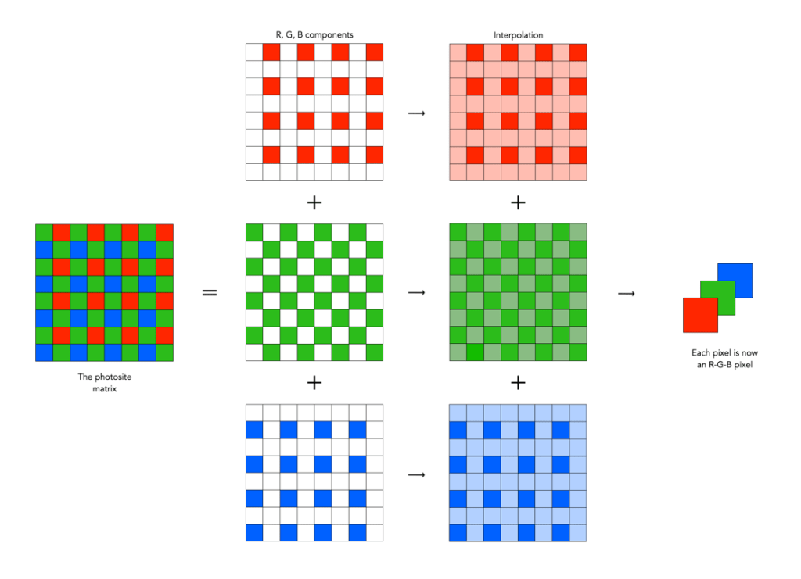
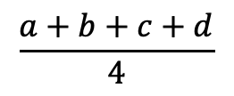
The Bayer pattern
In a modern digital camera only records
one-third of all the pixels per channel
How would we get the missing pixels?
b
a
d
c
$$\frac{a+b+c+d}{4}$$
  bilinear and bicubic interpolation more sophisticated interpolation algorithms are
  gradient based adaptive color plane smooth Hue transition and
  some are proprietary for particular cameras.
Notes:
What it means is down here where we have my three Channel we are missing a bunch of pixels all of these black pixels here are missing
In a modern digital camera for years for decades we are only recording one-third of all the pixels we need to represent a full-blown RGB color image.

Slide 22
Pixels
The image recorded by creating pixels by interpolating all of the missing pixels from the underlying bear pattern
We started with electronic sensor that converts light into a digital signal based on how much light there is then we interpolate those missing pixels to get the RGB image.
Every pixel is presented by a 8-bit number per channel i.e., a pixel is represented as three numbers in the range [0, 255].
For example:
  if I have a value of 0 it means it's black and
  if I have a value of 255 it's maximal value

Slide 23
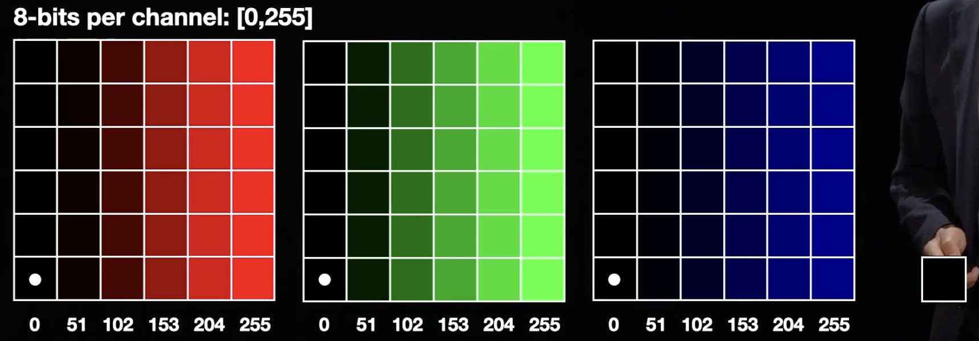


What does the pixel values represent?
A column in the red Channel a 255 value means we have really really bright red and as that value goes left it gets darker and darker red
Same with the green same and the blues

Slide 24
Displays
How do we transform the 3D PGB values to visualization and display on screen?
  Every display converts the pixel representation (3D RGB values) into a brightness
Typically: a value of 0 -> Black, 255->White and 128-> Gray

Slide 25
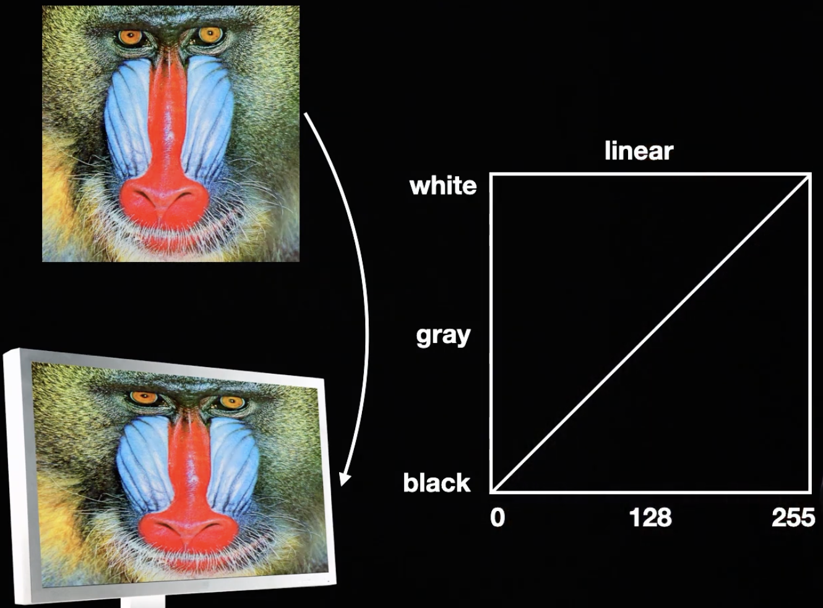
Displays

Slide 26
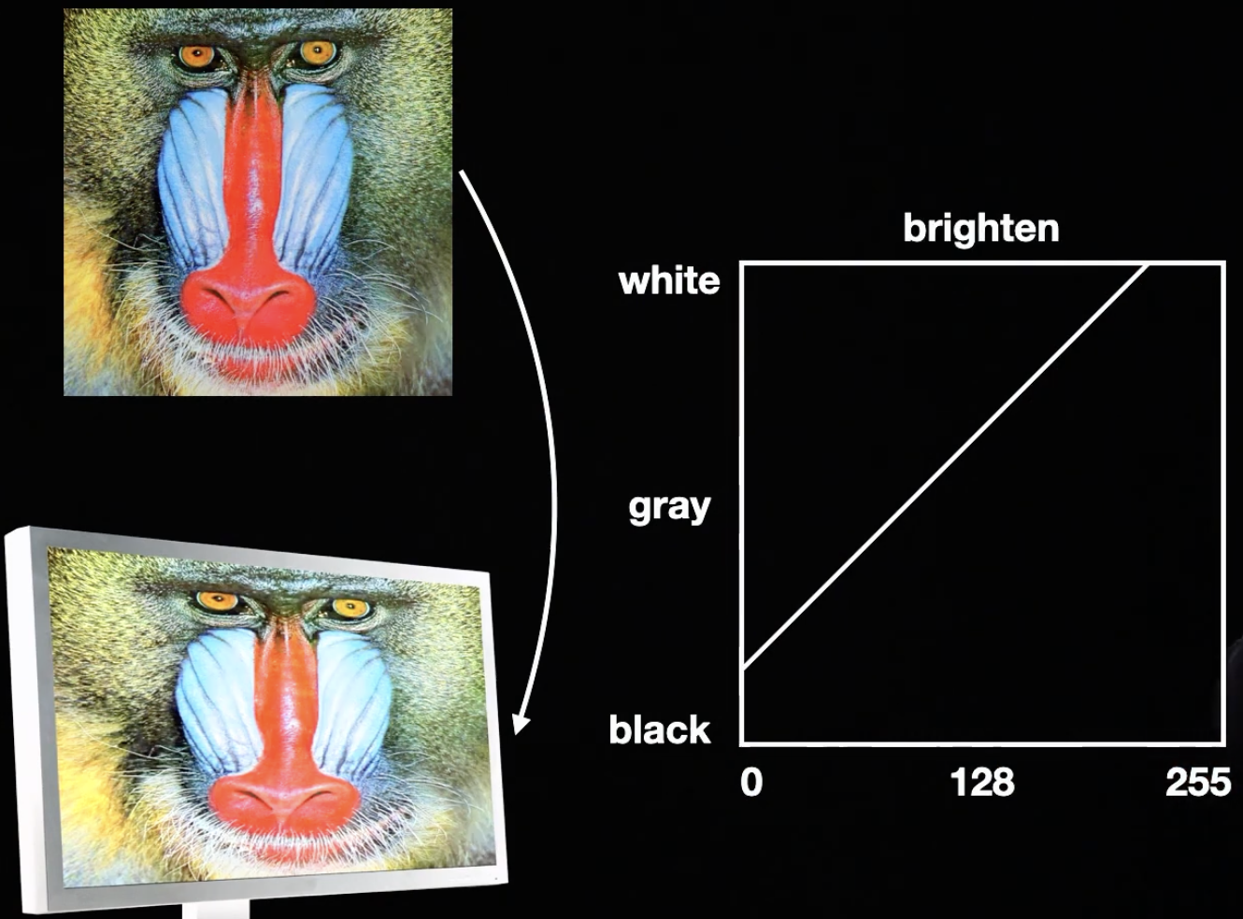
Displays Brightness

Slide 27
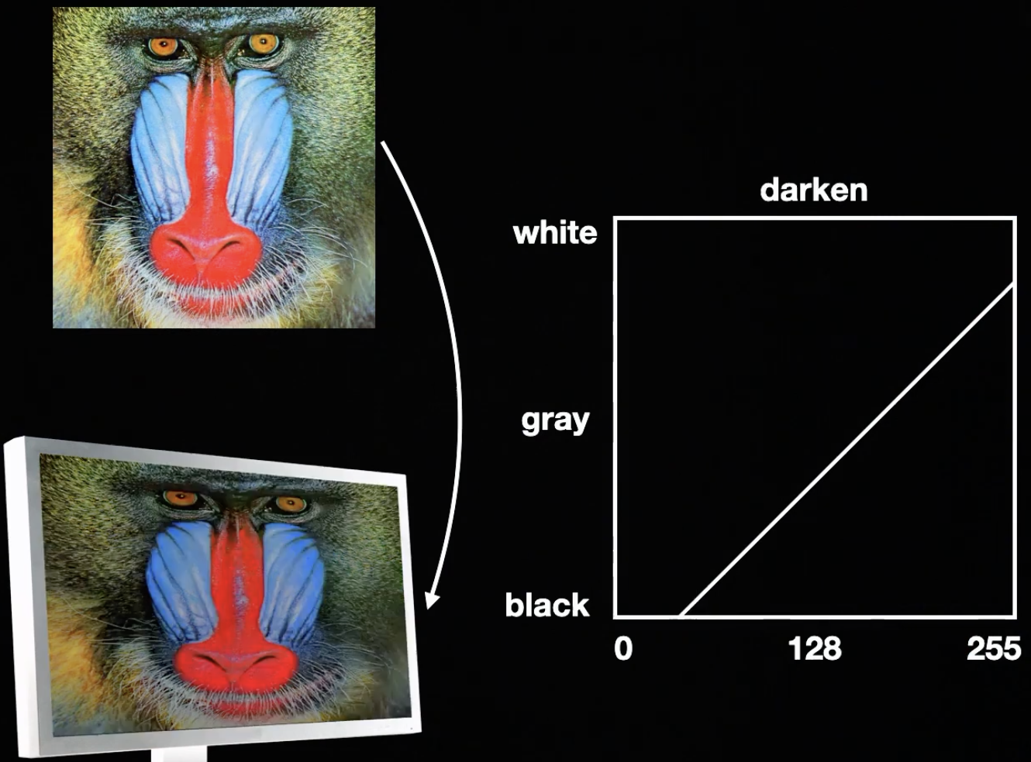
Displays

Slide 28
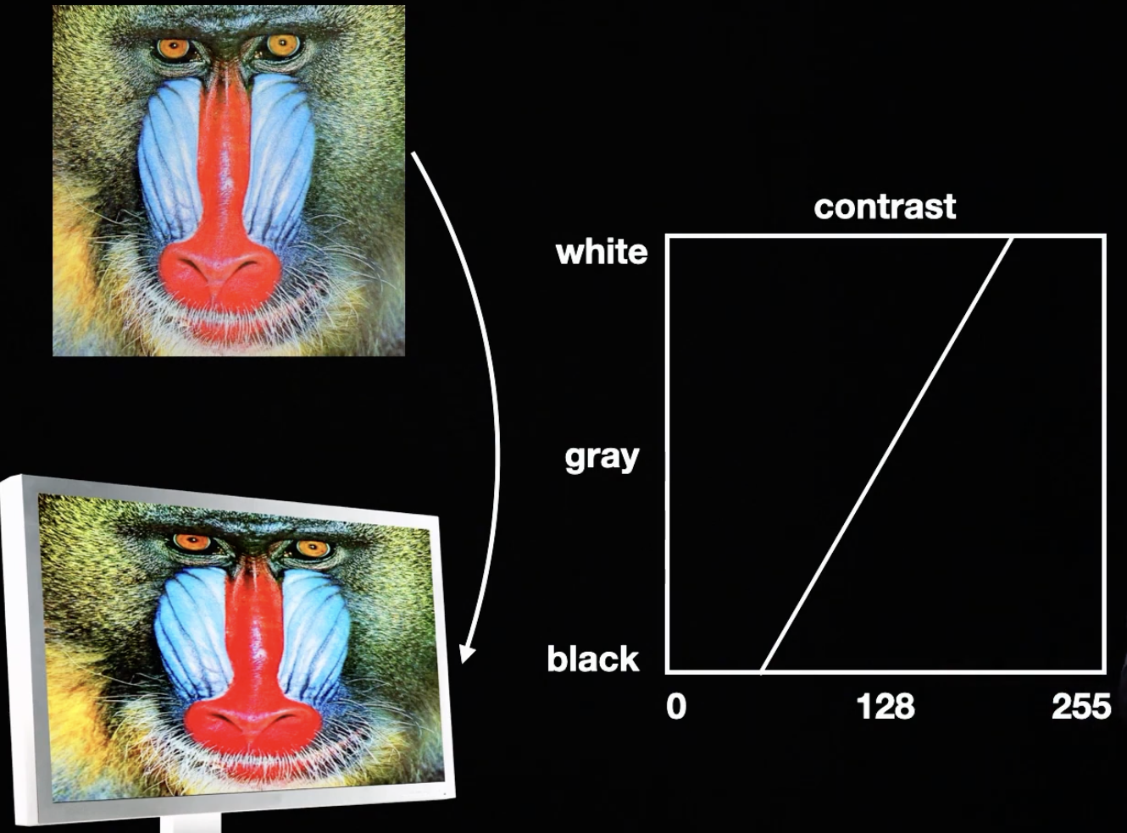
Displays
Contrast

Slide 29
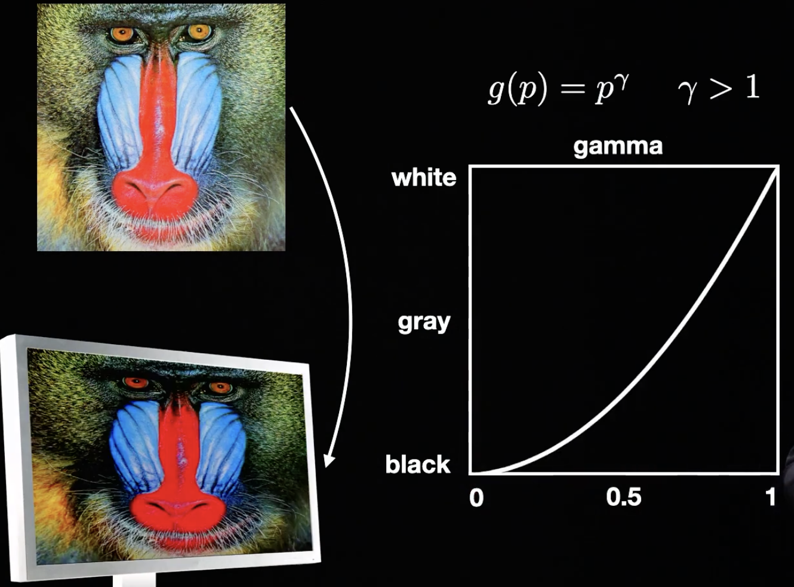
Displays gamma

Slide 30
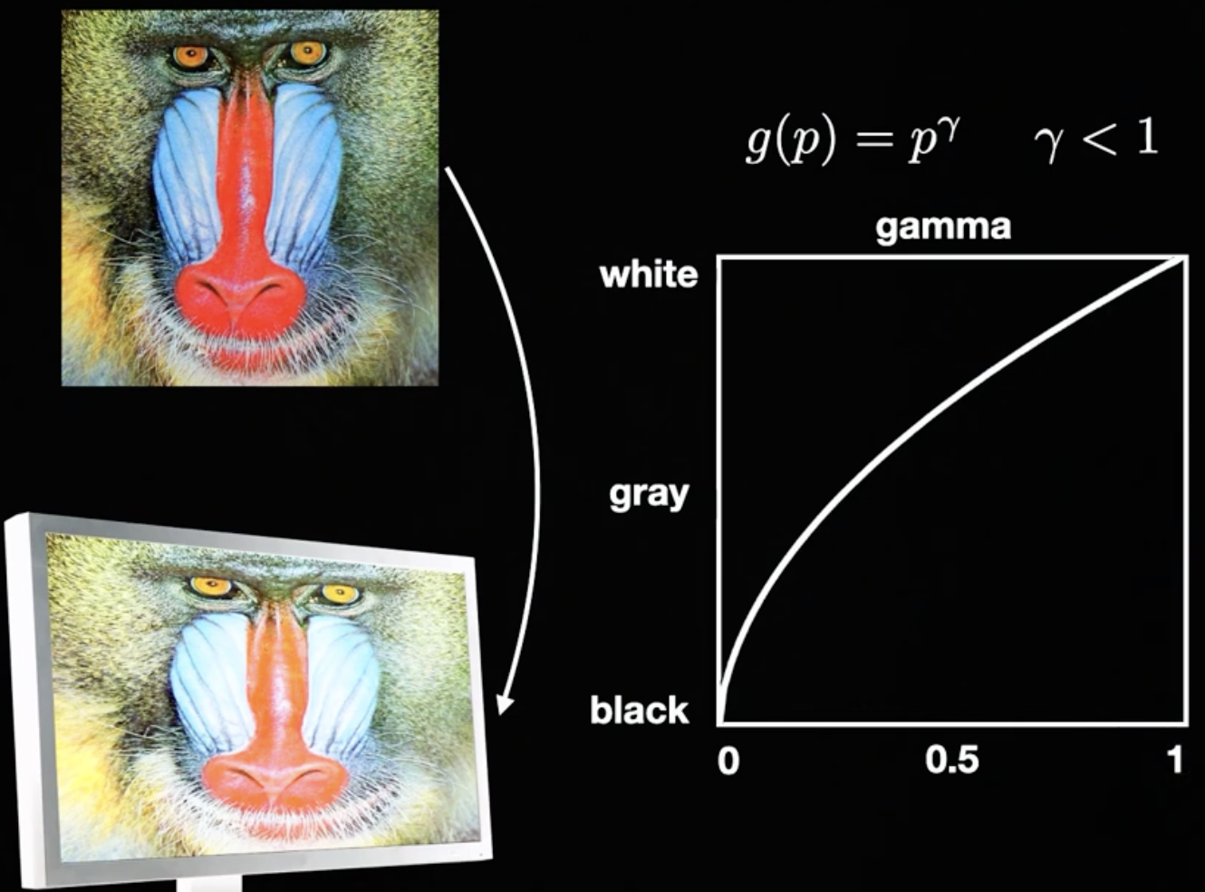
Displays gamma

Slide 31
Displays gamma

Slide 32
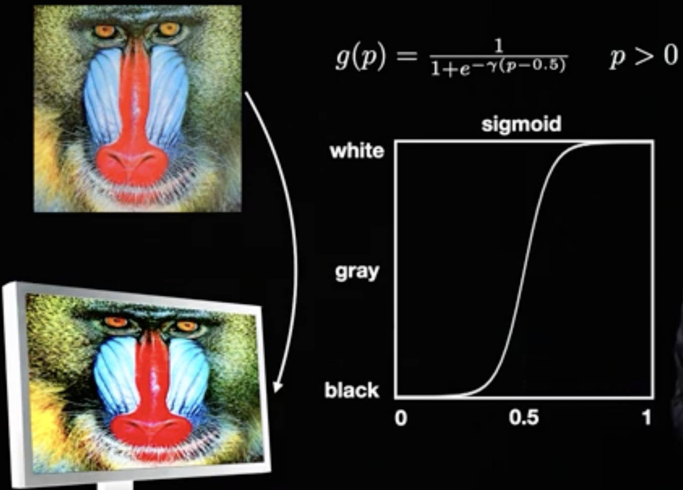
Displays sigmoid

Slide 33
Reading
https://www.youtube.com/watch?v=lyf5jGIrwQE&list=PLhwIOYE-ldwL6h-peJADfNm8bbO3GlKEy&index=11
https://www.youtube.com/watch?v=NBbzmOSJkTg&list=PLhwIOYE-ldwL6h-peJADfNm8bbO3GlKEy&index=12&t=608s
https://cvl-umass.github.io/intro-cv-spring-2025/assets/notes/imageformation.pdf
Notebook: https://www.kaggle.com/code/zahidbd/cv-color-lecture3/
Notebook: https://www.kaggle.com/code/zahidbd/lecture3-nb-2
Digital Image Processing, Rafael C. Gonzalez, Richard E. Woods
  2.3 Image Sensing and Acquisition
    IMAGE ACQUISITION USING SENSOR ARRAYS
    A SIMPLE IMAGE FORMATION MODEL
  2.4 Image Sampling and Quantization
    BASIC CONCEPTS IN SAMPLING AND QUANTIZATION
    REPRESENTING DIGITAL IMAGES
Computer Vision: A Modern Approach, by D.A. Forsyth
  1.1.3 Cameras with Lenses (discussion on aberrations)
Computer Vision: Algorithms and Applications, by Richard Szeliski
  2.2 Photometric image formation

