Slide 1
COMPUTER VISION
Week 6
Lecture 8 (03/09/2026)
0714 02 CSE 4239

Slide 2
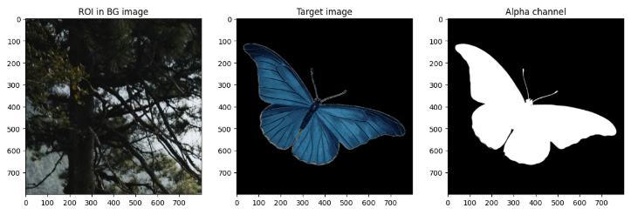
Matting and Compositing
The process of extracting the object from the original image is often called matting
The process of inserting an extracted object into another image (without visible artifacts) is called compositing.

Slide 3
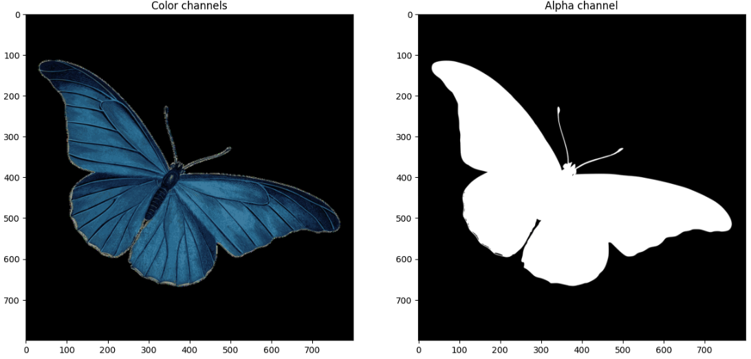
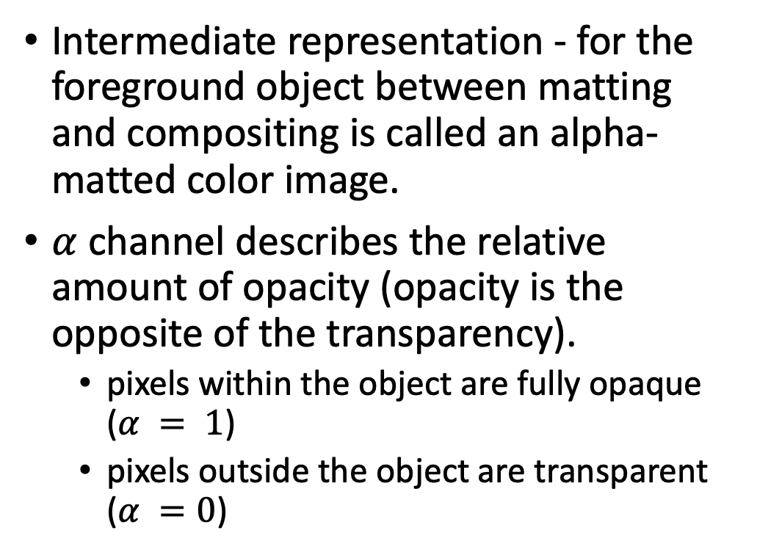

The $α$channel
Intermediate representation - for the foreground object between matting and compositing is called an alpha-matted color image.
$α$ channel describes the relative amount of opacity (opacity is the opposite of the transparency).
  pixels within the object are fully opaque ($α = 1$)
  pixels outside the object are transparent ($α =0$)
img = cv2.imread(img_loc, -1)
img.shape
(800, 800, 4)

Slide 4
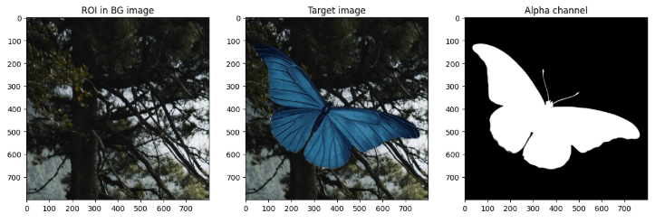
Compositing

Slide 5
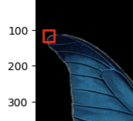
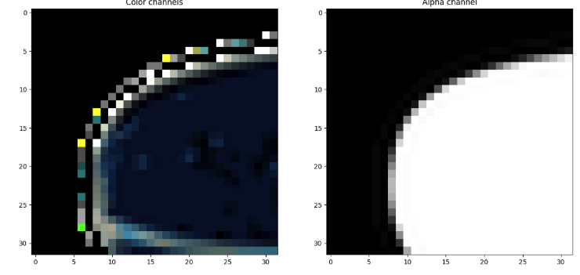
Take a deeper look
bgr_sub_img = img_bgr[r_start:r_start+span,c_start:c_start+sapn,:]
alpha_sub_img = img_alpha[r_start:r_start+span,c_start:c_start+sapn,:]

Slide 6
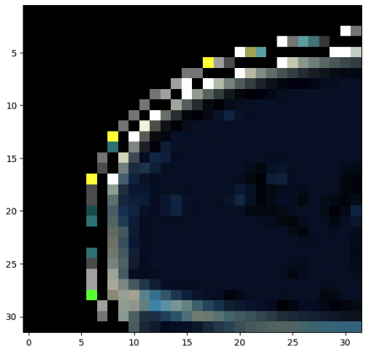
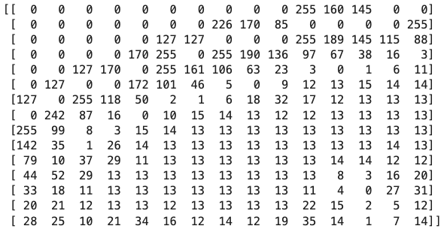
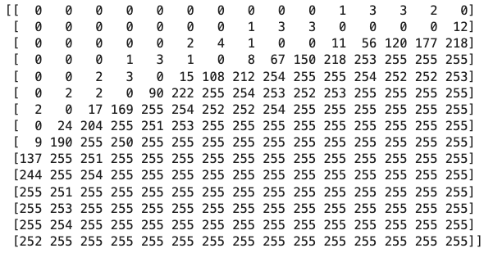
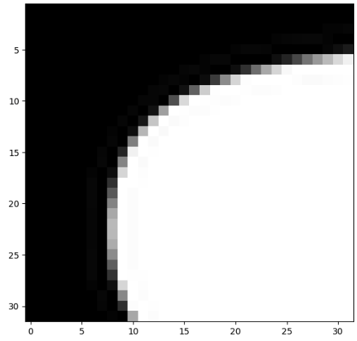
Take a deeper look

Slide 7
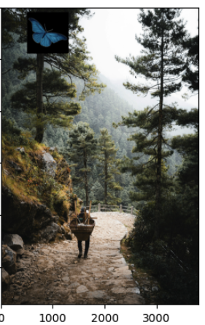
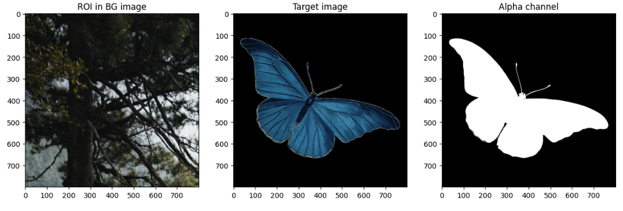
Create composition
Notebook: https://www.kaggle.com/code/zahidbd/lecture8-nb1-masking/
img_scene_bgr[
y_offset:y_offset+h,
x_offset:x_offset+w
] = img_bgr
y

Slide 8
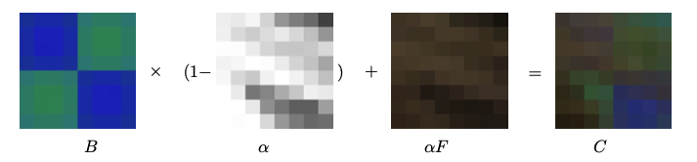

The over operator
$C=\left(1−α\right)∗B+α∗F$
  $C$: the output image
  $α∈[0,…,1]$: the alpha channel
  $B:$ the background image
  $F$: the foreground image

Slide 9
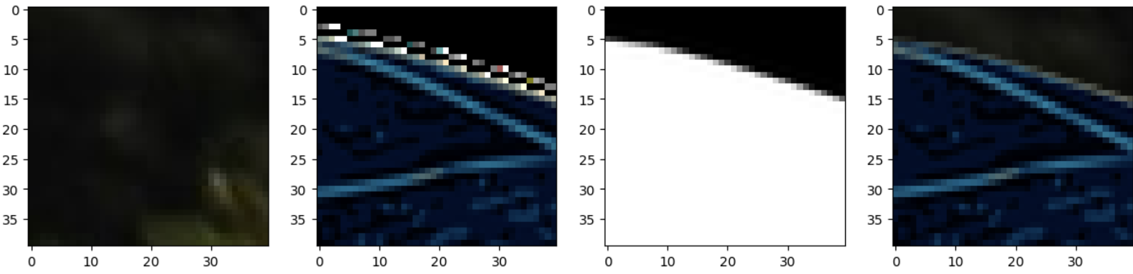
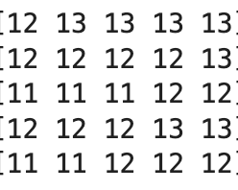
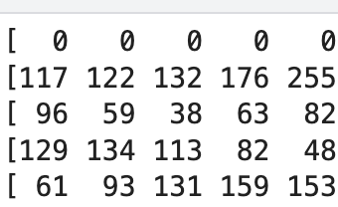
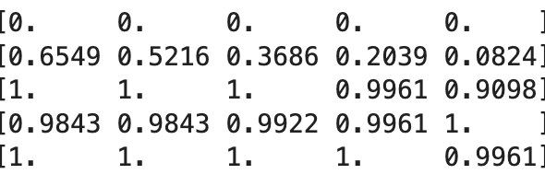
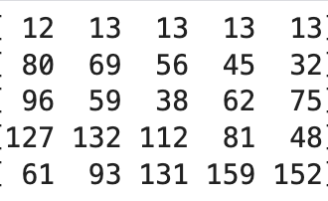

Over operator demo
$$C=\left(1−α\right)∗B+α∗F$$
B
F
$$α$$
C
$$B\left[1, 0\right]=12;F\left[1,0\right]=117;α\left[1,0\right]=0.6549⇒\left(1−α\right)=0.3451$$
$$C\left[1, 0\right]=0.3451∗0.6549∗117=80.76⇒80$$

Slide 10
Filtering
Filtering is a technique for modifying or enhancing an image. Used to:
  emphasize features i.e. smoothing, sharpening, and edge enhancement etc. or
  remove features from an image i.e. noise removal
Filtering is a neighborhood operation, in which the value of any given pixel in the output image is determined by applying some algorithm to the values of the pixels in the neighborhood of the corresponding input pixel.
A pixel’s neighborhood is a collection of pixels surrounding it.

Slide 11
Types of filtering
Spatial domain filtering refers to performing image processing operations directly on the pixels of an image.
  We alter a pixel's value based on its current value and the values of its immediate neighboring pixels.
  Mainly two types:
    Linear filtering
    Non-linear filtering
Frequency domain filtering - an image is first converted into sine and cosine waves (using a Fourier Transform) and then changes are applied.

Slide 12
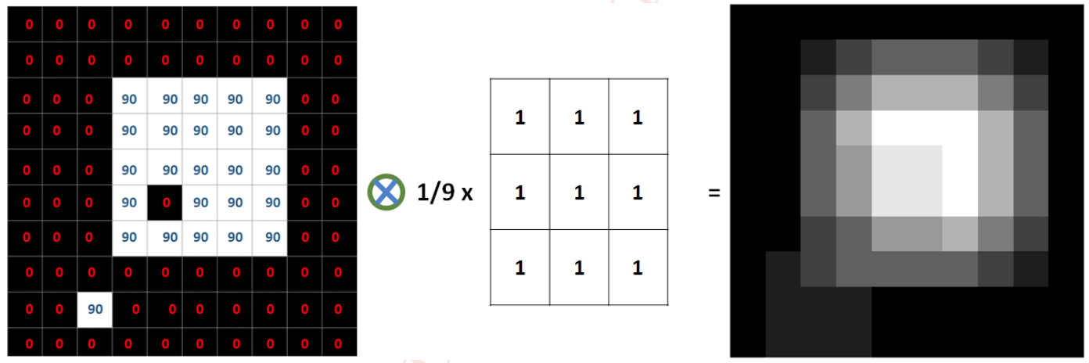
Moving average filtering
Replace each pixel with an average of all value of pixels in its neighborhood - Moving average.
Smoothed version means average version (replacing high or low values with mean).

Slide 13
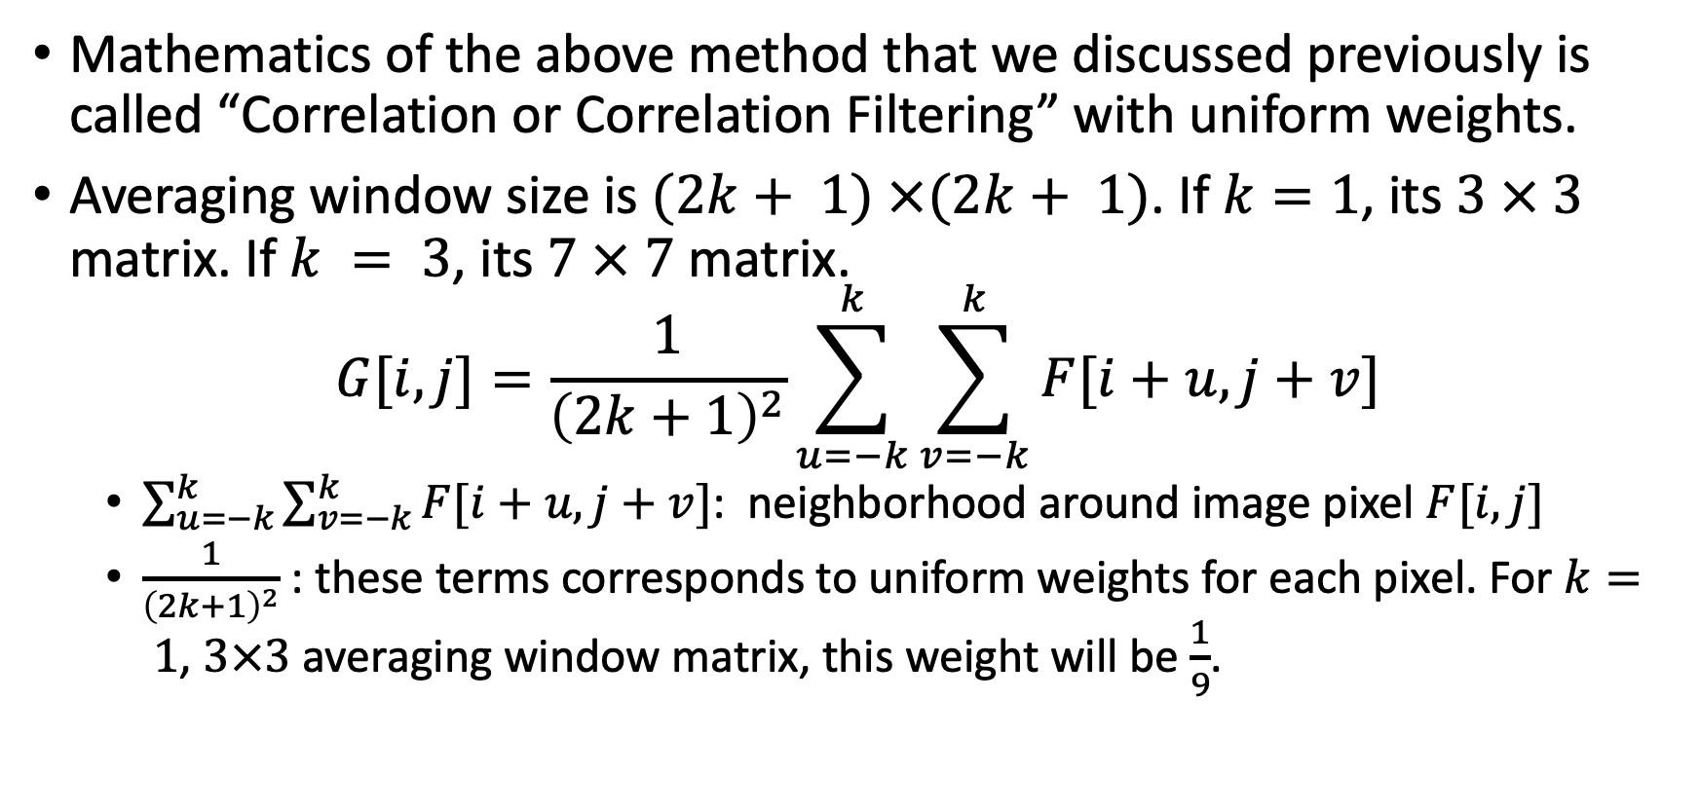
Correlation filtering
Mathematics of the above method that we discussed previously is called “Correlation or Correlation Filtering” with uniform weights.
Averaging window size is $(2k+ 1) ×(2k+ 1)$. If $k=1$, its $3 × 3$ matrix. If $k = 3$, its $7 × 7$ matrix.
$$G[i,j]=\frac{1}{{\left(2k+1\right)}^{2}}\sum_{u=−k}^{k}{\sum_{v=−k}^{k}{F[i+u, j+v]}}$$
  $\sum_{u=−k}^{k}{\sum_{v=−k}^{k}{F[i+u, j+v]}}$: neighborhood around image pixel $F[i,j]$
  $\frac{1}{{\left(2k+1\right)}^{2}}$: these terms corresponds to uniform weights for each pixel. For $k= 1$, $3×3$ averaging window matrix, this weight will be $\frac{1}{9}$.

Slide 14
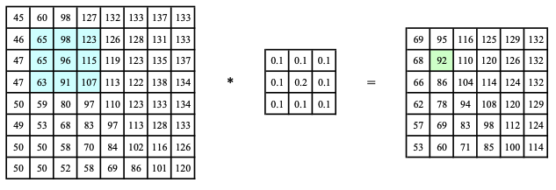



Linear filtering non-uniform weights
Neighborhood operator or local operator:
  uses a collection of pixel values in the vicinity of a given pixel to determine its final output value
$$H[i,j]$$
$$G[i,j]$$
$$F[i,j]$$

Slide 15
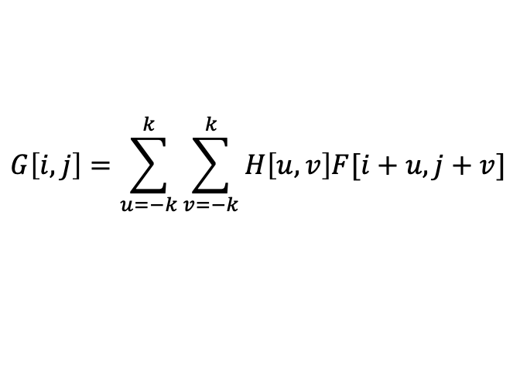
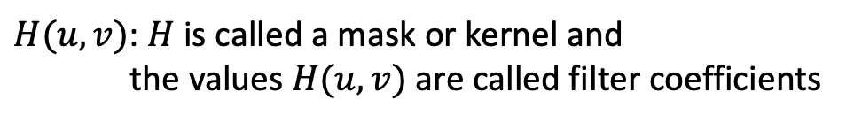




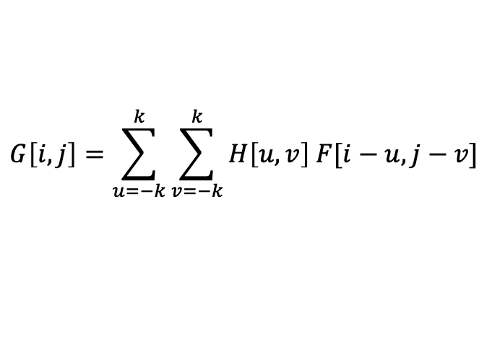
Uses of filtering
$$G\left[i,j\right]=\sum_{u=−k}^{k}{\sum_{v=−k}^{k}{H\left[u,v\right]F[i+u,j+v]}}$$
Filter images to add
  soft blur
  sharpen details
  accentuate edges
  remove noise
$H(u,v)$: $H$ is called a mask or kernel and
the values $H(u,v)$ are called filter coefficients
$$G=H⊗F$$
$⊗$: is called the correlation operator
$$G\left[i,j\right]=\sum_{u=−k}^{k}{\sum_{v=−k}^{k}{H\left[u,v\right] F[i−u,j−v]}}$$
$$G=F∗H$$
$∗$: is called the convolution operator

Slide 16
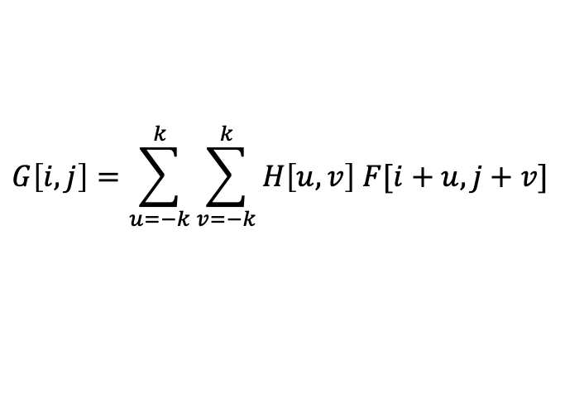
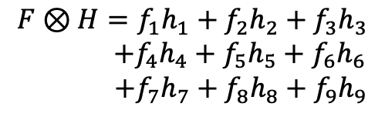

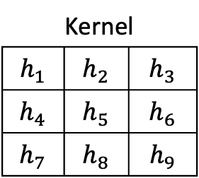
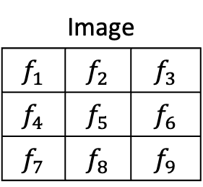
Correlation
$$G\left[i,j\right]=\sum_{u=−k}^{k}{\sum_{v=−k}^{k}{H\left[u,v\right] F[i+u,j+v]}}$$
Image
$$f_{1}$$ | $$f_{2}$$ | $$f_{3}$$
$$f_{4}$$ | $$f_{5}$$ | $$f_{6}$$
$$f_{7}$$ | $$f_{8}$$ | $$f_{9}$$
Kernel
$$h_{1}$$ | $$h_{2}$$ | $$h_{3}$$
$$h_{4}$$ | $$h_{5}$$ | $$h_{6}$$
$$h_{7}$$ | $$h_{8}$$ | $$h_{9}$$
$$F⊗H=f_{1}h_{1}+f_{2}h_{2}+f_{3}h_{3}$$
$+f_{4}h_{4}+f_{5}h_{5}+f_{6}h_{6}$
$$+f_{7}h_{7}+f_{8}h_{8}+f_{9}h_{9}$$
$$⊗$$

Slide 17

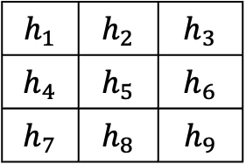

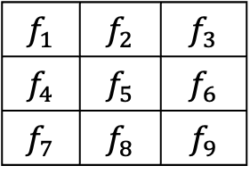
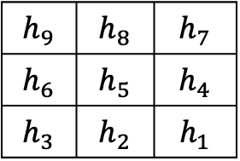

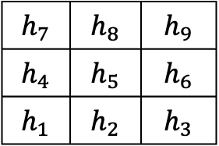
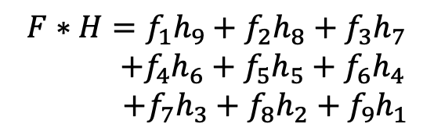
Convolution
Convolution is very similar to correlation, the only difference is flipped kernel.
$$h_{1}$$ | $$h_{2}$$ | $$h_{3}$$
$$h_{4}$$ | $$h_{5}$$ | $$h_{6}$$
$$h_{7}$$ | $$h_{8}$$ | $$h_{9}$$
$$h_{7}$$ | $$h_{8}$$ | $$h_{9}$$
$$h_{4}$$ | $$h_{5}$$ | $$h_{6}$$
$$h_{1}$$ | $$h_{2}$$ | $$h_{3}$$
$x$-flip
$$F∗H=f_{1}h_{9}+f_{2}h_{8}+f_{3}h_{7} \\ +f_{4}h_{6}+f_{5}h_{5}+f_{6}h_{4}$$
$+f_{7}h_{3}+f_{8}h_{2}+f_{9}h_{1}$
$y$-flip
$$f_{1}$$ | $$f_{2}$$ | $$f_{3}$$
$$f_{4}$$ | $$f_{5}$$ | $$f_{6}$$
$$f_{7}$$ | $$f_{8}$$ | $$f_{9}$$
$$h_{9}$$ | $$h_{8}$$ | $$h_{7}$$
$$h_{6}$$ | $$h_{5}$$ | $$h_{4}$$
$$h_{3}$$ | $$h_{2}$$ | $$h_{1}$$
$$∗$$

Slide 18
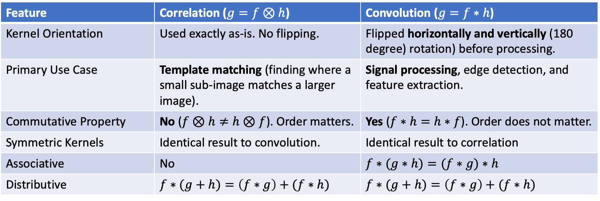
Correlation vs convolution
Feature | Correlation ($g=f⊗h$) | Convolution ($g=f∗h$)
Kernel Orientation | Used exactly as-is. No flipping. | Flipped horizontally and vertically (180 degree) rotation) before processing.
Primary Use Case | Template matching (finding where a small sub-image matches a larger image). | Signal processing, edge detection, and feature extraction.
Commutative Property | No ($f⊗h≠h⊗f$). Order matters. | Yes ($f∗h=h∗f$). Order does not matter.
Symmetric Kernels | Identical result to convolution. | Identical result to correlation
Associative | No | $$f∗(g∗h)=(f∗g)∗h$$
Distributive | $$f∗(g+h)=\left(f∗g\right)+(f∗h)$$ | $$f∗(g+h)=\left(f∗g\right)+(f∗h)$$

Slide 19
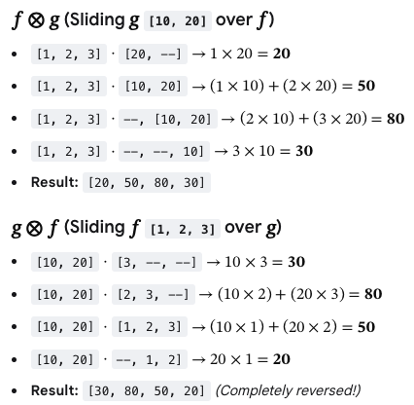
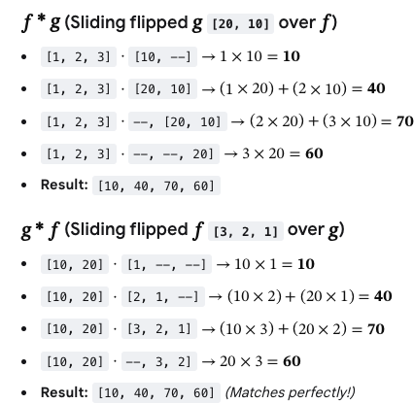
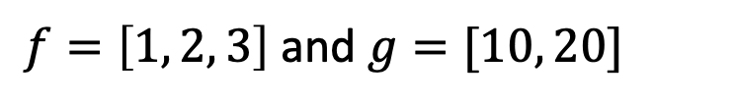
Example
$f=\left[1, 2, 3\right]$ and $g=[10, 20]$

Slide 20
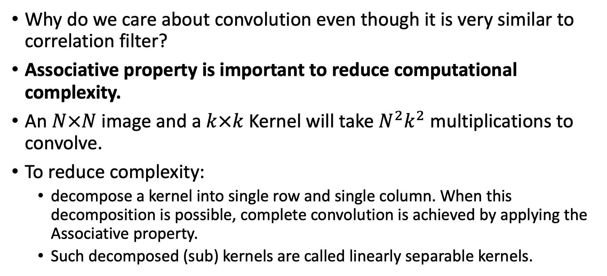
Why do we care?
Why do we care about convolution even though it is very similar to correlation filter?
Associative property is important to reduce computational complexity.
An $N×N$image and a $k×k$ Kernel will take $N^{2}k^{2}$ multiplications to convolve.
To reduce complexity:
  decompose a kernel into single row and single column. When this decomposition is possible, complete convolution is achieved by applying the Associative property.
  Such decomposed (sub) kernels are called linearly separable kernels.

Slide 21

Example of separable kernel
$\frac{1}{3}\left(\begin{matrix}1 \\ 1 \\ 1\end{matrix}\right)∗\frac{1}{3}\left(\begin{matrix}1 & 1 & 1\end{matrix}\right)=\frac{1}{9}\left(\begin{matrix}1 & 1 & 1 \\ 1 & 1 & 1 \\ 1 & 1 & 1\end{matrix}\right)$
$\left(\begin{matrix}1 \\ 2 \\ 1\end{matrix}\right)∗\left(\begin{matrix}1 & 0 & −1\end{matrix}\right)=\left(\begin{matrix}1 & 0 & −1 \\ 2 & 0 & −2 \\ 1 & 0 & −1\end{matrix}\right)$
$\left(\begin{matrix}3 & 6 & 9 \\ 4 & 8 & 12 \\ 5 & 10 & 15\end{matrix}\right)=\left(\begin{matrix}3 \\ 4 \\ 5\end{matrix}\right)∗\left(\begin{matrix}1 & 2 & 3\end{matrix}\right)$

Slide 22

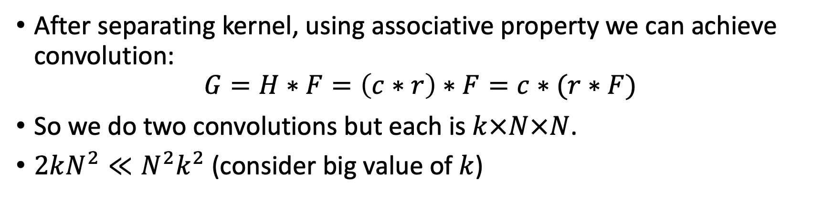



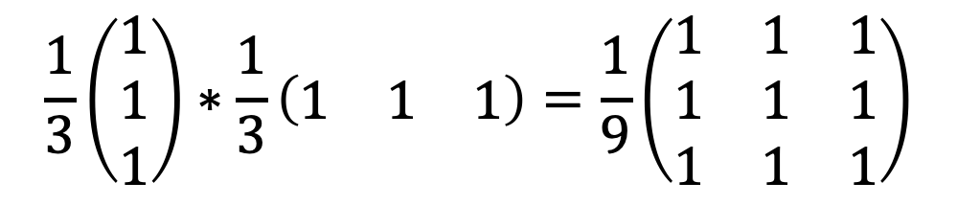

Linearly separable kernel
$$\frac{1}{3}\left(\begin{matrix}1 \\ 1 \\ 1\end{matrix}\right)∗\frac{1}{3}\left(\begin{matrix}1 & 1 & 1\end{matrix}\right)=\frac{1}{9}\left(\begin{matrix}1 & 1 & 1 \\ 1 & 1 & 1 \\ 1 & 1 & 1\end{matrix}\right)$$
$$c$$
$$∗$$
$$r$$
$$=$$
$$H$$
After separating kernel, using associative property we can achieve convolution:
$$G=H∗F=\left(c∗r\right)∗F=c∗(r∗F)$$
So we do two convolutions but each is $k×N×N$.
$2kN^{2}≪N^{2}k^{2}$(consider big value of $k$)

Slide 23
Readings
Szeliski book – Chap 3: Image processing
Notebooks:
  https://www.kaggle.com/code/zahidbd/lecture8-nb1-masking
  https://www.kaggle.com/code/zahidbd/lecture8-nb2-filtering

