Slide 1
COMPUTER VISION
Week 5
Lecture 6 (25/08/2026)
0714 02 CSE 4239

Slide 2
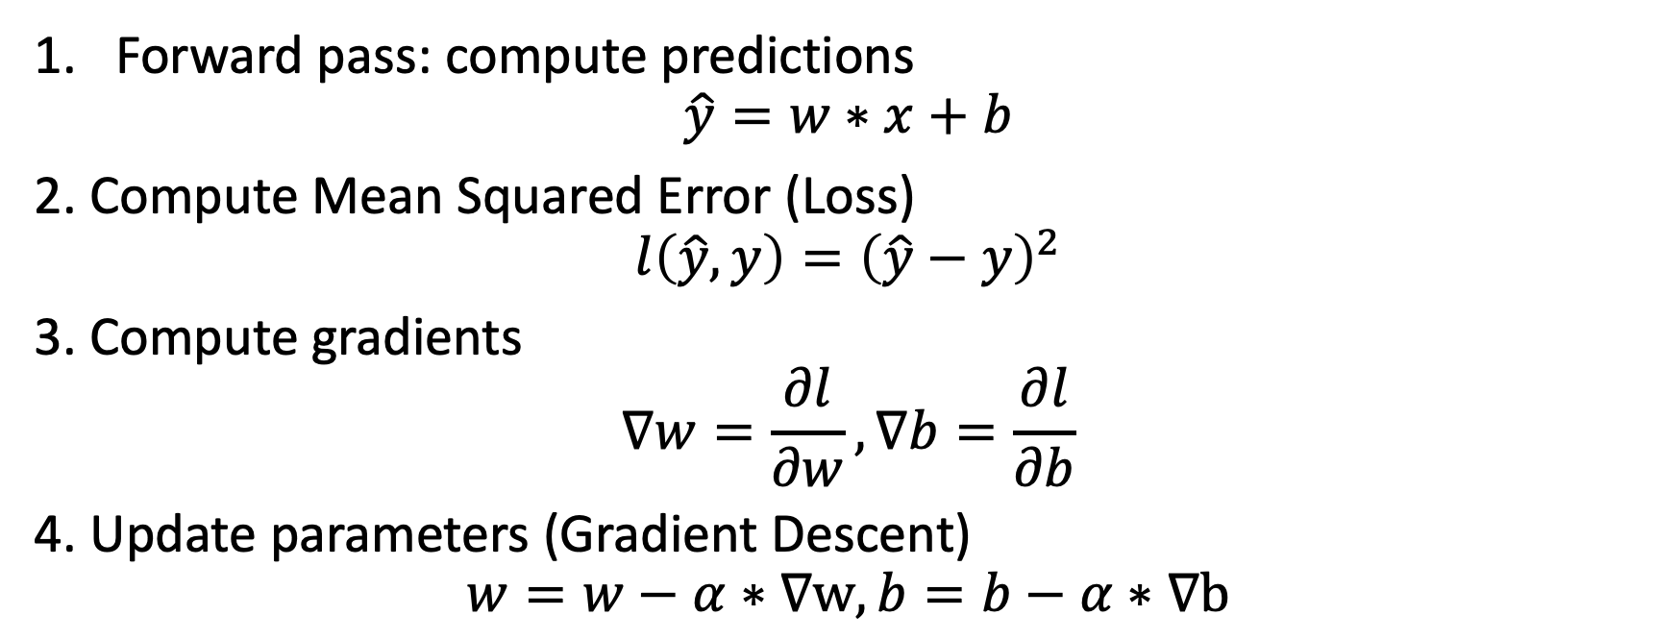
Steps in Training
Forward pass: compute predictions
$$\hat{y}=w∗x+b$$
2. Compute Mean Squared Error (Loss)
$$l\left(\hat{y},y\right)={\left(\hat{y}−y\right)}^{2}$$
3. Compute gradients
$$∇w=\frac{∂l}{∂w}, ∇b=\frac{∂l}{∂b}$$
4. Update parameters (Gradient Descent)
$$w=w−α∗∇w, b=b−α∗∇b$$

Slide 3
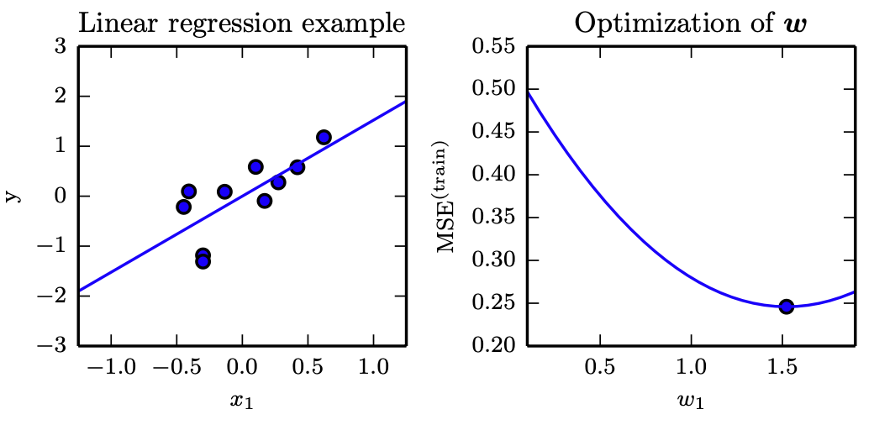
Linear regression
https://www.kaggle.com/code/zahidbd/lecture6-nb1

Slide 4
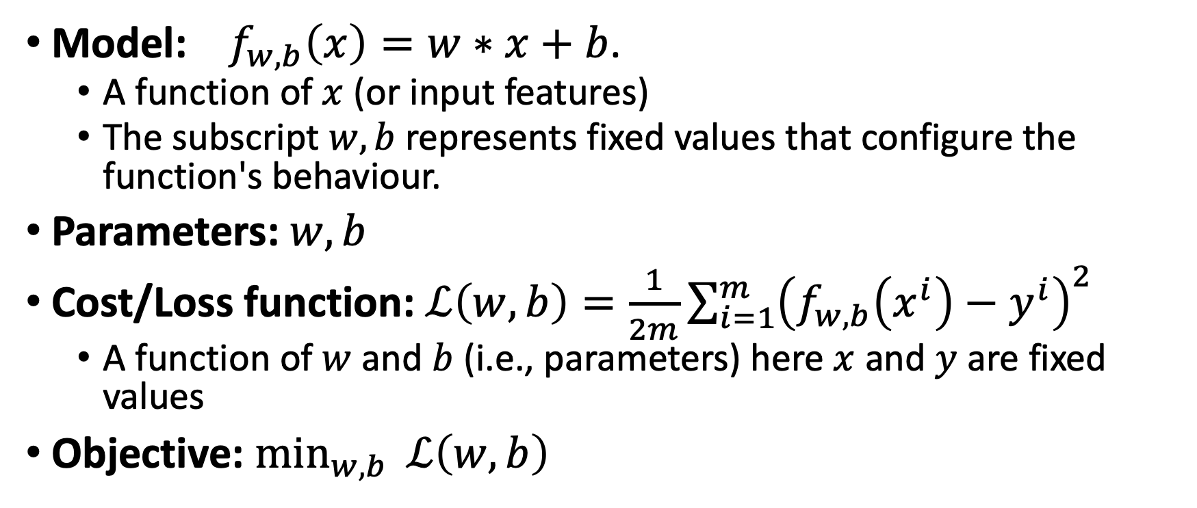
Notations
Model: $f_{w,b}\left(x\right)=w∗x+b$.
  A function of $x$ (or input features)
  The subscript $w,b$represents fixed values that configure the function's behaviour.
Parameters: $w,b$
Cost/Loss function: $ℒ\left(w,b\right)=\frac{1}{2m}\sum_{i=1}^{m}{{\left(f_{w,b}\left(x^{i}\right)−y^{i}\right)}^{2}}$
  A function of $w$ and $b$ (i.e., parameters) here $x$ and $y$ are fixed values
Objective: $\min_{w,b}{ℒ\left(w,b\right)}$
Notes:
configure the function's behavior means:
- the parameters determine the exact rule that transforms the input into an output.
Think of the model architecture (like a neural network or linear equation) as an empty machine, while the parameters are the settings, dials, and internal rules that dictate what that machine actually does when you feed it data.
While the model $f_{θ}\left(x\right)$is a function of inputs $x$parameterized by $θ$, the loss function flips this roles: during optimization, the loss is framed primarily as a function of the parameters $θ$, parameterized by the fixed training dataset $\left(X,y\right)$.

Slide 5
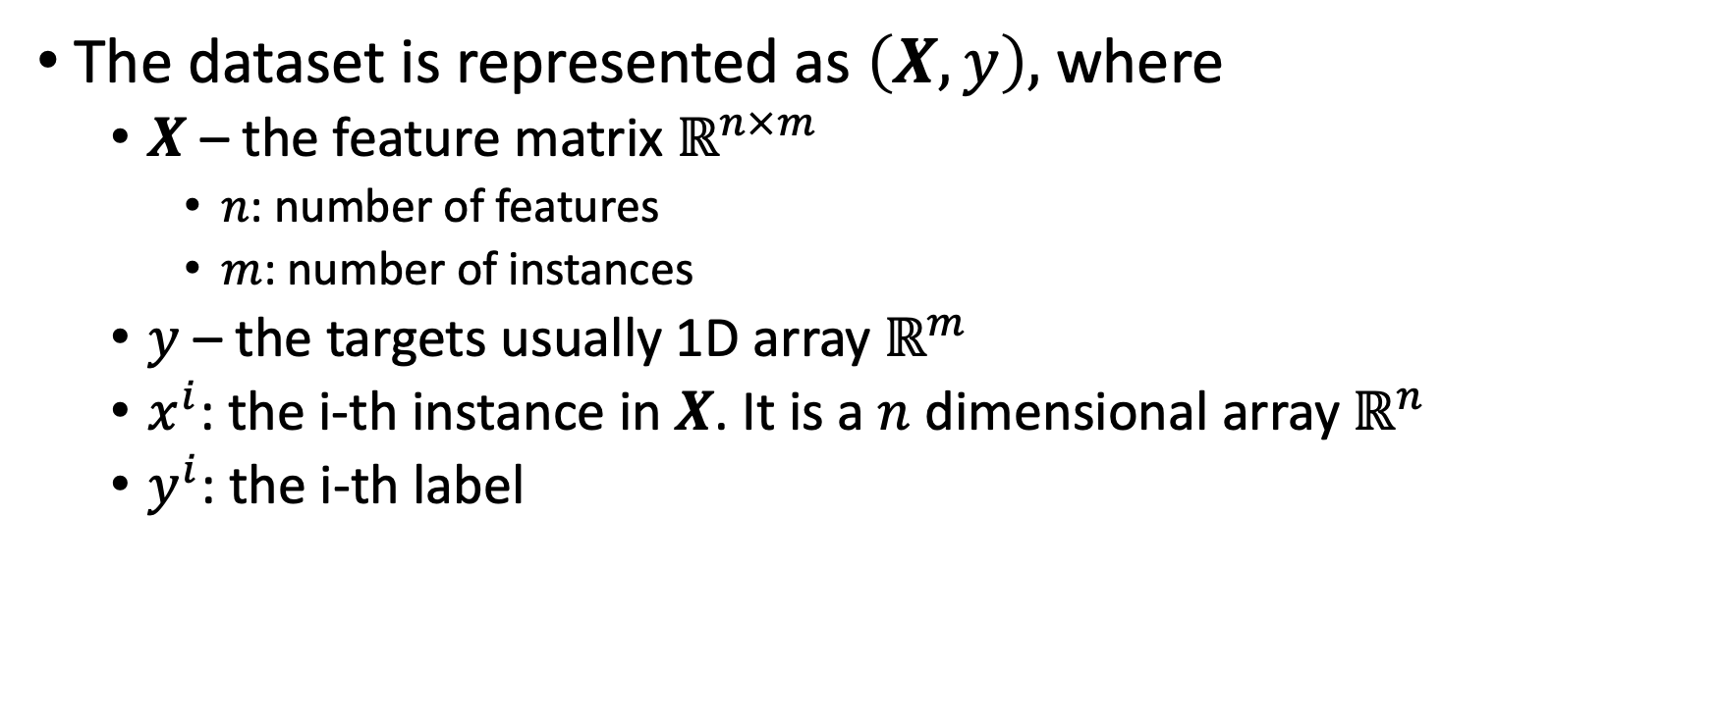
Notations
The dataset is represented as $\left(X,y\right),$where
  $X$ – the feature matrix $ℝ^{n×m}$
    $n$: number of features
    $m$: number of instances
  $y$ – the targets usually 1D array $ℝ^{m}$
  $x^{i}$: the i-th instance in $X$. It is a $n$ dimensional array $ℝ^{n}$
  $y^{i}$: the i-th label

Slide 6
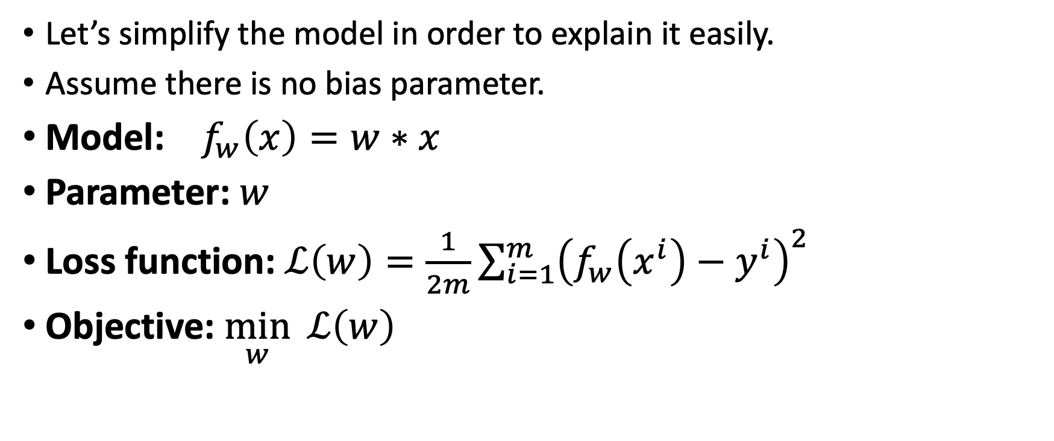
Cost function intuition
Let’s simplify the model in order to explain it easily.
Assume there is no bias parameter.
Model: $f_{w}\left(x\right)=w∗x$
Parameter: $w$
Loss function: $ℒ\left(w\right)=\frac{1}{2m}\sum_{i=1}^{m}{{\left(f_{w}\left(x^{i}\right)−y^{i}\right)}^{2}}$
Objective: $\min_{w}{ℒ\left(w\right)}$

Slide 7
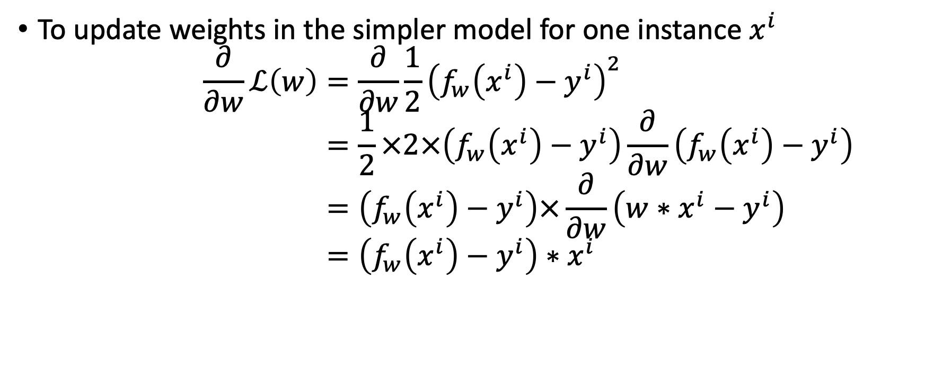
Parameter update rules
To update weights in the simpler model for one instance $x^{i}$
$$\frac{∂}{∂w}ℒ\left(w\right)=\frac{∂}{∂w}\frac{1}{2}{\left(f_{w}\left(x^{i}\right)−y^{i}\right)}^{2} \\ =\frac{1}{2}×2×\left(f_{w}\left(x^{i}\right)−y^{i}\right)\frac{∂}{∂w}\left(f_{w}\left(x^{i}\right)−y^{i}\right) \\ =\left(f_{w}\left(x^{i}\right)−y^{i}\right)×\frac{∂}{∂w}\left(w∗x^{i}−y^{i}\right) \\ =\left(f_{w}\left(x^{i}\right)−y^{i}\right)∗x^{i}$$

Slide 8
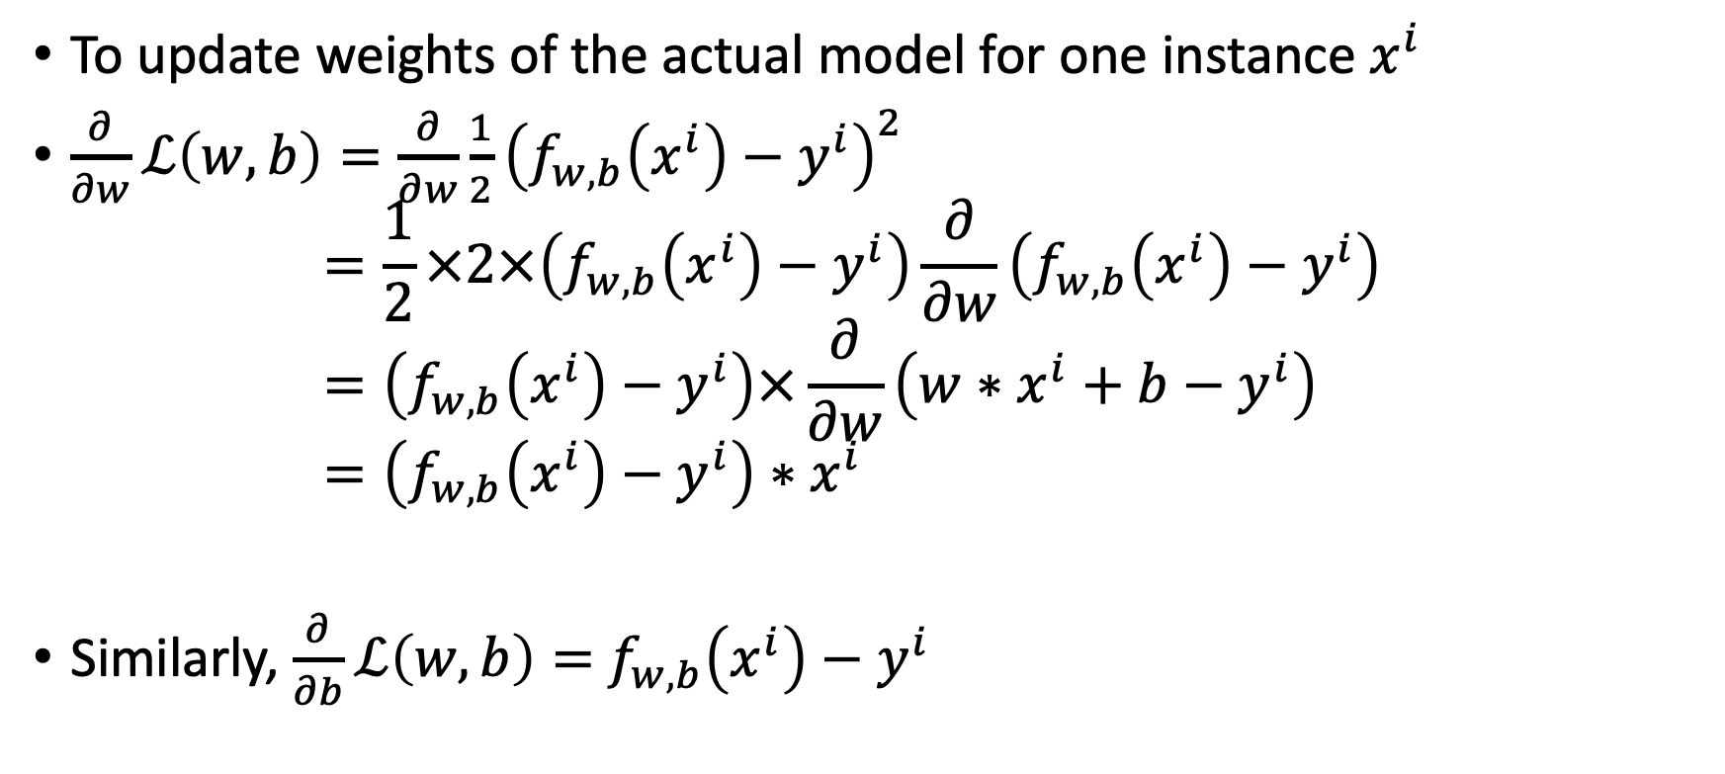
Parameter update rules
To update weights of the actual model for one instance $x^{i}$
$\frac{∂}{∂w}ℒ\left(w,b\right)=\frac{∂}{∂w}\frac{1}{2}{\left(f_{w,b}\left(x^{i}\right)−y^{i}\right)}^{2}$
$=\frac{1}{2}×2×\left(f_{w,b}\left(x^{i}\right)−y^{i}\right)\frac{∂}{∂w}\left(f_{w,b}\left(x^{i}\right)−y^{i}\right)$
$=\left(f_{w,b}\left(x^{i}\right)−y^{i}\right)×\frac{∂}{∂w}\left(w∗x^{i}+b−y^{i}\right)$
$=\left(f_{w,b}\left(x^{i}\right)−y^{i}\right)∗x^{i}$
Similarly, $\frac{∂}{∂b}ℒ\left(w,b\right)=$ $f_{w,b}\left(x^{i}\right)−y^{i}$

Slide 9
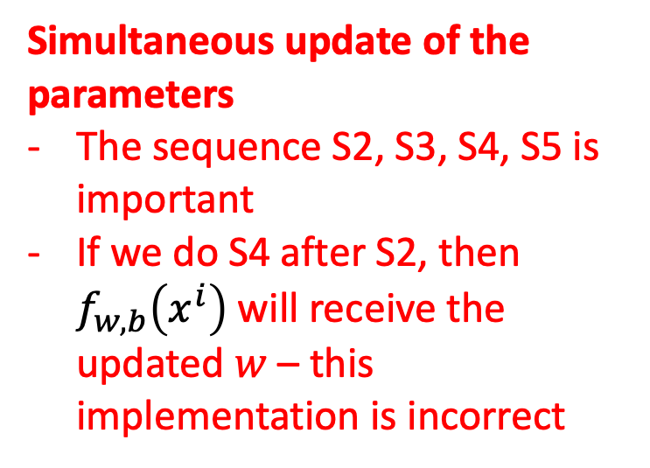
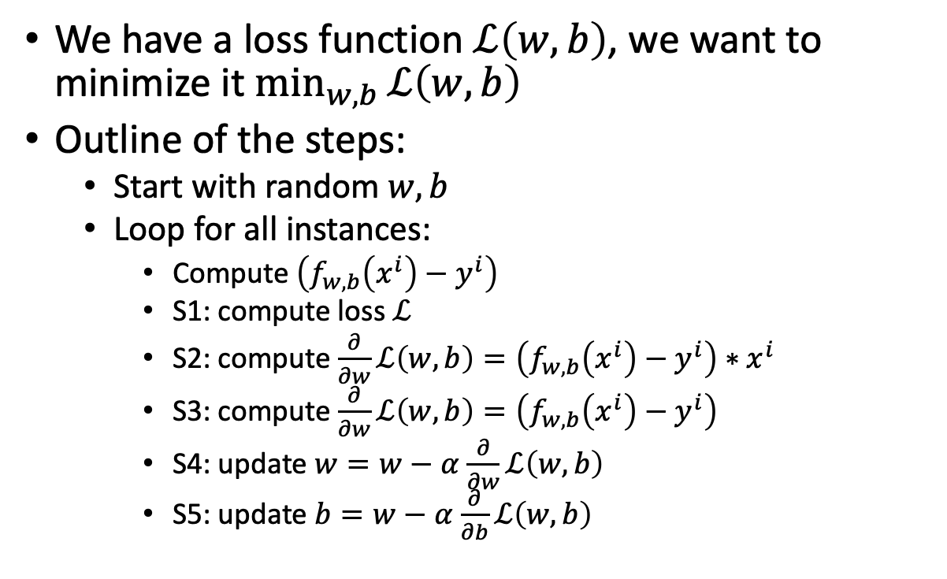
Weight updates in models: Gradient Descent
We have a loss function $ℒ\left(w,b\right)$, we want to minimize it $\min_{w,b}{ℒ\left(w,b\right)}$
Outline of the steps:
  Start with random $w,b$
  Loop for all instances:
    Compute $\left(f_{w,b}\left(x^{i}\right)−y^{i}\right)$
    S1: compute loss $ℒ$
    S2: compute $\frac{∂}{∂w}ℒ\left(w,b\right)=\left(f_{w,b}\left(x^{i}\right)−y^{i}\right)∗x^{i}$
    S3: compute $\frac{∂}{∂w}ℒ\left(w,b\right)=\left(f_{w,b}\left(x^{i}\right)−y^{i}\right)$
    S4: update $w=w−α$ $\frac{∂}{∂w}ℒ\left(w,b\right)$
    S5: update $b=w−α$ $\frac{∂}{∂b}ℒ\left(w,b\right)$
Simultaneous update of the parameters
The sequence S2, S3, S4, S5 is important
If we do S4 after S2, then $f_{w,b}\left(x^{i}\right)$ will receive the updated $w$ – this implementation is incorrect

Slide 10
Practical 1
https://www.kaggle.com/code/zahidbd/lecture6-nb1
Tasks:
  Implement a regression model using SGDRegressor from sklearn
  Observe the inner working of the library
  Implement without the library and cross check the output

Slide 11
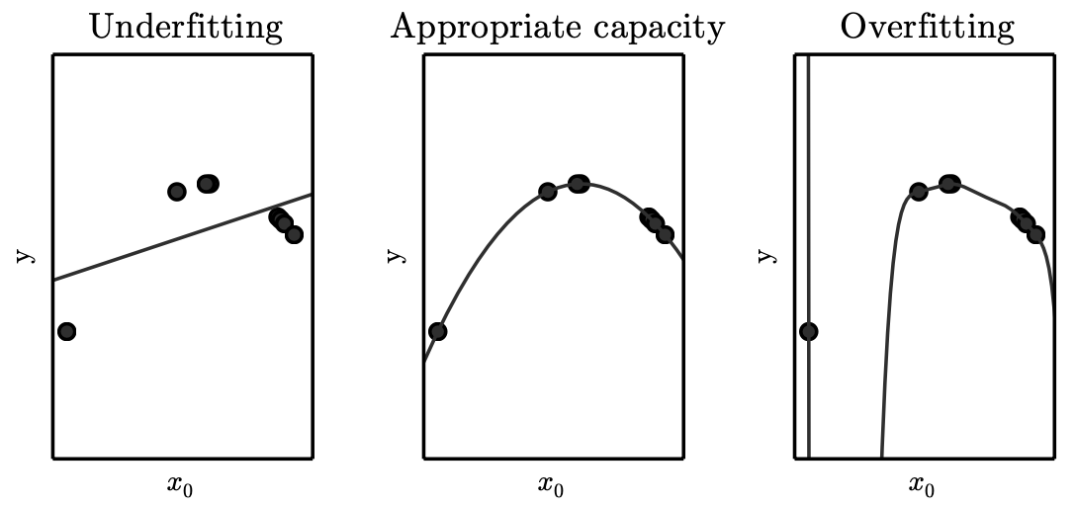
Underfitting and Overfitting in Polynomial Estimation

Slide 12
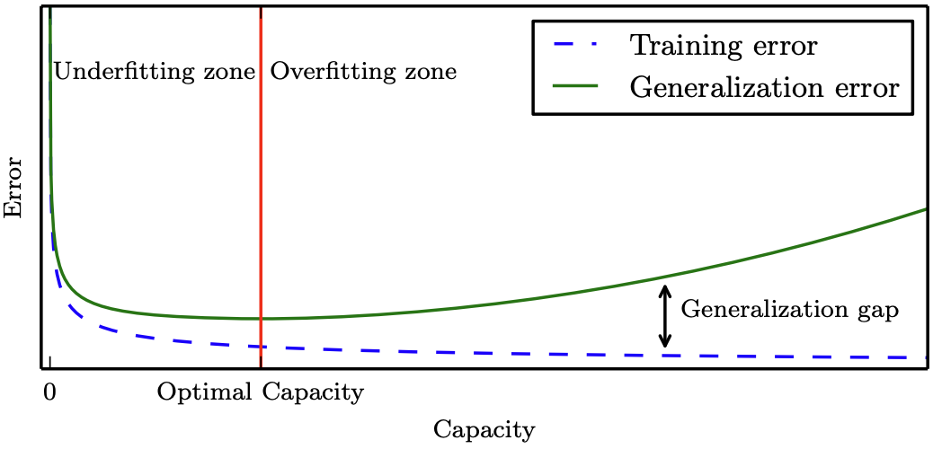
Generalization and capacity
Notes:
Underfitting zone: both errors high
Overfitting zone: gap between train & generalization error widens
No Free Lunch theorem: averaged over all possible tasks, no algorithm beats any other — we must pick a capacity fit to the task

Slide 13
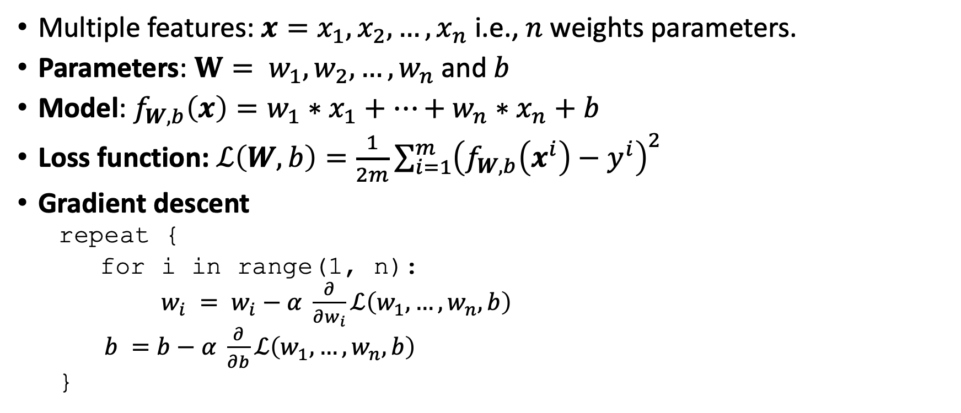
Gradient Descent for Multiple Regression
Multiple features:$x=x_{1},x_{2},…, x_{n}$ i.e., $n$ weights parameters.
Parameters: $W= w_{1},w_{2},…, w_{n}$and $b$
Model: $f_{W,b}\left(x\right)=w_{1}∗x_{1}+…+w_{n}∗x_{n}+b$
Loss function: $ℒ\left(W,b\right)=\frac{1}{2m}\sum_{i=1}^{m}{{\left(f_{W,b}\left(x^{i}\right)−y^{i}\right)}^{2}}$
Gradient descent
  repeat {
  for i in range(1, n):
  $w_{i} = w_{i}−α \frac{∂}{∂w_{i}}ℒ\left(w_{1},…,w_{n},b\right)$
  $b =b−α \frac{∂}{∂b}ℒ\left(w_{1},…,w_{n},b\right)$
  }

Slide 14
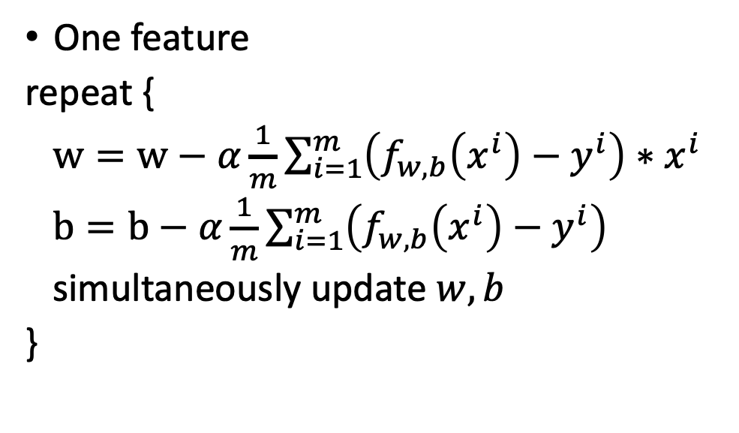

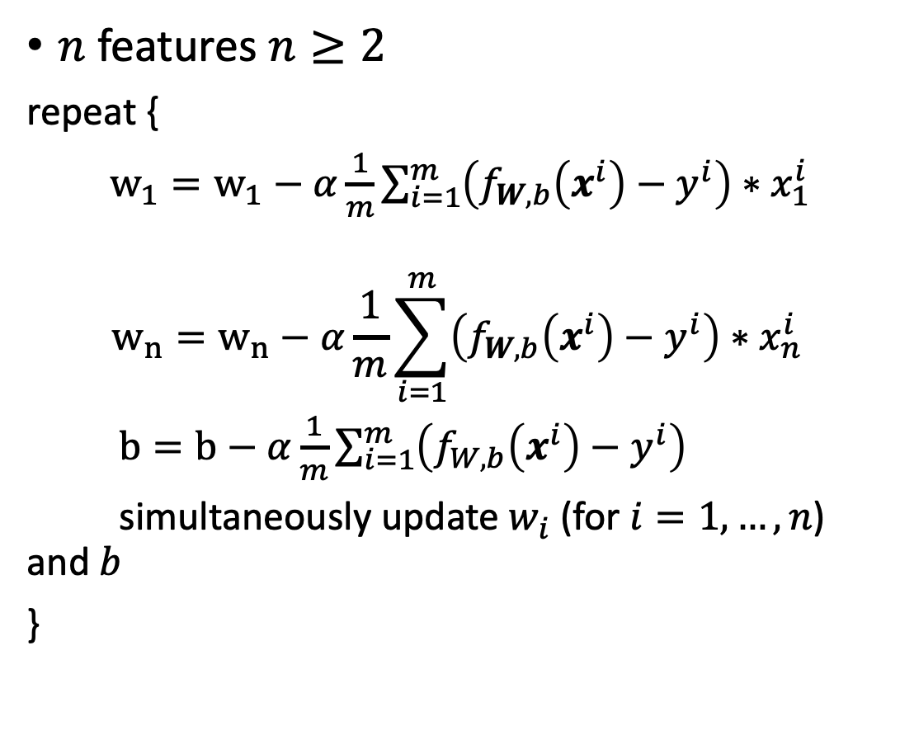
Multiple Regression for $m$ instances (batched)
One feature
repeat {
$w=w−α\frac{1}{m}\sum_{i=1}^{m}{\left(f_{w,b}\left(x^{i}\right)−y^{i}\right)∗x^{i}}$
$b=b−α\frac{1}{m}\sum_{i=1}^{m}{\left(f_{w,b}\left(x^{i}\right)−y^{i}\right)}$
simultaneously update $w, b$
}
$n$ features $n≥2$
repeat {
$w_{1}=w_{1}−α\frac{1}{m}\sum_{i=1}^{m}{\left(f_{W,b}\left(x^{i}\right)−y^{i}\right)∗x_{1}^{i}}$
$$w_{n}=w_{n}−α\frac{1}{m}\sum_{i=1}^{m}{\left(f_{W,b}\left(x^{i}\right)−y^{i}\right)∗x_{n}^{i}}$$
$b=b−α\frac{1}{m}\sum_{i=1}^{m}{\left(f_{W,b}\left(x^{i}\right)−y^{i}\right)}$
simultaneously update $w_{i}$(for $i=1, …, n$) and $b$
}

Slide 15
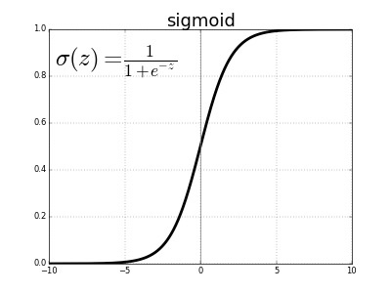
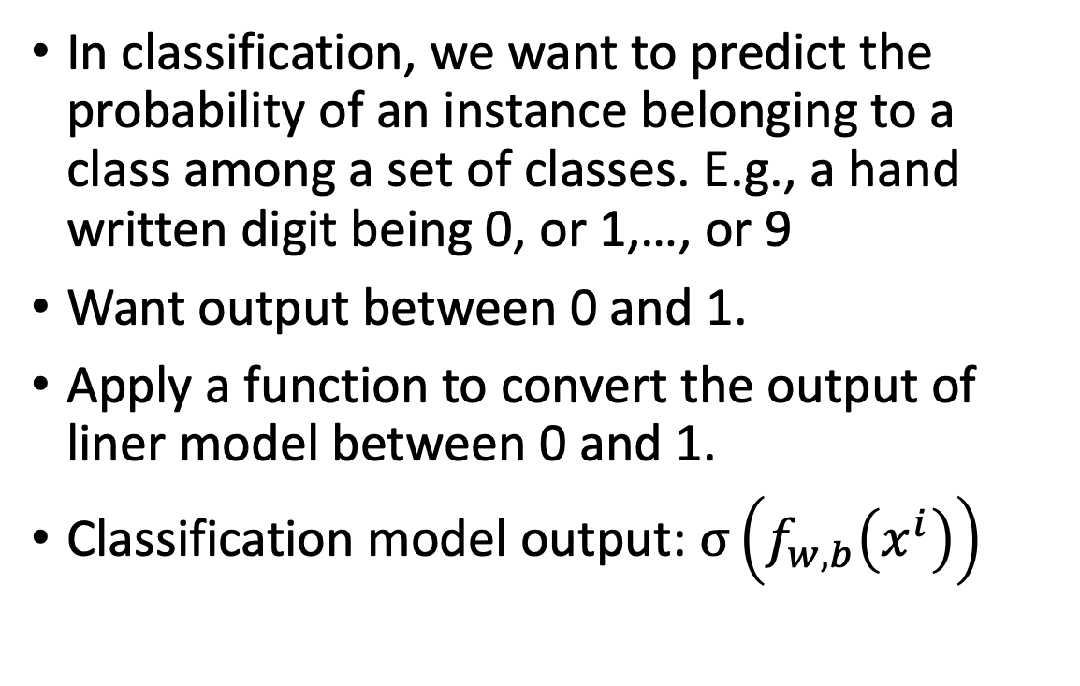
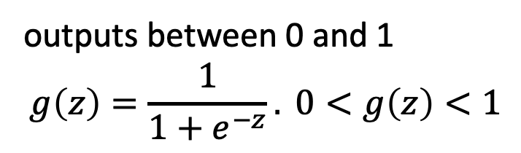
Classification using linear model
In classification, we want to predict the probability of an instance belonging to a class among a set of classes. E.g., a hand written digit being 0, or 1,…, or 9
Want output between 0 and 1.
Apply a function to convert the output of liner model between 0 and 1.
Classification model output: $σ\left(f_{w,b}\left(x^{i}\right)\right)$
outputs between 0 and 1
$$g\left(z\right)=\frac{1}{1+e^{−z}}. 0<g\left(z\right)<1$$

Slide 16
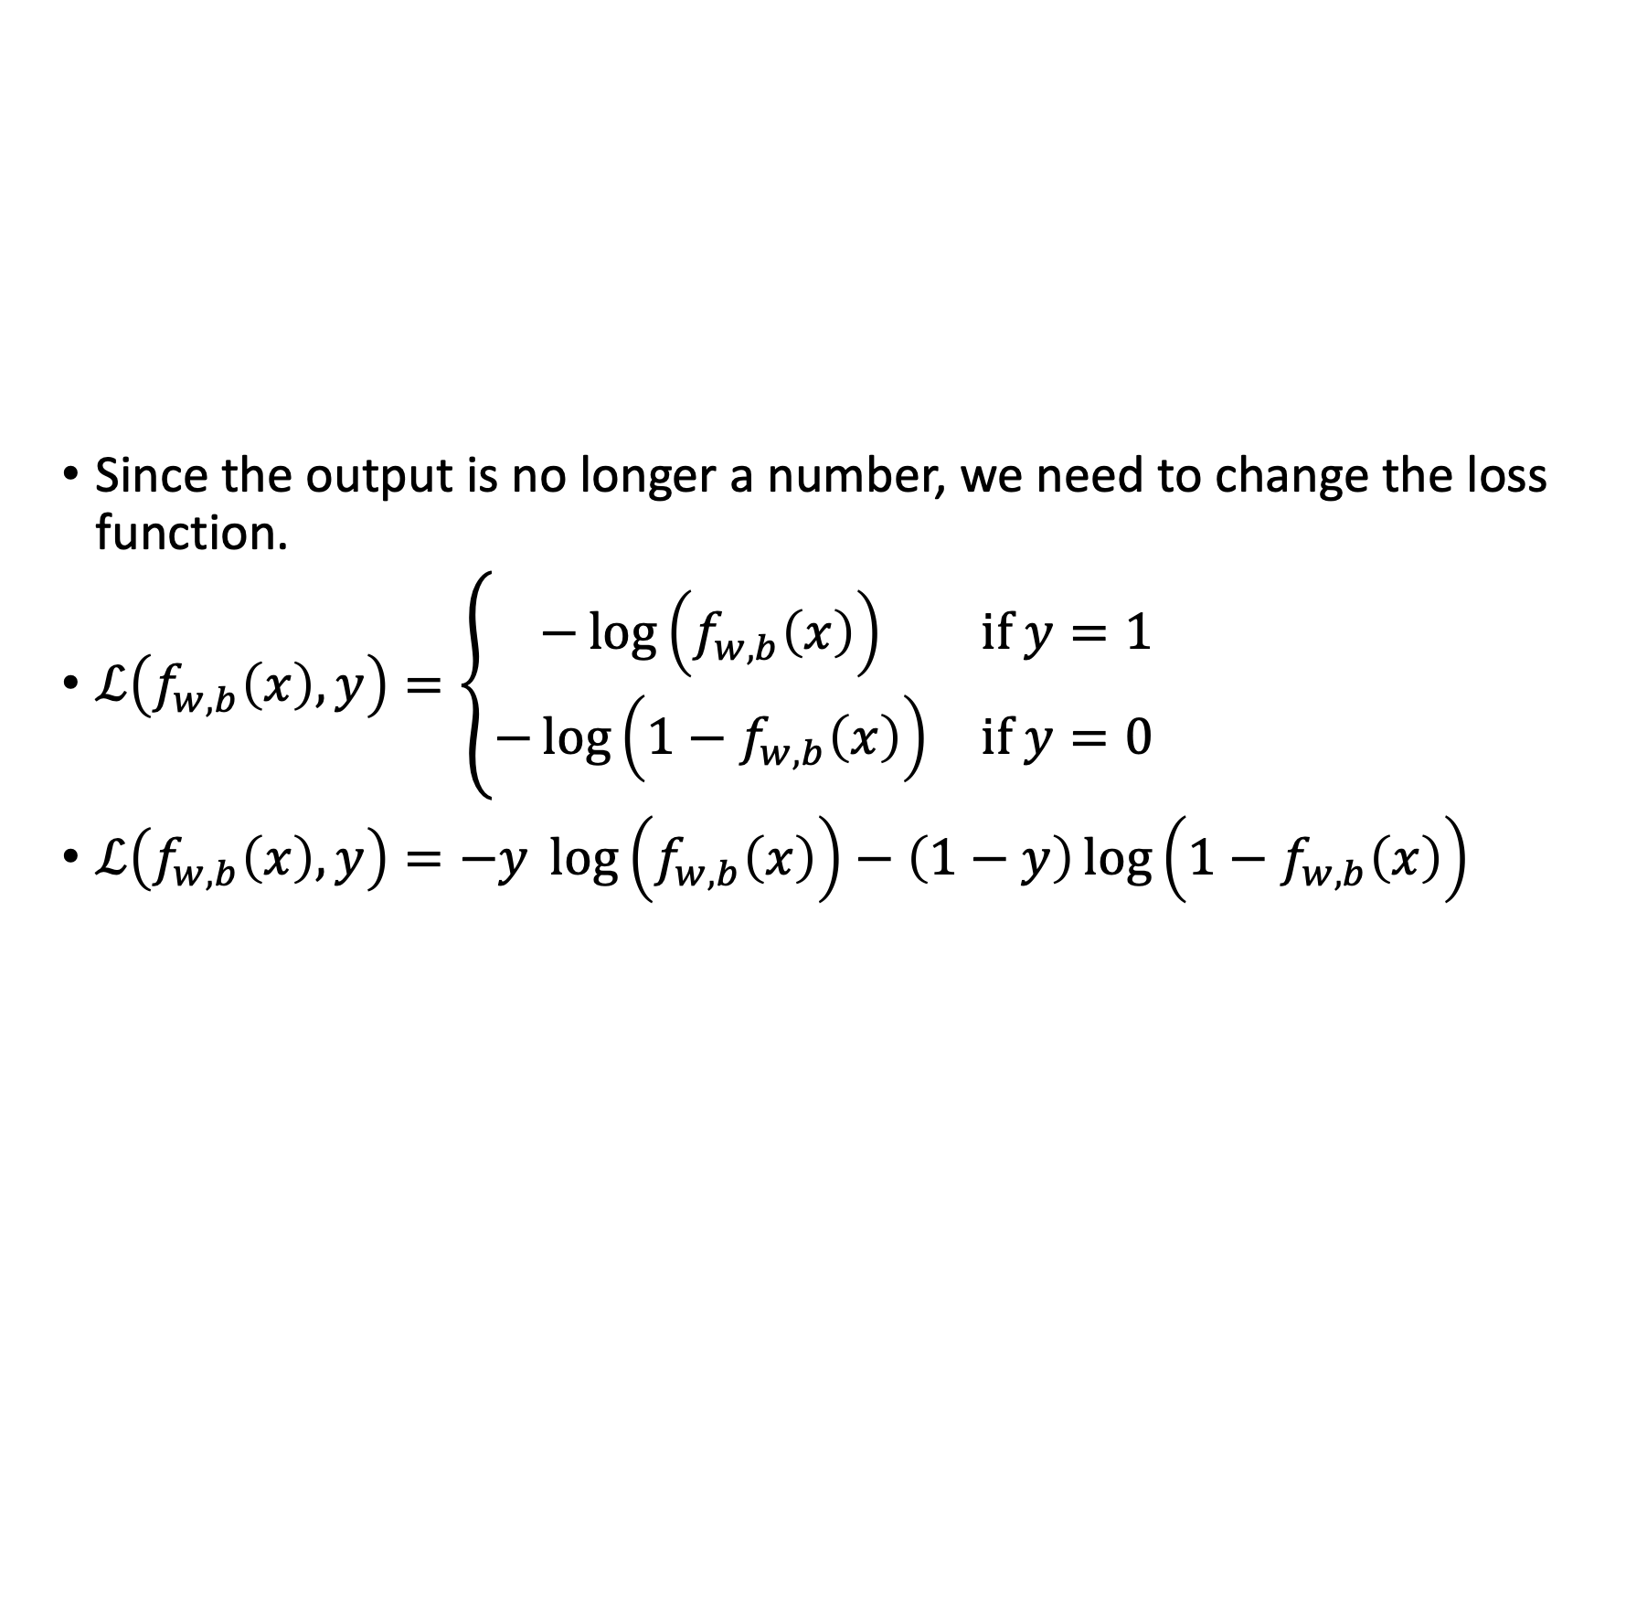
Loss function
Since the output is no longer a number, we need to change the loss function.
$ℒ\left(f_{w,b}\left(x\right),y\right)=\left\{\begin{matrix}−\log\left(f_{w,b}\left(x\right)\right) & \text{if }y=1 \\ −\log\left(1−f_{w,b}\left(x\right)\right) & \text{if }y=0\end{matrix}\right.$
$ℒ\left(f_{w,b}\left(x\right),y\right)=−y \log\left(f_{w,b}\left(x\right)\right)−\left(1−y\right)\log\left(1−f_{w,b}\left(x\right)\right)$

Slide 17
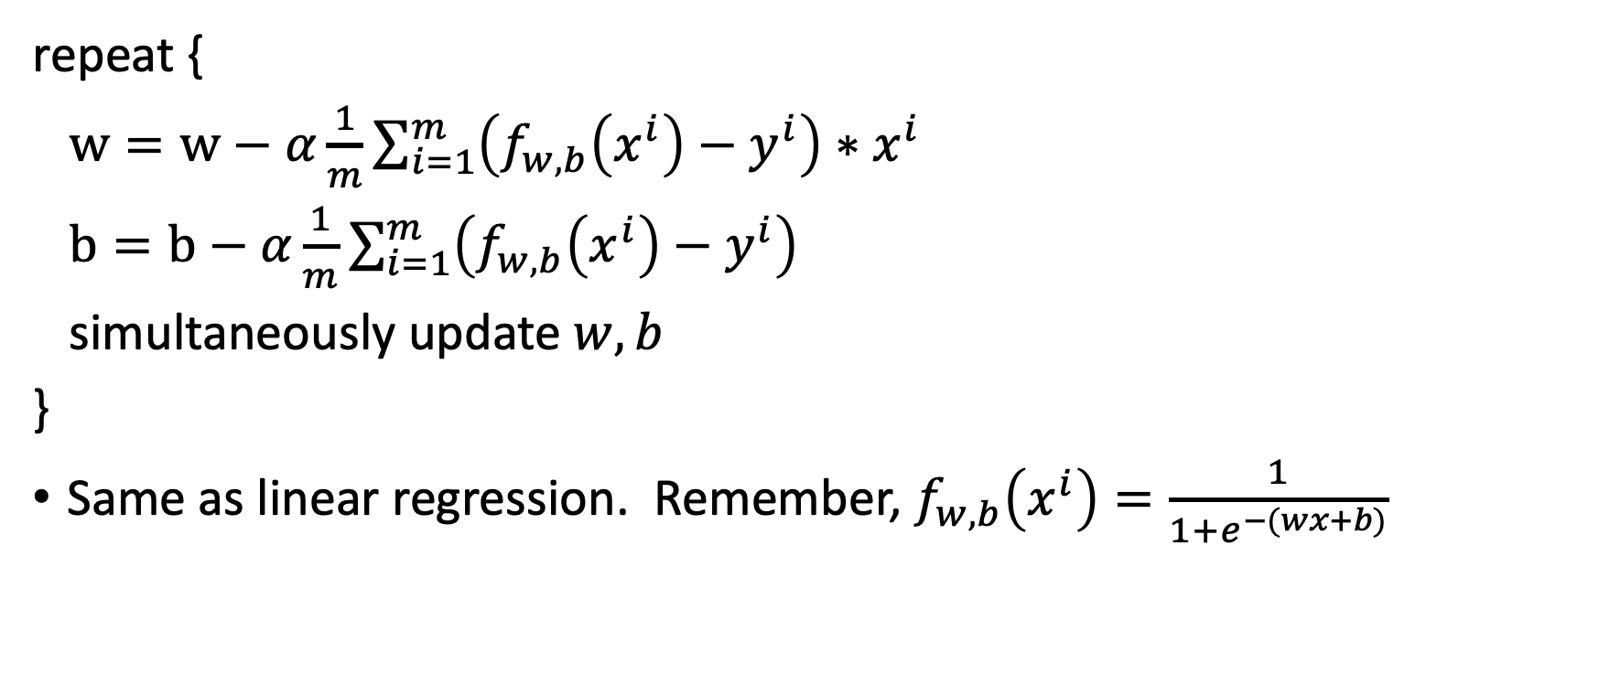
Gradient descent
repeat {
$w=w−α\frac{1}{m}\sum_{i=1}^{m}{\left(f_{w,b}\left(x^{i}\right)−y^{i}\right)∗x^{i}}$
$b=b−α\frac{1}{m}\sum_{i=1}^{m}{\left(f_{w,b}\left(x^{i}\right)−y^{i}\right)}$
simultaneously update $w, b$
}
Same as linear regression. Remember, $f_{w,b}\left(x^{i}\right)=\frac{1}{1+e^{−(wx+b)}}$

Slide 18
Practical 2: logistic regression walkthrough
https://www.kaggle.com/code/zahidbd/lecture6-nb1-2

Slide 19
Validation & Cross-Validation
Training set (~80%)
Validation set (~20%)
Test set
Held out from the original “training data” pool
k-Fold Cross-Validation
Validation set: used to select hyperparameters — its error slightly underestimates true generalization error
Test set: touched exactly once, after all tuning, to report final generalization error
Never touched until the very end
Each fold takes a turn as the test split; results are averaged — makes efficient use of small datasets.

Slide 20
Practical 3: Image classification using logistic regression
https://www.kaggle.com/code/zahidbd/lecture6-nb2

Slide 21
Reading
Deep learning book
  Chapter 5: https://www.deeplearningbook.org/contents/ml.html
  Sections: 5.1, 5.2 (skip 5.2.1). 5.3, 5.4.4, 5.9
Andrew Ng YT:
  https://www.youtube.com/watch?v=peNRqkfukYY&list=PLkDaE6sCZn6FNC6YRfRQc_FbeQrF8BwGI&index=12
  https://www.youtube.com/watch?v=bFNz2u0hl9E&list=PLkDaE6sCZn6FNC6YRfRQc_FbeQrF8BwGI&index=13
Note books:
  https://www.kaggle.com/code/zahidbd/lecture6-nb1
  https://www.kaggle.com/code/zahidbd/lecture6-nb1-2
  https://www.kaggle.com/code/zahidbd/lecture6-nb2

