Slide 1
COMPUTER VISION
Week 9
Lecture 14 (24/09/2026)
0714 02 CSE 4239

Slide 2
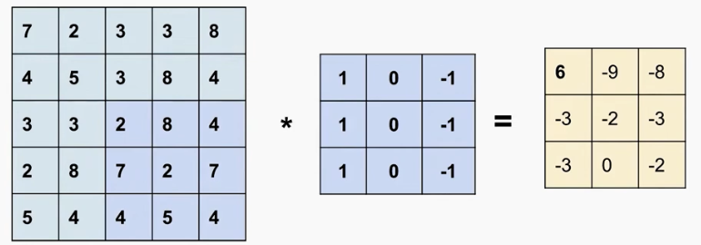
2D Convolution

Slide 3
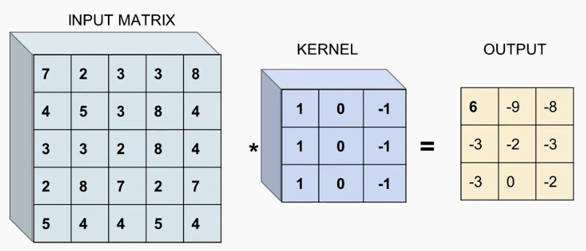
3D Convolution

Slide 4
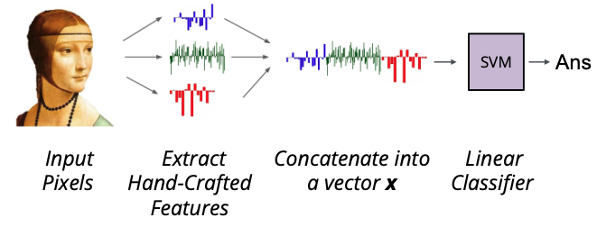
Before

Slide 5
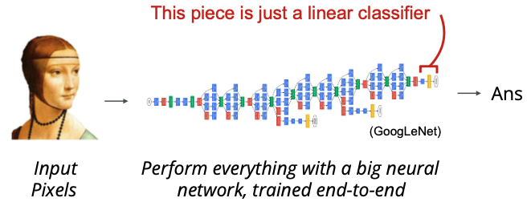
Now CNN

Slide 6
Types of layers in CNN
Commonly used types of layers in CNN
  Fully connected layer
  Activation layer
  Pooling layer
  Convolutional layer
  Batch normalization

Slide 7
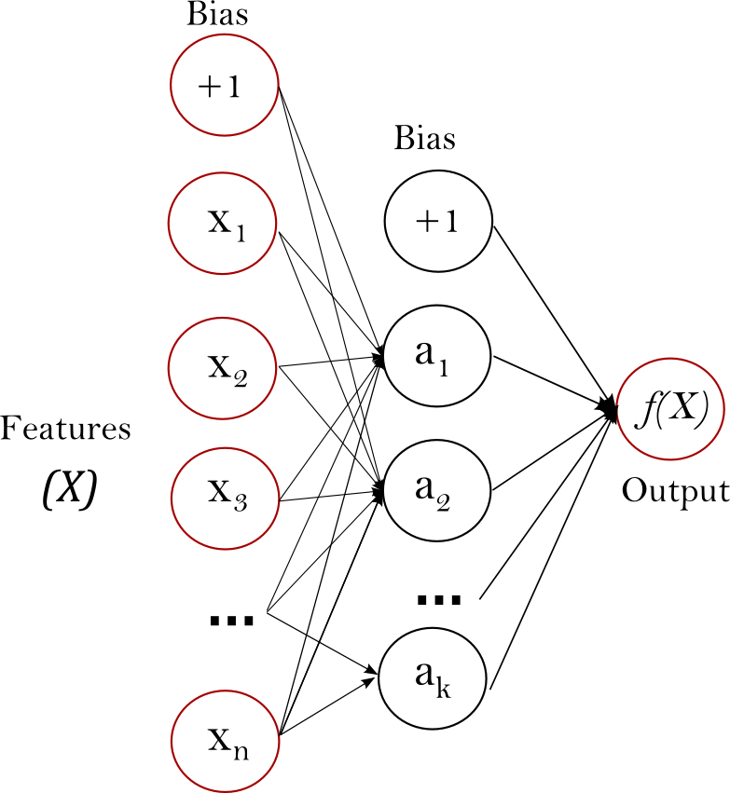

Fully connected layer
Output is a matrix multiplication followed by a bias addition.
$$x_{out}=W⋅x_{in}+b \\ x_{in}∈ℝ^{n}, x_{out}∈ℝ^{k}, W∈ℝ^{k×n}, b∈ℝ^{k}$$
Notes:
The last layer usually learns high level features and then classifies the input object based on the obtained knowledge.

Slide 8
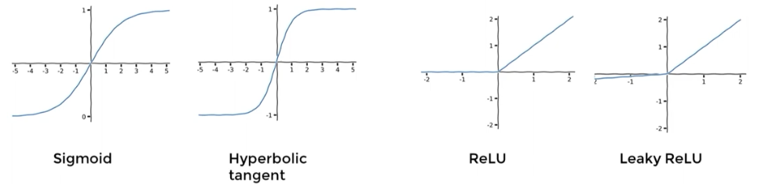
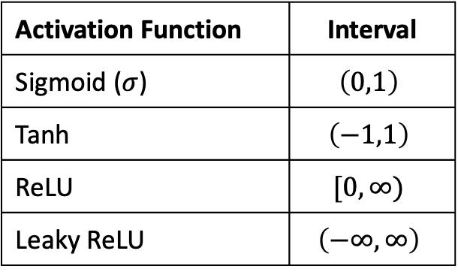
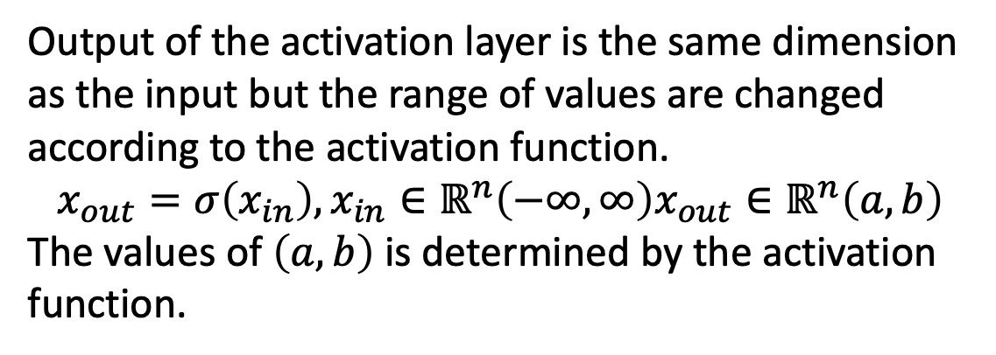
Activation layer
Output of the activation layer is the same dimension as the input but the range of values are changed according to the activation function.
$$x_{out}=σ\left(x_{in}\right), x_{in}∈ℝ^{n}\left(−∞,∞\right)x_{out}∈ℝ^{n}\left(a,b\right)$$
The values of $\left(a,b\right)$ is determined by the activation function.
Activation Function | Interval
Sigmoid ($σ$) | $$\left(0,1\right)$$
Tanh | $$\left(−1,1\right)$$
ReLU | $$[0,∞)$$
Leaky ReLU | $$\left(−∞,∞\right)$$
Notes:
Activation layer and activation function are the same thing.

Slide 9
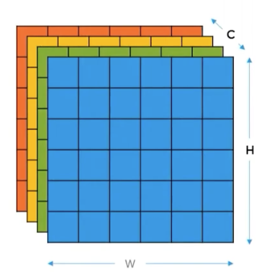
Convolutional layer: INPUT
CNNs operate on 2D data.
Inputs to a CNN layers is a 3D tensor
  Height: H
  Width: W
  Channel: C
H and W are called spatial resolution and C is called the depth.
The outputs of a CNN layer is called feature maps or activation maps.
Input and output of a CNN layer are both feature maps

Slide 10
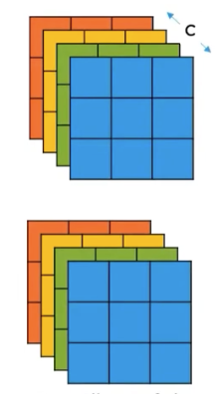
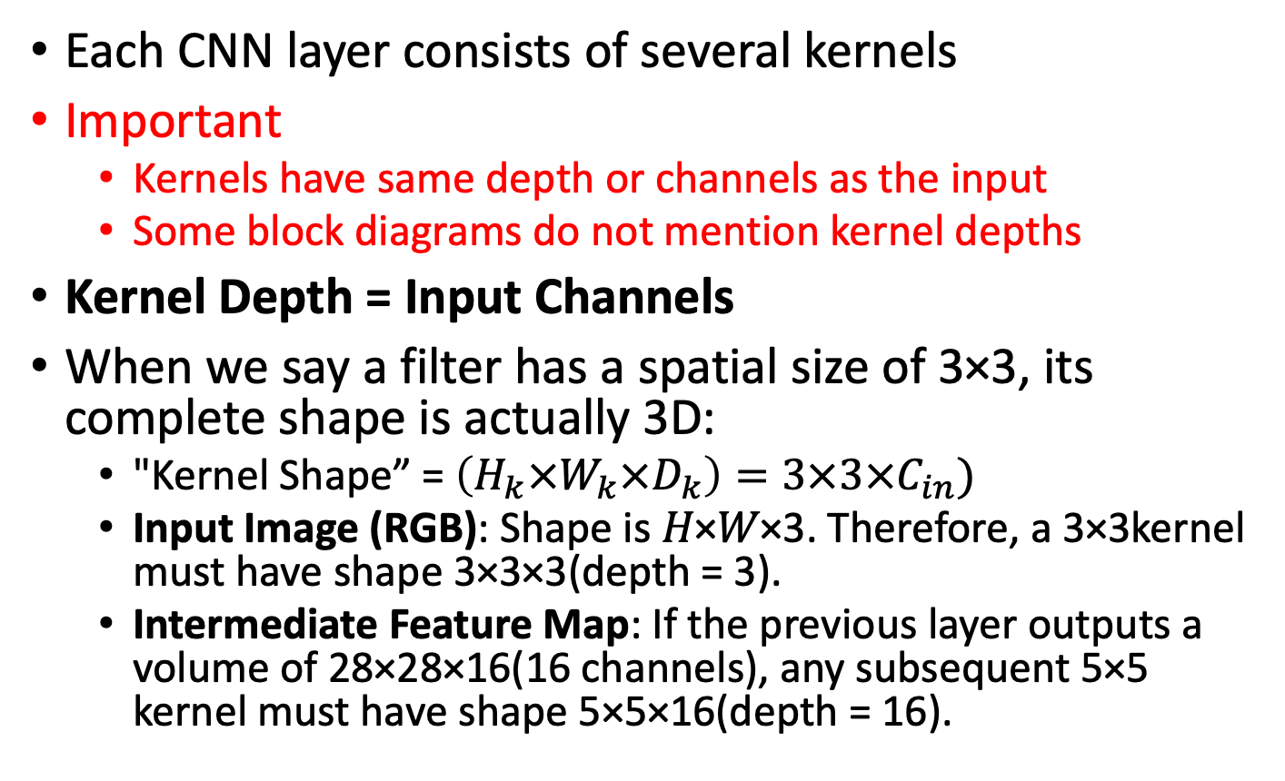
Convolutional layer: KERNEL
Each CNN layer consists of several kernels
Important
  Kernels have same depth or channels as the input
  Some block diagrams do not mention kernel depths
Kernel Depth = Input Channels
When we say a filter has a spatial size of 3×3, its complete shape is actually 3D:
  "Kernel Shape” = $\left(H_{k}×W_{k}×D_{k}\right)=3×3×C_{in})$
  Input Image (RGB): Shape is 𝐻×𝑊×3. Therefore, a 3×3kernel must have shape 3×3×3(depth = 3).
  Intermediate Feature Map: If the previous layer outputs a volume of 28×28×16(16 channels), any subsequent 5×5 kernel must have shape 5×5×16(depth = 16).

Slide 11
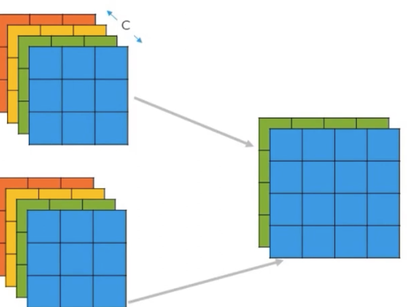
Convolutional layer: KERNEL
Each kernel/filter produces one channel in the output.
Also recall
  There are STRIDE and PADDING

Slide 12
Pooling Layer
Limitation of Conv operation
  The output depends on the precise location of the features in the input
  Changing the position or angle of objects will results in a different feature map
Solution: down sample the image.
  We will get a lower resolution version of the image that will still contain the large or important structural elements and it will suppress the non-important elements.
Pooling layer is a down sampling method that retains important elements and suppress unimportant elements in images.

Slide 13
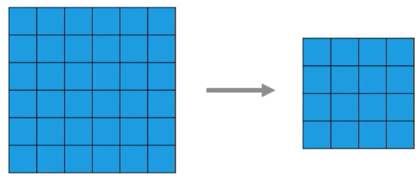
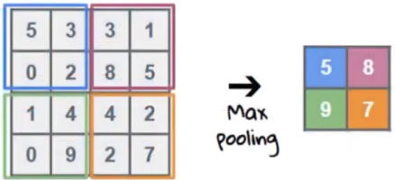
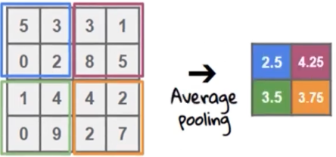
Pooling Layer
Decreases the number of parameters and computations in the network.
Pooling layer also has kernel size and stride.
It does not have any trainable parameter.

Slide 14
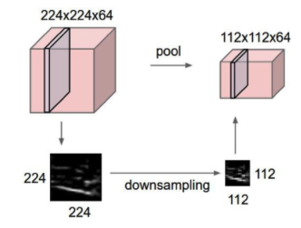
Pooling Layer

Slide 15
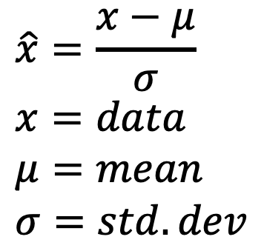
Batch Normalization Layer
Used in almost all CNNs.
What is a batch again?
Applies zero mean and unit variance to deep learning layers.
Usually applied to the outputs of convolutional and fully connected layers.
Batch Norm in CNNs normalizes per channel across all images and all spatial locations simultaneously.
$$\hat{x}=\frac{x−μ}{σ} \\ x=data \\ μ=mean \\ σ=std. dev$$
Notes:
A batch is a small set of images from the input that is used for loss calculation for one step for gradient calculation.

Slide 16
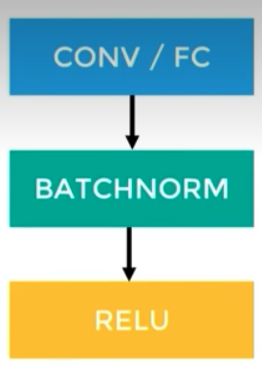
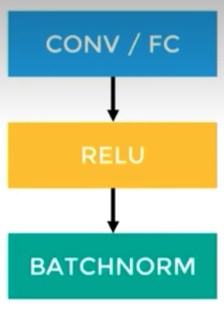
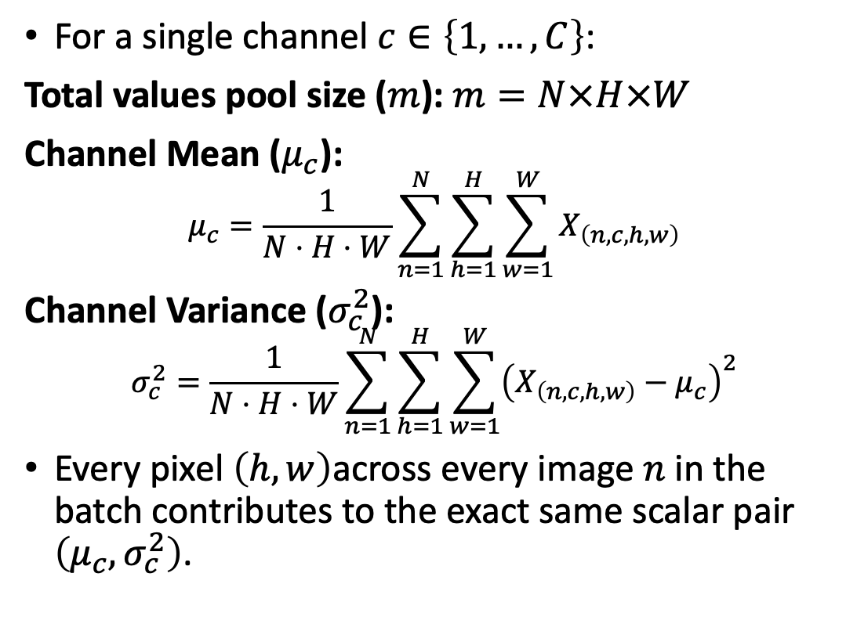
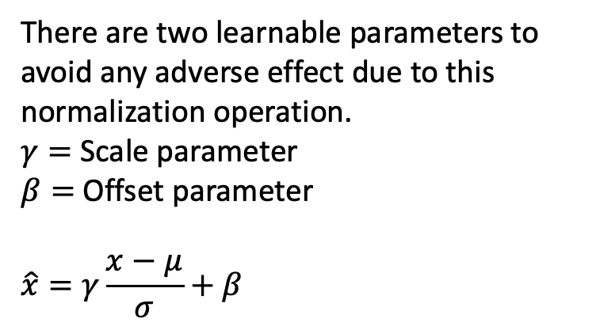
Batch Normalization Layer
There are two learnable parameters to avoid any adverse effect due to this normalization operation.
$γ=$ Scale parameter
$β=$Offset parameter
$$\hat{x}=γ\frac{x−μ}{σ}+β$$
For a single channel $c∈\left\{1,…,C\right\}$:
Total values pool size ($m$): $m=N×H×W$
Channel Mean ($μ_{c}$):
$$μ_{c}=\frac{1}{N⋅H⋅W}\sum_{n=1}^{N}{\sum_{h=1}^{H}{\sum_{w=1}^{W}{X_{\left(n,c,h,w\right)}}}}$$
Channel Variance ($σ_{c}^{2}$):
$$σ_{c}^{2}=\frac{1}{N⋅H⋅W}\sum_{n=1}^{N}{\sum_{h=1}^{H}{\sum_{w=1}^{W}{{\left(X_{\left(n,c,h,w\right)}−μ_{c}\right)}^{2}}}}$$
Every pixel $\left(h,w\right)$across every image $n$ in the batch contributes to the exact same scalar pair $\left(μ_{c},σ_{c}^{2}\right)$.
Notes:
A batch is a small set of images from the input that is used for loss calculation for one step for gradient calculation.

Slide 17
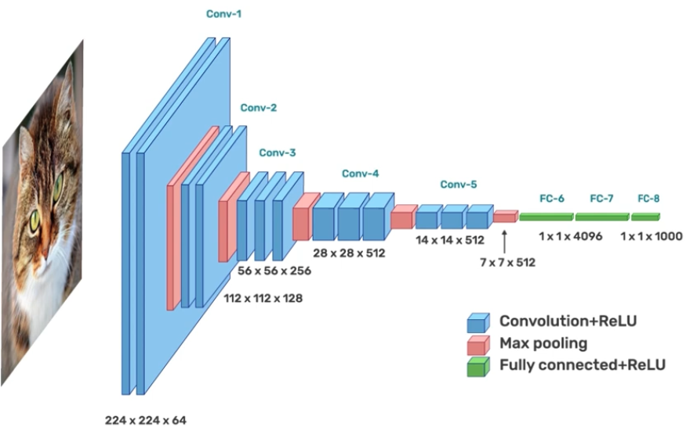
CNN Architecture

Slide 18
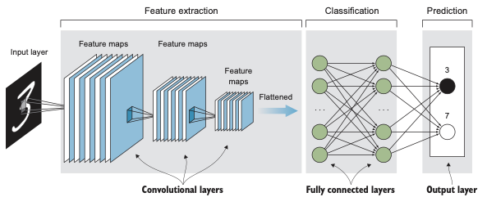
CNN Architecture

Slide 19
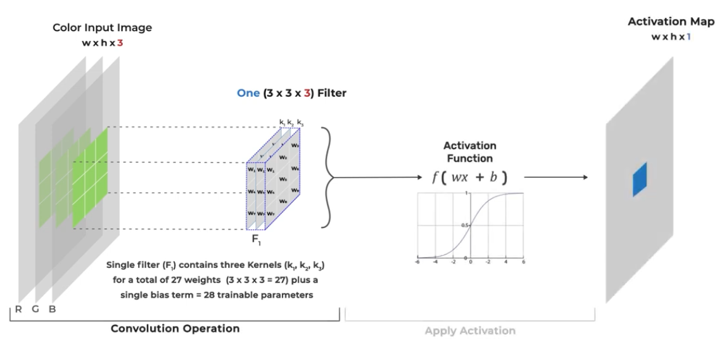
Kernels and Filters in Conv Layer

Slide 20
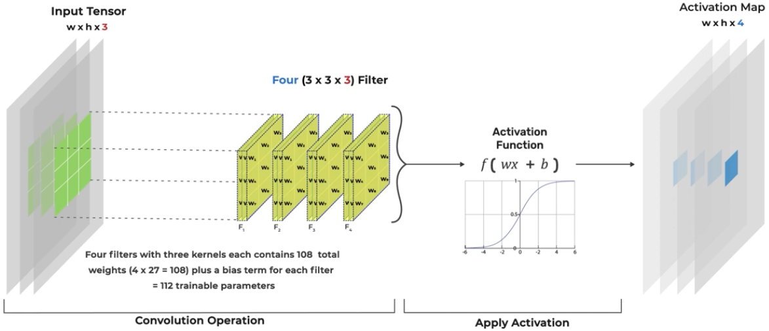
Kernels and Filters in Conv Layer

Slide 21
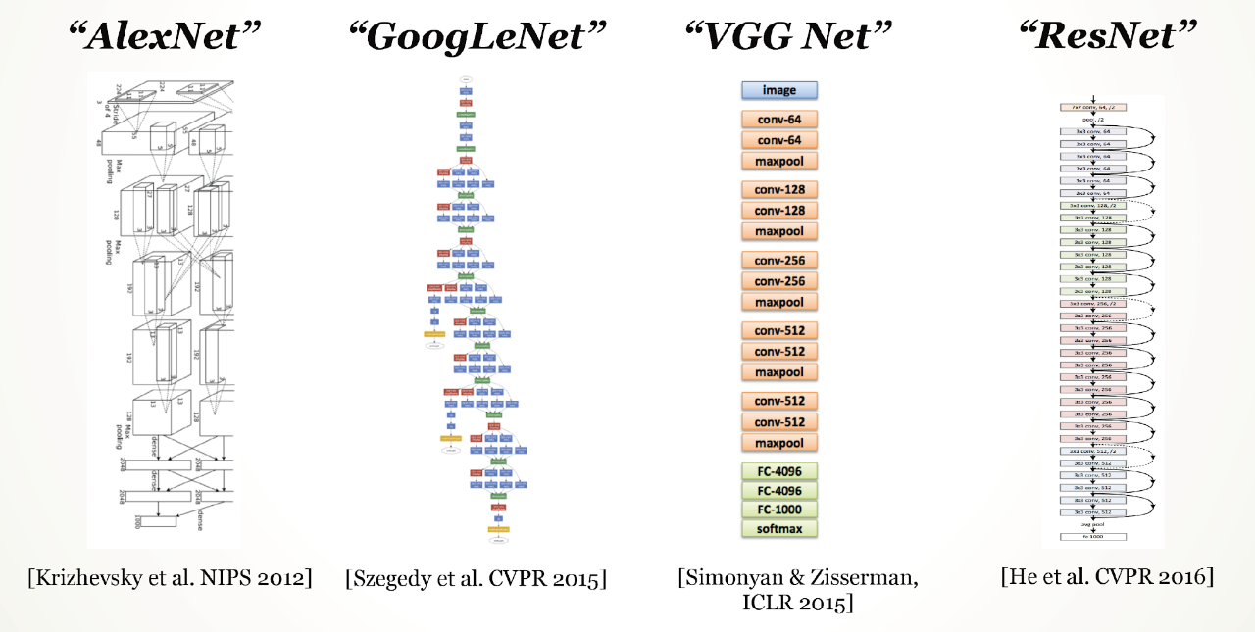

Slide 22
Readings
Deep Learning for Vision Systems, MOHAMED ELGENDY
  Chapter 3: up to 3.5 (must read all)
Notebooks:
  https://www.kaggle.com/code/zahidbd/lecture14-cnn-basic-nb1/

