Slide 1
COMPUTER VISION
Week 3
Lecture 4 (13/08/2026)
0714 02 CSE 4239

Slide 2
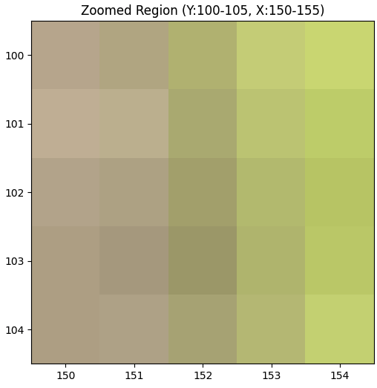
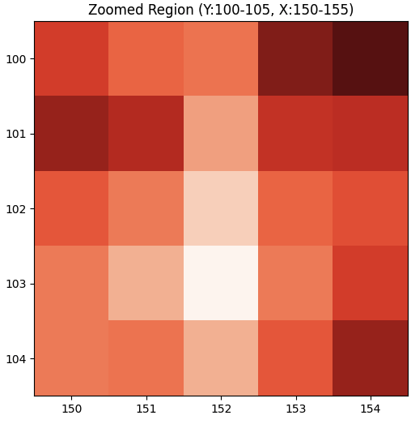
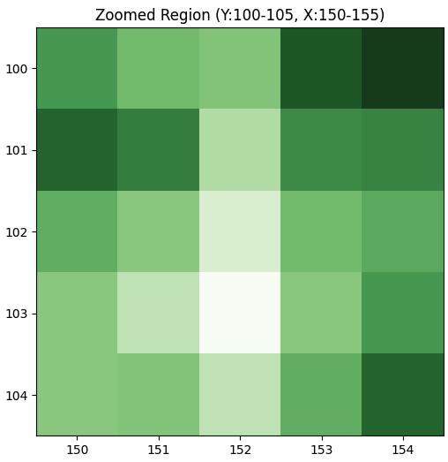
Practical
https://www.kaggle.com/code/zahidbd/lecture3-nb-2
ax.imshow(zoomed_region[..., 0], cmap="Reds");
ax.imshow(zoomed_region[..., 1], cmap="Reds");
ax.imshow(zoomed_region)

Slide 3
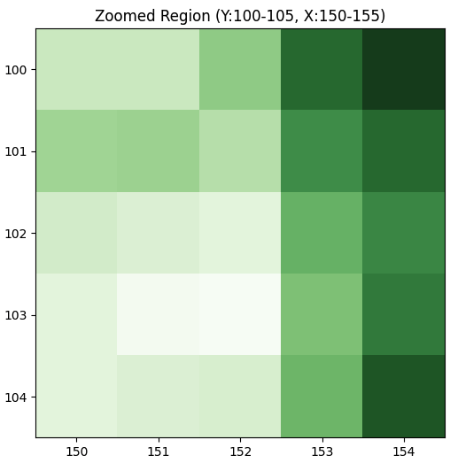
Practical
https://www.kaggle.com/code/zahidbd/lecture3-nb-2
ax.imshow(zoomed_region[..., 0], cmap="Reds");
ax.imshow(zoomed_region[..., 1], cmap="Greens");
ax.imshow(zoomed_region)

Slide 4
Image storage
Less concerning now – due to the innovation of cheap storage technologies.
Most cameras now produce JPEG images by default.

Slide 5
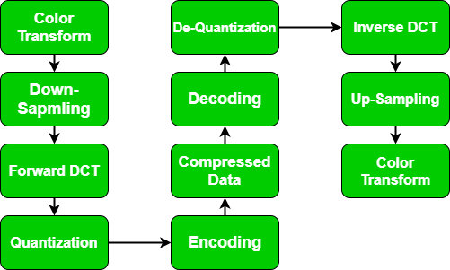
Going from RAW images to JPEG

Slide 6
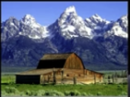
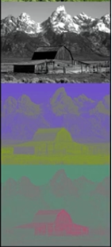
Step 1: transform
First, we transform the image into luminance (Y) chrominance(CbCr) YCbCr image.
  Y: Luminance (Brightness)
  Cb: Chrominance (Blue color difference)
  Cr: Chrominance (Red color difference)
The RGB channels are highly correlated. We don't want to compress on highly correlated channels – if we introduce an imperfection in one channel and it's going to magnify the imperfection
By converting to luminance and chrominance channels, we de couple the channels a bit.
Human eyes are very sensitive to brightness (Y), but not very sensitive to exact color details (Cb and Cr). Separating them allows us to compress the color data more aggressively.
Notes:
The RGB channels are highly correlated if I tell you the pixel value in the red Channel you've got a pretty good idea of what the what the value in the green and the blue channel and you don't want to be doing compression on highly correlated channels because it means if you introduce an imperfection in one channel and it's going to magnify the imperfection and so by converting to luminance and chrominance channels, we de couple the channels a bit.

Slide 7
Step 2: Down sampling
Optionally down sample the Cb and Cr channels. This step exploits human vision weaknesses.
We keep all the Luminance (Y) data.
We throw away a lot of the Chrominance (Cb, Cr) data.
Result: Instantly cuts the data size in with almost zero visible difference.
These changes may not matter to our visual system, but they may matter for the CV systems.
However, JPEG was not made for CV, it was meant for human viz system.

Slide 8
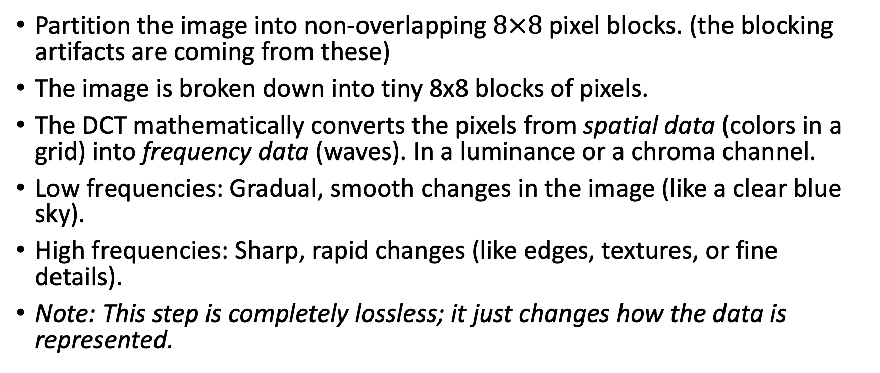
Step 3: DCT
Partition the image into non-overlapping $8×8$pixel blocks. (the blocking artifacts are coming from these)
The image is broken down into tiny 8x8 blocks of pixels.
The DCT mathematically converts the pixels from spatial data (colors in a grid) into frequency data (waves). In a luminance or a chroma channel.
Low frequencies: Gradual, smooth changes in the image (like a clear blue sky).
High frequencies: Sharp, rapid changes (like edges, textures, or fine details).
Note: This step is completely lossless; it just changes how the data is represented.
Notes:
The heart of JPEG - the discrete cosine transformation (DCT-II). DCT is a variant of the Fourier transform. What the DCT does is it converts the luminance Channel or the chroma Channel (each Channel separately now) into a frequency representation in terms of the discrete cosine transform.

Slide 9
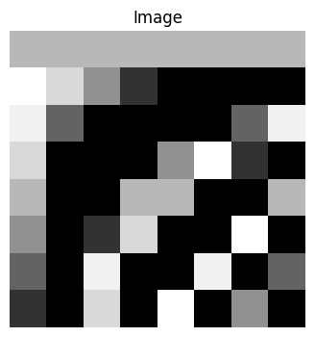
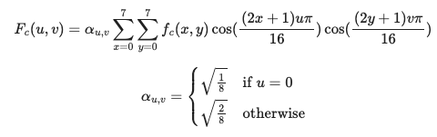
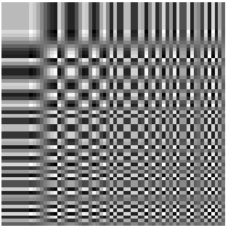
Step 3: DCT
Every 8x8 block of your image is made up of a combination of these 64 patterns.
Top-left corner = Low frequency (flat or smooth).
Bottom-right corner = High frequency (highly detailed).
The human visual system is more sensitive to these low frequencies than we the high frequencies.
Consequence: we can throw more away information corresponding to the high frequency values then to the low frequency values.
Notes:
This is the basis image of an 8x8 DCT matrix, with a size of 64x64. By observing the image, we can notice that the horizontal (row) frequencies increase from left to right, while the vertical (columns) frequencies increase from top to bottom.
The constant basis function in the top left corner is commonly referred to as the DC (Direct Current) basis function, and the corresponding DCT coefficient is known as the DC coefficient.
Any image can be composed by overlaying 64 cosine transformations from this reference image. Since we have set the size of the DCT matrix to be 8x8, we need to divide the image into several small 8x8 squares, referred to as blocks. The image is processed in units of blocks. Below, we will demonstrate 8 sets of DCT matrices along with their corresponding blocks.
Organization of Frequencies
DC Coefficient (Top-Left): Represents the average brightness or intensity of the entire 8×8 block.
AC Coefficients (Rest of the Grid): Move outward toward the bottom-right, representing progressively higher spatial frequencies (sharp edges, fine textures, rapid brightness changes).
Energy Compaction: Most of the image block's visual energy packs tightly into the low-frequency coefficients located near the top-left corner.

Slide 10
Problem
We've gone from RGB to luminance Chrominance (step 1).
  Integer to integer conversion
In step 3, we've gone from integer values now to floating point values
  from a compression perspective it is a very bad idea.
Where we are going to get me savings so the DCT does nothing to save you memory but this step the quantization does.

Slide 11
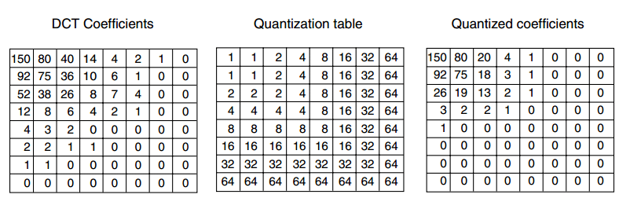
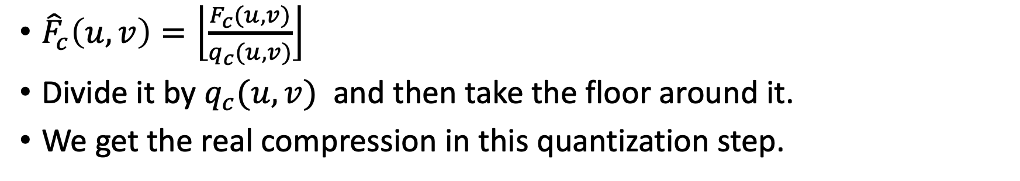
Step 4: Quantization
${\hat{F}}_{c}\left(u,v\right)=\left\lfloor \frac{F_{c}(u,v)}{q_{c}(u,v)}\right\rfloor$
Divide it by $q_{c}(u,v)$ and then take the floor around it.
We get the real compression in this quantization step.

Slide 12
Quantization
Notice we have a lot of 0 and that's because – we a quantize by dividing a big number in the high frequency channel.
If we divide by 10 for example and then take the floor everything between 0, and 1, 9 is going to be 0.
Up top are low frequencies - notice that we don't really want to quantize so much because we really care about these values.

Slide 13
Step 5: Encoding
Encoding zeros is really cheap using entropy encoding.
Entropy encoding or Huffman encoding or run life encoding where highly common values get represented with very few bits and less common values get represented more.
Standard entropy encoding - all of those zeros are going to be very efficient to encode and that's where the savings is now obviously on the unpacking so what's stored in a JPEG.

Slide 14
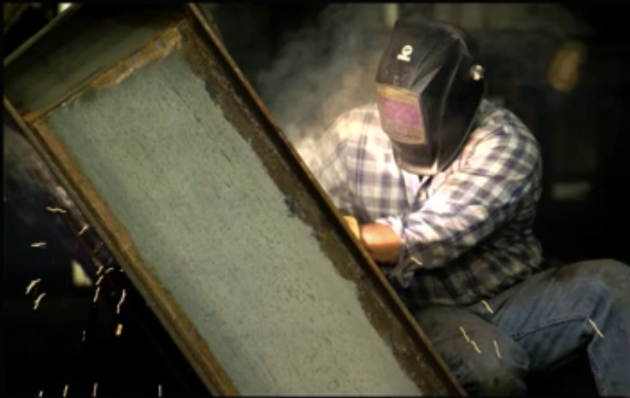

Slide 15
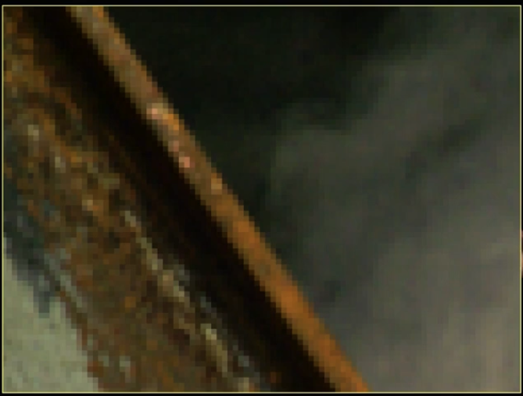
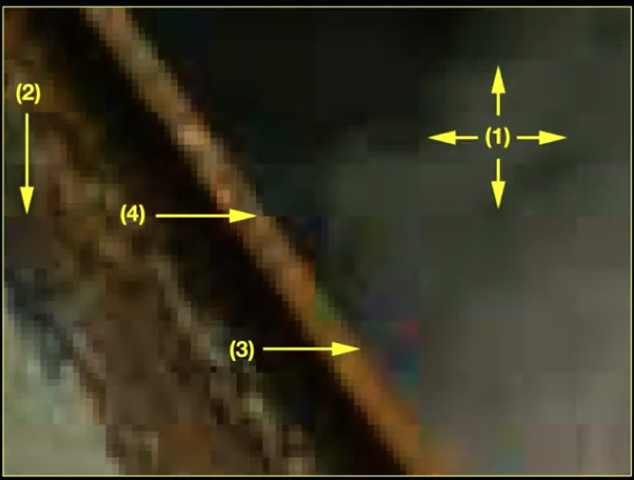

Slide 16
Compression artifacts
Blocking artifact: because of the partitions
big blurry patches: because of quantized all of the high frequency variations
Color aberrations.
  one is the chroma Channel may have been sub-sampled
  the chroma Channel tends to get quantized by a higher amount than the luminance Channel. The human visual system cares less about color than it does about intensity or luminance
Along the straight edge we get jaggies because - again the blocking artifact. It is different along each Edge.
Notes:
first of all we see that blocking artifact why well because I've partitioned the image into eight by eight blocks and each block doesn't know about its neighbor so it's doing a DCT it's doing the quantization and then you move on to the next one and it does the same thing and it creates an edge between them an artificial Edge which was not of course in the original scene and that could be really problematic for a lot of reasons.
We sometimes just see these big blurry patches because we quantized all of the high frequencies variations in the image and all that's left is this blurry patch
We see some interesting and weird color aberrations. Why? well two things
one is the chroma Channel may have been sub-sampled
the chroma Channel tends to get quantized by a higher amount than the luminance Channel. Because the human visual system cares less about color than it does about intensity or luminance
Along what should be a straight edge you get these jaggies because again of that blocking artifact is different along each Edge and so straight lines end up getting a little jaggy and all of these are highly highly undesirable.

Slide 17
Image processing

Slide 18
Point operators

Slide 19
Reading
https://www.youtube.com/watch?v=Um4OU7Jr3Sw&list=PLhwIOYE-ldwL6h-peJADfNm8bbO3GlKEy&index=15
https://www.csfieldguide.org.nz/en/chapters/coding-compression/image-compression-using-jpeg/
https://www.kaggle.com/code/zahidbd/lecture4-nb-1

