Slide 1
COMPUTER VISION
Week 6
Lecture 7 (01/09/2026)
0714 02 CSE 4239

Slide 2
Basic image operations
Raw image data acquired by imaging devices is rarely clean, well-formatted, or directly usable by higher-level recognition models.
Need basic image operations and filtering (from the DIP course) to prepare, refine, and extract structural information from visual data.
Point Operations (e.g., Histogram Equalization): Corrects exposure, enhances contrast, and standardizes luminance across dataset samples.
Filtering (e.g., Gaussian, Median Filters): Removes high-frequency noise or speckles while preserving underlying structures.
Notes:
Devices include
X-ray machines
Cameras
Video cameras
CCTV
MRI
Need basic image operations and filtering provides the foundational toolkit required to prepare, refine, and extract structural information from visual data.

Slide 3
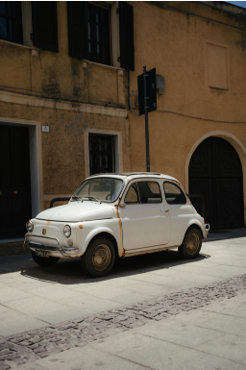
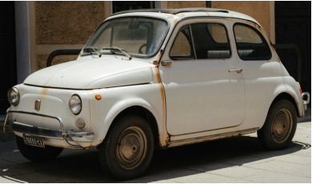
Image cropping and sampling
To remove unwanted area or to select area of interest in an image.

Slide 4
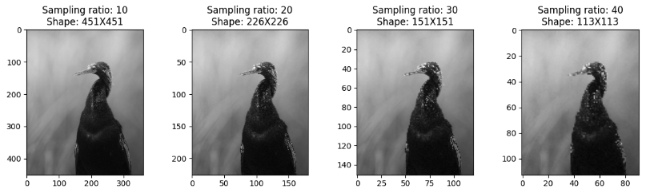
Sampling
Applied to reduce image size.
https://www.kaggle.com/code/zahidbd/lecture7-nb1-croping-sampling/

Slide 5
Point operators
Each output pixel’s value depends on only the corresponding input pixel value.
Examples of such operators:
  Brightness and contrast adjustments
  Colour correction and transformations.
Notes:
- (plus, potentially, some globally collected information or parameters)

Slide 6

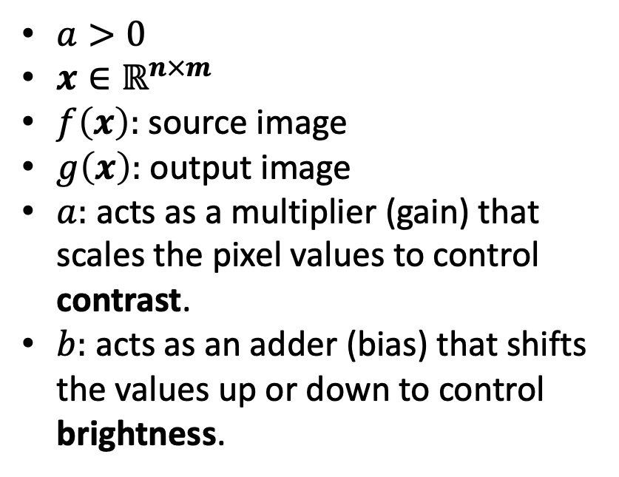
What Are Brightness and Contrast?
Brightness - the overall lightness or darkness of an image.
  Determined by the pixel intensity?
Contrast - the difference in intensity between pixels compared to a reference value (e.g., the mean pixel intensity).
  Measures how "sharp" or "distinct" the variations in the image are.
$$g\left(x\right)=a∗f\left(x\right)+b$$
$a>0$
$x∈ℝ^{n×m}$
$f\left(x\right):$ source image
$g\left(x\right):$ output image
$a:$ acts as a multiplier (gain) that scales the pixel values to control contrast.
$b:$ acts as an adder (bias) that shifts the values up or down to control brightness.
Notes:
- Brightness refers to the overall lightness or darkness of an image, determined by the pixel intensity.
- Contrast refers to the difference in intensity between pixels compared to a reference value (e.g., the mean pixel intensity). It essentially measures how "sharp" or "distinct" the variations in the image are.

Slide 7

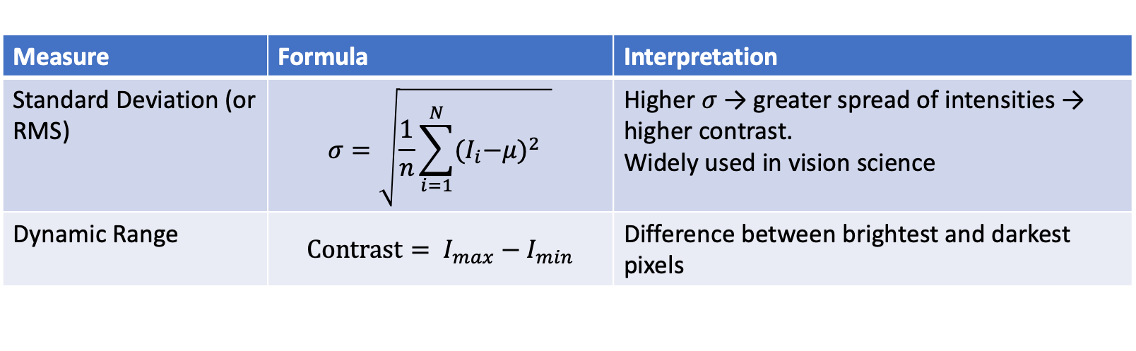
Brightness and contrast measures
Brightness: Average light intensity across all pixels in the image.
$Brightness=\frac{1}{N}\sum_{i=1}^{N}{I_{i}}$
where $I_{i}$is the intensity of pixel $i$ and $N$is total number of pixels.
For color images: Convert to grayscale first or compute mean across all channels
Contrast: Contrast quantifies the spread of pixel intensities.
Measure | Formula | Interpretation
Standard Deviation (or RMS) | $$σ=\sqrt{\frac{1}{n}\sum_{i=1}^{N}{{{(I}_{i}−μ)}^{2} }}$$ | Higher $σ$ → greater spread of intensities → higher contrast. Widely used in vision science
Dynamic Range | $$Contrast= I_{max}​−I_{min}​$$ | Difference between brightest and darkest pixels
Notes:
You can measure brightness and contrast in images using simple statistical metrics computed from pixel intensities. Brightness is typically the mean pixel intensity, while contrast is commonly measured as the standard deviation of pixel intensities or the difference between max and min intensity.[sciencedirect][pure.port.ac][uomus.edu][tutorialspoint]
Core Metrics
Brightness
Definition: Average light intensity across all pixels in the image.[pure.port.ac][uomus.edu]
Formula (grayscale or converted to luminance):
\text{Brightness} = \frac{1}{N} \sum_{i=1}^{N} I_i
where I_i is the intensity of pixel i and N is total number of pixels.[pure.port.ac][uomus.edu]
For color images: Convert to grayscale first using luminance weights (e.g., L = 0.30R + 0.59G + 0.11B) or compute mean across all channels.[cs.princeton][evidentscientific]
Contrast
Multiple standard measures exist:
Measure
Formula
Interpretation
Standard Deviation\sigma = \sqrt{\frac{1}{N}\sum_{i=1}^{N}(I_i - \mu)^2}Higher \sigma → greater spread of intensities → higher contrast [sciencedirect][uomus.edu]
Dynamic Range\text{Contrast} = I_{\max} - I_{\min}Difference between brightest and darkest pixels [blog.annimon][tutorialspoint]
RMS Contrast\text{RMS} = \sqrt{\frac{1}{N}\sum_{i=1}^{N}(I_i - \mu)^2}Equivalent to standard deviation; widely used in vision science
Low contrast images have pixel values clustered near the mean (small \sigma), while high contrast images span a wide intensity range.[uomus.edu][evidentscientific]
Python Implementation
Here's a concise function to compute these metrics:
import numpy as np
from PIL import Image
def measure_brightness_contrast(image_path):
img = Image.open(image_path).convert('L') # Convert to grayscale
pixels = np.array(img).flatten()
brightness = np.mean(pixels)
contrast_std = np.std(pixels) # Standard deviation measure
contrast_range = np.max(pixels) - np.min(pixels) # Dynamic range
return {
'brightness': brightness,
'contrast_std': contrast_std,
'contrast_range': contrast_range
}
Practical Notes
Normalization: For 8-bit images, pixel values range 0–255. You can normalize brightness to a 0–100% scale: \text{Brightness\%} = \frac{\text{mean}}{255} \times 100.[roberin]
Local vs Global: For more nuanced analysis, compute these metrics on local patches (e.g., non-overlapping tiles) and aggregate (e.g., mean of local standard deviations).[sciencedirect]
Tools: ImageJ/Fiji provides built-in measurement via Analyze → Measure after adjusting display with Image → Adjust → Brightness/Contrast.[imperial.ac][imagej]
These metrics are widely used in image quality assessment, enhancement evaluation (e.g., Contrast Improvement Index = C_{\text{enhanced}} / C_{\text{original}}), and preprocessing pipelines for computer vision.[sciencedirect][pure.port.ac]

Slide 8
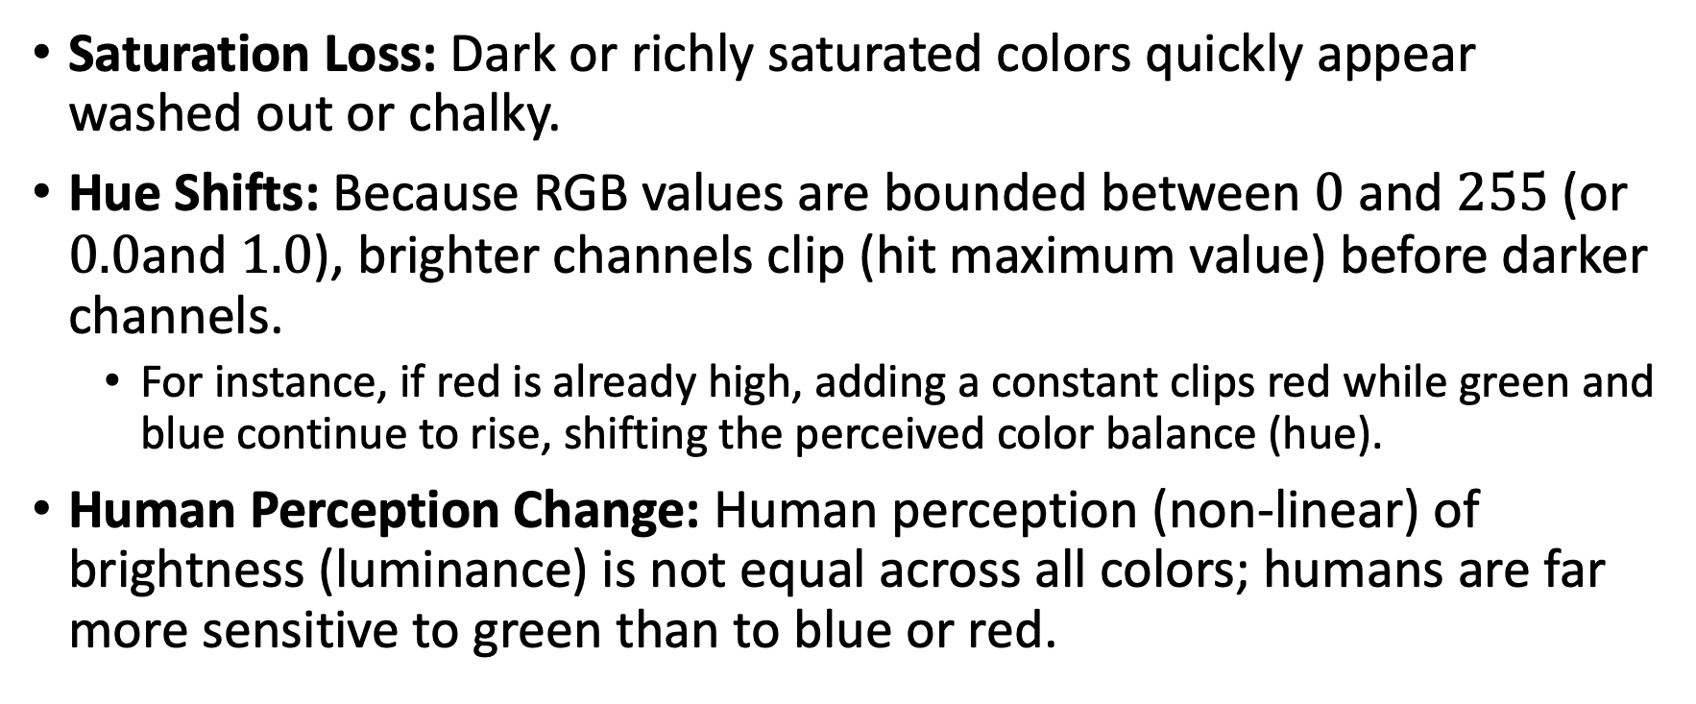
Problem with Direct RGB Manipulation
Saturation Loss: Dark or richly saturated colors quickly appear washed out or chalky.
Hue Shifts: Because RGB values are bounded between $0$ and $255$ (or $0.0$and $1.0$), brighter channels clip (hit maximum value) before darker channels.
  For instance, if red is already high, adding a constant clips red while green and blue continue to rise, shifting the perceived color balance (hue).
Human Perception Change: Human perception (non-linear) of brightness (luminance) is not equal across all colors; humans are far more sensitive to green than to blue or red.
Notes:
Core Concepts Explained
1. The Problem with Direct RGB Manipulation
When you add a constant offset $c$to every channel in an RGB image ($R′=R+c$, $G′=G+c$, $B′=B+c$), you attempt to increase the apparent brightness (intensity). However, this naive approach introduces severe visual artifacts:
Saturation Loss (Desaturation): Adding an equal constant to all channels shifts the color closer to pure white (where $R=G=B$). Dark or richly saturated colors quickly appear washed out or chalky.
Hue Shifts: Because RGB values are bounded between $0$and $255$(or $0.0$and $1.0$), brighter channels clip (hit maximum value) before darker channels. For instance, if red is already high, adding a constant clips red while green and blue continue to rise, shifting the perceived color balance (hue).
Non-linear Perception: Human perception of brightness (luminance) is not equal across all colors; humans are far more sensitive to green than to blue or red.
2. Decoupling Luminance from Chrominance
To modify brightness without changing the underlying color identity (hue and saturation), vision algorithms separate luminance (light intensity) from chrominance (color information):
Chromaticity Coordinates / Color Ratios: Chromaticity normalizes color relative to total intensity:
$$r=\frac{R}{R+G+B}, g=\frac{G}{R+G+B}, b=\frac{B}{R+G+B}$$
By preserving these ratios, you can adjust the luminance $Y$independently and then scale the original ratios back up to recalculate valid RGB values without altering hue or saturation.
Perceptual Color Spaces (e.g., HSV, Lab): In spaces like HSV (Hue, Saturation, Value) or CIELAB, brightness is isolated in a single channel (Value $V$or Lightness $L^{∗}$). Brightening an image simply means scaling this single channel while holding $H$and $S$constant.
3. Color Balancing & 3×3 Color Twist Matrices
Different light sources (e.g., warm incandescent vs. cool daylight) cast different color tints over an entire scene.
Simple Scaling: Multiplying each RGB channel by a scalar ($R′=k_{r}R$, $G′=k_{g}G$, $B′=b_{b}B$) offers a basic white-balance adjustment.
Color Twist Transform Matrix: For precise, color-accurate conversion (such as matching human perception under a specific illuminant), the image is mapped to the CIE XYZ color space via a linear $3×3$matrix transformation:
$$\begin{bmatrix} X \\ Y \\ Z \end{bmatrix} = \mathbf{M} \begin{bmatrix} R \\ G \\ B \end{bmatrix}$$
The chromatic adaptions (shifting the scene's nominal white point) are calculated in XYZ space, and the values are then transformed back to RGB.

Slide 9
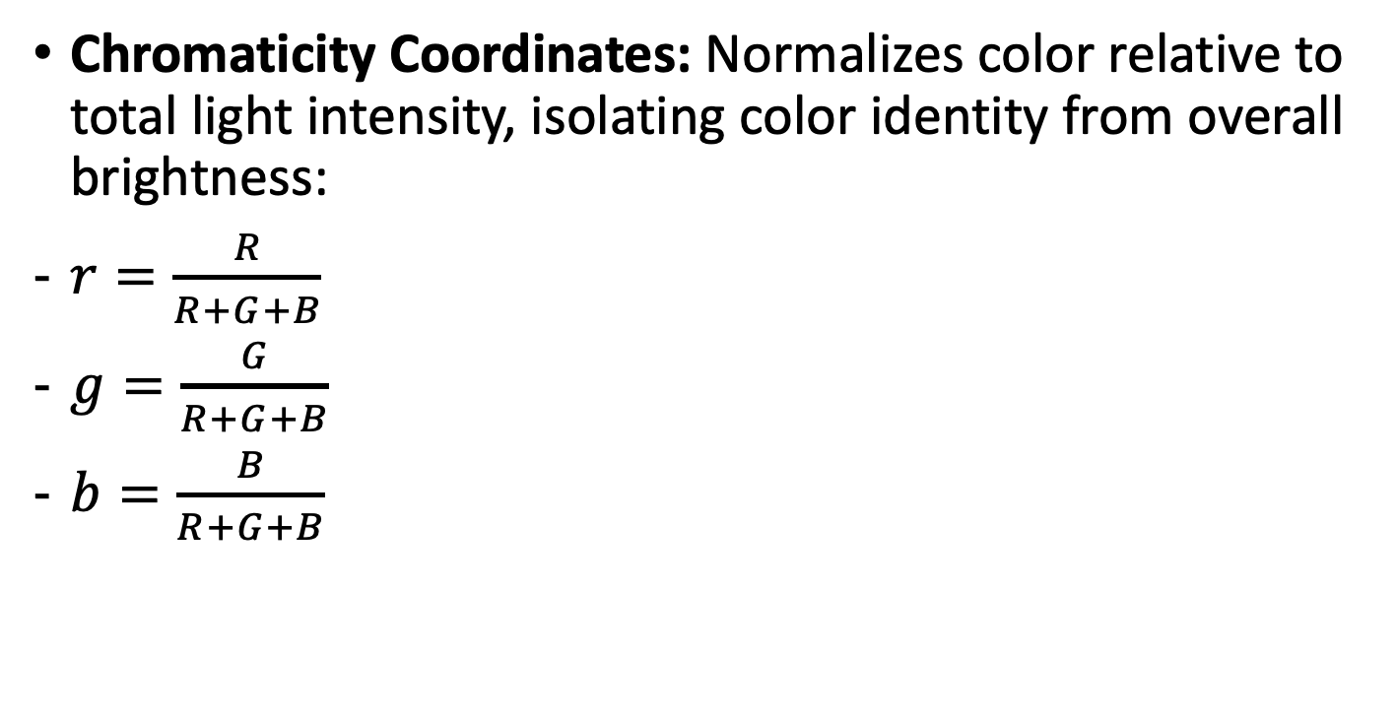
Decoupling Luminance & Chrominance
Chromaticity Coordinates: Normalizes color relative to total light intensity, isolating color identity from overall brightness:
$r=\frac{R}{R+G+B}$
$g=\frac{G}{R+G+B}$
$b=\frac{B}{R+G+B}$
Notes:
Perceptual Color Spaces (e.g., HSV, Lab): In spaces like HSV (Hue, Saturation, Value) or CIELAB, brightness is isolated in a single channel (Value $V$or Lightness $L^{∗}$). Brightening an image simply means scaling this single channel while holding $H$and $S$constant.

Slide 10
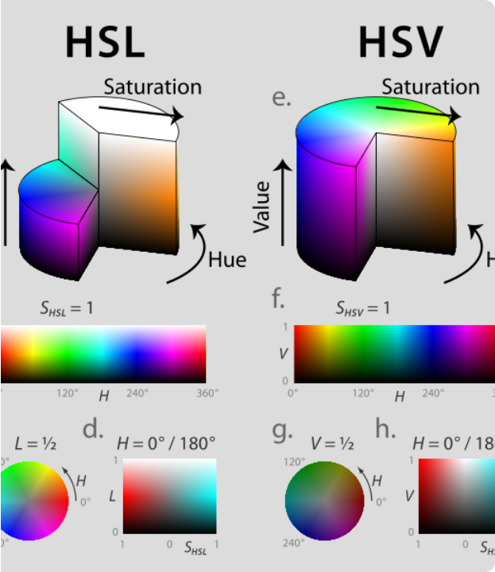
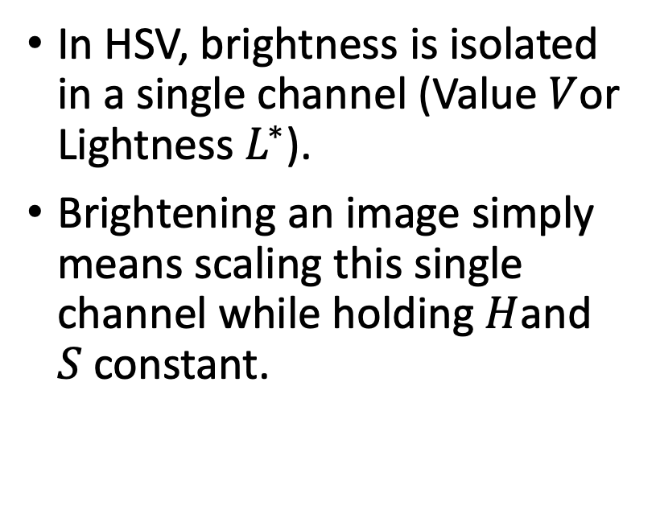
Perceptual Color Spaces
In HSV, brightness is isolated in a single channel (Value $V$or Lightness $L^{∗}$).
Brightening an image simply means scaling this single channel while holding $H$and $S$ constant.
Notes:
Perceptual Color Spaces (e.g., HSV, Lab): In spaces like HSV (Hue, Saturation, Value) or CIELAB, brightness is isolated in a single channel (Value $V$or Lightness $L^{∗}$).
- Brightening an image simply means scaling this single channel while holding $H$and $S$constant.

Slide 11
Changing contrast
img_float = (img_float - 127.5) * contrast + 127.5
Without offsetting the pivot point to mid-gray, gain multiplication acts purely as a gain scaling around zero, shifting brightness out of control.
The Broken Method (Pixel × Contrast)
If we multiply directly without shifting (Pixel × 2.0), the mathematical anchor point automatically defaults to 0 (pure black) instead of mid-tone gray.
• Dark Pixel (100) becomes 200 (brighter instead of darker!).
• Light Pixel (200) becomes 400 (clips aggressively to 255).
Visual Consequences
Without the 127.5 shift, increasing contrast aggressively brightens the entire image across all pixel tones.
It destroys dark shadow areas and transforms your contrast tool into an unwanted, unbalanced brightness boost.
Notes:
Without offsetting the pivot point to mid-gray, gain multiplication acts purely as a gain scaling around zero, shifting brightness out of control.
why do we need (img_float - 127.5) * contrast + 127.5 the 127.5 addition and subtraction?
- We need to subtract and add 127.5 because contrast scaling must be done relative to the mid-tone of the image, rather than absolute zero (black).
Here is exactly what happens if you don't do this, and why the math is designed this way:
1. The Midpoint Anchor (127.5)
In an 8-bit digital image, pixel values range from 0 (pure black) to 255 (pure white). The exact mathematical middle of this spectrum is:
\(\frac{255}{2}=127.5\)
When you adjust contrast, your goal is to make the bright pixels brighter and the dark pixels darker. To do that accurately, the computer needs to know what is considered "already bright" and what is "already dark". 127.5 acts as that balancing point.
2. The Step-by-Step Math Transformation
Let's break down the formula using a contrast multiplier of 2.0 (doubling the contrast) on two different pixels: a dark pixel (100) and a light pixel (200).
\(\text{New\ Value}=(\text{Pixel}-127.5)\times \text{Contrast}+127.5\)
Step
Dark Pixel (100)
Light Pixel (200)
1. Subtract 127.5
(Shifts 127.5 to become the "zero" point)\(100 - 127.5 = \mathbf{-27.5}\)
(Negative means it's dark)\(200 - 127.5 = \mathbf{+72.5}\)
(Positive means it's light)
2. Multiply by Contrast (2.0)
(Pushes values away from zero)\(-27.5 \times 2.0 = \mathbf{-55.0}\)
(Becomes even more negative)\(72.5 \times 2.0 = \mathbf{+145.0}\)
(Becomes even more positive)
3. Add 127.5 back
(Shifts back to original 0–255 scale)\(-55.0 + 127.5 = \mathbf{72.5}\)
(Successfully darkened from 100)\(145.0 + 127.5 = \mathbf{272.5} \rightarrow \mathbf{255}\)
(Successfully brightened from 200)
Because of this anchor, the dark pixel got darker (dropped from 100 to 72.5) and the bright pixel got brighter (rose from 200 to 255). The middle tones right around 127.5 stay perfectly balanced.
3. What happens if you skip it? (The Broken Way)
If you simply multiply the pixels directly without shifting (Pixel * Contrast), your anchor point automatically becomes 0 (pure black).
If you double the contrast of our pixels using just multiplication (Pixel * 2.0):
The dark pixel (100) becomes 200 (It got brighter, which is the opposite of what low contrast needs).
The light pixel (200) becomes 400 (Clips out to 255).
Without the 127.5 shift, increasing contrast would aggressively brighten the entire image and completely destroy your dark shadows, turning your contrast tool into a messy brightness tool.

Slide 12
Changing contrast
img_float = (img_float - 127.5) * contrast + 127.5
Transformation Step | Dark Pixel (100) | Light Pixel (200) | Result & Effect
1. Initial Value | 100 | 200 | Original pixel intensities
2. Subtract 127.5 | -27.5 (Below mid-tone) | +72.5 (Above mid-tone) | Establishes direction from center
3. Multiply by 2.0 | -55.0 (Pushed lower) | +145.0 (Pushed higher) | Scales distance from mid-tone
4. Add 127.5 Back | 72.5 (Darkened) | 255.0 (Brightened/Clipped) | Restores 0–255 image spectrum
https://www.kaggle.com/code/zahidbd/lecture7-nb2-br-cr
Notes:
Without offsetting the pivot point to mid-gray, gain multiplication acts purely as a gain scaling around zero, shifting brightness out of control.
why do we need (img_float - 127.5) * contrast + 127.5 the 127.5 addition and subtraction?
- We need to subtract and add 127.5 because contrast scaling must be done relative to the mid-tone of the image, rather than absolute zero (black).
Here is exactly what happens if you don't do this, and why the math is designed this way:
1. The Midpoint Anchor (127.5)
In an 8-bit digital image, pixel values range from 0 (pure black) to 255 (pure white). The exact mathematical middle of this spectrum is:
\(\frac{255}{2}=127.5\)
When you adjust contrast, your goal is to make the bright pixels brighter and the dark pixels darker. To do that accurately, the computer needs to know what is considered "already bright" and what is "already dark". 127.5 acts as that balancing point.
2. The Step-by-Step Math Transformation
Let's break down the formula using a contrast multiplier of 2.0 (doubling the contrast) on two different pixels: a dark pixel (100) and a light pixel (200).
\(\text{New\ Value}=(\text{Pixel}-127.5)\times \text{Contrast}+127.5\)
Step
Dark Pixel (100)
Light Pixel (200)
1. Subtract 127.5
(Shifts 127.5 to become the "zero" point)\(100 - 127.5 = \mathbf{-27.5}\)
(Negative means it's dark)\(200 - 127.5 = \mathbf{+72.5}\)
(Positive means it's light)
2. Multiply by Contrast (2.0)
(Pushes values away from zero)\(-27.5 \times 2.0 = \mathbf{-55.0}\)
(Becomes even more negative)\(72.5 \times 2.0 = \mathbf{+145.0}\)
(Becomes even more positive)
3. Add 127.5 back
(Shifts back to original 0–255 scale)\(-55.0 + 127.5 = \mathbf{72.5}\)
(Successfully darkened from 100)\(145.0 + 127.5 = \mathbf{272.5} \rightarrow \mathbf{255}\)
(Successfully brightened from 200)
Because of this anchor, the dark pixel got darker (dropped from 100 to 72.5) and the bright pixel got brighter (rose from 200 to 255). The middle tones right around 127.5 stay perfectly balanced.
3. What happens if you skip it? (The Broken Way)
If you simply multiply the pixels directly without shifting (Pixel * Contrast), your anchor point automatically becomes 0 (pure black).
If you double the contrast of our pixels using just multiplication (Pixel * 2.0):
The dark pixel (100) becomes 200 (It got brighter, which is the opposite of what low contrast needs).
The light pixel (200) becomes 400 (Clips out to 255).
Without the 127.5 shift, increasing contrast would aggressively brighten the entire image and completely destroy your dark shadows, turning your contrast tool into a messy brightness tool.

Slide 13
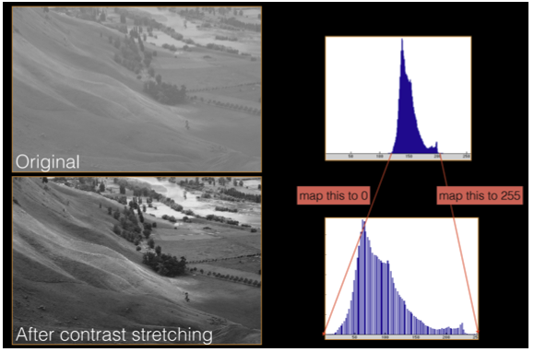

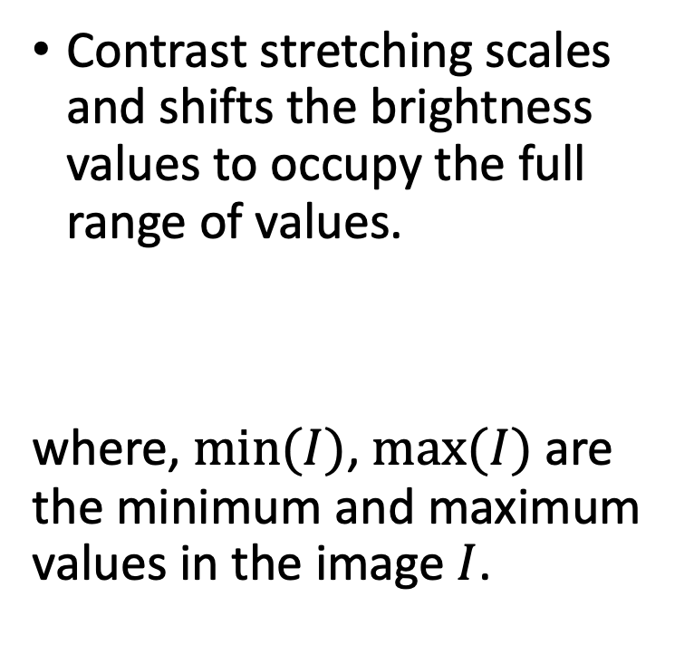
Contrast stretching
Contrast stretching scales and shifts the brightness values to occupy the full range of values.
where, $min⁡(I)$, $max⁡(I)$ are the minimum and maximum values in the image $I$.

Slide 14
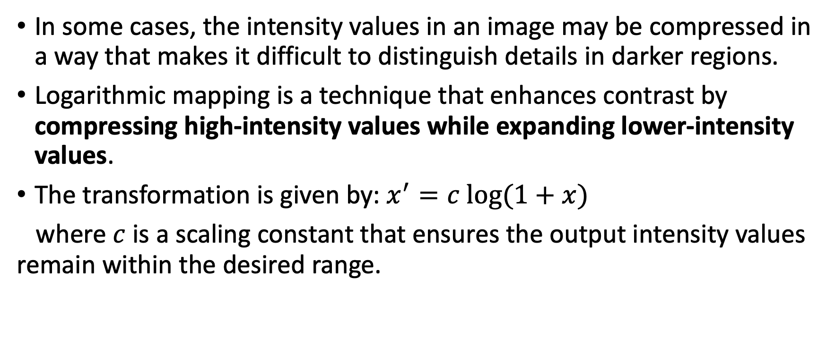
Logarithmic mapping
In some cases, the intensity values in an image may be compressed in a way that makes it difficult to distinguish details in darker regions.
Logarithmic mapping is a technique that enhances contrast by compressing high-intensity values while expanding lower-intensity values.
The transformation is given by: $x^{′}=c log(1+x)$
where $c$ is a scaling constant that ensures the output intensity values remain within the desired range.

Slide 15
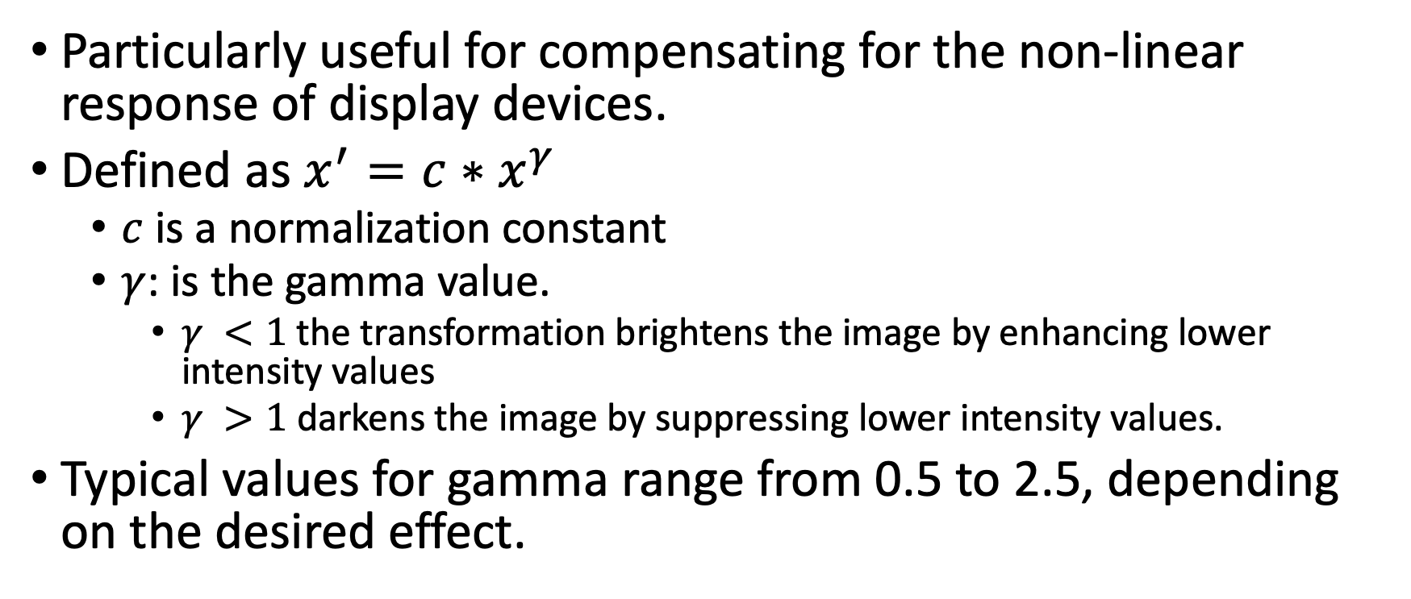
Gamma correction
Particularly useful for compensating for the non-linear response of display devices.
Defined as $x^{′}=c∗x^{γ}$
  $c$ is a normalization constant
  $γ$: is the gamma value.
    $γ <1$the transformation brightens the image by enhancing lower intensity values
    $γ >1$ darkens the image by suppressing lower intensity values.
Typical values for gamma range from 0.5 to 2.5, depending on the desired effect.

Slide 16

Image histogram
A histogram represents tabulated frequencies, typically by using bars in a graphical diagram.
Histograms of an image with gray levels in the range $[0,L−1]$ is a discrete function $h(r_{k}) = n_{k}$, where $r_{k}$ is kth gray level and $n_{k}$ is the number of pixels in the image having gray level $r_{k}$.

Slide 17
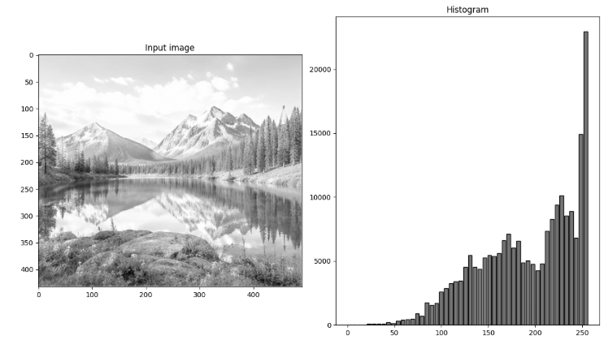
Image histogram examples: bright image

Slide 18
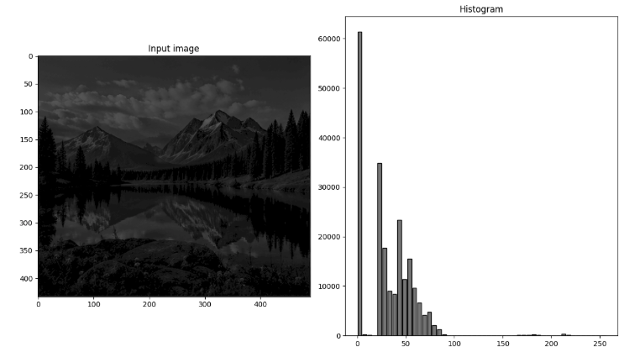
Image histogram examples: dark image

Slide 19
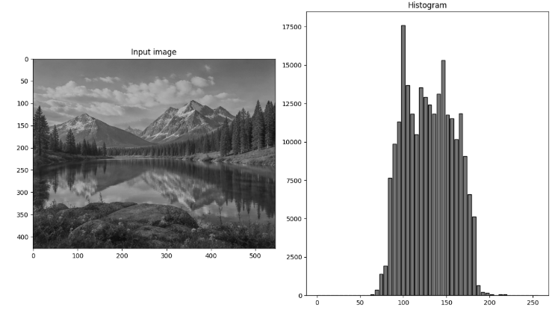
Image histogram examples: low contrast image

Slide 20
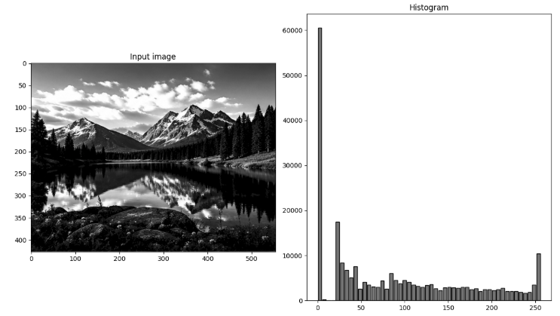
Image histogram examples

Slide 21
Image histogram stretching and equalization
Histogram provides a powerful tool to inspect distribution of intensities.
Histogram equalization involves transforming the intensity values so that the distribution of intensities are better spread (output values are distributed evenly between 0 and 255).
Histogram stretching is a simpler technique that aims to expand the existing range of pixel values in an image.

Slide 22
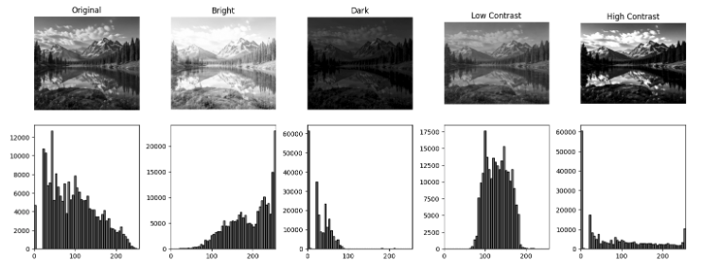

Slide 23
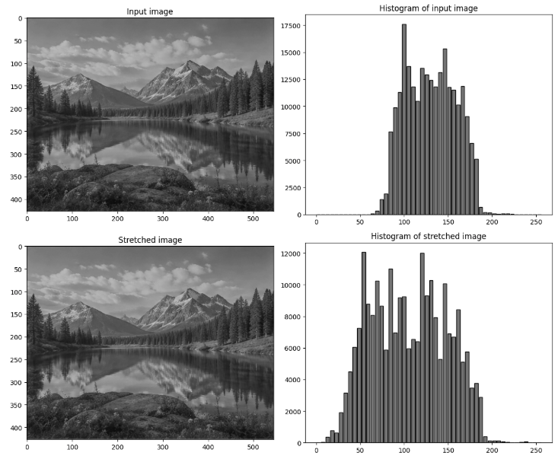
Image histogram stretching : Results

Slide 24
Observations
The shape of the original histogram is retained.
It’s a simple and computationally inexpensive method.
It is useful when you have prior knowledge about the minimum and maximum values in an image.

Slide 25
Image histogram equalization
Purpose: to spread out the intensity values across the entire range to make the image more visually appealing and informative.
Method: involves computing a cumulative distribution function (CDF) of the image’s histogram which is then used to map the original intensity values to new values. The resulting histogram is usually flat (i.e., uniform distribution).
Advantages: effective in enhancing images with low contrast
Considerations: histogram equalization (computationally complex) can sometimes lead to an overemphasis on noise if the image has a significant amount of it.

Slide 26
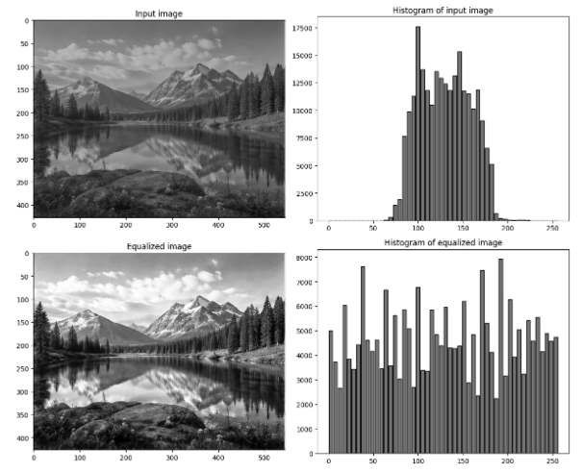
Image histogram equalization : Results

Slide 27
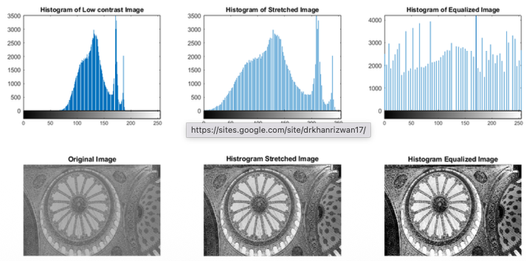
Comparing result of histogram stretching and equalization

Slide 28
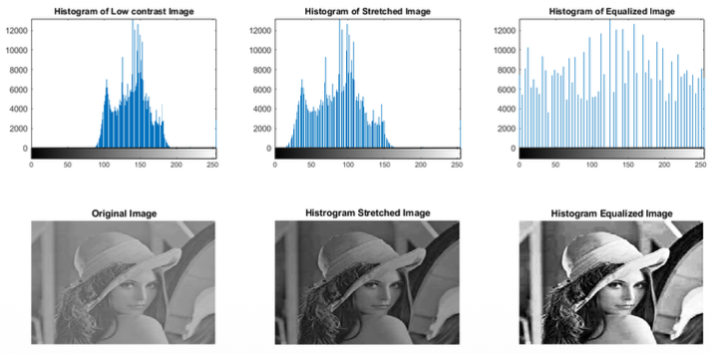

Slide 29
Readings
https://cvl-umass.github.io/intro-cv-spring-2025/assets/notes/imageprocessing.pdf
Szeliski book – Chap 3: Image processing
https://www.kaggle.com/code/zahidbd/lecture7-nb1-croping-sampling
https://www.kaggle.com/code/zahidbd/lecture7-nb2-br-cr
https://www.kaggle.com/code/zahidbd/lecture7-nb3-histogram

