Slide 1
COMPUTER VISION
Week 9
Lecture 13 (22/09/2026)
0714 02 CSE 4239

Slide 2
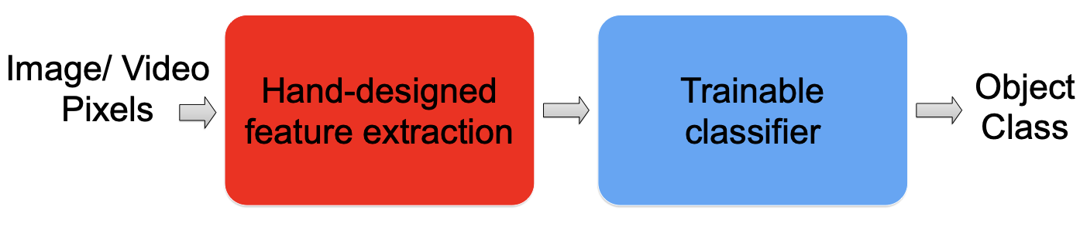
Traditional recognition approach

Slide 3
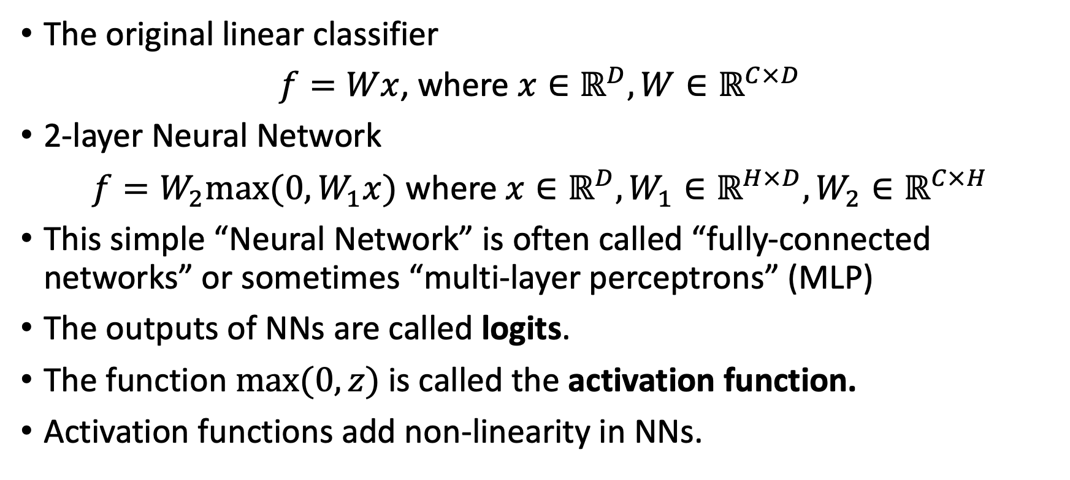
Introduction to Neural Network
The original linear classifier
$f=Wx$, where $x∈ℝ^{D},W∈ℝ^{C×D}$
2-layer Neural Network
$f=W_{2}max(0,W_{1}x)$ where $x∈ℝ^{D},W_{1}∈ℝ^{H×D},W_{2}∈ℝ^{C×H}$
This simple “Neural Network” is often called “fully-connected networks” or sometimes “multi-layer perceptrons” (MLP)
The outputs of NNs are called logits.
The function $\max{(0, z)}$is called the activation function.
Activation functions add non-linearity in NNs.

Slide 4
Main components NN
Input layer—Contains the feature vector.
Hidden layers—The neurons are stacked on top of each other in hidden layers.
  “hidden”: because we don’t see or control the input going into these layers or the output.
Weight connections (edges)—Weights are assigned to each connection between the nodes to reflect the importance of their influence on the final output prediction.
Output layer—We get the prediction from the output layer.

Slide 5
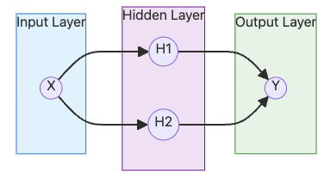
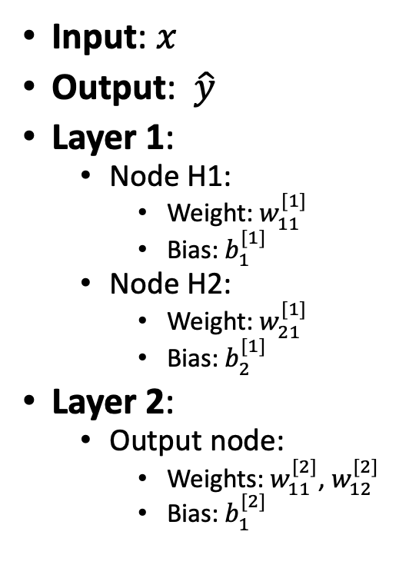
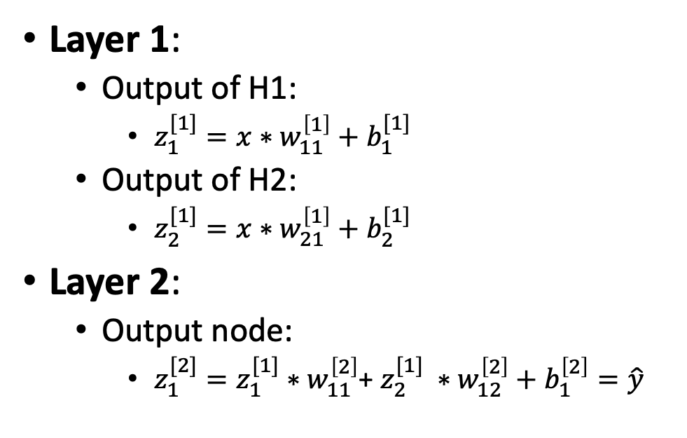
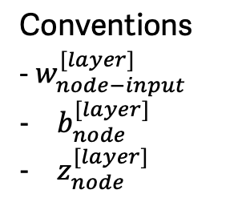
NN notations
Conventions
- $w_{node−input}^{[layer]}$
$b_{node}^{[layer]}$
$z_{node}^{[layer]}$
Layer 1:
  Output of H1:
    $z_{1}^{[1]}=x∗w_{11}^{\left[1\right]}+b_{1}^{[1]}$
  Output of H2:
    $z_{2}^{[1]}=x∗w_{21}^{\left[1\right]}+b_{2}^{[1]}$
Layer 2:
  Output node:
    $z_{1}^{[2]}=z_{1}^{[1]}∗w_{11}^{\left[2\right]}$+ $z_{2}^{[1]} ∗w_{12}^{\left[2\right]}+b_{1}^{\left[2\right]}=\hat{y}$
Input: $x$
Output: $\hat{y}$
Layer 1:
  Node H1:
    Weight: $w_{11}^{[1]}$
    Bias: $b_{1}^{[1]}$
  Node H2:
    Weight: $w_{21}^{[1]}$
    Bias: $b_{2}^{[1]}$
Layer 2:
  Output node:
    Weights: $w_{11}^{[2]}$, $w_{12}^{[2]}$
    Bias: $b_{1}^{[2]}$
$$\hat{y}=\left(x∗w_{11}^{\left[1\right]}+b_{1}^{\left[1\right]}\right)∗w_{11}^{\left[2\right]}+\left(x∗w_{21}^{\left[1\right]}+b_{2}^{\left[1\right]}\right)∗w_{12}^{\left[2\right]}+b_{1}^{\left[2\right]}$$

Slide 6
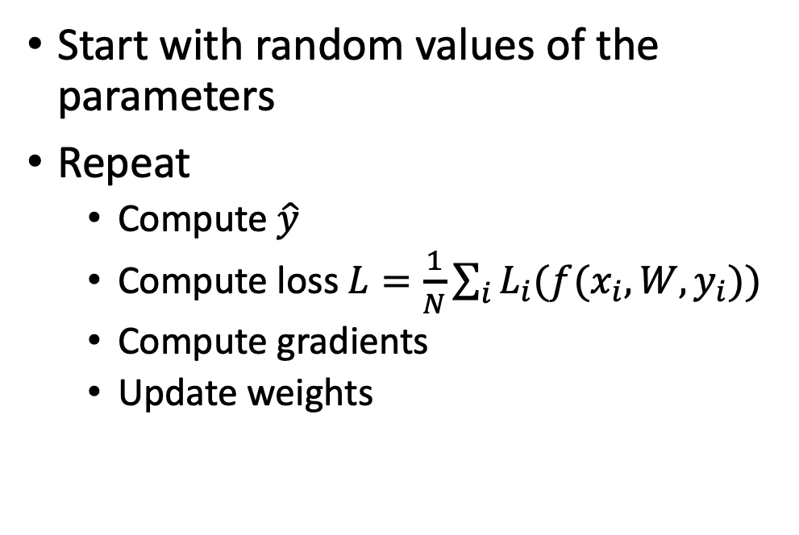
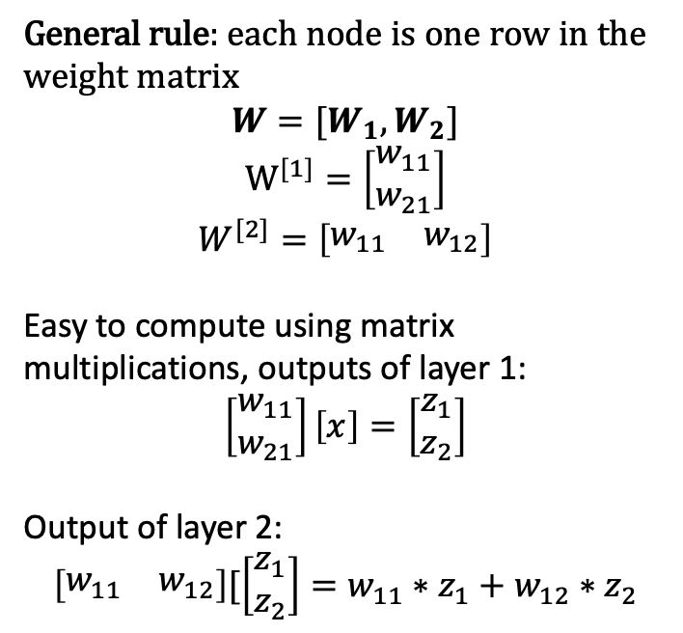
Computation in NN
$$\hat{y}=\left(x∗w_{11}^{\left[1\right]}+b_{1}^{\left[1\right]}\right)∗w_{11}^{\left[2\right]}+\left(x∗w_{21}^{\left[1\right]}+b_{2}^{\left[1\right]}\right)∗w_{12}^{\left[2\right]}+b_{1}^{\left[2\right]}$$
Start with random values of the parameters
Repeat
  Compute $\hat{y}$
  Compute loss $L=\frac{1}{N}\sum_{i}{L_{i}(f(x_{i}, W,y_{i}))}$
  Compute gradients
  Update weights
General rule: each node is one row in the weight matrix
$$W=[W_{1}, W_{2}]$$
$$W^{[1]}=\left[\begin{matrix}w_{11} \\ w_{21}\end{matrix}\right]$$
$$W^{[2]}=\left[\begin{matrix}w_{11} & w_{12}\end{matrix}\right]$$
Easy to compute using matrix multiplications, outputs of layer 1:
$$\left[\begin{matrix}w_{11} \\ w_{21}\end{matrix}\right]\left[x\right]=\left[\begin{matrix}z_{1} \\ z_{2}\end{matrix}\right]$$
Output of layer 2:
$$\left[\begin{matrix}w_{11} & w_{12}\end{matrix}\right][\left[\begin{matrix}z_{1} \\ z_{2}\end{matrix}\right]=w_{11}∗z_{1}+w_{12}∗z_{2}$$

Slide 7
NN from scratch
We can do the same linear regression problem using NN on excel. DIY.
Demo.

Slide 8
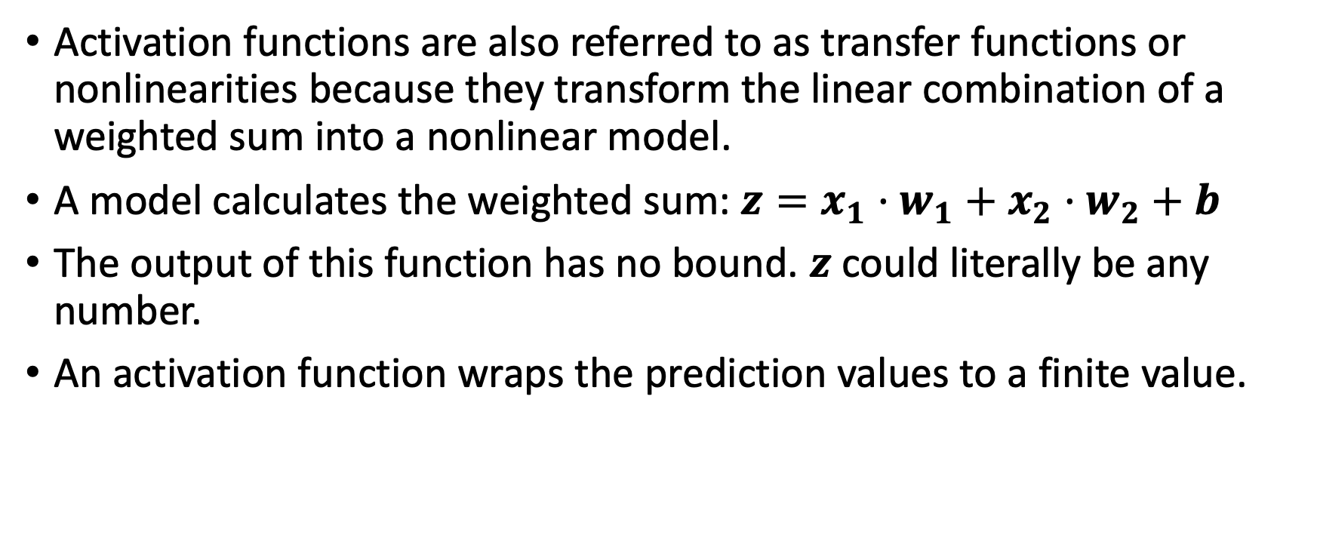
Activation functions
Activation functions are also referred to as transfer functions or nonlinearities because they transform the linear combination of a weighted sum into a nonlinear model.
A model calculates the weighted sum: $z=x_{1}·w_{1}+x_{2}·w_{2}+b$
The output of this function has no bound. $z$ could literally be any number.
An activation function wraps the prediction values to a finite value.

Slide 9
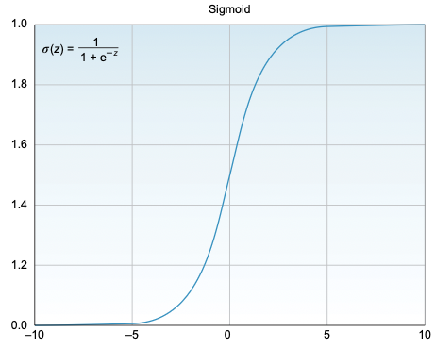
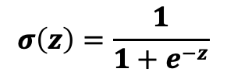
Sigmoid/logistic function
Used in binary classifiers to predict the probability of a class when you have two classes.
The sigmoid squishes all the values to a probability between 0 and 1, which reduces extreme values or outliers in the data without removing them.
Sigmoid or logistic functions convert infinite continuous variables (range between –∞ to +∞) into simple probabilities between 0 and 1.
$$σ\left(z\right)=\frac{1}{1+e^{−z}}$$

Slide 10

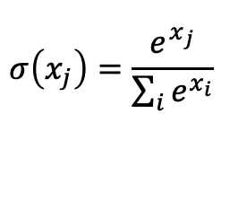
Softmax function
Used to obtain classification probabilities when we have more than two classes.
Forces the outputs of a neural network to sum to 1 (for example, 0 < output < 1).
$$σ\left(x_{j}\right)=\frac{e^{x_{j}}}{\sum_{i}{e^{x_{i}}}}$$

Slide 11
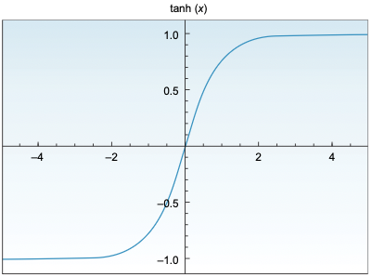
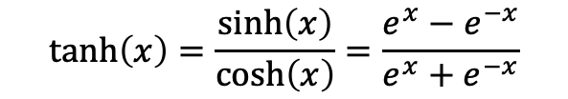
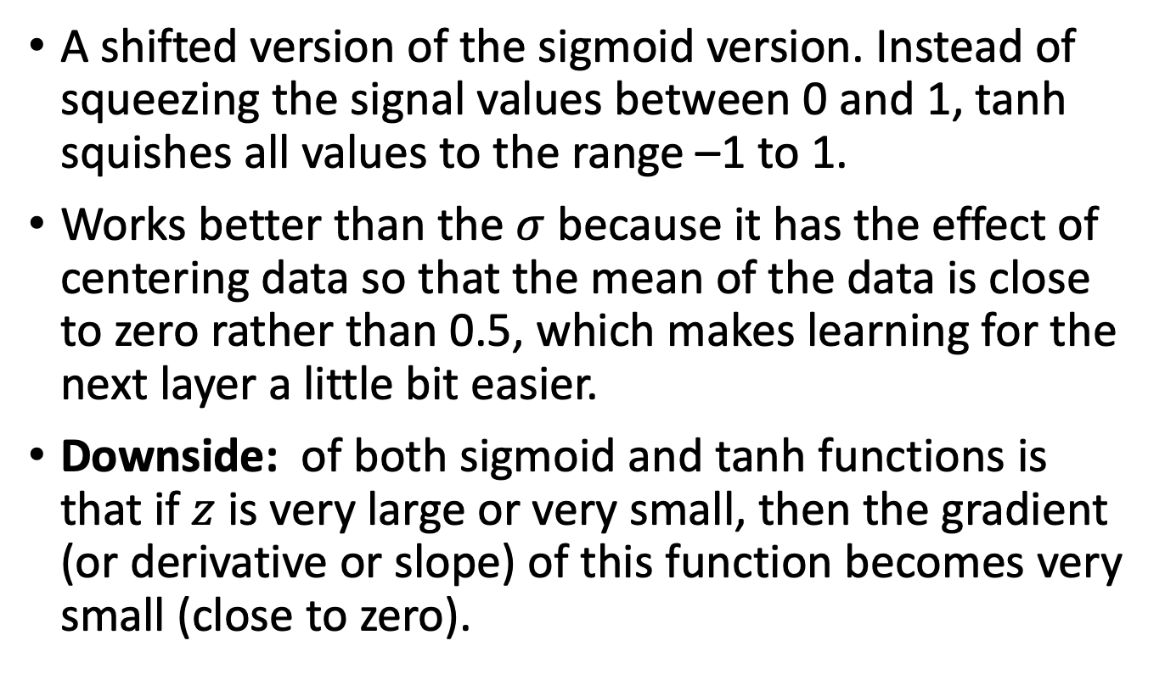
tanh
$$\tanh\left(x\right)=\frac{\sinh\left(x\right)}{\cosh\left(x\right)}=\frac{e^{x}−e^{−x}}{e^{x}+e^{−x}}$$
A shifted version of the sigmoid version. Instead of squeezing the signal values between 0 and 1, tanh squishes all values to the range –1 to 1.
Works better than the $σ$ because it has the effect of centering data so that the mean of the data is close to zero rather than 0.5, which makes learning for the next layer a little bit easier.
Downside: of both sigmoid and tanh functions is that if $z$ is very large or very small, then the gradient (or derivative or slope) of this function becomes very small (close to zero).

Slide 12
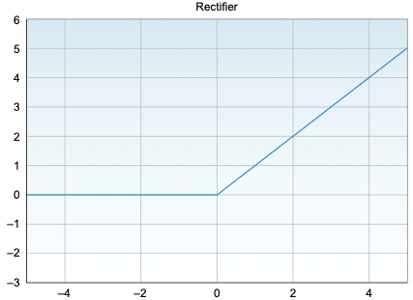

Rectified linear unit - ReLU
$$f\left(x\right)=\max{(0,x)}$$
The rectified linear unit (ReLU) activates a node only if the input is above zero.
But when the input is higher than zero, it has a linear relationship with the output variable.
Default choice for most model.

Slide 13
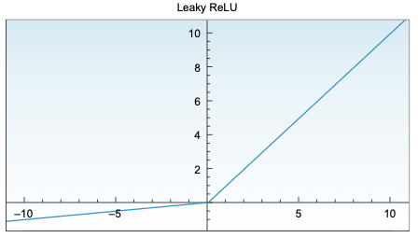

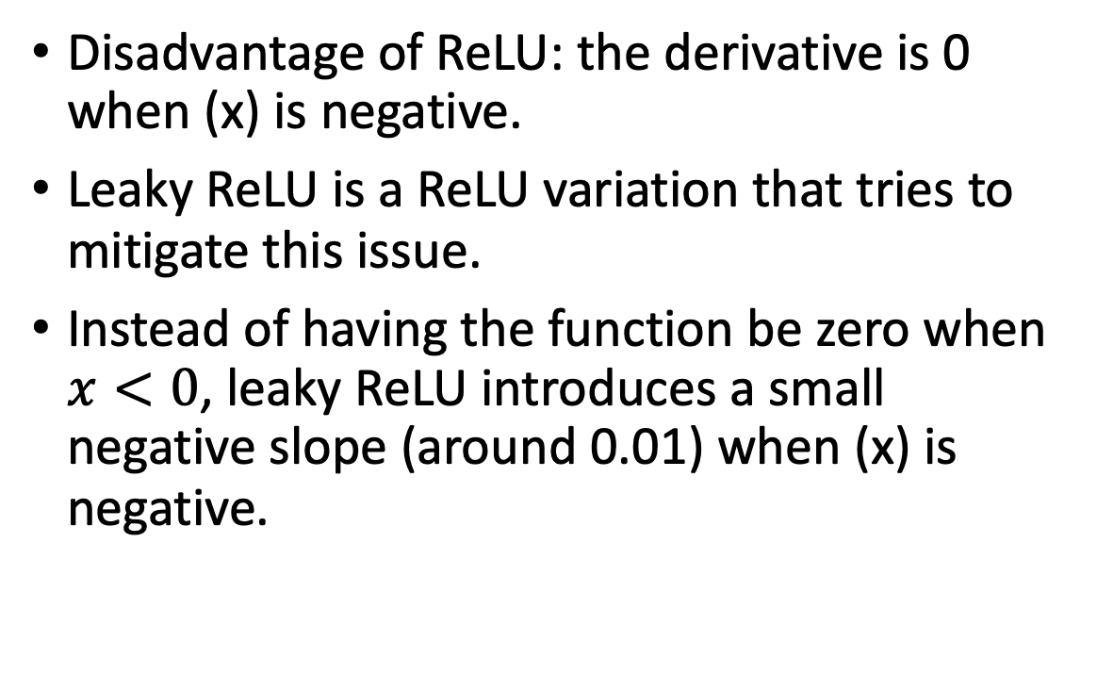
Leaky ReLU
$$f\left(x\right)=\max{(0.01x,x)}$$
Disadvantage of ReLU: the derivative is 0 when (x) is negative.
Leaky ReLU is a ReLU variation that tries to mitigate this issue.
Instead of having the function be zero when $x<0$, leaky ReLU introduces a small negative slope (around 0.01) when (x) is negative.

Slide 14
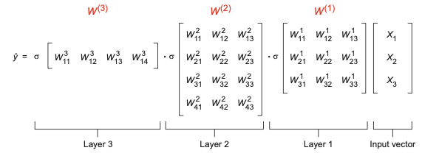
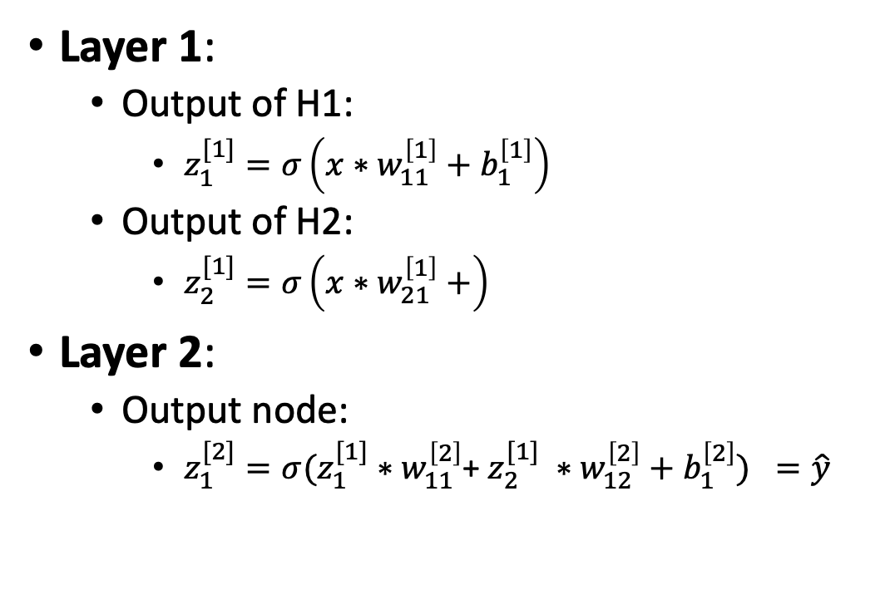
Feedforward calculations with activations
Layer 1:
  Output of H1:
    $z_{1}^{[1]}=σ\left(x∗w_{11}^{\left[1\right]}+b_{1}^{\left[1\right]}\right)$
  Output of H2:
    $z_{2}^{[1]}=σ\left(x∗w_{21}^{\left[1\right]}+\right)$
Layer 2:
  Output node:
    $z_{1}^{[2]}=σ(z_{1}^{[1]}∗w_{11}^{\left[2\right]}$+ $z_{2}^{[1]} ∗w_{12}^{\left[2\right]}+b_{1}^{\left[2\right]}) =\hat{y}$

Slide 15
How does a NN learns features?
Demo: tensorflow playground

Slide 16
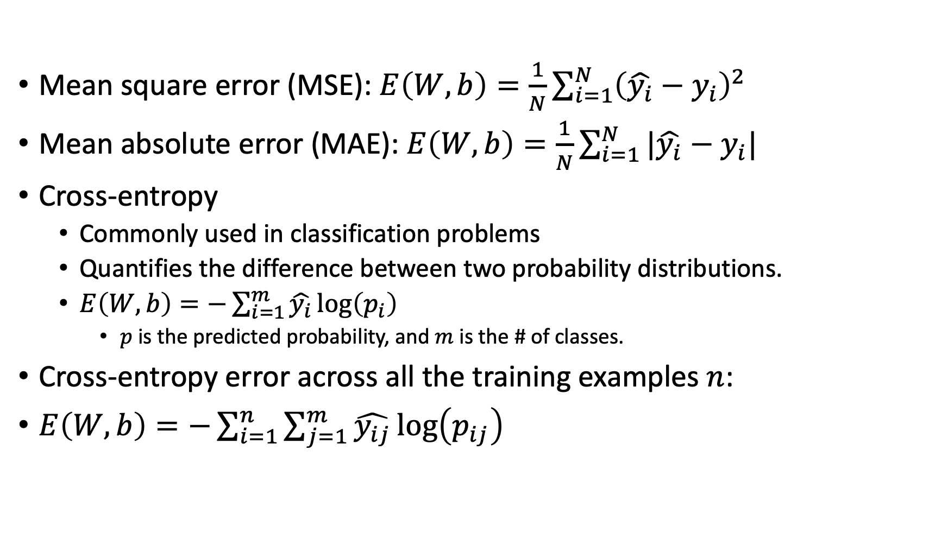
Error functions
Mean square error (MSE): $E\left(W,b\right)=\frac{1}{N}\sum_{i=1}^{N }{{\left(\hat{y_{i}}−y_{i}\right)}^{2} }$
Mean absolute error (MAE):$E\left(W,b\right)=\frac{1}{N}\sum_{i=1}^{N }{|\hat{y_{i}}−y_{i}| }$
Cross-entropy
  Commonly used in classification problems
  Quantifies the difference between two probability distributions.
  $E\left(W,b\right)=−\sum_{i=1}^{m }{\hat{y_{i}}\log\left(p_{i}\right) }$
    $p$is the predicted probability, and $m$ is the # of classes.
Cross-entropy error across all the training examples $n$:
$E\left(W,b\right)=−\sum_{i=1}^{n}{\sum_{j=1}^{m }{\hat{y_{ij}}\log\left(p_{ij}\right) }}$

Slide 17
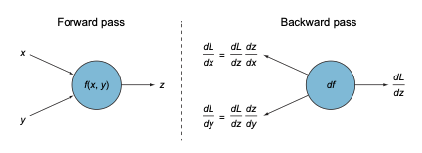
Backpropagation

Slide 18
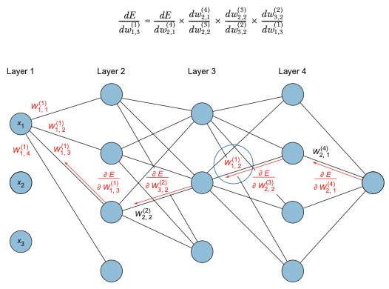
Backpropagation

Slide 19


Backpropagation
Feedforward: get the linear combination (weighted sum), and apply the activation function to get the output prediction:
Compare the prediction with the label to calculate the error or loss function:
Use a gradient descent optimization algorithm to compute the Δw that optimizes the error function:

Slide 20
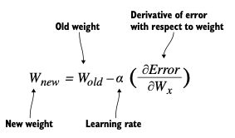
Weights update rule

Slide 21
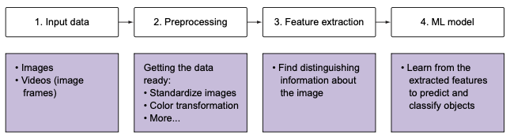
Computer vision pipeline

Slide 22
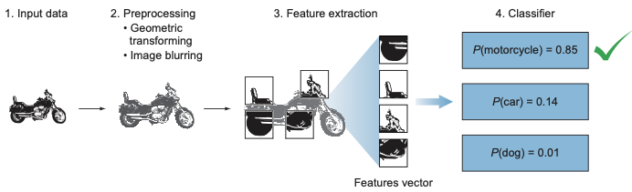
Computer vision pipeline

Slide 23
Feature
An individual measurable property or characteristic of an observed phenomenon.
Features are the input that we feed to our ML model to output a prediction or classification.
Selecting good features that clearly distinguish our objects increases the predictive power of ML algorithms.

Slide 24
Feature in CV
May be a distinct color or a specific shape such as a line, edge, or image segment.
E.g. the wheel is a strong feature that clearly distinguishes between motorcycles and dogs.
The same feature (a wheel) may not be a distinguishable feature to guess whether an object is a bicycle or a motorcycle.
  We need to look for more features like a mirror, license plate, or maybe a pedal, that collectively describe an object.
In CV, we want to transform the raw data (image) into a feature vector to show to our learning algorithm, which can learn the characteristics of the object.

Slide 25
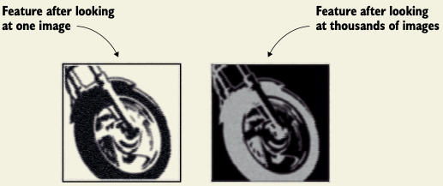
Feature generalizability
A very important characteristic of a feature is repeatability.
The feature should be able to detect motorcycles in general, not just this specific one.
In real-world problems, a feature is not an exact copy of a piece of the input image.

Slide 26
TRADITIONAL MACHINE LEARNING
Some of the handcrafted feature sets are:
  Histogram of oriented gradients (HOG)
  Haar Cascades
  Scale-invariant feature transform (SIFT)
  Speeded-Up Robust Feature (SURF)
WHY USE FEATURES?
  The input image has too much extra information that is not necessary for classification.
  The first step after preprocessing the image is to simplify it by extracting the important information and throwing away nonessential information.
  By extracting important colors or image segments, we can transform complex and large image data into smaller sets of features.

Slide 27
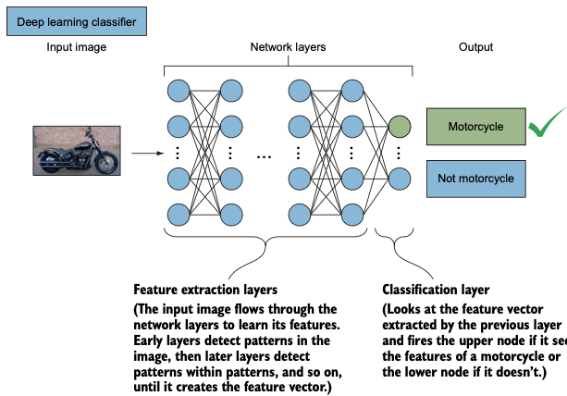

Slide 28
Face detection using NN
Kaggle note book
https://www.kaggle.com/code/zahidbd/lecture13-classification-nn-nb2/

Slide 29
Neural network hyperparameters
Number of hidden layers—we can have as many layers as we want, each with as many neurons as we want. The general idea is that the more neurons you have, the better your network will learn the training data. But if you have too many neurons, this might lead to a phenomenon called overfitting.
Activation function—There are many types of activation functions, the most popular being ReLU and softmax.
Error function— Mean square error is common for regression problems, and cross-entropy is common for classification problems.
Optimizer—Optimization algorithms are used to find the optimum weight values that minimize the error. Gradient descent, Adam and RMSprop are popular optimizers.
Batch size—the number of sub-samples given to the network, after which parameter update happens. Bigger batch sizes learn faster but require more memory space.
Number of epochs—The number of times the entire training dataset is shown to the network while training. May cause overfitting.
Learning rate—One of the optimizer’s input parameters. Theoretically, a learning rate that is too small is guaranteed to reach the minimum error (slow). A learning rate that is too big speeds up the learning but is not guaranteed to find the minimum error.
Notes:
It is recommended that you use ReLU activation in the hidden layers and Softmax for the output layer (you will see how this is implemented in most projects in this book).
A good default for batch size might be 32. Also try 64, 128, 256, and so on.
Increase the number of epochs until the validation accuracy starts decreasing even when training accuracy is increasing (overfitting).

Slide 30
Readings
https://cvl-umass.github.io/compsci682-fall-2024/notes/neural-networks-1/
Deep Learning for Vision Systems, MOHAMED ELGENDY
  Chapter 1: 1.3, 1.6, 1.7
  Chapter 2: 2.1, 2.2, 2.3, 2.4. 2.5, 2.6, 2.7
Notebooks:
  https://www.kaggle.com/code/zahidbd/lecture13-nn-basic-nb1
  https://www.kaggle.com/code/zahidbd/lecture13-classification-nn-nb2/

