Slide 1
COMPUTER VISION
Week 7
Lecture 10 (10/09/2026)
0714 02 CSE 4239

Slide 2
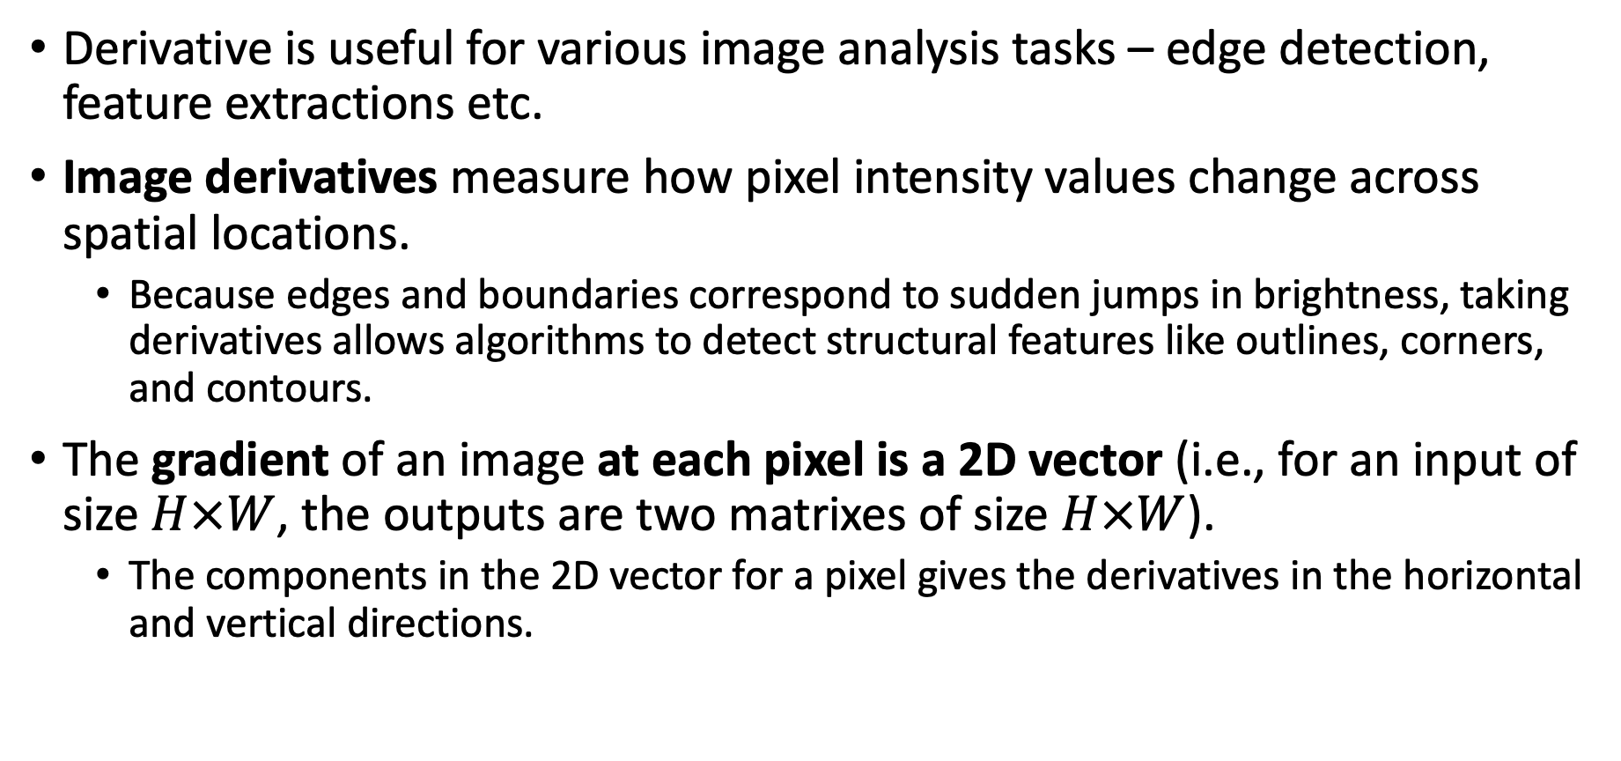
Derivative recap
Derivative is useful for various image analysis tasks – edge detection, feature extractions etc.
Image derivatives measure how pixel intensity values change across spatial locations.
  Because edges and boundaries correspond to sudden jumps in brightness, taking derivatives allows algorithms to detect structural features like outlines, corners, and contours.
The gradient of an image at each pixel is a 2D vector (i.e., for an input of size $H×W$, the outputs are two matrixes of size $H×W$).
  The components in the 2D vector for a pixel gives the derivatives in the horizontal and vertical directions.

Slide 3
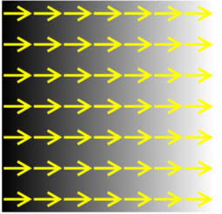
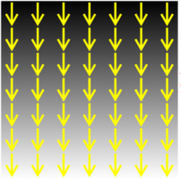
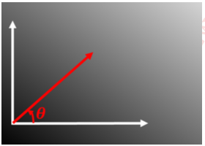
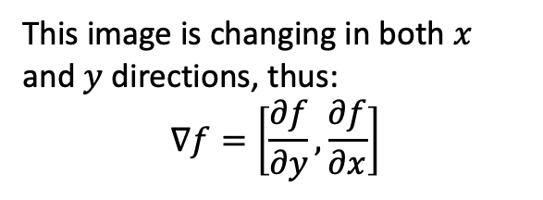
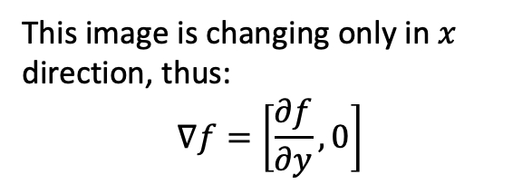
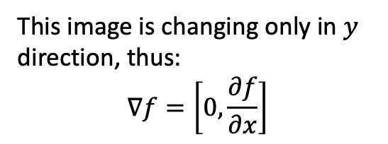
Derivative recap
Gradient points in the direction of the most rapid increase in intensity.
This image is changing in both $x$ and $y$ directions, thus:
$$∇f=\left[\frac{∂f}{∂y}, \frac{∂f}{∂x}\right]$$
This image is changing only in $x$
direction, thus:
$$∇f=\left[\frac{∂f}{∂y},0\right]$$
This image is changing only in $y$
direction, thus:
$$∇f=\left[0, \frac{∂f}{∂x}\right]$$

Slide 4
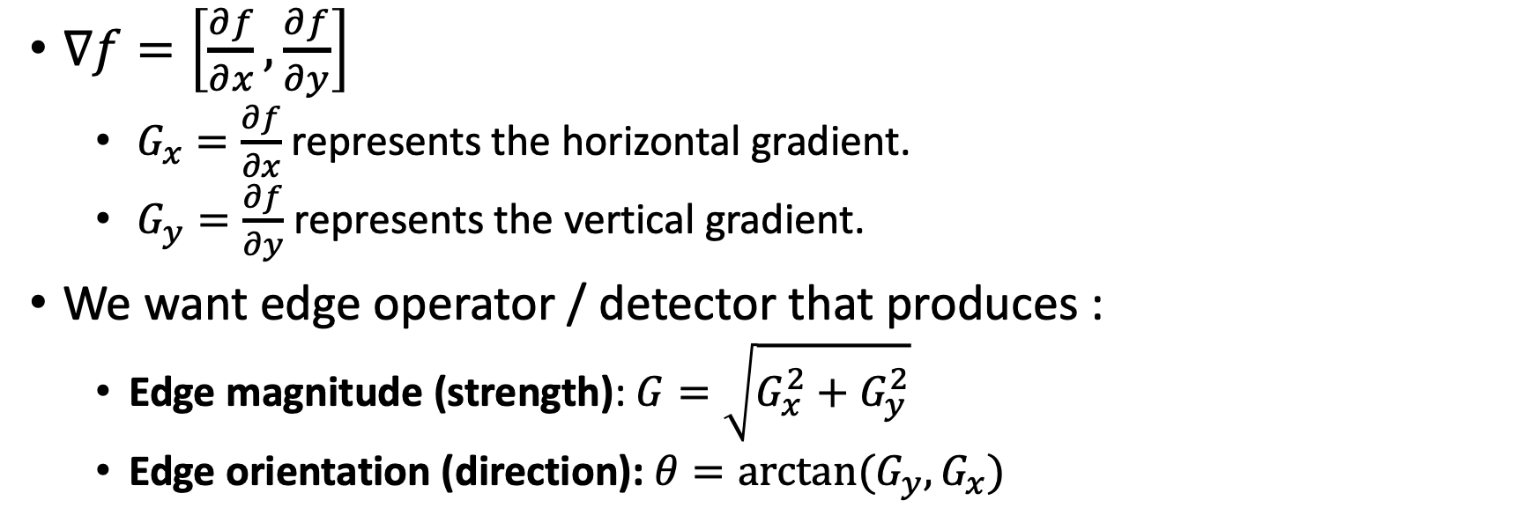
Gradient
$∇f=\left[\frac{∂f}{∂x},\frac{∂f}{∂y}\right]$
  $G_{x}=\frac{∂f}{∂x}$represents the horizontal gradient.
  $G_{y}=\frac{∂f}{∂y}$ represents the vertical gradient.
We want edge operator / detector that produces :
  Edge magnitude (strength): $G=\sqrt{G_{x}^{2}+G_{y}^{2}}$
  Edge orientation (direction): $θ=arctan(G_{y}, G_{x})$
Q: How do we apply $∇f$ to an image?? It has two components $G_{x}$ and $G_{y}$

Slide 5
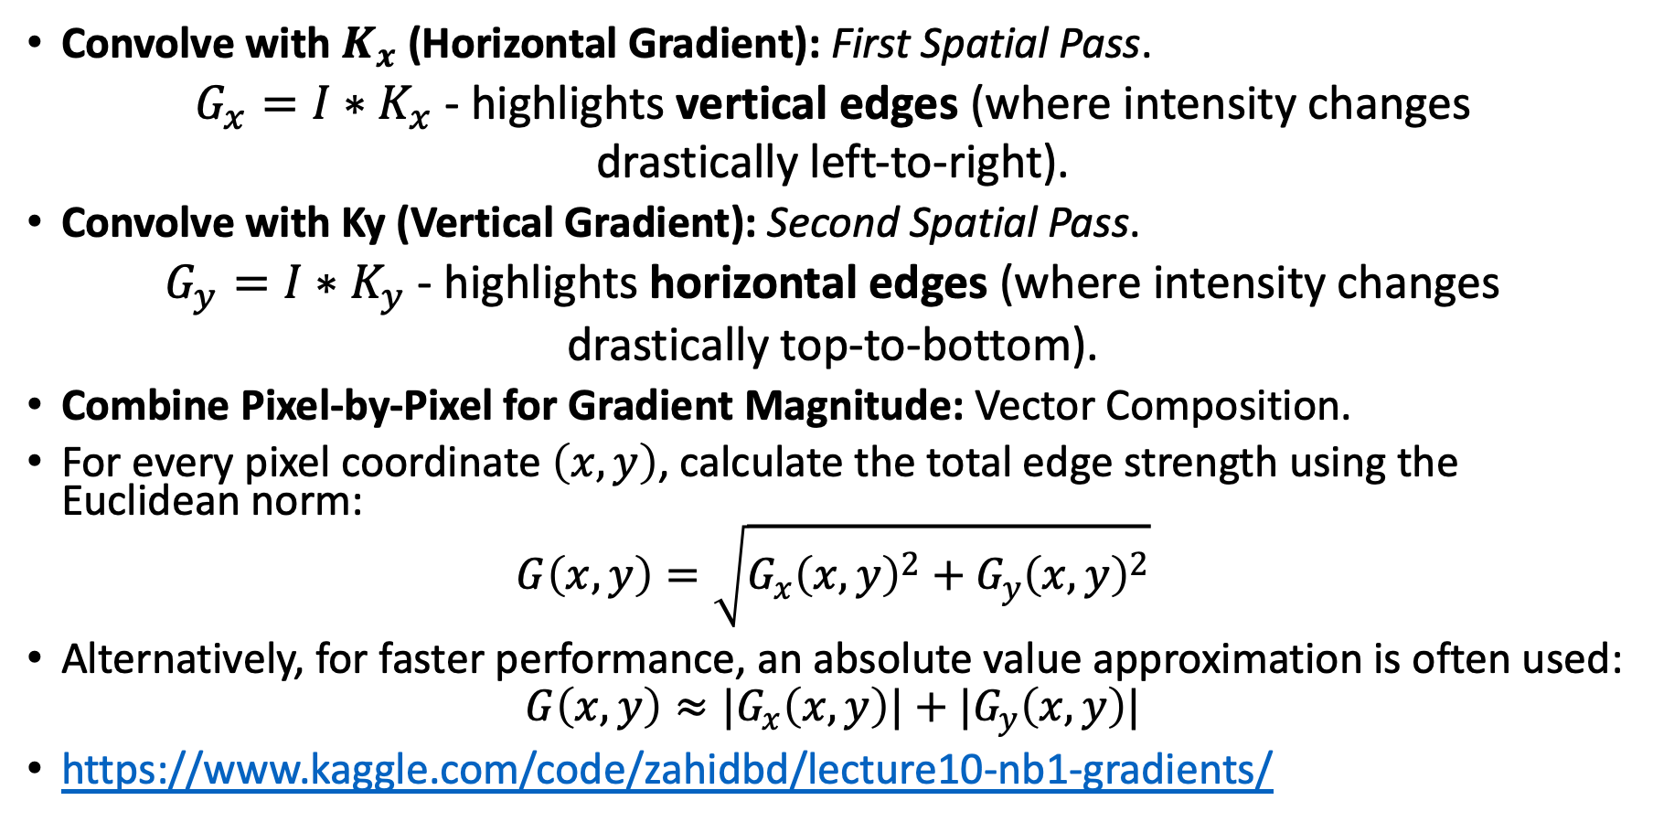
Gradient application Pipeline
Convolve with $K_{x}$ (Horizontal Gradient): First Spatial Pass.
$G_{x}=I∗K_{x}$ - highlights vertical edges (where intensity changes
drastically left-to-right).
Convolve with Ky (Vertical Gradient): Second Spatial Pass.
$G_{y}=I∗K_{y}$ - highlights horizontal edges (where intensity changes
drastically top-to-bottom).
Combine Pixel-by-Pixel for Gradient Magnitude: Vector Composition.
For every pixel coordinate $\left(x,y\right)$, calculate the total edge strength using the Euclidean norm:
$$G\left(x,y\right)=\sqrt{G_{x}{\left(x,y\right)}^{2}+G_{y}{\left(x,y\right)}^{2}}$$
Alternatively, for faster performance, an absolute value approximation is often used:
$$G\left(x,y\right)≈|G_{x}\left(x,y\right)|+|G_{y}\left(x,y\right)|$$
https://www.kaggle.com/code/zahidbd/lecture10-nb1-gradients/

Slide 6
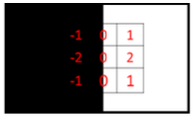
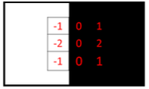
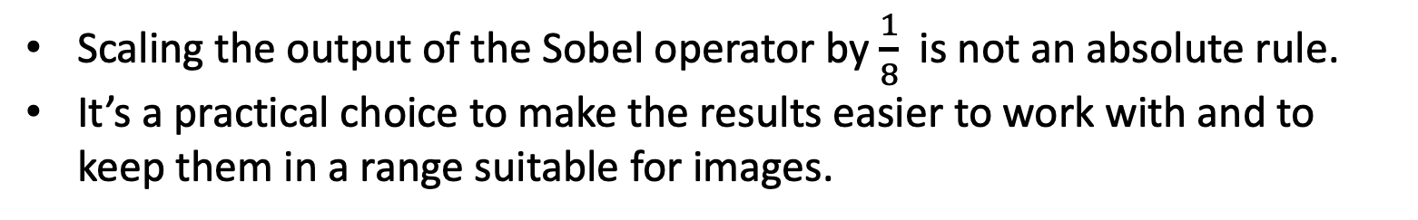
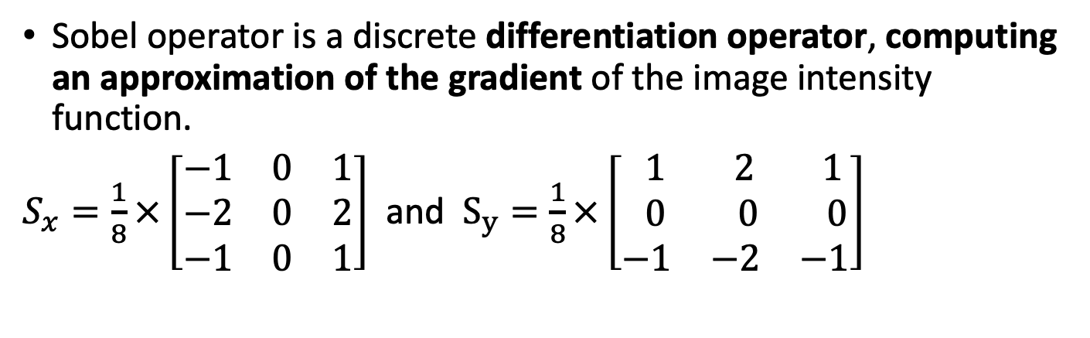


Sobel Mask
Sobel operator is a discrete differentiation operator, computing an approximation of the gradient of the image intensity function.
$S_{x}=\frac{1}{8}×\left[\begin{matrix}−1 & 0 & 1 \\ −2 & 0 & 2 \\ −1 & 0 & 1\end{matrix}\right]$ and $S_{y}=\frac{1}{8}×\left[\begin{matrix} 1 & 2 & 1 \\ 0 & 0 & 0 \\ −1 & −2 & −1\end{matrix}\right]$
$I∗S_{x}=$4
Responses: [-4, 4], to make it positive we may add 4 and get [0, 8]
Scaling the output of the Sobel operator by $\frac{1}{8}$ is not an absolute rule.
It’s a practical choice to make the results easier to work with and to keep them in a range suitable for images.
$I∗S_{x}=$-4

Slide 7
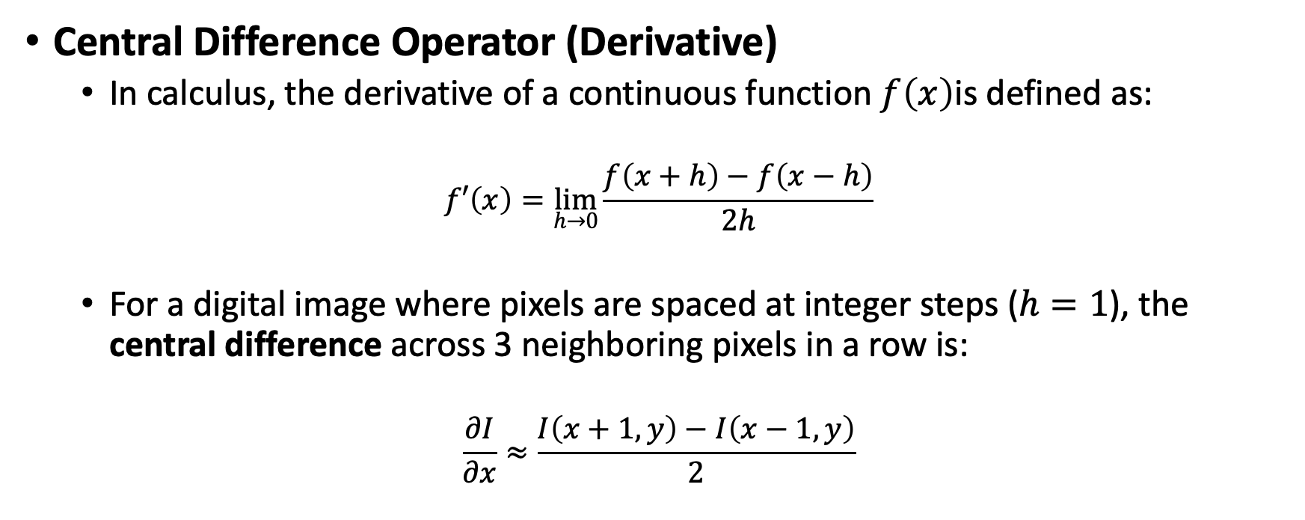
How do we get the weights in the Sobel operator?
Central Difference Operator (Derivative)
  In calculus, the derivative of a continuous function $f\left(x\right)$is defined as:
$$f′\left(x\right)=\lim_{h→0}{\frac{f\left(x+h\right)−f\left(x−h\right)}{2h}}$$
  For a digital image where pixels are spaced at integer steps ($h=1$), the central difference across 3 neighboring pixels in a row is:
$$\frac{∂I}{∂x}≈\frac{I\left(x+1,y\right)−I\left(x−1,y\right)}{2}$$

Slide 8

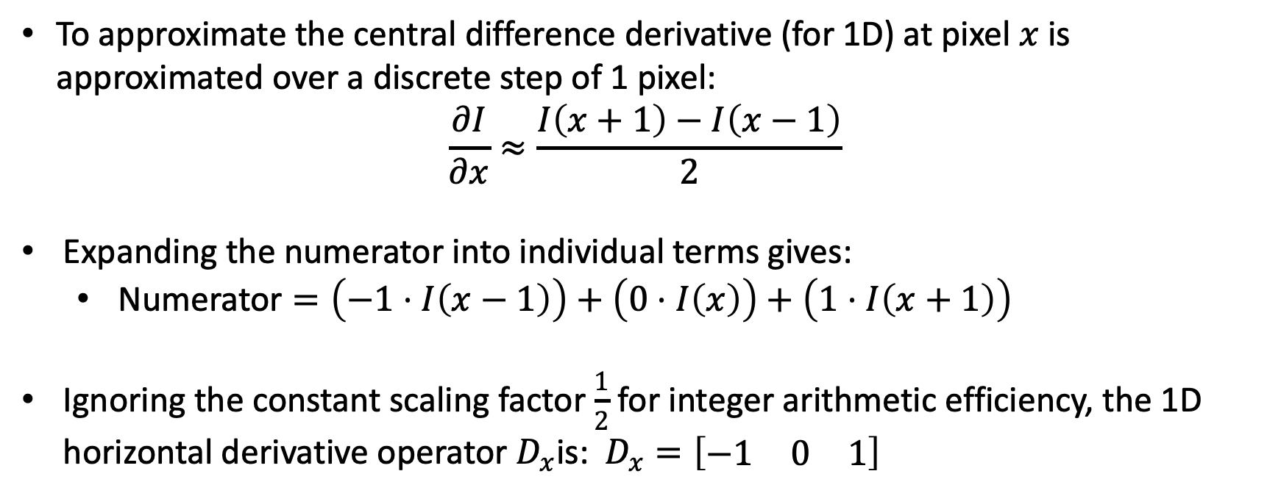
Horizontal Derivative Vector ($D_{x}$)
To approximate the central difference derivative (for 1D) at pixel $x$is approximated over a discrete step of 1 pixel:
$$\frac{∂I}{∂x}≈\frac{I\left(x+1\right)−I\left(x−1\right)}{2}$$
Expanding the numerator into individual terms gives:
  $\text{Numerator}=\left(−1⋅I\left(x−1\right)\right)+\left(0⋅I\left(x\right)\right)+\left(1⋅I\left(x+1\right)\right)$
Ignoring the constant scaling factor $\frac{1}{2}$ for integer arithmetic efficiency, the 1D horizontal derivative operator $D_{x}$is: $D_{x}=\left[\begin{matrix}−1 & 0 & 1\end{matrix}\right]$

Slide 9
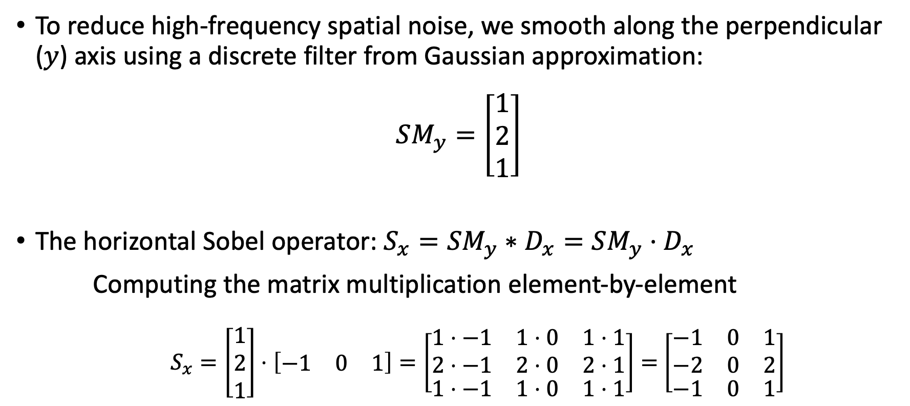


Vertical Smoothing Vector ($S_{y}$)
To reduce high-frequency spatial noise, we smooth along the perpendicular ($y$) axis using a discrete filter from Gaussian approximation:
$$SM_{y}=\left[\begin{matrix}1 \\ 2 \\ 1\end{matrix}\right]$$
The horizontal Sobel operator: $S_{x}=SM_{y}∗D_{x}=SM_{y}⋅D_{x}$
Computing the matrix multiplication element-by-element
  $S_{x}=\left[\begin{matrix}1 \\ 2 \\ 1\end{matrix}\right]⋅$ $\left[\begin{matrix}−1 & 0 & 1\end{matrix}\right]=\left[\begin{matrix}\begin{aligned}1⋅−1 \\ 2⋅−1\end{aligned} & \begin{aligned}1⋅0 \\ 2⋅0\end{aligned} & \begin{aligned}1⋅1 \\ 2⋅1\end{aligned} \\ 1⋅−1 & 1⋅0 & 1⋅1\end{matrix}\right]=$ $\left[\begin{matrix}\begin{aligned}−1 \\ −2\end{aligned} & \begin{aligned}0 \\ 0\end{aligned} & \begin{aligned}1 \\ 2\end{aligned} \\ −1 & 0 & 1\end{matrix}\right]$
The center weight of $2$ reflects the peak of the
1D Gaussian bell curve.

Slide 10
Edge detection: Naive thresholding
Compute gradient vector at each pixel by convolving image with horizontal and vertical derivative filters / masks.
Compute gradient magnitude at each pixel.
If magnitude at a pixel exceeds a threshold, report a possible edge point.
See notebook

Slide 11
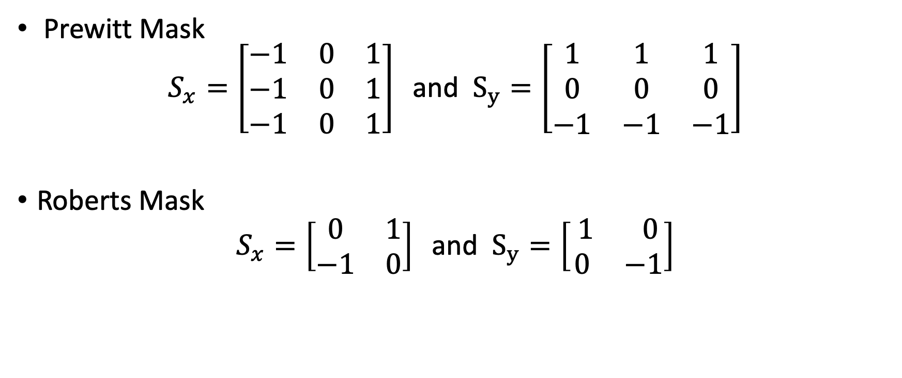
Other operators
Prewitt Mask
$$S_{x}=\left[\begin{matrix}−1 & 0 & 1 \\ −1 & 0 & 1 \\ −1 & 0 & 1\end{matrix}\right]\text{ and }S_{y}=\left[\begin{matrix}1 & 1 & 1 \\ 0 & 0 & 0 \\ −1 & −1 & −1\end{matrix}\right]$$
Roberts Mask
$$S_{x}=\left[\begin{matrix}0 & 1 \\ −1 & 0\end{matrix}\right]\text{ and }S_{y}=\left[\begin{matrix} 1 & 0 \\ 0 & −1\end{matrix}\right]$$

Slide 12
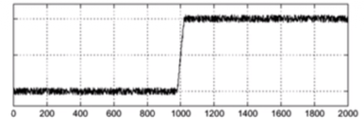
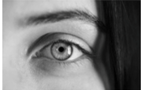
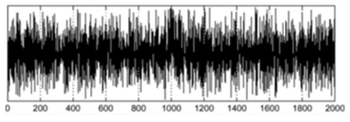
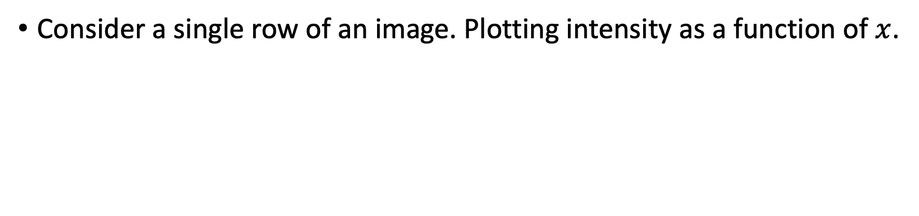

Effect of noise on edge detector
Consider a single row of an image. Plotting intensity as a function of $x$.
$$f(x)$$
Apply the derivative operator
Where is the edge?

Slide 13
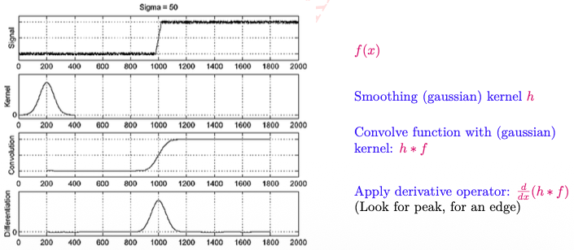
Edge detection in noisy image
We can filter, smooth an image to get rid of the noise.
Then apply edge detection.

Slide 14
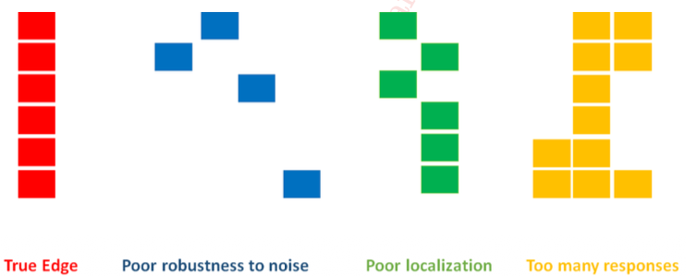
Problems with edge detection

Slide 15
Edge detection
The gradient magnitude is large along a thick trail and occluding contours are curves
  We must obtain a curve of the most distinctive points on this trail.
The gradient magnitude can be thought of as a chain of low hills.

Slide 16
Canny Edge Detector Algorithm
The steps of Canny edge detection algorithm:
Apply Gaussian filter to smooth the image in order to remove the noise.
Find the intensity gradients of the image.
Find magnitude and orientation of gradient.
Apply “non-maximum suppression” to get rid of spurious response to edge detection.
Apply “hysteresis threshold”.

Slide 17
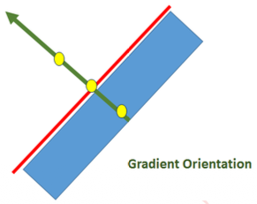
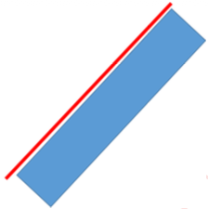




Non-maxima suppression (Non-interpolation)
Suppress the pixels in $G\left(x,y\right)$which are not local maxima.
Canny’s method is the first algorithm to use gradient orientation
$$(x^{′},y^{′})$$
Canny’s method will suppress pixels that are towards the outside of an edge based on local neighborhood information.
$$(x,y)$$
$$(x^{”},y^{”})$$
Blue region: Represents the edge area (gradient magnitude region).
Red line: Highlights the true line/boundary along the edge.
Green arrow: Represents the gradient orientation (direction of maximum intensity change), which is always perpendicular to the red edge line.
Pixel $(x,y)$will be retained as an edge pixel, only if its value is greater that $(x′,y′)$and $(x′′,y′′)$.

Slide 18
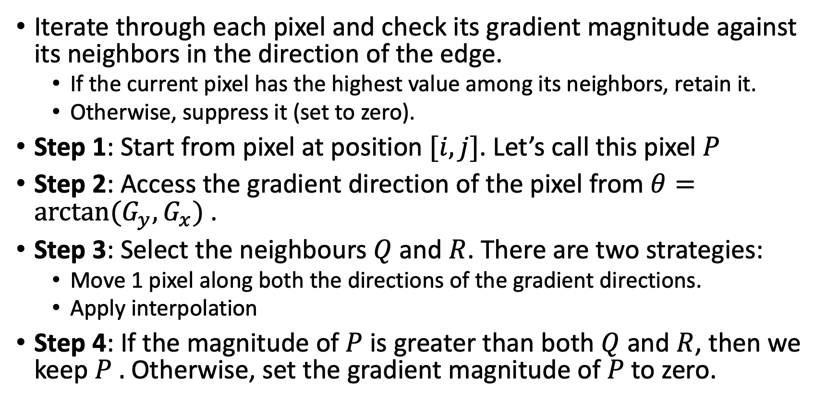
Non-maxima suppression
Iterate through each pixel and check its gradient magnitude against its neighbors in the direction of the edge.
  If the current pixel has the highest value among its neighbors, retain it.
  Otherwise, suppress it (set to zero).
Step 1: Start from pixel at position $[i, j]$. Let’s call this pixel $P$
Step 2: Access the gradient direction of the pixel from $θ=arctan(G_{y}, G_{x})$.
Step 3: Select the neighbours $Q$ and $R$. There are two strategies:
  Move 1 pixel along both the directions of the gradient directions.
  Apply interpolation
Step 4: If the magnitude of $P$ is greater than both $Q$ and $R$, then we keep $P .$ Otherwise, set the gradient magnitude of $P$to zero.

Slide 19
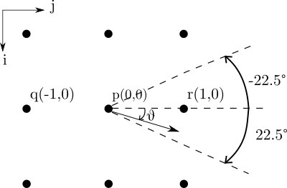
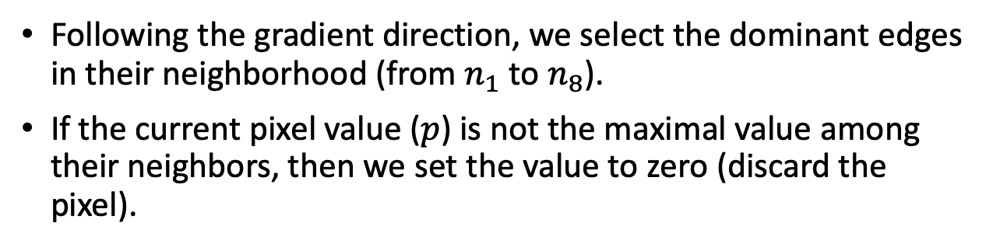
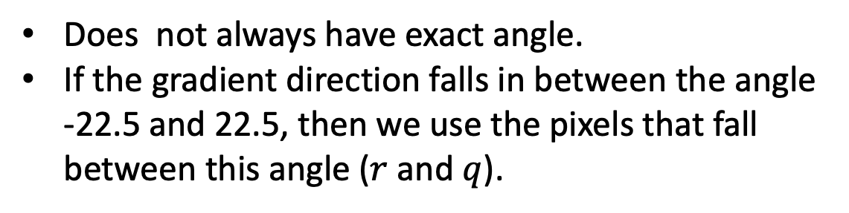
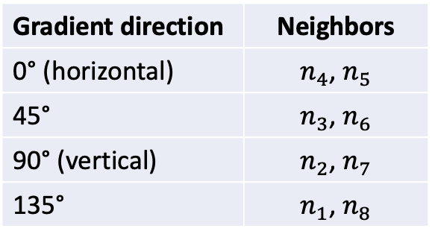
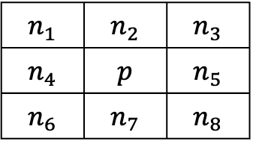
Neighbor selection (non-interpolation)
$$n_{1}$$ | $$n_{2}$$ | $$n_{3}$$
$$n_{4}$$ | $$p$$ | $$n_{5}$$
$$n_{6}$$ | $$n_{7}$$ | $$n_{8}$$
Following the gradient direction, we select the dominant edges in their neighborhood (from $n_{1}$ to $n_{8}$).
If the current pixel value ($p$) is not the maximal value among their neighbors, then we set the value to zero (discard the pixel).
Gradient direction | Neighbors
0° (horizontal) | $n_{4}$, $n_{5}$
45° | $n_{3}$, $n_{6}$
90° (vertical) | $n_{2}$, $n_{7}$
135° | $n_{1}$, $n_{8}$
Does not always have exact angle.
If the gradient direction falls in between the angle -22.5 and 22.5, then we use the pixels that fall between this angle ($r$ and $q$).

Slide 20
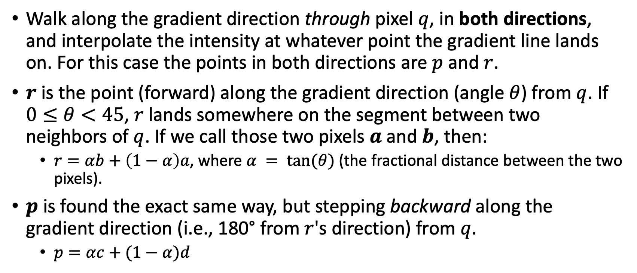
Neighbor selection (bilinear-interpolation)
Walk along the gradient direction through pixel $q$, in both directions, and interpolate the intensity at whatever point the gradient line lands on. For this case the points in both directions are $p$ and $r$.
$r$is the point (forward) along the gradient direction (angle $θ$) from $q$. If $0≤θ<45$, $r$lands somewhere on the segment between two neighbors of $q$. If we call those two pixels $a$ and $b$, then:
  $r=αb+\left(1−α\right)a$, where $α = tan⁡(θ)$(the fractional distance between the two pixels).
$p$ is found the exact same way, but stepping backward along the gradient direction (i.e., 180° from $r$'s direction) from $q$.
  $p=αc+(1−α)d$

Slide 21
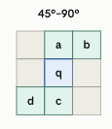
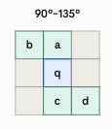
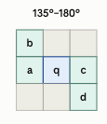
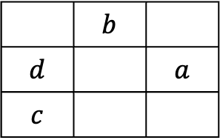
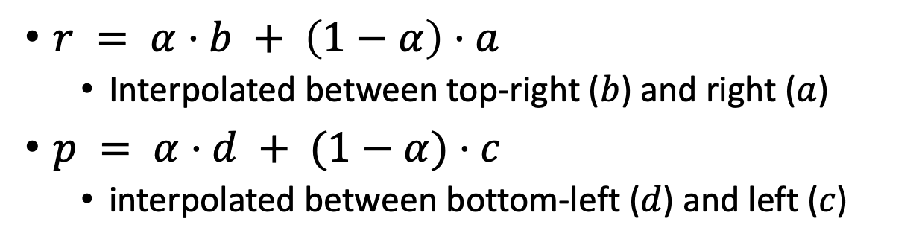


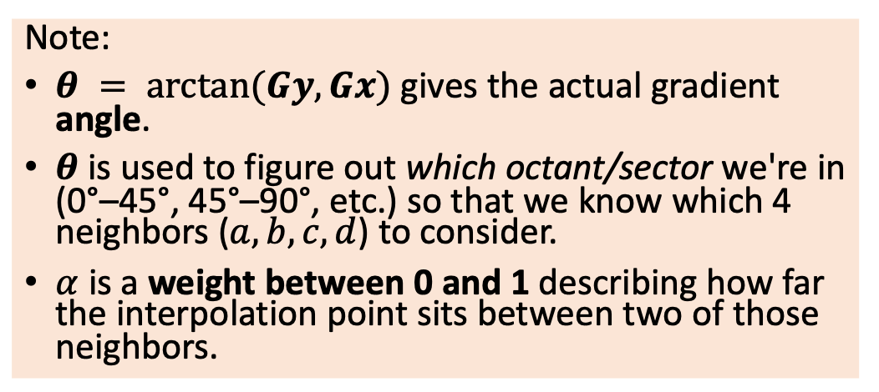

Bilinear-interpolation
0°–45°
Gradient
direction
$r = α·b + \left(1−α\right)·a$
  Interpolated between top-right ($b$) and right ($a$)
$p = α·d + (1−α)·c$
  interpolated between bottom-left ($d$) and left ($c$)
$$r$$
 | $$b$$
$$d$$ |  | $$a$$
$$c$$
$$q$$
$$p$$
Edge direction
Note:
$θ = arctan⁡(Gy, Gx)$gives the actual gradient angle.
$θ$is used to figure out which octant/sector we're in (0°–45°, 45°–90°, etc.) so that we know which 4 neighbors ($a, b, c, d$) to consider.
$α$ is a weight between 0 and 1 describing how far the interpolation point sits between two of those neighbors.

Slide 22
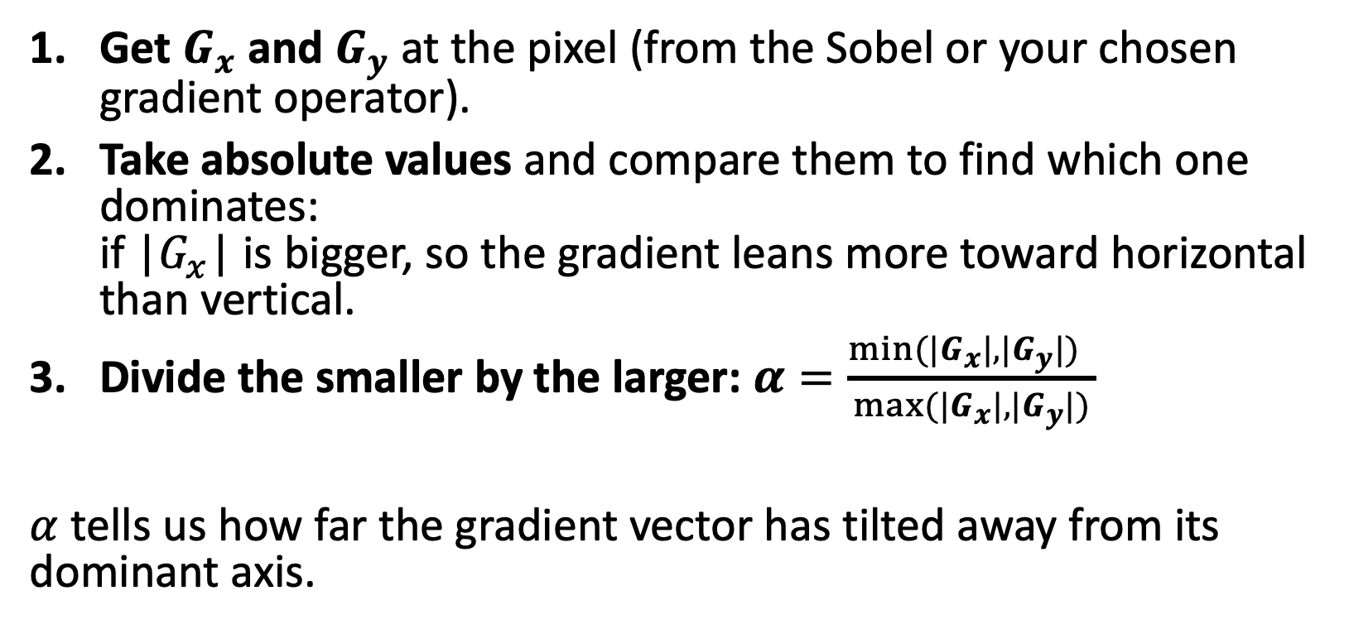

How to calculate $α$?
Get $G_{x}$ and $G_{y}$ at the pixel (from the Sobel or your chosen gradient operator).
Take absolute values and compare them to find which one dominates:
if |$G_{x}$| is bigger, so the gradient leans more toward horizontal than vertical.
Divide the smaller by the larger: $α=\frac{\min{(|G_{x}|,|G_{y}|)} }{\max{(|G_{x}|,|G_{y}|)}}$
$α$ tells us how far the gradient vector has tilted away from its dominant axis.

Slide 23
Hysteresis and double thresholding
Previously studied edge detector used one threshold value to record pixel as an edge.
Canny’s method uses two threshold values:
  High: Above high, record pixel as an edge.
  Low: Below low, record pixel as an non-edge.
  Between high and low: record it as an edge pixel, if it is connected to an edge pixel. This is due to the fact that edges do not occur in isolation, rather edge pixels are connected.

Slide 24
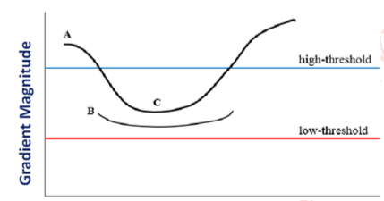
Hysteresis and double thresholding
All connected pixels, although below “high” threshold will be recorded as an edge pixels.
Isolated pixels above “low” will not be recorded as an edge pixels as they are not connected to pixels that are above “high” threshold.

Slide 25
Feature Descriptors
Crafted clever mathematical “fingerprints” to describe images.
HOG (Histogram of Oriented Gradients) [2005]
  looking at shapes or structures in images (HOG)
Haar Cascades[2001]
  looking at contrast (Haar).
SIFT[1999]
  transforms an image into a large collection of feature vectors
Think of these as feature representation methods for machine learning algorithms i.e., outputs of these methods are fed to SVM, Random Forest, NN, or KNN for various tasks.

Slide 26
Histogram of Oriented Gradients (HOG)
HOG is a feature descriptor used in computer vision and image processing for object detection.
Captures the structure or the shape of an object by analyzing the distribution (histograms) of gradient orientations.
HOG is especially popular for human and vehicle detection.
Core idea: We don’t need to know the color of an object to know what it is; we just need to know its edges.
  If we trace the outline of a person, a car, or a cup, we can recognize it regardless of the lighting.
HOG explicitly captures this “outline” information using gradients.

Slide 27
The HOG Pipeline (Step-by-Step)
2. Preprocessing: Gamma correction is often applied to normalize lighting.
2. Gradient Calculation: For every pixel, we calculate the Gradient Magnitude (how strong the edge is) and Gradient Orientation/Direction (which way the edge points).
  Result: The “texture” of the image is revealed, while flat colors are removed.
3. Cell Histograms (The “Histogram” in HOG): Calculating gradients for every single pixel gives too much detail (and noise). To fix this, we divide the image into small grid squares called Cells (typically 8x8 pixels). Inside each cell, we create a histogram of gradient directions.
  We usually use 9 bins (0° to 180°).

Slide 28
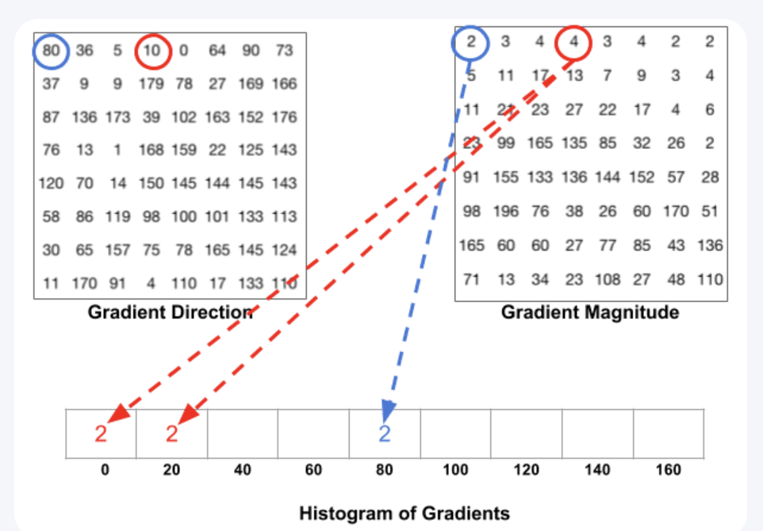
Cell Histograms
Red has an angle of 10 degrees and magnitude of 4.
- Since 10 degrees is half way between 0 and 20, the vote by the pixel splits evenly into the two bins.

Slide 29
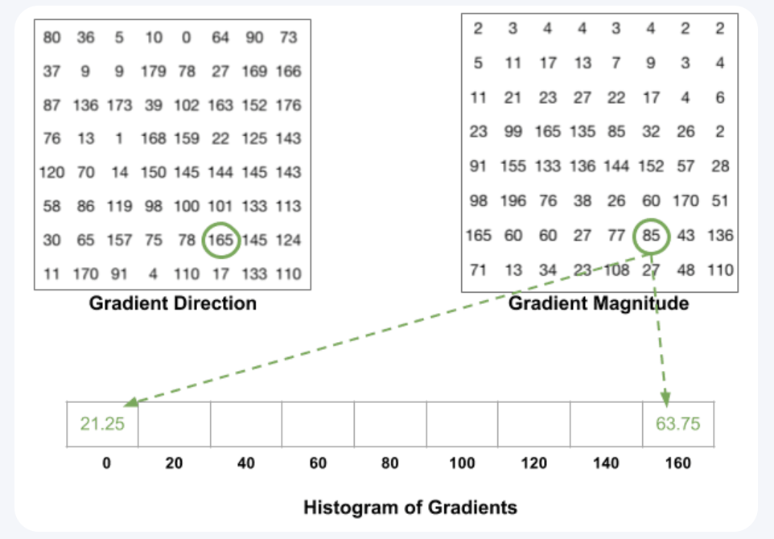
Cell Histograms
If the angle is greater than 160 degrees,
it is between 160 and 180, and we know the angle
wraps around making 0 and 180 equivalent.
The pixel with angle 165 degrees contributes
proportionally to the 0 degree bin and the
160 degree bin.

Slide 30
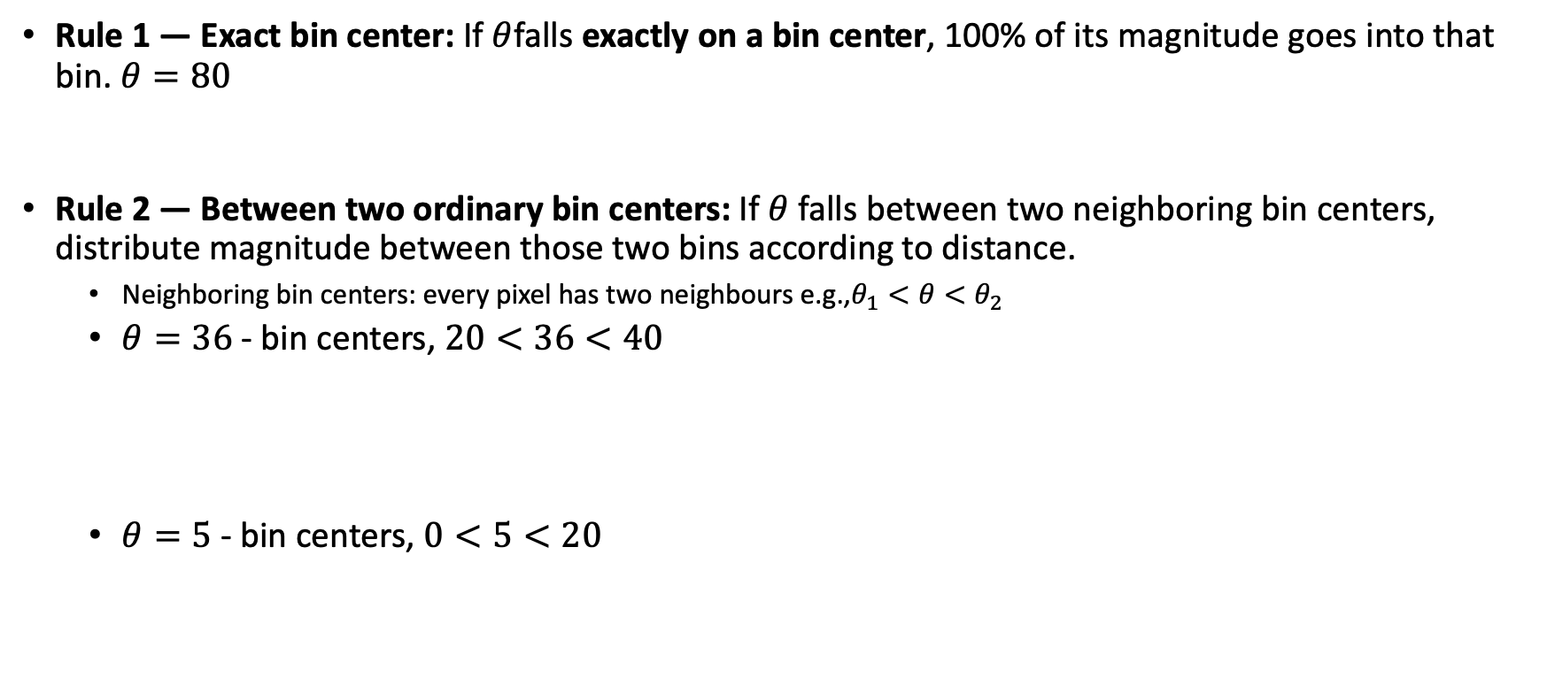
Cell Histograms - Interpolation
Rule 1 — Exact bin center: If $θ$falls exactly on a bin center, 100% of its magnitude goes into that bin. $θ=80$
Rule 2 — Between two ordinary bin centers: If $θ$falls between two neighboring bin centers, distribute magnitude between those two bins according to distance.
  Neighboring bin centers: every pixel has two neighbours e.g.,$θ_{1}<θ<θ_{2}$
  $θ=36$ - bin centers, $20<36<40$
  $θ=5$- bin centers, $0<5<20$
M
0
20
40
60
80
100
120
140
160
36
M
0
20
40
60
80
100
120
140
160
5
M
0
20
40
60
80
100
120
140
160

Slide 31
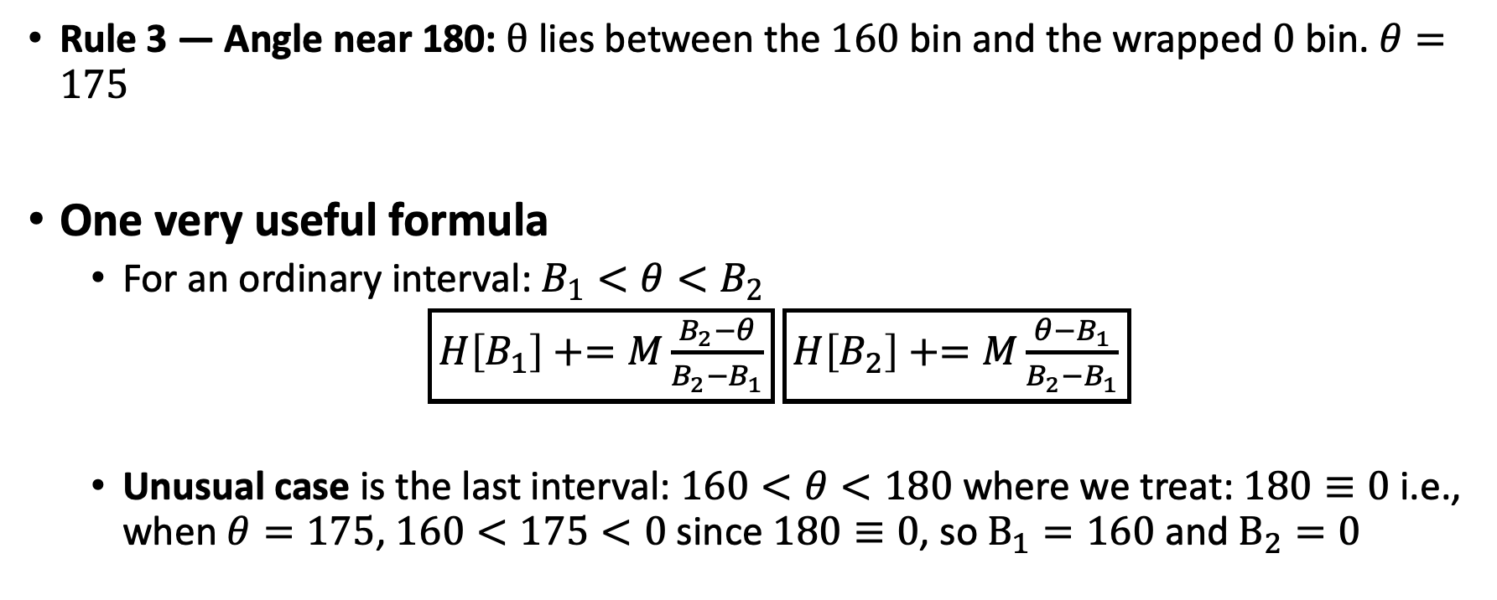

Cell Histograms - Interpolation
Rule 3 — Angle near 180: $θ$ lies between the $160$bin and the wrapped $0$ bin. $θ=175$
One very useful formula
  For an ordinary interval: $B_{1}<θ<B_{2}$
  $\boxed{H\left[B_{1}\right]+=M\frac{B_{2}−θ}{B_{2}−B_{1}}}$ $\boxed{H\left[B_{2}\right]+=M\frac{θ−B_{1}}{B_{2}−B_{1}}}$
  Unusual case is the last interval: $160<θ<180$ where we treat: $180≡0$ i.e., when $θ=175$, $160<175<0$ since $180≡0$, so $B_{1}=160$ and $B_{2}=0$
175
M
0
20
40
60
80
100
120
140
160
180$≡$0

Slide 32
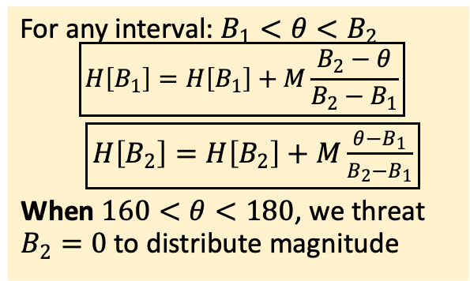
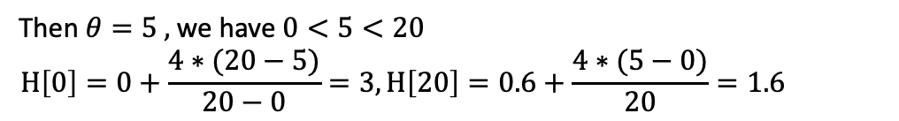

Cell Histograms – Workout example
For any interval: $B_{1}<θ<B_{2}$
  $$\boxed{H\left[B_{1}\right]=H\left[B_{1}\right]+M\frac{B_{2}−θ}{B_{2}−B_{1}}}$$
  $\boxed{H\left[B_{2}\right]=H\left[B_{2}\right]+M\frac{θ−B_{1}}{B_{2}−B_{1}}}$
  When $160<θ<180$, we threat $B_{2}=0$to distribute magnitude
For the first pixel, $θ=80 ,$exact center
2
0
20
40
60
80
100
120
140
160
Then $θ=36 ,$we have $20<36<40$
$$H\left[20\right]=0+\frac{3∗(40−36)}{40−20}=0.6,H\left[40\right]=0+\frac{3∗(36−20)}{20}=2.4$$
0.6
2.4
2
0
20
40
60
80
100
120
140
160
Then $θ=5 ,$we have $0<5<20$
$$H\left[0\right]=0+\frac{4∗(20−5)}{20−0}=3,H\left[20\right]=0.6+\frac{4∗(5−0)}{20}=1.6$$
3
1.6
2.4
2
0
20
40
60
80
100
120
140
160
Consider the case, $θ=165 , 160<165<180$, we get
$$H\left[160\right]=0+\frac{85∗(180−165)}{20}=63.75, H\left[0\right]=3+\frac{85∗(165−160)}{20}=24.25$$
24.25
1.6
2.4
2
63.75
0
20
40
60
80
100
120
140
160

Slide 33
The HOG Pipeline (Step-by-Step)
4. Block Normalization:
Lighting is never perfect. To make the descriptor robust to brightness changes, we group cells into larger Blocks (typically 2x2 cells or 16x16 pixels). We mathematically normalize the histograms within this block (e.g., L2-norm).
5. Feature Vector Construction:
All the normalized histograms are concatenated into one giant list of numbers. This is your feature vector.
Why it works: HOG is incredibly robust to geometric changes. A person’s arm might move slightly, but the general distribution of edge directions in that 8x8 cell remains roughly the same.

Slide 34
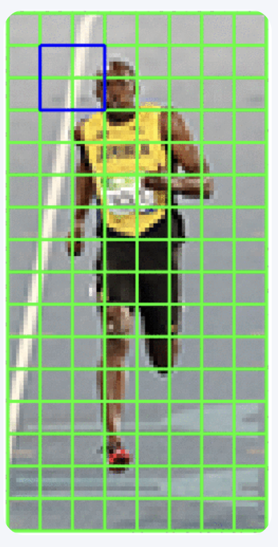
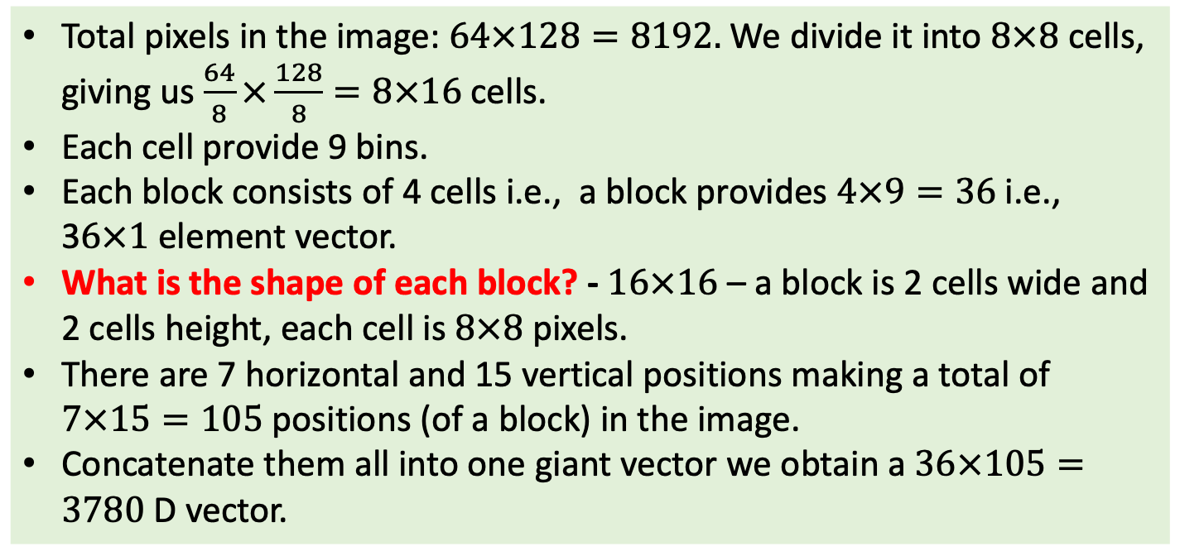
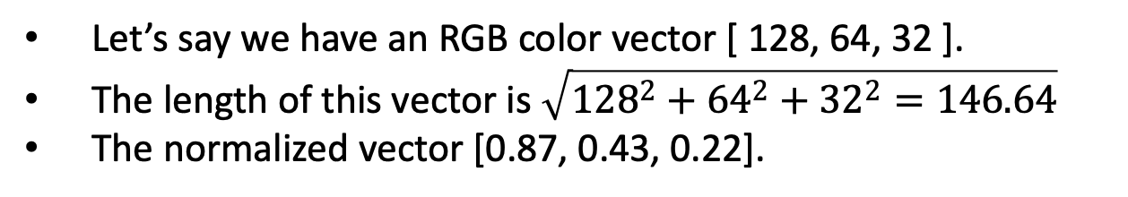
Block Normalization
Let’s say we have an RGB color vector [ 128, 64, 32 ].
The length of this vector is $\sqrt{{128}^{2}+{64}^{2}+{32}^{2}=146.64}$
The normalized vector [0.87, 0.43, 0.22].
Total pixels in the image: $64×128=8192.$We divide it into $8×8$cells, giving us $\frac{64}{8}×\frac{128}{8}=8×16$cells.
Each cell provide 9 bins.
Each block consists of 4 cells i.e., a block provides $4×9=36$i.e., 3$6×1$element vector.
What is the shape of each block? - $16×16$ – a block is 2 cells wide and 2 cells height, each cell is $8×8$ pixels.
There are 7 horizontal and 15 vertical positions making a total of $7×15=105$positions (of a block) in the image.
Concatenate them all into one giant vector we obtain a $36×105=3780$D vector.

Slide 35
Readings
Computer Vision - A Modern Approach - D. Forsyth, J. Ponce:
  Ch 5 (Local Image Features): section 5.4
Szeliski book – Chap 3: Image processing
  Sections: 3.2
https://cvl-umass.github.io/intro-cv-spring-2025/assets/notes/imageprocessing.pdf
  Sections: 4, 5, 7 and 8
Canny:
  https://medium.com/ai-in-plain-english/canny-edge-detection-in-python-4cbc1209adbc
  https://justin-liang.com/tutorials/canny/
HOG: https://learnopencv.com/histogram-of-oriented-gradients/
Notebooks:
  https://www.kaggle.com/code/zahidbd/lecture10-nb1-gradients/
  https://www.kaggle.com/code/zahidbd/lecture10-nb2-feature-extraction/

